Slide 1
Final Presentation
Team 9

Slide 2
Project Description
Our project, cAIorie, is all about helping you plan your meals and keep track of your calorie intake. The heart of our app lies in two main features: one, it lets you store the meals you've eaten and the calories consumed, and two, it introduces you to our AI, 'Dummy.' Dummy isn't just any AI; it's here to create customized meal plans for you as well as answer any health-related questions you might have

Slide 3
Group 1 - Artificial Intelligence
Devin W.
Created Meal Plan screen
Refined Home screen UI
Implemented AI API calls and response handling for “Ask Dummy”
Included pop up window for Ask Dummy sample questions
Researched OpenAI API implementation
Jesus D.
Parsed AI response
Developed functionality to update views with AI response on Meal Plan screen
Created progress dialogue for AI prompt buttons
Developed persistent data using SharedPreferences for profile screen and meal plan screen
Researched OpenAI API implementation
Updated UI to final versions
Bradley L.
Implemented the Meal Plan button functionality.
Implemented the Meal Input button functionality.
Created v1 of the generate meal plan button and ai functionality.
Created Gantt chart.
Implemented recommended calorie calculation.
Researched OpenAI API implementation

Slide 4
Group 2 - Database
Sebastian S. (Frederic)
Help create the database class and formatting
Created homescreen
Created our presentations
Worked on UI updates
Rehauled Meal Input Screen
Jake M.
Worked on database class formatting
Created profile screen
Created the base of the meals eaten screen
Created mascot “Dummy”
Polished the UI
Kenny M.
Database Implementation
Passing data from Meal Input to Days Screen
Implemented Popup Windows for displaying Meals on Days Screen
Rehauled Days Screen
Refined UI and general QOL aspects

Slide 5
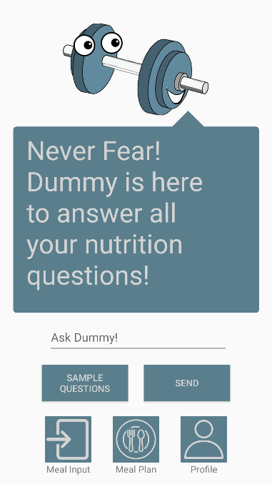
Ask Dummy / Home
This screen will allow you to ask the AI simple fitness and food related questions
This will also function as the home screen, allowing you to access the Meal Input, Meal Plan, and Profile Screens

Slide 6
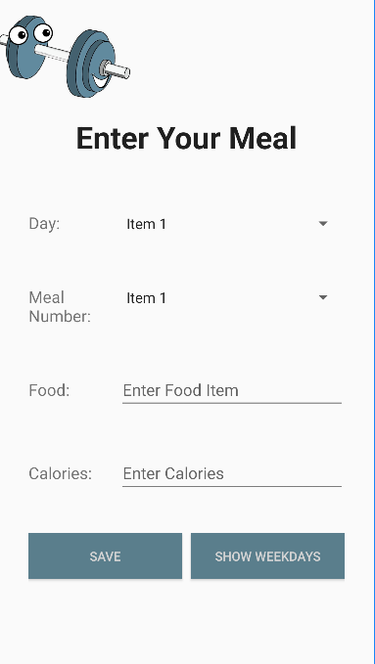
Meal Input
This screen will allow you to input the meals you’ve eaten into the database

Slide 7
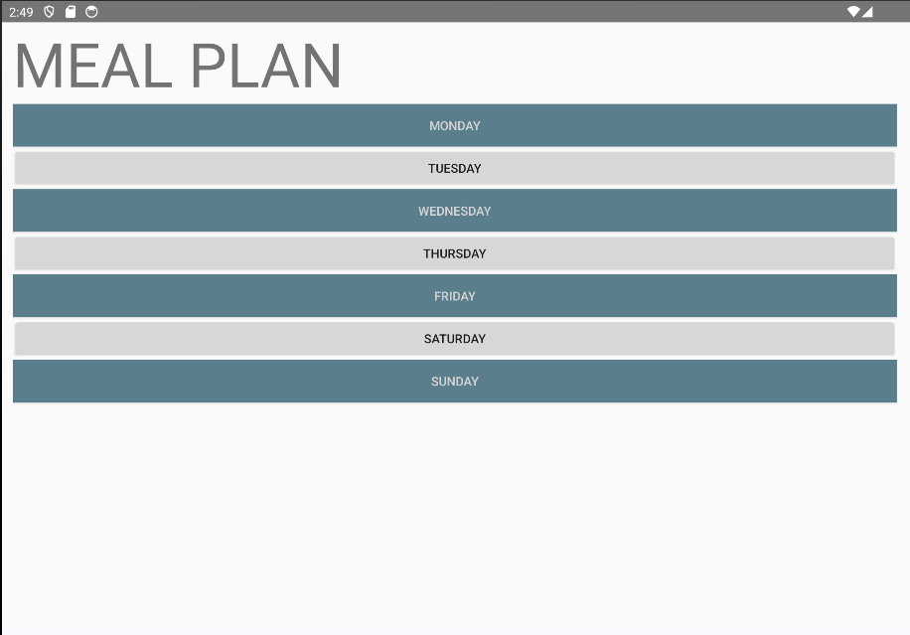
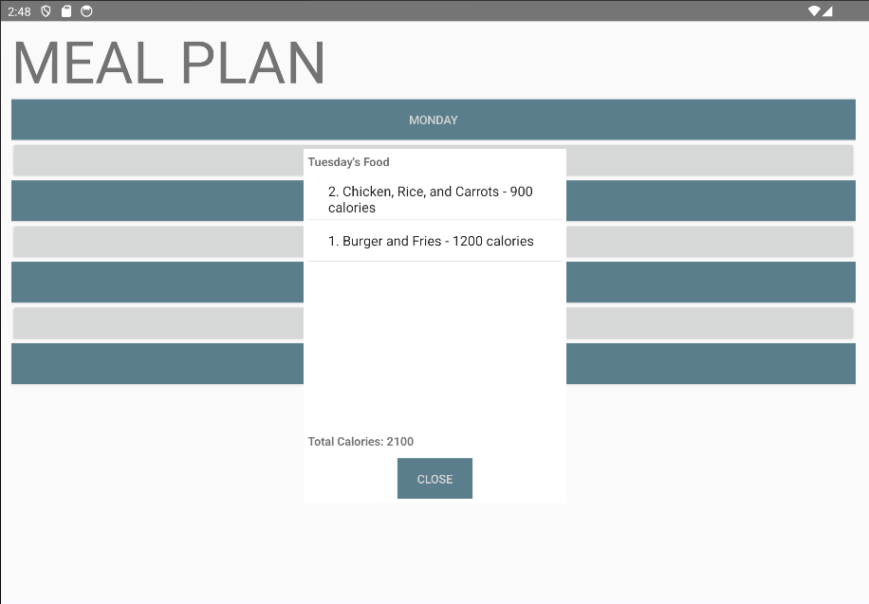
Meals Eaten
This screen is where you’ll be able to access the data stored in the database.
You do this by clicking on one of the days which will give you the meals you ate that day as well as the total calories eaten.

Slide 8
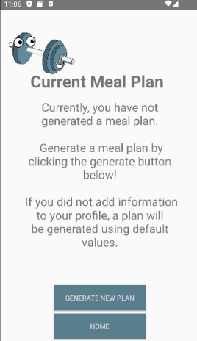
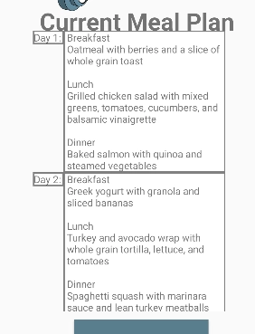
Meal Plan
This screen allows you to create a meal plan for your week through Dummy.

Slide 9
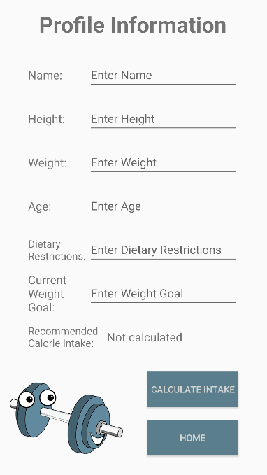
Profile
This is where the user’s profile data will be stored and the screen the AI will get it’s statistics for calculations and such from

Slide 10
Evolution of Our Project
At first, our project was just a basic calorie tracking app. But as we kept working on it, we came up with the idea of using AI to suggest meal options for our users. We also added the ability to ask our AI buddy 'Dummy' fitness and health questions. Plus, users can now set their calorie goals based on their profiles. These changes have made our app more helpful and user-friendly.

Slide 11
Project Takeaways
Through this project, our team not only deepened our understanding of the Android app development process but also gained insight into the effective utilization of databases, specifically SQLite, and the integration of AI through an API. Furthermore, this project served as a valuable opportunity for us to enhance our teamwork skills, necessitating collaboration in discussions, planning, and app development. Additionally, we also honed our proficiency in utilizing GitHub within a team environment, which became our primary platform for sharing project updates and facilitating concurrent work on the app

Slide 12
Item Checklist
Polish/Clean up UI - Completed
Correcting meal plan generation - Completed
Correct meals eaten format - Completed
Create sample questions - Completed
Correct meals eaten screen layout and display of info - Completed
Implement recommended cal intake based on profile screen. - Completed
Create database for meal plan data storage. - Changed method of storing
AI implementation - Completed
Database implementation - Completed
Generate meals through dummy - Completed
Meal input to database - Completed
Meal display from database - Completed
Ask Dummy questions - Completed

