Slide 1
Wimax Scheduling

Slide 2
Outline
Introduction
Key features of Wimax networks
Wimax frame structure
Wimax QoS service classes
Request and Grant mechanism
Scheduling
Simulation & results
Conclusion

Slide 3
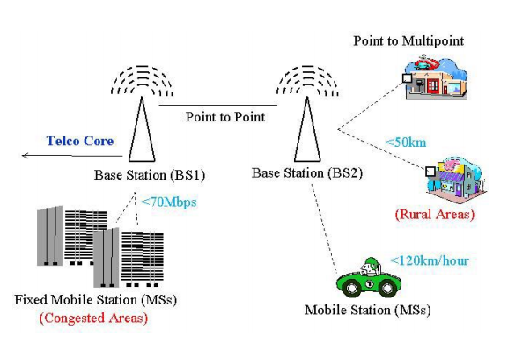
Introduction
802.16 provides wireless access over long distances in a variety of ways.
A WiMAX base station can provide broadband wireless access in range
Up to 50 kms for fixed stations
5 to 15 kms for mobile stations
With a maximum data rate of up to 70 Mbps

Slide 4
Key Features of WiMAX Networks
1. It uses of Orthogonal Frequency Division Multiple Access (OFDMA)
2.Time and Frequency Division Duplexing (TDD and FDD)
3.Advanced antenna techniques
Beam forming
Multiple Input Multiple Output (MIMO)

Slide 5
Key Features of WiMAX Networks
4.Per subscriber adaptive modulation
5.Advanced coding techniques
space-time coding and turbo coding
6.Multiple QoS classes

Slide 6
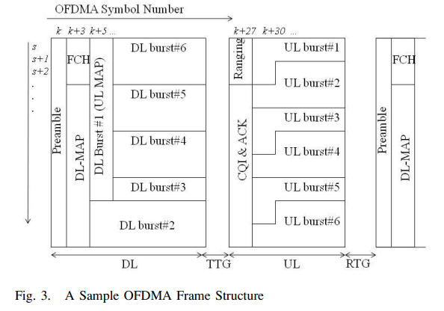
WiMAX Frame Structure
Each frame consists of downlink (DL) and uplink (UL) subframes:

Slide 7
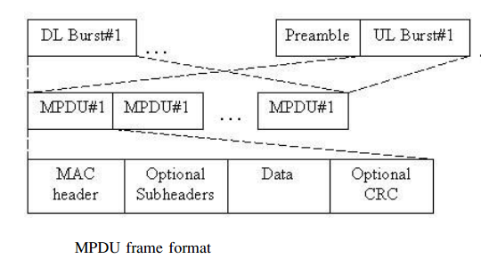
WiMAX Frame Structure
Each burst can contain MAC protocol data units (MPDUs)
The smallest unit from MAC to physical layer

Slide 8
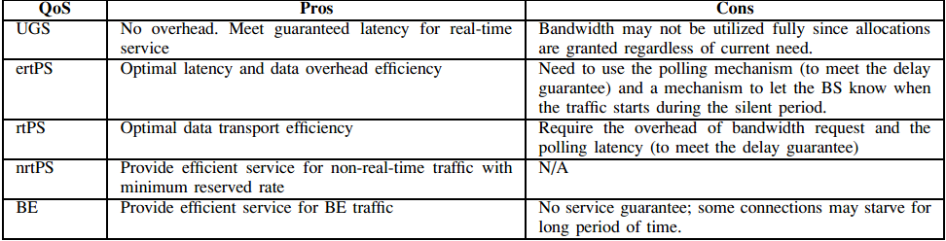
WiMAX QoS Service Classes
Comparison of wimax QoS service classes

Slide 9
Request/Grant Mechanism
BS scheduler:
Decide slot allocation for traffic going to various MSs.
For downlink, the BS has complete knowledge of the traffic
Queue lengths and packet sizes
For uplink traffic
The MSs send Bandwidth Request (BWR) packets to the BS.

Slide 10
Request/Grant Mechanism
There are a number of ways to request bandwidth.
These methods can be categorized
Implicit or explicit based on the need for polling

Slide 11
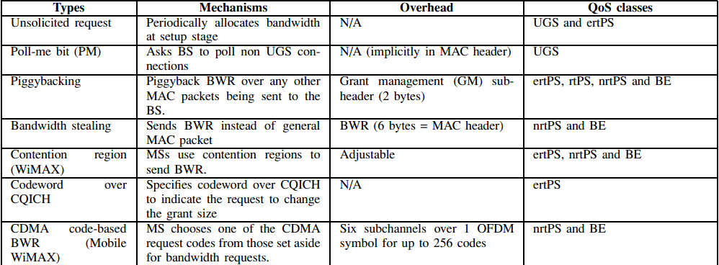
IMPLICIT Bandwidth Request Mechanisms

Slide 12
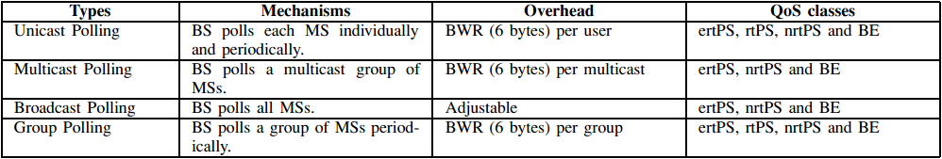
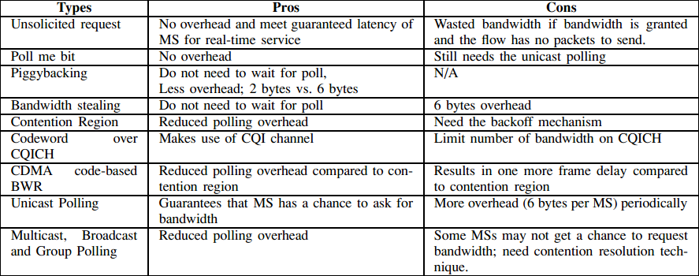
EXPLICIT Bandwidth Request Mechanisms

Slide 13
Scheduler
Scheduling is the main component of the MAC layer
Assure QoS to various service classes.
Distributor to allocate the resources among MSs.
Number of slots can be the allocated resource.
These slots are mapped into a number of sub channels
(OFDM symbols).

Slide 14
Permutation
The mapping process from logical subchannel to multiple physical subcarriers .
Fully Used Subchannelization (FUSC)
Adaptive Modulation and Coding (band-AMC).
PUSC

Slide 15
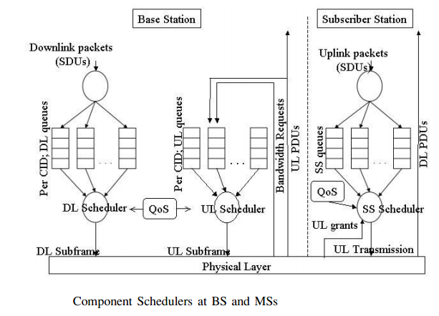
Scheduler
Packets from the upper layer are put into different queues.
DL-BS scheduler :
Decides which queue to
service.

Slide 16
Scheduler
CLASSIFICATION OF SCHEDULERS
Channel-unaware schedulers
Use no information of the channel state condition in making the scheduling decision.
Assume error-free channel
Channel-aware schedulers

Slide 17
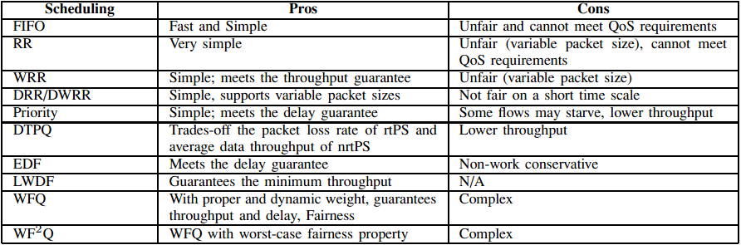
Channel-Unaware Schedulers

Slide 18
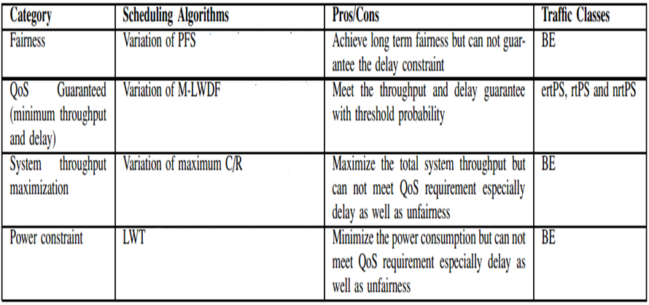
Channel-Aware Schedulers

Slide 19
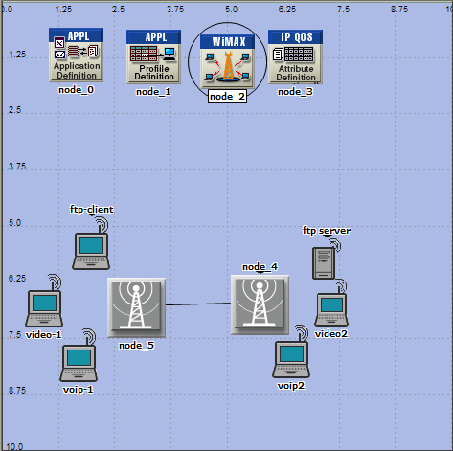
Simulation

Slide 20
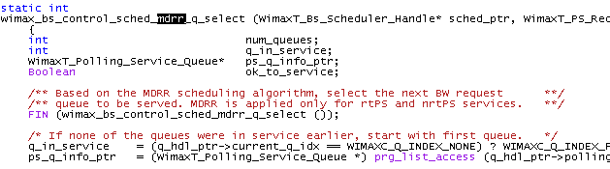
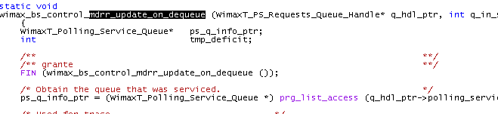
MDRR scheduler

Slide 21
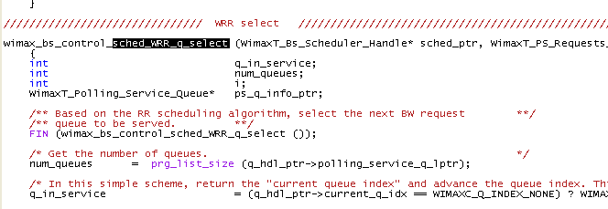
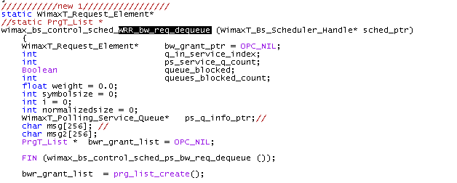
WRR scheduler

Slide 22
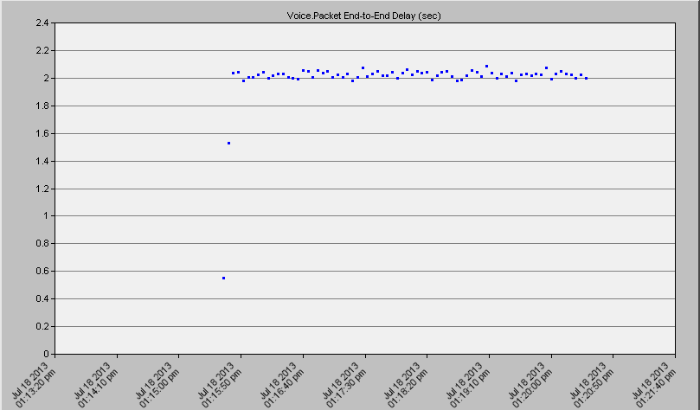
MDRR Results

Slide 23
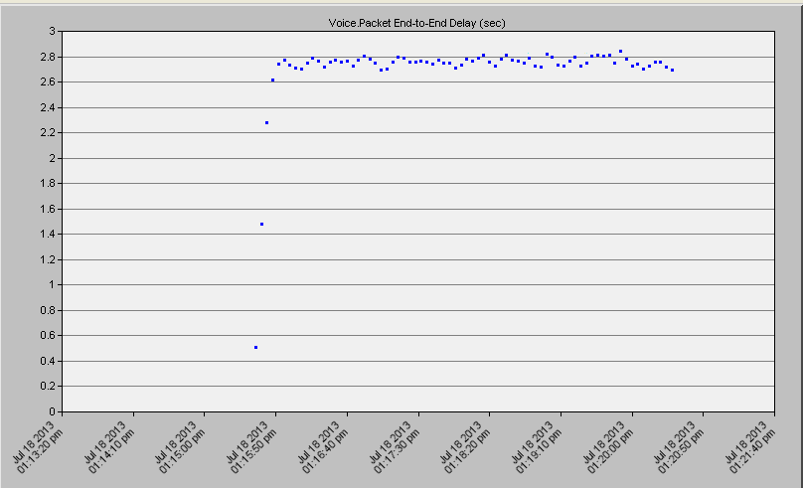
WRR Results

Slide 24
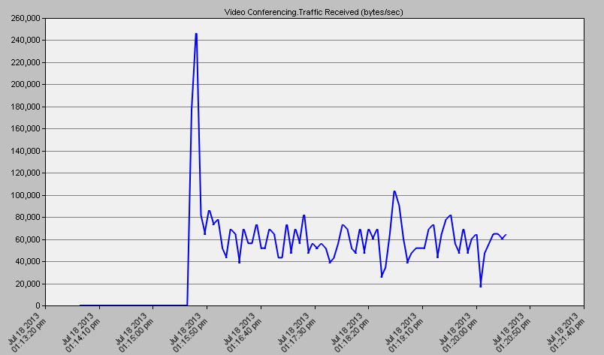
MDRR Result

Slide 25
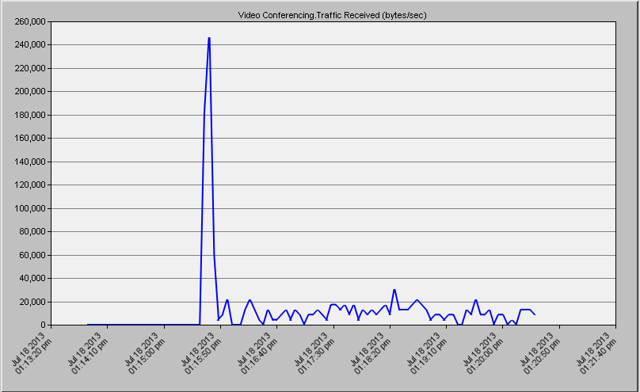
WRR Results

Slide 26
CONCLUSION
Scheduler should Consider WiMAX characteristics.
The goals of the schedulers :
QoS guarantees for all service classes,
Maximize the system goodput,
Maintain the fairness,
Minimize power consumption,
Less a complexity.

Slide 27
Thank you

