Slide 1
UVM
Planetary Rover Design using PIC Microcontroller and Custom H-bridges
Clark Van Dam Jan. 2013

Slide 2
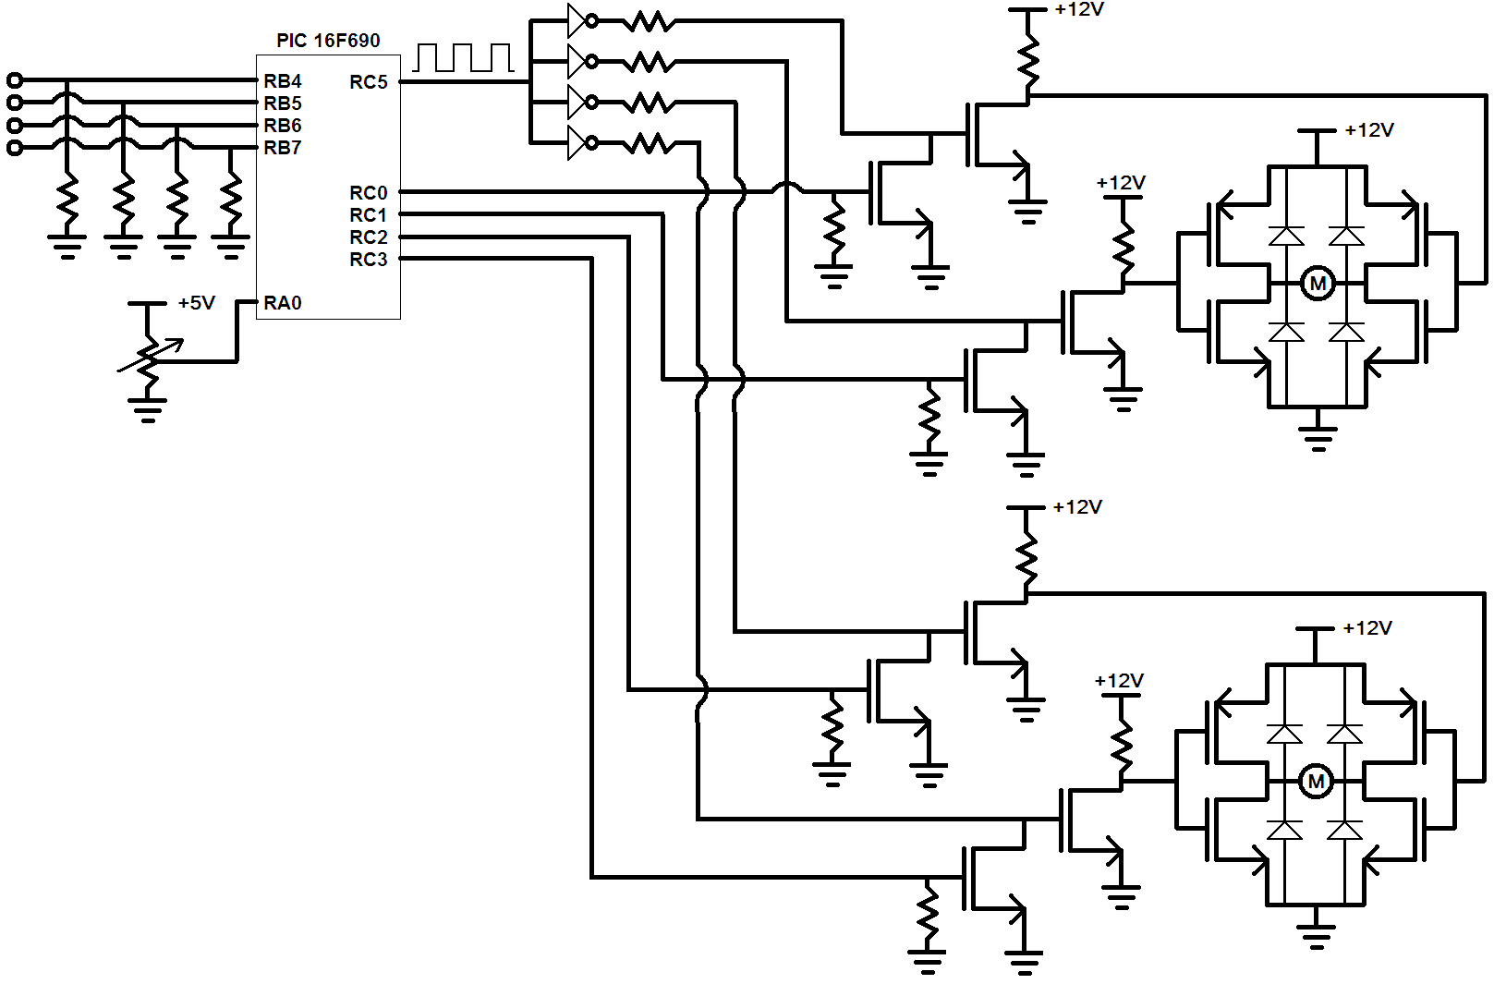
Planetary Rover - Schematic
PWM signal split and buffered.
Analog input sets PWM duty cycle.
Digital B-inputs interpret joystick or computer control.
Digital C-outputs sets appropriate left and right H-bridge signals.

Slide 3
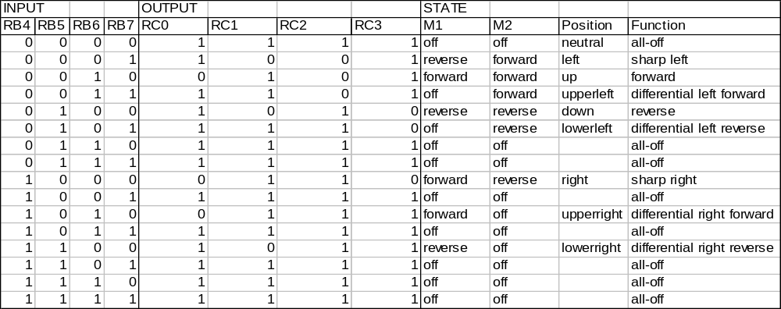
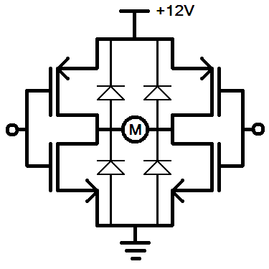
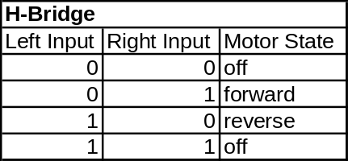
Planetary Rover – H-bridge Directional Control
Digital I/O State Description
Rover is Independent of specific hardware or software

Slide 4
Microcontroller Code:
See pwmDualMotor.c
Implement on PIC16F690 microcontroller with PICkit2 programmer using MPLAB IDE and HI-TECH C-compiler.

