Slide 1
7347 Season Recap
Alex, Matt, Filip, David, Ben, and Nick

Slide 2
Moment That Made You Laugh - Alex
When I was at an FRC Tournament and heard that the team had set a national high score in the first match.

Slide 3
Moment that Made You Laugh - Matt Iverson
The funniest memory of the robotics season for me was when we dumped all the small balls we had into our launcher without anything to catch them. The cleanup took a long time, but it was worth it.

Slide 4
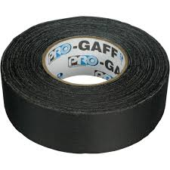
Moment that Made You Laugh - Filip L.
The best moments were when we initially rushed back to the robot and taped it together with gaffer’s tape in successive rounds. Then we replaced the parts with polycarbonate so that we wouldn’t have to work so much.

Slide 5

Moment that Made You Laugh
- Rohrbaugh
The best moments of the season were when Mrs. Lannen told us that we were going to State and when we won the Third Place Inspire Award at State and advanced to Super-Regionals

Slide 6
Moment that Made You Laugh - Ben Fishy Trout
I laughed the most when we heard we were moving on to state after three days of depression from losing at qualifiers. Nemo touched the boat.

Slide 7
Moment that Made You Laugh - Nick
I laughed the most when the robot threw a ball at Alex’s face.

Slide 8

Moment That Made You Cry - Alex
Realizing exactly how much the rest of my team had to learn about building a good robot.

Slide 9
Moment that Made You Cry - Matt Iverson
The worst part of my season was when we broke the slide we use to extend our scorer twice during the first competition.

Slide 10
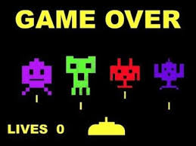
Moment that Made You Cry - Filip L.
I cried when we lost, qualifying 28th place out of 25 positions to get to Worlds. It felt that all of the effort we put in was pointless not because of our ineptitude (okay, maybe that accounted for some of the reason) but because our wiring spontaneously stopped working for three or so rounds.

Slide 11

Moment that Made You Cry
- Rohrbaugh
The worst moment of the season was the end of the last competition just after I knew that our season was over.

Slide 12
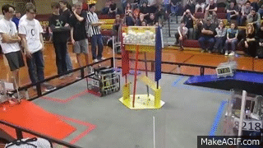
Moment that Made You Cry-Ben
When our teammates at our last qualifier pulled a full 90 and drove off the side of the ramp ultimately dooming our team to the infernal pit of shame.

Slide 13
Moment that Made You Cry-Nick
I cried when I had to tighten a screw on a servo with pliers.

Slide 14

I Wish I had Known … About Designing Robots - Alex
I know everything about designing robots.
My Creo skills could use some work though.

Slide 15
I wish I had known…about designing robots - Matt Iverson
I wish I had known how easily the parts that seem strong in the shop will break during actual competition. During the first tournament, we broke at least one part of the robot every round.

Slide 16

I wish I had known…about designing robots
Filip L.
Umm, programming in RobotC, prioritizing, wireless networking, circuitry, FTC regulations, CAD and designing in teams, communicating concepts to my teammates, calculus-based PID, scheduling, planning, manufacturing polycarbonate, cutting wood, gluing it, physics, brainstorming, scheduling, soldering, and making robots in general.

Slide 17
I wish I had known…about designing robots
- Rohrbaugh
I wish I had known more about the materials we were allowed to use. I thought that we were only allowed to use the TETRIX parts and a few other raw materials.

Slide 18
I wish I had known…about designing robots-Ben
I wish I had known more about quick and easy prototyping that would make our team more efficient at the beginning of the year.

Slide 19
I wish I had known…about designing robots-Nick
I wish I had known more about building things with the 3d printers and with plastic.

Slide 20
I Wish I had Known … About the Tournament - Alex
Being shorthanded at the tournament significantly reduces eliminates free time.

Slide 21
I wish I had known…about the tournament - Matt Iverson
I wish I had known how much of a problem the rod that holds up the center structure would be, since there were about 3 rounds that we got stuck on it and couldn’t score any points.

Slide 22

I wish I had known the importance of out-of-class volunteering and sponsorship about the tournament.
Filip L.
Wait, I was being judged to spend time outside of school to promote our team and FIRST robotics in general? I wish somebody had mentioned that at least for me to consider.

Slide 23
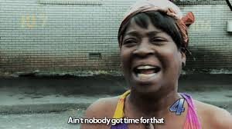
I wish I had known…about the tournament
- Rohrbaugh
I wish I had known what little time we would have between each match.

Slide 24
I wish I had known…about the tournament-Ben
I wish I had known more about Super-Regionals and how many teams would be there. I would have looked at more robots and taken more pictures if I had more time.

Slide 25
I wish I had known…about the tournament-Nick
I wish I had known that the driver’s meeting was going to take 2 hours so I could have made Ben go to it instead.

Slide 26
It’s All About Math and Science - Alex
PID control is used to maneuver the robot autonomously.
Rigorous and controlled testing is essential.
How quickly is it possible to score? Compute the energy required to lift a ball and divide by the power output of the motor.
If the balls are distributed evenly on the field, How frequently can we expect to intake a ball while driving at full speed?
*Continues for several hours*

Slide 27
It’s All About Math and Science-Matt
We used geometry to calculate how quickly the outside edge of our launcher was moving.

Slide 28
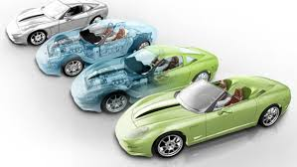
It’s All About Math and Science-Filip L.
CAD designs sorta like Sketchup help with planning the details of a mechanism’s work, position, and plausibility under the mathematical constraints.

Slide 29
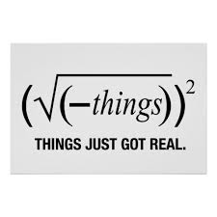
It’s All About Math and Science
- Rohrbaugh
At the beginning of the season we calculated the amount of balls our robot would have to process each second by using the speed of the robot, the dimensions of the field, and the number of balls distributed on the field. The end result was that our mechanism would have to handle 4 balls/second with the robot driving at full speed.

Slide 30
It’s All About Math and Science-Ben
We had to use many principles of physics to determine the effectiveness of our prototypes. The more rigid a surface the more energy it transferred to the ball.

Slide 31
It’s All About Math and Science-Nick
We tested where it was best for the launcher to hit the ball to find the most consistent way to score with our launching system.

Slide 32
Gracious Professionalism in Action - Alex
There is always a high degree of sportsmanship at FIRST competitions.
The Highlanders donated parts and shop time to our team.

Slide 33
Gracious Professionalism in Action-Matt
At the FTC West tournament, we needed a specific wire we didn’t have for repairs. One team came over to our pit 3 times to try to help us.

Slide 34

Gracious Professionalism in Action-Filip L.
A lot of teams (like ours) don’t consider bringing spare equipment for the robot in case a wire stops working or something of the likes. We lent our soldering equipment at the state tournament, and borrowed an NXT wire at super-regionals. That’s somewhat fair, IMHO.

Slide 35
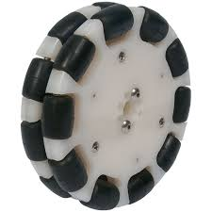
Gracious Professionalism in Action
- Rohrbaugh
I thought it was pretty cool that we gave two wheels to another team because they didn’t have any back at their shop and they were advancing to State.

Slide 36
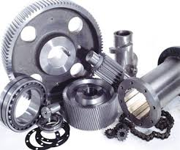
Gracious Professionalism in Action-Ben
At Super Regionals many teams willingly came to give us spare parts we needed.

Slide 37
Gracious Professionalism in Action-Nick
We helped a team at qualifiers solder a wire together so that it would reach.

Slide 38

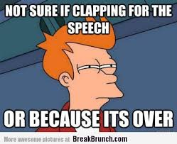
THE END
This text box allows Google Slides to wait for 2 seconds before starting to fade in the picture.
vv

