Slide 1

Analysis and Feature Selection for Predicting Visitor Conversion on E-Commerce Websites
RMT-30 Group 02 :
Ranie Sita Mannuela (DA)
Raodah Hasman (DS)
Raymond Samuel (DS,DE)
Rizky Chester Abadi (DA)

Slide 2

Introduction
E-commerce(electronic commerce) refers to the buying and selling of goods or services over the internet. It involves the transfer of money and data to execute these transactions. E-commerce can take various forms, for example Business-to-Consumer (B2C) or Business-to-Business (B2B).
E-commerce offers several advantages, including convenience, a wider selection of goods and services, competitive pricing, and the ability to reach a global market. It also encompasses various business models and technologies, including online retail, electronic payments, online auctions, internet banking, and online ticketing
E-Comerce

Slide 3
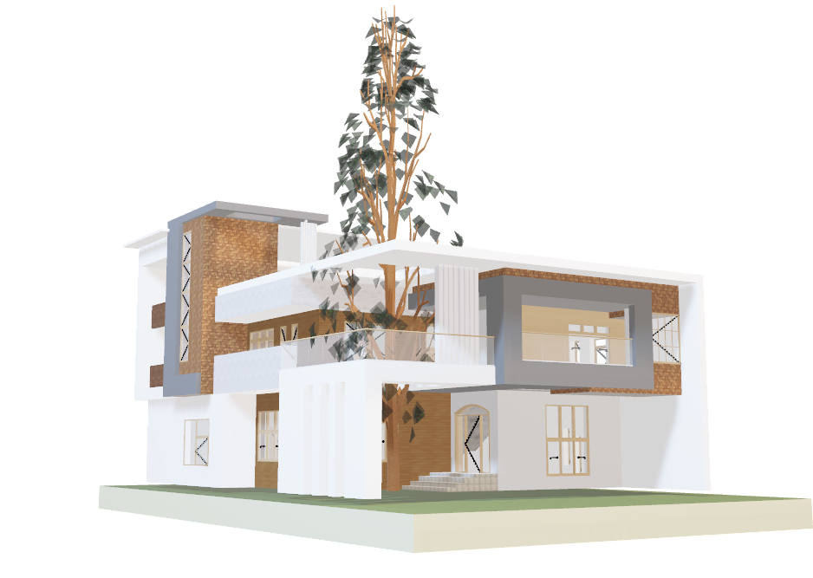
Introduction
Project Background
The rapid increase in E-Commerce usage in recent years has presented significant market opportunities, yet the conversion rate of purchases has not kept pace, necessitating solutions for personalized promotions to online buyers. In physical commerce, sellers can tailor offerings based on experience, which greatly impacts efficiency, conversion rates, and sales.
Many E-Commerce and IT companies are investing in systems to predict user behavior, mirroring seller behavior in virtual shopping. Academic studies propose machine learning methods from various angles: grouping visits based on navigation patterns or predicting behavior in real-time to boost completion rates and reduce cart abandonment. This program proposes a real-time online buyer behavior analysis system. The first predicts purchase intent during sessions, scoring visitors based on real-time session data.

Slide 4
Objective
Analysis of Online Shopping Behaviour in Real-Time, Including Predicting Users' Shopping Intentions
Problem Identification:
How are categories based on the type of visitors from each region?
What categories of operating systems are used by the users?
How are categories based on the number of users who make purchases from each region?
How is the distribution of the number of product pages visited by users?
Is there a relationship between the duration on administrative pages and bounce rates?
Which features have the most impact on revenue?
Descriptive Analysis: How is the analysis of the distribution of product page values and the analysis of the duration of administrative pages related to bounce rates?
Notes:
Fattah

Slide 5
Summary
Method/Model
Machine Learning Classification Model
Determine the variables that influence will they will generate Revenue or Not
Comparing several Classification algorithms
Implement the best Classification model
Impact
Increase in Sales Conversion
-By predicting user purchase intentions, the company can provide more personalized and targeted promotions, increasing the conversion of visitors into buyers.
Optimization of User Experience
-Implementing real-time data processing systems and enhancing the user experience on the website or app can retain and attract returning visitors.
Notes:
Fattah

Slide 6
Workflow Project
Dataset selection, Define the problem and Set objectives
The data workflow begins with the entire team collaboratively selecting a dataset, defining the thematic focus, formulating a problem statement, setting clear objectives, and establishing success criteria.
Data Visualization
The Data Analyst then conducts in-depth data exploration, followed by the development of interactive Tableau dashboards
Data Engineer
Data Scientist
Data Preprocessing
Once these foundational decisions are made, the Data Engineer developing Airflow scripts for data tasks and creates PostgreSQL databases for raw and cleaned data..
Model Development and Deployment
Subsequently, the Data Scientist builds a model with 4 Different model and choose the best Model one which is XGBoost and develops a user-friendly interface with HuggingFace and Streamlit. This interface facilitates the delivery of problem-specific recommendations. Throughout the process, ongoing collaboration ensures that data-driven insights are derived effectively."
Entire Team
Data Analyst

Slide 7
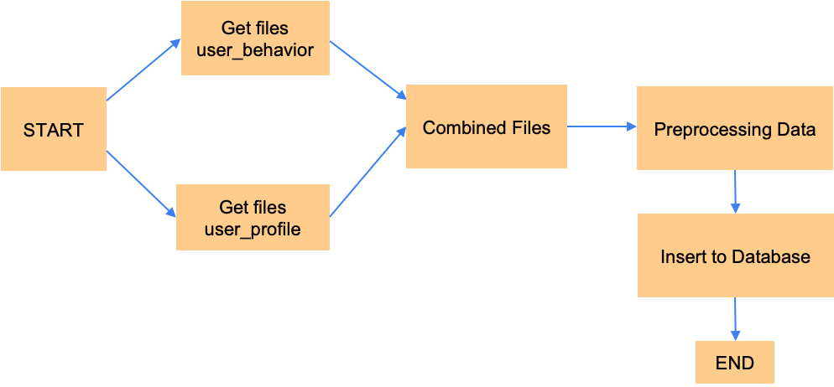
Process of Engineering Data
Notes:
Fattah

Slide 8
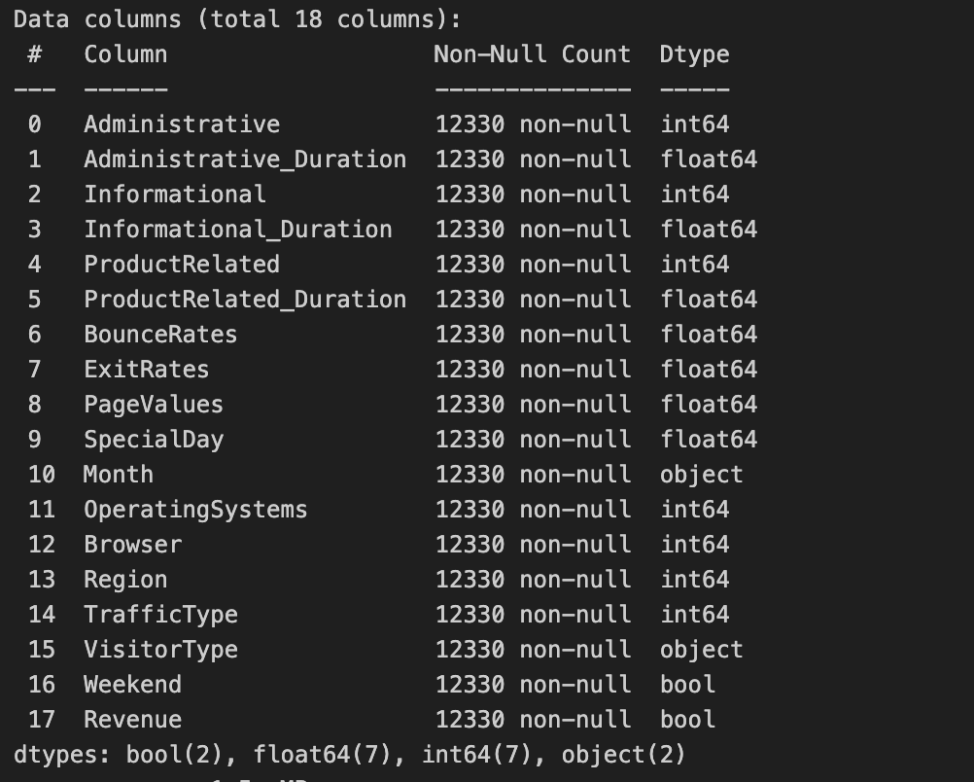
About Dataset
Sources : https://archive.ics.uci.edu/dataset/468/online+shoppers+purchasing+intention+dataset / Online_Shopper_Intention dataset
Have 18 column 12330 rows
Notes:
Fattah

Slide 9
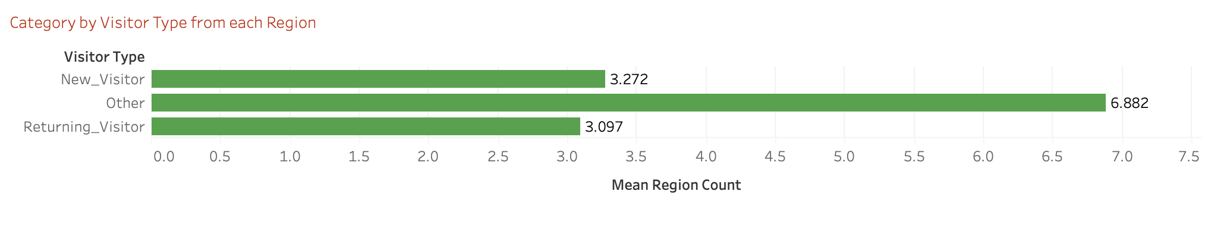
Analysis Data
Insight:
New Visitor is spread less across different regions compared to Returning Visitor and Other.
Other has the highest region spread.
Returning Visitor is in the middle between new visitors and other categories.
Business Recommendations:
Target New Visitors: Enhance marketing in regions with higher potential for new visitors to attract more new visitors.
Optimize for Other Visitor Categories: Identify what attracts the "Other" visitor category and apply those strategies in other regions.
Increase Returning Visitor Loyalty: Create loyalty programs or special offers to retain and increase engagement of returning visitors.
Notes:
Fahmi / Firhan

Slide 10
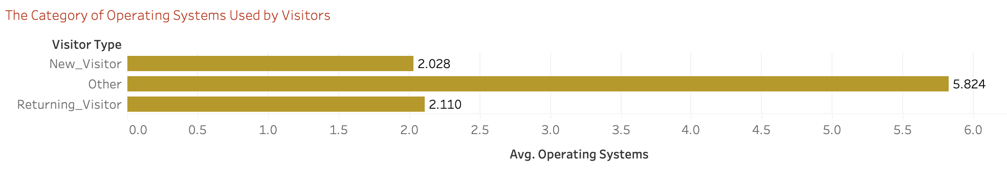
Analysis Data
Insight:
The Other visitor category uses a wider variety of operating systems compared to other visitors.
New Visitor and Returning Visitor tend to use more common or standard operating systems.
Business Recommendations:
Optimize Technology: Ensure the website or application is compatible with various operating systems, especially those used by the "Other" category.
Develop Applications: Consider developing features that support a variety of operating systems.
Targeted Marketing Campaigns: Use operating system data to target more specific marketing campaigns.
Notes:
Fahmi / Firhan

Slide 11
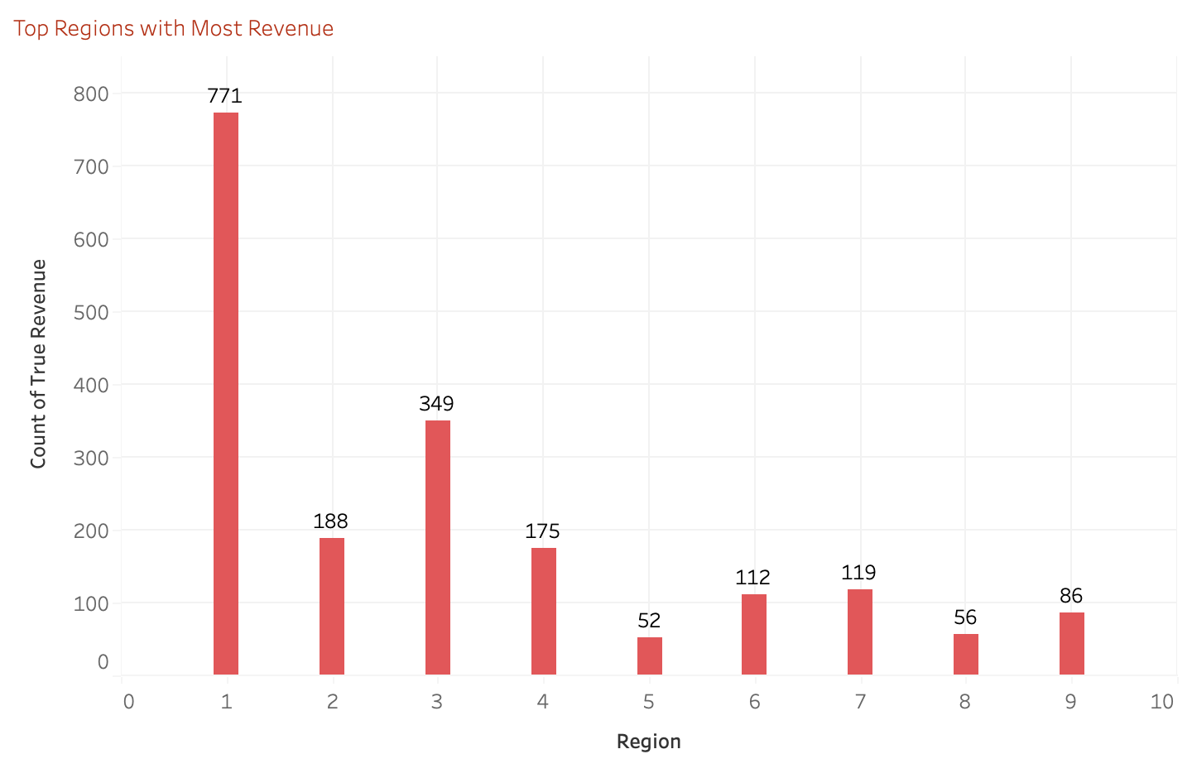
Analysis Data
Insight:
Region 1 is the highest revenue region, showing great market potential.
Regions 5, 6, 7, 8, and 9 have lower revenue and need better marketing strategies.
Region 3 and Region 4 have good market potential after Region 1.
Business Recommendations:
Focus on Region 1: Increase promotions and loyalty programs in Region 1 to maximize profits.
Strategies for Low Revenue Regions: Evaluate and develop more effective marketing strategies in Regions 5, 6, 7, 8, and 9.
Explore Markets in Regions 3 and 4: Enhance conversion and loyalty in Regions 3 and 4 to drive further growth.
Notes:
Fahmi / Firhan

Slide 12
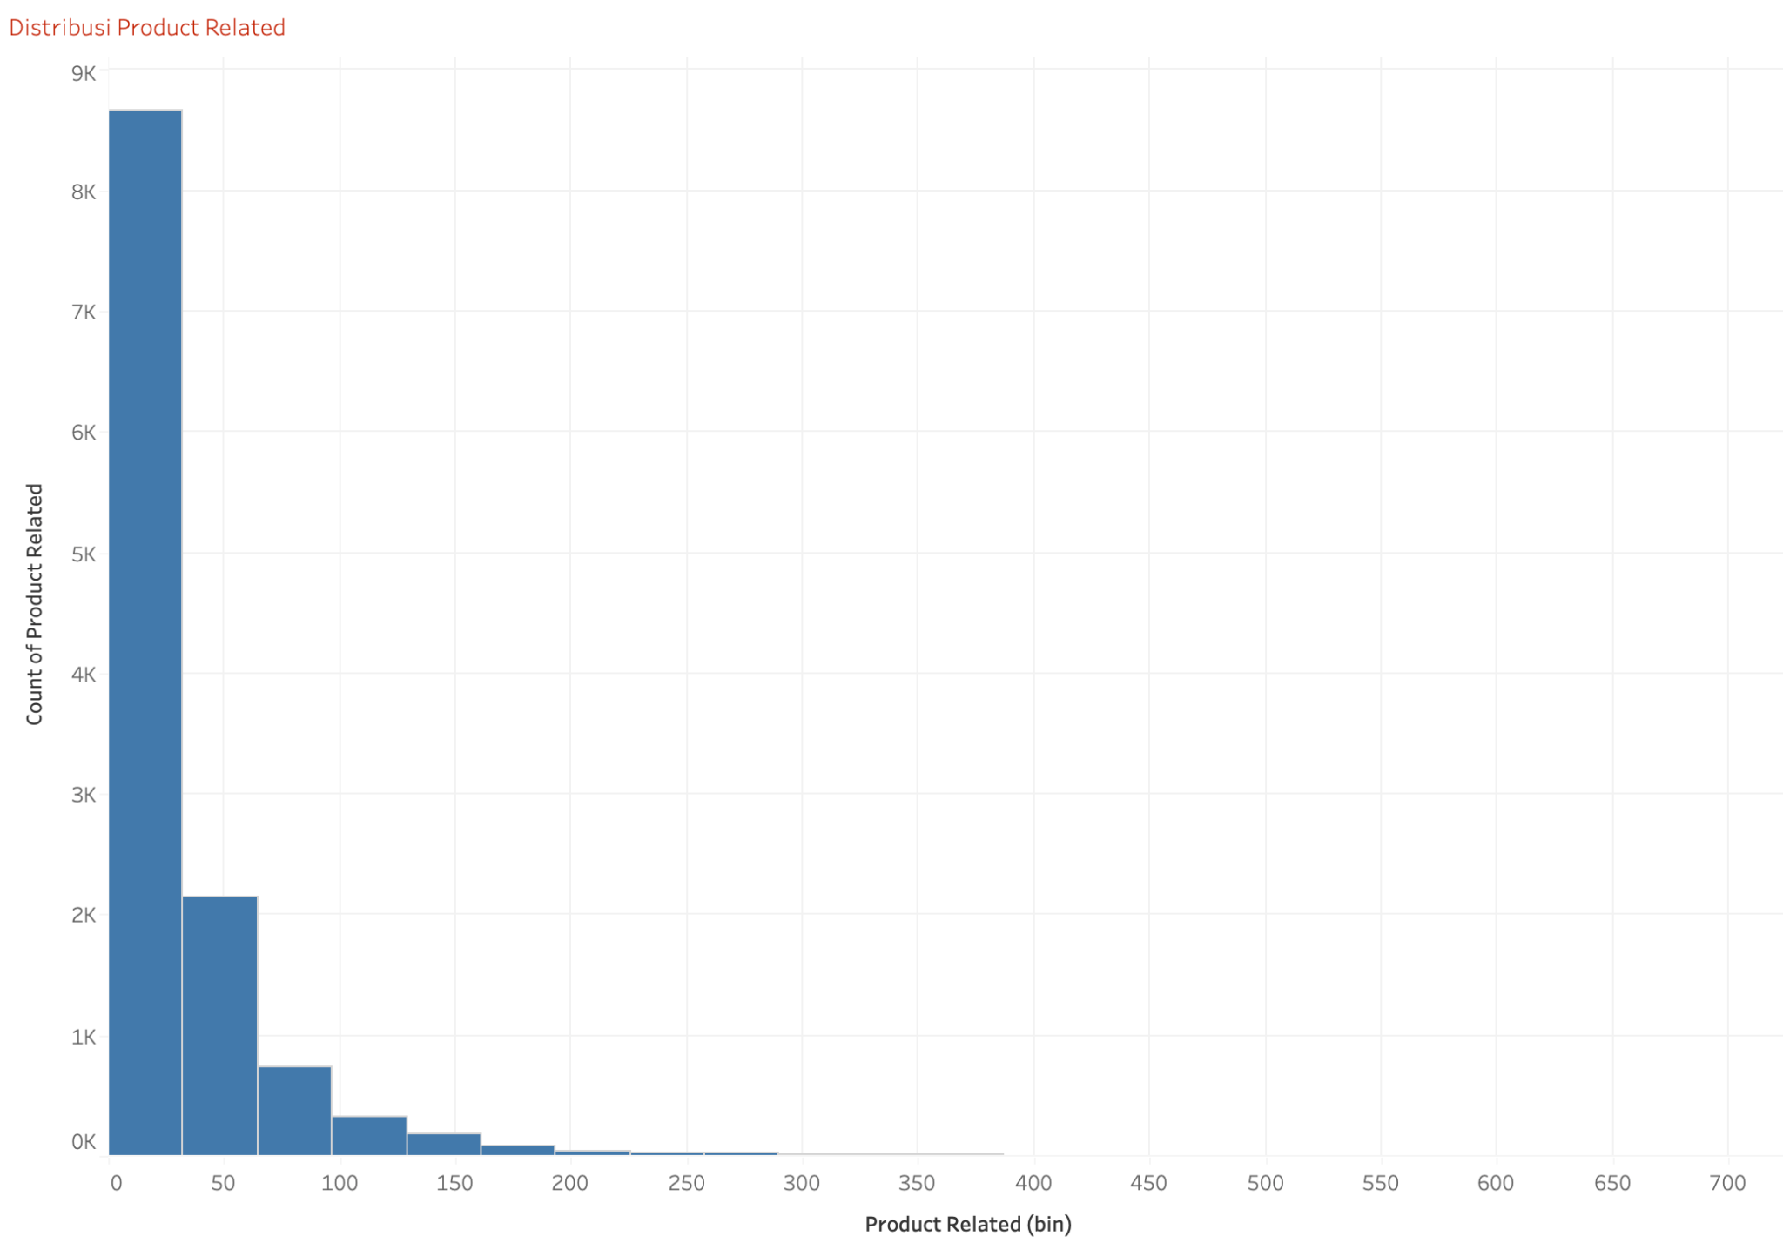
Analysis Data
Insight:
The histogram indicates that most users visit very few product-related pages. The distribution is positively skewed, with a majority of users viewing between 0 to 20 product-related pages.
Descriptive statistics reveal an average of 31.73 product-related pages viewed, with a significant portion of users (75th percentile) viewing up to 38 pages.
Business Recommendation:
Improve Product Discovery: Implement features like personalized recommendations and easy navigation to encourage users to explore more product-related pages.
Targeted Content: Create engaging content around products to retain user attention and potentially increase the number of pages viewed.
Notes:
Fahmi / Firhan

Slide 13
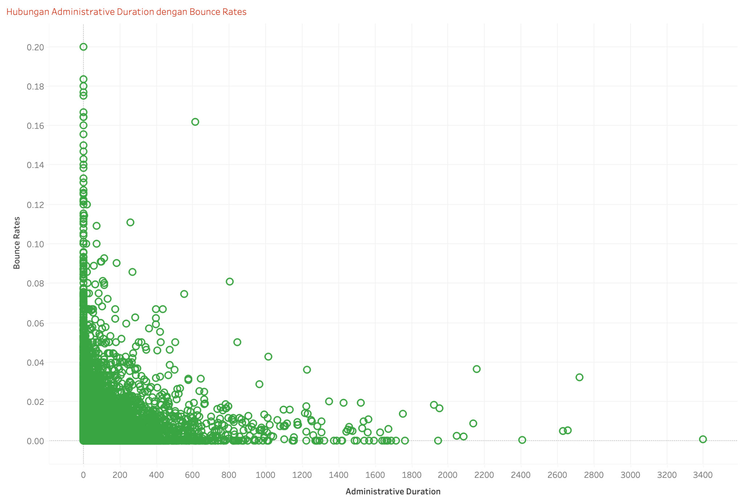
Analysis Data
Insight:
The scatter plot shows a negative but weak correlation between administrative duration and bounce rates. Users spending more time on administrative pages tend to have lower bounce rates.
Descriptive statistics show that the average administrative duration is around 80.82 seconds, and the average bounce rate is about 0.02 (2%).
Business Recommendation:
Enhance Administrative Content: Improve the quality and relevance of administrative content to keep users engaged and reduce bounce rates.
User Experience Optimization: Simplify navigation and ensure that information is easily accessible to decrease the likelihood of users leaving the site prematurely.
Notes:
Fahmi / Firhan

Slide 14
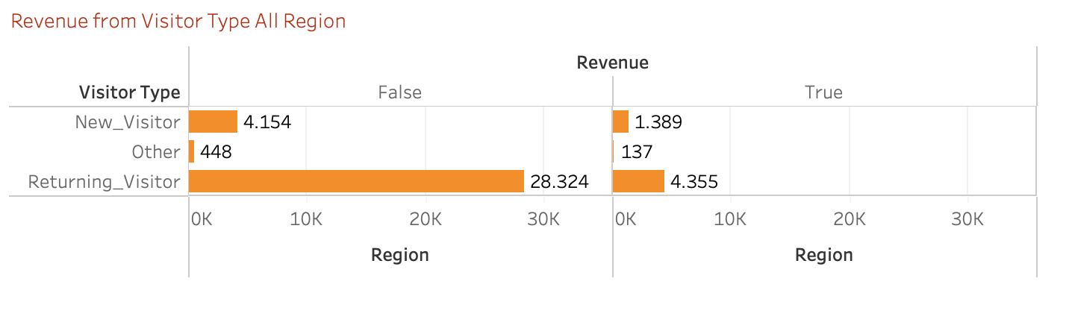
Analysis Data
Insight:
Returning visitors contribute the highest revenue compared to new visitors and other visitor types.
There is a noticeable difference in revenue between different regions, suggesting varied user behaviors or marketing effectiveness.
Business Recommendation:
Retention Strategies: Focus on strategies to retain existing customers, such as loyalty programs, personalized marketing, and improved customer service.
Regional Analysis: Investigate why certain regions perform better and apply successful strategies to underperforming areas.
Notes:
Fahmi / Firhan

Slide 15
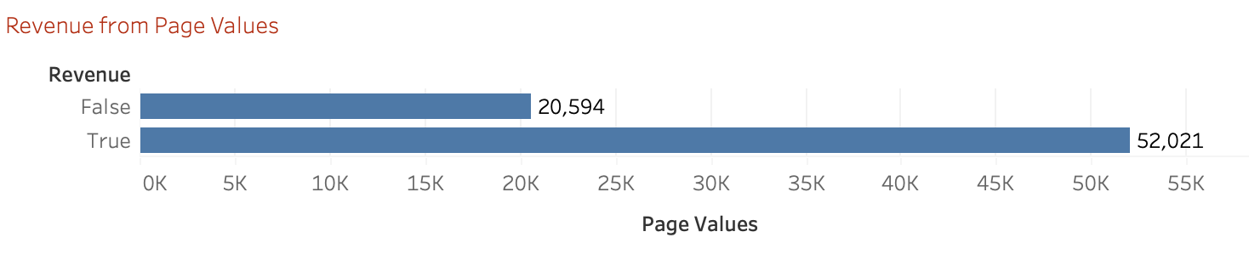
Analysis Data
Insight:
High-value pages generate significantly more revenue compared to low-value pages.
The disparity indicates that certain pages are more effective at converting visitors into paying customers.
Business Recommendation:
Content Optimization: Analyze and replicate successful elements from high-value pages across other pages. Focus on optimizing content, layout, and call-to-action elements.
Drive Traffic to High-Value Pages: Use targeted advertising and SEO strategies to direct more traffic to high-value pages.
Notes:
Fahmi / Firhan

Slide 16
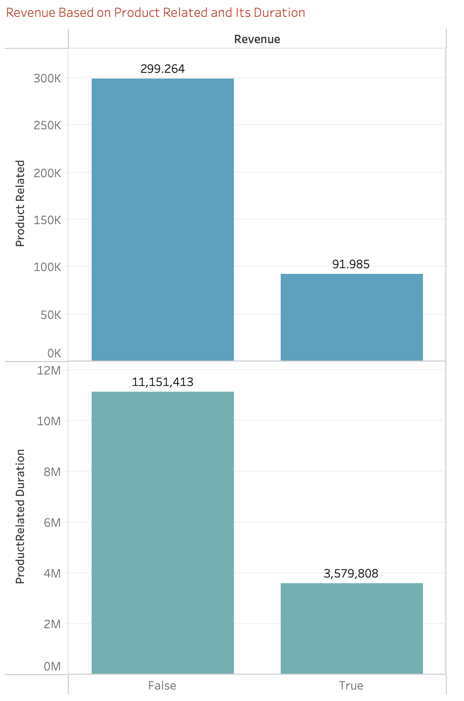
Analysis Data
Insight:
Product-related content and interactions significantly drive revenue, with pages having higher product-related durations generating more revenue.
Business Recommendation:
Emphasize Product-Related Content: Enhance product pages with detailed information, user reviews, and high-quality images to keep users engaged.
User Experience on Product Pages: Ensure an intuitive and seamless experience on product pages to increase the duration and likelihood of conversion.
Notes:
Fahmi / Firhan

Slide 17
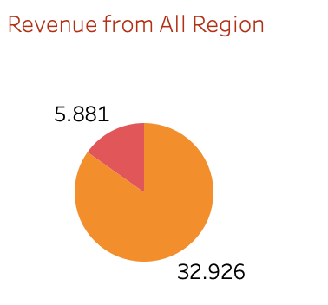
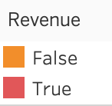
Analysis Data
Insight:
There is a clear distinction in revenue between region which visitor will buy and region which visitor will just leave and not buy.
Business Recommendation:
Analyze Contributing Factors: Investigate the factors contributing to higher revenue in regions marked as "False" and identify what makes these regions more successful. Factors could include local marketing strategies, customer preferences, and product availability.
Tailor Marketing Strategies: Apply successful strategies from high-performing regions to other regions. Customize marketing campaigns to resonate with local audiences, considering regional preferences and cultural differences
Notes:
Fahmi / Firhan

Slide 18
Model Evaluation
Precision | Logistic Regression | KNN | SVM | Decision Tree | Random Forest | XGBoost
0 | 0.88 | 0.90 | 0.90 | 0.92 | 0.92 | 0.89
1 | 0.78 | 0.73 | 0.81 | 0.72 | 0.76 | 0.87
Based on the comparison results, after tuning the parameters:
1. Based on score accuracy, Random Forest has the highest accuracy score, namely 90%
2. Based on the precision score, XGBoost has the highest precision value, namely 86%
Conclusion: Because this project will focus on precision metrics, which means we want to minimize the occurrence of True Positives (Visitors who are not actually shopping, but are categorized as shopping). Therefore, XGBoost is the best model with the highest precision score.

Slide 19

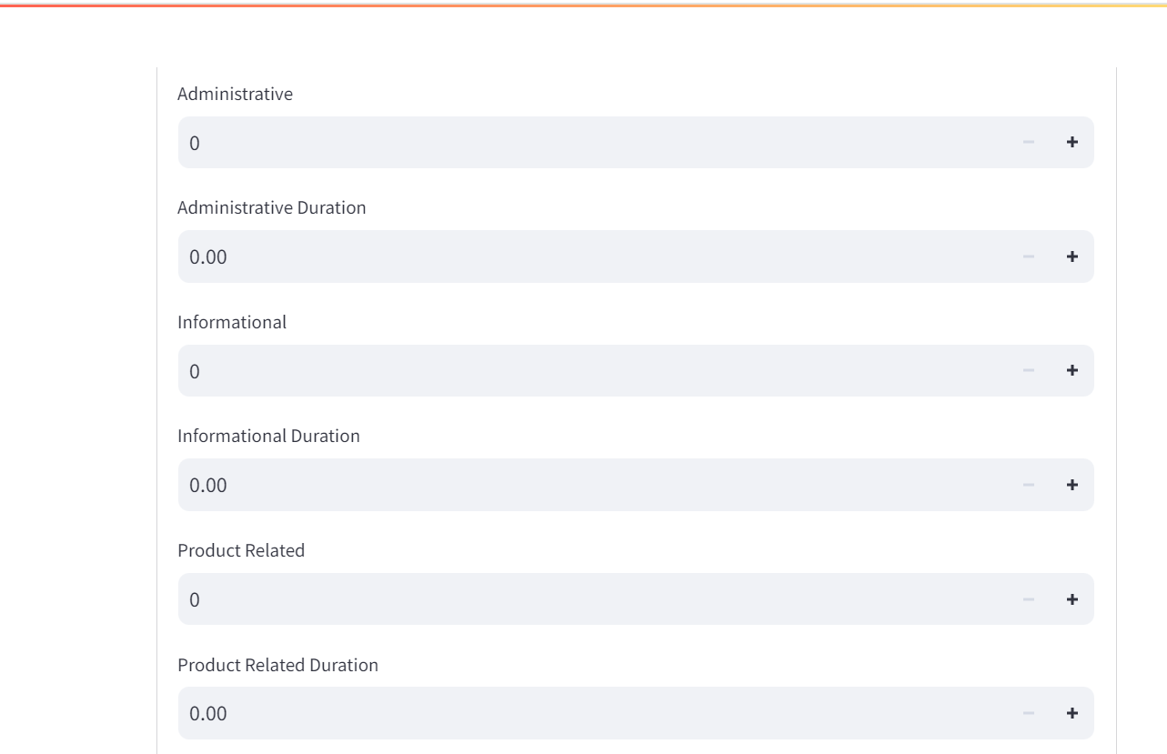
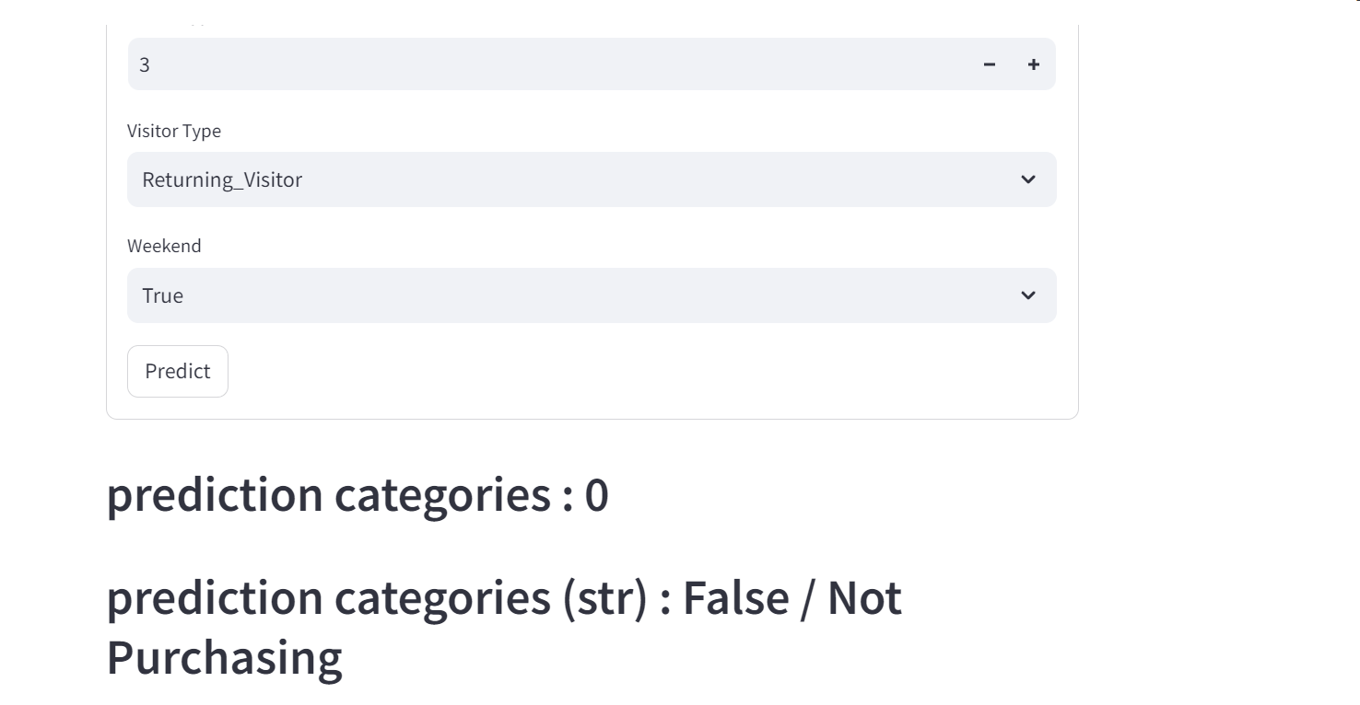
Demo Model
Property
Worth

Slide 20
Challenges
Limited Time : As a first time facing this challenge, we realize that we still need time to explore further to gain more information.
Time Coordination: One common issue is the difficulty in finding a suitable time for all group members to communicate and work together. Each member may have busy schedules or different time zones.
Difference in Understanding: Each group member may have a different level of understanding regarding machine learning concepts, data analysis, or data engineering. This can make collaboration and integration of work results challenging.
Resource Limitations: Sometimes limited access to the necessary hardware or specific software can be a constraint in the development of complex machine learning models.

Slide 21
Success Story
Effective Model Selection: We successfully identified and optimized the XGBoost model as the best choice for predicting user shopping intent in e-commerce. This demonstrates our expertise in selecting and configuring models to achieve the best results.
In-depth Analysis and Recommendations: We provide a robust analysis of user behavior and offer recommendations for improvement, such as data enrichment and real-time processing, showcasing our ability to translate findings into concrete steps to enhance project performance and impact.

Slide 22
Conclusion & Business Impact
The project successfully achieved its objective of predicting user shopping intent in an e-commerce environment. However, there are opportunities for further improvement to enhance the accuracy and effectiveness of the model.
To refine the model and better predict user behavior, several recommendations can be implemented:
Data Enrichment: Collecting additional data related to user demographics, browsing history, or external economic factors could provide valuable insights and improve predictive accuracy.
Feature Engineering: Exploring additional features or engineering existing ones could strengthen the model's predictive power. Techniques such as principal component analysis (PCA) or creating new features from existing data could be explored.
Real-time Data Processing: Implementing real-time data processing capabilities would allow for more timely and accurate recommendations to users, potentially improving conversion rates and customer satisfaction.

Slide 23




Thank You
Ranie SM
FTDS-RMT-030
Data Analyst
Raodah H
FTDS-RMT-030
Data Scientist
Raymond S
FTDS-RMT-030
Data Scientist
Data Engineer
Rizky CA
FTDS-RMT-030
Data Analyst
Hacktiv8id
Hacktiv8id
Hacktiv8
Hacktiv8 Indonesia

