Slide 1
Smart Questions

Slide 2
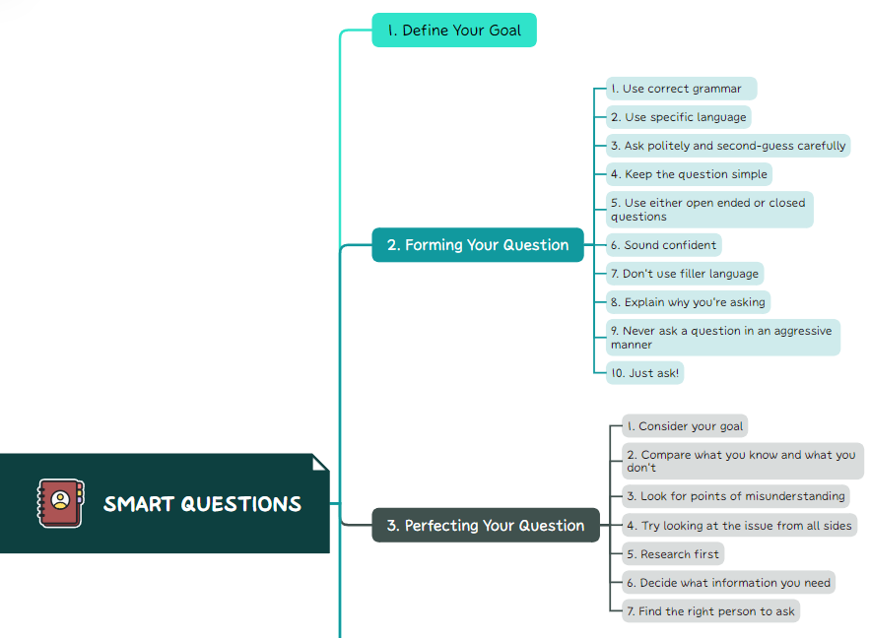
CONTENTS OF THIS TEMPLATE

Slide 3
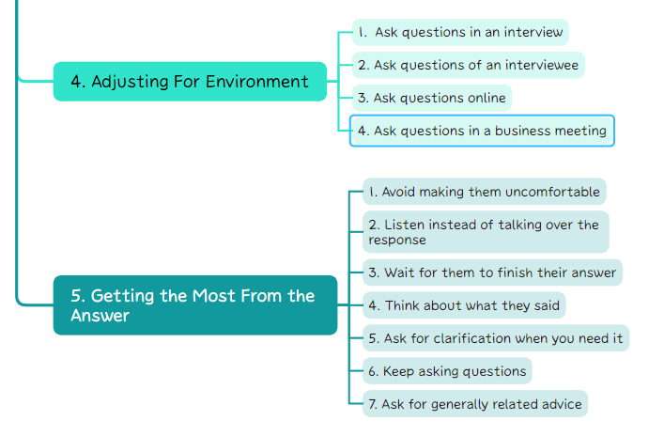
CONTENTS OF THIS TEMPLATE

Slide 4
01
Define your goal.

Slide 5

Figure out the purpose of your question.
Do you need to gather information?
Better understand a problem?
Get details on an important event?
If crafted carefully, smart questions can clearly and succinctly answer these questions, and more.

Slide 6
Figure out the purpose of your question.
Smart questions will:
Encourage learning and spark new ideas.
Unlock hidden value.
Improve your performance.
Prevent potential pitfalls.
Build lasting relationships.
Unlock learning.
Keep your conversations on track.

Slide 7
02
Forming Your Question

Slide 8

Use correct grammar
1.
Use the best grammar and pronunciation that you can. Speak clearly and enunciate.
This will not only make you appear more intelligent, but it will help make sure that the person you are asking can understand you and what you want to know.

Slide 9
Use specific language
2.
Try to be as specific as you can and use specific language. Don’t use hyperbole.
For example: don’t ask a business person if they’re hiring at all, if you’re really only interested in a particular position.
But instead ask if they are hiring for the position you’re looking for or would be qualified for.

Slide 10
Ask politely and second-guess carefully
3.
If you don't really feel comfortable with the answer or feel it doesn't meet your requirements
Proceed gently by asking how they know this information. Asking what general trends will shorten the path to that knowledge
Means you're looking for the tools to answer your own questions.

Slide 11
Keep the question simple
4.
Don’t ramble or explain anything more than what is needed to understand your problem and answer the question.
Extra information can be distracting and may cause you to get an answer for an entirely different question that what you wanted to ask

Slide 12
Use either open ended or closed questions
5.
When you need a specific answer or a firm yes or no, try to use closed ended questions.
When you need as much information as possible, use open ended questions.
Open ended questions usually start with phrases like “why” and “tell me more about”.
Closed ended questions usually start with phrases like “when” and “who”.

Slide 13
Sound confident
6.
Sound confident when you ask. Don’t be apologetic or self-deprecating.
This will make you seem like you are more intelligent and make someone less likely to judge you on what you’re asking.

Slide 14
Don’t use filler language
7.
Filler language is language like “erm”, ”um”, “uh“, “ah”, “em”, “like”, etc.
These are words you put in a sentence while you’re looking for the next word you want to use.
Use as little filler language as possible if you want to appear more intelligent, and want your question to seem more well-thought-out.

Slide 15
Explain why you’re asking
8.
If it helps and the situation allows, you should consider explaining why you’re asking or what your eventual goal is.
This may help clear up misunderstandings and may help the person you are asking to give you information you didn’t even know you needed.

Slide 16
Never ask a question in an aggressive manner
9.
This indicates that you are only asking the question to prove to the other person that you are right and they are wrong, meaning that you are argumentative and not open-minded.

Slide 17
Never ask a question in an aggressive manner
9.
Don't ask: "Isn't it true that more people would be well-fed if we ate grains directly rather than feeding it to animals and eating their meat?"
Ask: "Many vegetarians argue that there would be more food available if society didn't invest in meat production. The argument seems to make sense, but do you know of any arguments on the flip side?"

Slide 18
Just ask!
10.
The most important part of asking a question is to just ask!
There is essentially no such thing as a stupid question so you shouldn’t be ashamed to be asking for help.
Asking questions is what truly smart people do! Also, the longer you put off asking, the more difficult your problem may become.

Slide 19
03
Perfecting Your Question

Slide 20

1. Consider your goal.
You need to decide what the intended goal of your question is. What will the answer help you accomplish, really?
This will be helpful in deciding what information you require from the person you’re asking.
The more specifics you know about what you need, the more intelligent your questions will be

Slide 21
2. Compare what you know and what you don’t.
Think about what you know about this topic and what you don't know. Do you have a lot of information and only need small details? Did you know there's almost nothing?
The more information you know about a topic, the smarter your questions will be.

Slide 22
3. Look for points of misunderstanding
Examine what you know about the topic and what you’re confused about. Are you sure about the things that you do know?
Oftentimes what we think we know creates questions that don’t really have answers because our initial information was wrong

Slide 23
4. Try looking at the issue from all sides
It may be possible to answer your own questions, by looking at the problem from all sides.
A new approach may help you see something you couldn’t see before, resolving any problems you had on the issue.

Slide 24
5. Research first
If you still have questions and the opportunity is available, you should do your own research before asking the question.
Knowing as much as you can about the subject before asking the question is the most important part about asking a question intelligently.

Slide 25
6. Decide what information you need
Once you’ve done your research, you will be better informed about exactly what information you need.
Consider this and, if possible, write it down so you don’t forget anything when you’re ready to ask.

Slide 26
7. Find the right person to ask
Being informed about the issue will help you be better prepared for this, but under certain circumstances you still might want to be sure that you’re contacting the correct person

Slide 27
04
Adjusting for Environment

Slide 28

1. Ask questions in an interview
You want to show that you think really hard about how you work and how you'd work well in that particular environment.
Show them that you're in line with their company values and policies.

Slide 29

1. Ask questions in an interview
Ask questions like:
"Can you please describe a typical week in this position?"
"What opportunities will I have for growth and advancement?"
"How does this company manage its employees?"

Slide 30
2. Ask questions of an interviewee
When asking questions of an interviewee, you should be looking for signs of what type of employee they'll be.
Avoid the standard questions, as you'll get a pre-packaged response rather than pure honesty

Slide 31
2. Ask questions of an interviewee
Ask questions like:
"What types of work would you not want to do in this position?"
→ This question reveals weaknesses that you can expect.
"How do you think this job will have to change in the next 5 years? 10?"
→ This question reveals how they respond to change and whether they can plan ahead.

Slide 32
3. Ask questions online
People will be most likely to answer your online questions if they are, in fact, reasonable questions.
People don't want to answer something that you could have found out for yourself with 2 minutes and a Google search

Slide 33
3. Ask questions online
To increase your chances even further. In the mean time make sure to:
Always research first.
Keep calm.
Use the best spelling and grammar possible.

Slide 34
4. Ask questions in a business meeting
Questions asked in business meetings can vary widely, depending on your business and role.
You can follow these basic ideas:
Ask questions that move things forward and solve problems.
Get to the point. Don't ramble.
Look to the future.

Slide 35
05
Getting the Most From the Answer

Slide 36

1. Avoid making them uncomfortable
As a member of the public or a student in class, you are seeking information, not a roasting.
Even if you are trying to extract information in the public interest, you have to realize that a delicate approach may be necessary to get real answers.

Slide 37
2. Listen instead of talking over the response
If you want to get the most from the answer you are given, you need to start by listening to what the person has to say.
Only intervene if they have clearly misunderstood an important piece of information

Slide 38
3. Think about what they said
Think through all of the information they just gave you.
Think about how the answer applies to your problem and if all of your questions were addressed

Slide 39
4. Ask for clarification when you need it
If the answer they give you contains something you don't understand, don't be too embarrassed to ask for further clarification.
This will help keep further problems from arising because you did not get all the information you needed.

Slide 40
5. Keep asking questions
Ask more questions if they come up until you have as complete an answer as possible.
Asking more questions will also show the person that you’re asking that you’re really processing and appreciating the information they’re giving you.

Slide 41
6. Ask for generally related advice
You can also ask for general advice about the area you are asking about if the person is an expert.
They may have some expert advice that they wish someone had given them.

Slide 42
THANKS
Do you have any questions?
nhutp9673@gmail.com
By Pham Minh Nhut

