Slide 1





AUTONOMY AT WORK
Why it Matters and How to Foster it
PHAM MINH NHUT

Slide 2

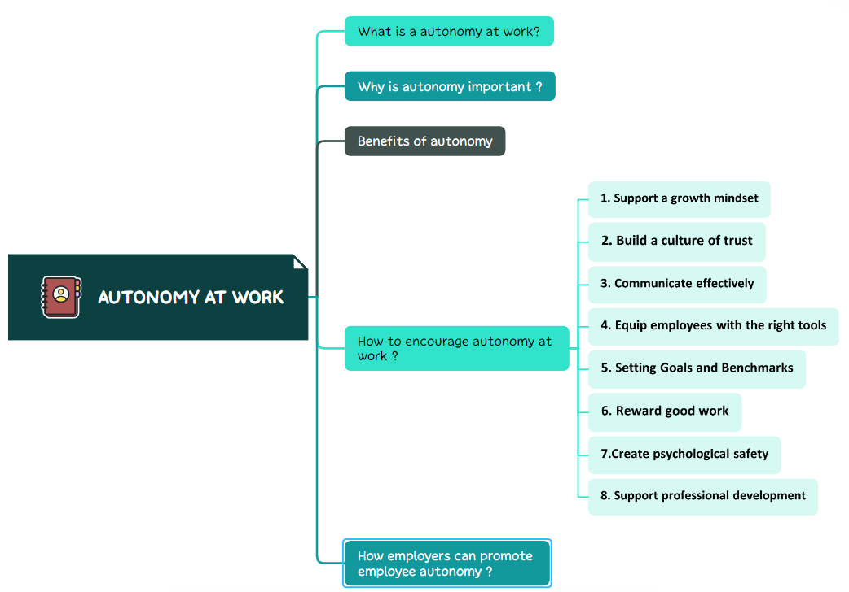


Slide 3
01.
What is autonomy at work?
A few important things to note

Slide 4

What is autonomy in the workplace?
Job autonomy means employees have some level of control over how they get work done, such as how they accomplish tasks, set deadlines, and where or when they work.

Slide 5

A few important things to note
Giving more autonomy does not mean waiving standards for employees. Any workplace should set clearly defined goals for employees to achieve

Slide 6
Examples of autonomy at work
Let employees set their own schedule.
Give employees a say in setting deadlines.
Offer remote or hybrid work arrangements.
Set goals and standards with input from team members.
Let employees design their own process for completing tasks and projects.
Grant the freedom to expand duties when needed.

Slide 7
02.
Why is autonomy important?

Slide 8

Why is autonomy important?
Employees work autonomously and in a way that suits their interests, you'll help them reach their full potential.
One person may thrive on group collaboration, while another can’t concentrate until they’re alone.
If you try to cram each of them into the same schedule, process, and location, they will struggle to do their best work.
→ As a result, they can lose motivation and become disengaged

Slide 9
03.
Benefits of autonomy

Slide 10
Increases job satisfaction
Creates employee engagement and motivation
Improves employee retention
Encourages creativity and innovation
Builds a culture of trust
Boosts productivity
Employees feel valued
Develops leadership qualities in employees
Promotes skill development
Benefits of autonomy

Slide 11
04.
How to encourage autonomy at work?

Slide 12
1. Support a growth mindset
A growth mindset specifies that skill and intelligence are something that can be developed.
How to encourage autonomy at work?
An employee encouraged into a growth mindset is positioned to develop themselves and will strive to move beyond where they are today.
2. Build a culture of trust
The first steps are delegating tasks to employees and giving them the freedom to find their own path to success.
The more tasks are delegated over time, the quicker a sense of workforce trust will develop.

Slide 13
3. Communicate effectively
A person can't make smart decisions or A team may end up in conflict if members are unsure about what they are trying to achieve.
In both cases, it is the responsibility of the leader to clarify what the task is.
How to encourage autonomy at work?
4. Equip employees with the right tools
With enhanced autonomy in the workplace, workers need tools that set them up for success.
For example:
If you have the option to work remotely, your company will need to provide software solutions that allow employees to easily connect with each other virtually.

Slide 14
5. Setting Goals and Benchmarks
Knowing the project's direction simplifies decision-making.
Individuals and teams should set their goals, with leader verification.
Recording benchmarks is crucial for future reference.
Employees understanding their potential strive for consistent or improved results.
How to encourage autonomy at work?
6. Reward good work
Giving credit for good work reinforces that free thinking is not only allowed but rewarded.
Employees will understand what they can achieve and appreciate that their approach delivers results.

Slide 15
7.Create psychological safety
Psychological safety frees employees from the fear that they’ll be ridiculed, punished, or looked down on when things don’t go as planned.
When managers create this sense of safety, employees can get creative, take reasonable risks
How to encourage autonomy at work?
8. Support professional development
Employees encouraged to recognize their own weaknesses and develop their own skills have a clear career path forward.
This benefits the company as a whole, given that a more skilled workforce increases productivity.

Slide 16
05.
How employers can promote employee autonomy ?

Slide 17

How employers can promote employee autonomy?
You can set the stage for a conversation by demonstrating your competence and capabilities before you sit down at the negotiating table.
Let's start the conversation with some clear examples like:
What would it look like in your situation?
How it will support the company's goals.
If you do great work and proactively make your workplace better

Slide 18
Thanks!
Do you have any questions?
nhutp9673@gmail.com
By Pham Minh Nhut

