Slide 1
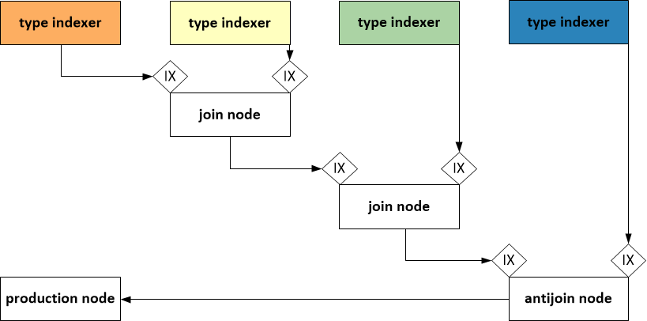

Slide 2
Distributed graph model
Model change
notification
Edge type 1 indexer
Edge type 2 indexer
Edge type 3 indexer
Edge type 4 indexer
Join
Update
propagation
Join
Anti-join
Production
Query results + Query result changes

Slide 3

vm0
vm1
vm2
vm3
T_{BM}
2
Rete
P
⋈
⋈
IncQuery-D Middleware (model / query management, indexing, notification)
1
DB
Shard 0
DB
Shard 1
DB
Shard 2
DB
Shard 3
Cloud infrastructure

Slide 4
:edgeType1
V1 : Type1
V2 : Type2
NEG
:edgeType4
:edgeType2
V4 : Type4
V3 : Type3
:edgeType3

