Slide 1
MONDO online demonstration

Slide 2
Prerequisites:
- org.mondo.collaboration.online.emfhandler.rest (the OSGi framework) is running with permissions to read/write disk (the hosting eclipse application is run as root/super user)
- glassfish server that is hosting org.mondo.collaboration.online.server and MondoOnlineCollaborationClient applications is running (with permissions to read/write disk, it shouldn't be required but just to be sure)
- the SVN server hosting the repository at the configured path (in the config.properties) is running and reachable

Slide 3
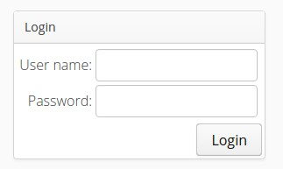
Navigate to the application's URL:
http://localhost:8080/MondoOnlineCollaborationClient/#!Login

Slide 4
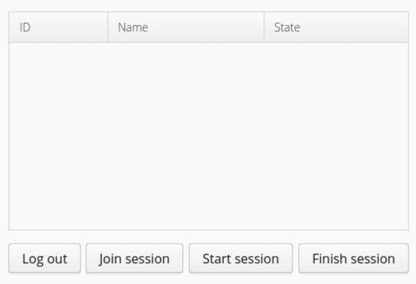
Login with the Username/pass: test/test

Slide 5
Click the "Start session" button. This should navigate the browser to another page that presents the available models after loading them from the respository (using the credentials entered in #2). If the checkout fails then a warning message informs about the failure and the browser will not be navigated to the "Start session" page.

Slide 6
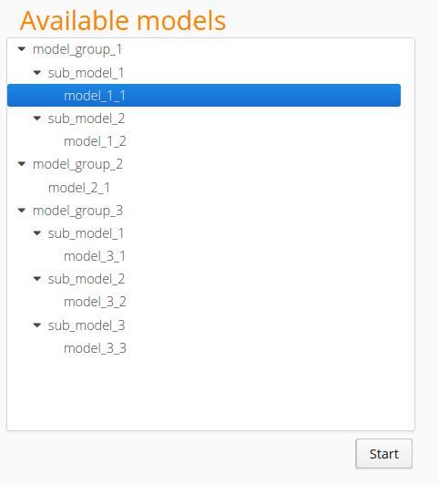

Slide 7
Select the "model_group_1/sub_model_1/model_1_1" model then click the "Start" button. (This step initializes the parsing of the EMF model into JSON, and creates a modeling session with the model and an empty set of users). Afterwards the browser is navigated back to the "Session selection" page and a session for the selected model should be listed.

Slide 8
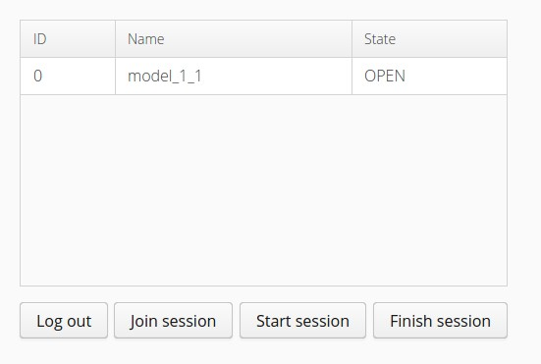

Slide 9
Click on the started session then press the "Join session" button. The browser is navigated to the "Collaboration page" and the model is visualised. (The JSON model is visualised as a result of this step)

Slide 10
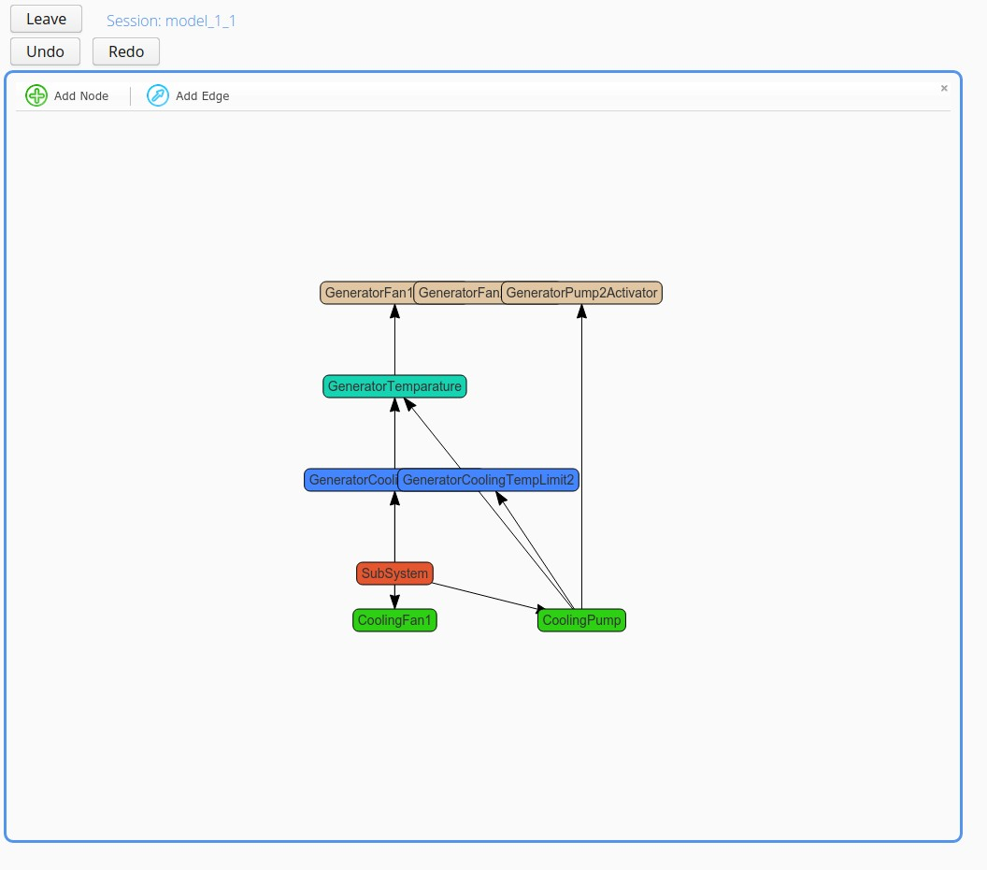

Slide 11
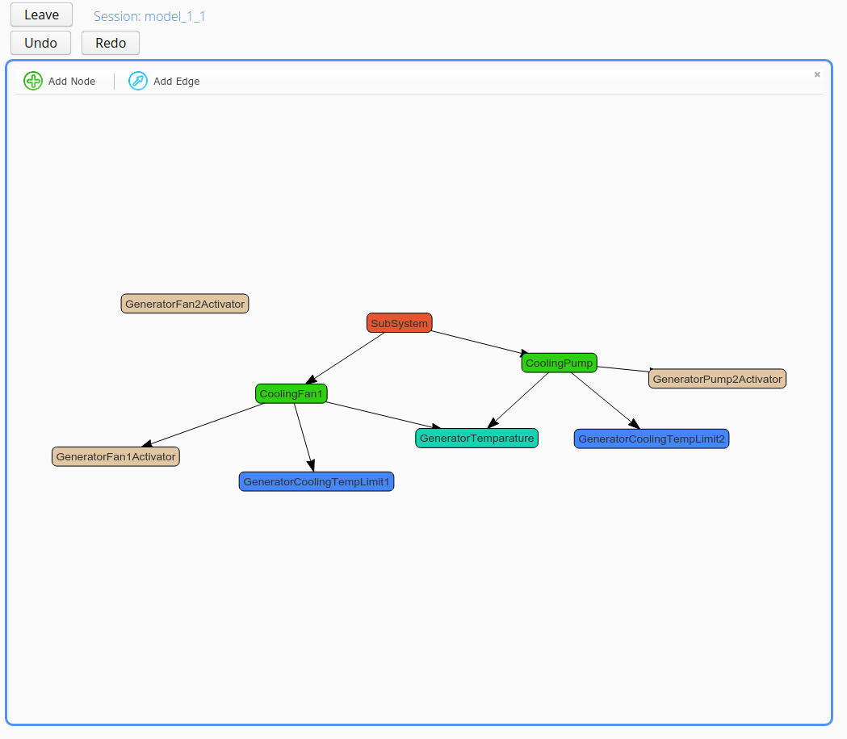
Organize the model by dragging the nodes. The model flickers after each move because the positions are stored centrally.

Slide 12
Open a new tab in the browser. Login with another user (in this case this user does not have to have acces to the repository.) Join the same session by selecting it and pressing the "Join session" button. This new tab is another instance of the Client application and could be a remote from connection as well (with a proper IP address in the URL field).

Slide 13
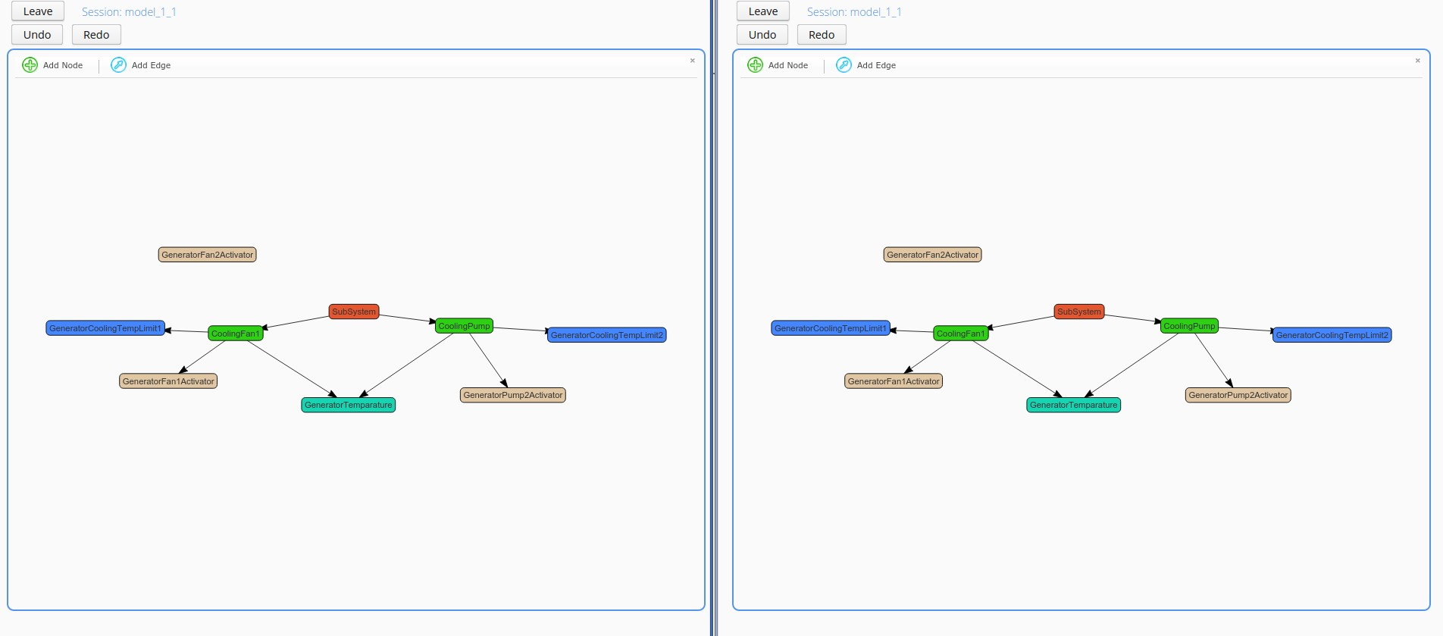
Detach/organize the browser tabs so that both can be seen at the same time.

Slide 14
(At this point node draggings and modifications should be propagated in real time to the other user.)
Delete the "System Output" called "GeneratorFan1Activator" (the brown node attached to the "CoolingFan1" control unit): click on the node then click on the appearing "Delete selected" button on the top.

Slide 15
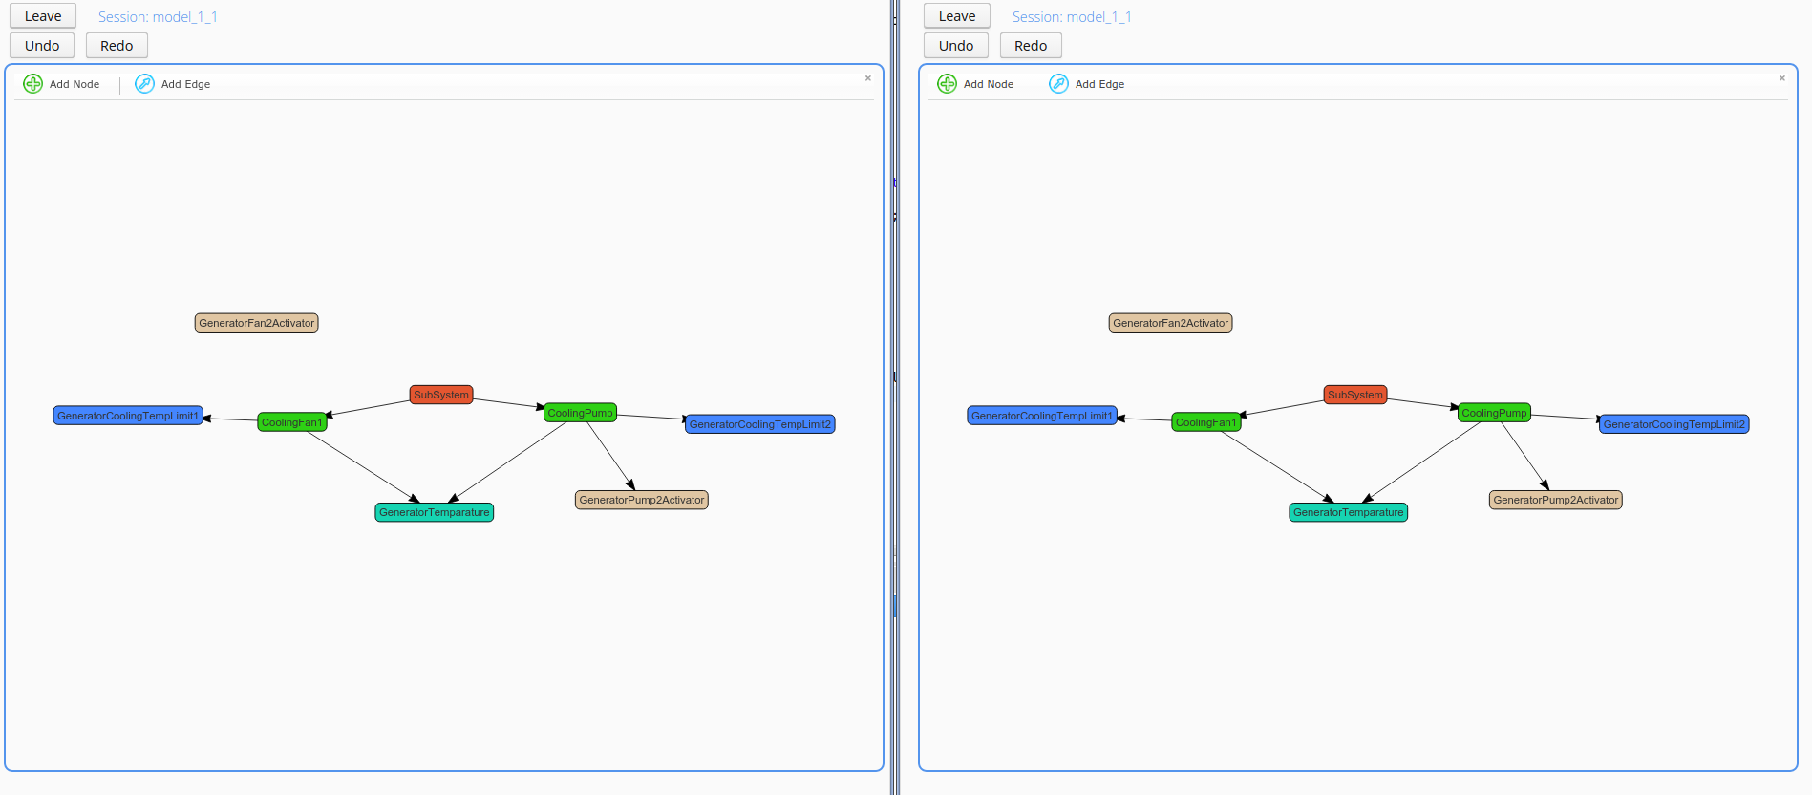

Slide 16
Connect the "GeneratorFan2Activator" to the "CoolingFan1" by pressing the "Add Edge" button then dragging the cursor from "GeneratorFan2Activator" to "CoolingFan1". (this creates an output reference of "GeneratorFan2Activator" in the "CoolingFan1" control unit).

Slide 17
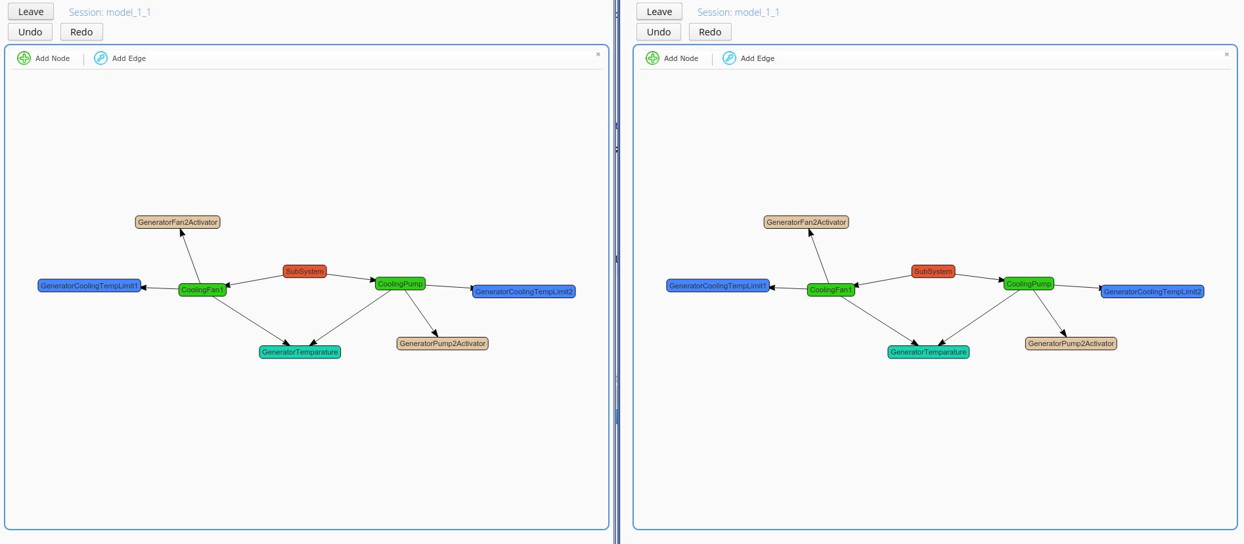

Slide 18
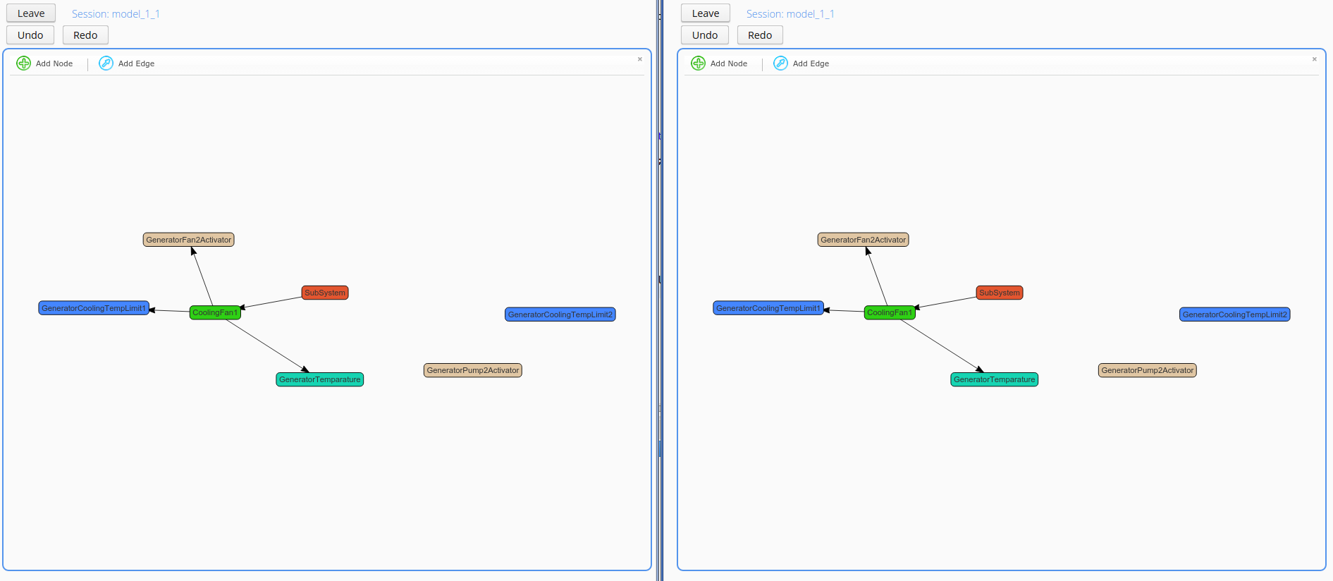
Delete the "CoolingPump" node previously.

Slide 19
Press the "Add Node" button then click somewhere (blank) in the modeling area. Add the name "NewCoolingPump1", change the ID to "new_cooling_pump_1" then select the "wtctrls" option from the dropdown list near "nodeType".

Slide 20
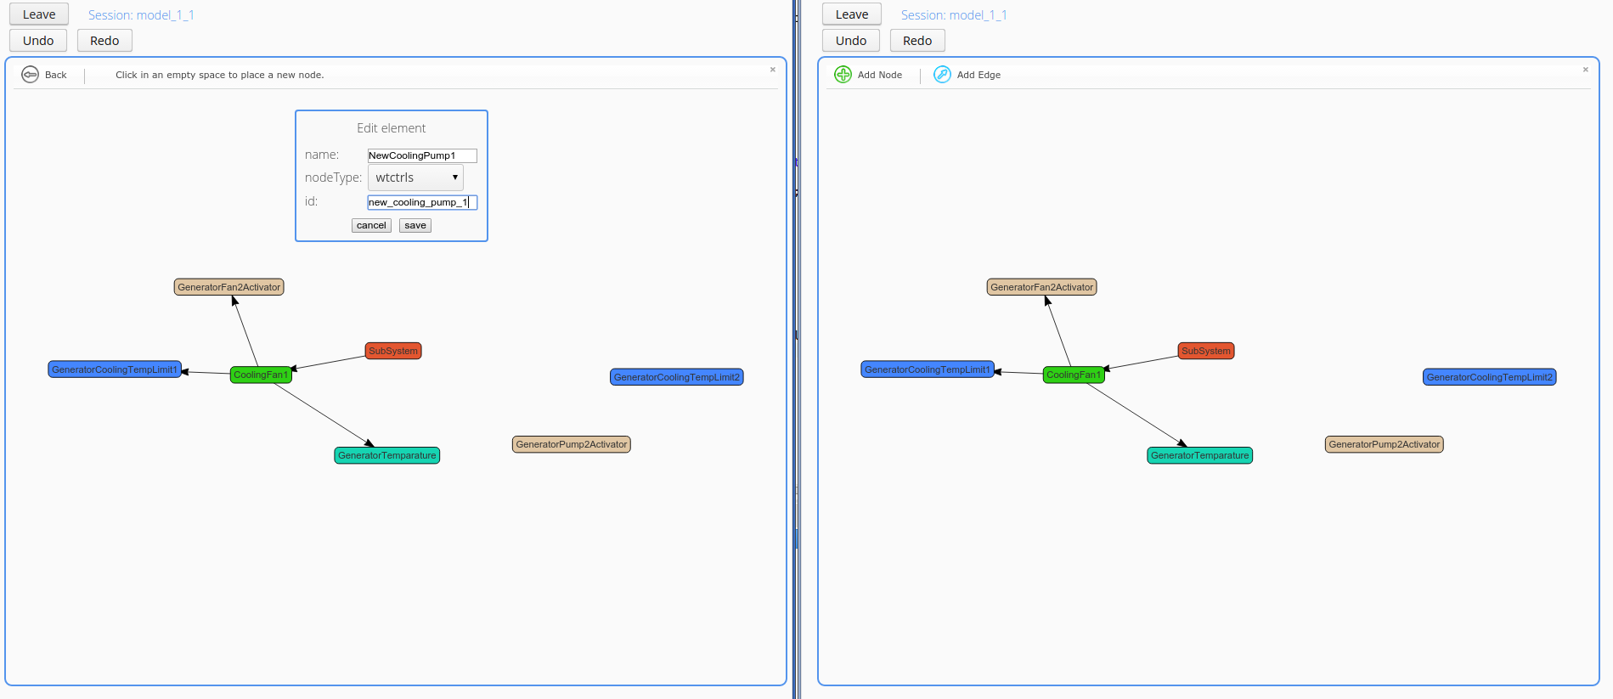

Slide 21
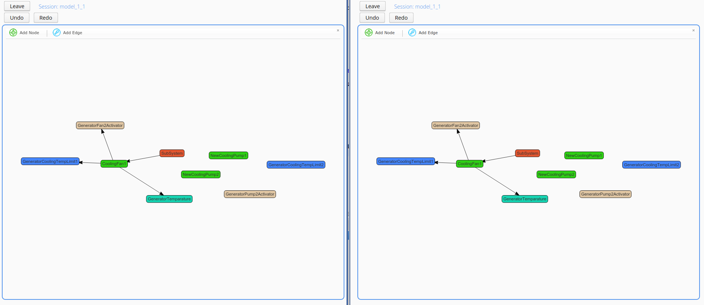
Add a new node by repeating the previous step but this time name the node "NewCoolingPump2" and set the ID to "new_cooling_pump_2".

Slide 22
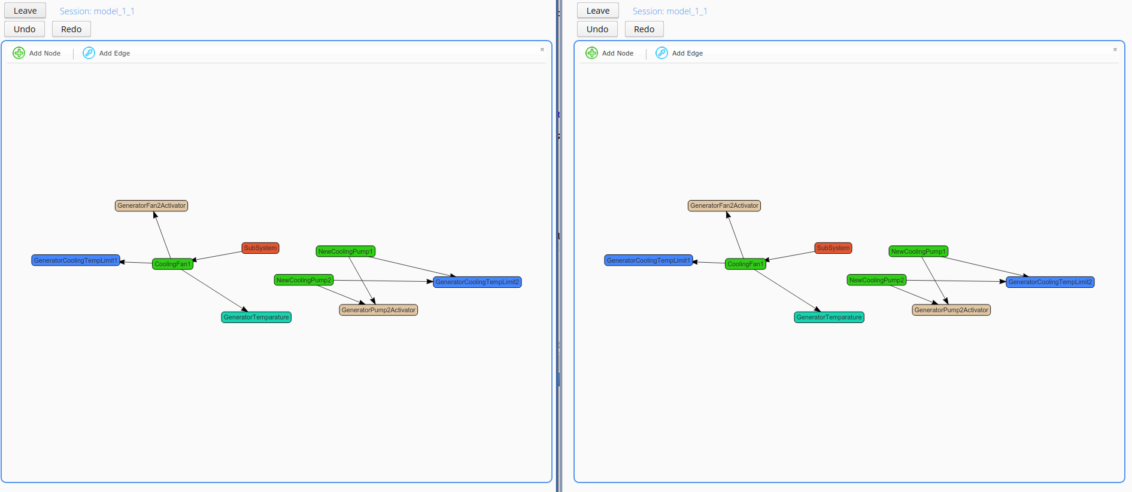
Connect the GeneratorPump2Activator and GeneratorCoolingTempLimit2 nodes to both "NewCoolingPump1" and "NewCoolingPump2"

Slide 23
Now add a new subsystem node with the "Add Node" button: this time set the name of the node to "CoolingPumpSubsystem", the ID to "cooling_pump_subsystem" and the nodeType to "subsystems" and eventually hit "save".

Slide 24
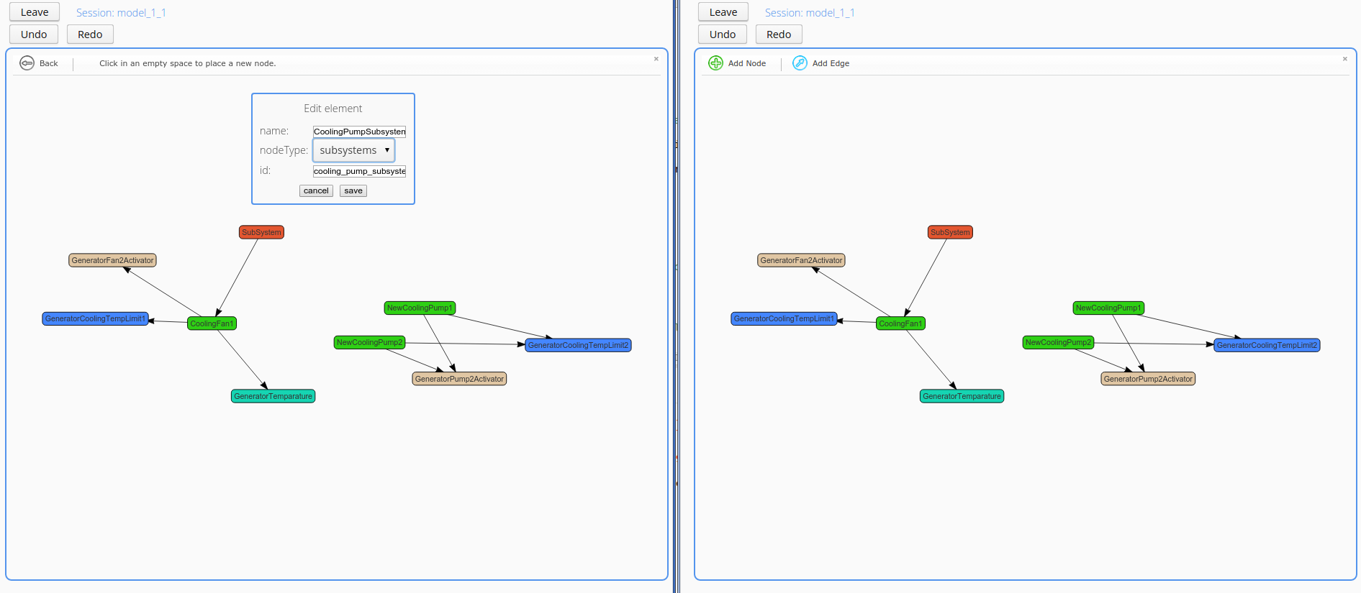

Slide 25
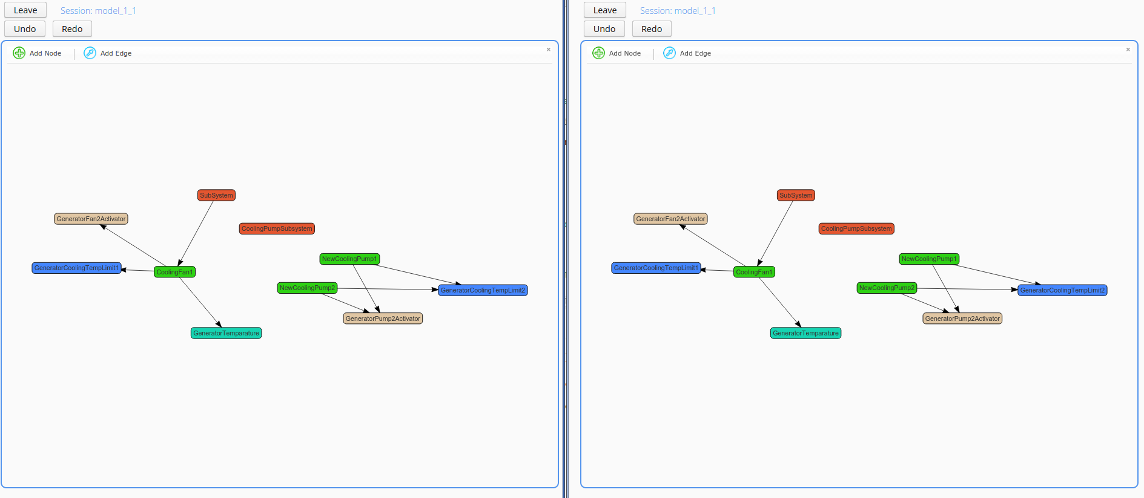

Slide 26
Add a new edge FROM "SubSystem" TO "CoolingPumpSubsystem". This is important: start dragging the edge FROM "SubSystem" INTO "CoolingPumpSubsystem" because subsystems may contain other subsystems, so the order matters.

Slide 27
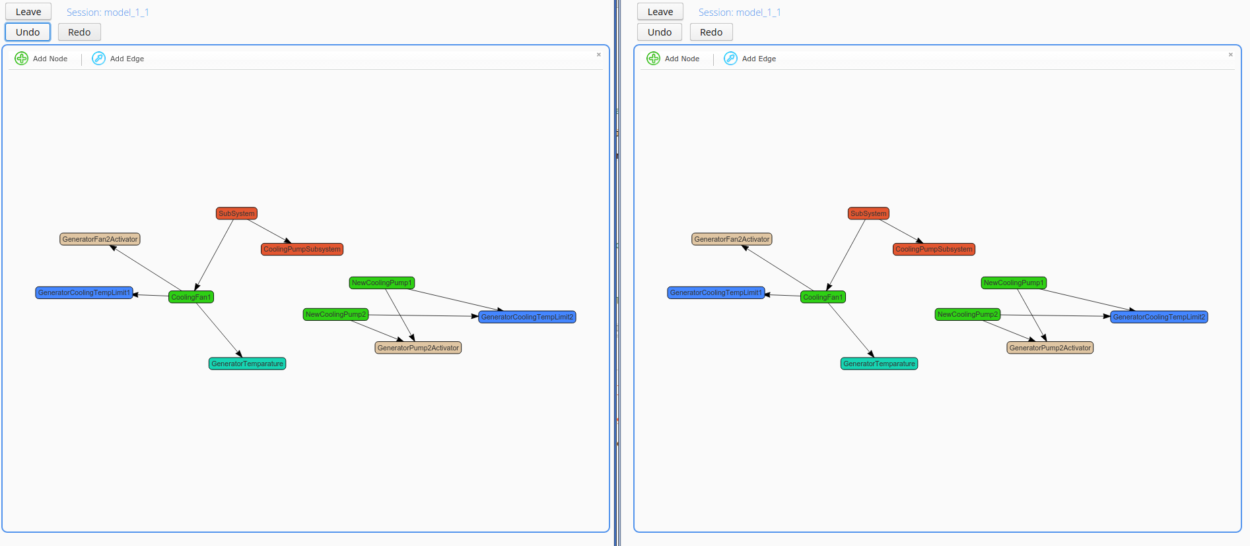

Slide 28
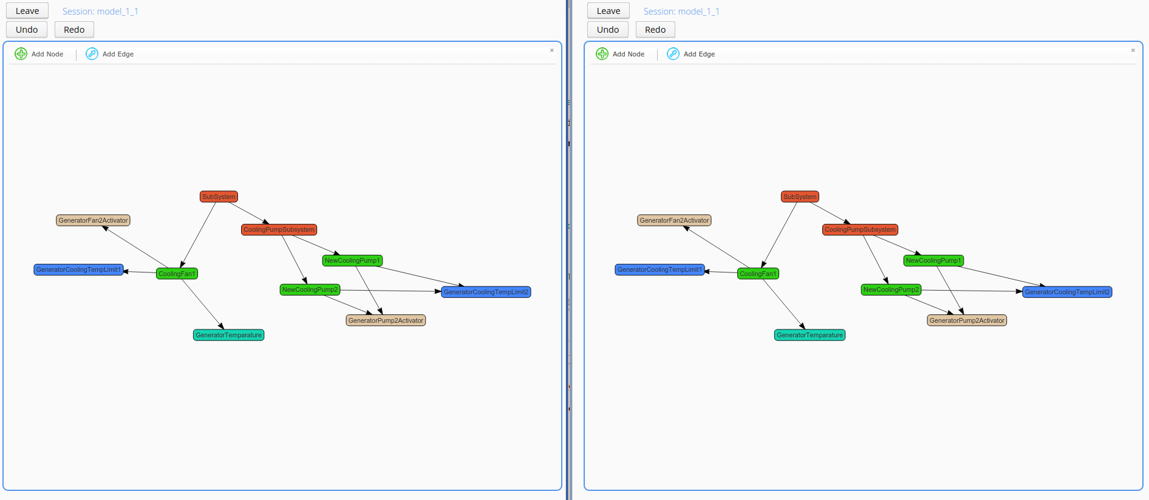
Connect the newly created control units ("NewCoolingPump1", "NewCoolingPump2") to the new "CoolingPumpSubsystem" using the "Add Edge" button.

Slide 29
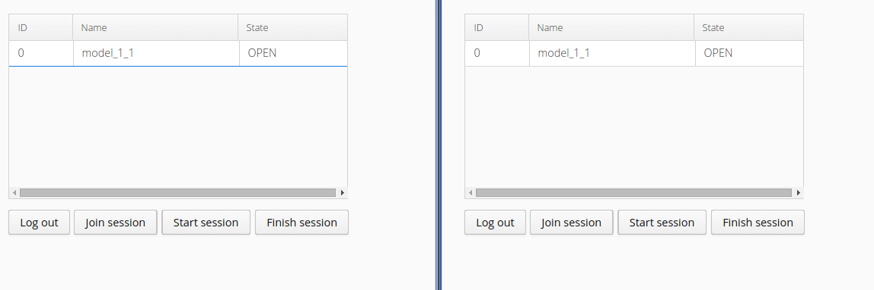
Leave the modeling session with both users by pressing the "Leave" button.

Slide 30
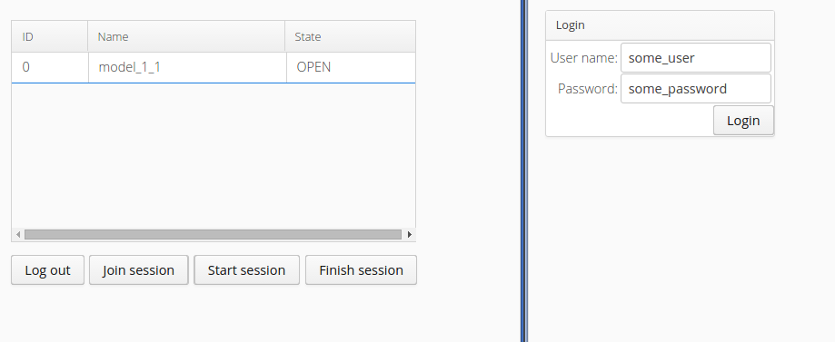
Log out with the second user and close the browser tab.

Slide 31
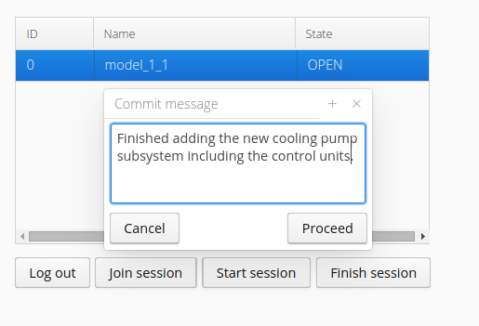
With the first user click on the model and press the "Finish session" button, add a commit message then press Proceed.

Slide 32
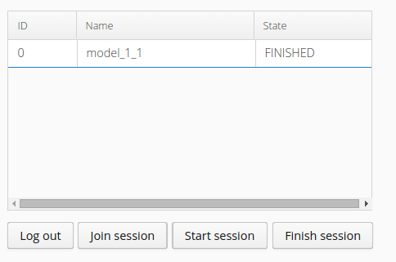
The collaboration session is finished and the modified model is committed to the repository.

Slide 33
If we load the result model and the original in the editor the editor generated from the metamodel we can see the difference between the state of the model before and after the collaboration session.

Slide 34
