Slide 1

Velvo
UX Scenario Document (File Version 4.3)
Submission Date: 2026 / __ / __
App Ver.: 1.0.0
App Developer: FTanBorn
E-mail address: (support e-mail)

Slide 2
Table of Contents
1. Basic Information
2. Document History
3. Page Description (how to read this document)
4. Detailed Login Information
5. Main Page Description (5-1 Start page · 5-2 Main page)
6. Sub Page Description (flow chart, movie, series, player, live TV, search, settings)
7. Paid Content
8. In-App Ad
Appendix: Notes for LG QA

Slide 3
1. Basic Information
Item | Information
App title | Velvo
App ID / version | io.github.ftanborn.velvo / 1.0.0
What it is | A media player for the user's own M3U playlist or Xtream Codes account. The app contains no channels, movies or series of its own.
Main feature | Choosing the audio and embedded subtitle language of the video being watched, with subtitle size, color and position settings.
Price / payment / ads | Free. No in-app purchases, no payment, no advertisements.
Accounts | No Velvo account. The user enters a playlist address; test playlist in section 4.
Interface languages | English and Turkish. "Automatic" follows the TV language; can be changed in Settings › Language and subtitles.
Remote controls | Magic Remote (pointer, OK, wheel) and the standard remote (arrows, OK, BACK, color and media keys).
Data | Playlist details, profiles and preferences are stored only on the TV. Privacy policy: https://ftanborn.github.io/velvo/privacy.html
Source code | https://github.com/FTanBorn/velvo (GPL-3.0)

Slide 4
2. Document History
No. | Sent | Version | File Name | Contents
1 | __.__.2026 | 1.0.0 | UX Scenario | Initial document

Slide 5
3. Page Description
Each page shows a screenshot of the app with numbered pink markers.
The table on the right describes the menu or UI button with the same number.
All screenshots were taken with the English interface and the demo playlist from section 4.
Every button can be used with the arrow keys + OK and with the Magic Remote pointer.

Slide 6
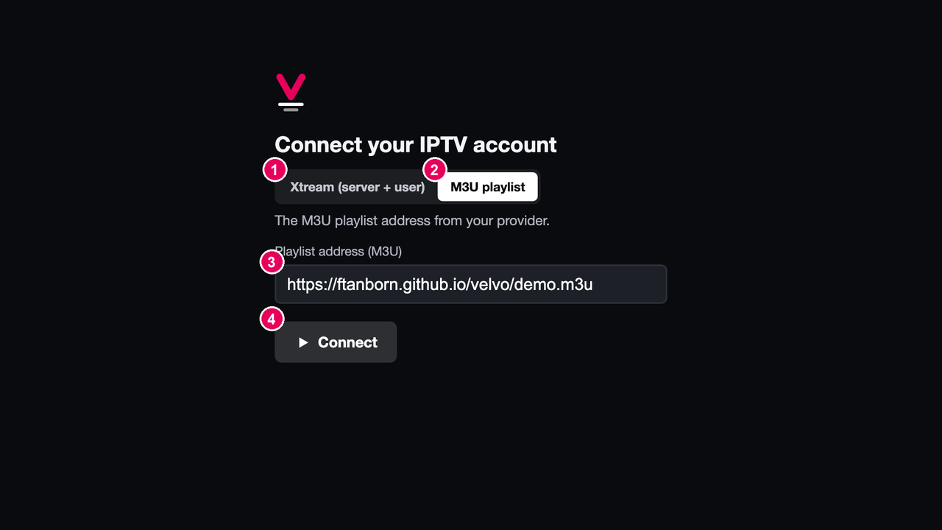
4. Detailed Login Information
Login page
No. | Description
1 | Xtream: server address, username and password from the user's provider. Not needed for QA.
2 | M3U playlist: select this for QA.
3 | Playlist address: enter https://ftanborn.github.io/velvo/demo.m3u (LG virtual keyboard).
4 | Connect: checks the playlist and opens the Main page.
Test Accounts (ID / PW): not required. Activation Codes: not required.
Test playlist (M3U): https://ftanborn.github.io/velvo/demo.m3u. It works on any number of devices and contains only openly licensed Blender Foundation films and public test streams.
The login page appears on first launch. The playlist stays saved after relaunch and TV reboot; Settings › IPTV account › Sign out removes it.

Slide 7
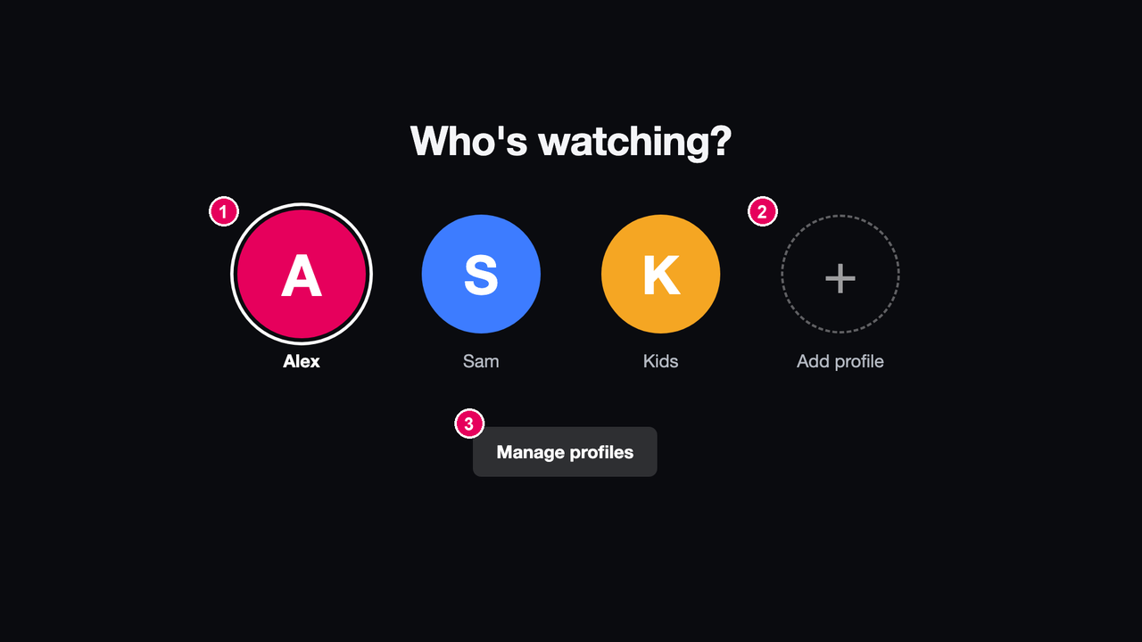
5. Main Page Description
5-1 Start page (profiles)
No. | Description
1 | Profile: OK opens the Main page for this profile.
2 | Add profile: enter a name with the on-screen keyboard and pick a color.
3 | Manage profiles: rename, recolor or delete profiles.
This page appears at launch when the TV has more than one profile. With a single profile the app opens the Main page directly.
Each profile has its own language preferences, watch progress and My List.

Slide 8
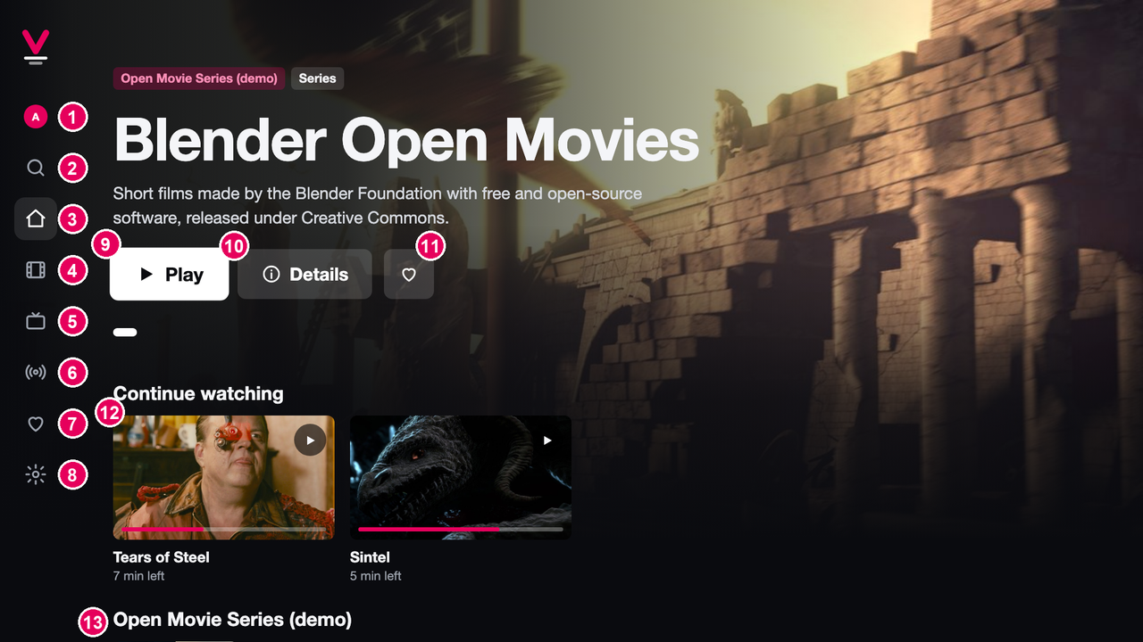
5. Main Page Description
5-2 Main page (Home)
No. | Description
1 | Profile: switch to another profile.
2 | Search
3 | Home (this page)
4 | Movies: categories and titles
5 | Series: categories and titles
6 | Live TV: categories and channels
7 | My List: saved movies and series
8 | Settings
9 | Play: plays the featured title.
10 | Details: opens the detail page.
11 | Add to / remove from My List
12 | Continue watching: resumes where the user stopped.
13 | Content rows: one row per category; ▼ or the Magic Remote wheel scrolls down.
The menu on the left (1–8) is reachable from every page with ◀.
Titles open the detail page with OK.

Slide 9
6. Sub Page Description
6-1 Flow chart
Search (6-6)
App launch
Login (4)
no playlist saved
Main page
Home (5-2)
Movies
Profiles (5-1)
2+ profiles
Series
Live TV (6-5)
My List
With a saved playlist and one profile, the app opens the Main page directly.
BACK returns to the previous page.
BACK on the Main page exits the app (webOS.platformBack).
Live TV channels open the player directly; CH+ / CH− switch channels.
Search, Movies, Series and My List open the detail page.
Detail
movie (6-2) / series (6-3)
Settings (6-7)
Player (6-4)

Slide 10
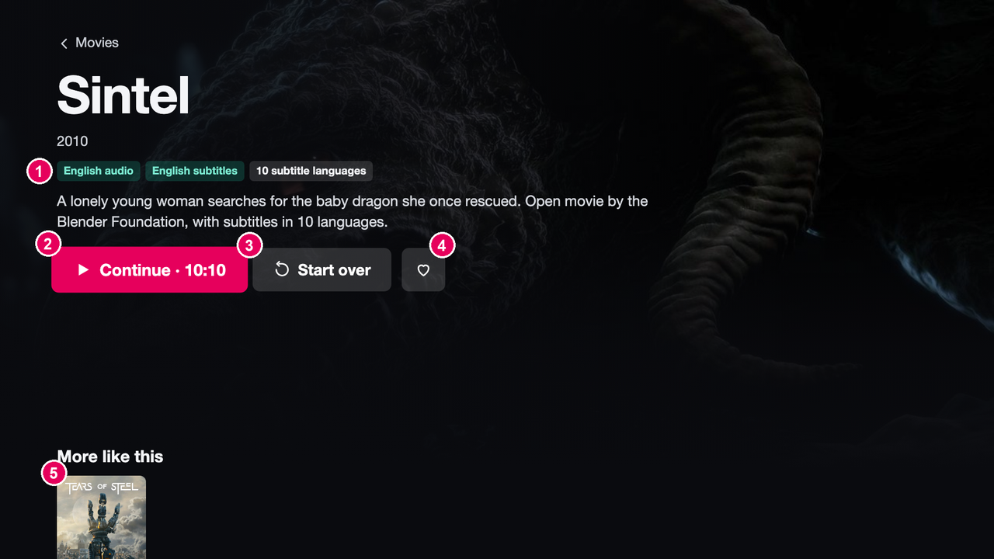
6. Sub Page Description
6-2 Movie detail
No. | Description
1 | Language badges: audio and subtitle languages found inside the video file. The user's preferred languages are highlighted.
2 | Play / Continue: starts or resumes playback (shows the resume time).
3 | Start over: plays from the beginning.
4 | Add to / remove from My List
5 | More like this: titles from the same category.
For MKV files Velvo reads the track list before playback ("Reading audio and subtitles…" is shown for a moment).

Slide 11
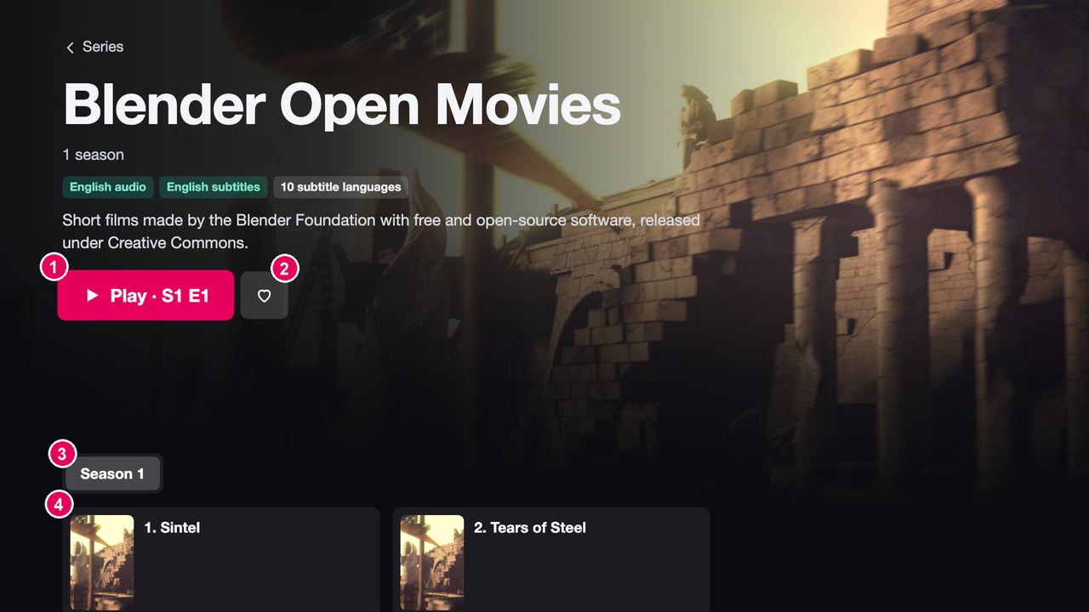
6. Sub Page Description
6-3 Series detail
No. | Description
1 | Play: plays the next episode to watch (here S1 E1).
2 | Add to / remove from My List
3 | Season selector
4 | Episodes: OK plays the episode; a bar shows the watched part.
The audio and subtitle choice made in one episode is applied automatically to the next episodes of the same series.

Slide 12
6. Sub Page Description
6-4 Player
[Player screenshot from the TV]
No. | Description
1 | Rewind 10 s
2 | Play / Pause
3 | Forward 10 s
4 | Audio: list of audio tracks
5 | Subtitles: Off + subtitle tracks, and Size, Color, Position (◀ ▶)
6 | Next episode (series only)
7 | Seek bar with elapsed and total time
Keys: any key shows the control bar · OK on ⏯ pauses/resumes · ◀ ▶ seek 10 s while the bar is hidden · YELLOW = next audio track · BLUE = next subtitle track · PLAY, PAUSE, STOP, FF, REW media keys · CH+ / CH− change channel in live TV.
BACK closes an open popup first, then leaves the player and returns to the previous page.

Slide 13
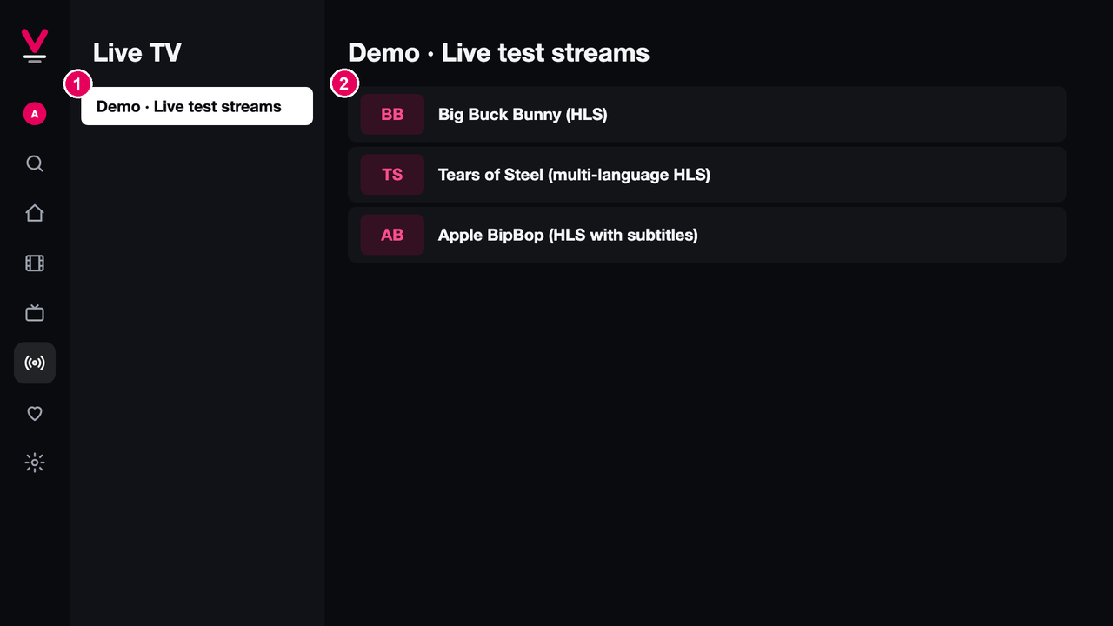
6. Sub Page Description
6-5 Live TV
No. | Description
1 | Channel categories
2 | Channels: OK plays the channel. Channels without a logo show short initials.
In the player, CH+ / CH− switch to the previous or next channel of the same category.

Slide 14
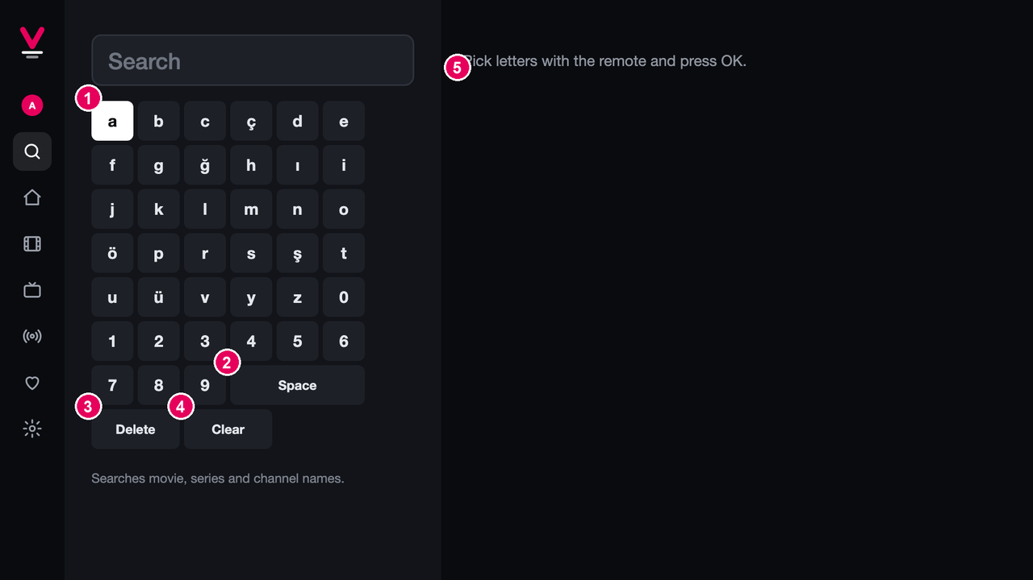
6. Sub Page Description
6-6 Search
No. | Description
1 | On-screen keyboard: letters and digits
2 | Space
3 | Delete the last character
4 | Clear the search
5 | Results: movies, series and live channels whose names match
OK on a result opens its detail page (or plays a channel).

Slide 15
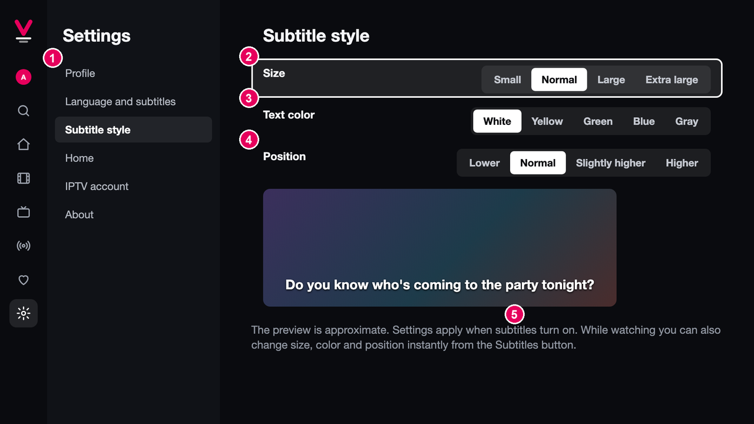
6. Sub Page Description
6-7 Settings
No. | Description
1 | Settings tabs: Profile · Language and subtitles (app language, preferred audio and subtitle language) · Subtitle style · Home (choose and order rows) · IPTV account (sign out) · About (version, license, source code)
2 | Subtitle size
3 | Subtitle color
4 | Subtitle position
5 | Preview of the selected style
Subtitle style can also be changed while watching, from the Subtitles button in the player.

Slide 16
7. Paid Content
None.
Velvo is free. It has no in-app purchases, no payment methods and no paid content, so no test credit cards or voucher codes are needed.

Slide 17
8. In-App Ad
None.
Velvo shows no advertisements (no banner or video ads).

Slide 18
Appendix: Notes for LG QA
Content
Velvo is a player only and contains no content. Please use the demo M3U playlist from section 4; it contains only openly licensed Blender Foundation films and public test streams.
Testing subtitles and audio
Movies › "Sintel (2010)" has 1 audio track and 10 embedded subtitle tracks. In the player, open Subtitles to select a language and change size, color and position. On TV models where the platform does not allow embedded subtitle selection, Velvo hides the subtitle list and shows a message instead.
Interface language
Settings › Language and subtitles › App language: Automatic (follows the TV language), Türkçe or English.
Data
All user data stays on the TV. Settings › IPTV account › Sign out removes the saved playlist.
Contact
FTanBorn · (support e-mail) · https://github.com/FTanBorn/velvo/issues

