Slide 1
A BRIEF INTRODUCTION TO SHAPLEY VALUES
Tim Hargreaves
WDSS Virtual Talk: Opening the Black Box
10th June 2020

Slide 2
Background

Slide 3
History
Originated from cooperative game theory
Introduced by Lloyd Shapley in 1951
Led to Nobel Prize in Economics in 2012

Slide 4


Original Purpose
How do we distribute prize money from a data science competition between the following team?
Ann Chovey
Star data scientist
Performed most of the work
Barry Cuda
Reasonably strong output
Gets in the way of Cat’s work
Cat Fische
Usually a good worker
Slowed down by Barry’s meddling
Dan Eo
Little direct input
Great friends with Ann and sparks her ideas
Image Credit: Community Vectors by Vecteezy

Slide 5
Generating Shapley Values
Live Demo

Slide 6
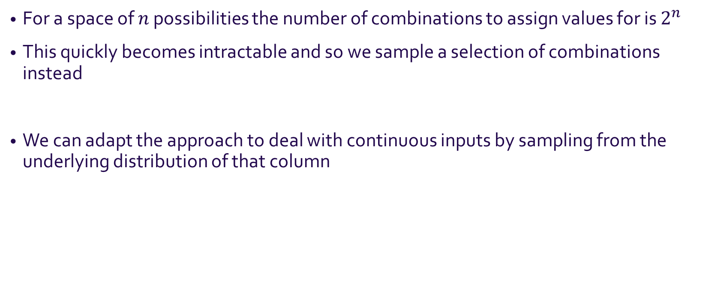
Nuances
For a space of $n$ possibilities the number of combinations to assign values for is $2^{n}$
This quickly becomes intractable and so we sample a selection of combinations instead
We can adapt the approach to deal with continuous inputs by sampling from the underlying distribution of that column

Slide 7
Other Uses
Calculating how much to each pay for a meal
Splitting taxi fares
The airport problem
Efficient auctions

Slide 8
Shapley Values for Machine learning

Slide 9
Application to Model Interpretability
Just a few tweaks allow us to apply Shapley values to a ML model:
We treat our model features as players
We treat the model prediction for a single instance as the pay-out
We query our model with other instance to measure change in pay-out
Note: The computed Shapley values will apply to that specific instance, not the whole model

Slide 10
A Loan Approval Example
Loan ID | Gender | Married | Dependents | Education | Self Employed | Applicant Income | Coapplicant Income | Loan Amount | Loan Amount Term | Credit History | Property Area
LP001616 | Male | Yes | 1 | Graduate | No | 3750 | 0.0 | 116.0 | 360.0 | 1.0 | Semiurban
LP001630 | Male | No | 0 | Not Graduate | No | 2333 | 1451.0 | 102.0 | 480.0 | 0.0 | Urban
LP001633 | Male | Yes | 1 | Graduate | No | 6400 | 7250.0 | 180.0 | 360.0 | 0.0 | Urban
LP001636 | Male | Yes | 0 | Graduate | No | 4600 | 0.0 | 73.0 | 180.0 | 1.0 | Semiurban
LP001637 | Male | Yes | 1 | Graduate | No | 33846 | 0.0 | 260.0 | 360.0 | 1.0 | Semiurban
A random forest model was trained on 384 labelled examples
The performance on a test set was reasonable (AUROCC=0.82)
The highlighted loan application was rejected with moderate probability. Why?
Data Source: Analytics Vidhya Loan Prediction Competition

Slide 11
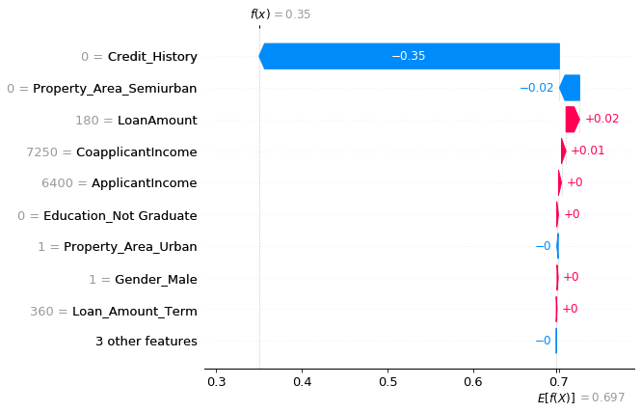
A Loan Approval Example
The model predicated a 35% chance of being rejected compared to the average acceptance rate of 70%
The largest factor in the decision is clearly the absence of credit history
The size of the loan helped somewhat
Source Notebook: WDSS GitHub

Slide 12
Shapley Values In Practice

Slide 13
Strengths
Offers a full explanation
Might be the only legally valid method
Allows contrastive explanations
Can be simple to explain

Slide 14
Drawbacks
Potential to be misinterpreted
Computationally expensive
Explanations are dense
A simple implementation might include unlikely instances
Notes:
Key point: no special politics knowledge
Power of data science
Inspire people with knowledge of the field

Slide 15
Further Reading
Source notebook—https://github.com/warwickdatascience/opening-the-black-box
Theoretical background—https://christophm.github.io/interpretable-ml-book/shapley.html
Python package—https://github.com/slundberg/shap
R package—https://github.com/ModelOriented/shapper

Slide 16
Any Questions?

