Slide 1
Classes used to build a maze
Path:
Name
Length
Start angle
End angle
Foraging pheromone
Exploration pheromone
Intersection:
Name
Dictionary of adjacent intersections = neighbor
Key = Intersection
Value = Linking path starting at the intersection and ending at the neighbor (all path are one-directional, but the reverse path is automatically built)
Maze:
Dictionary of intersections = nodes
Key = Name of the intersection
Value = Intersection
Number of intersection (helps to build a visual graph)

Slide 2
Maze
‘’Intersection 1’’
Intersection1 (type Intersection)
‘’Intersection 2’’
Intersection2 (type Intersection)
‘’Intersection 3’’
Intersection3 (type Intersection)
…
Intersection
Neighbor1 (type Intersection)
PathA (type Path)
Neighbor2 (type Intersection)
PathB (type Path)
Neighbor3 (type Intersection)
PathC (type Path)
…

Slide 3
How to call the various objects
Create a maze:
maze = Maze()
Get the name of intersection1:
intersection1.get_id()
Get access to an intersection using its name ‘name’:
maze.get_intersection(‘name’)
Get the neighbors of intersection1:
intersection1.get_connections()
Get the path going from intersection1 to intersection2:
intersection1.get_path(intersection2)

Slide 4
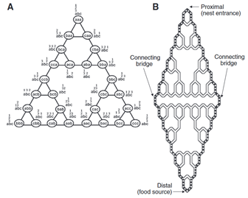
Tower_of_hanoi.py
‘Up’
1
3
2
tower_hanoi(size,name)
Maze as a lot of symmetry
Recursive function
tower_hanoi(3)
mirror_Hanoi(size)
Experimental setup
Create 2 tower of Hanoi mazes (‘up’, and ‘down’)
Link them together on both sides
‘Down’
mirror_hanoi(3)

Slide 5
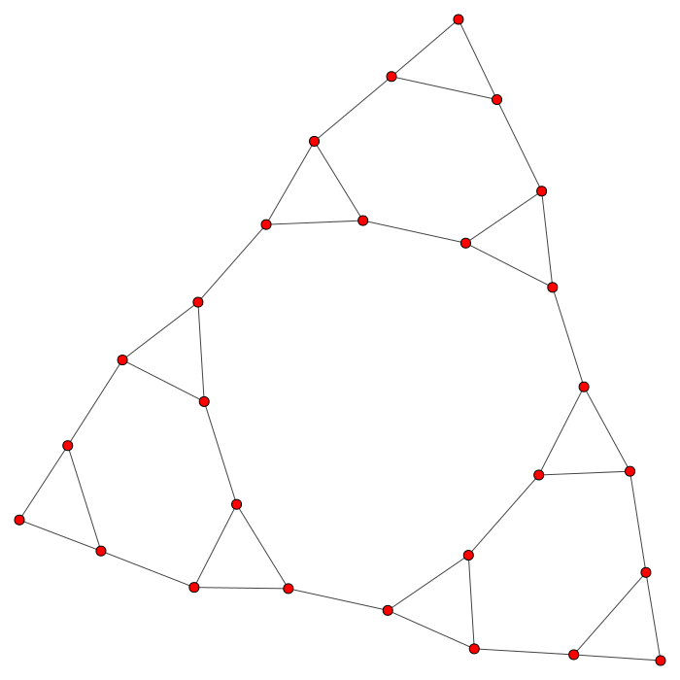
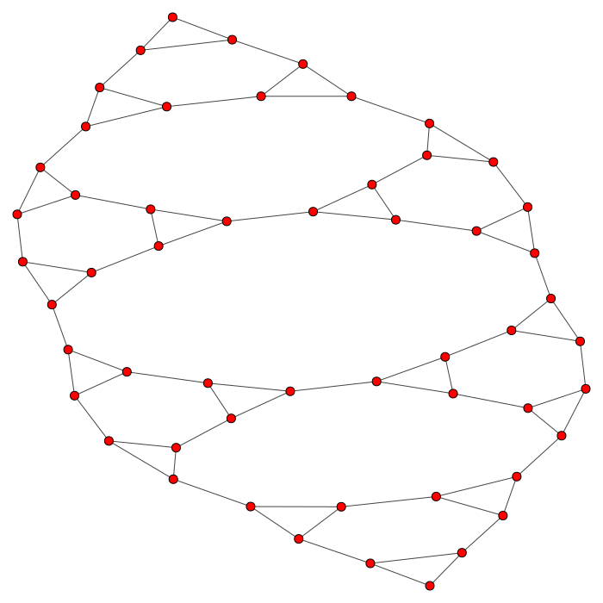
Layout_maze.py
Install igraph
Plot visual representation that kind of works
tower_hanoi(3)
mirror_hanoi(3)

Slide 6
Characteristics ants should have
Current_intersection
Former_intersection
Next_intersection
Current_path
Current_angle

