Slide 1

Title: Tumor Detection in Brain MRI Images Based on the Improved U-Net
（基於改进的U-Net的腦部核磁共振圖像中的腫瘤检测）
Presentation of FYP
Student Name : Xiangyu Gao 高翔宇
Supervisor : Xiaolin Tian
Notes:
Dear teachers and students. I’m very glad to stand here today to give a brief introduction to my final year project. My name is GaoXiangyu and the title of my final year project is that Tumor Detection in Brain MRI Images Based on the Improved U-Net.

Slide 2
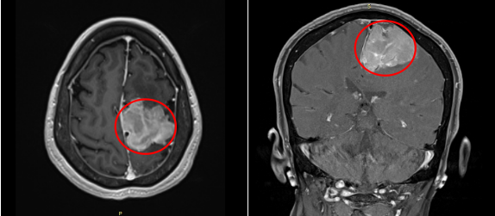
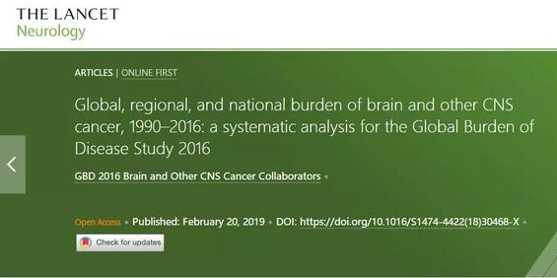
Background
Page 1/11
Notes:
(1)According to the report of the authoritative medical journal ”The Lancet“, there were 330 000 cases of brain cancer and 227 000 related deaths worldwide.
Thus, Brain tumors have become one of the important diseases endangering human health.

Slide 3
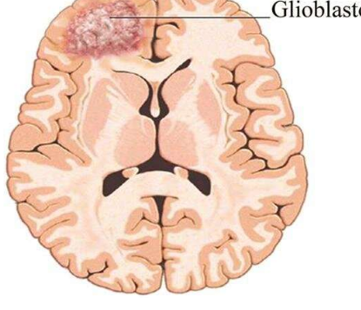
Motivation
Brain Tumor
1. High fatality rate
2. Difficult to find
3. Easily misdiagnosed
Page 2/11
Notes:
(2)Because of its Highly fatality rate, Difficult to find and Easy to be misdiagnosed. So, it is particularly important to be able to use computer to assist doctors to identify and judge the location and size of brain tumors.

Slide 4
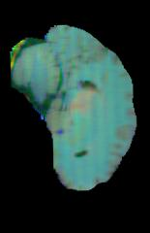
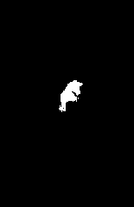
Objective of the Project
system
(a)brain image with tumor (b)its ground truth
Figure 1: Two Examples of Dataset
Page 3/11
Notes:
(3)And The project I wanted to do is to detect brain tumors. When you input a image with brain tumor into this system, it can output the size and location of the tumor as shown in the figure.

Slide 5
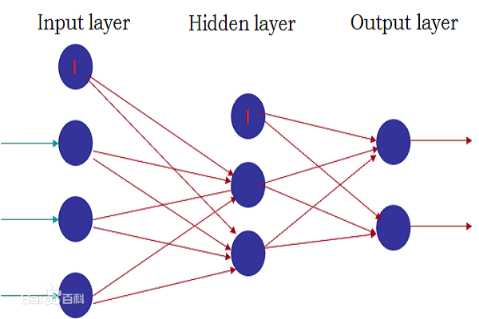
Research Status
ANN
FCN
Page 4/11
Notes:
(4)In order to achieve this function, some researchers chose to use ANN(Artificial Neural Network) and FCN(Full Convolution Network) as networks for deep learning.
They are both deep learning networks. Due to time constraints, I will not go into details.
But these two networks also have problems. Because the ANN network needs to convert a two-dimensional image into a one-dimensional vector, the number of trainable parameters increases dramatically with the increase of image size. This leads to poor results. However, the results obtained by FCN are not precise enough, and the relationship between pixels is not fully considered, resulting in a lack of spatial consistency.

Slide 6
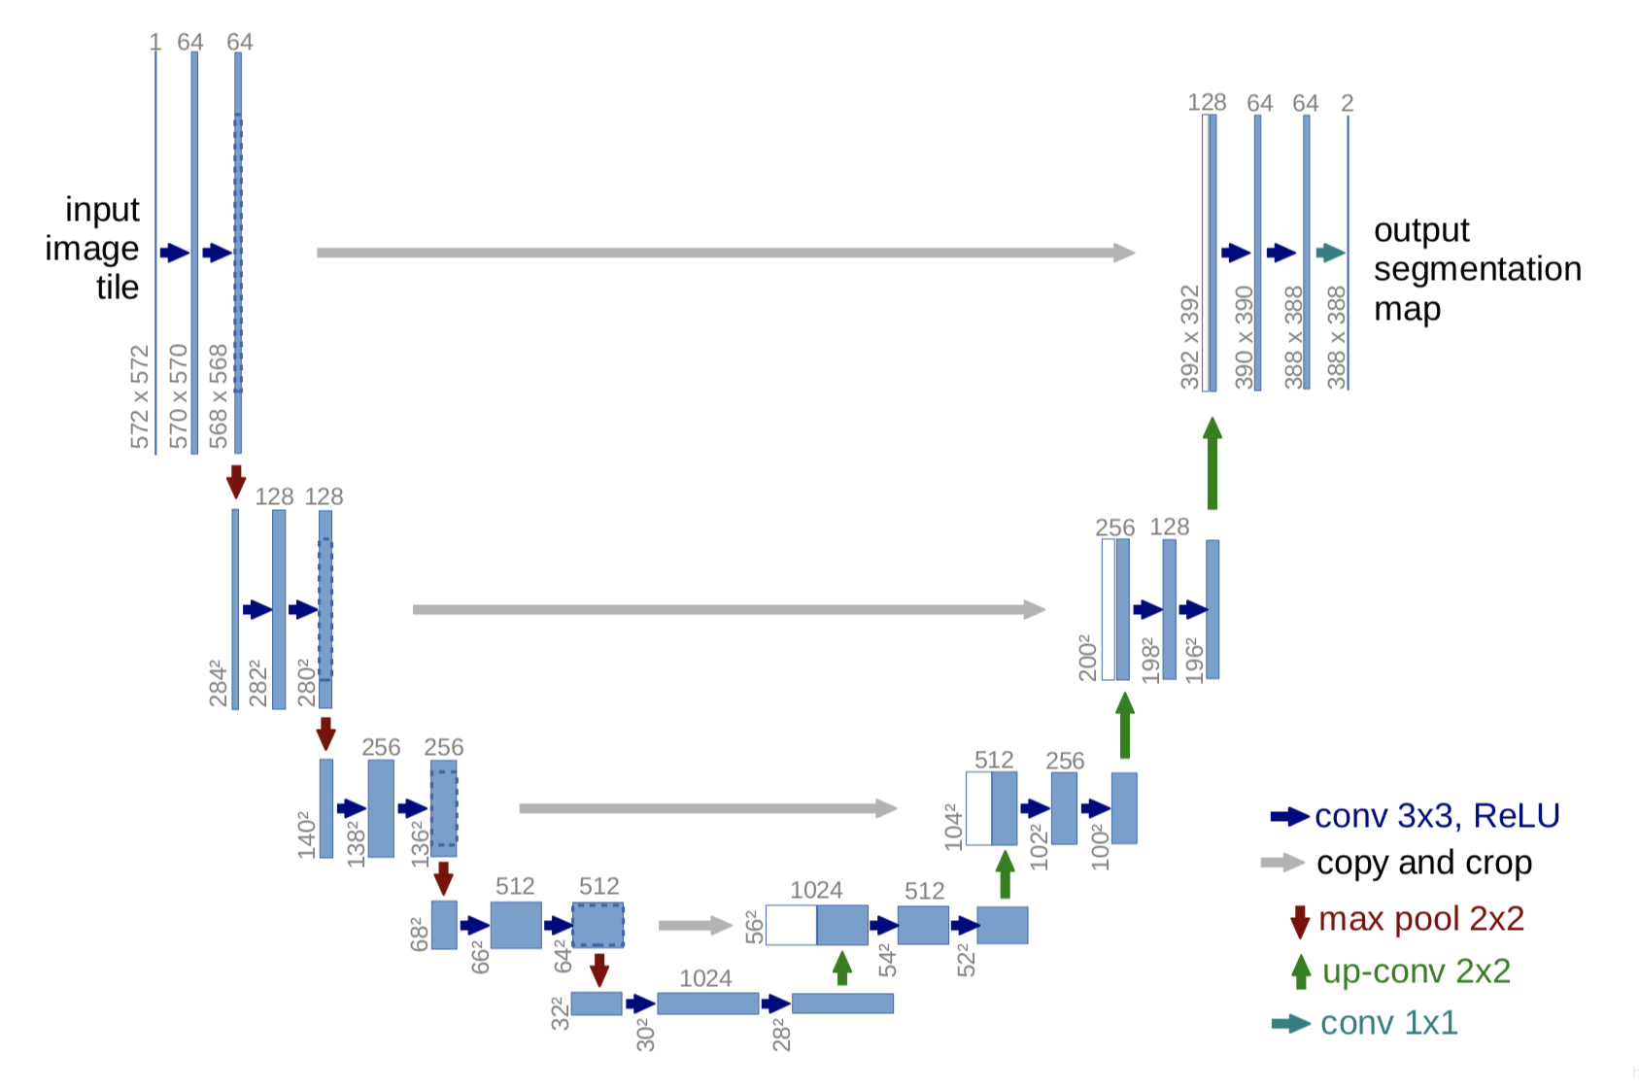
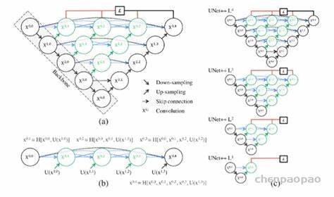
Research Status
U-Net
U-Net++
Page 5/11
Notes:
(5)Therefore, U-Net and U-Net based networks have emerged. U-Net is an improved network structure based on FCN. As it is excellent in using small data set training,simple and efficient. I choose it as my project’s network.

Slide 7
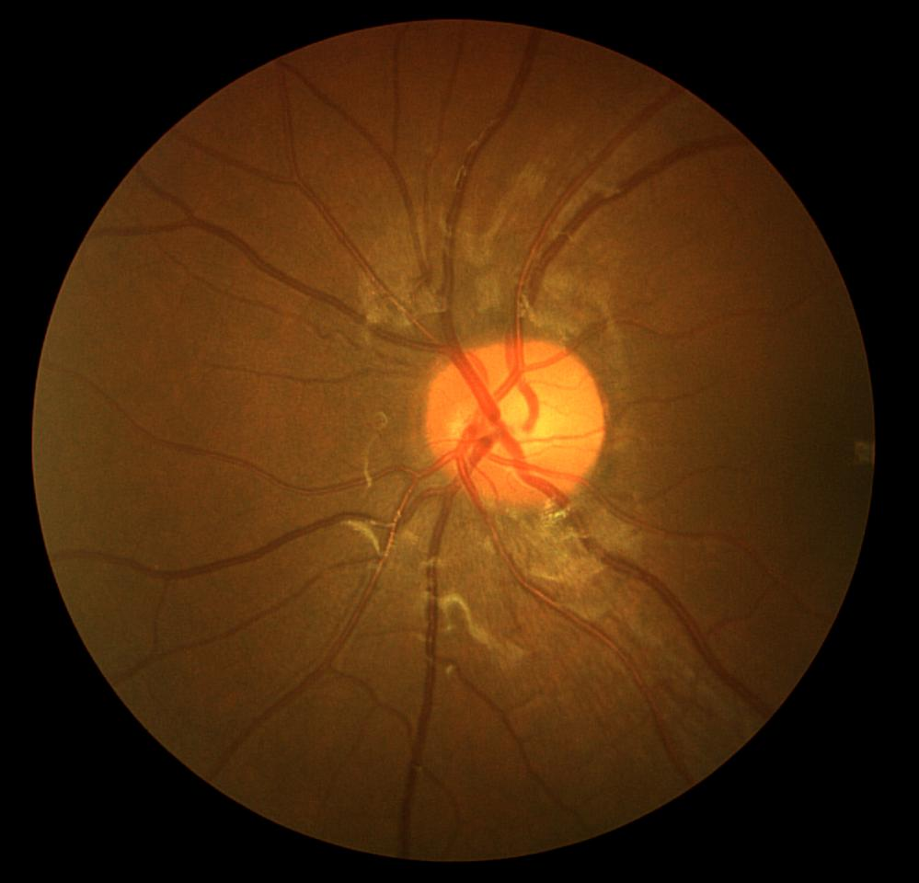
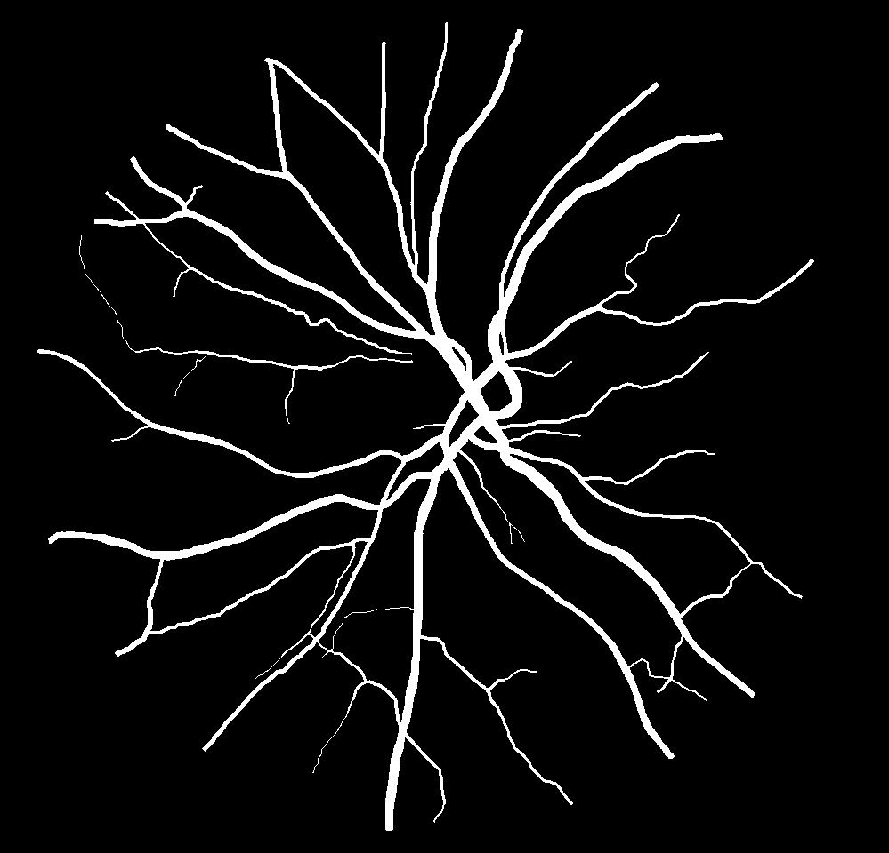
The Test Dataset
(a)found image (b)Its ground truth
Figure 2: The Test Dataset
Page 6/11
Notes:
(6)After I configure the environment and setup parameters, I firstly chose a small dataset of funds vascular image to test the network.

Slide 8
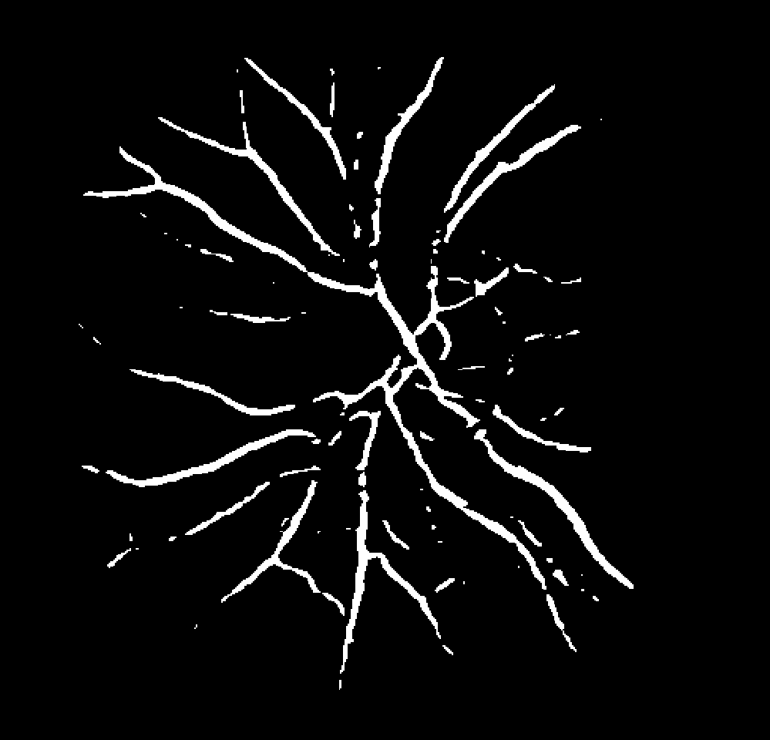
Experimental Results
(a)found image (b)its ground truth (c)detection result
    Figure 3: Experimetal Results
Page 7/11
Notes:
(7) I successfully used the U-Net model and the U-Net++ model to detect the position of vascular. The effect is as Figure shows. We can see it can basically detect the fundus vascular. So, I have successfully verified these networks
After that, I tried to use the network to detect brain tumor images. The training process is very successful. After trained the network, I tried to use the network to detect the brain tumor. But It always reports many errors. So there must be some problems in it.

Slide 9
Future Work
Solve the error in testing the brain image
Try to improve it by adding some attention mechanism and so on.
Try to improve accuracy and speed on this basis
Page 8/11
Notes:
(8)It is not perfect so far. So, in the future work, I will firstly solve the error in testing the brain image, then Try to improve it by adding some attention mechanism and so on. And after that, Try to improve accuracy and speed on this basis. These are my work of final year project in the first semester.

Slide 10
References
[1] “Global, regional, and national burden of brain and other CNS cancer,1990–2016: a systematic analysis for the Global Burden of Disease Study 2016” , Neurology
[2] Ronneberger, Olaf, Philipp Fischer, and Thomas Brox. “U-Net: Convolutional Networks for Biomedical Image Segmentation.” (2015): n. pag. Print.
[3] Zhou, Zongwei et al. “UNet++: A Nested U-Net Architecture for Medical Image Segmentation.” (2018): n. pag. Print.
[4] Huang, Huimin et al. “UNet 3+: A Full-Scale Connected UNet for Medical Image Segmentation.” ICASSP 2020 - 2020 IEEE International Conference on Acoustics, Speech and Signal Processing (ICASSP). IEEE, 2020. 1055–1059.
[5] Rajeshwar Nalbalwar Umakant Majhi Raj Patil Prof.Sudhanshu Gonge 2014 Detection of Brain Tumor by using ANN International Journal of Research in Advent Technology 2.
[6] Veeramuthu, A et al. “MRI Brain Tumor Image Classification Using a Combined Feature and Image-Based Classifier.” Frontiers in psychology 13 (2022): 848784–848784. Web.
[7] Varuna Shree, N., and T. N. R. Kumar. “Identification and Classification of Brain Tumor MRI Images with Feature Extraction Using DWT and Probabilistic Neural Network.” Brain informatics 5.1 (2018): 23–30. Web.
[8] Long J, Shelhamer E, and Darrell T Fully convolutional networks for semantic segmentation. In Proceedings of the IEEE conference on computer vision and pattern recognition, pages 3431–3440, 2015.
Page 9/11
Notes:
(9)And here are my references

Slide 11
Thank You!
Page 10/11
Notes:
(9)Thank you And the remaining time is reserved for Q&A

Slide 12
Q & A
Page 11/11

