Slide 1
TOPOLOGICAL GIFT WRAPPING 2D Matteo Maraziti, Federico Tocci, Giacomo Scordino

Slide 2
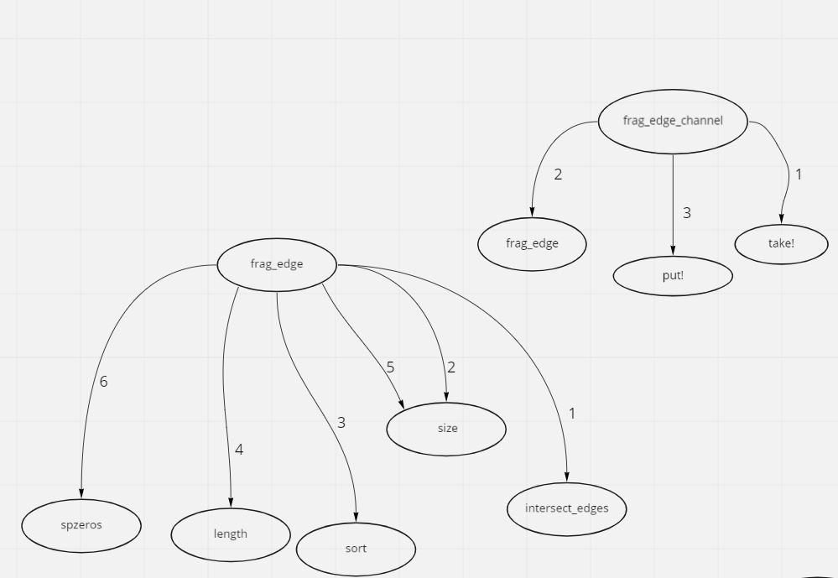
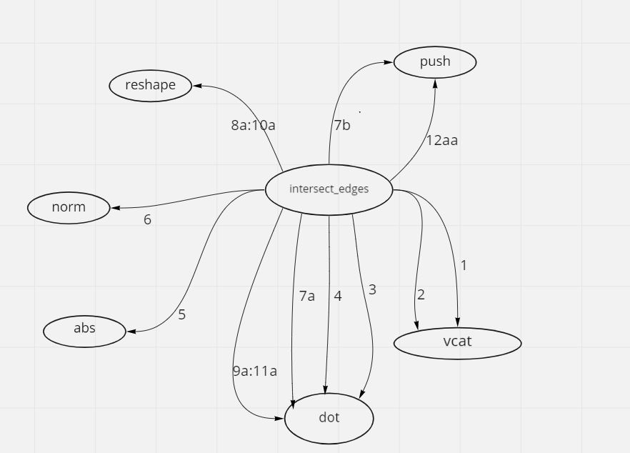

Slide 3
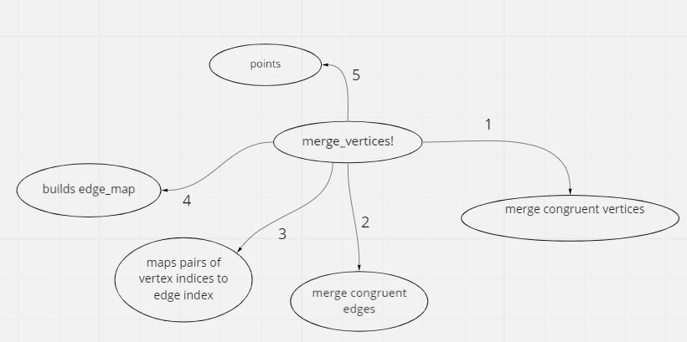

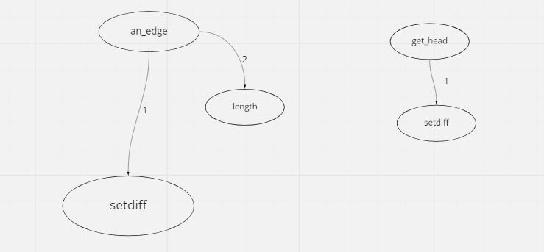
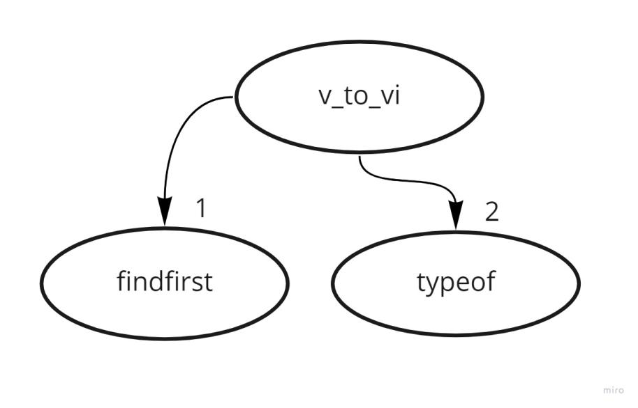

Slide 4


Slide 5


Slide 6

