Slide 1
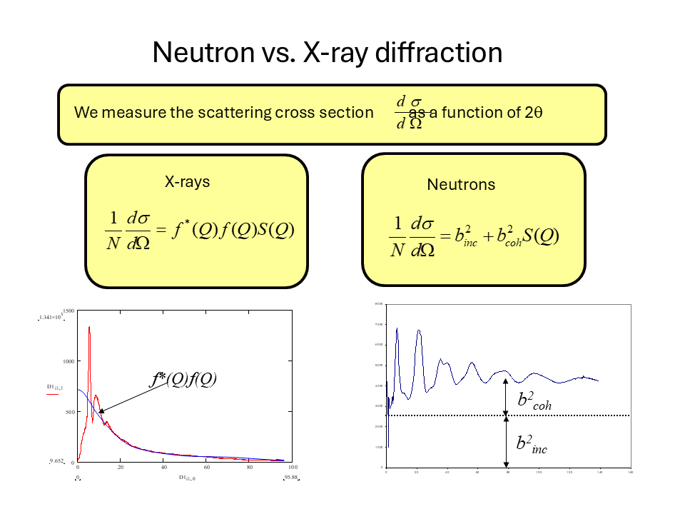
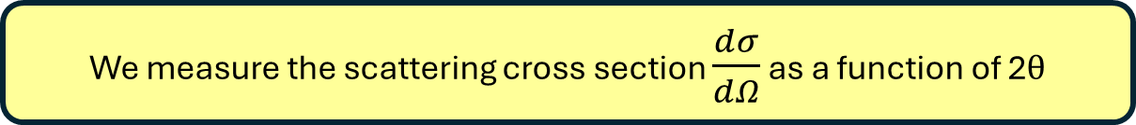
We measure the scattering cross section $\frac{dσ}{dΩ}$ as a function of 2$θ$

