Slide 1
Lecture 3:
Loops
SCIF10002 – Introduction to Coding and Data
Tom Maullin-Sapey
9th October 2025
Slide 0/11

Slide 2
Today’s Lecture
Slide 1/11

Slide 3
Today’s Lecture
Lecture 3: Loops
Slide 1/11

Slide 4
Today’s Lecture
Lecture 3: Loops
Recap: Accessing Noteable
Slide 1/11

Slide 5
Today’s Lecture
Lecture 3: Loops
Recap: Accessing Noteable
Recap: If Statements
Slide 1/11

Slide 6
Today’s Lecture
Lecture 3: Loops
Recap: Accessing Noteable
Recap: If Statements
For Loops
Slide 1/11

Slide 7
Today’s Lecture
Lecture 3: Loops
Recap: Accessing Noteable
Recap: If Statements
For Loops
While Loops
Slide 1/11

Slide 8
Today’s Lecture
Lecture 3: Loops
Recap: Accessing Noteable
Recap: If Statements
For Loops
While Loops
Practical
Slide 1/11

Slide 9
Today’s Lecture
Lecture 3: Loops
Recap: Accessing Noteable
Recap: If Statements
For Loops
While Loops
Practical
Lecture 4: Functions
Recap: For and While Loops
Functions
Inputs and Outputs
Practical
Slide 1/11

Slide 10
Recap: Accessing Noteable
Slide 2/11

Slide 11
Recap: Accessing Noteable
Open Blackboard
Slide 2/11

Slide 12
Recap: Accessing Noteable
Open Blackboard
Go to “Introduction to Coding and Data Analysis for Scientists 2025”
Slide 2/11

Slide 13
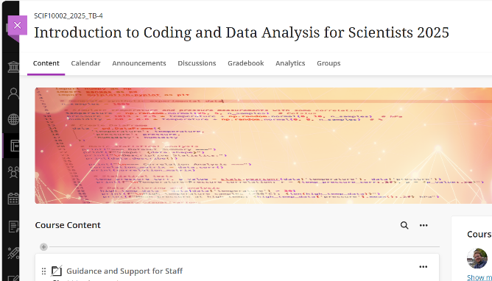
Recap: Accessing Noteable
Open Blackboard
Go to “Introduction to Coding and Data Analysis for Scientists 2025”
Slide 2/11

Slide 14
Recap: Accessing Noteable
Open Blackboard
Go to “Introduction to Coding and Data Analysis for Scientists 2025”
Click “Unit Information and Resources”
Slide 2/11

Slide 15
Recap: Accessing Noteable
Open Blackboard
Go to “Introduction to Coding and Data Analysis for Scientists 2025”
Click “Unit Information and Resources”
Open Noteable
Slide 2/11

Slide 16
Recap: Accessing Noteable
Open Blackboard
Go to “Introduction to Coding and Data Analysis for Scientists 2025”
Click “Unit Information and Resources”
Open Noteable
Make sure “Jupyter Classic (Legacy)” is selected.
Slide 2/11

Slide 17
Recap: Accessing Noteable
Open Blackboard
Go to “Introduction to Coding and Data Analysis for Scientists 2025”
Click “Unit Information and Resources”
Open Noteable
Make sure “Jupyter Classic (Legacy)” is selected.
Click Start
Slide 2/11

Slide 18
Recap: Accessing Noteable
Open Blackboard
Go to “Introduction to Coding and Data Analysis for Scientists 2025”
Click “Unit Information and Resources”
Open Noteable
Make sure “Jupyter Classic (Legacy)” is selected.
Click Start
Click “+GitRepo”
Slide 2/11

Slide 19
Recap: Accessing Noteable
Open Blackboard
Go to “Introduction to Coding and Data Analysis for Scientists 2025”
Click “Unit Information and Resources”
Open Noteable
Make sure “Jupyter Classic (Legacy)” is selected.
Click Start
Click “+GitRepo”
Slide 2/11

Slide 20
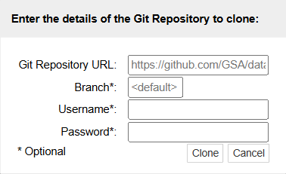
Recap: Accessing Noteable
Open Blackboard
Go to “Introduction to Coding and Data Analysis for Scientists 2025”
Click “Unit Information and Resources”
Open Noteable
Make sure “Jupyter Classic (Legacy)” is selected.
Click Start
Click “+GitRepo”
Slide 2/11

Slide 21
Recap: Accessing Noteable
Open Blackboard
Go to “Introduction to Coding and Data Analysis for Scientists 2025”
Click “Unit Information and Resources”
Open Noteable
Make sure “Jupyter Classic (Legacy)” is selected.
Click Start
Click “+GitRepo”
Paste into Git Repository URL: git@github.com:TomMaullin/SCIF10002-2025.git
Slide 2/11

Slide 22
Recap: Accessing Noteable
Open Blackboard
Go to “Introduction to Coding and Data Analysis for Scientists 2025”
Click “Unit Information and Resources”
Open Noteable
Make sure “Jupyter Classic (Legacy)” is selected.
Click Start
Click “+GitRepo”
Paste into Git Repository URL: git@github.com:TomMaullin/SCIF10002-2025.git
Press clone
Slide 2/11

Slide 23
Important: Assessed Coursework 1
Slide 3/11

Slide 24
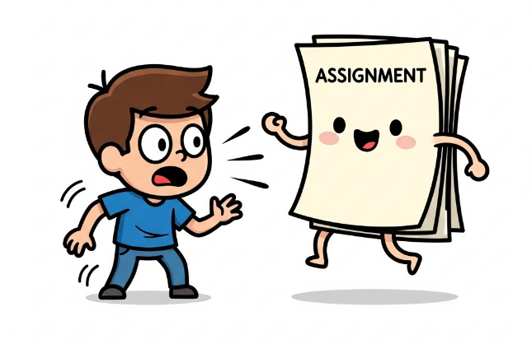
Important: Assessed Coursework 1
Slide 3/11

Slide 25
Important: Assessed Coursework 1
The first assignment will be released this week!
Slide 3/11

Slide 26
Important: Assessed Coursework 1
The first assignment will be released this week!
Released Wednesday 8th October at 12:00PM
Slide 3/11

Slide 27
Important: Assessed Coursework 1
The first assignment will be released this week!
Released Wednesday 8th October at 12:00PM
Due Wednesday 22nd October at 12:00PM
Slide 3/11

Slide 28
Important: Assessed Coursework 1
The first assignment will be released this week!
Released Wednesday 8th October at 12:00PM
Due Wednesday 22nd October at 12:00PM
This is assessed (15% of your grade!)
Slide 3/11

Slide 29
Important: Assessed Coursework 1
The first assignment will be released this week!
Released Wednesday 8th October at 12:00PM
Due Wednesday 22nd October at 12:00PM
This is assessed (15% of your grade!)
Submission is via Noteable
Slide 3/11

Slide 30
Important: Assessed Coursework 1
The first assignment will be released this week!
Released Wednesday 8th October at 12:00PM
Due Wednesday 22nd October at 12:00PM
This is assessed (15% of your grade!)
Submission is via Noteable
You can submit as many times as you like up until the submission date
Slide 3/11

Slide 31
Noteable Submission
Slide 4/11

Slide 32
Noteable Submission
Download using the Assignments tab on notable
Slide 4/11

Slide 33
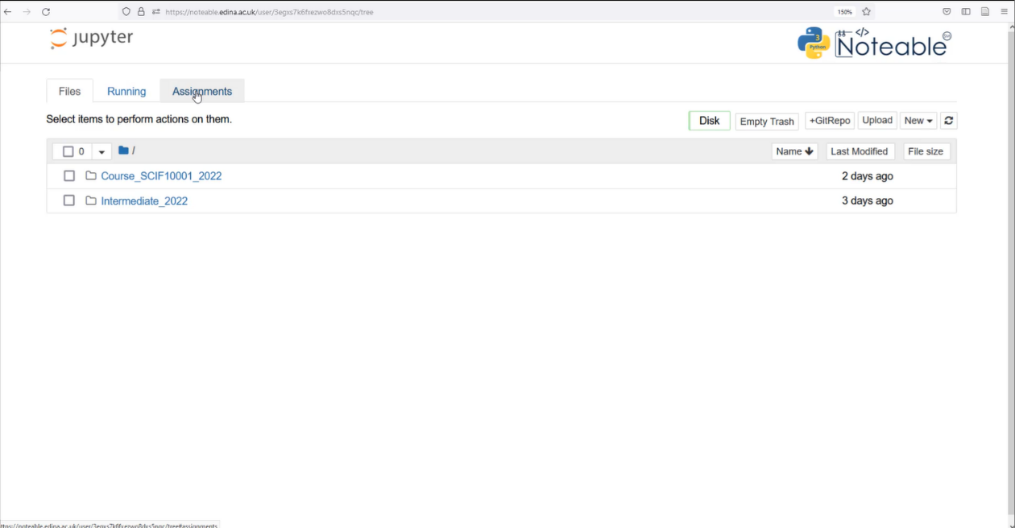
Noteable Submission
Download using the Assignments tab on noteable
Slide 4/11

Slide 34
Noteable Submission
Download using the Assignments tab on noteable
Slide 4/11

Slide 35
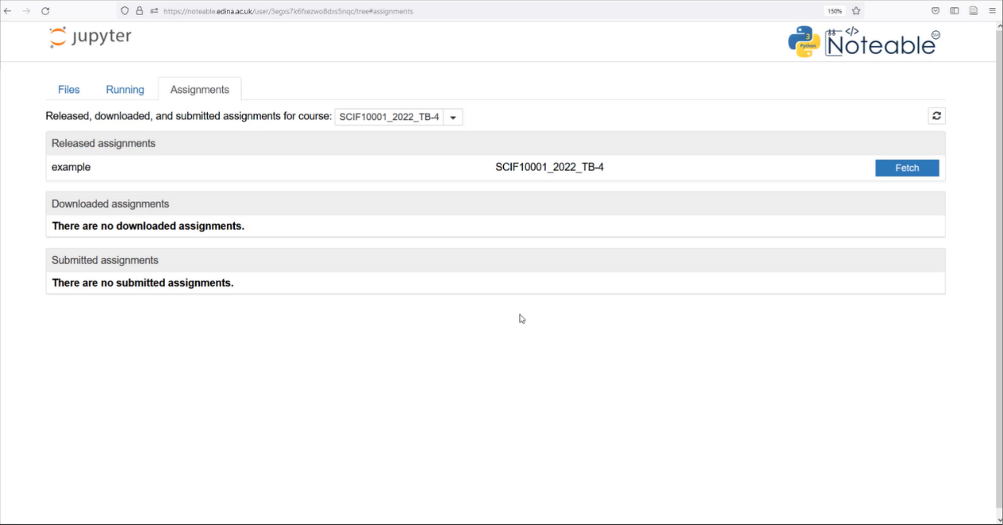
Noteable Submission
Download using the Assignments tab on noteable
Slide 4/11

Slide 36
Noteable Submission
Download using the Assignments tab on noteable
Slide 4/11

Slide 37
Noteable Submission
Download using the Assignments tab on noteable
Press Fetch and click on the assignment
Slide 4/11

Slide 38
Noteable Submission
Download using the Assignments tab on noteable
Press Fetch and click on the assignment
Slide 4/11

Slide 39
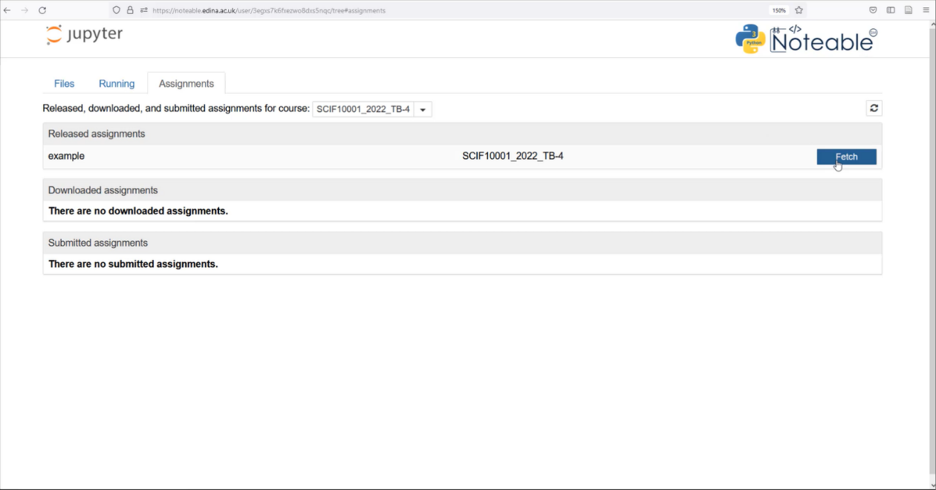
Noteable Submission
Download using the Assignments tab on noteable
Press Fetch and click on the assignment
Slide 4/11

Slide 40
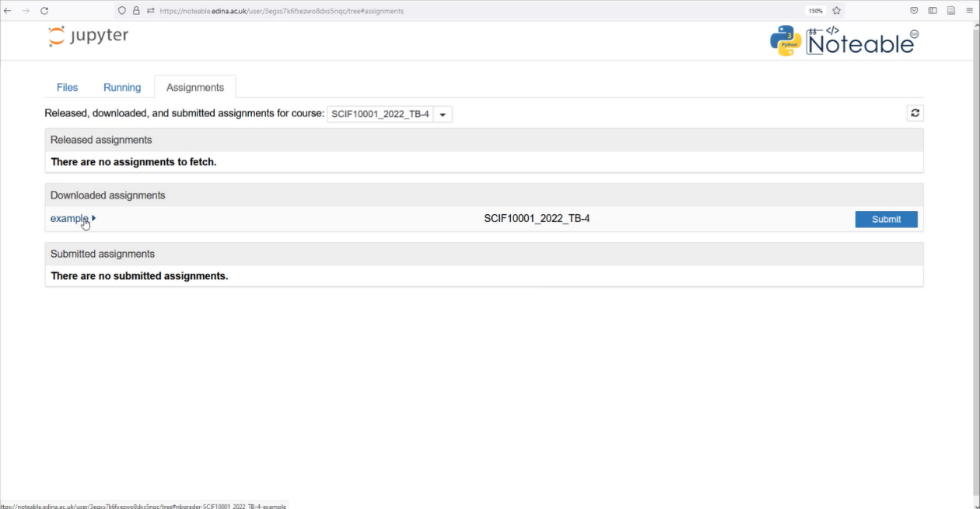
Noteable Submission
Download using the Assignments tab on noteable
Press Fetch and click on the assignment
Slide 4/11

Slide 41
Noteable Submission
Download using the Assignments tab on noteable
Press Fetch and click on the assignment
Slide 4/11

Slide 42
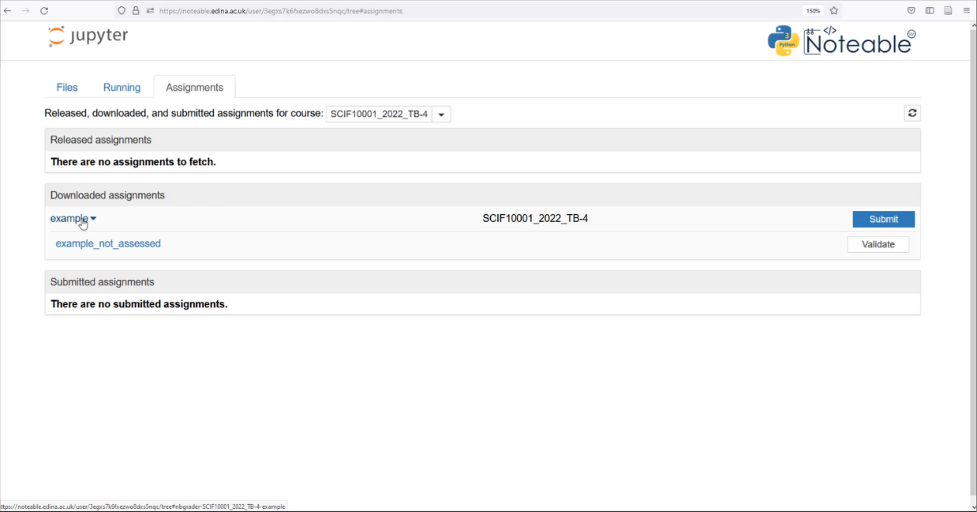
Noteable Submission
Download using the Assignments tab on noteable
Press Fetch and click on the assignment
Slide 4/11

Slide 43
Noteable Submission
Download using the Assignments tab on noteable
Press Fetch and click on the assignment
Slide 4/11

Slide 44
Noteable Submission
Download using the Assignments tab on noteable
Press Fetch and click on the assignment
Slide 4/11

Slide 45
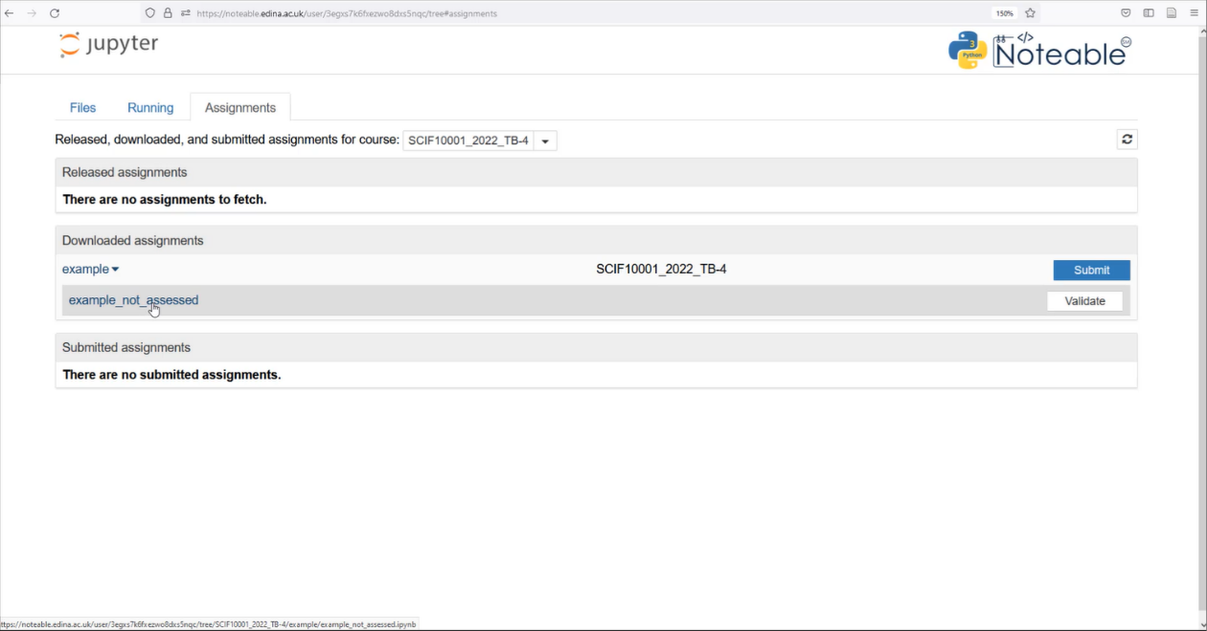
Noteable Submission
Download using the Assignments tab on noteable
Press Fetch and click on the assignment
Slide 4/11

Slide 46
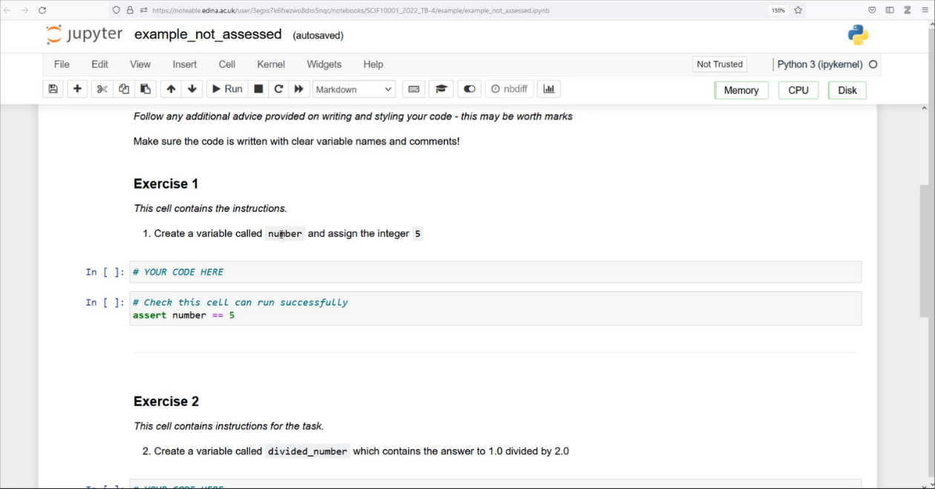
Noteable Submission
Download using the Assignments tab on noteable
Press Fetch and click on the assignment
Slide 4/11

Slide 47
Noteable Submission
Download using the Assignments tab on noteable
Press Fetch and click on the assignment
Fill your answers in and Validate
Slide 4/11

Slide 48
Noteable Submission
Download using the Assignments tab on noteable
Press Fetch and click on the assignment
Fill your answers in and Validate
Slide 4/11

Slide 49
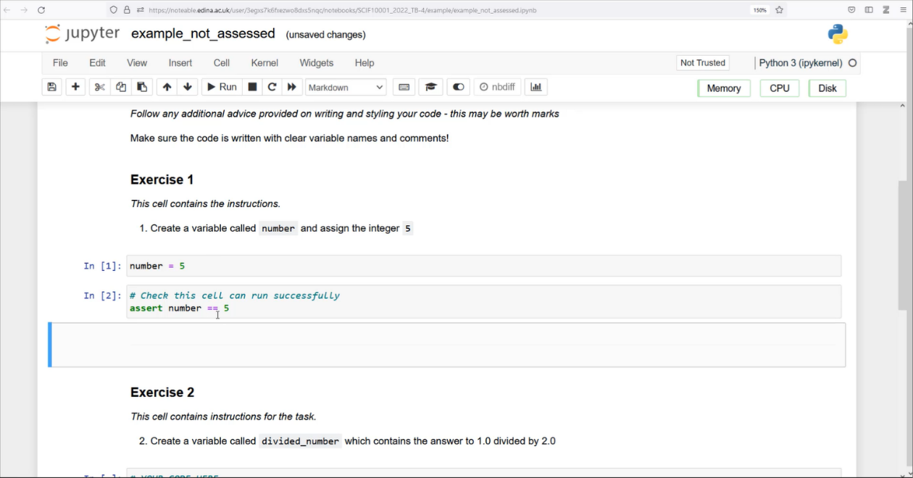
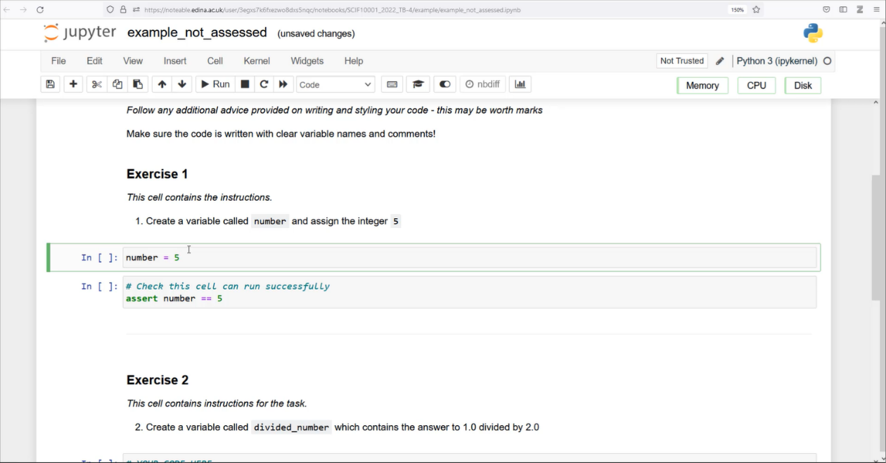
Noteable Submission
Download using the Assignments tab on noteable
Press Fetch and click on the assignment
Fill your answers in and Validate
Slide 4/11

Slide 50
Noteable Submission
Download using the Assignments tab on noteable
Press Fetch and click on the assignment
Fill your answers in and Validate
Slide 4/11

Slide 51
Noteable Submission
Download using the Assignments tab on noteable
Press Fetch and click on the assignment
Fill your answers in and Validate
Slide 4/11

Slide 52
Noteable Submission
Download using the Assignments tab on noteable
Press Fetch and click on the assignment
Fill your answers in and Validate
Slide 4/11

Slide 53
Noteable Submission
Download using the Assignments tab on noteable
Press Fetch and click on the assignment
Fill your answers in and Validate
Slide 4/11

Slide 54
Noteable Submission
Download using the Assignments tab on noteable
Press Fetch and click on the assignment
Fill your answers in and Validate
Slide 4/11

Slide 55
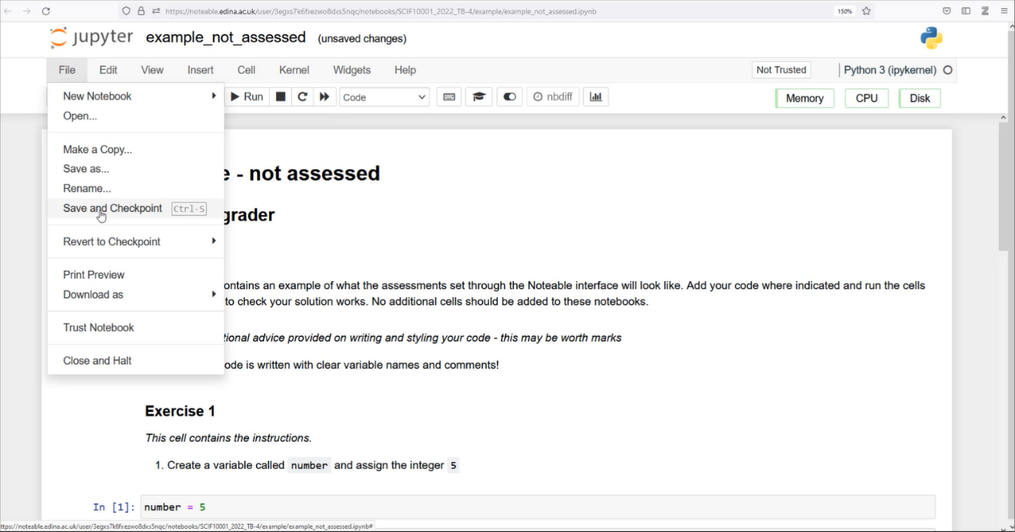
Noteable Submission
Download using the Assignments tab on noteable
Press Fetch and click on the assignment
Fill your answers in and Validate
Slide 4/11

Slide 56
Noteable Submission
Download using the Assignments tab on noteable
Press Fetch and click on the assignment
Fill your answers in and Validate
Slide 4/11

Slide 57
Noteable Submission
Download using the Assignments tab on noteable
Press Fetch and click on the assignment
Fill your answers in and Validate
Slide 4/11

Slide 58
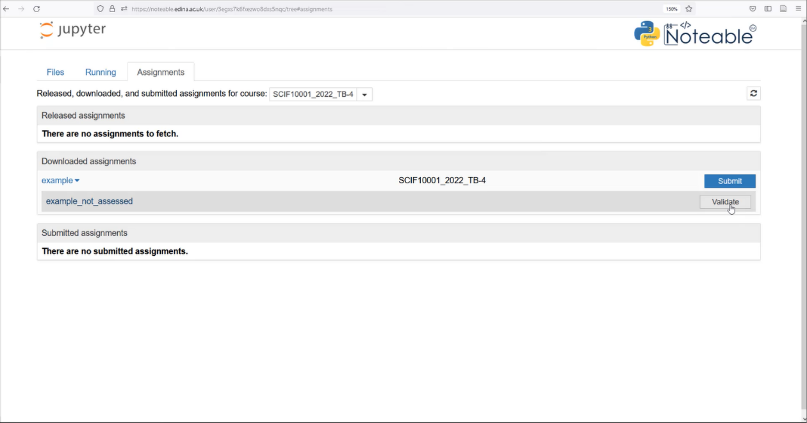
Noteable Submission
Download using the Assignments tab on noteable
Press Fetch and click on the assignment
Fill your answers in and Validate
Slide 4/11

Slide 59
Noteable Submission
Download using the Assignments tab on noteable
Press Fetch and click on the assignment
Fill your answers in and Validate
Slide 4/11

Slide 60

Noteable Submission
Download using the Assignments tab on noteable
Press Fetch and click on the assignment
Fill your answers in and Validate
Slide 4/11

Slide 61
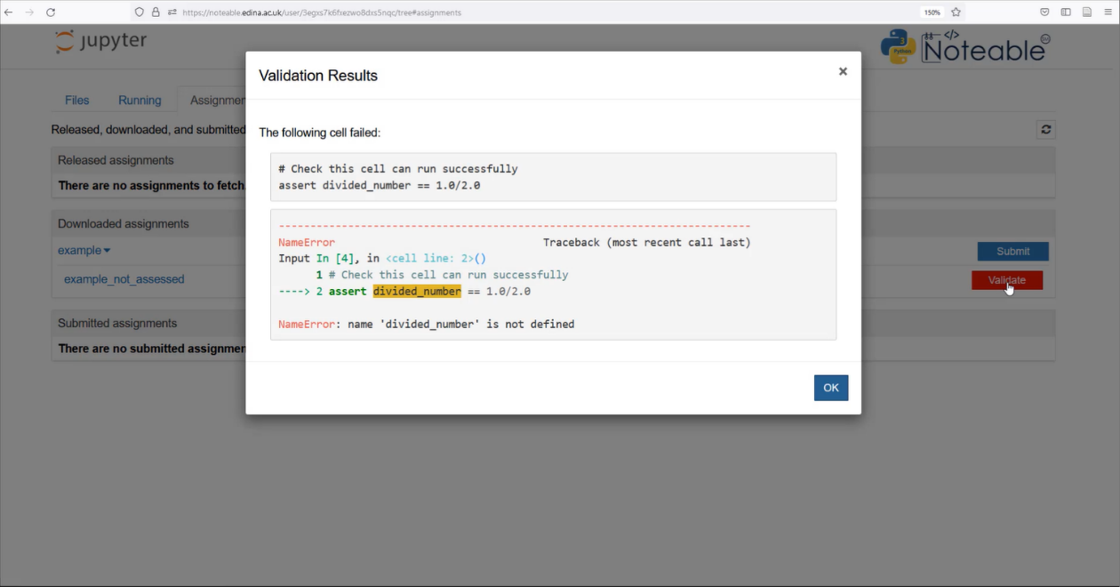
Noteable Submission
Download using the Assignments tab on noteable
Press Fetch and click on the assignment
Fill your answers in and Validate
Slide 4/11

Slide 62
Noteable Submission
Download using the Assignments tab on noteable
Press Fetch and click on the assignment
Fill your answers in and Validate
Slide 4/11

Slide 63
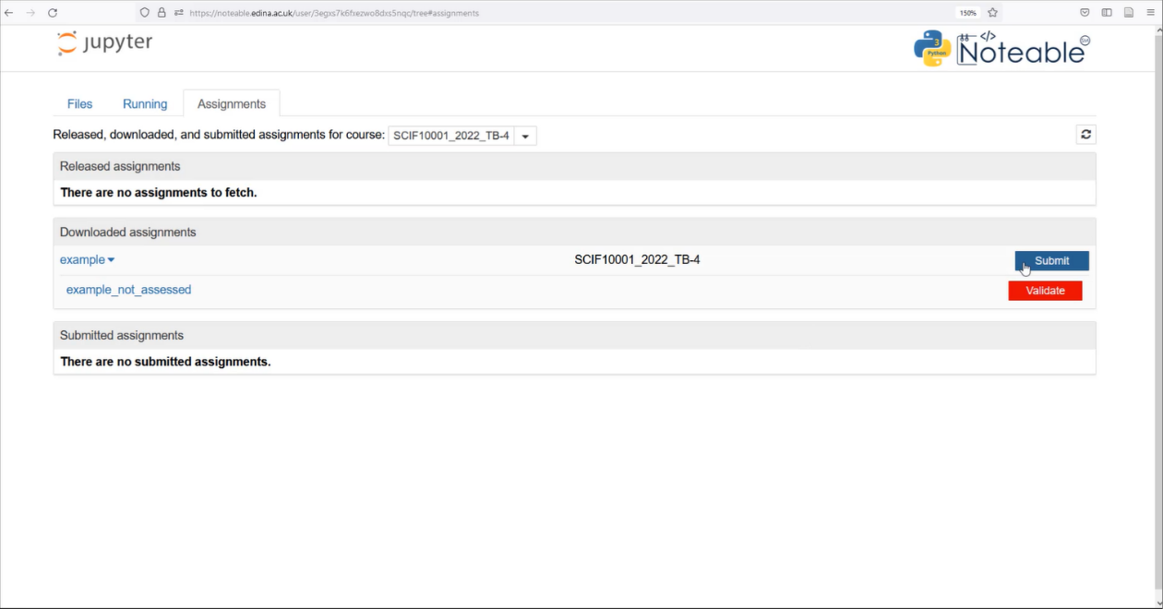
Noteable Submission
Download using the Assignments tab on noteable
Press Fetch and click on the assignment
Fill your answers in and Validate
Slide 4/11

Slide 64
Noteable Submission
Download using the Assignments tab on noteable
Press Fetch and click on the assignment
Fill your answers in and Validate
Once done, save your answers and Submit
Slide 4/11

Slide 65
Noteable Submission
Download using the Assignments tab on noteable
Press Fetch and click on the assignment
Fill your answers in and Validate
Once done, save your answers and Submit
Slide 4/11

Slide 66
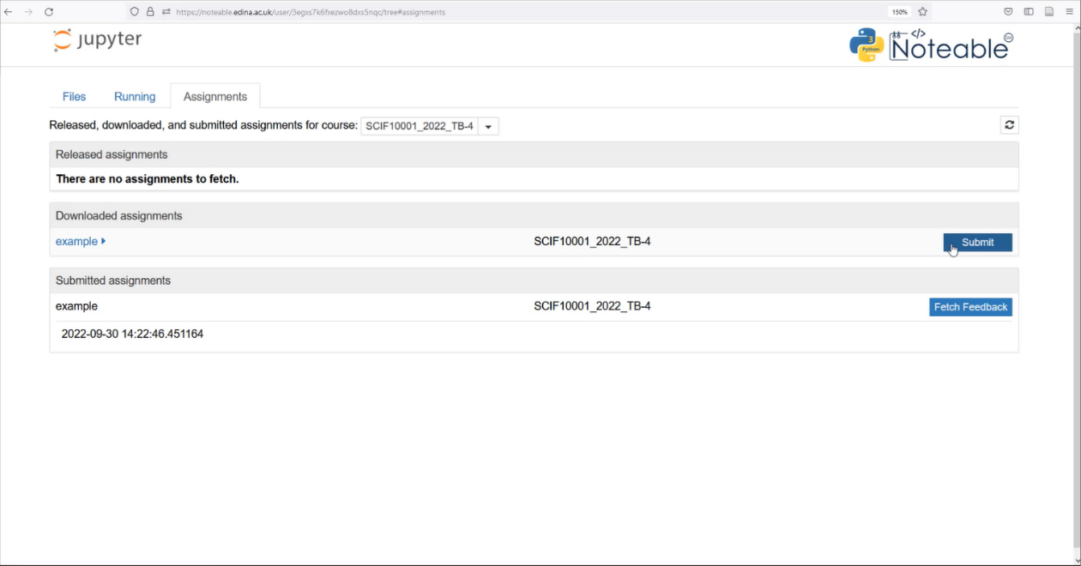
Noteable Submission
Download using the Assignments tab on noteable
Press Fetch and click on the assignment
Fill your answers in and Validate
Once done, save your answers and Submit
Slide 4/11

Slide 67
Noteable Submission
Download using the Assignments tab on noteable
Press Fetch and click on the assignment
Fill your answers in and Validate
Once done, save your answers and Submit
Slide 4/11

Slide 68
Noteable Submission
Download using the Assignments tab on noteable
Press Fetch and click on the assignment
Fill your answers in and Validate
Once done, save your answers and Submit
Slide 4/11

Slide 69
Noteable Submission
Download using the Assignments tab on noteable
Press Fetch and click on the assignment
Fill your answers in and Validate
Once done, save your answers and Submit
Slide 4/11

Slide 70
Noteable Submission
Download using the Assignments tab on noteable
Press Fetch and click on the assignment
Fill your answers in and Validate
Once done, save your answers and Submit
Feedback will be available when you see the (view feedback) option
Slide 4/11

Slide 71
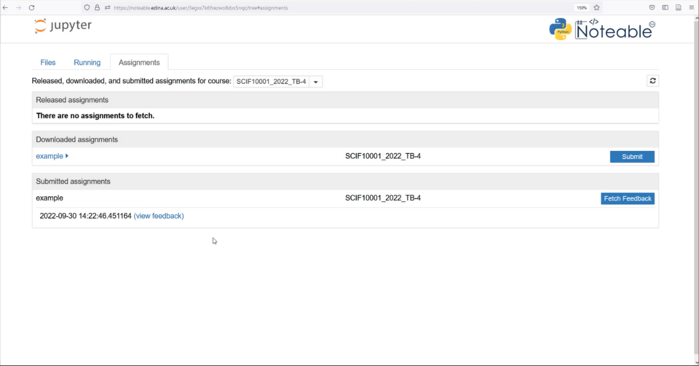
Noteable Submission
Download using the Assignments tab on noteable
Press Fetch and click on the assignment
Fill your answers in and Validate
Once done, save your answers and Submit
Feedback will be available when you see the (view feedback) option
Slide 4/11

Slide 72
Noteable Submission
Download using the Assignments tab on noteable
Press Fetch and click on the assignment
Fill your answers in and Validate
Once done, save your answers and Submit
Feedback will be available when you see the (view feedback) option
Slide 4/11

Slide 73
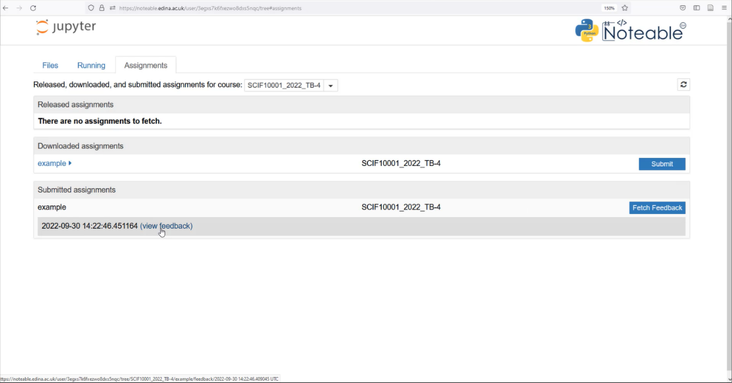
Noteable Submission
Download using the Assignments tab on noteable
Press Fetch and click on the assignment
Fill your answers in and Validate
Once done, save your answers and Submit
Feedback will be available when you see the (view feedback) option
Slide 4/11

Slide 74
Noteable Submission
Download using the Assignments tab on noteable
Press Fetch and click on the assignment
Fill your answers in and Validate
Once done, save your answers and Submit
Feedback will be available when you see the (view feedback) option
Slide 4/11

Slide 75
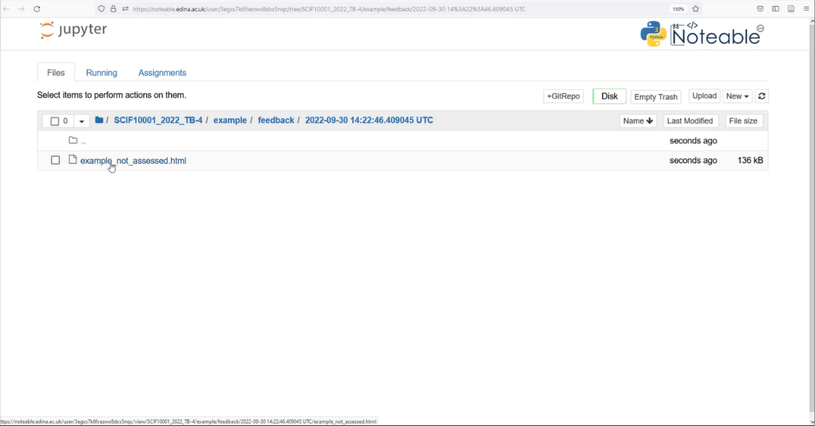
Noteable Submission
Download using the Assignments tab on noteable
Press Fetch and click on the assignment
Fill your answers in and Validate
Once done, save your answers and Submit
Feedback will be available when you see the (view feedback) option
Slide 4/11

Slide 76
Noteable Submission
Download using the Assignments tab on noteable
Press Fetch and click on the assignment
Fill your answers in and Validate
Once done, save your answers and Submit
Feedback will be available when you see the (view feedback) option
Slide 4/11

Slide 77
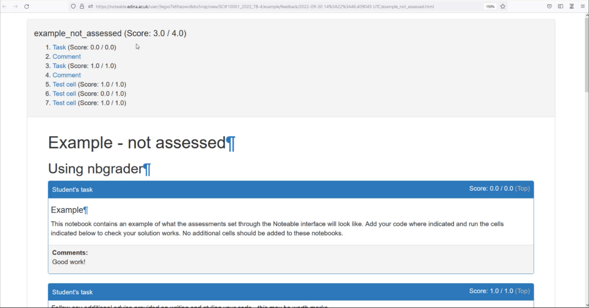
Noteable Submission
Download using the Assignments tab on noteable
Press Fetch and click on the assignment
Fill your answers in and Validate
Once done, save your answers and Submit
Feedback will be available when you see the (view feedback) option
Slide 4/11

Slide 78
Recap: If Statements
Slide 5/11

Slide 79
Recap: If Statements
Last week, we looked at the if statement
Slide 5/11

Slide 80
Recap: If Statements
Last week, we looked at the if statement
if statements allow us run code only when a specific condition is true
Slide 5/11

Slide 81
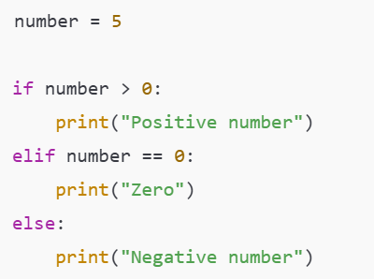

Recap: If Statements
Last week, we looked at the if statement
if statements allow us run code only when a specific condition is true
Slide 5/11

Slide 82
Recap: If Statements
Last week, we looked at the if statement
if statements allow us run code only when a specific condition is true
Slide 5/11

Slide 83
Recap: If Statements
Last week, we looked at the if statement
if statements allow us run code only when a specific condition is true
Slide 5/11

Slide 84
Recap: If Statements
Last week, we looked at the if statement
if statements allow us run code only when a specific condition is true
Slide 5/11

Slide 85
Recap: If Statements
Last week, we looked at the if statement
if statements allow us run code only when a specific condition is true
We can add elif and else statements to give us finer control over when code is executed
Slide 5/11

Slide 86
Recap: If Statements
Last week, we looked at the if statement
if statements allow us run code only when a specific condition is true
We can add elif and else statements to give us finer control over when code is executed
An elif runs if it’s Boolean is True and all previous clauses (ifs and elifs) did not execute
Slide 5/11

Slide 87
Recap: If Statements
Last week, we looked at the if statement
if statements allow us run code only when a specific condition is true
We can add elif and else statements to give us finer control over when code is executed
An elif runs if it’s Boolean is True and all previous clauses (ifs and elifs) did not execute
Slide 5/11

Slide 88
Recap: If Statements
Last week, we looked at the if statement
if statements allow us run code only when a specific condition is true
We can add elif and else statements to give us finer control over when code is executed
An elif runs if it’s Boolean is True and all previous clauses (ifs and elifs) did not execute
Slide 5/11

Slide 89
Recap: If Statements
Last week, we looked at the if statement
if statements allow us run code only when a specific condition is true
We can add elif and else statements to give us finer control over when code is executed
An elif runs if it’s Boolean is True and all previous clauses (ifs and elifs) did not execute
An else runs if all other clauses did not execute
Slide 5/11

Slide 90
Recap: If Statements
Last week, we looked at the if statement
if statements allow us run code only when a specific condition is true
We can add elif and else statements to give us finer control over when code is executed
An elif runs if it’s Boolean is True and all previous clauses (ifs and elifs) did not execute
An else runs if all other clauses did not execute
Slide 5/11

Slide 91
Recap: If Statements
Last week, we looked at the if statement
if statements allow us run code only when a specific condition is true
We can add elif and else statements to give us finer control over when code is executed
An elif runs if it’s Boolean is True and all previous clauses (ifs and elifs) did not execute
An else runs if all other clauses did not execute
Slide 5/11

Slide 92
Recap: If Statements
Last week, we looked at the if statement
if statements allow us run code only when a specific condition is true
We can add elif and else statements to give us finer control over when code is executed
An elif runs if it’s Boolean is True and all previous clauses (ifs and elifs) did not execute
An else runs if all other clauses did not execute
Today, we will look at another feature of Python that gives us finer control over our code - loops
Slide 5/11

Slide 93
Motivation
Slide 6/11

Slide 94
Motivation
Suppose we want to do a very repetitive computation
Slide 6/11

Slide 95
Motivation
Suppose we want to do a very repetitive computation
For instance, suppose we want to print the square of each item in this list
Slide 6/11

Slide 96

Motivation
Suppose we want to do a very repetitive computation
For instance, suppose we want to print the square of each item in this list
Slide 6/11

Slide 97
Motivation
Suppose we want to do a very repetitive computation
For instance, suppose we want to print the square of each item in this list
We could just write something like this…
Slide 6/11

Slide 98
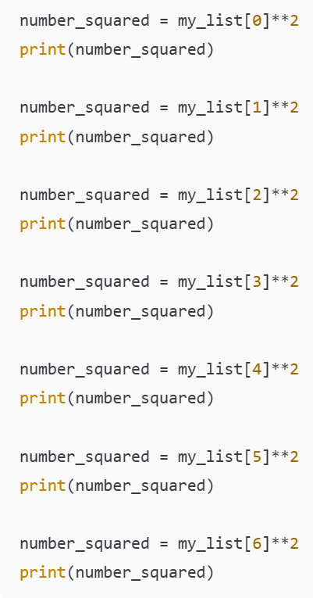
Motivation
Suppose we want to do a very repetitive computation
For instance, suppose we want to print the square of each item in this list
We could just write something like this…
Slide 6/11

Slide 99
Motivation
Suppose we want to do a very repetitive computation
For instance, suppose we want to print the square of each item in this list
We could just write something like this…
Slide 6/11

Slide 100
Motivation
Suppose we want to do a very repetitive computation
For instance, suppose we want to print the square of each item in this list
We could just write something like this…
Slide 6/11

Slide 101
Motivation
Suppose we want to do a very repetitive computation
For instance, suppose we want to print the square of each item in this list
We could just write something like this…
Slide 6/11

Slide 102
Motivation
Suppose we want to do a very repetitive computation
For instance, suppose we want to print the square of each item in this list
We could just write something like this…
Slide 6/11

Slide 103
Motivation
Suppose we want to do a very repetitive computation
For instance, suppose we want to print the square of each item in this list
We could just write something like this…
Slide 6/11

Slide 104
Motivation
Suppose we want to do a very repetitive computation
For instance, suppose we want to print the square of each item in this list
We could just write something like this…
Slide 6/11

Slide 105
Motivation
Suppose we want to do a very repetitive computation
For instance, suppose we want to print the square of each item in this list
We could just write something like this…
Slide 6/11

Slide 106
Motivation
Suppose we want to do a very repetitive computation
For instance, suppose we want to print the square of each item in this list
We could just write something like this…
But it would be nice to be able to do this automatically!
Slide 6/11

Slide 107
Motivation
Suppose we want to do a very repetitive computation
For instance, suppose we want to print the square of each item in this list
We could just write something like this…
But it would be nice to be able to do this automatically!
This is what loops do!
Slide 6/11

Slide 108
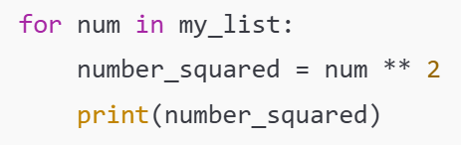
Motivation
Suppose we want to do a very repetitive computation
For instance, suppose we want to print the square of each item in this list
We could just write something like this…
But it would be nice to be able to do this automatically!
This is what loops do!
Slide 6/11

Slide 109
Motivation
Suppose we want to do a very repetitive computation
For instance, suppose we want to print the square of each item in this list
We could just write something like this…
But it would be nice to be able to do this automatically!
This is what loops do!
For Loop
Slide 6/11

Slide 110
Motivation
Suppose we want to do a very repetitive computation
For instance, suppose we want to print the square of each item in this list
We could just write something like this…
But it would be nice to be able to do this automatically!
This is what loops do!
Slide 6/11

Slide 111
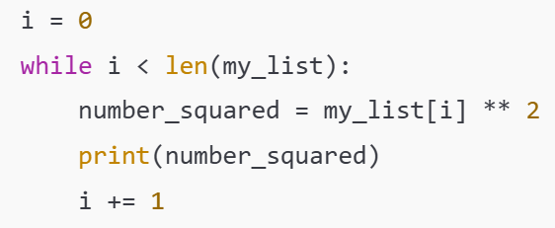
Motivation
Suppose we want to do a very repetitive computation
For instance, suppose we want to print the square of each item in this list
We could just write something like this…
But it would be nice to be able to do this automatically!
This is what loops do!
Slide 6/11

Slide 112
Motivation
Suppose we want to do a very repetitive computation
For instance, suppose we want to print the square of each item in this list
We could just write something like this…
But it would be nice to be able to do this automatically!
This is what loops do!
While Loop
Slide 6/11

Slide 113
Motivation
Suppose we want to do a very repetitive computation
For instance, suppose we want to print the square of each item in this list
We could just write something like this…
But it would be nice to be able to do this automatically!
This is what loops do!
Slide 6/11

Slide 114
Motivation
Suppose we want to do a very repetitive computation
For instance, suppose we want to print the square of each item in this list
We could just write something like this…
But it would be nice to be able to do this automatically!
This is what loops do!
Slide 6/11

Slide 115
Motivation
Suppose we want to do a very repetitive computation
For instance, suppose we want to print the square of each item in this list
We could just write something like this…
But it would be nice to be able to do this automatically!
This is what loops do!
Much shorter code!
Slide 6/11

Slide 116
Motivation
Suppose we want to do a very repetitive computation
For instance, suppose we want to print the square of each item in this list
We could just write something like this…
But it would be nice to be able to do this automatically!
This is what loops do!
Slide 6/11

Slide 117
Iterable Objects
Slide 7/11

Slide 118
Iterable Objects
An iterable object is an object which contains lots of elements that we could list one by one
Slide 7/11

Slide 119
Iterable Objects
An iterable object is an object which contains lots of elements that we could list one by one
We’ve already seen an example – the list
Slide 7/11

Slide 120
Iterable Objects
An iterable object is an object which contains lots of elements that we could list one by one
We’ve already seen an example – the list
Other examples include:
Slide 7/11

Slide 121
Iterable Objects
An iterable object is an object which contains lots of elements that we could list one by one
We’ve already seen an example – the list
Other examples include:
Tuples – like lists but use round brackets and can’t be changed
Slide 7/11

Slide 122

Iterable Objects
An iterable object is an object which contains lots of elements that we could list one by one
We’ve already seen an example – the list
Other examples include:
Tuples – like lists but use round brackets and can’t be changed
Slide 7/11

Slide 123
Iterable Objects
An iterable object is an object which contains lots of elements that we could list one by one
We’ve already seen an example – the list
Other examples include:
Tuples – like lists but use round brackets and can’t be changed
Dictionaries – records “keys” and “values” so that we can look up data using labels of our choosing
Slide 7/11

Slide 124

Iterable Objects
An iterable object is an object which contains lots of elements that we could list one by one
We’ve already seen an example – the list
Other examples include:
Tuples – like lists but use round brackets and can’t be changed
Dictionaries – records “keys” and “values” so that we can look up data using labels of our choosing
Slide 7/11

Slide 125
Iterable Objects
An iterable object is an object which contains lots of elements that we could list one by one
We’ve already seen an example – the list
Other examples include:
Tuples – like lists but use round brackets and can’t be changed
Dictionaries – records “keys” and “values” so that we can look up data using labels of our choosing
Slide 7/11

Slide 126
Iterable Objects
An iterable object is an object which contains lots of elements that we could list one by one
We’ve already seen an example – the list
Other examples include:
Tuples – like lists but use round brackets and can’t be changed
Dictionaries – records “keys” and “values” so that we can look up data using labels of our choosing
A range object – a python object that represents a sequence of numbers, saved in a useful, memory-efficient way
Slide 7/11

Slide 127

Iterable Objects
An iterable object is an object which contains lots of elements that we could list one by one
We’ve already seen an example – the list
Other examples include:
Tuples – like lists but use round brackets and can’t be changed
Dictionaries – records “keys” and “values” so that we can look up data using labels of our choosing
A range object – a python object that represents a sequence of numbers, saved in a useful, memory-efficient way
Slide 7/11

Slide 128
Iterable Objects
An iterable object is an object which contains lots of elements that we could list one by one
We’ve already seen an example – the list
Other examples include:
Tuples – like lists but use round brackets and can’t be changed
Dictionaries – records “keys” and “values” so that we can look up data using labels of our choosing
A range object – a python object that represents a sequence of numbers, saved in a useful, memory-efficient way
A for loop performs an operation on each element in an iterable object
Slide 7/11

Slide 129
For Loops
Slide 8/11

Slide 130
For Loops
A for loop lets you run code for every element in an iterable object
Slide 8/11

Slide 131
For Loops
A for loop lets you run code for every element in an iterable object
Let’s look at an example:
Slide 8/11

Slide 132
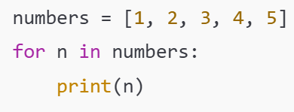
For Loops
A for loop lets you run code for every element in an iterable object
Let’s look at an example:
Slide 8/11

Slide 133
For Loops
A for loop lets you run code for every element in an iterable object
Let’s look at an example:
Slide 8/11

Slide 134
For Loops
A for loop lets you run code for every element in an iterable object
Let’s look at an example:
“for” keyword
Slide 8/11

Slide 135
For Loops
A for loop lets you run code for every element in an iterable object
Let’s look at an example:
Slide 8/11

Slide 136
For Loops
A for loop lets you run code for every element in an iterable object
Let’s look at an example:
“in” keyword
Slide 8/11

Slide 137
For Loops
A for loop lets you run code for every element in an iterable object
Let’s look at an example:
Slide 8/11

Slide 138
For Loops
A for loop lets you run code for every element in an iterable object
Let’s look at an example:
Colon
Slide 8/11

Slide 139
For Loops
A for loop lets you run code for every element in an iterable object
Let’s look at an example:
Slide 8/11

Slide 140
For Loops
A for loop lets you run code for every element in an iterable object
Let’s look at an example:
Iterable object (something we can list the elements in one by one)
Slide 8/11

Slide 141
For Loops
A for loop lets you run code for every element in an iterable object
Let’s look at an example:
Iterable object (something we can list the elements in one by one)
Slide 8/11

Slide 142
For Loops
A for loop lets you run code for every element in an iterable object
Let’s look at an example:
Iterable object (something we can list the elements in one by one)
Slide 8/11

Slide 143
For Loops
A for loop lets you run code for every element in an iterable object
Let’s look at an example:
Slide 8/11

Slide 144
For Loops
A for loop lets you run code for every element in an iterable object
Let’s look at an example:
Variable name This is a name we choose for an arbitrary element in the list
Slide 8/11

Slide 145
For Loops
A for loop lets you run code for every element in an iterable object
Let’s look at an example:
Variable name This is a name we choose for an arbitrary element in the list
Slide 8/11

Slide 146
For Loops
A for loop lets you run code for every element in an iterable object
Let’s look at an example:
Slide 8/11

Slide 147
For Loops
A for loop lets you run code for every element in an iterable object
Let’s look at an example:
Body of the loop
This code will be run for every element in the iterable object
Slide 8/11

Slide 148
For Loops
A for loop lets you run code for every element in an iterable object
Let’s look at an example:
Slide 8/11

Slide 149
For Loops
A for loop lets you run code for every element in an iterable object
Let’s look at an example:
Indentation – This is important! This is how Python tells what is inside the loop!
Slide 8/11

Slide 150
For Loops
A for loop lets you run code for every element in an iterable object
Let’s look at an example:
Indentation – This is important! This is how Python tells what is inside the loop!
Slide 8/11

Slide 151
For Loops
A for loop lets you run code for every element in an iterable object
Let’s look at an example:
Slide 8/11

Slide 152
For Loops
A for loop lets you run code for every element in an iterable object
Let’s look at an example:
Translation:
“For every number in the list, print that number”
Slide 8/11

Slide 153
For Loops
A for loop lets you run code for every element in an iterable object
Let’s look at an example:
Slide 8/11

Slide 154
For Loops
A for loop lets you run code for every element in an iterable object
Let’s look at an example:
This code will print:
1
2
3
4
5
Slide 8/11

Slide 155
For Loops
A for loop lets you run code for every element in an iterable object
Let’s look at an example:
This code will print:
1
2
3
4
5
Slide 8/11

Slide 156
For Loops
A for loop lets you run code for every element in an iterable object
Let’s look at an example:
This code will print:
1
2
3
4
5
Slide 8/11

Slide 157
For Loops
A for loop lets you run code for every element in an iterable object
Let’s look at an example:
This code will print:
1
2
3
4
5
Slide 8/11

Slide 158
For Loops
A for loop lets you run code for every element in an iterable object
Let’s look at an example:
This code will print:
1
2
3
4
5
Slide 8/11

Slide 159
For Loops
A for loop lets you run code for every element in an iterable object
Let’s look at an example:
This code will print:
1
2
3
4
5
Slide 8/11

Slide 160
For Loops
A for loop lets you run code for every element in an iterable object
Let’s look at an example:
Slide 8/11

Slide 161
While Loops
Slide 9/11

Slide 162
While Loops
A while loop lets you run code repeatedly so long as a Boolean statement is True
Slide 9/11

Slide 163
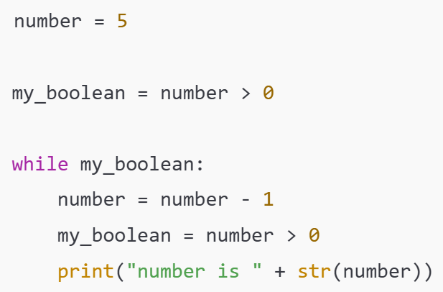
While Loops
A while loop lets you run code repeatedly so long as a Boolean statement is True
Slide 9/11

Slide 164
While Loops
A while loop lets you run code repeatedly so long as a Boolean statement is True
Slide 9/11

Slide 165
While Loops
A while loop lets you run code repeatedly so long as a Boolean statement is True
“while” keyword
Slide 9/11

Slide 166
While Loops
A while loop lets you run code repeatedly so long as a Boolean statement is True
Slide 9/11

Slide 167
While Loops
A while loop lets you run code repeatedly so long as a Boolean statement is True
Colon
Slide 9/11

Slide 168
While Loops
A while loop lets you run code repeatedly so long as a Boolean statement is True
Slide 9/11

Slide 169
While Loops
A while loop lets you run code repeatedly so long as a Boolean statement is True
Boolean Condition
Slide 9/11

Slide 170
While Loops
A while loop lets you run code repeatedly so long as a Boolean statement is True
Boolean Condition
Slide 9/11

Slide 171
While Loops
A while loop lets you run code repeatedly so long as a Boolean statement is True
Slide 9/11

Slide 172
While Loops
A while loop lets you run code repeatedly so long as a Boolean statement is True
Body of the loop:
Slide 9/11

Slide 173
While Loops
A while loop lets you run code repeatedly so long as a Boolean statement is True
Body of the loop:
This will execute over and over again until the Boolean is set to False
Slide 9/11

Slide 174
While Loops
A while loop lets you run code repeatedly so long as a Boolean statement is True
Body of the loop:
This will execute over and over again until the Boolean is set to False
Slide 9/11

Slide 175
While Loops
A while loop lets you run code repeatedly so long as a Boolean statement is True
Body of the loop:
This will execute over and over again until the Boolean is set to False
First, number = 5.
Slide 9/11

Slide 176
While Loops
A while loop lets you run code repeatedly so long as a Boolean statement is True
Body of the loop:
This will execute over and over again until the Boolean is set to False
First, number = 5.
Slide 9/11

Slide 177
While Loops
A while loop lets you run code repeatedly so long as a Boolean statement is True
Body of the loop:
This will execute over and over again until the Boolean is set to False
First, number = 5.
Check if number > 0.
Slide 9/11

Slide 178
While Loops
A while loop lets you run code repeatedly so long as a Boolean statement is True
Body of the loop:
This will execute over and over again until the Boolean is set to False
First, number = 5.
Check if number > 0.
Slide 9/11

Slide 179
While Loops
A while loop lets you run code repeatedly so long as a Boolean statement is True
Body of the loop:
This will execute over and over again until the Boolean is set to False
First, number = 5.
Check if number > 0.
Slide 9/11

Slide 180
While Loops
A while loop lets you run code repeatedly so long as a Boolean statement is True
Body of the loop:
This will execute over and over again until the Boolean is set to False
First, number = 5.
Check if number > 0.
As number > 0, we move into the while loop
Slide 9/11

Slide 181
While Loops
A while loop lets you run code repeatedly so long as a Boolean statement is True
Body of the loop:
This will execute over and over again until the Boolean is set to False
First, number = 5.
Check if number > 0.
As number > 0, we move into the while loop
Slide 9/11

Slide 182
While Loops
A while loop lets you run code repeatedly so long as a Boolean statement is True
Body of the loop:
This will execute over and over again until the Boolean is set to False
First, number = 5.
Check if number > 0.
As number > 0, we move into the while loop
Slide 9/11

Slide 183
While Loops
A while loop lets you run code repeatedly so long as a Boolean statement is True
Body of the loop:
This will execute over and over again until the Boolean is set to False
First, number = 5.
Check if number > 0.
As number > 0, we move into the while loop
Slide 9/11

Slide 184
While Loops
A while loop lets you run code repeatedly so long as a Boolean statement is True
Body of the loop:
This will execute over and over again until the Boolean is set to False
First, number = 5.
Check if number > 0.
As number > 0, we move into the while loop
Slide 9/11

Slide 185
While Loops
A while loop lets you run code repeatedly so long as a Boolean statement is True
Body of the loop:
This will execute over and over again until the Boolean is set to False
First, number = 5.
Check if number > 0.
As number > 0, we move into the while loop
Slide 9/11

Slide 186
While Loops
A while loop lets you run code repeatedly so long as a Boolean statement is True
Body of the loop:
This will execute over and over again until the Boolean is set to False
Next, number = number – 1 = 4.
Check if number > 0.
As number > 0, we move into the while loop
Slide 9/11

Slide 187
While Loops
A while loop lets you run code repeatedly so long as a Boolean statement is True
Body of the loop:
This will execute over and over again until the Boolean is set to False
Next, number = number – 1 = 4.
Check if number > 0.
As number > 0, we move into the while loop
Slide 9/11

Slide 188
While Loops
A while loop lets you run code repeatedly so long as a Boolean statement is True
Body of the loop:
This will execute over and over again until the Boolean is set to False
Next, number = number – 1 = 4.
Check if number > 0.
As number > 0, we move into the while loop
Slide 9/11

Slide 189
While Loops
A while loop lets you run code repeatedly so long as a Boolean statement is True
Body of the loop:
This will execute over and over again until the Boolean is set to False
Next, number = number – 1 = 4.
Check if number > 0.
As number > 0, we move into the while loop
Slide 9/11

Slide 190
While Loops
A while loop lets you run code repeatedly so long as a Boolean statement is True
Body of the loop:
This will execute over and over again until the Boolean is set to False
Next, number = number – 1 = 4.
Check if number > 0.
As number > 0, we move into the while loop
Slide 9/11

Slide 191
While Loops
A while loop lets you run code repeatedly so long as a Boolean statement is True
Body of the loop:
This will execute over and over again until the Boolean is set to False
Next, number = number – 1 = 4.
Check if number > 0.
As number > 0, we move into the while loop
Slide 9/11

Slide 192
While Loops
A while loop lets you run code repeatedly so long as a Boolean statement is True
Body of the loop:
This will execute over and over again until the Boolean is set to False
Next, number = number – 1 = 4.
Check if number > 0.
We print the number.
As number > 0, we move into the while loop
Slide 9/11

Slide 193
While Loops
A while loop lets you run code repeatedly so long as a Boolean statement is True
Body of the loop:
This will execute over and over again until the Boolean is set to False
Next, number = number – 1 = 4.
Check if number > 0.
We print the number.
As number > 0, we move into the while loop
Slide 9/11

Slide 194
While Loops
A while loop lets you run code repeatedly so long as a Boolean statement is True
Body of the loop:
This will execute over and over again until the Boolean is set to False
Next, number = number – 1 = 4.
Check if number > 0.
We print the number.
As number > 0, we move into the while loop
Slide 9/11

Slide 195
While Loops
A while loop lets you run code repeatedly so long as a Boolean statement is True
Body of the loop:
This will execute over and over again until the Boolean is set to False
Next, number = number – 1 = 4.
Check if number > 0.
We print the number.
As number > 0, we move into the while loop
Slide 9/11

Slide 196
While Loops
A while loop lets you run code repeatedly so long as a Boolean statement is True
Body of the loop:
This will execute over and over again until the Boolean is set to False
Next, number = number – 1 = 4.
Check if number > 0.
We print the number.
As my_boolean is True, we repeat the loop.
Slide 9/11

Slide 197
While Loops
A while loop lets you run code repeatedly so long as a Boolean statement is True
Body of the loop:
This will execute over and over again until the Boolean is set to False
Next, number = number – 1 = 4.
Check if number > 0.
We print the number.
As my_boolean is True, we repeat the loop.
Slide 9/11

Slide 198
While Loops
A while loop lets you run code repeatedly so long as a Boolean statement is True
Body of the loop:
This will execute over and over again until the Boolean is set to False
Next, number = number – 1 = 4.
Check if number > 0.
We print the number.
As my_boolean is True, we repeat the loop.
Slide 9/11

Slide 199
While Loops
A while loop lets you run code repeatedly so long as a Boolean statement is True
Body of the loop:
This will execute over and over again until the Boolean is set to False
Next, number = number – 1 = 4.
Check if number > 0.
We print the number.
As my_boolean is True, we repeat the loop.
Slide 9/11

Slide 200
While Loops
A while loop lets you run code repeatedly so long as a Boolean statement is True
Body of the loop:
This will execute over and over again until the Boolean is set to False
Next, number = number – 1 = 3.
Check if number > 0.
We print the number.
As my_boolean is True, we repeat the loop.
Slide 9/11

Slide 201
While Loops
A while loop lets you run code repeatedly so long as a Boolean statement is True
Body of the loop:
This will execute over and over again until the Boolean is set to False
Next, number = number – 1 = 3.
Check if number > 0.
We print the number.
As my_boolean is True, we repeat the loop.
Slide 9/11

Slide 202
While Loops
A while loop lets you run code repeatedly so long as a Boolean statement is True
Body of the loop:
This will execute over and over again until the Boolean is set to False
Next, number = number – 1 = 3.
Check if number > 0.
We print the number.
As my_boolean is True, we repeat the loop.
Slide 9/11

Slide 203
While Loops
A while loop lets you run code repeatedly so long as a Boolean statement is True
Body of the loop:
This will execute over and over again until the Boolean is set to False
Next, number = number – 1 = 3.
Check if number > 0.
We print the number.
As my_boolean is True, we repeat the loop.
Slide 9/11

Slide 204
While Loops
A while loop lets you run code repeatedly so long as a Boolean statement is True
Body of the loop:
This will execute over and over again until the Boolean is set to False
Next, number = number – 1 = 3.
Check if number > 0.
We print the number.
As my_boolean is True, we repeat the loop.
Slide 9/11

Slide 205
While Loops
A while loop lets you run code repeatedly so long as a Boolean statement is True
Body of the loop:
This will execute over and over again until the Boolean is set to False
Next, number = number – 1 = 3.
Check if number > 0.
We print the number.
As my_boolean is True, we repeat the loop.
Slide 9/11

Slide 206
While Loops
A while loop lets you run code repeatedly so long as a Boolean statement is True
Body of the loop:
This will execute over and over again until the Boolean is set to False
Next, number = number – 1 = 3.
Check if number > 0.
We print the number.
As my_boolean is True, we repeat the loop.
Slide 9/11

Slide 207
While Loops
A while loop lets you run code repeatedly so long as a Boolean statement is True
Body of the loop:
This will execute over and over again until the Boolean is set to False
Next, number = number – 1 = 3.
Check if number > 0.
We print the number.
As my_boolean is True, we repeat the loop.
Slide 9/11

Slide 208
While Loops
A while loop lets you run code repeatedly so long as a Boolean statement is True
Body of the loop:
This will execute over and over again until the Boolean is set to False
Next, number = number – 1 = 3.
Check if number > 0.
We print the number.
As my_boolean is True, we repeat the loop.
Slide 9/11

Slide 209
While Loops
A while loop lets you run code repeatedly so long as a Boolean statement is True
Body of the loop:
This will execute over and over again until the Boolean is set to False
Next, number = number – 1 = 3.
Check if number > 0.
We print the number.
As my_boolean is True, we repeat the loop.
Slide 9/11

Slide 210
While Loops
A while loop lets you run code repeatedly so long as a Boolean statement is True
Body of the loop:
This will execute over and over again until the Boolean is set to False
Next, number = number – 1 = 3.
Check if number > 0.
We print the number.
As my_boolean is True, we repeat the loop.
Slide 9/11

Slide 211
While Loops
A while loop lets you run code repeatedly so long as a Boolean statement is True
Body of the loop:
This will execute over and over again until the Boolean is set to False
Next, number = number – 1 = 3.
Check if number > 0.
We print the number.
As my_boolean is True, we repeat the loop.
Slide 9/11

Slide 212
While Loops
A while loop lets you run code repeatedly so long as a Boolean statement is True
Body of the loop:
This will execute over and over again until the Boolean is set to False
Next, number = number – 1 = 3.
Check if number > 0.
We print the number.
As my_boolean is True, we repeat the loop.
Slide 9/11

Slide 213
While Loops
A while loop lets you run code repeatedly so long as a Boolean statement is True
Body of the loop:
This will execute over and over again until the Boolean is set to False
Next, number = number – 1 = 2.
Check if number > 0.
We print the number.
As my_boolean is True, we repeat the loop.
Slide 9/11

Slide 214
While Loops
A while loop lets you run code repeatedly so long as a Boolean statement is True
Body of the loop:
This will execute over and over again until the Boolean is set to False
Next, number = number – 1 = 2.
Check if number > 0.
We print the number.
As my_boolean is True, we repeat the loop.
Slide 9/11

Slide 215
While Loops
A while loop lets you run code repeatedly so long as a Boolean statement is True
Body of the loop:
This will execute over and over again until the Boolean is set to False
Next, number = number – 1 = 2.
Check if number > 0.
We print the number.
As my_boolean is True, we repeat the loop.
Slide 9/11

Slide 216
While Loops
A while loop lets you run code repeatedly so long as a Boolean statement is True
Body of the loop:
This will execute over and over again until the Boolean is set to False
Next, number = number – 1 = 2.
Check if number > 0.
We print the number.
As my_boolean is True, we repeat the loop.
Slide 9/11

Slide 217
While Loops
A while loop lets you run code repeatedly so long as a Boolean statement is True
Body of the loop:
This will execute over and over again until the Boolean is set to False
Next, number = number – 1 = 2.
Check if number > 0.
We print the number.
As my_boolean is True, we repeat the loop.
Slide 9/11

Slide 218
While Loops
A while loop lets you run code repeatedly so long as a Boolean statement is True
Body of the loop:
This will execute over and over again until the Boolean is set to False
Next, number = number – 1 = 2.
Check if number > 0.
We print the number.
As my_boolean is True, we repeat the loop.
Slide 9/11

Slide 219
While Loops
A while loop lets you run code repeatedly so long as a Boolean statement is True
Body of the loop:
This will execute over and over again until the Boolean is set to False
Next, number = number – 1 = 2.
Check if number > 0.
We print the number.
As my_boolean is True, we repeat the loop.
Slide 9/11

Slide 220
While Loops
A while loop lets you run code repeatedly so long as a Boolean statement is True
Body of the loop:
This will execute over and over again until the Boolean is set to False
Next, number = number – 1 = 2.
Check if number > 0.
We print the number.
As my_boolean is True, we repeat the loop.
Slide 9/11

Slide 221
While Loops
A while loop lets you run code repeatedly so long as a Boolean statement is True
Body of the loop:
This will execute over and over again until the Boolean is set to False
Next, number = number – 1 = 2.
Check if number > 0.
We print the number.
As my_boolean is True, we repeat the loop.
Slide 9/11

Slide 222
While Loops
A while loop lets you run code repeatedly so long as a Boolean statement is True
Body of the loop:
This will execute over and over again until the Boolean is set to False
Next, number = number – 1 = 2.
Check if number > 0.
We print the number.
As my_boolean is True, we repeat the loop.
Slide 9/11

Slide 223
While Loops
A while loop lets you run code repeatedly so long as a Boolean statement is True
Body of the loop:
This will execute over and over again until the Boolean is set to False
Next, number = number – 1 = 2.
Check if number > 0.
We print the number.
As my_boolean is True, we repeat the loop.
Slide 9/11

Slide 224
While Loops
A while loop lets you run code repeatedly so long as a Boolean statement is True
Body of the loop:
This will execute over and over again until the Boolean is set to False
Next, number = number – 1 = 2.
Check if number > 0.
We print the number.
As my_boolean is True, we repeat the loop.
Slide 9/11

Slide 225
While Loops
A while loop lets you run code repeatedly so long as a Boolean statement is True
Body of the loop:
This will execute over and over again until the Boolean is set to False
Next, number = number – 1 = 2.
Check if number > 0.
We print the number.
As my_boolean is True, we repeat the loop.
Slide 9/11

Slide 226
While Loops
A while loop lets you run code repeatedly so long as a Boolean statement is True
Body of the loop:
This will execute over and over again until the Boolean is set to False
Next, number = number – 1 = 1.
Check if number > 0.
We print the number.
As my_boolean is True, we repeat the loop.
Slide 9/11

Slide 227
While Loops
A while loop lets you run code repeatedly so long as a Boolean statement is True
Body of the loop:
This will execute over and over again until the Boolean is set to False
Next, number = number – 1 = 1.
Check if number > 0.
We print the number.
As my_boolean is True, we repeat the loop.
Slide 9/11

Slide 228
While Loops
A while loop lets you run code repeatedly so long as a Boolean statement is True
Body of the loop:
This will execute over and over again until the Boolean is set to False
Next, number = number – 1 = 1.
Check if number > 0.
We print the number.
As my_boolean is True, we repeat the loop.
Slide 9/11

Slide 229
While Loops
A while loop lets you run code repeatedly so long as a Boolean statement is True
Body of the loop:
This will execute over and over again until the Boolean is set to False
Next, number = number – 1 = 1.
Check if number > 0.
We print the number.
As my_boolean is True, we repeat the loop.
Slide 9/11

Slide 230
While Loops
A while loop lets you run code repeatedly so long as a Boolean statement is True
Body of the loop:
This will execute over and over again until the Boolean is set to False
Next, number = number – 1 = 1.
Check if number > 0.
We print the number.
As my_boolean is True, we repeat the loop.
Slide 9/11

Slide 231
While Loops
A while loop lets you run code repeatedly so long as a Boolean statement is True
Body of the loop:
This will execute over and over again until the Boolean is set to False
Next, number = number – 1 = 1.
Check if number > 0.
We print the number.
As my_boolean is True, we repeat the loop.
Slide 9/11

Slide 232
While Loops
A while loop lets you run code repeatedly so long as a Boolean statement is True
Body of the loop:
This will execute over and over again until the Boolean is set to False
Next, number = number – 1 = 1.
Check if number > 0.
We print the number.
As my_boolean is True, we repeat the loop.
Slide 9/11

Slide 233
While Loops
A while loop lets you run code repeatedly so long as a Boolean statement is True
Body of the loop:
This will execute over and over again until the Boolean is set to False
Next, number = number – 1 = 1.
Check if number > 0.
We print the number.
As my_boolean is True, we repeat the loop.
Slide 9/11

Slide 234
While Loops
A while loop lets you run code repeatedly so long as a Boolean statement is True
Body of the loop:
This will execute over and over again until the Boolean is set to False
Next, number = number – 1 = 1.
Check if number > 0.
We print the number.
As my_boolean is True, we repeat the loop.
Slide 9/11

Slide 235
While Loops
A while loop lets you run code repeatedly so long as a Boolean statement is True
Body of the loop:
This will execute over and over again until the Boolean is set to False
Next, number = number – 1 = 1.
Check if number > 0.
We print the number.
As my_boolean is True, we repeat the loop.
Slide 9/11

Slide 236
While Loops
A while loop lets you run code repeatedly so long as a Boolean statement is True
Body of the loop:
This will execute over and over again until the Boolean is set to False
Next, number = number – 1 = 1.
Check if number > 0.
We print the number.
As my_boolean is True, we repeat the loop.
Slide 9/11

Slide 237
While Loops
A while loop lets you run code repeatedly so long as a Boolean statement is True
Body of the loop:
This will execute over and over again until the Boolean is set to False
Next, number = number – 1 = 1.
Check if number > 0.
We print the number.
As my_boolean is True, we repeat the loop.
Slide 9/11

Slide 238
While Loops
A while loop lets you run code repeatedly so long as a Boolean statement is True
Body of the loop:
This will execute over and over again until the Boolean is set to False
Next, number = number – 1 = 1.
Check if number > 0.
We print the number.
As my_boolean is True, we repeat the loop.
Slide 9/11

Slide 239
While Loops
A while loop lets you run code repeatedly so long as a Boolean statement is True
Body of the loop:
This will execute over and over again until the Boolean is set to False
Next, number = number – 1 = 0.
Check if number > 0.
We print the number.
As my_boolean is True, we repeat the loop.
Slide 9/11

Slide 240
While Loops
A while loop lets you run code repeatedly so long as a Boolean statement is True
Body of the loop:
This will execute over and over again until the Boolean is set to False
Next, number = number – 1 = 0.
Check if number > 0.
We print the number.
As my_boolean is True, we repeat the loop.
Slide 9/11

Slide 241
While Loops
A while loop lets you run code repeatedly so long as a Boolean statement is True
Body of the loop:
This will execute over and over again until the Boolean is set to False
Next, number = number – 1 = 0.
Check if number > 0.
We print the number.
As my_boolean is True, we repeat the loop.
Slide 9/11

Slide 242
While Loops
A while loop lets you run code repeatedly so long as a Boolean statement is True
Body of the loop:
This will execute over and over again until the Boolean is set to False
Next, number = number – 1 = 0.
Check if number > 0.
We print the number.
As my_boolean is True, we repeat the loop.
Slide 9/11

Slide 243
While Loops
A while loop lets you run code repeatedly so long as a Boolean statement is True
Body of the loop:
This will execute over and over again until the Boolean is set to False
Next, number = number – 1 = 0.
Check if number > 0.
We print the number.
As my_boolean is True, we repeat the loop.
Slide 9/11

Slide 244
While Loops
A while loop lets you run code repeatedly so long as a Boolean statement is True
Body of the loop:
This will execute over and over again until the Boolean is set to False
Next, number = number – 1 = 0.
Check if number > 0.
We print the number.
As my_boolean is True, we repeat the loop.
Slide 9/11

Slide 245
While Loops
A while loop lets you run code repeatedly so long as a Boolean statement is True
Body of the loop:
This will execute over and over again until the Boolean is set to False
Next, number = number – 1 = 0.
Check if number > 0.
We print the number.
As my_boolean is True, we repeat the loop.
Slide 9/11

Slide 246
While Loops
A while loop lets you run code repeatedly so long as a Boolean statement is True
Body of the loop:
This will execute over and over again until the Boolean is set to False
Next, number = number – 1 = 0.
Check if number > 0.
We print the number.
As my_boolean is True, we repeat the loop.
Slide 9/11

Slide 247
While Loops
A while loop lets you run code repeatedly so long as a Boolean statement is True
Body of the loop:
This will execute over and over again until the Boolean is set to False
Next, number = number – 1 = 0.
Check if number > 0.
We print the number.
As my_boolean is True, we repeat the loop.
Slide 9/11

Slide 248
While Loops
A while loop lets you run code repeatedly so long as a Boolean statement is True
Body of the loop:
This will execute over and over again until the Boolean is set to False
Next, number = number – 1 = 0.
Check if number > 0.
We print the number.
Now my_boolean is False!!
Slide 9/11

Slide 249
While Loops
A while loop lets you run code repeatedly so long as a Boolean statement is True
Body of the loop:
This will execute over and over again until the Boolean is set to False
Next, number = number – 1 = 0.
Check if number > 0.
We print the number.
Now my_boolean is False!!
Slide 9/11

Slide 250
While Loops
A while loop lets you run code repeatedly so long as a Boolean statement is True
Body of the loop:
This will execute over and over again until the Boolean is set to False
Next, number = number – 1 = 0.
Check if number > 0.
We print the number.
Now my_boolean is False!!
We stop here!
Slide 9/11

Slide 251
While Loops
A while loop lets you run code repeatedly so long as a Boolean statement is True
Body of the loop:
This will execute over and over again until the Boolean is set to False
Next, number = number – 1 = 0.
Check if number > 0.
We print the number.
Now my_boolean is False!!
We stop here!
Slide 9/11

Slide 252
While Loops
A while loop lets you run code repeatedly so long as a Boolean statement is True
Slide 9/11

Slide 253
While Loops
A while loop lets you run code repeatedly so long as a Boolean statement is True
In the end we will have printed:
number is 5
number is 4
number is 3
number is 2
number is 1
number is 0
Slide 9/11

Slide 254
While Loops
A while loop lets you run code repeatedly so long as a Boolean statement is True
In the end we will have printed:
number is 5
number is 4
number is 3
number is 2
number is 1
number is 0
Slide 9/11

Slide 255
While Loops
A while loop lets you run code repeatedly so long as a Boolean statement is True
In the end we will have printed:
number is 5
number is 4
number is 3
number is 2
number is 1
number is 0
Slide 9/11

Slide 256
While Loops
A while loop lets you run code repeatedly so long as a Boolean statement is True
In the end we will have printed:
number is 5
number is 4
number is 3
number is 2
number is 1
number is 0
Slide 9/11

Slide 257
While Loops
A while loop lets you run code repeatedly so long as a Boolean statement is True
In the end we will have printed:
number is 5
number is 4
number is 3
number is 2
number is 1
number is 0
Slide 9/11

Slide 258
While Loops
A while loop lets you run code repeatedly so long as a Boolean statement is True
In the end we will have printed:
number is 5
number is 4
number is 3
number is 2
number is 1
number is 0
Slide 9/11

Slide 259
While Loops
A while loop lets you run code repeatedly so long as a Boolean statement is True
In the end we will have printed:
number is 5
number is 4
number is 3
number is 2
number is 1
number is 0
Slide 9/11

Slide 260
While Loops
A while loop lets you run code repeatedly so long as a Boolean statement is True
Slide 9/11

Slide 261
While Loops
A while loop lets you run code repeatedly so long as a Boolean statement is True
Indentation. Again, this is how Python tells what is inside the loop!
Slide 9/11

Slide 262
While Loops
A while loop lets you run code repeatedly so long as a Boolean statement is True
Indentation. Again, this is how Python tells what is inside the loop!
Slide 9/11

Slide 263
While Loops
A while loop lets you run code repeatedly so long as a Boolean statement is True
Slide 9/11

Slide 264
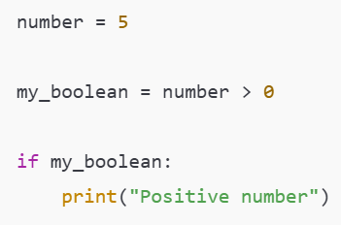
While Loops
A while loop lets you run code repeatedly so long as a Boolean statement is True
Slide 9/11

Slide 265
While Loops
A while loop lets you run code repeatedly so long as a Boolean statement is True
An if statement executes once if the Boolean is True
A while loop executes repeatedly until the Boolean is False
Slide 9/11

Slide 266
While Loops
A while loop lets you run code repeatedly so long as a Boolean statement is True
An if statement executes once if the Boolean is True
A while loop executes repeatedly until the Boolean is False
Slide 9/11

Slide 267
While Loops
A while loop lets you run code repeatedly so long as a Boolean statement is True
Slide 9/11

Slide 268
Practical
Slide 10/11

Slide 269
Practical
We now move over to Python
Slide 10/11

Slide 270
Practical
We now move over to Python
Please open `week_03_home.ipynb`
Slide 10/11

Slide 271
Practical
We now move over to Python
Please open `week_03_home.ipynb`
For the rest of today, you must work through a Python notebook
Slide 10/11

Slide 272
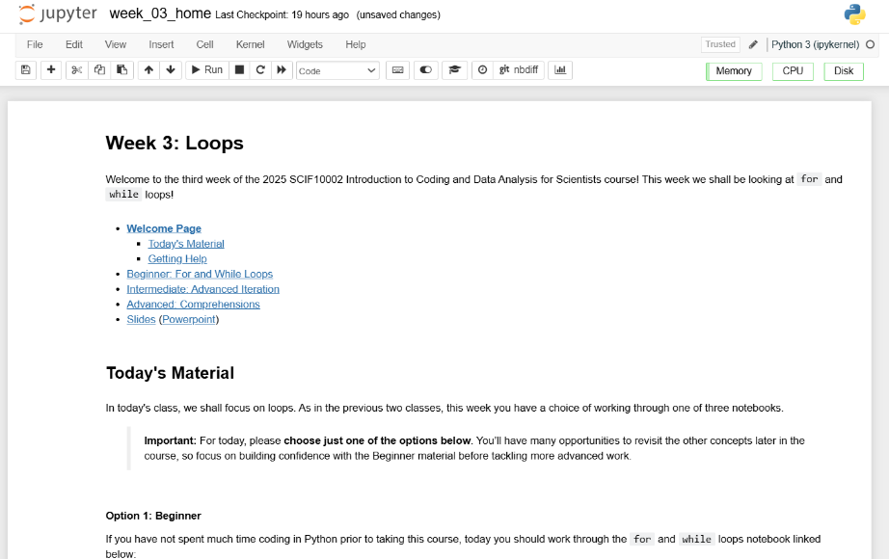
Practical
We now move over to Python
Please open `week_03_home.ipynb`
For the rest of today, you must work through a Python notebook
Slide 10/11

Slide 273
Practical
We now move over to Python
Please open `week_03_home.ipynb`
For the rest of today, you must work through a Python notebook
You have a choice of one of three options
Slide 10/11

Slide 274
Practical
We now move over to Python
Please open `week_03_home.ipynb`
For the rest of today, you must work through a Python notebook
You have a choice of one of three options
Option 1: Beginner – For and While Loops
Slide 10/11

Slide 275
Practical
We now move over to Python
Please open `week_03_home.ipynb`
For the rest of today, you must work through a Python notebook
You have a choice of one of three options
Option 1: Beginner – For and While Loops
Option 2: Intermediate – Advanced Iteration
Slide 10/11

Slide 276
Practical
We now move over to Python
Please open `week_03_home.ipynb`
For the rest of today, you must work through a Python notebook
You have a choice of one of three options
Option 1: Beginner – For and While Loops
Option 2: Intermediate – Advanced Iteration
Option 3: Advanced – Comprehensions
Slide 10/11

Slide 277
Practical
We now move over to Python
Please open `week_03_home.ipynb`
For the rest of today, you must work through a Python notebook
You have a choice of one of three options
Option 1: Beginner – For and While Loops
Option 2: Intermediate – Advanced Iteration
Option 3: Advanced – Comprehensions
Choose this if you are just getting started with loops
Slide 10/11

Slide 278
Practical
We now move over to Python
Please open `week_03_home.ipynb`
For the rest of today, you must work through a Python notebook
You have a choice of one of three options
Option 1: Beginner – For and While Loops
Option 2: Intermediate – Advanced Iteration
Option 3: Advanced – Comprehensions
Slide 10/11

Slide 279
Practical
We now move over to Python
Please open `week_03_home.ipynb`
For the rest of today, you must work through a Python notebook
You have a choice of one of three options
Option 1: Beginner – For and While Loops
Option 2: Intermediate – Advanced Iteration
Option 3: Advanced – Comprehensions
Choose this if you already have some experience with loops in Python and want to broaden pre-existing knowledge
Slide 10/11

Slide 280
Practical
We now move over to Python
Please open `week_03_home.ipynb`
For the rest of today, you must work through a Python notebook
You have a choice of one of three options
Option 1: Beginner – For and While Loops
Option 2: Intermediate – Advanced Iteration
Option 3: Advanced – Comprehensions
Slide 10/11

Slide 281
Practical
We now move over to Python
Please open `week_03_home.ipynb`
For the rest of today, you must work through a Python notebook
You have a choice of one of three options
Option 1: Beginner – For and While Loops
Option 2: Intermediate – Advanced Iteration
Option 3: Advanced – Comprehensions
Choose this if you have a lot of experience already and have been programming for years
Slide 10/11

Slide 282
Practical
We now move over to Python
Please open `week_03_home.ipynb`
For the rest of today, you must work through a Python notebook
You have a choice of one of three options
Option 1: Beginner – For and While Loops
Option 2: Intermediate – Advanced Iteration
Option 3: Advanced – Comprehensions
Slide 10/11

Slide 283
Practical
We now move over to Python
Please open `week_03_home.ipynb`
For the rest of today, you must work through a Python notebook
You have a choice of one of three options
Option 1: Beginner – For and While Loops
Option 2: Intermediate – Advanced Iteration
Option 3: Advanced – Comprehensions
Important: If you choose the intermediate or advanced options, make sure you are comfortable with the material in Beginner first!!
Slide 10/11

Slide 284
Practical
We now move over to Python
Please open `week_03_home.ipynb`
For the rest of today, you must work through a Python notebook
You have a choice of one of three options
Option 1: Beginner – For and While Loops
Option 2: Intermediate – Advanced Iteration
Option 3: Advanced – Comprehensions
Slide 10/11

Slide 285
Next Time
Lecture 3: Loops
Recap: Accessing Noteable
Recap: If Statements
For Loops
While Loops
Practical
Lecture 4: Functions
Recap: For and While Loops
Functions
Inputs and Outputs
Practical
Slide 11/11

