Slide 1
Lecture 3:
Functions
SCIF10002 – Introduction to Coding and Data
Tom Maullin-Sapey
16th October 2025
Slide 0/12

Slide 2
Today’s Lecture
Slide 1/12

Slide 3
Today’s Lecture
Lecture 4: Functions
Slide 1/12

Slide 4
Today’s Lecture
Lecture 4: Functions
Recap: For and While Loops
Slide 1/12

Slide 5
Today’s Lecture
Lecture 4: Functions
Recap: For and While Loops
Functions
Slide 1/12

Slide 6
Today’s Lecture
Lecture 4: Functions
Recap: For and While Loops
Functions
Inputs and Outputs
Slide 1/12

Slide 7
Today’s Lecture
Lecture 4: Functions
Recap: For and While Loops
Functions
Inputs and Outputs
Practical
Slide 1/12

Slide 8
Today’s Lecture
Lecture 4: Functions
Recap: For and While Loops
Functions
Inputs and Outputs
Practical
Lecture 5: Consolidation Week
Slide 1/12

Slide 9
Today’s Lecture
Lecture 4: Functions
Recap: For and While Loops
Functions
Inputs and Outputs
Practical
Lecture 5: Consolidation Week
Recap: The course so far
Slide 1/12

Slide 10
Today’s Lecture
Lecture 4: Functions
Recap: For and While Loops
Functions
Inputs and Outputs
Practical
Lecture 5: Consolidation Week
Recap: The course so far
Recap: Why learn to code
Slide 1/12

Slide 11
Today’s Lecture
Lecture 4: Functions
Recap: For and While Loops
Functions
Inputs and Outputs
Practical
Lecture 5: Consolidation Week
Recap: The course so far
Recap: Why learn to code
Tackling Problems: A Worked Example
Slide 1/12

Slide 12
Today’s Lecture
Lecture 4: Functions
Recap: For and While Loops
Functions
Inputs and Outputs
Practical
Lecture 5: Consolidation Week
Recap: The course so far
Recap: Why learn to code
Tackling Problems: A Worked Example
What’s next
Slide 1/12

Slide 13
Today’s Lecture
Lecture 4: Functions
Recap: For and While Loops
Functions
Inputs and Outputs
Practical
Lecture 5: Consolidation Week
Recap: The course so far
Recap: Why learn to code
Tackling Problems: A Worked Example
What’s next
Practical
Slide 1/12

Slide 14
Important: Assessed Coursework 1
Slide 2/12

Slide 15
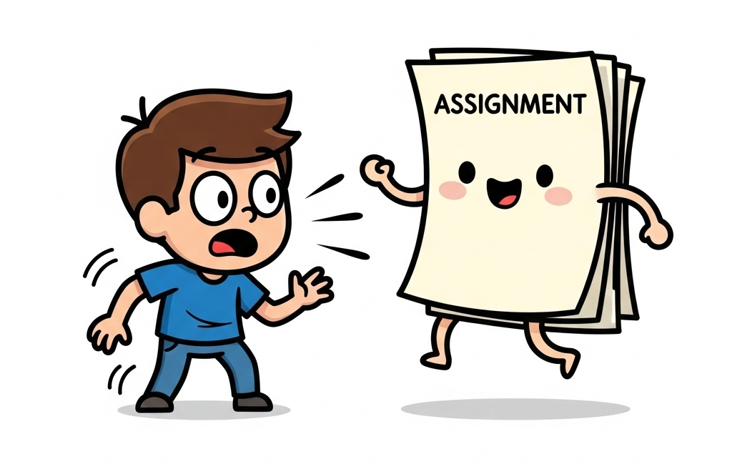
Important: Assessed Coursework 1
Slide 2/12

Slide 16
Important: Assessed Coursework 1
The first assignment has been released!
Slide 2/12

Slide 17
Important: Assessed Coursework 1
The first assignment has been released!
Released Wednesday 8th October at 12:00PM
Slide 2/12

Slide 18
Important: Assessed Coursework 1
The first assignment has been released!
Released Wednesday 8th October at 12:00PM
Due Wednesday 22nd October at 12:00PM
Slide 2/12

Slide 19
Important: Assessed Coursework 1
The first assignment has been released!
Released Wednesday 8th October at 12:00PM
Due Wednesday 22nd October at 12:00PM
This is assessed (15% of your grade!)
Slide 2/12

Slide 20
Important: Assessed Coursework 1
The first assignment has been released!
Released Wednesday 8th October at 12:00PM
Due Wednesday 22nd October at 12:00PM
This is assessed (15% of your grade!)
Submission is via Noteable
Slide 2/12

Slide 21
Important: Assessed Coursework 1
The first assignment has been released!
Released Wednesday 8th October at 12:00PM
Due Wednesday 22nd October at 12:00PM
This is assessed (15% of your grade!)
Submission is via Noteable
You can submit as many times as you like up until the submission date
Slide 2/12

Slide 22
Noteable Submission
Slide 3/12

Slide 23
Noteable Submission
Download using the Assignments tab on notable
Slide 3/12

Slide 24
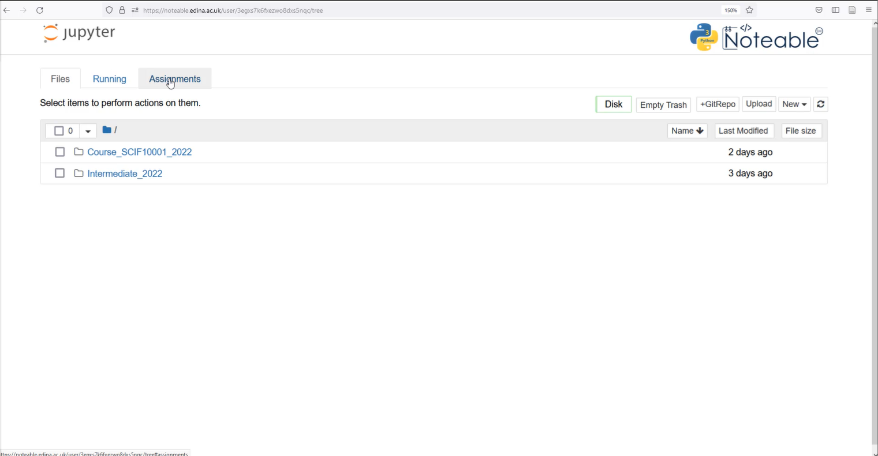
Noteable Submission
Download using the Assignments tab on noteable
Slide 3/12

Slide 25
Noteable Submission
Download using the Assignments tab on noteable
Slide 3/12

Slide 26
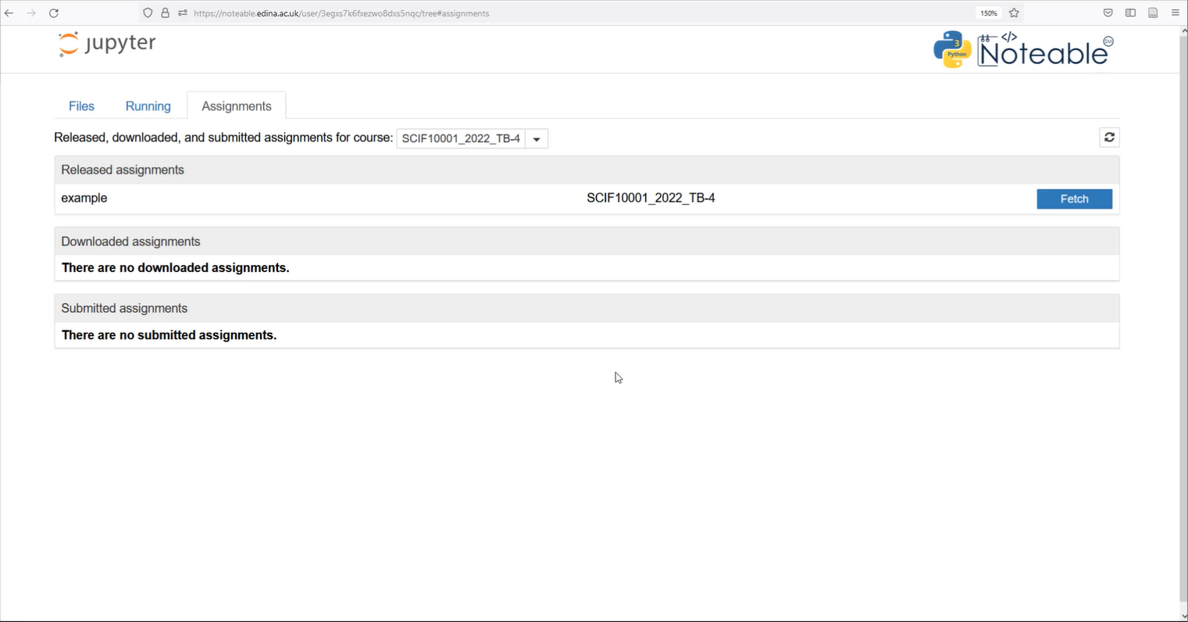
Noteable Submission
Download using the Assignments tab on noteable
Slide 3/12

Slide 27
Noteable Submission
Download using the Assignments tab on noteable
Slide 3/12

Slide 28
Noteable Submission
Download using the Assignments tab on noteable
Press Fetch and click on the assignment
Slide 3/12

Slide 29
Noteable Submission
Download using the Assignments tab on noteable
Press Fetch and click on the assignment
Slide 3/12

Slide 30
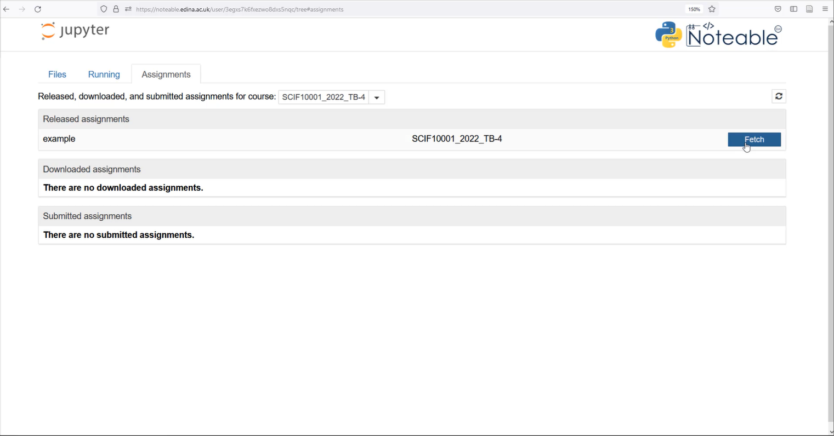
Noteable Submission
Download using the Assignments tab on noteable
Press Fetch and click on the assignment
Slide 3/12

Slide 31
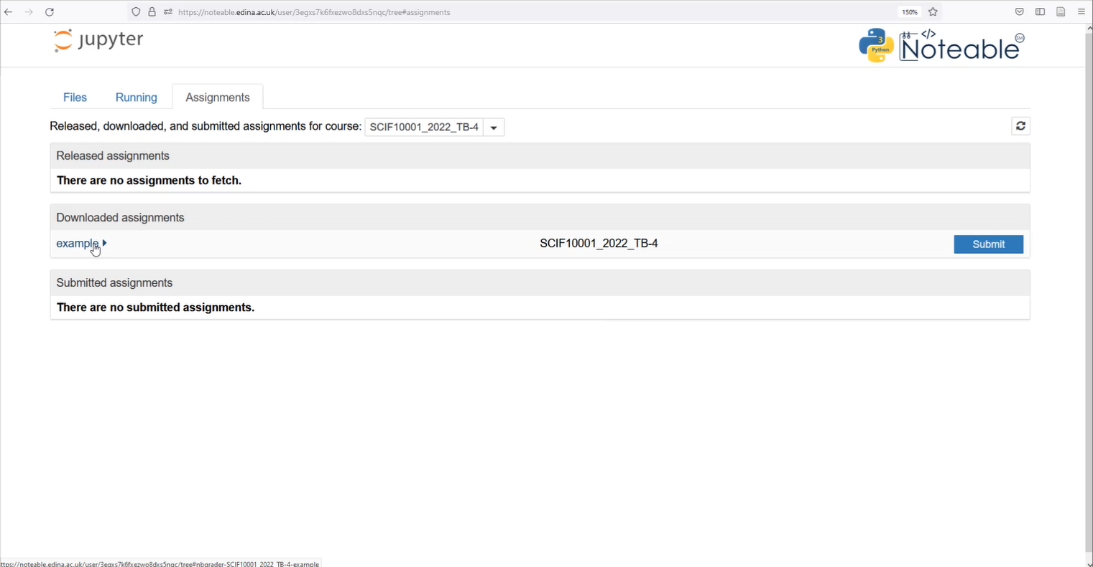
Noteable Submission
Download using the Assignments tab on noteable
Press Fetch and click on the assignment
Slide 3/12

Slide 32
Noteable Submission
Download using the Assignments tab on noteable
Press Fetch and click on the assignment
Slide 3/12

Slide 33
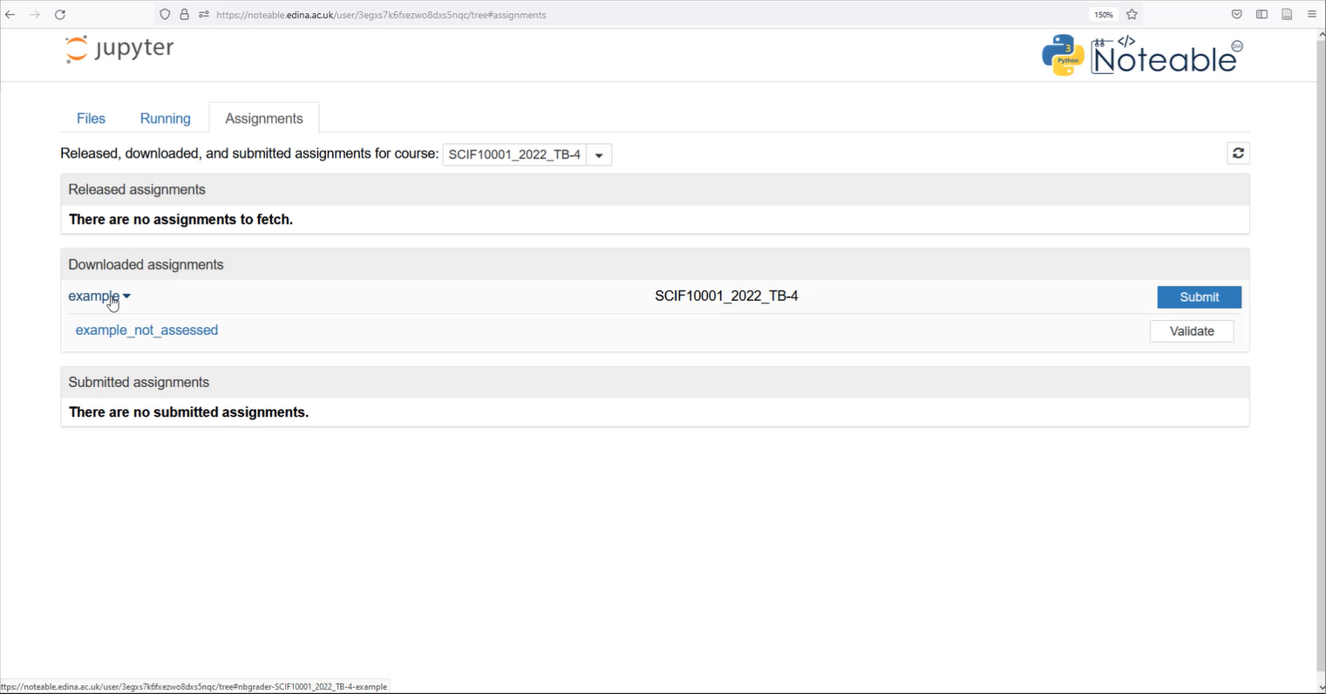
Noteable Submission
Download using the Assignments tab on noteable
Press Fetch and click on the assignment
Slide 3/12

Slide 34
Noteable Submission
Download using the Assignments tab on noteable
Press Fetch and click on the assignment
Slide 3/12

Slide 35
Noteable Submission
Download using the Assignments tab on noteable
Press Fetch and click on the assignment
Slide 3/12

Slide 36
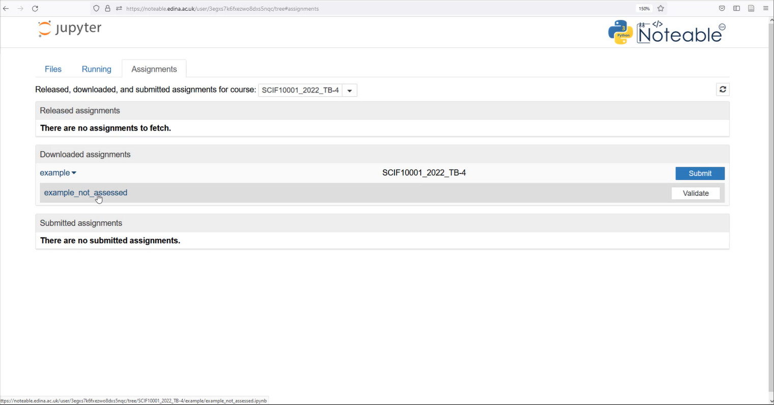
Noteable Submission
Download using the Assignments tab on noteable
Press Fetch and click on the assignment
Slide 3/12

Slide 37
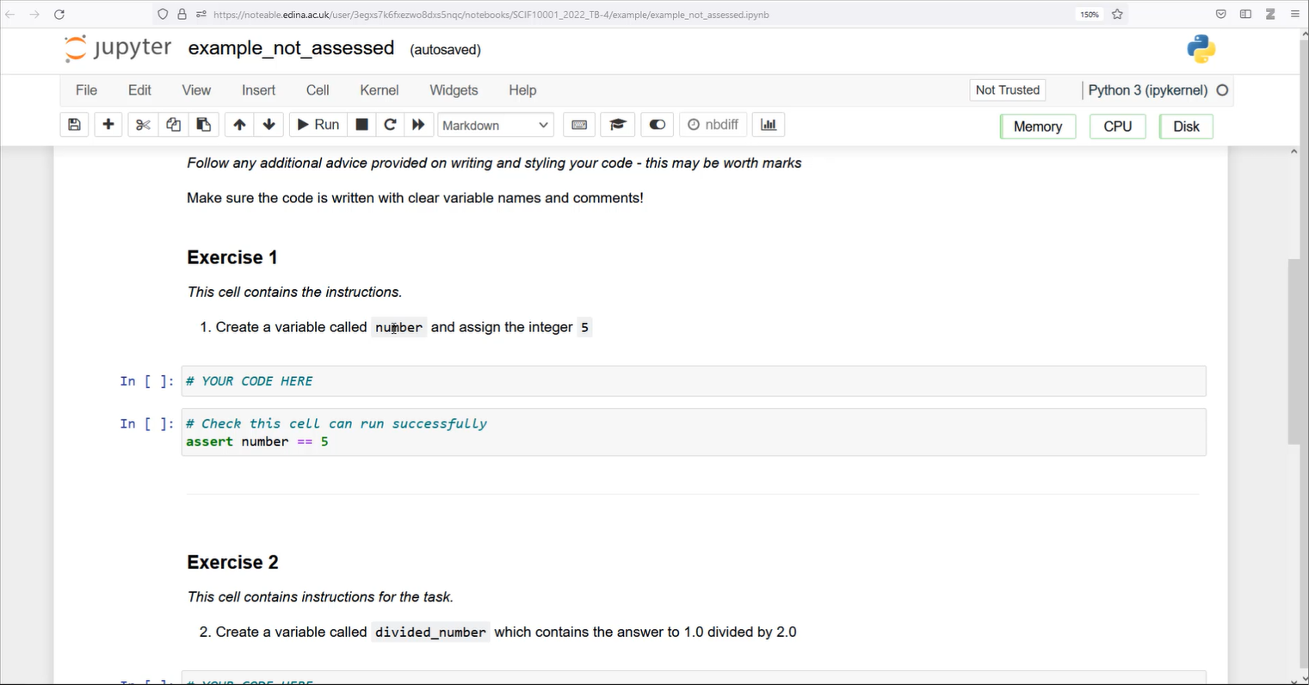
Noteable Submission
Download using the Assignments tab on noteable
Press Fetch and click on the assignment
Slide 3/12

Slide 38
Noteable Submission
Download using the Assignments tab on noteable
Press Fetch and click on the assignment
Fill your answers in and Validate
Slide 3/12

Slide 39
Noteable Submission
Download using the Assignments tab on noteable
Press Fetch and click on the assignment
Fill your answers in and Validate
Slide 3/12

Slide 40
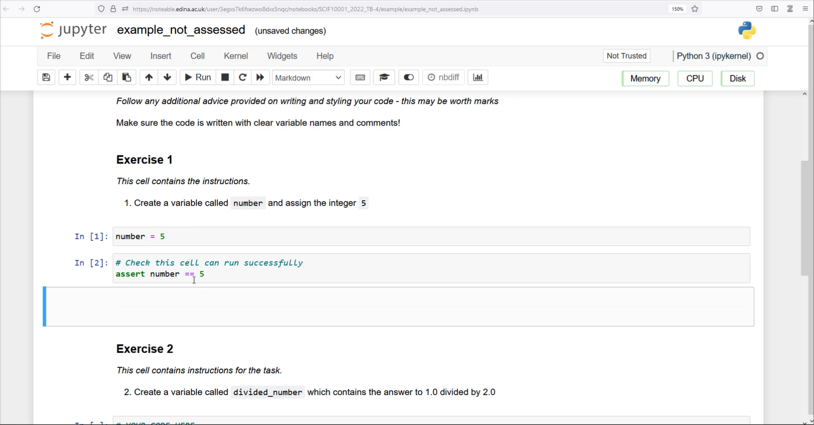
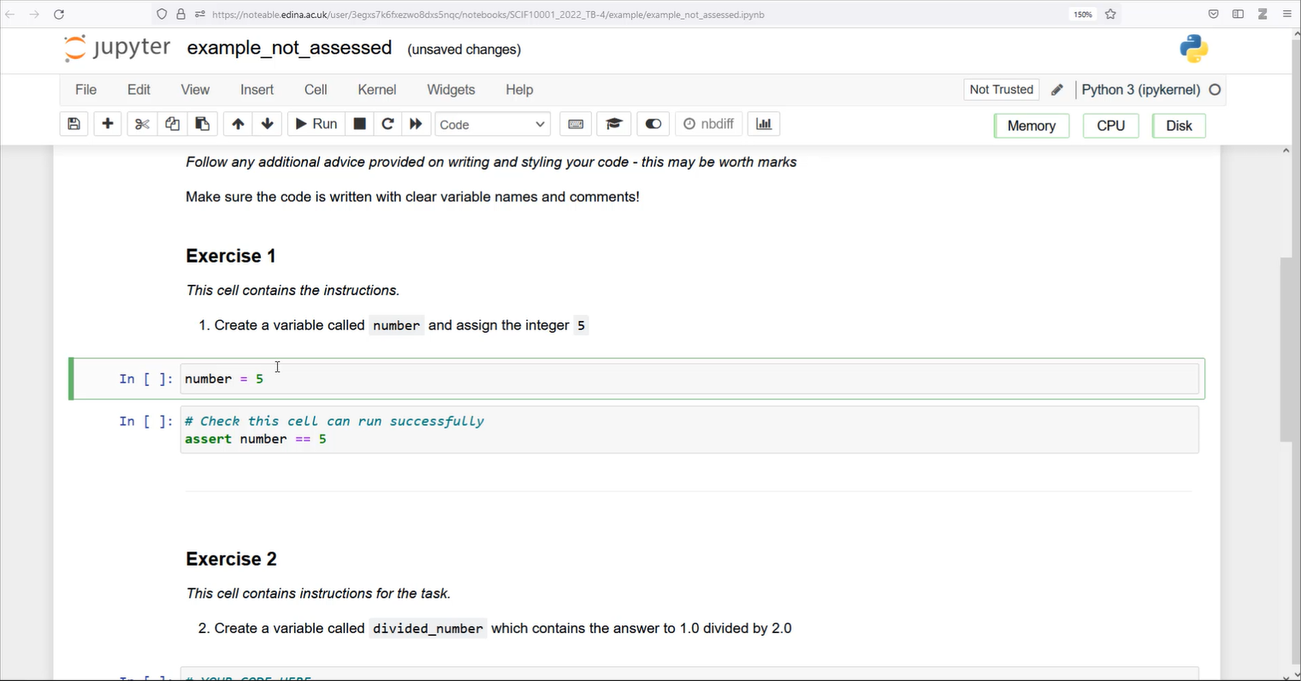
Noteable Submission
Download using the Assignments tab on noteable
Press Fetch and click on the assignment
Fill your answers in and Validate
Slide 3/12

Slide 41
Noteable Submission
Download using the Assignments tab on noteable
Press Fetch and click on the assignment
Fill your answers in and Validate
Slide 3/12

Slide 42
Noteable Submission
Download using the Assignments tab on noteable
Press Fetch and click on the assignment
Fill your answers in and Validate
Slide 3/12

Slide 43
Noteable Submission
Download using the Assignments tab on noteable
Press Fetch and click on the assignment
Fill your answers in and Validate
Slide 3/12

Slide 44
Noteable Submission
Download using the Assignments tab on noteable
Press Fetch and click on the assignment
Fill your answers in and Validate
Slide 3/12

Slide 45
Noteable Submission
Download using the Assignments tab on noteable
Press Fetch and click on the assignment
Fill your answers in and Validate
Slide 3/12

Slide 46
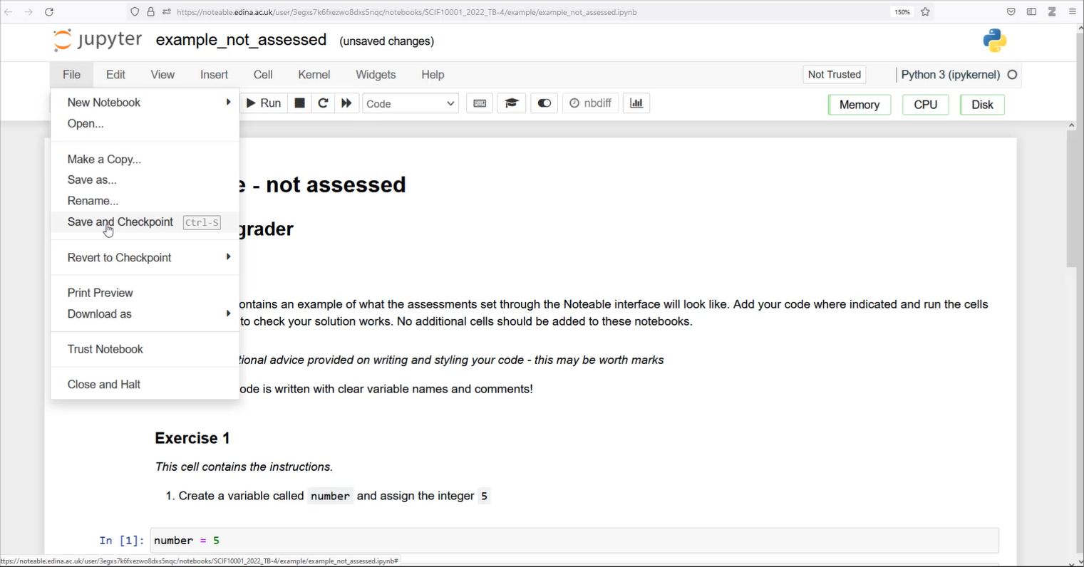
Noteable Submission
Download using the Assignments tab on noteable
Press Fetch and click on the assignment
Fill your answers in and Validate
Slide 3/12

Slide 47
Noteable Submission
Download using the Assignments tab on noteable
Press Fetch and click on the assignment
Fill your answers in and Validate
Slide 3/12

Slide 48
Noteable Submission
Download using the Assignments tab on noteable
Press Fetch and click on the assignment
Fill your answers in and Validate
Slide 3/12

Slide 49
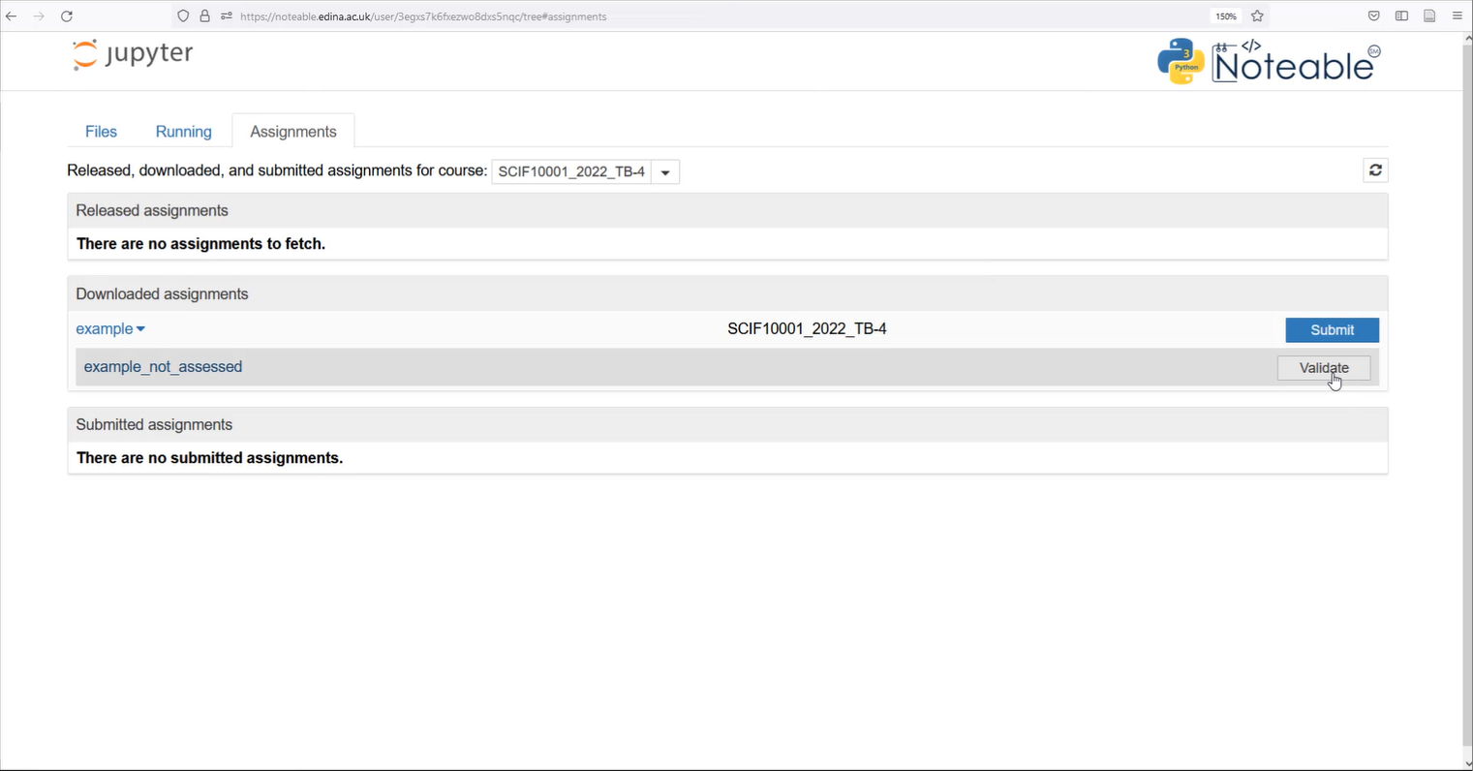
Noteable Submission
Download using the Assignments tab on noteable
Press Fetch and click on the assignment
Fill your answers in and Validate
Slide 3/12

Slide 50
Noteable Submission
Download using the Assignments tab on noteable
Press Fetch and click on the assignment
Fill your answers in and Validate
Slide 3/12

Slide 51
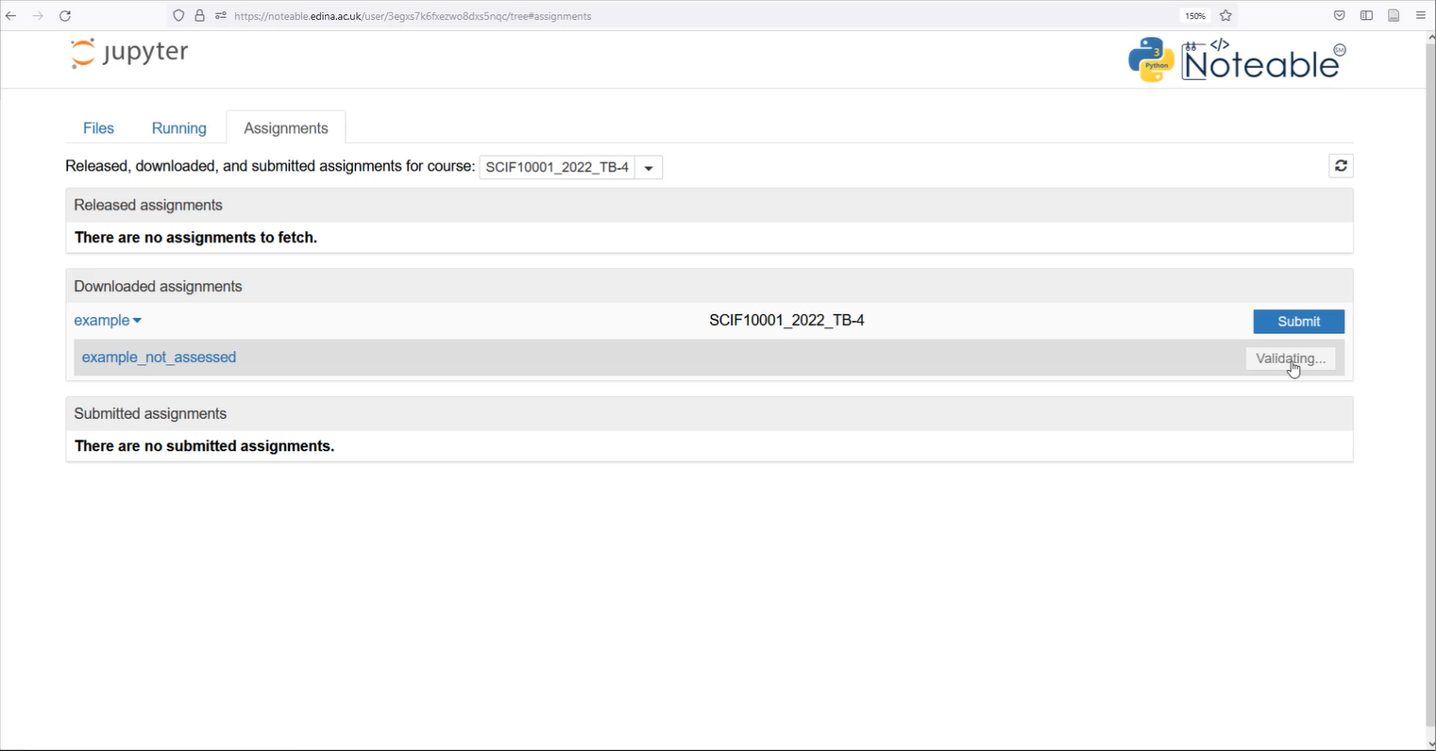
Noteable Submission
Download using the Assignments tab on noteable
Press Fetch and click on the assignment
Fill your answers in and Validate
Slide 3/12

Slide 52
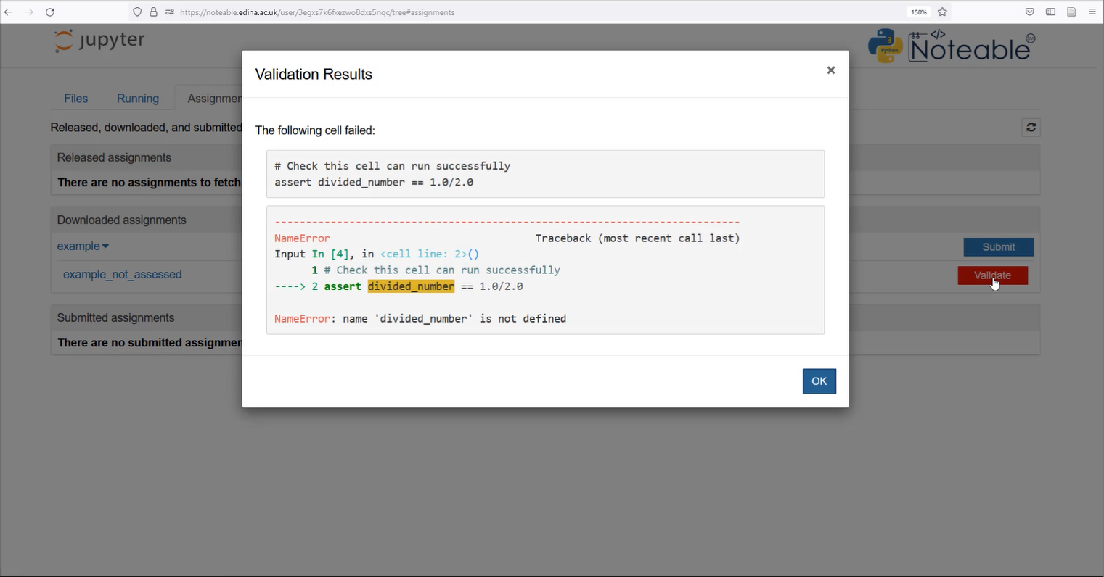
Noteable Submission
Download using the Assignments tab on noteable
Press Fetch and click on the assignment
Fill your answers in and Validate
Slide 3/12

Slide 53
Noteable Submission
Download using the Assignments tab on noteable
Press Fetch and click on the assignment
Fill your answers in and Validate
Slide 3/12

Slide 54
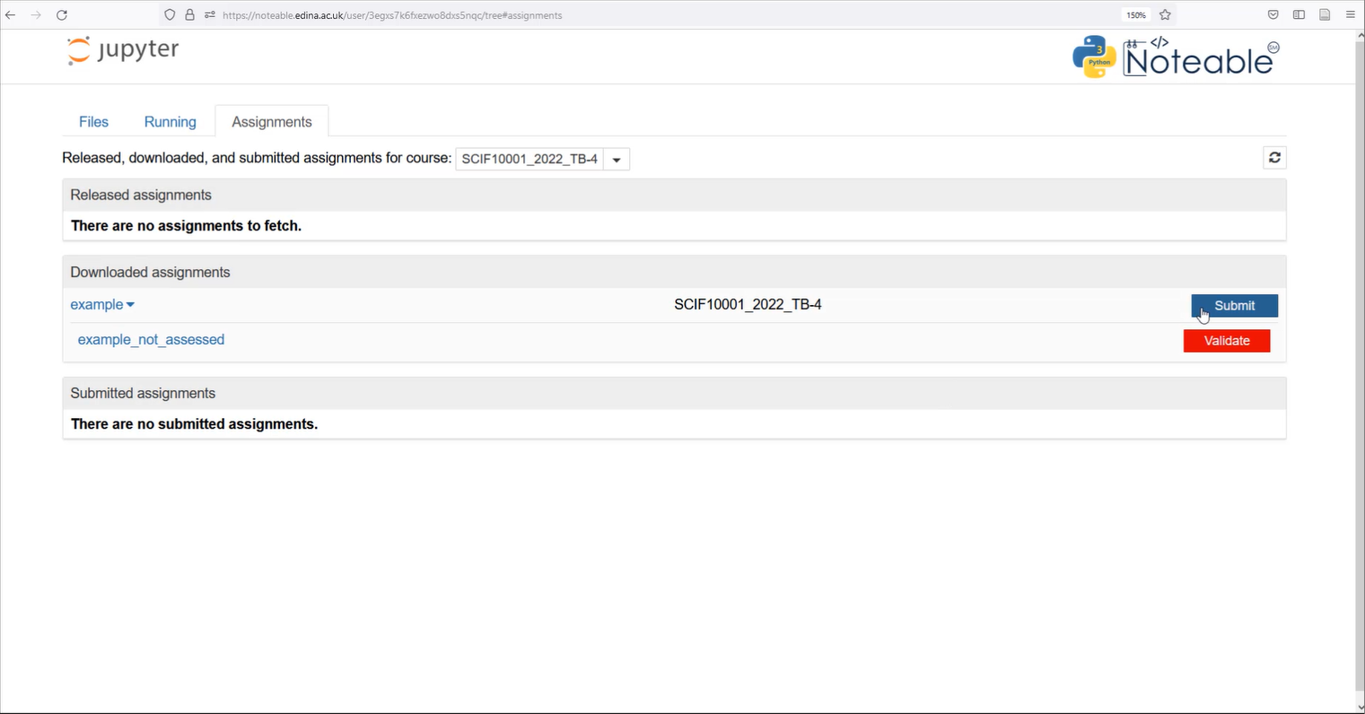
Noteable Submission
Download using the Assignments tab on noteable
Press Fetch and click on the assignment
Fill your answers in and Validate
Slide 3/12

Slide 55
Noteable Submission
Download using the Assignments tab on noteable
Press Fetch and click on the assignment
Fill your answers in and Validate
Once done, save your answers and Submit
Slide 3/12

Slide 56
Noteable Submission
Download using the Assignments tab on noteable
Press Fetch and click on the assignment
Fill your answers in and Validate
Once done, save your answers and Submit
Slide 3/12

Slide 57
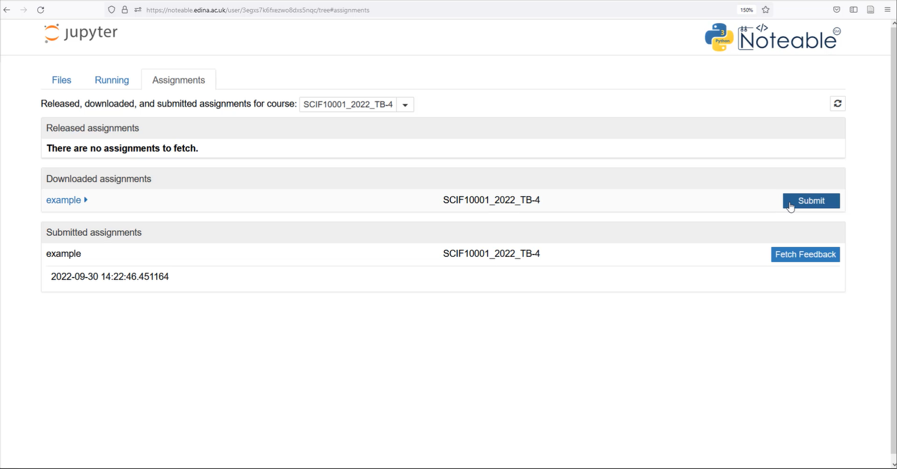
Noteable Submission
Download using the Assignments tab on noteable
Press Fetch and click on the assignment
Fill your answers in and Validate
Once done, save your answers and Submit
Slide 3/12

Slide 58
Noteable Submission
Download using the Assignments tab on noteable
Press Fetch and click on the assignment
Fill your answers in and Validate
Once done, save your answers and Submit
Slide 3/12

Slide 59
Noteable Submission
Download using the Assignments tab on noteable
Press Fetch and click on the assignment
Fill your answers in and Validate
Once done, save your answers and Submit
Slide 3/12

Slide 60
Noteable Submission
Download using the Assignments tab on noteable
Press Fetch and click on the assignment
Fill your answers in and Validate
Once done, save your answers and Submit
Slide 3/12

Slide 61
Noteable Submission
Download using the Assignments tab on noteable
Press Fetch and click on the assignment
Fill your answers in and Validate
Once done, save your answers and Submit
Feedback will be available when you see the (view feedback) option
Slide 3/12

Slide 62
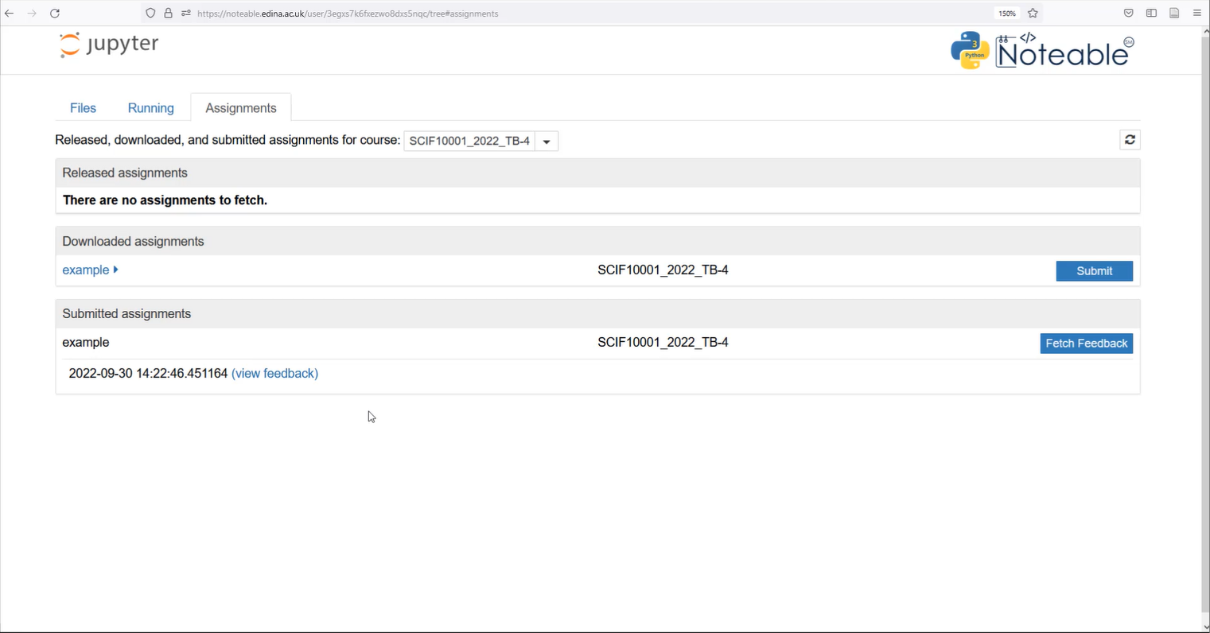
Noteable Submission
Download using the Assignments tab on noteable
Press Fetch and click on the assignment
Fill your answers in and Validate
Once done, save your answers and Submit
Feedback will be available when you see the (view feedback) option
Slide 3/12

Slide 63
Noteable Submission
Download using the Assignments tab on noteable
Press Fetch and click on the assignment
Fill your answers in and Validate
Once done, save your answers and Submit
Feedback will be available when you see the (view feedback) option
Slide 3/12

Slide 64
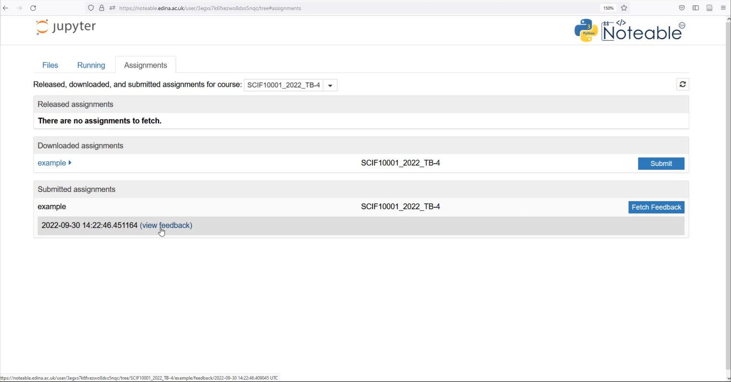
Noteable Submission
Download using the Assignments tab on noteable
Press Fetch and click on the assignment
Fill your answers in and Validate
Once done, save your answers and Submit
Feedback will be available when you see the (view feedback) option
Slide 3/12

Slide 65
Noteable Submission
Download using the Assignments tab on noteable
Press Fetch and click on the assignment
Fill your answers in and Validate
Once done, save your answers and Submit
Feedback will be available when you see the (view feedback) option
Slide 3/12

Slide 66
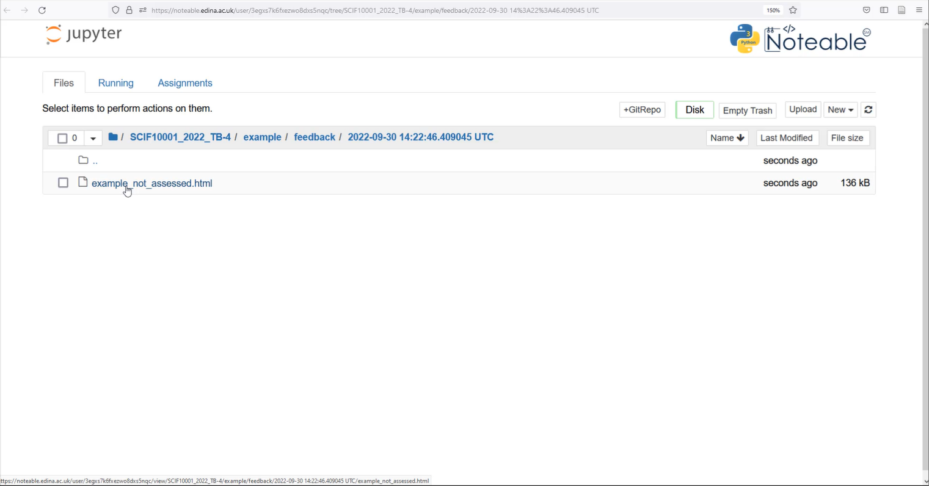
Noteable Submission
Download using the Assignments tab on noteable
Press Fetch and click on the assignment
Fill your answers in and Validate
Once done, save your answers and Submit
Feedback will be available when you see the (view feedback) option
Slide 3/12

Slide 67
Noteable Submission
Download using the Assignments tab on noteable
Press Fetch and click on the assignment
Fill your answers in and Validate
Once done, save your answers and Submit
Feedback will be available when you see the (view feedback) option
Slide 3/12

Slide 68
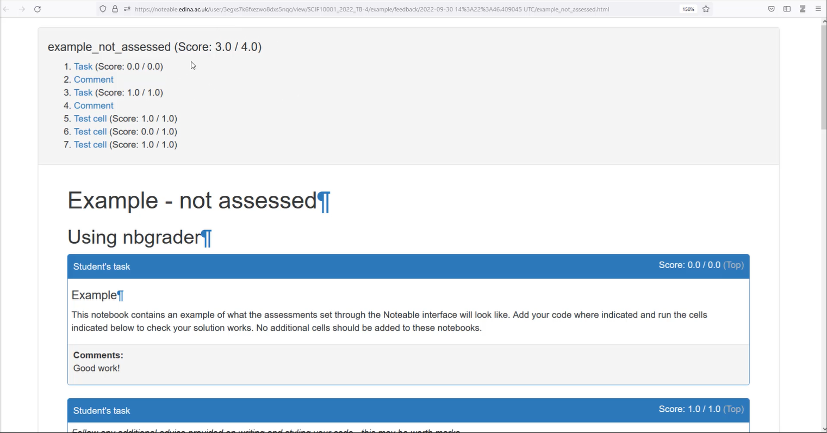
Noteable Submission
Download using the Assignments tab on noteable
Press Fetch and click on the assignment
Fill your answers in and Validate
Once done, save your answers and Submit
Feedback will be available when you see the (view feedback) option
Slide 3/12

Slide 69
Recap: For and While Loops
Slide 4/12

Slide 70
Recap: For and While Loops
Loops can be used to simplify repetitive computation
Slide 4/12

Slide 71
Recap: For and While Loops
Loops can be used to simplify repetitive computation
Last week, we saw an example where we wanted to print the square of each item in this list
Slide 4/12

Slide 72

Recap: For and While Loops
Loops can be used to simplify repetitive computation
Last week, we saw an example where we wanted to print the square of each item in this list
Slide 4/12

Slide 73
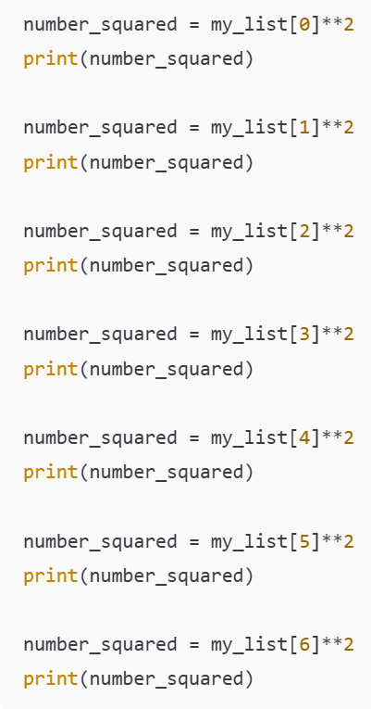

Recap: For and While Loops
Loops can be used to simplify repetitive computation
Last week, we saw an example where we wanted to print the square of each item in this list
Slide 4/12

Slide 74
Recap: For and While Loops
Loops can be used to simplify repetitive computation
Last week, we saw an example where we wanted to print the square of each item in this list
Slide 4/12

Slide 75
Recap: For and While Loops
Loops can be used to simplify repetitive computation
Last week, we saw an example where we wanted to print the square of each item in this list
Slide 4/12

Slide 76
Recap: For and While Loops
Loops can be used to simplify repetitive computation
Last week, we saw an example where we wanted to print the square of each item in this list
Slide 4/12

Slide 77
Recap: For and While Loops
Loops can be used to simplify repetitive computation
Last week, we saw an example where we wanted to print the square of each item in this list
Slide 4/12

Slide 78
Recap: For and While Loops
Loops can be used to simplify repetitive computation
Last week, we saw an example where we wanted to print the square of each item in this list
Slide 4/12

Slide 79
Recap: For and While Loops
Loops can be used to simplify repetitive computation
Last week, we saw an example where we wanted to print the square of each item in this list
Slide 4/12

Slide 80
Recap: For and While Loops
Loops can be used to simplify repetitive computation
Last week, we saw an example where we wanted to print the square of each item in this list
Slide 4/12

Slide 81
Recap: For and While Loops
Loops can be used to simplify repetitive computation
Last week, we saw an example where we wanted to print the square of each item in this list
Instead of writing something like this…
Slide 4/12

Slide 82
Recap: For and While Loops
Loops can be used to simplify repetitive computation
Last week, we saw an example where we wanted to print the square of each item in this list
Instead of writing something like this…
Loops let us do all this automatically!
Slide 4/12

Slide 83
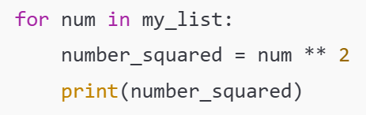
Recap: For and While Loops
Loops can be used to simplify repetitive computation
Last week, we saw an example where we wanted to print the square of each item in this list
Instead of writing something like this…
Loops let us do all this automatically!
Slide 4/12

Slide 84
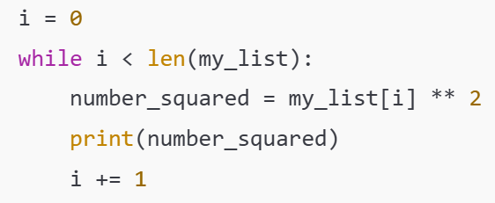
Recap: For and While Loops
Loops can be used to simplify repetitive computation
Last week, we saw an example where we wanted to print the square of each item in this list
Instead of writing something like this…
Loops let us do all this automatically!
Slide 4/12

Slide 85
Recap: For and While Loops
Loops can be used to simplify repetitive computation
Last week, we saw an example where we wanted to print the square of each item in this list
Instead of writing something like this…
Loops let us do all this automatically!
For Loop
Slide 4/12

Slide 86
Recap: For and While Loops
Loops can be used to simplify repetitive computation
Last week, we saw an example where we wanted to print the square of each item in this list
Instead of writing something like this…
Loops let us do all this automatically!
Slide 4/12

Slide 87
Recap: For and While Loops
Loops can be used to simplify repetitive computation
Last week, we saw an example where we wanted to print the square of each item in this list
Instead of writing something like this…
Loops let us do all this automatically!
While Loop
Slide 4/12

Slide 88
Recap: For and While Loops
Loops can be used to simplify repetitive computation
Last week, we saw an example where we wanted to print the square of each item in this list
Instead of writing something like this…
Loops let us do all this automatically!
Slide 4/12

Slide 89
Motivation
Slide 5/12

Slide 90
Motivation
Loops let you simplify code which repeats over and over again.
Slide 5/12

Slide 91
Motivation
Loops let you simplify code which repeats over and over again.
However, sometimes you have code that repeats itself in a less straightforward manner…
Slide 5/12

Slide 92
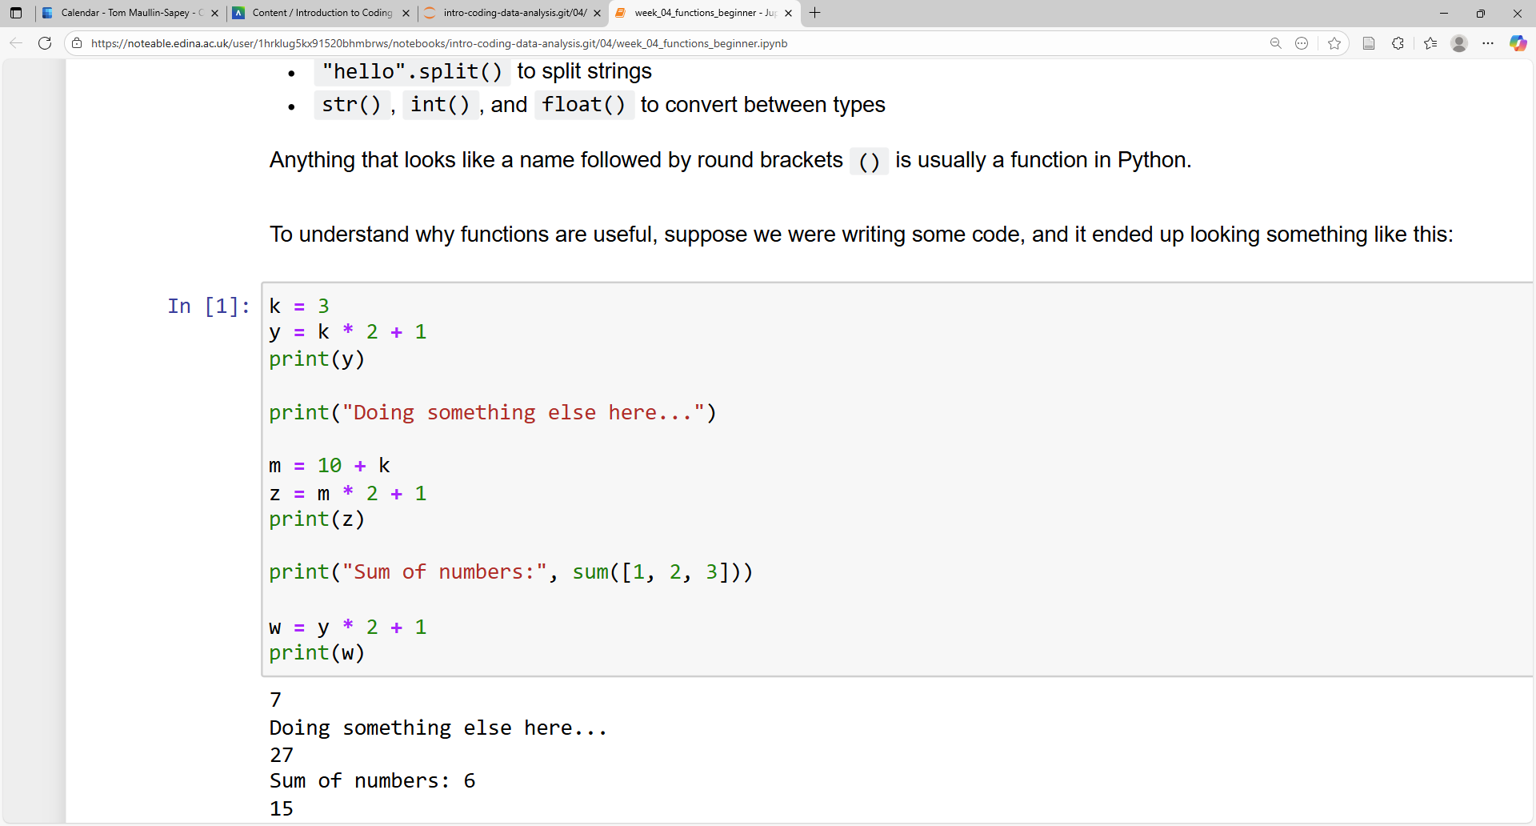
Motivation
Loops let you simplify code which repeats over and over again.
However, sometimes you have code that repeats itself in a less straightforward manner…
Slide 5/12

Slide 93
Motivation
Loops let you simplify code which repeats over and over again.
However, sometimes you have code that repeats itself in a less straightforward manner…
Do some computation
Slide 5/12

Slide 94
Motivation
Loops let you simplify code which repeats over and over again.
However, sometimes you have code that repeats itself in a less straightforward manner…
Do some computation
Slide 5/12

Slide 95
Motivation
Loops let you simplify code which repeats over and over again.
However, sometimes you have code that repeats itself in a less straightforward manner…
Do some computation
Do some other stuff
Slide 5/12

Slide 96
Motivation
Loops let you simplify code which repeats over and over again.
However, sometimes you have code that repeats itself in a less straightforward manner…
Do some computation
Do some other stuff
Slide 5/12

Slide 97
Motivation
Loops let you simplify code which repeats over and over again.
However, sometimes you have code that repeats itself in a less straightforward manner…
Do some computation
Do some other stuff
Do the same computation again
Slide 5/12

Slide 98
Motivation
Loops let you simplify code which repeats over and over again.
However, sometimes you have code that repeats itself in a less straightforward manner…
Do some computation
Do some other stuff
Do the same computation again
Slide 5/12

Slide 99
Motivation
Loops let you simplify code which repeats over and over again.
However, sometimes you have code that repeats itself in a less straightforward manner…
Do some computation
Do some other stuff
Do the same computation again
Slide 5/12

Slide 100
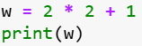
Motivation
Loops let you simplify code which repeats over and over again.
However, sometimes you have code that repeats itself in a less straightforward manner…
Do some computation
Do some other stuff
Do the same computation again
Slide 5/12

Slide 101
Motivation
Loops let you simplify code which repeats over and over again.
However, sometimes you have code that repeats itself in a less straightforward manner…
Do some computation
Do some other stuff
Do the same computation again
Slide 5/12

Slide 102
Motivation
Loops let you simplify code which repeats over and over again.
However, sometimes you have code that repeats itself in a less straightforward manner…
Do some computation
Do some other stuff
Do the same computation again
This is repetitive…
Slide 5/12

Slide 103
Motivation
Loops let you simplify code which repeats over and over again.
However, sometimes you have code that repeats itself in a less straightforward manner…
Do some computation
Do some other stuff
Do the same computation again
Slide 5/12

Slide 104
Motivation
Loops let you simplify code which repeats over and over again.
However, sometimes you have code that repeats itself in a less straightforward manner…
Do some computation
Do some other stuff
Do the same computation again
Slide 5/12

Slide 105
Motivation
Loops let you simplify code which repeats over and over again.
However, sometimes you have code that repeats itself in a less straightforward manner…
Do some computation
Do some other stuff
Do the same computation again
But these lines don’t repeat…
Loops aren’t as useful here
Slide 5/12

Slide 106
Motivation
Loops let you simplify code which repeats over and over again.
However, sometimes you have code that repeats itself in a less straightforward manner…
Do some computation
Do some other stuff
Do the same computation again
But these lines don’t repeat…
Loops aren’t as useful here
Slide 5/12

Slide 107
Motivation
Loops let you simplify code which repeats over and over again.
However, sometimes you have code that repeats itself in a less straightforward manner…
Do some computation
Do some other stuff
Do the same computation again
Slide 5/12

Slide 108
Motivation
Loops let you simplify code which repeats over and over again.
However, sometimes you have code that repeats itself in a less straightforward manner…
Do some computation
Do some other stuff
Do the same computation again
We want a way of doing the same computation whenever we like…
…without repeatedly writing the same code
Slide 5/12

Slide 109
Motivation
Loops let you simplify code which repeats over and over again.
However, sometimes you have code that repeats itself in a less straightforward manner…
Do some computation
Do some other stuff
Do the same computation again
We want a way of doing the same computation whenever we like…
…without repeatedly writing the same code
Slide 5/12

Slide 110
Motivation
Loops let you simplify code which repeats over and over again.
However, sometimes you have code that repeats itself in a less straightforward manner…
Do some computation
Do some other stuff
Do the same computation again
Slide 5/12

Slide 111
Motivation
Loops let you simplify code which repeats over and over again.
However, sometimes you have code that repeats itself in a less straightforward manner…
Do some computation
Do some other stuff
Do the same computation again
In such cases, you might want to use a Function
Slide 5/12

Slide 112
Motivation
Loops let you simplify code which repeats over and over again.
However, sometimes you have code that repeats itself in a less straightforward manner…
Do some computation
Do some other stuff
Do the same computation again
In such cases, you might want to use a Function
You can think of a function as a block of pre-prepared code that you might want to run over and over again.
Slide 5/12

Slide 113
Functions
Slide 6/12

Slide 114
Functions
Let’s look at an example
Slide 6/12

Slide 115
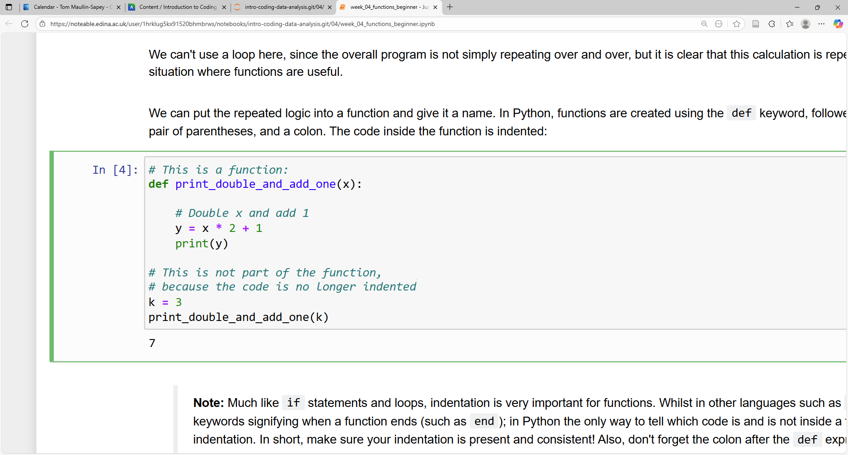
Functions
Let’s look at an example
Slide 6/12

Slide 116
Functions
Let’s look at an example
Slide 6/12

Slide 117
Functions
Let’s look at an example
def keyword
(stands for definition)
Slide 6/12

Slide 118
Functions
Let’s look at an example
def keyword
(stands for definition)
Slide 6/12

Slide 119
Functions
Let’s look at an example
Slide 6/12

Slide 120
Functions
Let’s look at an example
Colon
Slide 6/12

Slide 121
Functions
Let’s look at an example
Slide 6/12

Slide 122
Functions
Let’s look at an example
Name of the function
Slide 6/12

Slide 123
Functions
Let’s look at an example
Slide 6/12

Slide 124
Functions
Let’s look at an example
Input
Slide 6/12

Slide 125
Functions
Let’s look at an example
Slide 6/12

Slide 126
Functions
Let’s look at an example
Body of the function
Slide 6/12

Slide 127
Functions
Let’s look at an example
Slide 6/12

Slide 128
Functions
Let’s look at an example
Indentation
(This tells us what lies inside the function)
Slide 6/12

Slide 129
Functions
Let’s look at an example
Indentation
(This tells us what lies inside the function)
Slide 6/12

Slide 130
Functions
Let’s look at an example
Slide 6/12

Slide 131
Functions
Let’s look at an example
You can think of this as a black box
Slide 6/12

Slide 132
Functions
Let’s look at an example
You can think of this as a black box
Slide 6/12

Slide 133
Functions
Let’s look at an example
You can think of this as a black box
Function
Slide 6/12

Slide 134
Functions
Let’s look at an example
You can think of this as a black box
- Put a variable x in
Function
Slide 6/12

Slide 135
Functions
Let’s look at an example
You can think of this as a black box
- Put a variable x in
Function
x
Slide 6/12

Slide 136
Functions
Let’s look at an example
You can think of this as a black box
- Put a variable x in
- Double x and add 1
Function
x
Slide 6/12

Slide 137
Functions
Let’s look at an example
You can think of this as a black box
- Put a variable x in
- Double x and add 1
- print the result
Function
x
Slide 6/12

Slide 138
Functions
Let’s look at an example
You can think of this as a black box
- Put a variable x in
- Double x and add 1
- print the result
Function
x
Print x*2 + 1
Slide 6/12

Slide 139
Functions
Let’s look at an example
Function
Slide 6/12

Slide 140
Functions
Let’s look at an example
Suppose we ran this:
Function
Slide 6/12

Slide 141

Functions
Let’s look at an example
Suppose we ran this:
Function
Slide 6/12

Slide 142
Functions
Let’s look at an example
Suppose we ran this:
Function
Slide 6/12

Slide 143
Functions
Let’s look at an example
Suppose we ran this:
Function
Slide 6/12

Slide 144
Functions
Let’s look at an example
Suppose we ran this:
This will run the code inside the function, but with x replaced by k.
Function
Slide 6/12

Slide 145
Functions
Let’s look at an example
Suppose we ran this:
This will run the code inside the function, but with x replaced by k.
Function
Slide 6/12

Slide 146
Functions
Let’s look at an example
Suppose we ran this:
This will run the code inside the function, but with x replaced by k.
Function
Slide 6/12

Slide 147
Functions
Let’s look at an example
Suppose we ran this:
This will run the code inside the function, but with x replaced by k.
Function
Slide 6/12

Slide 148
Functions
Let’s look at an example
Suppose we ran this:
This will run the code inside the function, but with x replaced by k. E.g. it will run:
Function
Slide 6/12

Slide 149
Functions
Let’s look at an example
Suppose we ran this:
This will run the code inside the function, but with x replaced by k. E.g. it will run:
Function
Slide 6/12

Slide 150
Functions
Let’s look at an example
Suppose we ran this:
This will run the code inside the function, but with x replaced by k. E.g. it will run: y = k * 2 + 1
Function
Slide 6/12

Slide 151
Functions
Let’s look at an example
Suppose we ran this:
This will run the code inside the function, but with x replaced by k. E.g. it will run: y = k * 2 + 1
Function
Slide 6/12

Slide 152
Functions
Let’s look at an example
Suppose we ran this:
This will run the code inside the function, but with x replaced by k. E.g. it will run: y = k * 2 + 1
Function
Slide 6/12

Slide 153
Functions
Let’s look at an example
Suppose we ran this:
This will run the code inside the function, but with x replaced by k. E.g. it will run: y = k * 2 + 1
print(y)
Function
Slide 6/12

Slide 154
Functions
Let’s look at an example
Suppose we ran this:
This will run the code inside the function, but with x replaced by k. E.g. it will run: y = k * 2 + 1
print(y)
Function
Slide 6/12

Slide 155
Functions
Let’s look at an example
Suppose we ran this:
This will run the code inside the function, but with x replaced by k. E.g. it will run: y = k * 2 + 1
print(y)
Function
k=3
Slide 6/12

Slide 156
Functions
Let’s look at an example
Suppose we ran this:
This will run the code inside the function, but with x replaced by k. E.g. it will run: y = k * 2 + 1
print(y)
Function
k=3
Print 3*2+1 (i.e. 7)
Slide 6/12

Slide 157
Functions
Slide 6/12

Slide 158
Functions
We can use this function to simplify the code from earlier!
Slide 7/12

Slide 159
Functions
We can use this function to simplify the code from earlier!
Slide 7/12

Slide 160
Functions
We can use this function to simplify the code from earlier!
Slide 7/12

Slide 161
Functions
We can use this function to simplify the code from earlier!
Slide 7/12

Slide 162
Functions
We can use this function to simplify the code from earlier!
Slide 7/12

Slide 163
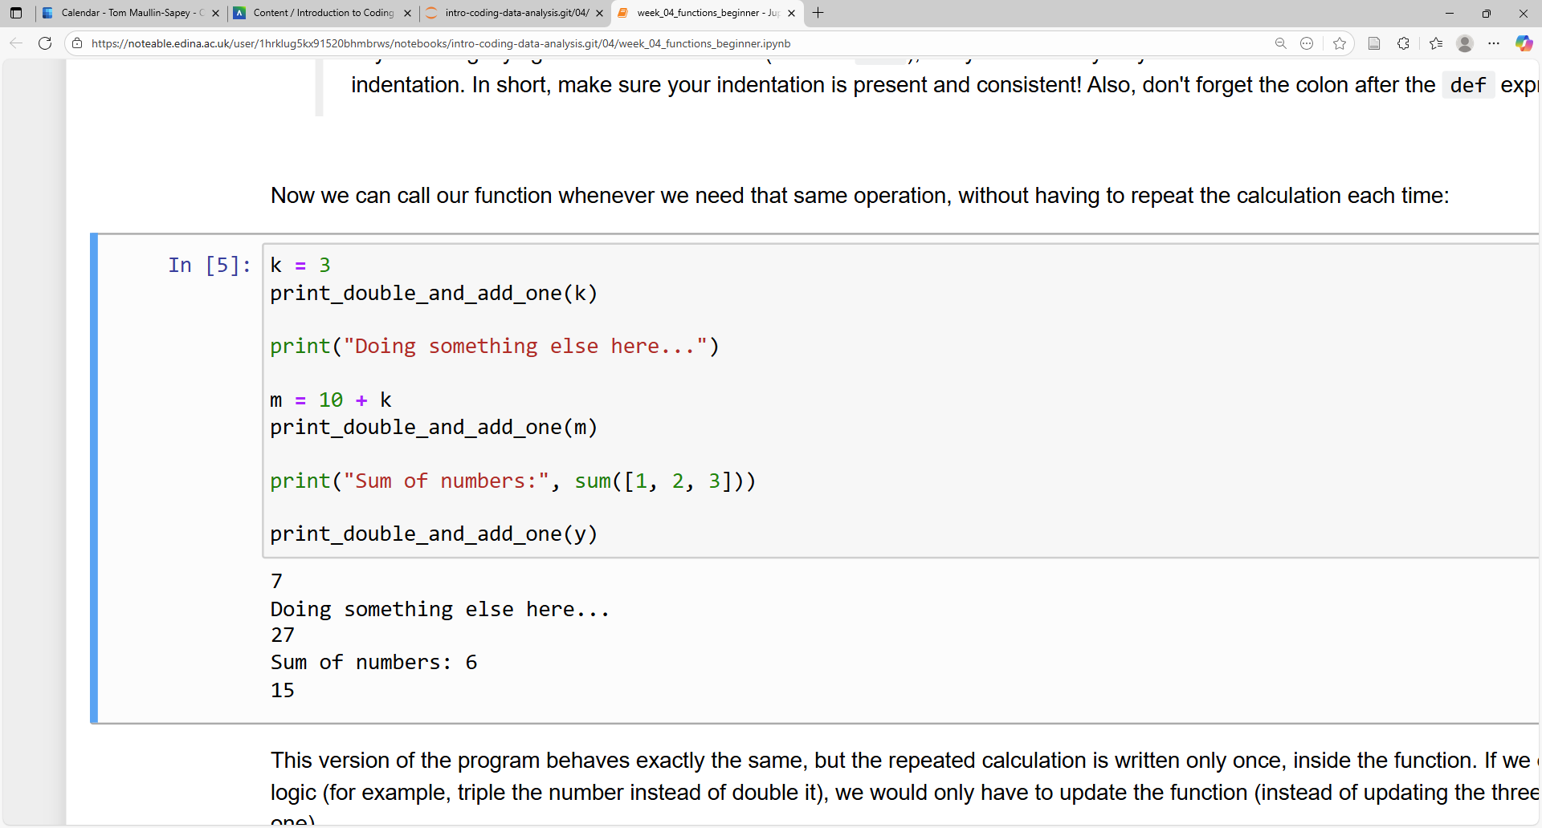
Functions
We can use this function to simplify the code from earlier!
Slide 7/12

Slide 164
Functions
We can use this function to simplify the code from earlier!
Slide 7/12

Slide 165
Functions
We can use this function to simplify the code from earlier!
Slide 7/12

Slide 166
Functions
We can use this function to simplify the code from earlier!
Slide 7/12

Slide 167
Functions
We can use this function to simplify the code from earlier!
Slide 7/12

Slide 168
Functions
We can use this function to simplify the code from earlier!
Slide 7/12

Slide 169
Functions
We can use this function to simplify the code from earlier!
Slide 7/12

Slide 170
Functions
We can use this function to simplify the code from earlier!
Slide 7/12

Slide 171
Functions
We can use this function to simplify the code from earlier!
Slide 7/12

Slide 172
Functions
We can use this function to simplify the code from earlier!
Slide 7/12

Slide 173
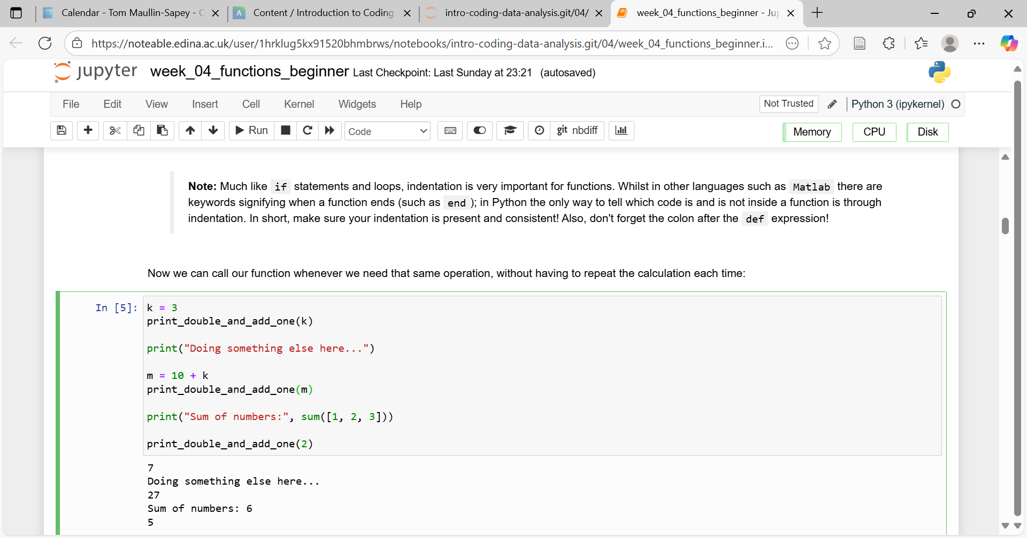
Functions
We can use this function to simplify the code from earlier!
Slide 7/12

Slide 174
Functions
We can use this function to simplify the code from earlier!
Slide 7/12

Slide 175
Functions
We can use this function to simplify the code from earlier!
Slide 7/12

Slide 176
Functions
Slide 8/12

Slide 177
Functions
We’ve reduced this…
Slide 8/12

Slide 178
Functions
We’ve reduced this…
Slide 8/12

Slide 179
Functions
We’ve reduced this…
Slide 8/12

Slide 180
Functions
To this…
We’ve reduced this…
Slide 8/12

Slide 181
Functions
To this…
We’ve reduced this…
Slide 8/12

Slide 182
Functions
To this…
We’ve reduced this…
Slide 8/12

Slide 183
Functions
To this…
We’ve reduced this…
Slide 8/12

Slide 184
Motivation
Slide 9/12

Slide 185
Motivation
Functions are useful for a number of reasons
Slide 9/12

Slide 186
Motivation
Functions are useful for a number of reasons
Reduce repetitiveness in code
Slide 9/12

Slide 187
Motivation
Functions are useful for a number of reasons
Reduce repetitiveness in code
Help organise code
Slide 9/12

Slide 188
Motivation
Functions are useful for a number of reasons
Reduce repetitiveness in code
Help organise code
Easier to edit, maintain and debug
Slide 9/12

Slide 189
Motivation
Functions are useful for a number of reasons
Reduce repetitiveness in code
Help organise code
Easier to edit, maintain and debug
Makes code easier to share
Slide 9/12

Slide 190
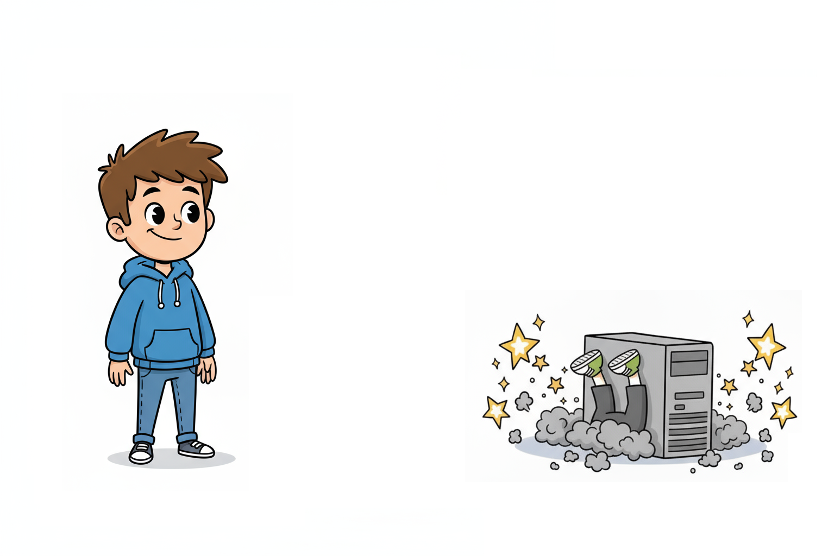
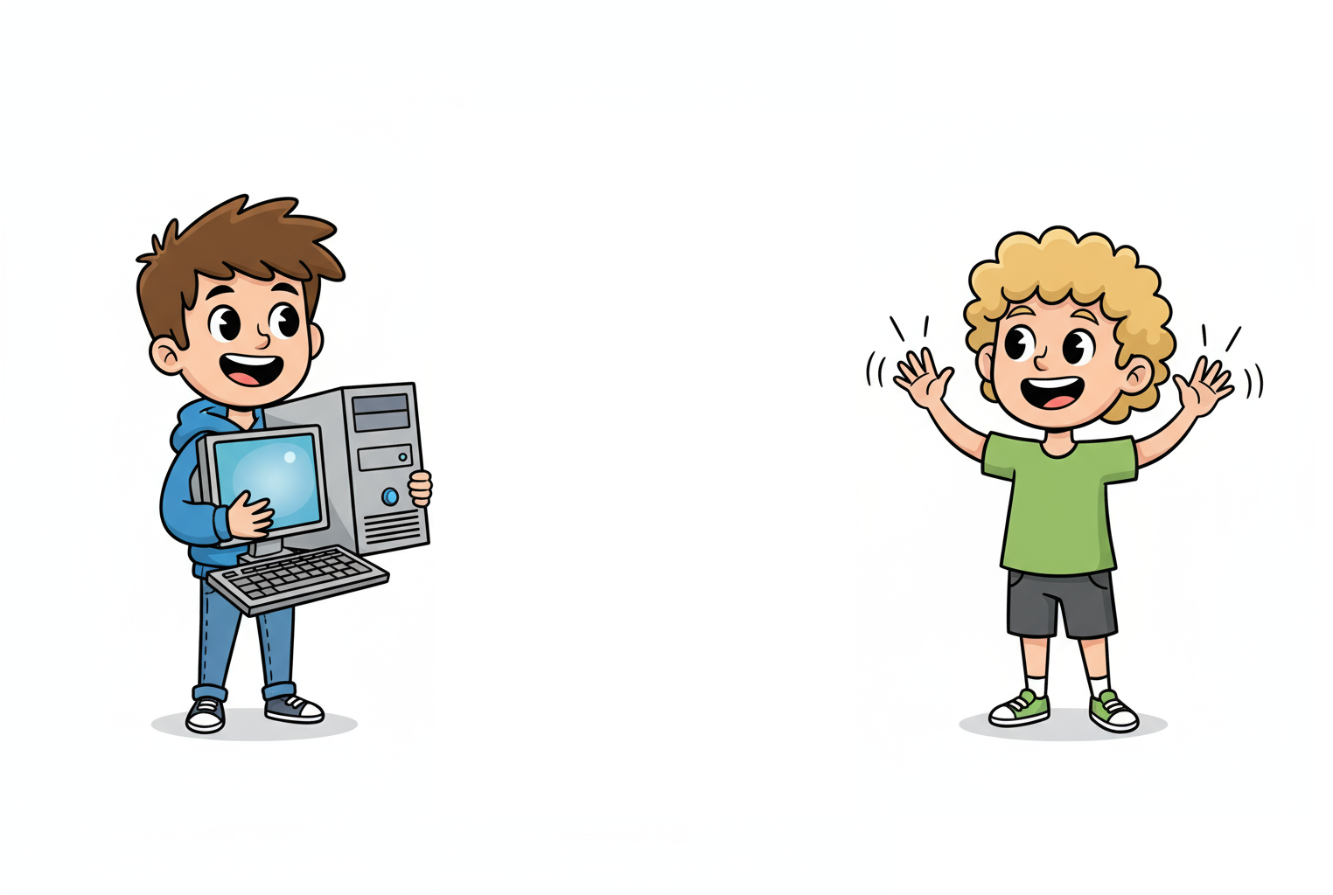
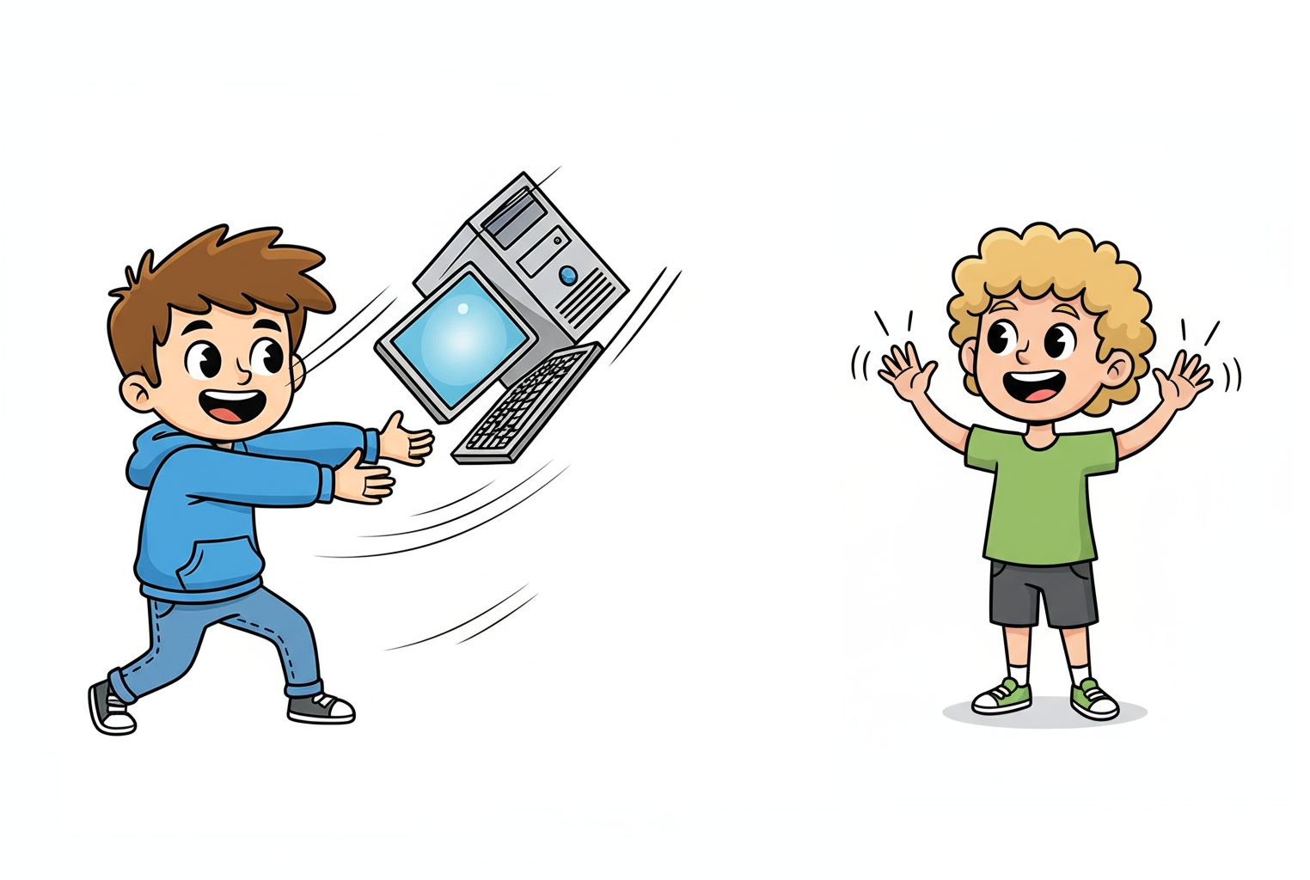
Motivation
Functions are useful for a number of reasons
Reduce repetitiveness in code
Help organise code
Easier to edit, maintain and debug
Makes code easier to share
Slide 9/12

Slide 191
Motivation
Functions are useful for a number of reasons
Reduce repetitiveness in code
Help organise code
Easier to edit, maintain and debug
Makes code easier to share
Hey can you share that bit of code with me?
Slide 9/12

Slide 192
Motivation
Functions are useful for a number of reasons
Reduce repetitiveness in code
Help organise code
Easier to edit, maintain and debug
Makes code easier to share
Slide 9/12

Slide 193
Motivation
Functions are useful for a number of reasons
Reduce repetitiveness in code
Help organise code
Easier to edit, maintain and debug
Makes code easier to share
Sure!
Slide 9/12

Slide 194
Motivation
Functions are useful for a number of reasons
Reduce repetitiveness in code
Help organise code
Easier to edit, maintain and debug
Makes code easier to share
Slide 9/12

Slide 195
Motivation
Functions are useful for a number of reasons
Reduce repetitiveness in code
Help organise code
Easier to edit, maintain and debug
Makes code easier to share
Slide 9/12

Slide 196
Motivation
Functions are useful for a number of reasons
Reduce repetitiveness in code
Help organise code
Easier to edit, maintain and debug
Makes code easier to share
Entire codebase
Slide 9/12

Slide 197
Motivation
Functions are useful for a number of reasons
Reduce repetitiveness in code
Help organise code
Easier to edit, maintain and debug
Makes code easier to share
Slide 9/12

Slide 198
Motivation
Functions are useful for a number of reasons
Reduce repetitiveness in code
Help organise code
Easier to edit, maintain and debug
Makes code easier to share
Improve readability
Slide 9/12

Slide 199
Inputs and Outputs
Slide 10/12

Slide 200
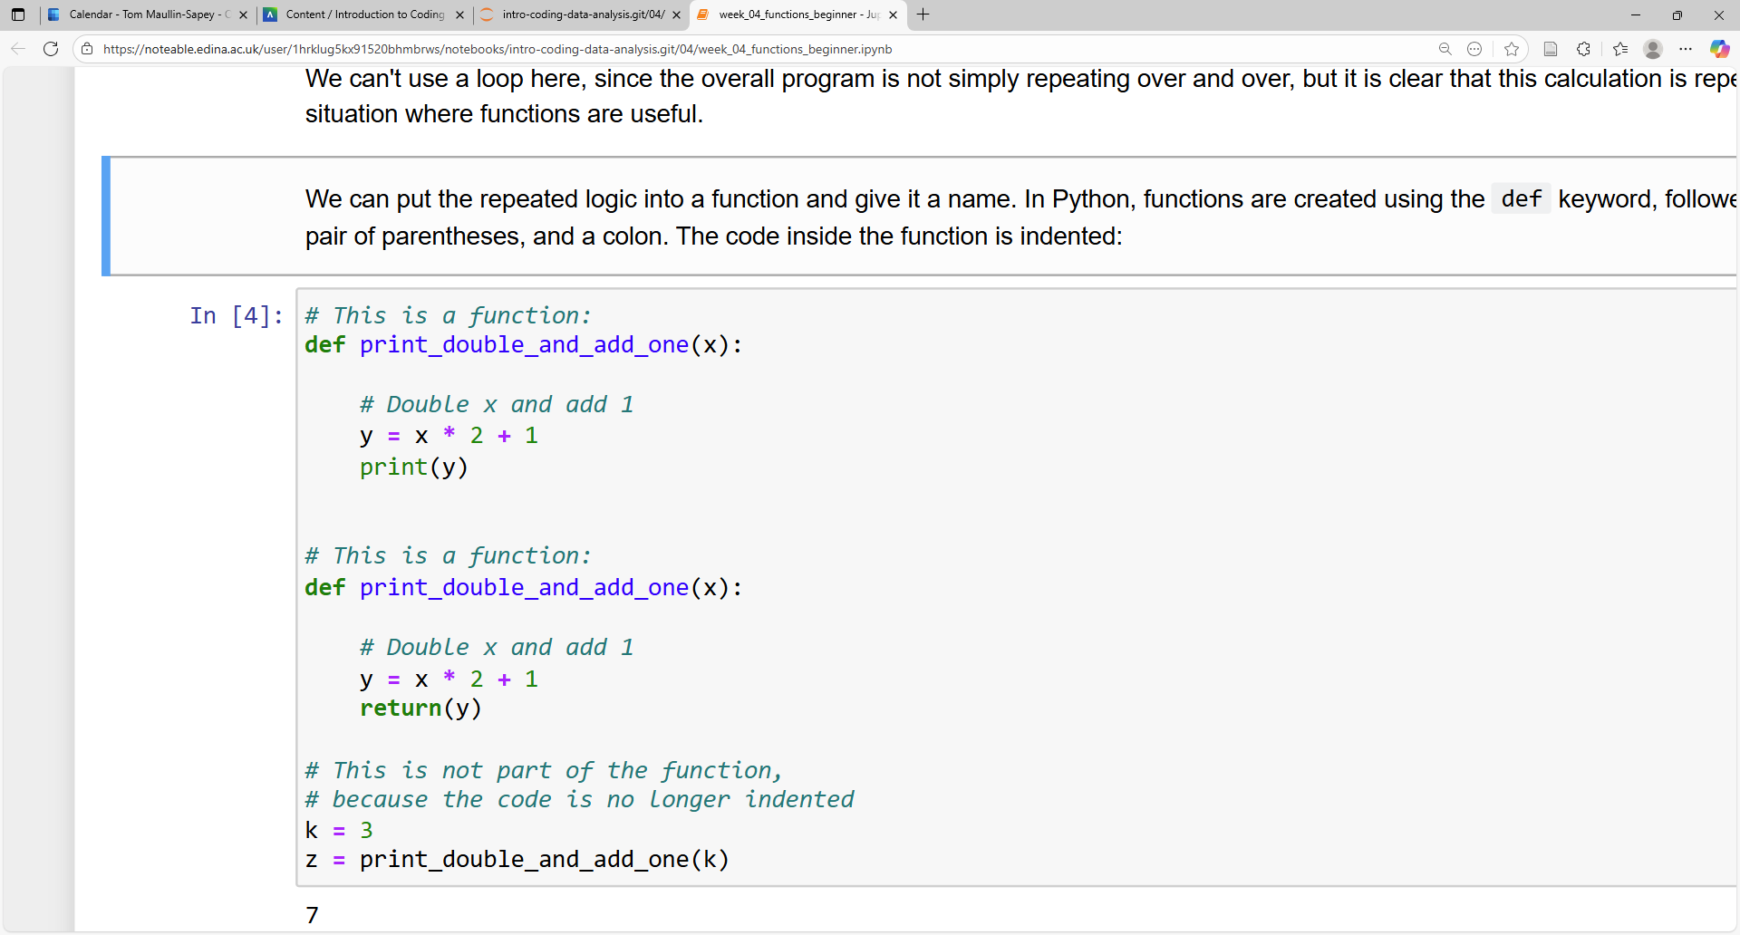
Inputs and Outputs
Slide 10/12

Slide 201
Inputs and Outputs
Instead of printing the result of our function, we can return it
Slide 10/12

Slide 202
Inputs and Outputs
Instead of printing the result of our function, we can return it
Slide 10/12

Slide 203
Inputs and Outputs
Instead of printing the result of our function, we can return it
Slide 10/12

Slide 204
Inputs and Outputs
Instead of printing the result of our function, we can return it
Slide 10/12

Slide 205
Inputs and Outputs
Instead of printing the result of our function, we can return it
Slide 10/12

Slide 206
Inputs and Outputs
Instead of printing the result of our function, we can return it
Slide 10/12

Slide 207
Inputs and Outputs
Instead of printing the result of our function, we can return it
This means that the function will “spit out” the value of y, and we can save it using the = operator
Slide 10/12

Slide 208
Inputs and Outputs
Instead of printing the result of our function, we can return it
This means that the function will “spit out” the value of y, and we can save it using the = operator
Slide 10/12

Slide 209
Inputs and Outputs
Instead of printing the result of our function, we can return it
This means that the function will “spit out” the value of y, and we can save it using the = operator
Slide 10/12

Slide 210
Inputs and Outputs
Instead of printing the result of our function, we can return it
This means that the function will “spit out” the value of y, and we can save it using the = operator
Slide 10/12

Slide 211
Inputs and Outputs
Instead of printing the result of our function, we can return it
This means that the function will “spit out” the value of y, and we can save it using the = operator
This will save the result as z
Slide 10/12

Slide 212
Inputs and Outputs
Instead of printing the result of our function, we can return it
This means that the function will “spit out” the value of y, and we can save it using the = operator
Slide 10/12

Slide 213
Inputs and Outputs
Instead of printing the result of our function, we can return it
This means that the function will “spit out” the value of y, and we can save it using the = operator
For this example:
Slide 10/12

Slide 214
Inputs and Outputs
Instead of printing the result of our function, we can return it
This means that the function will “spit out” the value of y, and we can save it using the = operator
For this example:
x is an input: A variable specified in the function definition
Slide 10/12

Slide 215
Inputs and Outputs
Instead of printing the result of our function, we can return it
This means that the function will “spit out” the value of y, and we can save it using the = operator
For this example:
x is an input: A variable specified in the function definition
Slide 10/12

Slide 216
Inputs and Outputs
Instead of printing the result of our function, we can return it
This means that the function will “spit out” the value of y, and we can save it using the = operator
For this example:
x is an input: A variable specified in the function definition
Slide 10/12

Slide 217
Inputs and Outputs
Instead of printing the result of our function, we can return it
This means that the function will “spit out” the value of y, and we can save it using the = operator
For this example:
x is an input: A variable specified in the function definition
Slide 10/12

Slide 218
Inputs and Outputs
Instead of printing the result of our function, we can return it
This means that the function will “spit out” the value of y, and we can save it using the = operator
For this example:
x is an input: A variable specified in the function definition
y is an output: A variable given back using the return statement
Slide 10/12

Slide 219
Inputs and Outputs
Instead of printing the result of our function, we can return it
This means that the function will “spit out” the value of y, and we can save it using the = operator
For this example:
x is an input: A variable specified in the function definition
y is an output: A variable given back using the return statement
Slide 10/12

Slide 220
Inputs and Outputs
Instead of printing the result of our function, we can return it
This means that the function will “spit out” the value of y, and we can save it using the = operator
For this example:
x is an input: A variable specified in the function definition
y is an output: A variable given back using the return statement
Slide 10/12

Slide 221
Inputs and Outputs
Instead of printing the result of our function, we can return it
This means that the function will “spit out” the value of y, and we can save it using the = operator
For this example:
x is an input: A variable specified in the function definition
y is an output: A variable given back using the return statement
Slide 10/12

Slide 222
Inputs and Outputs
Instead of printing the result of our function, we can return it
This means that the function will “spit out” the value of y, and we can save it using the = operator
For this example:
x is an input: A variable specified in the function definition
y is an output: A variable given back using the return statement
You can have multiple inputs and outputs
Slide 10/12

Slide 223
Inputs and Outputs
Instead of printing the result of our function, we can return it
This means that the function will “spit out” the value of y, and we can save it using the = operator
For this example:
x is an input: A variable specified in the function definition
y is an output: A variable given back using the return statement
You can have multiple inputs and outputs
More on this in the practical…
Slide 10/12

Slide 224
Inputs and Outputs
Instead of printing the result of our function, we can return it
This means that the function will “spit out” the value of y, and we can save it using the = operator
For this example:
x is an input: A variable specified in the function definition
y is an output: A variable given back using the return statement
You can have multiple inputs and outputs
Slide 10/12

Slide 225
Practical
Slide 11/12

Slide 226
Practical
We now move over to Python
Slide 11/12

Slide 227
Practical
We now move over to Python
Please open `week_04_home.ipynb`
Slide 11/12

Slide 228
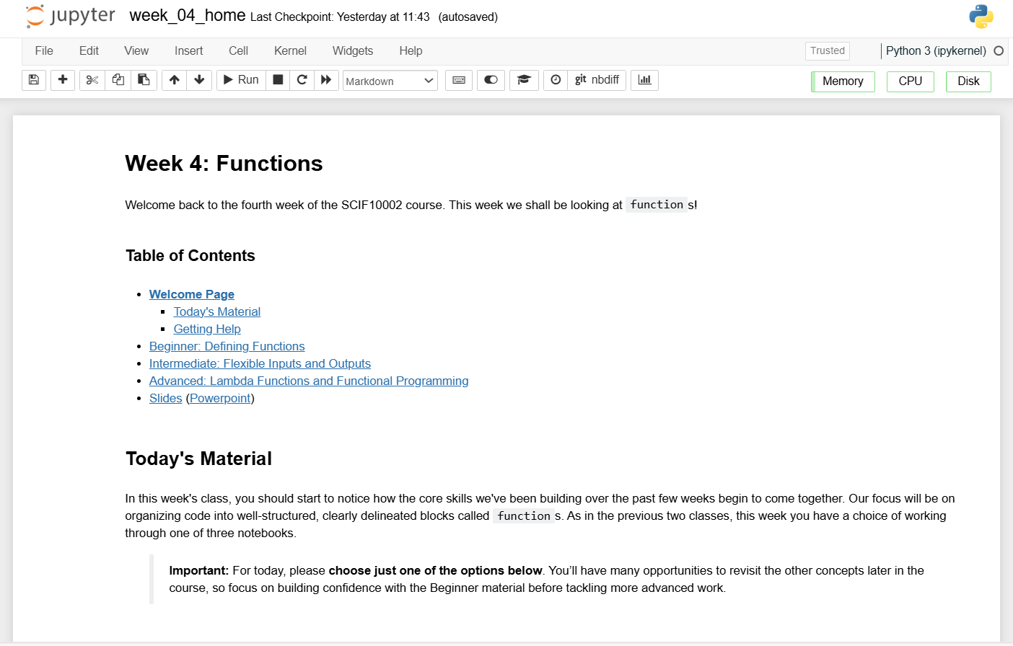
Practical
We now move over to Python
Please open `week_04_home.ipynb`
Slide 11/12

Slide 229
Practical
We now move over to Python
Please open `week_04_home.ipynb`
For the rest of today, you must work through a Python notebook
Slide 11/12

Slide 230
Practical
We now move over to Python
Please open `week_04_home.ipynb`
For the rest of today, you must work through a Python notebook
You have a choice of one of three options
Slide 11/12

Slide 231
Practical
We now move over to Python
Please open `week_04_home.ipynb`
For the rest of today, you must work through a Python notebook
You have a choice of one of three options
Option 1: Beginner – Defining Functions
Slide 11/12

Slide 232
Practical
We now move over to Python
Please open `week_04_home.ipynb`
For the rest of today, you must work through a Python notebook
You have a choice of one of three options
Option 1: Beginner – Defining Functions
Option 2: Intermediate – Flexible Inputs and Outputs
Slide 11/12

Slide 233
Practical
We now move over to Python
Please open `week_04_home.ipynb`
For the rest of today, you must work through a Python notebook
You have a choice of one of three options
Option 1: Beginner – Defining Functions
Option 2: Intermediate – Flexible Inputs and Outputs
Option 3: Advanced – Lambda Functions and Functional Programming
Slide 11/12

Slide 234
Practical
We now move over to Python
Please open `week_04_home.ipynb`
For the rest of today, you must work through a Python notebook
You have a choice of one of three options
Option 1: Beginner – Defining Functions
Option 2: Intermediate – Flexible Inputs and Outputs
Option 3: Advanced – Lambda Functions and Functional Programming
Do this if you are relatively new to Python
Slide 11/12

Slide 235
Practical
We now move over to Python
Please open `week_04_home.ipynb`
For the rest of today, you must work through a Python notebook
You have a choice of one of three options
Option 1: Beginner – Defining Functions
Option 2: Intermediate – Flexible Inputs and Outputs
Option 3: Advanced – Lambda Functions and Functional Programming
Slide 11/12

Slide 236
Practical
We now move over to Python
Please open `week_04_home.ipynb`
For the rest of today, you must work through a Python notebook
You have a choice of one of three options
Option 1: Beginner – Defining Functions
Option 2: Intermediate – Flexible Inputs and Outputs
Option 3: Advanced – Lambda Functions and Functional Programming
Do this if you have some prior experience writing functions in Python
Slide 11/12

Slide 237
Practical
We now move over to Python
Please open `week_04_home.ipynb`
For the rest of today, you must work through a Python notebook
You have a choice of one of three options
Option 1: Beginner – Defining Functions
Option 2: Intermediate – Flexible Inputs and Outputs
Option 3: Advanced – Lambda Functions and Functional Programming
Slide 11/12

Slide 238
Practical
We now move over to Python
Please open `week_04_home.ipynb`
For the rest of today, you must work through a Python notebook
You have a choice of one of three options
Option 1: Beginner – Defining Functions
Option 2: Intermediate – Flexible Inputs and Outputs
Option 3: Advanced – Lambda Functions and Functional Programming
Do this if you are already a pro at Python
Slide 11/12

Slide 239
Practical
We now move over to Python
Please open `week_04_home.ipynb`
For the rest of today, you must work through a Python notebook
You have a choice of one of three options
Option 1: Beginner – Defining Functions
Option 2: Intermediate – Flexible Inputs and Outputs
Option 3: Advanced – Lambda Functions and Functional Programming
Slide 11/12

Slide 240
Next Time
Lecture 4: Functions
Recap: For and While Loops
Functions
Inputs and Outputs
Practical
Lecture 5: Consolidation Week
Recap: The course so far
Recap: Why learn to code?
Tackling Problems: A Worked Example
What’s next?
Practical
Slide 12/12

