Slide 1
Lecture 3:
Loops
SCIF10002 – Introduction to Coding and Data
Tom Maullin-Sapey
9th October 2025
Slide 0/9

Slide 2
Today’s Lecture
Slide 1/9

Slide 3
Today’s Lecture
Lecture 3: Loops
Slide 1/9

Slide 4
Today’s Lecture
Lecture 3: Loops
Recap: Accessing Noteable
Slide 1/9

Slide 5
Today’s Lecture
Lecture 3: Loops
Recap: Accessing Noteable
Recap: If Statements
Slide 1/9

Slide 6
Today’s Lecture
Lecture 3: Loops
Recap: Accessing Noteable
Recap: If Statements
For Loops
Slide 1/9

Slide 7
Today’s Lecture
Lecture 3: Loops
Recap: Accessing Noteable
Recap: If Statements
For Loops
While Loops
Slide 1/9

Slide 8
Today’s Lecture
Lecture 3: Loops
Recap: Accessing Noteable
Recap: If Statements
For Loops
While Loops
Practical
Slide 1/9

Slide 9
Today’s Lecture
Lecture 3: Loops
Recap: Accessing Noteable
Recap: If Statements
For Loops
While Loops
Practical
Lecture 4: Functions
Recap: For and While Loops
Functions
Inputs and Outputs
Practical
Slide 1/9

Slide 10
Recap: Accessing Noteable
Slide 2/9

Slide 11
Recap: Accessing Noteable
Open Blackboard
Slide 2/9

Slide 12
Recap: Accessing Noteable
Open Blackboard
Go to “Introduction to Coding and Data Analysis for Scientists 2025”
Slide 2/9

Slide 13
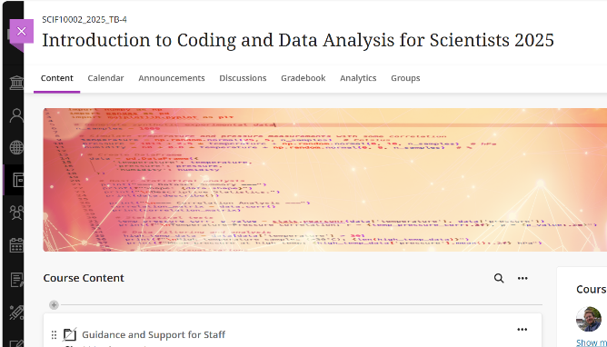
Recap: Accessing Noteable
Open Blackboard
Go to “Introduction to Coding and Data Analysis for Scientists 2025”
Slide 2/9

Slide 14
Recap: Accessing Noteable
Open Blackboard
Go to “Introduction to Coding and Data Analysis for Scientists 2025”
Click “Unit Information and Resources”
Slide 2/9

Slide 15
Recap: Accessing Noteable
Open Blackboard
Go to “Introduction to Coding and Data Analysis for Scientists 2025”
Click “Unit Information and Resources”
Open Noteable
Slide 2/9

Slide 16
Recap: Accessing Noteable
Open Blackboard
Go to “Introduction to Coding and Data Analysis for Scientists 2025”
Click “Unit Information and Resources”
Open Noteable
Make sure “Jupyter Classic (Legacy)” is selected.
Slide 2/9

Slide 17
Recap: Accessing Noteable
Open Blackboard
Go to “Introduction to Coding and Data Analysis for Scientists 2025”
Click “Unit Information and Resources”
Open Noteable
Make sure “Jupyter Classic (Legacy)” is selected.
Click Start
Slide 2/9

Slide 18
Recap: Accessing Noteable
Open Blackboard
Go to “Introduction to Coding and Data Analysis for Scientists 2025”
Click “Unit Information and Resources”
Open Noteable
Make sure “Jupyter Classic (Legacy)” is selected.
Click Start
Click “+GitRepo”
Slide 2/9

Slide 19
Recap: Accessing Noteable
Open Blackboard
Go to “Introduction to Coding and Data Analysis for Scientists 2025”
Click “Unit Information and Resources”
Open Noteable
Make sure “Jupyter Classic (Legacy)” is selected.
Click Start
Click “+GitRepo”
Slide 2/9

Slide 20
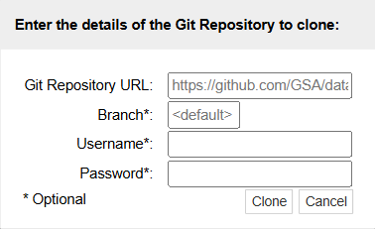
Recap: Accessing Noteable
Open Blackboard
Go to “Introduction to Coding and Data Analysis for Scientists 2025”
Click “Unit Information and Resources”
Open Noteable
Make sure “Jupyter Classic (Legacy)” is selected.
Click Start
Click “+GitRepo”
Slide 2/9

Slide 21
Recap: Accessing Noteable
Open Blackboard
Go to “Introduction to Coding and Data Analysis for Scientists 2025”
Click “Unit Information and Resources”
Open Noteable
Make sure “Jupyter Classic (Legacy)” is selected.
Click Start
Click “+GitRepo”
Paste into Git Repository URL: git@github.com:TomMaullin/SCIF10002-2025.git
Slide 2/9

Slide 22
Recap: Accessing Noteable
Open Blackboard
Go to “Introduction to Coding and Data Analysis for Scientists 2025”
Click “Unit Information and Resources”
Open Noteable
Make sure “Jupyter Classic (Legacy)” is selected.
Click Start
Click “+GitRepo”
Paste into Git Repository URL: git@github.com:TomMaullin/SCIF10002-2025.git
Press clone
Slide 2/9

Slide 23
Recap: If Statements
Slide 3/9

Slide 24
Recap: If Statements
Last week, we looked at the if statement
Slide 3/9

Slide 25
Recap: If Statements
Last week, we looked at the if statement
if statements allow us run code only when a specific condition is true
Slide 3/9

Slide 26
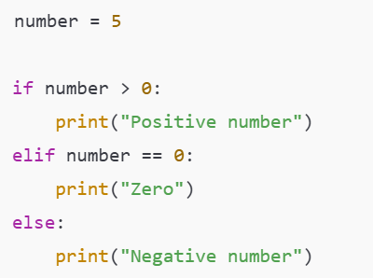

Recap: If Statements
Last week, we looked at the if statement
if statements allow us run code only when a specific condition is true
Slide 3/9

Slide 27
Recap: If Statements
Last week, we looked at the if statement
if statements allow us run code only when a specific condition is true
Slide 3/9

Slide 28
Recap: If Statements
Last week, we looked at the if statement
if statements allow us run code only when a specific condition is true
Slide 3/9

Slide 29
Recap: If Statements
Last week, we looked at the if statement
if statements allow us run code only when a specific condition is true
Slide 3/9

Slide 30
Recap: If Statements
Last week, we looked at the if statement
if statements allow us run code only when a specific condition is true
We can add elif and else statements to give us finer control over when code is executed
Slide 3/9

Slide 31
Recap: If Statements
Last week, we looked at the if statement
if statements allow us run code only when a specific condition is true
We can add elif and else statements to give us finer control over when code is executed
An elif runs if it’s Boolean is True and all previous clauses (ifs and elifs) did not execute
Slide 3/9

Slide 32
Recap: If Statements
Last week, we looked at the if statement
if statements allow us run code only when a specific condition is true
We can add elif and else statements to give us finer control over when code is executed
An elif runs if it’s Boolean is True and all previous clauses (ifs and elifs) did not execute
Slide 3/9

Slide 33
Recap: If Statements
Last week, we looked at the if statement
if statements allow us run code only when a specific condition is true
We can add elif and else statements to give us finer control over when code is executed
An elif runs if it’s Boolean is True and all previous clauses (ifs and elifs) did not execute
Slide 3/9

Slide 34
Recap: If Statements
Last week, we looked at the if statement
if statements allow us run code only when a specific condition is true
We can add elif and else statements to give us finer control over when code is executed
An elif runs if it’s Boolean is True and all previous clauses (ifs and elifs) did not execute
An else runs if all other clauses did not execute
Slide 3/9

Slide 35
Recap: If Statements
Last week, we looked at the if statement
if statements allow us run code only when a specific condition is true
We can add elif and else statements to give us finer control over when code is executed
An elif runs if it’s Boolean is True and all previous clauses (ifs and elifs) did not execute
An else runs if all other clauses did not execute
Slide 3/9

Slide 36
Recap: If Statements
Last week, we looked at the if statement
if statements allow us run code only when a specific condition is true
We can add elif and else statements to give us finer control over when code is executed
An elif runs if it’s Boolean is True and all previous clauses (ifs and elifs) did not execute
An else runs if all other clauses did not execute
Slide 3/9

Slide 37
Recap: If Statements
Last week, we looked at the if statement
if statements allow us run code only when a specific condition is true
We can add elif and else statements to give us finer control over when code is executed
An elif runs if it’s Boolean is True and all previous clauses (ifs and elifs) did not execute
An else runs if all other clauses did not execute
Today, we will look at another feature of Python that gives us finer control over our code - loops
Slide 3/9

Slide 38
Motivation
Slide 4/9

Slide 39
Motivation
Suppose we want to do a very repetitive computation
Slide 4/9

Slide 40
Motivation
Suppose we want to do a very repetitive computation
For instance, suppose we want to print the square of each item in this list
Slide 4/9

Slide 41

Motivation
Suppose we want to do a very repetitive computation
For instance, suppose we want to print the square of each item in this list
Slide 4/9

Slide 42
Motivation
Suppose we want to do a very repetitive computation
For instance, suppose we want to print the square of each item in this list
We could just write something like this…
Slide 4/9

Slide 43
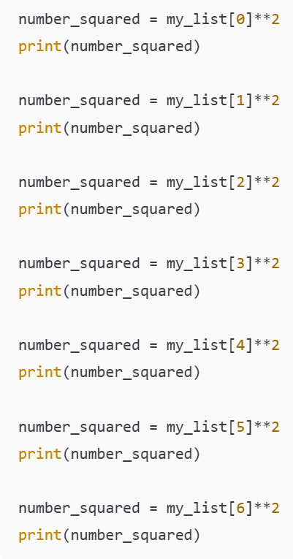
Motivation
Suppose we want to do a very repetitive computation
For instance, suppose we want to print the square of each item in this list
We could just write something like this…
Slide 4/9

Slide 44
Motivation
Suppose we want to do a very repetitive computation
For instance, suppose we want to print the square of each item in this list
We could just write something like this…
Slide 4/9

Slide 45
Motivation
Suppose we want to do a very repetitive computation
For instance, suppose we want to print the square of each item in this list
We could just write something like this…
Slide 4/9

Slide 46
Motivation
Suppose we want to do a very repetitive computation
For instance, suppose we want to print the square of each item in this list
We could just write something like this…
Slide 4/9

Slide 47
Motivation
Suppose we want to do a very repetitive computation
For instance, suppose we want to print the square of each item in this list
We could just write something like this…
Slide 4/9

Slide 48
Motivation
Suppose we want to do a very repetitive computation
For instance, suppose we want to print the square of each item in this list
We could just write something like this…
Slide 4/9

Slide 49
Motivation
Suppose we want to do a very repetitive computation
For instance, suppose we want to print the square of each item in this list
We could just write something like this…
Slide 4/9

Slide 50
Motivation
Suppose we want to do a very repetitive computation
For instance, suppose we want to print the square of each item in this list
We could just write something like this…
Slide 4/9

Slide 51
Motivation
Suppose we want to do a very repetitive computation
For instance, suppose we want to print the square of each item in this list
We could just write something like this…
But it would be nice to be able to do this automatically!
Slide 4/9

Slide 52
Motivation
Suppose we want to do a very repetitive computation
For instance, suppose we want to print the square of each item in this list
We could just write something like this…
But it would be nice to be able to do this automatically!
This is what loops do!
Slide 4/9

Slide 53
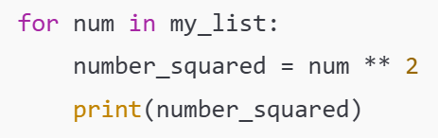
Motivation
Suppose we want to do a very repetitive computation
For instance, suppose we want to print the square of each item in this list
We could just write something like this…
But it would be nice to be able to do this automatically!
This is what loops do!
Slide 4/9

Slide 54
Motivation
Suppose we want to do a very repetitive computation
For instance, suppose we want to print the square of each item in this list
We could just write something like this…
But it would be nice to be able to do this automatically!
This is what loops do!
For Loop
Slide 4/9

Slide 55
Motivation
Suppose we want to do a very repetitive computation
For instance, suppose we want to print the square of each item in this list
We could just write something like this…
But it would be nice to be able to do this automatically!
This is what loops do!
Slide 4/9

Slide 56
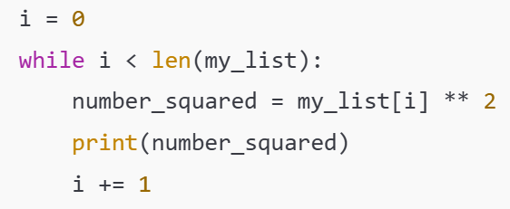
Motivation
Suppose we want to do a very repetitive computation
For instance, suppose we want to print the square of each item in this list
We could just write something like this…
But it would be nice to be able to do this automatically!
This is what loops do!
Slide 4/9

Slide 57
Motivation
Suppose we want to do a very repetitive computation
For instance, suppose we want to print the square of each item in this list
We could just write something like this…
But it would be nice to be able to do this automatically!
This is what loops do!
While Loop
Slide 4/9

Slide 58
Motivation
Suppose we want to do a very repetitive computation
For instance, suppose we want to print the square of each item in this list
We could just write something like this…
But it would be nice to be able to do this automatically!
This is what loops do!
Slide 4/9

Slide 59
Motivation
Suppose we want to do a very repetitive computation
For instance, suppose we want to print the square of each item in this list
We could just write something like this…
But it would be nice to be able to do this automatically!
This is what loops do!
Slide 4/9

Slide 60
Motivation
Suppose we want to do a very repetitive computation
For instance, suppose we want to print the square of each item in this list
We could just write something like this…
But it would be nice to be able to do this automatically!
This is what loops do!
Much shorter code!
Slide 4/9

Slide 61
Motivation
Suppose we want to do a very repetitive computation
For instance, suppose we want to print the square of each item in this list
We could just write something like this…
But it would be nice to be able to do this automatically!
This is what loops do!
Slide 4/9

Slide 62
Iterable Objects
Slide 5/9

Slide 63
Iterable Objects
An iterable object is an object which contains lots of elements that we could list one by one
Slide 5/9

Slide 64
Iterable Objects
An iterable object is an object which contains lots of elements that we could list one by one
We’ve already seen an example – the list
Slide 5/9

Slide 65
Iterable Objects
An iterable object is an object which contains lots of elements that we could list one by one
We’ve already seen an example – the list
Other examples include:
Slide 5/9

Slide 66
Iterable Objects
An iterable object is an object which contains lots of elements that we could list one by one
We’ve already seen an example – the list
Other examples include:
Tuples – like lists but use round brackets and can’t be changed
Slide 5/9

Slide 67

Iterable Objects
An iterable object is an object which contains lots of elements that we could list one by one
We’ve already seen an example – the list
Other examples include:
Tuples – like lists but use round brackets and can’t be changed
Slide 5/9

Slide 68
Iterable Objects
An iterable object is an object which contains lots of elements that we could list one by one
We’ve already seen an example – the list
Other examples include:
Tuples – like lists but use round brackets and can’t be changed
Dictionaries – records “keys” and “values” so that we can look up data using labels of our choosing
Slide 5/9

Slide 69

Iterable Objects
An iterable object is an object which contains lots of elements that we could list one by one
We’ve already seen an example – the list
Other examples include:
Tuples – like lists but use round brackets and can’t be changed
Dictionaries – records “keys” and “values” so that we can look up data using labels of our choosing
Slide 5/9

Slide 70
Iterable Objects
An iterable object is an object which contains lots of elements that we could list one by one
We’ve already seen an example – the list
Other examples include:
Tuples – like lists but use round brackets and can’t be changed
Dictionaries – records “keys” and “values” so that we can look up data using labels of our choosing
Slide 5/9

Slide 71
Iterable Objects
An iterable object is an object which contains lots of elements that we could list one by one
We’ve already seen an example – the list
Other examples include:
Tuples – like lists but use round brackets and can’t be changed
Dictionaries – records “keys” and “values” so that we can look up data using labels of our choosing
A range object – a python object that represents a sequence of numbers, saved in a useful, memory-efficient way
Slide 5/9

Slide 72

Iterable Objects
An iterable object is an object which contains lots of elements that we could list one by one
We’ve already seen an example – the list
Other examples include:
Tuples – like lists but use round brackets and can’t be changed
Dictionaries – records “keys” and “values” so that we can look up data using labels of our choosing
A range object – a python object that represents a sequence of numbers, saved in a useful, memory-efficient way
Slide 5/9

Slide 73
Iterable Objects
An iterable object is an object which contains lots of elements that we could list one by one
We’ve already seen an example – the list
Other examples include:
Tuples – like lists but use round brackets and can’t be changed
Dictionaries – records “keys” and “values” so that we can look up data using labels of our choosing
A range object – a python object that represents a sequence of numbers, saved in a useful, memory-efficient way
A for loop performs an operation on each element in an iterable object
Slide 5/9

Slide 74
For Loops
Slide 6/9

Slide 75
For Loops
A for loop lets you run code for every element in an iterable object
Slide 6/9

Slide 76
For Loops
A for loop lets you run code for every element in an iterable object
Let’s look at an example:
Slide 6/9

Slide 77
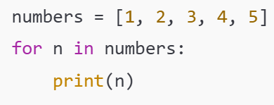
For Loops
A for loop lets you run code for every element in an iterable object
Let’s look at an example:
Slide 6/9

Slide 78
For Loops
A for loop lets you run code for every element in an iterable object
Let’s look at an example:
Slide 6/9

Slide 79
For Loops
A for loop lets you run code for every element in an iterable object
Let’s look at an example:
“for” keyword
Slide 6/9

Slide 80
For Loops
A for loop lets you run code for every element in an iterable object
Let’s look at an example:
Slide 6/9

Slide 81
For Loops
A for loop lets you run code for every element in an iterable object
Let’s look at an example:
“in” keyword
Slide 6/9

Slide 82
For Loops
A for loop lets you run code for every element in an iterable object
Let’s look at an example:
Slide 6/9

Slide 83
For Loops
A for loop lets you run code for every element in an iterable object
Let’s look at an example:
Colon
Slide 6/9

Slide 84
For Loops
A for loop lets you run code for every element in an iterable object
Let’s look at an example:
Slide 6/9

Slide 85
For Loops
A for loop lets you run code for every element in an iterable object
Let’s look at an example:
Iterable object (something we can list the elements in one by one)
Slide 6/9

Slide 86
For Loops
A for loop lets you run code for every element in an iterable object
Let’s look at an example:
Iterable object (something we can list the elements in one by one)
Slide 6/9

Slide 87
For Loops
A for loop lets you run code for every element in an iterable object
Let’s look at an example:
Iterable object (something we can list the elements in one by one)
Slide 6/9

Slide 88
For Loops
A for loop lets you run code for every element in an iterable object
Let’s look at an example:
Slide 6/9

Slide 89
For Loops
A for loop lets you run code for every element in an iterable object
Let’s look at an example:
Variable name This is a name we choose for an arbitrary element in the list
Slide 6/9

Slide 90
For Loops
A for loop lets you run code for every element in an iterable object
Let’s look at an example:
Variable name This is a name we choose for an arbitrary element in the list
Slide 6/9

Slide 91
For Loops
A for loop lets you run code for every element in an iterable object
Let’s look at an example:
Slide 6/9

Slide 92
For Loops
A for loop lets you run code for every element in an iterable object
Let’s look at an example:
Body of the loop
This code will be run for every element in the iterable object
Slide 6/9

Slide 93
For Loops
A for loop lets you run code for every element in an iterable object
Let’s look at an example:
Slide 6/9

Slide 94
For Loops
A for loop lets you run code for every element in an iterable object
Let’s look at an example:
Indentation – This is important! This is how Python tells what is inside the loop!
Slide 6/9

Slide 95
For Loops
A for loop lets you run code for every element in an iterable object
Let’s look at an example:
Indentation – This is important! This is how Python tells what is inside the loop!
Slide 6/9

Slide 96
For Loops
A for loop lets you run code for every element in an iterable object
Let’s look at an example:
Slide 6/9

Slide 97
For Loops
A for loop lets you run code for every element in an iterable object
Let’s look at an example:
Translation:
“For every number in the list, print that number”
Slide 6/9

Slide 98
For Loops
A for loop lets you run code for every element in an iterable object
Let’s look at an example:
Slide 6/9

Slide 99
For Loops
A for loop lets you run code for every element in an iterable object
Let’s look at an example:
This code will print:
1
2
3
4
5
Slide 6/9

Slide 100
For Loops
A for loop lets you run code for every element in an iterable object
Let’s look at an example:
This code will print:
1
2
3
4
5
Slide 6/9

Slide 101
For Loops
A for loop lets you run code for every element in an iterable object
Let’s look at an example:
This code will print:
1
2
3
4
5
Slide 6/9

Slide 102
For Loops
A for loop lets you run code for every element in an iterable object
Let’s look at an example:
This code will print:
1
2
3
4
5
Slide 6/9

Slide 103
For Loops
A for loop lets you run code for every element in an iterable object
Let’s look at an example:
This code will print:
1
2
3
4
5
Slide 6/9

Slide 104
For Loops
A for loop lets you run code for every element in an iterable object
Let’s look at an example:
This code will print:
1
2
3
4
5
Slide 6/9

Slide 105
For Loops
A for loop lets you run code for every element in an iterable object
Let’s look at an example:
Slide 6/9

Slide 106
While Loops
Slide 7/9

Slide 107
While Loops
A while loop lets you run code repeatedly so long as a Boolean statement is True
Slide 7/9

Slide 108
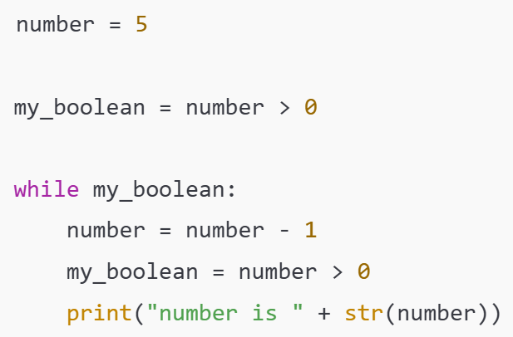
While Loops
A while loop lets you run code repeatedly so long as a Boolean statement is True
Slide 7/9

Slide 109
While Loops
A while loop lets you run code repeatedly so long as a Boolean statement is True
Slide 7/9

Slide 110
While Loops
A while loop lets you run code repeatedly so long as a Boolean statement is True
“while” keyword
Slide 7/9

Slide 111
While Loops
A while loop lets you run code repeatedly so long as a Boolean statement is True
Slide 7/9

Slide 112
While Loops
A while loop lets you run code repeatedly so long as a Boolean statement is True
Colon
Slide 7/9

Slide 113
While Loops
A while loop lets you run code repeatedly so long as a Boolean statement is True
Slide 7/9

Slide 114
While Loops
A while loop lets you run code repeatedly so long as a Boolean statement is True
Boolean Condition
Slide 7/9

Slide 115
While Loops
A while loop lets you run code repeatedly so long as a Boolean statement is True
Boolean Condition
Slide 7/9

Slide 116
While Loops
A while loop lets you run code repeatedly so long as a Boolean statement is True
Slide 7/9

Slide 117
While Loops
A while loop lets you run code repeatedly so long as a Boolean statement is True
Body of the loop:
Slide 7/9

Slide 118
While Loops
A while loop lets you run code repeatedly so long as a Boolean statement is True
Body of the loop:
This will execute over and over again until the Boolean is set to False
Slide 7/9

Slide 119
While Loops
A while loop lets you run code repeatedly so long as a Boolean statement is True
Body of the loop:
This will execute over and over again until the Boolean is set to False
Slide 7/9

Slide 120
While Loops
A while loop lets you run code repeatedly so long as a Boolean statement is True
Body of the loop:
This will execute over and over again until the Boolean is set to False
First, number = 5.
Slide 7/9

Slide 121
While Loops
A while loop lets you run code repeatedly so long as a Boolean statement is True
Body of the loop:
This will execute over and over again until the Boolean is set to False
First, number = 5.
Slide 7/9

Slide 122
While Loops
A while loop lets you run code repeatedly so long as a Boolean statement is True
Body of the loop:
This will execute over and over again until the Boolean is set to False
First, number = 5.
Check if number > 0.
Slide 7/9

Slide 123
While Loops
A while loop lets you run code repeatedly so long as a Boolean statement is True
Body of the loop:
This will execute over and over again until the Boolean is set to False
First, number = 5.
Check if number > 0.
Slide 7/9

Slide 124
While Loops
A while loop lets you run code repeatedly so long as a Boolean statement is True
Body of the loop:
This will execute over and over again until the Boolean is set to False
First, number = 5.
Check if number > 0.
Slide 7/9

Slide 125
While Loops
A while loop lets you run code repeatedly so long as a Boolean statement is True
Body of the loop:
This will execute over and over again until the Boolean is set to False
First, number = 5.
Check if number > 0.
As number > 0, we move into the while loop
Slide 7/9

Slide 126
While Loops
A while loop lets you run code repeatedly so long as a Boolean statement is True
Body of the loop:
This will execute over and over again until the Boolean is set to False
First, number = 5.
Check if number > 0.
As number > 0, we move into the while loop
Slide 7/9

Slide 127
While Loops
A while loop lets you run code repeatedly so long as a Boolean statement is True
Body of the loop:
This will execute over and over again until the Boolean is set to False
First, number = 5.
Check if number > 0.
As number > 0, we move into the while loop
Slide 7/9

Slide 128
While Loops
A while loop lets you run code repeatedly so long as a Boolean statement is True
Body of the loop:
This will execute over and over again until the Boolean is set to False
First, number = 5.
Check if number > 0.
As number > 0, we move into the while loop
Slide 7/9

Slide 129
While Loops
A while loop lets you run code repeatedly so long as a Boolean statement is True
Body of the loop:
This will execute over and over again until the Boolean is set to False
First, number = 5.
Check if number > 0.
As number > 0, we move into the while loop
Slide 7/9

Slide 130
While Loops
A while loop lets you run code repeatedly so long as a Boolean statement is True
Body of the loop:
This will execute over and over again until the Boolean is set to False
First, number = 5.
Check if number > 0.
As number > 0, we move into the while loop
Slide 7/9

Slide 131
While Loops
A while loop lets you run code repeatedly so long as a Boolean statement is True
Body of the loop:
This will execute over and over again until the Boolean is set to False
Next, number = number – 1 = 4.
Check if number > 0.
As number > 0, we move into the while loop
Slide 7/9

Slide 132
While Loops
A while loop lets you run code repeatedly so long as a Boolean statement is True
Body of the loop:
This will execute over and over again until the Boolean is set to False
Next, number = number – 1 = 4.
Check if number > 0.
As number > 0, we move into the while loop
Slide 7/9

Slide 133
While Loops
A while loop lets you run code repeatedly so long as a Boolean statement is True
Body of the loop:
This will execute over and over again until the Boolean is set to False
Next, number = number – 1 = 4.
Check if number > 0.
As number > 0, we move into the while loop
Slide 7/9

Slide 134
While Loops
A while loop lets you run code repeatedly so long as a Boolean statement is True
Body of the loop:
This will execute over and over again until the Boolean is set to False
Next, number = number – 1 = 4.
Check if number > 0.
As number > 0, we move into the while loop
Slide 7/9

Slide 135
While Loops
A while loop lets you run code repeatedly so long as a Boolean statement is True
Body of the loop:
This will execute over and over again until the Boolean is set to False
Next, number = number – 1 = 4.
Check if number > 0.
As number > 0, we move into the while loop
Slide 7/9

Slide 136
While Loops
A while loop lets you run code repeatedly so long as a Boolean statement is True
Body of the loop:
This will execute over and over again until the Boolean is set to False
Next, number = number – 1 = 4.
Check if number > 0.
As number > 0, we move into the while loop
Slide 7/9

Slide 137
While Loops
A while loop lets you run code repeatedly so long as a Boolean statement is True
Body of the loop:
This will execute over and over again until the Boolean is set to False
Next, number = number – 1 = 4.
Check if number > 0.
We print the number.
As number > 0, we move into the while loop
Slide 7/9

Slide 138
While Loops
A while loop lets you run code repeatedly so long as a Boolean statement is True
Body of the loop:
This will execute over and over again until the Boolean is set to False
Next, number = number – 1 = 4.
Check if number > 0.
We print the number.
As number > 0, we move into the while loop
Slide 7/9

Slide 139
While Loops
A while loop lets you run code repeatedly so long as a Boolean statement is True
Body of the loop:
This will execute over and over again until the Boolean is set to False
Next, number = number – 1 = 4.
Check if number > 0.
We print the number.
As number > 0, we move into the while loop
Slide 7/9

Slide 140
While Loops
A while loop lets you run code repeatedly so long as a Boolean statement is True
Body of the loop:
This will execute over and over again until the Boolean is set to False
Next, number = number – 1 = 4.
Check if number > 0.
We print the number.
As number > 0, we move into the while loop
Slide 7/9

Slide 141
While Loops
A while loop lets you run code repeatedly so long as a Boolean statement is True
Body of the loop:
This will execute over and over again until the Boolean is set to False
Next, number = number – 1 = 4.
Check if number > 0.
We print the number.
As my_boolean is True, we repeat the loop.
Slide 7/9

Slide 142
While Loops
A while loop lets you run code repeatedly so long as a Boolean statement is True
Body of the loop:
This will execute over and over again until the Boolean is set to False
Next, number = number – 1 = 4.
Check if number > 0.
We print the number.
As my_boolean is True, we repeat the loop.
Slide 7/9

Slide 143
While Loops
A while loop lets you run code repeatedly so long as a Boolean statement is True
Body of the loop:
This will execute over and over again until the Boolean is set to False
Next, number = number – 1 = 4.
Check if number > 0.
We print the number.
As my_boolean is True, we repeat the loop.
Slide 7/9

Slide 144
While Loops
A while loop lets you run code repeatedly so long as a Boolean statement is True
Body of the loop:
This will execute over and over again until the Boolean is set to False
Next, number = number – 1 = 4.
Check if number > 0.
We print the number.
As my_boolean is True, we repeat the loop.
Slide 7/9

Slide 145
While Loops
A while loop lets you run code repeatedly so long as a Boolean statement is True
Body of the loop:
This will execute over and over again until the Boolean is set to False
Next, number = number – 1 = 3.
Check if number > 0.
We print the number.
As my_boolean is True, we repeat the loop.
Slide 7/9

Slide 146
While Loops
A while loop lets you run code repeatedly so long as a Boolean statement is True
Body of the loop:
This will execute over and over again until the Boolean is set to False
Next, number = number – 1 = 3.
Check if number > 0.
We print the number.
As my_boolean is True, we repeat the loop.
Slide 7/9

Slide 147
While Loops
A while loop lets you run code repeatedly so long as a Boolean statement is True
Body of the loop:
This will execute over and over again until the Boolean is set to False
Next, number = number – 1 = 3.
Check if number > 0.
We print the number.
As my_boolean is True, we repeat the loop.
Slide 7/9

Slide 148
While Loops
A while loop lets you run code repeatedly so long as a Boolean statement is True
Body of the loop:
This will execute over and over again until the Boolean is set to False
Next, number = number – 1 = 3.
Check if number > 0.
We print the number.
As my_boolean is True, we repeat the loop.
Slide 7/9

Slide 149
While Loops
A while loop lets you run code repeatedly so long as a Boolean statement is True
Body of the loop:
This will execute over and over again until the Boolean is set to False
Next, number = number – 1 = 3.
Check if number > 0.
We print the number.
As my_boolean is True, we repeat the loop.
Slide 7/9

Slide 150
While Loops
A while loop lets you run code repeatedly so long as a Boolean statement is True
Body of the loop:
This will execute over and over again until the Boolean is set to False
Next, number = number – 1 = 3.
Check if number > 0.
We print the number.
As my_boolean is True, we repeat the loop.
Slide 7/9

Slide 151
While Loops
A while loop lets you run code repeatedly so long as a Boolean statement is True
Body of the loop:
This will execute over and over again until the Boolean is set to False
Next, number = number – 1 = 3.
Check if number > 0.
We print the number.
As my_boolean is True, we repeat the loop.
Slide 7/9

Slide 152
While Loops
A while loop lets you run code repeatedly so long as a Boolean statement is True
Body of the loop:
This will execute over and over again until the Boolean is set to False
Next, number = number – 1 = 3.
Check if number > 0.
We print the number.
As my_boolean is True, we repeat the loop.
Slide 7/9

Slide 153
While Loops
A while loop lets you run code repeatedly so long as a Boolean statement is True
Body of the loop:
This will execute over and over again until the Boolean is set to False
Next, number = number – 1 = 3.
Check if number > 0.
We print the number.
As my_boolean is True, we repeat the loop.
Slide 7/9

Slide 154
While Loops
A while loop lets you run code repeatedly so long as a Boolean statement is True
Body of the loop:
This will execute over and over again until the Boolean is set to False
Next, number = number – 1 = 3.
Check if number > 0.
We print the number.
As my_boolean is True, we repeat the loop.
Slide 7/9

Slide 155
While Loops
A while loop lets you run code repeatedly so long as a Boolean statement is True
Body of the loop:
This will execute over and over again until the Boolean is set to False
Next, number = number – 1 = 3.
Check if number > 0.
We print the number.
As my_boolean is True, we repeat the loop.
Slide 7/9

Slide 156
While Loops
A while loop lets you run code repeatedly so long as a Boolean statement is True
Body of the loop:
This will execute over and over again until the Boolean is set to False
Next, number = number – 1 = 3.
Check if number > 0.
We print the number.
As my_boolean is True, we repeat the loop.
Slide 7/9

Slide 157
While Loops
A while loop lets you run code repeatedly so long as a Boolean statement is True
Body of the loop:
This will execute over and over again until the Boolean is set to False
Next, number = number – 1 = 3.
Check if number > 0.
We print the number.
As my_boolean is True, we repeat the loop.
Slide 7/9

Slide 158
While Loops
A while loop lets you run code repeatedly so long as a Boolean statement is True
Body of the loop:
This will execute over and over again until the Boolean is set to False
Next, number = number – 1 = 2.
Check if number > 0.
We print the number.
As my_boolean is True, we repeat the loop.
Slide 7/9

Slide 159
While Loops
A while loop lets you run code repeatedly so long as a Boolean statement is True
Body of the loop:
This will execute over and over again until the Boolean is set to False
Next, number = number – 1 = 2.
Check if number > 0.
We print the number.
As my_boolean is True, we repeat the loop.
Slide 7/9

Slide 160
While Loops
A while loop lets you run code repeatedly so long as a Boolean statement is True
Body of the loop:
This will execute over and over again until the Boolean is set to False
Next, number = number – 1 = 2.
Check if number > 0.
We print the number.
As my_boolean is True, we repeat the loop.
Slide 7/9

Slide 161
While Loops
A while loop lets you run code repeatedly so long as a Boolean statement is True
Body of the loop:
This will execute over and over again until the Boolean is set to False
Next, number = number – 1 = 2.
Check if number > 0.
We print the number.
As my_boolean is True, we repeat the loop.
Slide 7/9

Slide 162
While Loops
A while loop lets you run code repeatedly so long as a Boolean statement is True
Body of the loop:
This will execute over and over again until the Boolean is set to False
Next, number = number – 1 = 2.
Check if number > 0.
We print the number.
As my_boolean is True, we repeat the loop.
Slide 7/9

Slide 163
While Loops
A while loop lets you run code repeatedly so long as a Boolean statement is True
Body of the loop:
This will execute over and over again until the Boolean is set to False
Next, number = number – 1 = 2.
Check if number > 0.
We print the number.
As my_boolean is True, we repeat the loop.
Slide 7/9

Slide 164
While Loops
A while loop lets you run code repeatedly so long as a Boolean statement is True
Body of the loop:
This will execute over and over again until the Boolean is set to False
Next, number = number – 1 = 2.
Check if number > 0.
We print the number.
As my_boolean is True, we repeat the loop.
Slide 7/9

Slide 165
While Loops
A while loop lets you run code repeatedly so long as a Boolean statement is True
Body of the loop:
This will execute over and over again until the Boolean is set to False
Next, number = number – 1 = 2.
Check if number > 0.
We print the number.
As my_boolean is True, we repeat the loop.
Slide 7/9

Slide 166
While Loops
A while loop lets you run code repeatedly so long as a Boolean statement is True
Body of the loop:
This will execute over and over again until the Boolean is set to False
Next, number = number – 1 = 2.
Check if number > 0.
We print the number.
As my_boolean is True, we repeat the loop.
Slide 7/9

Slide 167
While Loops
A while loop lets you run code repeatedly so long as a Boolean statement is True
Body of the loop:
This will execute over and over again until the Boolean is set to False
Next, number = number – 1 = 2.
Check if number > 0.
We print the number.
As my_boolean is True, we repeat the loop.
Slide 7/9

Slide 168
While Loops
A while loop lets you run code repeatedly so long as a Boolean statement is True
Body of the loop:
This will execute over and over again until the Boolean is set to False
Next, number = number – 1 = 2.
Check if number > 0.
We print the number.
As my_boolean is True, we repeat the loop.
Slide 7/9

Slide 169
While Loops
A while loop lets you run code repeatedly so long as a Boolean statement is True
Body of the loop:
This will execute over and over again until the Boolean is set to False
Next, number = number – 1 = 2.
Check if number > 0.
We print the number.
As my_boolean is True, we repeat the loop.
Slide 7/9

Slide 170
While Loops
A while loop lets you run code repeatedly so long as a Boolean statement is True
Body of the loop:
This will execute over and over again until the Boolean is set to False
Next, number = number – 1 = 2.
Check if number > 0.
We print the number.
As my_boolean is True, we repeat the loop.
Slide 7/9

Slide 171
While Loops
A while loop lets you run code repeatedly so long as a Boolean statement is True
Body of the loop:
This will execute over and over again until the Boolean is set to False
Next, number = number – 1 = 1.
Check if number > 0.
We print the number.
As my_boolean is True, we repeat the loop.
Slide 7/9

Slide 172
While Loops
A while loop lets you run code repeatedly so long as a Boolean statement is True
Body of the loop:
This will execute over and over again until the Boolean is set to False
Next, number = number – 1 = 1.
Check if number > 0.
We print the number.
As my_boolean is True, we repeat the loop.
Slide 7/9

Slide 173
While Loops
A while loop lets you run code repeatedly so long as a Boolean statement is True
Body of the loop:
This will execute over and over again until the Boolean is set to False
Next, number = number – 1 = 1.
Check if number > 0.
We print the number.
As my_boolean is True, we repeat the loop.
Slide 7/9

Slide 174
While Loops
A while loop lets you run code repeatedly so long as a Boolean statement is True
Body of the loop:
This will execute over and over again until the Boolean is set to False
Next, number = number – 1 = 1.
Check if number > 0.
We print the number.
As my_boolean is True, we repeat the loop.
Slide 7/9

Slide 175
While Loops
A while loop lets you run code repeatedly so long as a Boolean statement is True
Body of the loop:
This will execute over and over again until the Boolean is set to False
Next, number = number – 1 = 1.
Check if number > 0.
We print the number.
As my_boolean is True, we repeat the loop.
Slide 7/9

Slide 176
While Loops
A while loop lets you run code repeatedly so long as a Boolean statement is True
Body of the loop:
This will execute over and over again until the Boolean is set to False
Next, number = number – 1 = 1.
Check if number > 0.
We print the number.
As my_boolean is True, we repeat the loop.
Slide 7/9

Slide 177
While Loops
A while loop lets you run code repeatedly so long as a Boolean statement is True
Body of the loop:
This will execute over and over again until the Boolean is set to False
Next, number = number – 1 = 1.
Check if number > 0.
We print the number.
As my_boolean is True, we repeat the loop.
Slide 7/9

Slide 178
While Loops
A while loop lets you run code repeatedly so long as a Boolean statement is True
Body of the loop:
This will execute over and over again until the Boolean is set to False
Next, number = number – 1 = 1.
Check if number > 0.
We print the number.
As my_boolean is True, we repeat the loop.
Slide 7/9

Slide 179
While Loops
A while loop lets you run code repeatedly so long as a Boolean statement is True
Body of the loop:
This will execute over and over again until the Boolean is set to False
Next, number = number – 1 = 1.
Check if number > 0.
We print the number.
As my_boolean is True, we repeat the loop.
Slide 7/9

Slide 180
While Loops
A while loop lets you run code repeatedly so long as a Boolean statement is True
Body of the loop:
This will execute over and over again until the Boolean is set to False
Next, number = number – 1 = 1.
Check if number > 0.
We print the number.
As my_boolean is True, we repeat the loop.
Slide 7/9

Slide 181
While Loops
A while loop lets you run code repeatedly so long as a Boolean statement is True
Body of the loop:
This will execute over and over again until the Boolean is set to False
Next, number = number – 1 = 1.
Check if number > 0.
We print the number.
As my_boolean is True, we repeat the loop.
Slide 7/9

Slide 182
While Loops
A while loop lets you run code repeatedly so long as a Boolean statement is True
Body of the loop:
This will execute over and over again until the Boolean is set to False
Next, number = number – 1 = 1.
Check if number > 0.
We print the number.
As my_boolean is True, we repeat the loop.
Slide 7/9

Slide 183
While Loops
A while loop lets you run code repeatedly so long as a Boolean statement is True
Body of the loop:
This will execute over and over again until the Boolean is set to False
Next, number = number – 1 = 1.
Check if number > 0.
We print the number.
As my_boolean is True, we repeat the loop.
Slide 7/9

Slide 184
While Loops
A while loop lets you run code repeatedly so long as a Boolean statement is True
Body of the loop:
This will execute over and over again until the Boolean is set to False
Next, number = number – 1 = 0.
Check if number > 0.
We print the number.
As my_boolean is True, we repeat the loop.
Slide 7/9

Slide 185
While Loops
A while loop lets you run code repeatedly so long as a Boolean statement is True
Body of the loop:
This will execute over and over again until the Boolean is set to False
Next, number = number – 1 = 0.
Check if number > 0.
We print the number.
As my_boolean is True, we repeat the loop.
Slide 7/9

Slide 186
While Loops
A while loop lets you run code repeatedly so long as a Boolean statement is True
Body of the loop:
This will execute over and over again until the Boolean is set to False
Next, number = number – 1 = 0.
Check if number > 0.
We print the number.
As my_boolean is True, we repeat the loop.
Slide 7/9

Slide 187
While Loops
A while loop lets you run code repeatedly so long as a Boolean statement is True
Body of the loop:
This will execute over and over again until the Boolean is set to False
Next, number = number – 1 = 0.
Check if number > 0.
We print the number.
As my_boolean is True, we repeat the loop.
Slide 7/9

Slide 188
While Loops
A while loop lets you run code repeatedly so long as a Boolean statement is True
Body of the loop:
This will execute over and over again until the Boolean is set to False
Next, number = number – 1 = 0.
Check if number > 0.
We print the number.
As my_boolean is True, we repeat the loop.
Slide 7/9

Slide 189
While Loops
A while loop lets you run code repeatedly so long as a Boolean statement is True
Body of the loop:
This will execute over and over again until the Boolean is set to False
Next, number = number – 1 = 0.
Check if number > 0.
We print the number.
As my_boolean is True, we repeat the loop.
Slide 7/9

Slide 190
While Loops
A while loop lets you run code repeatedly so long as a Boolean statement is True
Body of the loop:
This will execute over and over again until the Boolean is set to False
Next, number = number – 1 = 0.
Check if number > 0.
We print the number.
As my_boolean is True, we repeat the loop.
Slide 7/9

Slide 191
While Loops
A while loop lets you run code repeatedly so long as a Boolean statement is True
Body of the loop:
This will execute over and over again until the Boolean is set to False
Next, number = number – 1 = 0.
Check if number > 0.
We print the number.
As my_boolean is True, we repeat the loop.
Slide 7/9

Slide 192
While Loops
A while loop lets you run code repeatedly so long as a Boolean statement is True
Body of the loop:
This will execute over and over again until the Boolean is set to False
Next, number = number – 1 = 0.
Check if number > 0.
We print the number.
As my_boolean is True, we repeat the loop.
Slide 7/9

Slide 193
While Loops
A while loop lets you run code repeatedly so long as a Boolean statement is True
Body of the loop:
This will execute over and over again until the Boolean is set to False
Next, number = number – 1 = 0.
Check if number > 0.
We print the number.
Now my_boolean is False!!
Slide 7/9

Slide 194
While Loops
A while loop lets you run code repeatedly so long as a Boolean statement is True
Body of the loop:
This will execute over and over again until the Boolean is set to False
Next, number = number – 1 = 0.
Check if number > 0.
We print the number.
Now my_boolean is False!!
Slide 7/9

Slide 195
While Loops
A while loop lets you run code repeatedly so long as a Boolean statement is True
Body of the loop:
This will execute over and over again until the Boolean is set to False
Next, number = number – 1 = 0.
Check if number > 0.
We print the number.
Now my_boolean is False!!
We stop here!
Slide 7/9

Slide 196
While Loops
A while loop lets you run code repeatedly so long as a Boolean statement is True
Body of the loop:
This will execute over and over again until the Boolean is set to False
Next, number = number – 1 = 0.
Check if number > 0.
We print the number.
Now my_boolean is False!!
We stop here!
Slide 7/9

Slide 197
While Loops
A while loop lets you run code repeatedly so long as a Boolean statement is True
Slide 7/9

Slide 198
While Loops
A while loop lets you run code repeatedly so long as a Boolean statement is True
In the end we will have printed:
number is 5
number is 4
number is 3
number is 2
number is 1
number is 0
Slide 7/9

Slide 199
While Loops
A while loop lets you run code repeatedly so long as a Boolean statement is True
In the end we will have printed:
number is 5
number is 4
number is 3
number is 2
number is 1
number is 0
Slide 7/9

Slide 200
While Loops
A while loop lets you run code repeatedly so long as a Boolean statement is True
In the end we will have printed:
number is 5
number is 4
number is 3
number is 2
number is 1
number is 0
Slide 7/9

Slide 201
While Loops
A while loop lets you run code repeatedly so long as a Boolean statement is True
In the end we will have printed:
number is 5
number is 4
number is 3
number is 2
number is 1
number is 0
Slide 7/9

Slide 202
While Loops
A while loop lets you run code repeatedly so long as a Boolean statement is True
In the end we will have printed:
number is 5
number is 4
number is 3
number is 2
number is 1
number is 0
Slide 7/9

Slide 203
While Loops
A while loop lets you run code repeatedly so long as a Boolean statement is True
In the end we will have printed:
number is 5
number is 4
number is 3
number is 2
number is 1
number is 0
Slide 7/9

Slide 204
While Loops
A while loop lets you run code repeatedly so long as a Boolean statement is True
In the end we will have printed:
number is 5
number is 4
number is 3
number is 2
number is 1
number is 0
Slide 7/9

Slide 205
While Loops
A while loop lets you run code repeatedly so long as a Boolean statement is True
Slide 7/9

Slide 206
While Loops
A while loop lets you run code repeatedly so long as a Boolean statement is True
Indentation. Again, this is how Python tells what is inside the loop!
Slide 7/9

Slide 207
While Loops
A while loop lets you run code repeatedly so long as a Boolean statement is True
Indentation. Again, this is how Python tells what is inside the loop!
Slide 7/9

Slide 208
While Loops
A while loop lets you run code repeatedly so long as a Boolean statement is True
Slide 7/9

Slide 209
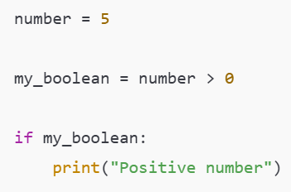
While Loops
A while loop lets you run code repeatedly so long as a Boolean statement is True
Slide 7/9

Slide 210
While Loops
A while loop lets you run code repeatedly so long as a Boolean statement is True
An if statement executes once if the Boolean is True
A while loop executes repeatedly until the Boolean is False
Slide 7/9

Slide 211
While Loops
A while loop lets you run code repeatedly so long as a Boolean statement is True
An if statement executes once if the Boolean is True
A while loop executes repeatedly until the Boolean is False
Slide 7/9

Slide 212
While Loops
A while loop lets you run code repeatedly so long as a Boolean statement is True
Slide 7/9

Slide 213
Practical
Slide 8/9

Slide 214
Practical
We now move over to Python
Slide 8/9

Slide 215
Practical
We now move over to Python
Please open `week_03_home.ipynb`
Slide 8/9

Slide 216
Practical
We now move over to Python
Please open `week_03_home.ipynb`
For the rest of today, you must work through a Python notebook
Slide 8/9

Slide 217
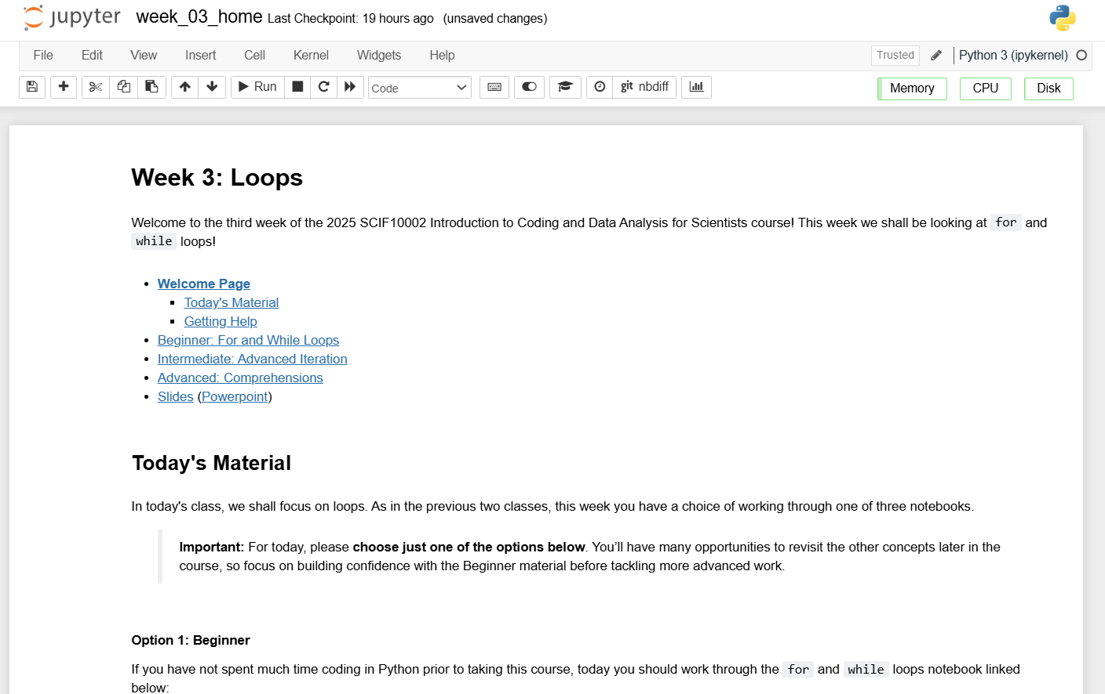
Practical
We now move over to Python
Please open `week_03_home.ipynb`
For the rest of today, you must work through a Python notebook
Slide 8/9

Slide 218
Practical
We now move over to Python
Please open `week_03_home.ipynb`
For the rest of today, you must work through a Python notebook
You have a choice of one of three options
Slide 8/9

Slide 219
Practical
We now move over to Python
Please open `week_03_home.ipynb`
For the rest of today, you must work through a Python notebook
You have a choice of one of three options
Option 1: Beginner – For and While Loops
Slide 8/9

Slide 220
Practical
We now move over to Python
Please open `week_03_home.ipynb`
For the rest of today, you must work through a Python notebook
You have a choice of one of three options
Option 1: Beginner – For and While Loops
Option 2: Intermediate – Advanced Iteration
Slide 8/9

Slide 221
Practical
We now move over to Python
Please open `week_03_home.ipynb`
For the rest of today, you must work through a Python notebook
You have a choice of one of three options
Option 1: Beginner – For and While Loops
Option 2: Intermediate – Advanced Iteration
Option 3: Advanced – Comprehensions
Slide 8/9

Slide 222
Practical
We now move over to Python
Please open `week_03_home.ipynb`
For the rest of today, you must work through a Python notebook
You have a choice of one of three options
Option 1: Beginner – For and While Loops
Option 2: Intermediate – Advanced Iteration
Option 3: Advanced – Comprehensions
Choose this if you are just getting started with loops
Slide 8/9

Slide 223
Practical
We now move over to Python
Please open `week_03_home.ipynb`
For the rest of today, you must work through a Python notebook
You have a choice of one of three options
Option 1: Beginner – For and While Loops
Option 2: Intermediate – Advanced Iteration
Option 3: Advanced – Comprehensions
Slide 8/9

Slide 224
Practical
We now move over to Python
Please open `week_03_home.ipynb`
For the rest of today, you must work through a Python notebook
You have a choice of one of three options
Option 1: Beginner – For and While Loops
Option 2: Intermediate – Advanced Iteration
Option 3: Advanced – Comprehensions
Choose this if you already have some experience with loops in Python and want to broaden pre-existing knowledge
Slide 8/9

Slide 225
Practical
We now move over to Python
Please open `week_03_home.ipynb`
For the rest of today, you must work through a Python notebook
You have a choice of one of three options
Option 1: Beginner – For and While Loops
Option 2: Intermediate – Advanced Iteration
Option 3: Advanced – Comprehensions
Slide 8/9

Slide 226
Practical
We now move over to Python
Please open `week_03_home.ipynb`
For the rest of today, you must work through a Python notebook
You have a choice of one of three options
Option 1: Beginner – For and While Loops
Option 2: Intermediate – Advanced Iteration
Option 3: Advanced – Comprehensions
Choose this if you have a lot of experience already and have been programming for years
Slide 8/9

Slide 227
Practical
We now move over to Python
Please open `week_03_home.ipynb`
For the rest of today, you must work through a Python notebook
You have a choice of one of three options
Option 1: Beginner – For and While Loops
Option 2: Intermediate – Advanced Iteration
Option 3: Advanced – Comprehensions
Slide 8/9

Slide 228
Practical
We now move over to Python
Please open `week_03_home.ipynb`
For the rest of today, you must work through a Python notebook
You have a choice of one of three options
Option 1: Beginner – For and While Loops
Option 2: Intermediate – Advanced Iteration
Option 3: Advanced – Comprehensions
Important: If you choose the intermediate or advanced options, make sure you are comfortable with the material in Beginner first!!
Slide 8/9

Slide 229
Practical
We now move over to Python
Please open `week_03_home.ipynb`
For the rest of today, you must work through a Python notebook
You have a choice of one of three options
Option 1: Beginner – For and While Loops
Option 2: Intermediate – Advanced Iteration
Option 3: Advanced – Comprehensions
Slide 8/9

Slide 230
Next Time
Lecture 3: Loops
Recap: Accessing Noteable
Recap: If Statements
For Loops
While Loops
Practical
Lecture 4: Functions
Recap: For and While Loops
Functions
Inputs and Outputs
Practical
Slide 9/9

