Slide 1
Lecture 1:
Introduction & Data Types
SCIF10002 – Introduction to Coding and Data
Slide 0/19

Slide 2
Today’s Lecture
Slide 1/19

Slide 3
Today’s Lecture
Lecture 1: Introduction and Data Types
Slide 1/19

Slide 4
Today’s Lecture
Lecture 1: Introduction and Data Types
  Course Structure
Slide 1/19

Slide 5
Today’s Lecture
Lecture 1: Introduction and Data Types
  Course Structure
  Setting up Noteable
Slide 1/19

Slide 6
Today’s Lecture
Lecture 1: Introduction and Data Types
  Course Structure
  Setting up Noteable
  Introduction to Coding
Slide 1/19

Slide 7
Today’s Lecture
Lecture 1: Introduction and Data Types
  Course Structure
  Setting up Noteable
  Introduction to Coding
  Data Types
Slide 1/19

Slide 8
Today’s Lecture
Lecture 1: Introduction and Data Types
  Course Structure
  Setting up Noteable
  Introduction to Coding
  Data Types
  Practical
Slide 1/19

Slide 9
Today’s Lecture
Lecture 1: Introduction and Data Types
  Course Structure
  Setting up Noteable
  Introduction to Coding
  Data Types
  Practical
Lecture 2: Booleans and Conditionals
  Recap: Accessing Noteable
  Recap: Booleans
  If statements
  Practical
Slide 1/19

Slide 10
Course Structure
Slide 2/19

Slide 11
Course Structure
This course will run for 20 weeks
Slide 2/19

Slide 12
Course Structure
This course will run for 20 weeks
We will cover:
Slide 2/19

Slide 13
Course Structure
This course will run for 20 weeks
We will cover:
  Data types, conditionals and loops
Slide 2/19

Slide 14
Course Structure
This course will run for 20 weeks
We will cover:
  Data types, conditionals and loops
  Building functions
Slide 2/19

Slide 15
Course Structure
This course will run for 20 weeks
We will cover:
  Data types, conditionals and loops
  Building functions
  Numpy arrays and linear algebra in python
Slide 2/19

Slide 16
Course Structure
This course will run for 20 weeks
We will cover:
  Data types, conditionals and loops
  Building functions
  Numpy arrays and linear algebra in python
  Pandas dataframes
Slide 2/19

Slide 17
Course Structure
This course will run for 20 weeks
We will cover:
  Data types, conditionals and loops
  Building functions
  Numpy arrays and linear algebra in python
  Pandas dataframes
  Plotting and visualisation
Slide 2/19

Slide 18
Course Structure
This course will run for 20 weeks
We will cover:
  Data types, conditionals and loops
  Building functions
  Numpy arrays and linear algebra in python
  Pandas dataframes
  Plotting and visualisation
Slide 2/19

Slide 19
Course Structure
This course will run for 20 weeks
We will cover:
  Data types, conditionals and loops
  Building functions
  Numpy arrays and linear algebra in python
  Pandas dataframes
  Plotting and visualisation
Contact Details:
Email: ft14968@Bristol.ac.uk
Slide 2/19

Slide 20
Course Structure
This course will run for 20 weeks
We will cover:
  Data types, conditionals and loops
  Building functions
  Numpy arrays and linear algebra in python
  Pandas dataframes
  Plotting and visualisation
Classes:
  1 lecture per week (Thursday)
  1 small-group tutorial per two weeks (date should be on calendar)
Contact Details:
Email: ft14968@Bristol.ac.uk
Slide 2/19

Slide 21
Lectures
Slide 3/19

Slide 22

Lectures
Slide 3/19

Slide 23
Lectures
The weekly lecture will consist of
Slide 3/19

Slide 24
Lectures
The weekly lecture will consist of
  ≈ 30-40 minutes presentation time covering:
Slide 3/19

Slide 25
Lectures
The weekly lecture will consist of
  ≈ 30-40 minutes presentation time covering:
    Key concepts
Slide 3/19

Slide 26
Lectures
The weekly lecture will consist of
  ≈ 30-40 minutes presentation time covering:
    Key concepts
    Administrative points (e.g. homework submission etc)
Slide 3/19

Slide 27
Lectures
The weekly lecture will consist of
  ≈ 30-40 minutes presentation time covering:
    Key concepts
    Administrative points (e.g. homework submission etc)
    Code Demonstrations
Slide 3/19

Slide 28
Lectures
The weekly lecture will consist of
  ≈ 30-40 minutes presentation time covering:
    Key concepts
    Administrative points (e.g. homework submission etc)
    Code Demonstrations
10 minute break on the hour
Slide 3/19

Slide 29
Lectures
The weekly lecture will consist of
  ≈ 30-40 minutes presentation time covering:
    Key concepts
    Administrative points (e.g. homework submission etc)
    Code Demonstrations
Slide 3/19

Slide 30
Lectures
The weekly lecture will consist of
  ≈ 30-40 minutes presentation time covering:
    Key concepts
    Administrative points (e.g. homework submission etc)
    Code Demonstrations
Please bring a laptop/device – must be able to type code and access the internet!
Slide 3/19

Slide 31
Lectures
The weekly lecture will consist of
  ≈ 30-40 minutes presentation time covering:
    Key concepts
    Administrative points (e.g. homework submission etc)
    Code Demonstrations
Don’t be this guy!
Please bring a laptop/device – must be able to type code and access the internet!
Slide 3/19

Slide 32
Lectures
The weekly lecture will consist of
  ≈ 30-40 minutes presentation time covering:
    Key concepts
    Administrative points (e.g. homework submission etc)
    Code Demonstrations
Slide 3/19

Slide 33
Lectures
The weekly lecture will consist of
  ≈ 30-40 minutes presentation time covering:
    Key concepts
    Administrative points (e.g. homework submission etc)
    Code Demonstrations
  ≈ 1-1.5 hours practical
Slide 3/19

Slide 34
Lectures
The weekly lecture will consist of
  ≈ 30-40 minutes presentation time covering:
    Key concepts
    Administrative points (e.g. homework submission etc)
    Code Demonstrations
  ≈ 1-1.5 hours practical
    Designed to provide hands on experience
Slide 3/19

Slide 35
Lectures
The weekly lecture will consist of
  ≈ 30-40 minutes presentation time covering:
    Key concepts
    Administrative points (e.g. homework submission etc)
    Code Demonstrations
  ≈ 1-1.5 hours practical
    Designed to provide hands on experience
CRUCIAL TO CODING!!
Slide 3/19

Slide 36
Lectures
The weekly lecture will consist of
  ≈ 30-40 minutes presentation time covering:
    Key concepts
    Administrative points (e.g. homework submission etc)
    Code Demonstrations
  ≈ 1-1.5 hours practical
    Designed to provide hands on experience
Slide 3/19

Slide 37
Lectures
The weekly lecture will consist of
  ≈ 30-40 minutes presentation time covering:
    Key concepts
    Administrative points (e.g. homework submission etc)
    Code Demonstrations
  ≈ 1-1.5 hours practical
    Designed to provide hands on experience
Opportunity to ask for help from
Slide 3/19

Slide 38
Lectures
The weekly lecture will consist of
  ≈ 30-40 minutes presentation time covering:
    Key concepts
    Administrative points (e.g. homework submission etc)
    Code Demonstrations
  ≈ 1-1.5 hours practical
    Designed to provide hands on experience
Opportunity to ask for help from
  Lecturer
Slide 3/19

Slide 39
Lectures
The weekly lecture will consist of
  ≈ 30-40 minutes presentation time covering:
    Key concepts
    Administrative points (e.g. homework submission etc)
    Code Demonstrations
  ≈ 1-1.5 hours practical
    Designed to provide hands on experience
Opportunity to ask for help from
  Lecturer
  PhD helpers
Slide 3/19

Slide 40
Lectures
The weekly lecture will consist of
  ≈ 30-40 minutes presentation time covering:
    Key concepts
    Administrative points (e.g. homework submission etc)
    Code Demonstrations
  ≈ 1-1.5 hours practical
    Designed to provide hands on experience
Opportunity to ask for help from
  Lecturer
  PhD helpers
  Each other!
Slide 3/19

Slide 41
Assignments
Slide 4/19

Slide 42
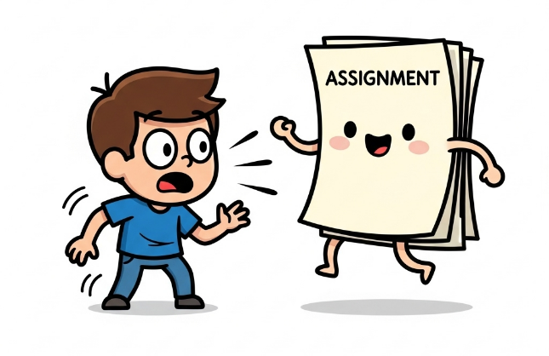
Assignments
Slide 4/19

Slide 43
Assignments
Formative:
Slide 4/19

Slide 44
Assignments
Formative:
  Weekly (optional) assignments available on quarto
Slide 4/19

Slide 45
Assignments
Formative:
  Weekly (optional) assignments available on quarto
Summative:
Slide 4/19

Slide 46
Assignments
Formative:
  Weekly (optional) assignments available on quarto
Summative:
  This module is 100% coursework
Slide 4/19

Slide 47
Assignments
Formative:
  Weekly (optional) assignments available on quarto
Summative:
  This module is 100% coursework
  4 pieces of coursework
Slide 4/19

Slide 48
Assignments
Formative:
  Weekly (optional) assignments available on quarto
Summative:
  This module is 100% coursework
  4 pieces of coursework
    Assignment 1 (15%)
Slide 4/19

Slide 49
Assignments
Formative:
  Weekly (optional) assignments available on quarto
Summative:
  This module is 100% coursework
  4 pieces of coursework
    Assignment 1 (15%)
    Assignment 2 (30%)
Slide 4/19

Slide 50
Assignments
Formative:
  Weekly (optional) assignments available on quarto
Summative:
  This module is 100% coursework
  4 pieces of coursework
    Assignment 1 (15%)
    Assignment 2 (30%)
    Assignment 3 (15%)
Slide 4/19

Slide 51
Assignments
Formative:
  Weekly (optional) assignments available on quarto
Summative:
  This module is 100% coursework
  4 pieces of coursework
    Assignment 1 (15%)
    Assignment 2 (30%)
    Assignment 3 (15%)
    Assignment 4 (40%)
Slide 4/19

Slide 52
Assignments
Formative:
  Weekly (optional) assignments available on quarto
Summative:
  This module is 100% coursework
  4 pieces of coursework
    Assignment 1 (15%)
    Assignment 2 (30%)
    Assignment 3 (15%)
    Assignment 4 (40%)
  Assignments 1-3 will be exercises
Slide 4/19

Slide 53
Assignments
Formative:
  Weekly (optional) assignments available on quarto
Summative:
  This module is 100% coursework
  4 pieces of coursework
    Assignment 1 (15%)
    Assignment 2 (30%)
    Assignment 3 (15%)
    Assignment 4 (40%)
  Assignments 1-3 will be exercises
  Assignment 4 will be different
Slide 4/19

Slide 54
Assignments
Formative:
  Weekly (optional) assignments available on quarto
Summative:
  This module is 100% coursework
  4 pieces of coursework
    Assignment 1 (15%)
    Assignment 2 (30%)
    Assignment 3 (15%)
    Assignment 4 (40%)
  Assignments 1-3 will be exercises
  Assignment 4 will be different
    Project report analysing a dataset
Slide 4/19

Slide 55
Online Material
Slide 5/19

Slide 56
Online Material
The course material is available online via:
Slide 5/19

Slide 57
Online Material
The course material is available online via:
  Quarto – online searchable version
Slide 5/19

Slide 58

Online Material
The course material is available online via:
  Quarto – online searchable version
Slide 5/19

Slide 59
Online Material
The course material is available online via:
  Quarto – online searchable version
  Noteable – interactive interface we shall work in during class
Slide 5/19

Slide 60

Online Material
The course material is available online via:
  Quarto – online searchable version
  Noteable – interactive interface we shall work in during class
Slide 5/19

Slide 61
Accessing Noteable
Slide 6/19

Slide 62
Accessing Noteable
Open Blackboard
Slide 6/19

Slide 63
Accessing Noteable
Open Blackboard
  Go to “Introduction to Coding and Data Analysis for Scientists 2025”
Slide 6/19

Slide 64
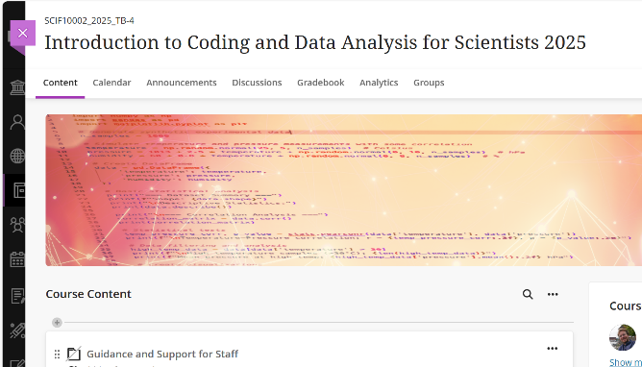
Accessing Noteable
Open Blackboard
  Go to “Introduction to Coding and Data Analysis for Scientists 2025”
Slide 6/19

Slide 65
Accessing Noteable
Open Blackboard
  Go to “Introduction to Coding and Data Analysis for Scientists 2025”
  Click “Unit Information and Resources”
Slide 6/19

Slide 66
Accessing Noteable
Open Blackboard
  Go to “Introduction to Coding and Data Analysis for Scientists 2025”
  Click “Unit Information and Resources”
  Open Noteable
Slide 6/19

Slide 67
Accessing Noteable
Open Blackboard
  Go to “Introduction to Coding and Data Analysis for Scientists 2025”
  Click “Unit Information and Resources”
  Open Noteable
    Make sure “Jupyter Classic (Legacy)” is selected.
Slide 6/19

Slide 68
Accessing Noteable
Open Blackboard
  Go to “Introduction to Coding and Data Analysis for Scientists 2025”
  Click “Unit Information and Resources”
  Open Noteable
    Make sure “Jupyter Classic (Legacy)” is selected.
    Click Start
Slide 6/19

Slide 69
Accessing Noteable
Open Blackboard
  Go to “Introduction to Coding and Data Analysis for Scientists 2025”
  Click “Unit Information and Resources”
  Open Noteable
    Make sure “Jupyter Classic (Legacy)” is selected.
    Click Start
  Click “+GitRepo”
Slide 6/19

Slide 70
Accessing Noteable
Open Blackboard
  Go to “Introduction to Coding and Data Analysis for Scientists 2025”
  Click “Unit Information and Resources”
  Open Noteable
    Make sure “Jupyter Classic (Legacy)” is selected.
    Click Start
  Click “+GitRepo”
Slide 6/19

Slide 71
Accessing Noteable
Open Blackboard
  Go to “Introduction to Coding and Data Analysis for Scientists 2025”
  Click “Unit Information and Resources”
  Open Noteable
    Make sure “Jupyter Classic (Legacy)” is selected.
    Click Start
  Click “+GitRepo”
Slide 6/19

Slide 72
Accessing Noteable
Open Blackboard
  Go to “Introduction to Coding and Data Analysis for Scientists 2025”
  Click “Unit Information and Resources”
  Open Noteable
    Make sure “Jupyter Classic (Legacy)” is selected.
    Click Start
  Click “+GitRepo”
Slide 6/19

Slide 73
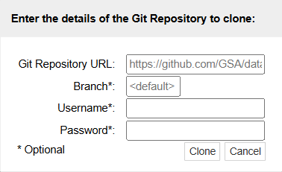
Accessing Noteable
Open Blackboard
  Go to “Introduction to Coding and Data Analysis for Scientists 2025”
  Click “Unit Information and Resources”
  Open Noteable
    Make sure “Jupyter Classic (Legacy)” is selected.
    Click Start
  Click “+GitRepo”
Slide 6/19

Slide 74
Accessing Noteable
Open Blackboard
  Go to “Introduction to Coding and Data Analysis for Scientists 2025”
  Click “Unit Information and Resources”
  Open Noteable
    Make sure “Jupyter Classic (Legacy)” is selected.
    Click Start
  Click “+GitRepo”
Slide 6/19

Slide 75
Accessing Noteable
Open Blackboard
  Go to “Introduction to Coding and Data Analysis for Scientists 2025”
  Click “Unit Information and Resources”
  Open Noteable
    Make sure “Jupyter Classic (Legacy)” is selected.
    Click Start
  Click “+GitRepo”
  Paste into Git Repository URL:
  https://github.com/FTurci/intro-coding-data-analysis-mirror.git
Slide 6/19

Slide 76
Accessing Noteable
Open Blackboard
  Go to “Introduction to Coding and Data Analysis for Scientists 2025”
  Click “Unit Information and Resources”
  Open Noteable
    Make sure “Jupyter Classic (Legacy)” is selected.
    Click Start
  Click “+GitRepo”
  Paste into Git Repository URL:
  https://github.com/FTurci/intro-coding-data-analysis-mirror.git
  Press clone
Slide 6/19

Slide 77
Accessing Noteable
Open Blackboard
  Go to “Introduction to Coding and Data Analysis for Scientists 2025”
  Click “Unit Information and Resources”
  Open Noteable
    Make sure “Jupyter Classic (Legacy)” is selected.
    Click Start
  Click “+GitRepo”
  Paste into Git Repository URL:
  https://github.com/FTurci/intro-coding-data-analysis-mirror.git
  Press clone
Slide 6/19

Slide 78
Introduction to Coding
Slide 7/19

Slide 79

Introduction to Coding
Slide 7/19

Slide 80
Introduction to Coding
In this module, we shall be learning to code in Python
Slide 7/19

Slide 81
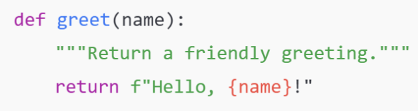
Introduction to Coding
In this module, we shall be learning to code in Python
Slide 7/19

Slide 82
Introduction to Coding
In this module, we shall be learning to code in Python
Python is a programming language
Slide 7/19

Slide 83
Introduction to Coding
In this module, we shall be learning to code in Python
Python is a programming language
  In the same way humans communicate using different languages, there are many languages we can use to communicate with a computer
Slide 7/19

Slide 84
Introduction to Coding
In this module, we shall be learning to code in Python
Python is a programming language
  In the same way humans communicate using different languages, there are many languages we can use to communicate with a computer
Python is particularly useful for:
Slide 7/19

Slide 85
Introduction to Coding
In this module, we shall be learning to code in Python
Python is a programming language
  In the same way humans communicate using different languages, there are many languages we can use to communicate with a computer
Python is particularly useful for:
  Analysing data
Slide 7/19

Slide 86
Introduction to Coding
In this module, we shall be learning to code in Python
Python is a programming language
  In the same way humans communicate using different languages, there are many languages we can use to communicate with a computer
Python is particularly useful for:
  Analysing data
  Making plots and visualisations
Slide 7/19

Slide 87
Introduction to Coding
In this module, we shall be learning to code in Python
Python is a programming language
  In the same way humans communicate using different languages, there are many languages we can use to communicate with a computer
Python is particularly useful for:
  Analysing data
  Making plots and visualisations
  Running simulations
Slide 7/19

Slide 88
Introduction to Coding
In this module, we shall be learning to code in Python
Python is a programming language
  In the same way humans communicate using different languages, there are many languages we can use to communicate with a computer
Python is particularly useful for:
  Analysing data
  Making plots and visualisations
  Running simulations
  Machine learning and AI
Slide 7/19

Slide 89
Learning to Code
Slide 8/19

Slide 90
Learning to Code
In fact, learning to code is a lot like learning a language
Slide 8/19

Slide 91
Learning to Code
In fact, learning to code is a lot like learning a language
When learning French, you might:
Slide 8/19

Slide 92
Learning to Code
In fact, learning to code is a lot like learning a language
When learning French, you might:
  Learn many phrases
Slide 8/19

Slide 93
Learning to Code
In fact, learning to code is a lot like learning a language
When learning French, you might:
  Learn many phrases
  Practice writing sentences
Slide 8/19

Slide 94
Learning to Code
In fact, learning to code is a lot like learning a language
When learning French, you might:
  Learn many phrases
  Practice writing sentences
  Speak to people who know the language
Slide 8/19

Slide 95
Learning to Code
In fact, learning to code is a lot like learning a language
When learning French, you might:
  Learn many phrases
  Practice writing sentences
  Speak to people who know the language
You can’t learn a language by listening to other people describe it…
Slide 8/19

Slide 96
Learning to Code
In fact, learning to code is a lot like learning a language
When learning French, you might:
  Learn many phrases
  Practice writing sentences
  Speak to people who know the language
You can’t learn a language by listening to other people describe it…
Hands-on experience and regular practice are crucial!
Slide 8/19

Slide 97
Learning to Code
In fact, learning to code is a lot like learning a language
When learning French, you might:
  Learn many phrases
  Practice writing sentences
  Speak to people who know the language
You can’t learn a language by listening to other people describe it…
Hands-on experience and regular practice are crucial!
Our goal is to give you as much practice as possible!
Slide 8/19

Slide 98
Learning to Code
In fact, learning to code is a lot like learning a language
When learning French, you might:
  Learn many phrases
  Practice writing sentences
  Speak to people who know the language
You can’t learn a language by listening to other people describe it…
Hands-on experience and regular practice are crucial!
Slide 8/19

Slide 99
Getting Started
Slide 9/19

Slide 100
Getting Started
So… what actually is coding?
Slide 9/19

Slide 101
Getting Started
So… what actually is coding?
You can think of writing code as like writing a recipe…
Slide 9/19

Slide 102
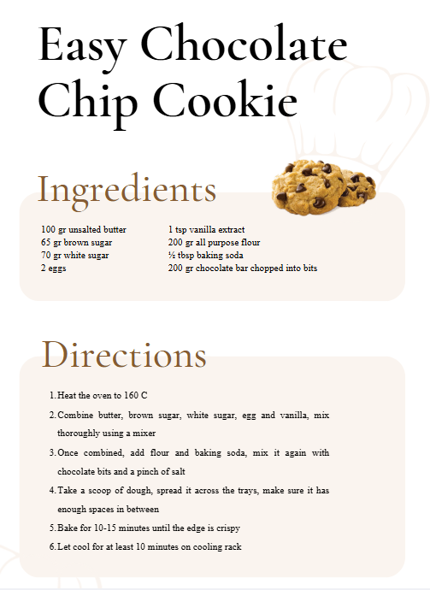
Getting Started
So… what actually is coding?
You can think of writing code as like writing a recipe…
Slide 9/19

Slide 103
Getting Started
So… what actually is coding?
You can think of writing code as like writing a recipe…
  You might start by specifying some ingredients…
Slide 9/19

Slide 104
Getting Started
So… what actually is coding?
You can think of writing code as like writing a recipe…
  You might start by specifying some ingredients…
Slide 9/19

Slide 105
Getting Started
So… what actually is coding?
You can think of writing code as like writing a recipe…
  You might start by specifying some ingredients…
Slide 9/19

Slide 106
Getting Started
So… what actually is coding?
You can think of writing code as like writing a recipe…
  You might start by specifying some ingredients…
  Then list some instructions…
Slide 9/19

Slide 107
Getting Started
So… what actually is coding?
You can think of writing code as like writing a recipe…
  You might start by specifying some ingredients…
  Then list some instructions…
Slide 9/19

Slide 108
Getting Started
So… what actually is coding?
You can think of writing code as like writing a recipe…
  You might start by specifying some ingredients…
  Then list some instructions…
Slide 9/19

Slide 109
Getting Started
So… what actually is coding?
You can think of writing code as like writing a recipe…
  You might start by specifying some ingredients…
  Then list some instructions…
  To get a desired output
Slide 9/19

Slide 110
Getting Started
So… what actually is coding?
You can think of writing code as like writing a recipe…
  You might start by specifying some ingredients…
  Then list some instructions…
  To get a desired output
Slide 9/19

Slide 111
Getting Started
So… what actually is coding?
You can think of writing code as like writing a recipe…
  You might start by specifying some ingredients…
  Then list some instructions…
  To get a desired output
Slide 9/19

Slide 112
Getting Started
So… what actually is coding?
You can think of writing code as like writing a recipe…
  You might start by specifying some ingredients…
  Then list some instructions…
  To get a desired output
Coding is pretty similar
Slide 9/19

Slide 113
Getting Started
So… what actually is coding?
You can think of writing code as like writing a recipe…
  You might start by specifying some ingredients…
  Then list some instructions…
  To get a desired output
Coding is pretty similar
Slide 9/19

Slide 114
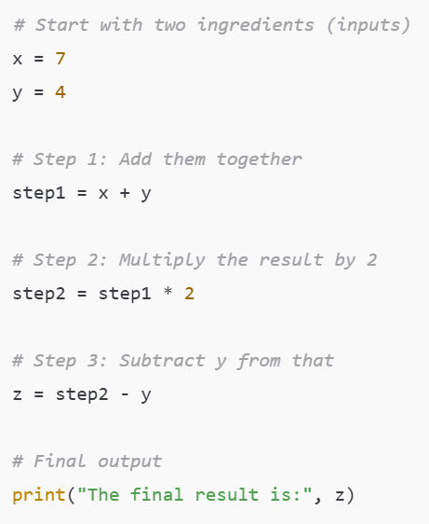
Getting Started
So… what actually is coding?
You can think of writing code as like writing a recipe…
  You might start by specifying some ingredients…
  Then list some instructions…
  To get a desired output
Coding is pretty similar
Slide 9/19

Slide 115
Getting Started
So… what actually is coding?
You can think of writing code as like writing a recipe…
  You might start by specifying some inputs…
  Then list some instructions…
  To get a desired output
Coding is pretty similar
Slide 10/19

Slide 116
Getting Started
So… what actually is coding?
You can think of writing code as like writing a recipe…
  You might start by specifying some inputs…
  Then list some instructions…
  To get a desired output
Coding is pretty similar
Slide 10/19

Slide 117
Getting Started
So… what actually is coding?
You can think of writing code as like writing a recipe…
  You might start by specifying some inputs…
  Then list some instructions…
  To get a desired output
Coding is pretty similar
Slide 10/19

Slide 118
Getting Started
So… what actually is coding?
You can think of writing code as like writing a recipe…
  You might start by specifying some inputs…
  Then list some instructions…
  To get a desired output
Coding is pretty similar
Slide 10/19

Slide 119
Getting Started
So… what actually is coding?
You can think of writing code as like writing a recipe…
  You might start by specifying some inputs…
  Then list some instructions…
  To get a desired output
Coding is pretty similar
Slide 10/19

Slide 120
Getting Started
So… what actually is coding?
You can think of writing code as like writing a recipe…
  You might start by specifying some inputs…
  Then list some instructions…
  To get a desired output
Coding is pretty similar
Slide 10/19

Slide 121
Getting Started
So… what actually is coding?
You can think of writing code as like writing a recipe…
  You might start by specifying some inputs…
  Then list some instructions…
  To get a desired output
Coding is pretty similar
Slide 10/19

Slide 122
Getting Started
So… what actually is coding?
You can think of writing code as like writing a recipe…
  You might start by specifying some inputs…
  Then list some instructions…
  To get a desired output
Coding is pretty similar
Slide 10/19

Slide 123
Getting Started
So… what actually is coding?
You can think of writing code as like writing a recipe…
  You might start by specifying some inputs…
  Then list some instructions…
  To get a desired output
Coding is pretty similar
Slide 10/19

Slide 124
Getting Started
So… what actually is coding?
You can think of writing code as like writing a recipe…
  You might start by specifying some inputs…
  Then list some instructions…
  To get a desired output
Coding is pretty similar
Here we are producing some output that might be difficult to compute or evaluate by hand
Slide 10/19

Slide 125
Getting Started
Slide 10/19

Slide 126
Assigning Variables
Slide 11/19

Slide 127

Assigning Variables
Slide 11/19

Slide 128
Assigning Variables
Slide 11/19

Slide 129
Assigning Variables
In this code, x and y are variables
Slide 11/19

Slide 130
Assigning Variables
In this code, x and y are variables
These are named pieces of data which we can use for future computations
Slide 11/19

Slide 131
Assigning Variables
In this code, x and y are variables
These are named pieces of data which we can use for future computations
The ‘=‘ symbol is the assignment operator.
Slide 11/19

Slide 132
Assigning Variables
In this code, x and y are variables
These are named pieces of data which we can use for future computations
The ‘=‘ symbol is the assignment operator.
Assignment operator
Slide 11/19

Slide 133
Assigning Variables
In this code, x and y are variables
These are named pieces of data which we can use for future computations
The ‘=‘ symbol is the assignment operator.
Slide 11/19

Slide 134
Assigning Variables
In this code, x and y are variables
These are named pieces of data which we can use for future computations
The ‘=‘ symbol is the assignment operator.
  Unlike in maths, this is an instruction
Slide 11/19

Slide 135
Assigning Variables
In this code, x and y are variables
These are named pieces of data which we can use for future computations
The ‘=‘ symbol is the assignment operator.
  Unlike in maths, this is an instruction
  E.g. “x=7” means “Save the integer 7 under the variable name x”
Slide 11/19

Slide 136
Data Types
Slide 12/19

Slide 137
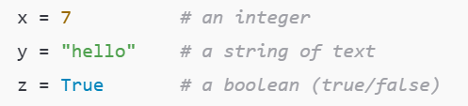
Data Types
Slide 12/19

Slide 138
Data Types
When writing the recipe, some foods were of the “same type”
Slide 12/19

Slide 139
Data Types
When writing the recipe, some foods were of the “same type”
  E.g. we had 2 eggs
Slide 12/19

Slide 140
Data Types
When writing the recipe, some foods were of the “same type”
  E.g. we had 2 eggs
In the same way, in coding we have different types of data
Slide 12/19

Slide 141
Data Types
When writing the recipe, some foods were of the “same type”
  E.g. we had 2 eggs
In the same way, in coding we have different types of data
Today, we shall look at some of these
Slide 12/19

Slide 142
Data Types
When writing the recipe, some foods were of the “same type”
  E.g. we had 2 eggs
In the same way, in coding we have different types of data
Today, we shall look at some of these
Understanding data types is important, as we want to use different data types for different tasks
Slide 12/19

Slide 143
Numeric Data Types
Slide 13/19

Slide 144
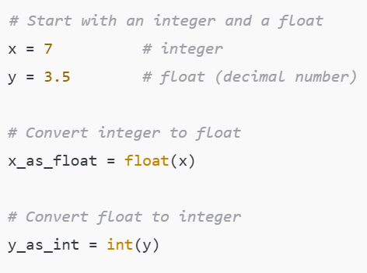

Numeric Data Types
Slide 13/19

Slide 145
Numeric Data Types
The most ubiquitous data types are numeric
Slide 13/19

Slide 146
Numeric Data Types
The most ubiquitous data types are numeric
Slide 13/19

Slide 147
Numeric Data Types
The most ubiquitous data types are numeric
  Integers: Whole numbers/Integers
Slide 13/19

Slide 148
Numeric Data Types
The most ubiquitous data types are numeric
  Integers: Whole numbers/Integers
  ℤ = {…, -3, -2, -1, 0, 1, 2, 3,… }
Slide 13/19

Slide 149
Numeric Data Types
The most ubiquitous data types are numeric
  Integers: Whole numbers/Integers
  ℤ = {…, -3, -2, -1, 0, 1, 2, 3,… }
Slide 13/19

Slide 150
Numeric Data Types
The most ubiquitous data types are numeric
  Integers: Whole numbers/Integers
  ℤ = {…, -3, -2, -1, 0, 1, 2, 3,… }
  Floats: Decimal numbers
Slide 13/19

Slide 151
Numeric Data Types
The most ubiquitous data types are numeric
  Integers: Whole numbers/Integers
  ℤ = {…, -3, -2, -1, 0, 1, 2, 3,… }
  Floats: Decimal numbers
  ℝ = Real numbers
Slide 13/19

Slide 152
Numeric Data Types
The most ubiquitous data types are numeric
  Integers: Whole numbers/Integers
  ℤ = {…, -3, -2, -1, 0, 1, 2, 3,… }
  Floats: Decimal numbers
  ℝ = Real numbers
Slide 13/19

Slide 153
Numeric Data Types
The most ubiquitous data types are numeric
  Integers: Whole numbers/Integers
  ℤ = {…, -3, -2, -1, 0, 1, 2, 3,… }
  Floats: Decimal numbers
  ℝ = Real numbers
We can convert between float’s and integers using the float and int functions.
Slide 13/19

Slide 154
Numeric Data Types
The most ubiquitous data types are numeric
  Integers: Whole numbers/Integers
  ℤ = {…, -3, -2, -1, 0, 1, 2, 3,… }
  Floats: Decimal numbers
  ℝ = Real numbers
We can convert between float’s and integers using the float and int functions.
Slide 13/19

Slide 155
Numeric Data Types
The most ubiquitous data types are numeric
  Integers: Whole numbers/Integers
  ℤ = {…, -3, -2, -1, 0, 1, 2, 3,… }
  Floats: Decimal numbers
  ℝ = Real numbers
We can convert between float’s and integers using the float and int functions.
Slide 13/19

Slide 156
Numeric Data Types
The most ubiquitous data types are numeric
  Integers: Whole numbers/Integers
  ℤ = {…, -3, -2, -1, 0, 1, 2, 3,… }
  Floats: Decimal numbers
  ℝ = Real numbers
We can convert between float’s and integers using the float and int functions.
  What do you think might happen if we convert y to an integer?
Slide 13/19

Slide 157
Numeric Data Types
The most ubiquitous data types are numeric
  Integers: Whole numbers/Integers
  ℤ = {…, -3, -2, -1, 0, 1, 2, 3,… }
  Floats: Decimal numbers
  ℝ = Real numbers
We can convert between float’s and integers using the float and int functions.
  What do you think might happen if we convert y to an integer?
Warning: A computer cannot actually describe arbitrarily small and large numbers – it approximates instead
Slide 13/19

Slide 158
Numeric Data Types
The most ubiquitous data types are numeric
  Integers: Whole numbers/Integers
  ℤ = {…, -3, -2, -1, 0, 1, 2, 3,… }
  Floats: Decimal numbers
  ℝ = Real numbers
We can convert between float’s and integers using the float and int functions.
  What do you think might happen if we convert y to an integer?
Slide 13/19

Slide 159
Strings
Slide 14/19

Slide 160
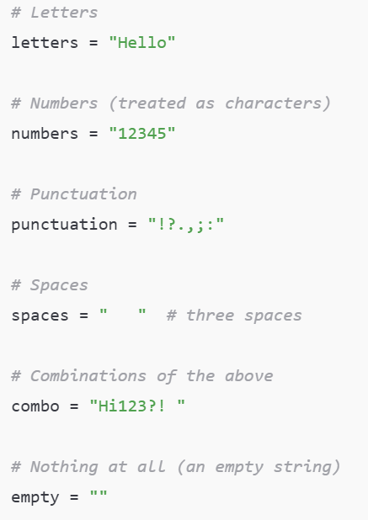
Strings
Slide 14/19

Slide 161
Strings
A string is a sequence of characters. Strings can contain:
Slide 14/19

Slide 162
Strings
A string is a sequence of characters. Strings can contain:
Letters
Slide 14/19

Slide 163
Strings
A string is a sequence of characters. Strings can contain:
Letters
Slide 14/19

Slide 164
Strings
A string is a sequence of characters. Strings can contain:
Letters
  Numbers (treated as characters)
Slide 14/19

Slide 165
Strings
A string is a sequence of characters. Strings can contain:
Letters
  Numbers (treated as characters)
Slide 14/19

Slide 166
Strings
A string is a sequence of characters. Strings can contain:
Letters
  Numbers (treated as characters)
  Punctuation
Slide 14/19

Slide 167
Strings
A string is a sequence of characters. Strings can contain:
Letters
  Numbers (treated as characters)
  Punctuation
Slide 14/19

Slide 168
Strings
A string is a sequence of characters. Strings can contain:
Letters
  Numbers (treated as characters)
  Punctuation
  Spaces
Slide 14/19

Slide 169
Strings
A string is a sequence of characters. Strings can contain:
Letters
  Numbers (treated as characters)
  Punctuation
  Spaces
Slide 14/19

Slide 170
Strings
A string is a sequence of characters. Strings can contain:
Letters
  Numbers (treated as characters)
  Punctuation
  Spaces
  Combinations of the above
Slide 14/19

Slide 171
Strings
A string is a sequence of characters. Strings can contain:
Letters
  Numbers (treated as characters)
  Punctuation
  Spaces
  Combinations of the above
Slide 14/19

Slide 172
Strings
A string is a sequence of characters. Strings can contain:
Letters
  Numbers (treated as characters)
  Punctuation
  Spaces
  Combinations of the above
  Nothing at all
Slide 14/19

Slide 173
Strings
A string is a sequence of characters. Strings can contain:
Letters
  Numbers (treated as characters)
  Punctuation
  Spaces
  Combinations of the above
  Nothing at all
Slide 14/19

Slide 174
Strings
A string is a sequence of characters. Strings can contain:
Letters
  Numbers (treated as characters)
  Punctuation
  Spaces
  Combinations of the above
  Nothing at all
Slide 14/19

Slide 175
Strings
A string is a sequence of characters. Strings can contain:
Letters
  Numbers (treated as characters)
  Punctuation
  Spaces
  Combinations of the above
  Nothing at all
Slide 14/19

Slide 176
Strings
A string is a sequence of characters. Strings can contain:
Letters
  Numbers (treated as characters)
  Punctuation
  Spaces
  Combinations of the above
  Nothing at all
Slide 14/19

Slide 177
Strings
A string is a sequence of characters. Strings can contain:
Letters
  Numbers (treated as characters)
  Punctuation
  Spaces
  Combinations of the above
  Nothing at all
Slide 14/19

Slide 178
Strings
A string is a sequence of characters. Strings can contain:
Letters
  Numbers (treated as characters)
  Punctuation
  Spaces
  Combinations of the above
  Nothing at all
Slide 14/19

Slide 179
Strings
A string is a sequence of characters. Strings can contain:
Letters
  Numbers (treated as characters)
  Punctuation
  Spaces
  Combinations of the above
  Nothing at all
Slide 14/19

Slide 180
Strings
A string is a sequence of characters. Strings can contain:
Letters
  Numbers (treated as characters)
  Punctuation
  Spaces
  Combinations of the above
  Nothing at all
Slide 14/19

Slide 181
Strings
A string is a sequence of characters. Strings can contain:
Letters
  Numbers (treated as characters)
  Punctuation
  Spaces
  Combinations of the above
  Nothing at all
In practice, there are many things we may want to do with text in Python
Slide 14/19

Slide 182
Strings
A string is a sequence of characters. Strings can contain:
Letters
  Numbers (treated as characters)
  Punctuation
  Spaces
  Combinations of the above
  Nothing at all
In practice, there are many things we may want to do with text in Python
Split it into sentences
Slide 14/19

Slide 183
Strings
A string is a sequence of characters. Strings can contain:
Letters
  Numbers (treated as characters)
  Punctuation
  Spaces
  Combinations of the above
  Nothing at all
In practice, there are many things we may want to do with text in Python
Split it into sentences
Search through it
Slide 14/19

Slide 184
Strings
A string is a sequence of characters. Strings can contain:
Letters
  Numbers (treated as characters)
  Punctuation
  Spaces
  Combinations of the above
  Nothing at all
In practice, there are many things we may want to do with text in Python
Split it into sentences
Search through it
Replace words
Slide 14/19

Slide 185
Strings
A string is a sequence of characters. Strings can contain:
Letters
  Numbers (treated as characters)
  Punctuation
  Spaces
  Combinations of the above
  Nothing at all
In practice, there are many things we may want to do with text in Python
Split it into sentences
Search through it
Replace words
After todays practical you will be able to perform some of these operations!
Slide 14/19

Slide 186
Strings
A string is a sequence of characters. Strings can contain:
Letters
  Numbers (treated as characters)
  Punctuation
  Spaces
  Combinations of the above
  Nothing at all
In practice, there are many things we may want to do with text in Python
Split it into sentences
Search through it
Replace words
Slide 14/19

Slide 187
Booleans
Slide 15/19

Slide 188
Booleans
A Boolean is variable that can be either True or False
Slide 15/19

Slide 189
Booleans
A Boolean is variable that can be either True or False
Booleans represent logical statements.
Slide 15/19

Slide 190
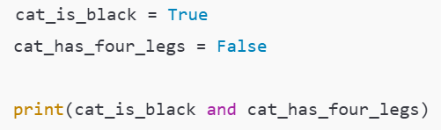
Booleans
A Boolean is variable that can be either True or False
Booleans represent logical statements.
Slide 15/19

Slide 191
Booleans
A Boolean is variable that can be either True or False
Booleans represent logical statements.
For instance, we might think of:
Slide 15/19

Slide 192
Booleans
A Boolean is variable that can be either True or False
Booleans represent logical statements.
For instance, we might think of:
cat_is_black as representing the sentence “The cat is black”
Slide 15/19

Slide 193
Booleans
A Boolean is variable that can be either True or False
Booleans represent logical statements.
For instance, we might think of:
cat_is_black as representing the sentence “The cat is black”
Slide 15/19

Slide 194
Booleans
A Boolean is variable that can be either True or False
Booleans represent logical statements.
For instance, we might think of:
cat_is_black as representing the sentence “The cat is black”
cat_has_four_legs as representing the sentence “The cat has four legs”
Slide 15/19

Slide 195
Booleans
A Boolean is variable that can be either True or False
Booleans represent logical statements.
For instance, we might think of:
cat_is_black as representing the sentence “The cat is black”
cat_has_four_legs as representing the sentence “The cat has four legs”
Slide 15/19

Slide 196
Booleans
A Boolean is variable that can be either True or False
Booleans represent logical statements.
For instance, we might think of:
cat_is_black as representing the sentence “The cat is black”
cat_has_four_legs as representing the sentence “The cat has four legs”
We can use logical operators to combine Boolean statements
Slide 15/19

Slide 197
Booleans
A Boolean is variable that can be either True or False
Booleans represent logical statements.
For instance, we might think of:
cat_is_black as representing the sentence “The cat is black”
cat_has_four_legs as representing the sentence “The cat has four legs”
We can use logical operators to combine Boolean statements
cat_is_black and cat_has_four_legs represents the sentence “The cat is black and has four legs”
Slide 15/19

Slide 198
Booleans
A Boolean is variable that can be either True or False
Booleans represent logical statements.
For instance, we might think of:
cat_is_black as representing the sentence “The cat is black”
cat_has_four_legs as representing the sentence “The cat has four legs”
We can use logical operators to combine Boolean statements
cat_is_black and cat_has_four_legs represents the sentence “The cat is black and has four legs”
Slide 15/19

Slide 199
Booleans
A Boolean is variable that can be either True or False
Booleans represent logical statements.
For instance, we might think of:
cat_is_black as representing the sentence “The cat is black”
cat_has_four_legs as representing the sentence “The cat has four legs”
We can use logical operators to combine Boolean statements
cat_is_black and cat_has_four_legs represents the sentence “The cat is black and has four legs”
Slide 15/19

Slide 200

Booleans
A Boolean is variable that can be either True or False
Booleans represent logical statements.
For instance, we might think of:
cat_is_black as representing the sentence “The cat is black”
cat_has_four_legs as representing the sentence “The cat has four legs”
We can use logical operators to combine Boolean statements
cat_is_black and cat_has_four_legs represents the sentence “The cat is black and has four legs”
Slide 15/19

Slide 201
Booleans
A Boolean is variable that can be either True or False
Booleans represent logical statements.
For instance, we might think of:
cat_is_black as representing the sentence “The cat is black”
cat_has_four_legs as representing the sentence “The cat has four legs”
We can use logical operators to combine Boolean statements
cat_is_black and cat_has_four_legs represents the sentence “The cat is black and has four legs”
Slide 15/19

Slide 202

Booleans
A Boolean is variable that can be either True or False
Booleans represent logical statements.
For instance, we might think of:
cat_is_black as representing the sentence “The cat is black”
cat_has_four_legs as representing the sentence “The cat has four legs”
We can use logical operators to combine Boolean statements
cat_is_black and cat_has_four_legs represents the sentence “The cat is black and has four legs”
Slide 15/19

Slide 203

Booleans
A Boolean is variable that can be either True or False
Booleans represent logical statements.
For instance, we might think of:
cat_is_black as representing the sentence “The cat is black”
cat_has_four_legs as representing the sentence “The cat has four legs”
We can use logical operators to combine Boolean statements
cat_is_black and cat_has_four_legs represents the sentence “The cat is black and has four legs”
Slide 15/19

Slide 204
Booleans
A Boolean is variable that can be either True or False
Booleans represent logical statements.
For instance, we might think of:
cat_is_black as representing the sentence “The cat is black”
cat_has_four_legs as representing the sentence “The cat has four legs”
We can use logical operators to combine Boolean statements
cat_is_black and cat_has_four_legs represents the sentence “The cat is black and has four legs”
Slide 15/19

Slide 205
Booleans
A Boolean is variable that can be either True or False
Booleans represent logical statements.
For instance, we might think of:
cat_is_black as representing the sentence “The cat is black”
cat_has_four_legs as representing the sentence “The cat has four legs”
We can use logical operators to combine Boolean statements
cat_is_black and cat_has_four_legs represents the sentence “The cat is black and has four legs”
Slide 15/19

Slide 206
Booleans
A Boolean is variable that can be either True or False
Booleans represent logical statements.
For instance, we might think of:
cat_is_black as representing the sentence “The cat is black”
cat_has_four_legs as representing the sentence “The cat has four legs”
We can use logical operators to combine Boolean statements
cat_is_black and cat_has_four_legs represents the sentence “The cat is black and has four legs”
Slide 15/19

Slide 207

Booleans
A Boolean is variable that can be either True or False
Booleans represent logical statements.
For instance, we might think of:
cat_is_black as representing the sentence “The cat is black”
cat_has_four_legs as representing the sentence “The cat has four legs”
We can use logical operators to combine Boolean statements
cat_is_black and cat_has_four_legs represents the sentence “The cat is black and has four legs”
Slide 15/19

Slide 208
Booleans
A Boolean is variable that can be either True or False
Booleans represent logical statements.
For instance, we might think of:
cat_is_black as representing the sentence “The cat is black”
cat_has_four_legs as representing the sentence “The cat has four legs”
We can use logical operators to combine Boolean statements
cat_is_black and cat_has_four_legs represents the sentence “The cat is black and has four legs”
Slide 15/19

Slide 209
Booleans
A Boolean is variable that can be either True or False
Booleans represent logical statements.
For instance, we might think of:
cat_is_black as representing the sentence “The cat is black”
cat_has_four_legs as representing the sentence “The cat has four legs”
We can use logical operators to combine Boolean statements
cat_is_black and cat_has_four_legs represents the sentence “The cat is black and has four legs”
Slide 15/19

Slide 210
Booleans
A Boolean is variable that can be either True or False
Booleans represent logical statements.
For instance, we might think of:
cat_is_black as representing the sentence “The cat is black”
cat_has_four_legs as representing the sentence “The cat has four legs”
We can use logical operators to combine Boolean statements
cat_is_black and cat_has_four_legs represents the sentence “The cat is black and has four legs”
Slide 15/19

Slide 211
Booleans
A Boolean is variable that can be either True or False
Booleans represent logical statements.
For instance, we might think of:
cat_is_black as representing the sentence “The cat is black”
cat_has_four_legs as representing the sentence “The cat has four legs”
We can use logical operators to combine Boolean statements
cat_is_black and cat_has_four_legs represents the sentence “The cat is black and has four legs”
Slide 15/19

Slide 212
Booleans
A Boolean is variable that can be either True or False
Booleans represent logical statements.
For instance, we might think of:
cat_is_black as representing the sentence “The cat is black”
cat_has_four_legs as representing the sentence “The cat has four legs”
We can use logical operators to combine Boolean statements
cat_is_black and cat_has_four_legs represents the sentence “The cat is black and has four legs”
Slide 15/19

Slide 213
Booleans
A Boolean is variable that can be either True or False
Booleans represent logical statements.
For instance, we might think of:
cat_is_black as representing the sentence “The cat is black”
cat_has_four_legs as representing the sentence “The cat has four legs”
We can use logical operators to combine Boolean statements
cat_is_black and cat_has_four_legs represents the sentence “The cat is black and has four legs”
Slide 15/19

Slide 214
Booleans
A Boolean is variable that can be either True or False
Booleans represent logical statements.
For instance, we might think of:
cat_is_black as representing the sentence “The cat is black”
cat_has_four_legs as representing the sentence “The cat has four legs”
We can use logical operators to combine Boolean statements
cat_is_black and cat_has_four_legs represents the sentence “The cat is black and has four legs”
Slide 15/19

Slide 215
Collections
Slide 16/19

Slide 216
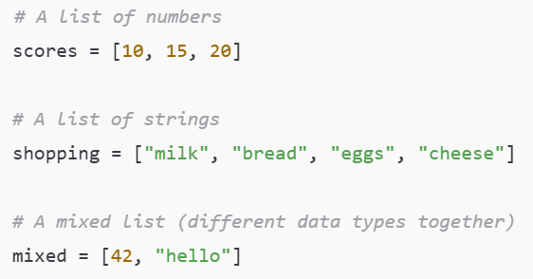
Collections
Slide 16/19

Slide 217
Collections
We’ve now seen some simple examples of datatypes:
Slide 16/19

Slide 218
Collections
We’ve now seen some simple examples of datatypes:
  Numeric, strings, and booleans.
Slide 16/19

Slide 219
Collections
We’ve now seen some simple examples of datatypes:
  Numeric, strings, and booleans.
Data types don’t always have to be this simple!
Slide 16/19

Slide 220
Collections
We’ve now seen some simple examples of datatypes:
  Numeric, strings, and booleans.
Data types don’t always have to be this simple!
  Sometimes we need data types that can hold more complex information.
Slide 16/19

Slide 221
Collections
We’ve now seen some simple examples of datatypes:
  Numeric, strings, and booleans.
Data types don’t always have to be this simple!
  Sometimes we need data types that can hold more complex information.
We’ll see more examples throughout the course but for now we’ll provide just one
Slide 16/19

Slide 222
Collections
We’ve now seen some simple examples of datatypes:
  Numeric, strings, and booleans.
Data types don’t always have to be this simple!
  Sometimes we need data types that can hold more complex information.
We’ll see more examples throughout the course but for now we’ll provide just one
A collection is any in-built data type that can group multiple objects together.
Slide 16/19

Slide 223
Collections
We’ve now seen some simple examples of datatypes:
  Numeric, strings, and booleans.
Data types don’t always have to be this simple!
  Sometimes we need data types that can hold more complex information.
We’ll see more examples throughout the course but for now we’ll provide just one
A collection is any in-built data type that can group multiple objects together.
The most common collection is a list: an ordered group of items.
Slide 16/19

Slide 224
Collections
We’ve now seen some simple examples of datatypes:
  Numeric, strings, and booleans.
Data types don’t always have to be this simple!
  Sometimes we need data types that can hold more complex information.
We’ll see more examples throughout the course but for now we’ll provide just one
A collection is any in-built data type that can group multiple objects together.
The most common collection is a list: an ordered group of items.
Slide 16/19

Slide 225
Collections
We’ve now seen some simple examples of datatypes:
  Numeric, strings, and booleans.
Data types don’t always have to be this simple!
  Sometimes we need data types that can hold more complex information.
We’ll see more examples throughout the course but for now we’ll provide just one
A collection is any in-built data type that can group multiple objects together.
The most common collection is a list: an ordered group of items.
Slide 16/19

Slide 226
Collections
We’ve now seen some simple examples of datatypes:
  Numeric, strings, and booleans.
Data types don’t always have to be this simple!
  Sometimes we need data types that can hold more complex information.
We’ll see more examples throughout the course but for now we’ll provide just one
A collection is any in-built data type that can group multiple objects together.
The most common collection is a list: an ordered group of items.
Slide 16/19

Slide 227
Collections
We’ve now seen some simple examples of datatypes:
  Numeric, strings, and booleans.
Data types don’t always have to be this simple!
  Sometimes we need data types that can hold more complex information.
We’ll see more examples throughout the course but for now we’ll provide just one
A collection is any in-built data type that can group multiple objects together.
The most common collection is a list: an ordered group of items.
  Lists let you store, organize, and work with many values at once.
Slide 16/19

Slide 228
Practical
Slide 17/19

Slide 229
Practical
We have students from a range of courses and backgrounds in this class
Slide 17/19

Slide 230
Practical
We have students from a range of courses and backgrounds in this class
  Chemistry
Slide 17/19

Slide 231

Practical
We have students from a range of courses and backgrounds in this class
  Chemistry
Slide 17/19

Slide 232
Practical
We have students from a range of courses and backgrounds in this class
  Chemistry
  Physics
Slide 17/19

Slide 233
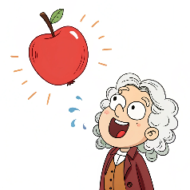
Practical
We have students from a range of courses and backgrounds in this class
  Chemistry
  Physics
Slide 17/19

Slide 234
Practical
We have students from a range of courses and backgrounds in this class
  Chemistry
  Physics
  Data Science
Slide 17/19

Slide 235

Practical
We have students from a range of courses and backgrounds in this class
  Chemistry
  Physics
  Data Science
Slide 17/19

Slide 236
Practical
We have students from a range of courses and backgrounds in this class
  Chemistry
  Physics
  Data Science
Some people in the room will have less experience than others
Slide 17/19

Slide 237
Practical
We have students from a range of courses and backgrounds in this class
  Chemistry
  Physics
  Data Science
Some people in the room will have less experience than others
For the first few weeks, we shall try to account for the differences in ability where possible
Slide 17/19

Slide 238
Practical
Slide 18/19

Slide 239
Practical
We now move over to Python
Slide 18/19

Slide 240
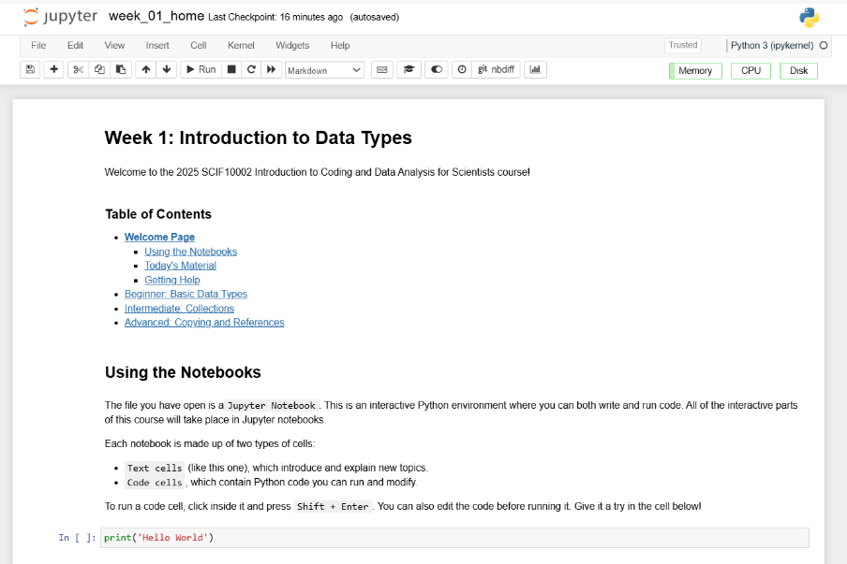
Practical
We now move over to Python
Slide 18/19

Slide 241
Practical
We now move over to Python
  Please open `week_01_home.ipynb`
Slide 18/19

Slide 242
Practical
We now move over to Python
  Please open `week_01_home.ipynb`
For the rest of today, you must work through a Python notebook
Slide 18/19

Slide 243
Practical
We now move over to Python
  Please open `week_01_home.ipynb`
For the rest of today, you must work through a Python notebook
You have a choice of one of three options
Slide 18/19

Slide 244
Practical
We now move over to Python
  Please open `week_01_home.ipynb`
For the rest of today, you must work through a Python notebook
You have a choice of one of three options
  Option 1: Beginner - Basic Data Types
Slide 18/19

Slide 245
Practical
We now move over to Python
  Please open `week_01_home.ipynb`
For the rest of today, you must work through a Python notebook
You have a choice of one of three options
  Option 1: Beginner - Basic Data Types
  Option 2: Intermediate - Collections
Slide 18/19

Slide 246
Practical
We now move over to Python
  Please open `week_01_home.ipynb`
For the rest of today, you must work through a Python notebook
You have a choice of one of three options
  Option 1: Beginner - Basic Data Types
  Option 2: Intermediate - Collections
  Option 3: Advanced - Copying and References
Slide 18/19

Slide 247
Practical
We now move over to Python
  Please open `week_01_home.ipynb`
For the rest of today, you must work through a Python notebook
You have a choice of one of three options
  Option 1: Beginner - Basic Data Types
  Option 2: Intermediate - Collections
  Option 3: Advanced - Copying and References
Choose this if you are new to the Python language or do not code regularly
Slide 18/19

Slide 248
Practical
We now move over to Python
  Please open `week_01_home.ipynb`
For the rest of today, you must work through a Python notebook
You have a choice of one of three options
  Option 1: Beginner - Basic Data Types
  Option 2: Intermediate - Collections
  Option 3: Advanced - Copying and References
Slide 18/19

Slide 249
Practical
We now move over to Python
  Please open `week_01_home.ipynb`
For the rest of today, you must work through a Python notebook
You have a choice of one of three options
  Option 1: Beginner - Basic Data Types
  Option 2: Intermediate - Collections
  Option 3: Advanced - Copying and References
Choose this if you have some experience with Python and are reasonably confident in your programming abilities
Slide 18/19

Slide 250
Practical
We now move over to Python
  Please open `week_01_home.ipynb`
For the rest of today, you must work through a Python notebook
You have a choice of one of three options
  Option 1: Beginner - Basic Data Types
  Option 2: Intermediate - Collections
  Option 3: Advanced - Copying and References
Slide 18/19

Slide 251
Practical
We now move over to Python
  Please open `week_01_home.ipynb`
For the rest of today, you must work through a Python notebook
You have a choice of one of three options
  Option 1: Beginner - Basic Data Types
  Option 2: Intermediate - Collections
  Option 3: Advanced - Copying and References
Choose this if you are a very strong Python programmer with a lot of experience
Slide 18/19

Slide 252
Practical
We now move over to Python
  Please open `week_01_home.ipynb`
For the rest of today, you must work through a Python notebook
You have a choice of one of three options
  Option 1: Beginner - Basic Data Types
  Option 2: Intermediate - Collections
  Option 3: Advanced - Copying and References
Slide 18/19

Slide 253
Practical
We now move over to Python
  Please open `week_01_home.ipynb`
For the rest of today, you must work through a Python notebook
You have a choice of one of three options
  Option 1: Beginner - Basic Data Types
  Option 2: Intermediate - Collections
  Option 3: Advanced - Copying and References
Important: If you choose the intermediate or advanced options, make sure you are comfortable with the material in Beginner first!!
Slide 18/19

Slide 254
Practical
We now move over to Python
  Please open `week_01_home.ipynb`
For the rest of today, you must work through a Python notebook
You have a choice of one of three options
  Option 1: Beginner - Basic Data Types
  Option 2: Intermediate - Collections
  Option 3: Advanced - Copying and References
Important: If you choose the intermediate or advanced options, make sure you are comfortable with the material in Beginner first!!
Slide 18/19

Slide 255
Practical
We now move over to Python
  Please open `week_01_home.ipynb`
For the rest of today, you must work through a Python notebook
You have a choice of one of three options
  Option 1: Beginner - Basic Data Types
  Option 2: Intermediate - Collections
  Option 3: Advanced - Copying and References
Slide 18/19

Slide 256
Next Time
Lecture 1: Introduction and Data Types
  Course Structure
  Setting up Noteable
  Introduction to Coding
  Data Types
  Practical
Lecture 2: Booleans and Conditionals
  Recap: Accessing Noteable
  Recap: Booleans
  If statements
  Practical
Slide 19/19

