Slide 1




Human-Centered Computing
RESEARCH GROUP
Von Bits und Beats
Bau dein eigenes Musikinstrument
Jesse Josua Benjamin, Nicolo Knapp, Tim Korjakow

Slide 2
Team
Human-Centered Computing
RESEARCH GROUP
Workshopleiter*in 1
Informatikstudent @ Freie Universität Berlin
Workshopleiter*in 2
Informatikstudent @ Technische Universität Berlin

Slide 3
Agenda
Human-Centered Computing
RESEARCH GROUP
Einführung in die Programmierung
Kurze Pause
Bau eines Musikinstruments (Theremin)
Evaluation & Goody Bags

Slide 4
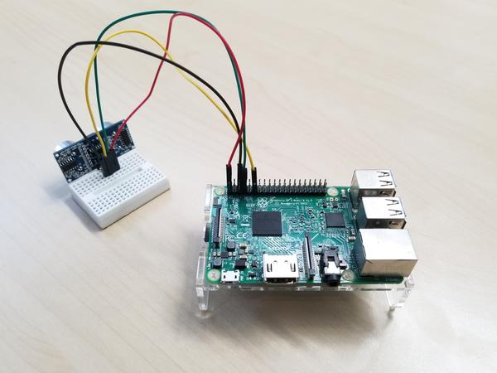
Motivation
Human-Centered Computing
RESEARCH GROUP
Theremin
Raspberry Pi
Ultraschallsensor

Slide 5
Human-Centered Computing
RESEARCH GROUP
(kurze) Einführung in die Programmierung

Slide 6
Variablen
Human-Centered Computing
RESEARCH GROUP
Programm
Ausgabe
x = 5
print(x)
5

Slide 7
Variablen
Human-Centered Computing
RESEARCH GROUP
Programm
Ausgabe
x = 5
y = 3.17
x = “Girl’s Day 2019”
print(x)
print(y)

Slide 8
Variablen
Human-Centered Computing
RESEARCH GROUP
Programm
Ausgabe
x = 5
y = 3.17
x = “Girl’s Day 2019”
print(x)
print(y)
“Girl’s Day 2019”
3.17

Slide 9
Schleifen
Human-Centered Computing
RESEARCH GROUP
Programm
Ausgabe
print(1)
print(2)
1
2

Slide 10

Schleifen
Human-Centered Computing
RESEARCH GROUP
Programm
Ausgabe
1
2
3
4
5
6
7

Slide 11
Schleifen
Human-Centered Computing
RESEARCH GROUP
Programm
Ausgabe
i = 1
while i < 8:
print(i)
i = i+1
1
2
3
4
5
6
7

Slide 12
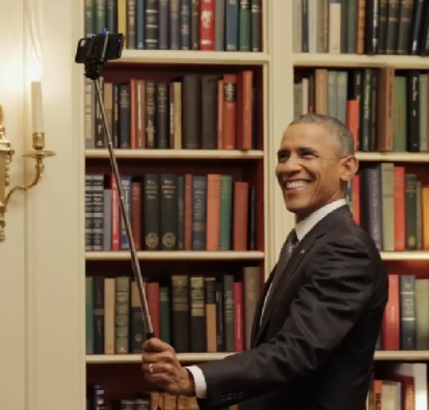
Funktionen
Human-Centered Computing
RESEARCH GROUP
Funktion “Selfie machen”
Handy aus der Tasche holen
Kamera App öffnen
Selfie schießen
Selfie Posten
… but first let me take a selfie

Slide 13
Funktionen
Human-Centered Computing
RESEARCH GROUP
Programm
Ausgabe
def say_hello(name):
print(“Hallo ” + name)
say_hello(“Lisa”)
say_hello(“Max”)
say_hello(“Katharina”)

Slide 14
Funktionen
Human-Centered Computing
RESEARCH GROUP
Programm
Ausgabe
def say_hello(name):
print(“Hallo ” + name)
say_hello(“Lisa”)
say_hello(“Max”)
say_hello(“Katharina”)
“Hallo Lisa”
“Hallo Max”
“Hallo Katharina”

Slide 15
Funktionen
Human-Centered Computing
RESEARCH GROUP
Programm
import math
def kreisumfang(radius):
c = 2 * math.pi * radius
return c
a = kreisumfang(1)
print(a)
Ausgabe
6.283185307179586

Slide 16
Human-Centered Computing
RESEARCH GROUP
(kurze) Pause

Slide 17
Human-Centered Computing
RESEARCH GROUP
Bau eines Musikinstruments (Theremin)

