Slide 1
Evaluation of WIT using the Guidelines for human-AI interaction design
From Franziska and Lukas

Slide 2
Severity*
The following 0 to 4 rating scale can be used to rate the severity of usability problems:
0 = I don't agree that this is a usability problem at all
1 = Cosmetic problem only: need not be fixed unless extra time is available on project
2 = Minor usability problem: fixing this should be given low priority
3 = Major usability problem: important to fix, so should be given high priority
4 = Usability catastrophe: imperative to fix this before product can be released
Source: https://www.nngroup.com/articles/how-to-rate-the-severity-of-usability-problems/

Slide 3
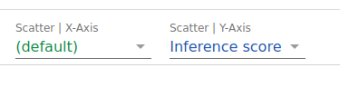
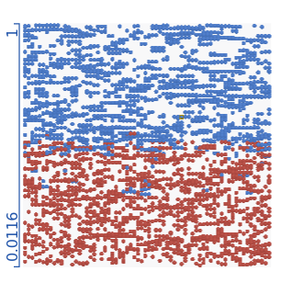
Issue 1: X-Axis
Heuristic:
4 Show contextually relevant information
Description:
It is not clear what the default is and thus the X-axis has no label.
Severity*: 3
Recommendation:
It should be recognizable what the default is.

Slide 4
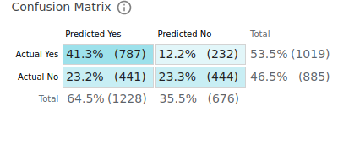
Issue 2: Coloring
Heuristic:
2 Make clear how well the system can do what it can do.
Description:
The coloring can be confusing. Different shades of blue are used for the confusion matrix.
Severity*: 1
Recommendation:
Different colors for the predictions.

