Slide 1
Evaluation of WIT using the Guidelines for
human-AI interaction design
From Jonas W. and Sebastian K.

Slide 2
Severity*
The following 0 to 4 rating scale can be used to rate the severity of usability problems:
0 = I don't agree that this is a usability problem at all
1 = Cosmetic problem only: need not be fixed unless extra time is available on project
2 = Minor usability problem: fixing this should be given low priority
3 = Major usability problem: important to fix, so should be given high priority
4 = Usability catastrophe: imperative to fix this before product can be released
Source: https://www.nngroup.com/articles/how-to-rate-the-severity-of-usability-problems/

Slide 3
Please copy the following page for each issue you find.

Slide 4
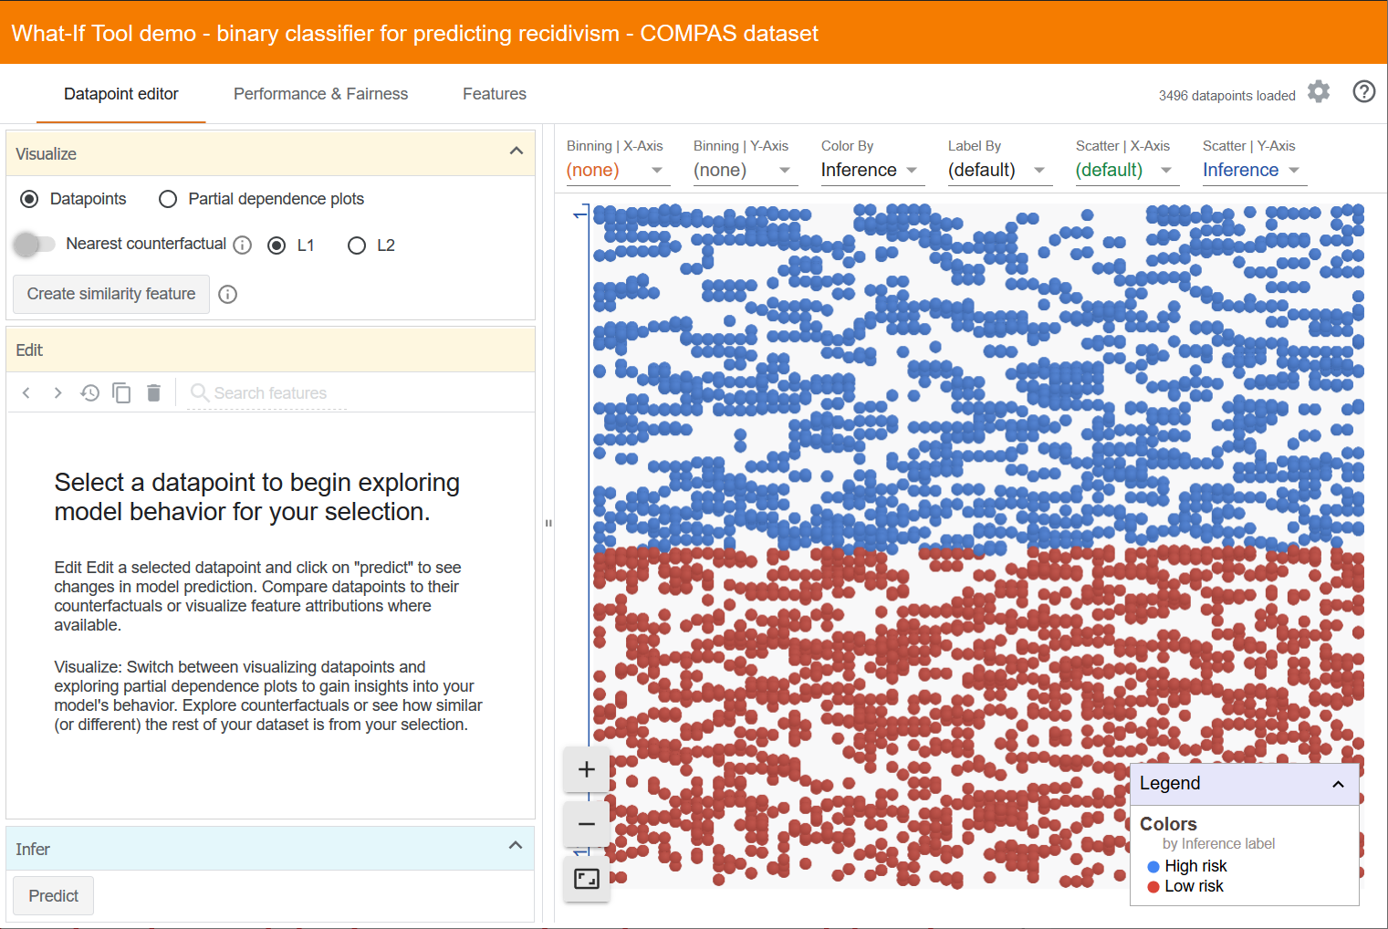
Issue X: Interface functionality not directly clear
Heuristic:
Guideline 1. Make clear what the system can do.
Description:
User is not presented with tool functionality
Severity*: 1
Recommendation:
Opening the tool could show a short general tool description

Slide 5
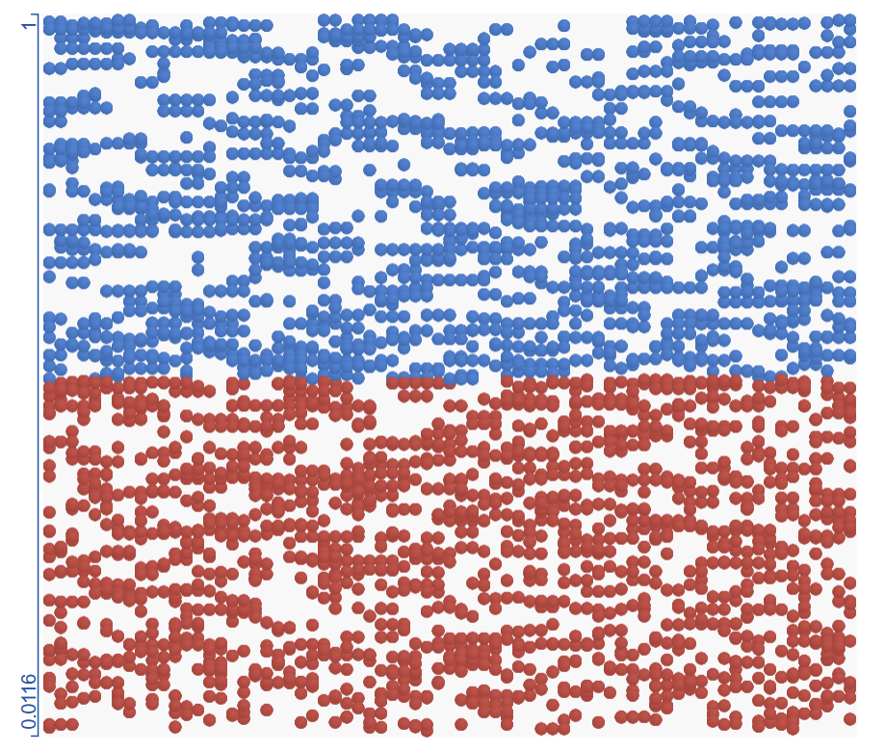
Issue X: General data plot is missing captions
Heuristic:
Guideline 4. Show contextually relevant information.
Description:
User is not presented with contextually relevant information
Severity*: 2
Recommendation:
Plot should automatically label axis

Slide 6
Issue X: Feedback
Heuristic:
Guideline 15. Encourage granular feedback.
Description:
There is no visible possibility to give feedback
Severity*: 1
Recommendation:
A feedback button could be implemented into the tool

