Slide 1
Evaluation of WIT using the Guidelines for
human-AI interaction design
From Gorgin and Xin

Slide 2
Severity*
The following 0 to 4 rating scale can be used to rate the severity of usability problems:
0 = I don't agree that this is a usability problem at all
1 = Cosmetic problem only: need not be fixed unless extra time is available on project
2 = Minor usability problem: fixing this should be given low priority
3 = Major usability problem: important to fix, so should be given high priority
4 = Usability catastrophe: imperative to fix this before product can be released
Source: https://www.nngroup.com/articles/how-to-rate-the-severity-of-usability-problems/

Slide 3
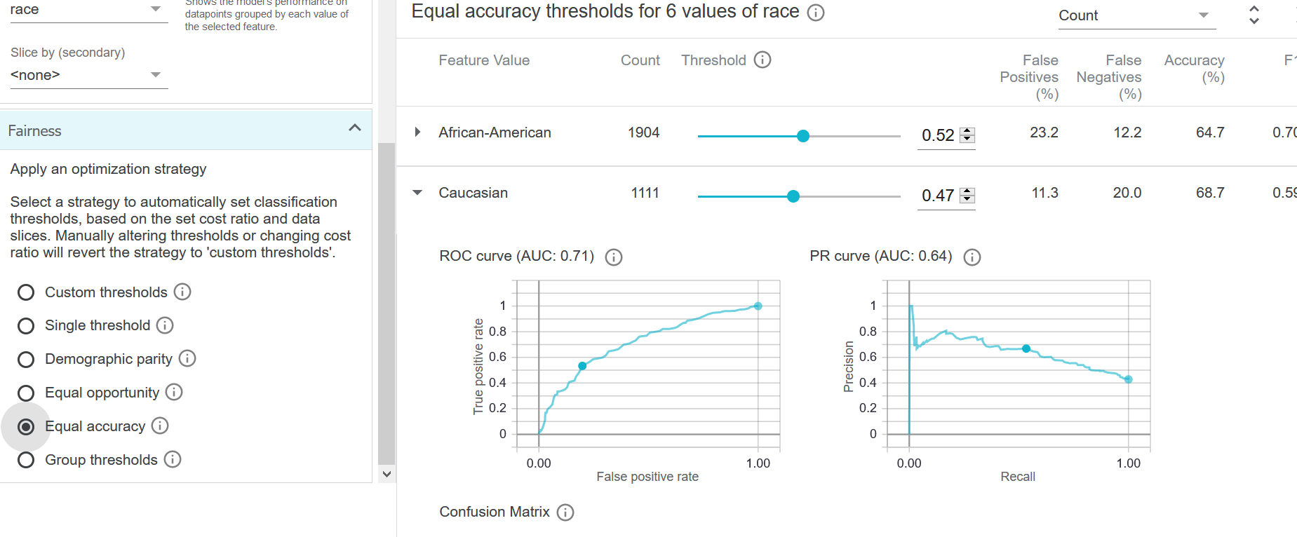
Issue 1: [changes unclear]
Heuristic:
[G4. Show contextually relevant information.]
Description:
[Unable to see what changes are caused in „Performance“ by changing/setting parameters.]
Severity*: [3]
Recommendation:
[Option 1: Highlight the block where changed are caused; Option 2: Generate an window to show user where changes can be found]

Slide 4
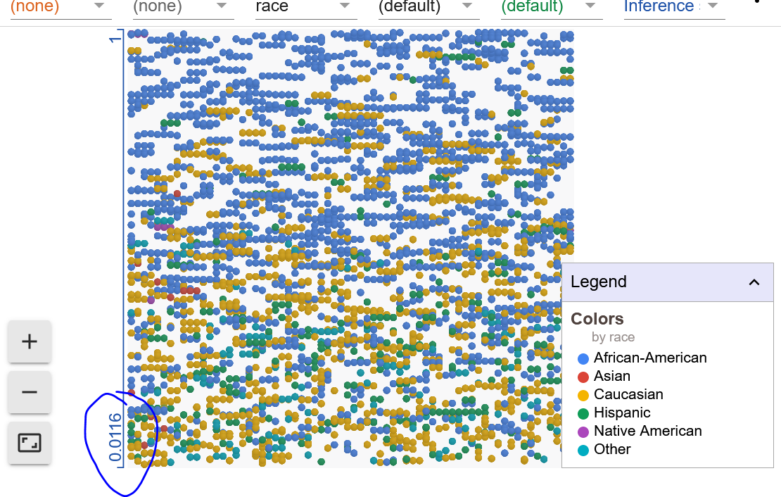
Issue 2: [Index unclear]
Heuristic:
[G4. Show contextually relevant information.]
Description:
[At first sight it may confusing why there is a 0.0116.]
Severity*: [3]
Recommendation:
[Just add information of 0.0116 which informs the users that the possibility of all data points of recidivism ranges from 0.0116 to 1.]

Slide 5
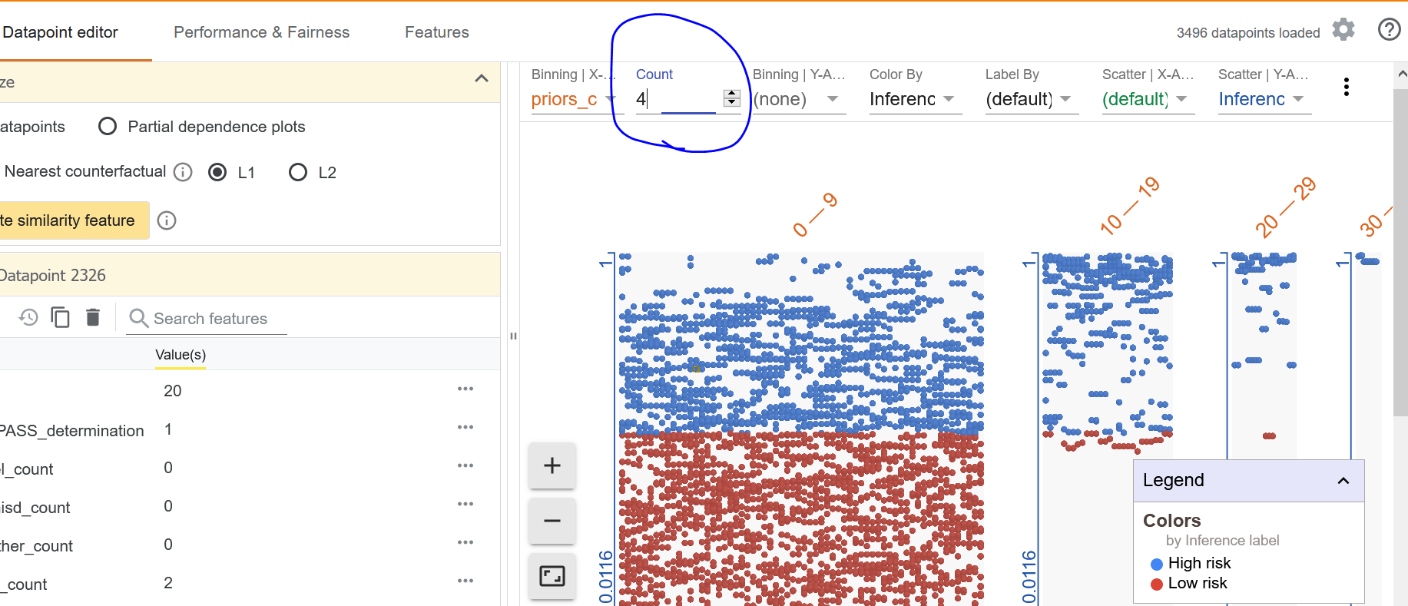
Issue 3: [Variable/Attribute unclear]
Heuristic:
[G4. Show contextually relevant information.]
Description:
[For some attributes, it is unclear what the „count“ means and influence the display. ]
Severity*: [3]
Recommendation:
[Add additional information. ]

Slide 6
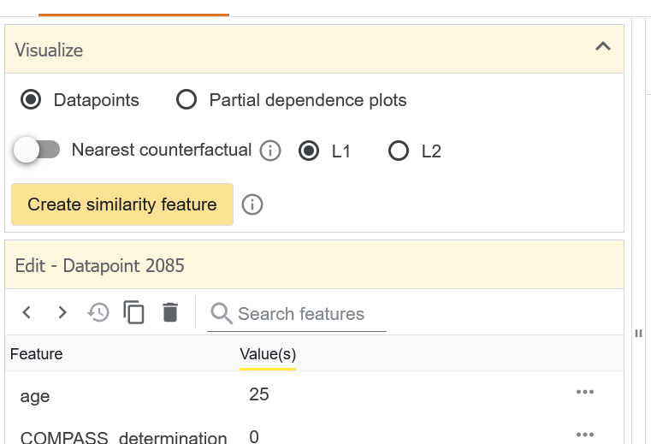
Issue 4: [L1 & L2 unclear]
Heuristic:
[G4. Show contextually relevant information.]
Description:
[L1 & L2 are not clarified and users may don‘t know what are they and how to choose between L1 and L2. ]
Severity*: [3]
Recommendation:
[Tell the users how L1 and L2 regularization will influence the result of nearest counterfactuals.]

Slide 7
Issue 5: [no “undo” option]
Heuristic:
[G12. Remember recent interactions. G9. Support efficient correction.]
Description:
[There is no „undo“ option or checkpoint preservation to go back to a previous status. ]
Severity*: [3]
Recommendation:
[Maintain short term memory or give users the right to preserve their own pathways.]

