Slide 1
All-in-One Store DX Platform
Reservations • Orders • Payments • Staff Management • Payroll All in one system.
TimeBaiBai Service Overview
2026 / Company Name Inc.

Slide 2
Do any of these sound familiar?
📞
Scattered Reservations
😰
No-Shows & Last-Minute Cancellations
Phone, LINE, email... different booking methods cause double-booking anxiety.
Customers book but don't show up. Lost revenue and wasted prep.
📝
Overwhelmed Order Taking
📦
Inventory Blind Spots
Can't take orders during rush hour. Order mistakes keep happening.
Items run out without warning. No idea when to reorder.

Slide 3
TimeBaiBai solves it all
One-stop platform for everything your store needs. Get started with just a smartphone.
6+
7
24h
$0
Core Modules
Languages Supported
Auto Booking
Paper Cost Savings
Reservations, table ordering, inventory, shift management, payroll, website management... Manage everything from a single dashboard — no more juggling separate tools. Setup is simple. Start using it the same day your account is created. No complicated installation or hardware required. Just access it from your phone or PC.

Slide 4
Key Features ① Reservations / Table Ordering
Online Reservation System
QR Table Ordering System
● Book via LINE — complete the reservation right from the chat
● Email reservations also supported for customer convenience
● Prepaid booking confirmation — auto-confirm on payment (prevents no-shows)
● Switch between prepaid / postpaid with one click in admin
● Staff calendars show real-time availability
● Two booking flows: by date or by staff member
● QR code check-in (zero reception effort)
● Auto LINE notification to staff on booking confirmation
● 7-language support (Japanese, English, Chinese, Korean, Spanish, Portuguese)
● Place QR codes on each table to get started
● Customers scan with their phone → browse menu → order
● Photo menus help customers visualize dishes
● Category tabs for quick item discovery
● Cart function for easy additional orders
● Real-time order status tracking
● Cash, credit card, and e-money payment support
● Bulk QR code generation and printable download from admin

Slide 5
Key Features ② Inventory / Staff & Shift Management
Inventory Management
Staff & Shift Management
● Real-time stock level tracking for all products
● Auto-deduct inventory linked to incoming orders
● Automatic alerts when stock runs low
● QR code receiving (no barcode scanner needed)
● Full history of all stock-in / stock-out transactions (audit-ready)
● Organized by product category for easy management
● Unified inventory for EC shop and in-store stock
● Stocktake function for bulk adjustments
● Staff submit shift preferences from their phones
● Three-level requests: Available / Preferred / Unavailable
● Managers finalize shifts from the admin dashboard
● Auto-scheduling for efficient staff allocation
● Confirmed shifts auto-notified to staff via LINE
● Staff profiles with photos and descriptions
● Staff types: Cast (service) / Store Staff
● Role-based permissions: Owner / Manager / Staff / Developer

Slide 6
Key Features ③ Payroll / Website Management
Payroll & Attendance Management
Website & Marketing Management
● Auto-generate attendance data from shift records
● Auto-classify regular, overtime, night, and holiday hours
● Payroll calculation for hourly and salaried employees
● Auto-calculate social insurance premiums
● Auto-apply income tax and resident tax deductions
● One-click payslip generation
● Bank transfer CSV export (Zengin format)
● Easy setup for allowances (commuting, housing, family)
● Edit your store's website from the admin panel
● Hero banners (sliders) to showcase your store
● Easy update for news and media features
● Banner ad placement and management
● Social media integration (X / Instagram embeds)
● Custom HTML blocks for flexible layouts
● Privacy policy and legal pages editable from admin
● Built-in EC shop for online sales

Slide 7
Key Features ④ Data Analytics / Security
Data Analytics & AI
Security & Audit
● Sales dashboard with daily/weekly/monthly/yearly trend charts
● Menu Engineering (Star/Dog classification) for profit improvement
● ABC analysis, RFM analysis, cohort analysis, basket analysis
● NPS (customer satisfaction) auto-aggregation for retention
● AI predicts optimal staffing by time slot
● Demand & revenue forecasting for procurement and staffing
● Business insights auto-detect anomalies and opportunities
● KPI scorecards for at-a-glance business health
● Full access logging (login, operations, anomaly detection)
● IP-based rate limiting blocks unauthorized access automatically
● Customer PII encrypted with AES for secure storage
● Automated security audit (12 checks daily)
● Role-based access control (Owner / Manager / Staff / Developer)
● Complete audit trail: operation history and shift change logs
● SSL encryption and CSRF protection built in
● PCI DSS-compliant external payment service integration

Slide 8
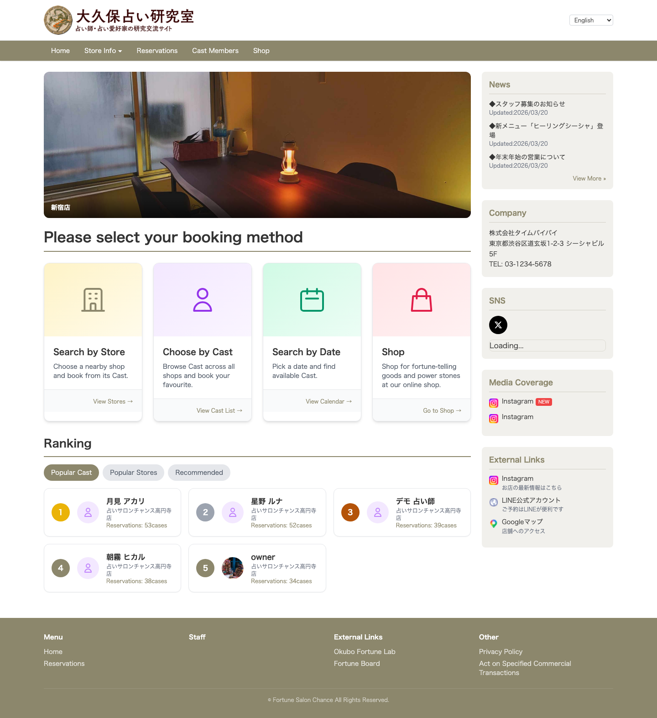
Customer View — Top Page
The first screen customers see
✓ Hero banners showcase your store's appeal
✓ Clear booking flow with multiple options
✓ Staff ranking to promote popular cast members
✓ Auto-display news and media features
✓ 7-language support for international customers

Slide 9
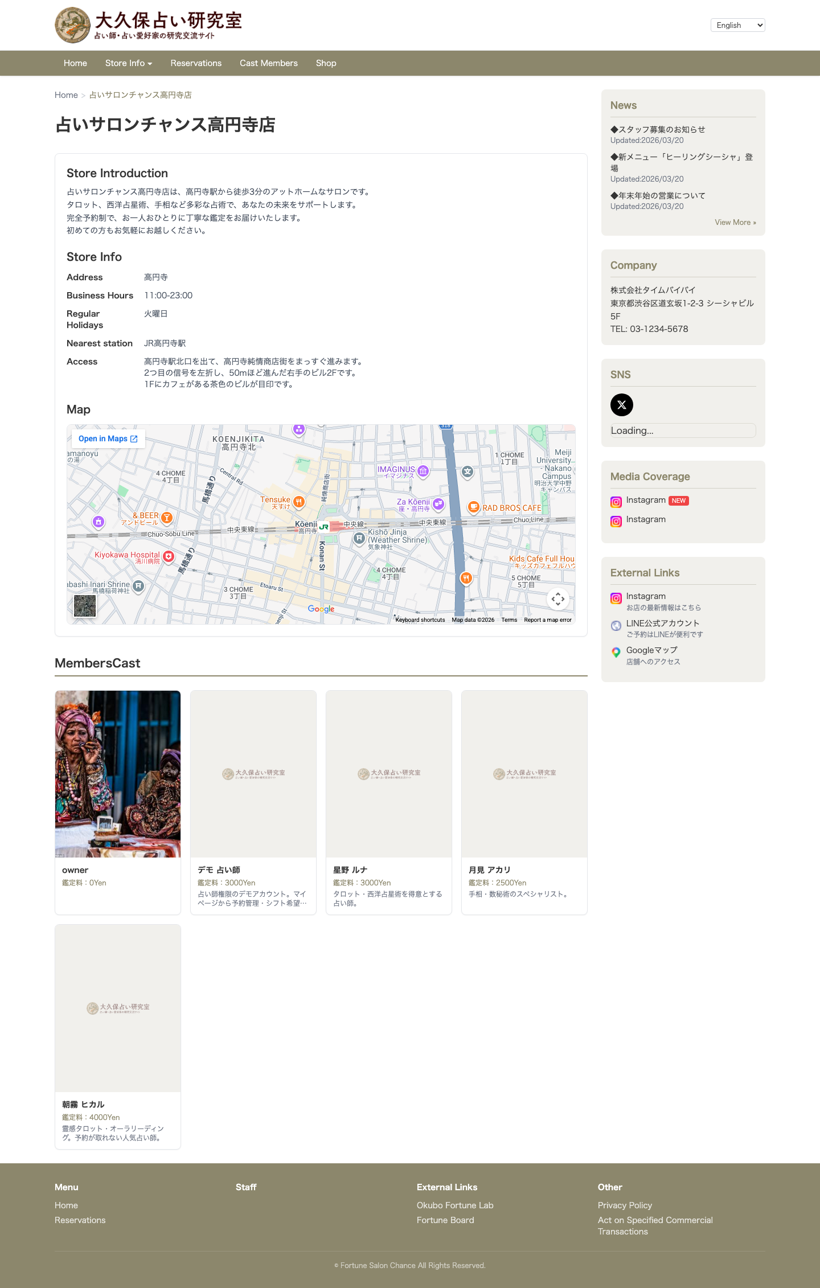
Customer View — Staff Profiles & Store Info
Present your staff attractively
✓ Staff photos and profile descriptions
✓ Display specialties and qualifications
✓ Direct link to booking calendar
✓ Store info (hours, map, access directions)
✓ Easy content updates from admin panel

Slide 10
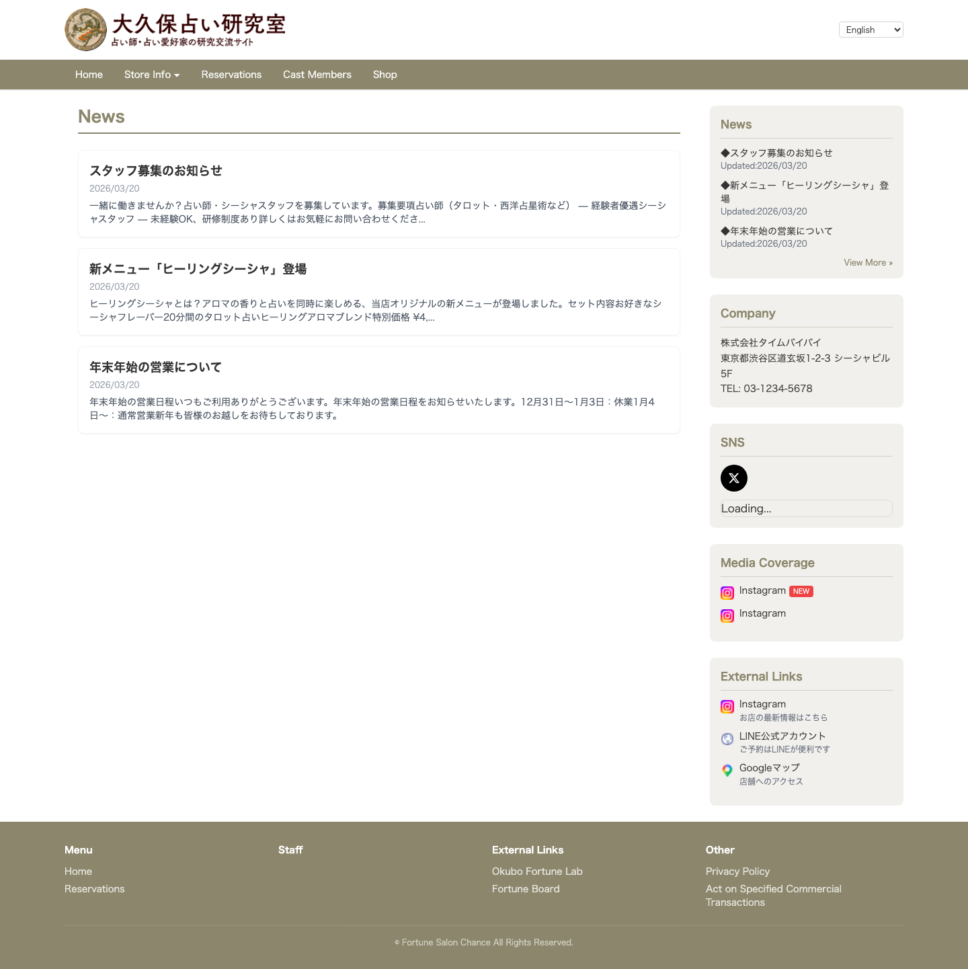
Customer View — News & Announcements
Keep customers informed
✓ Post new menu items, campaigns, and promotions
✓ One-click publishing from admin panel
✓ Auto-sorted by date for fresh content
✓ Social media integration for broader reach
✓ Drive repeat visits with timely updates

Slide 11
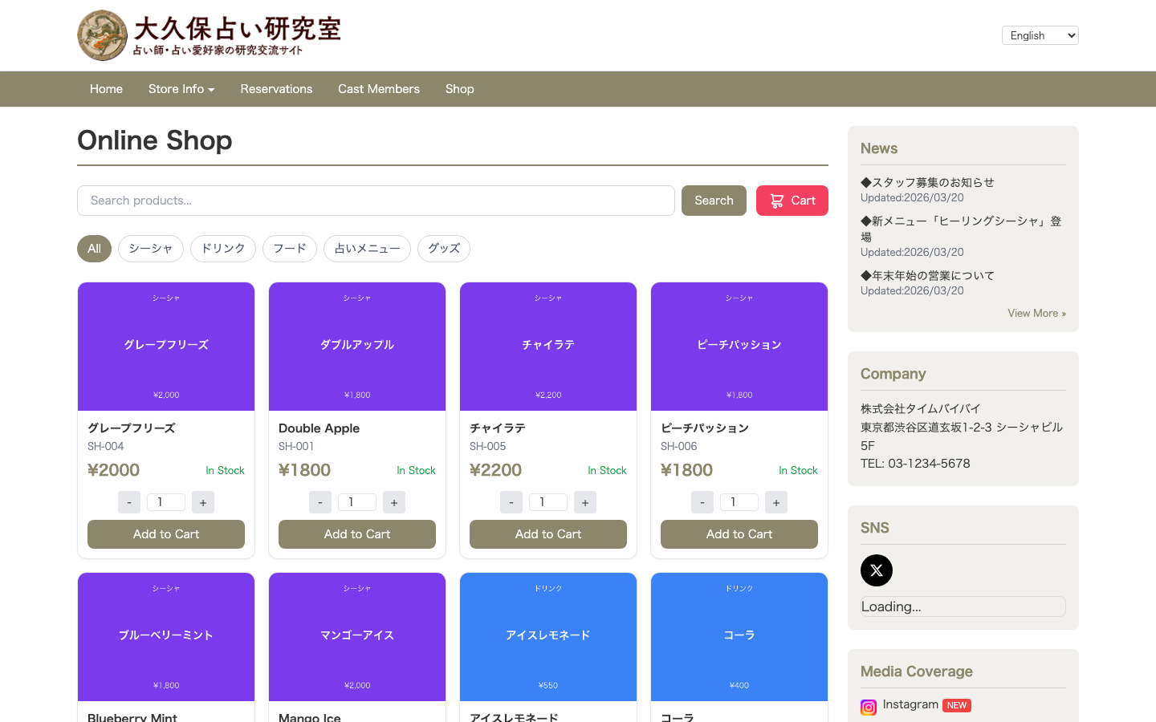
Customer View — Online Shop
Expand your sales channels with EC
✓ Sell your products online
✓ Product search and category filtering
✓ Shopping cart for multi-item purchases
✓ Credit card and e-money payments
✓ Unified inventory prevents stock discrepancies

Slide 12
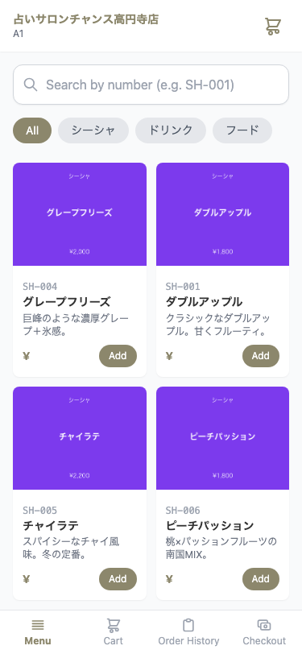
Customer View — QR Table Ordering
Easy ordering from smartphone
✓ Just scan the QR code on the table
✓ Photo menus convey the dish visually
✓ Category tabs for quick item discovery
✓ Cart function for easy additional orders
✓ Real-time order status tracking

Slide 13
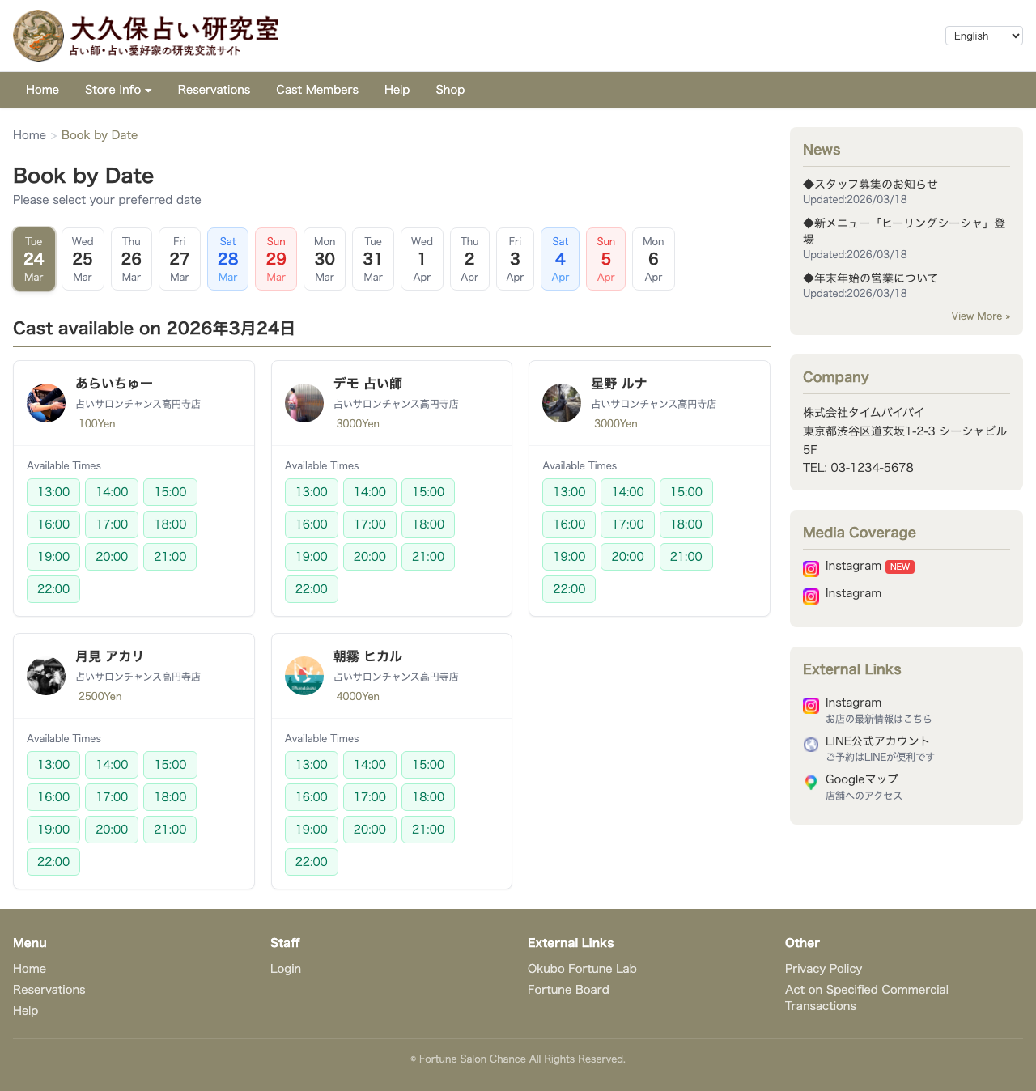
Customer View — Booking Calendar
24/7 online reservations
✓ View staff availability on calendar at a glance
✓ Customers pick their preferred date and time slot
✓ Prepaid confirmation prevents no-shows
✓ LINE and email booking support
✓ Auto-notification to staff on confirmation

Slide 14
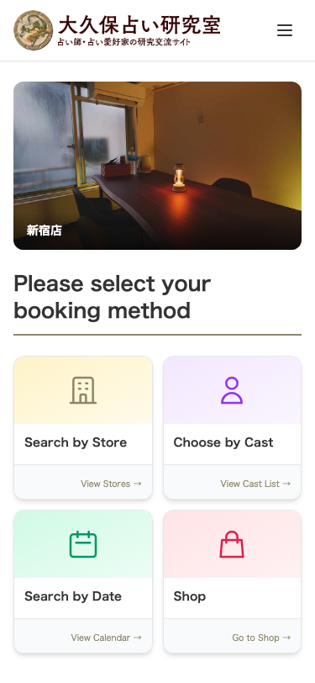
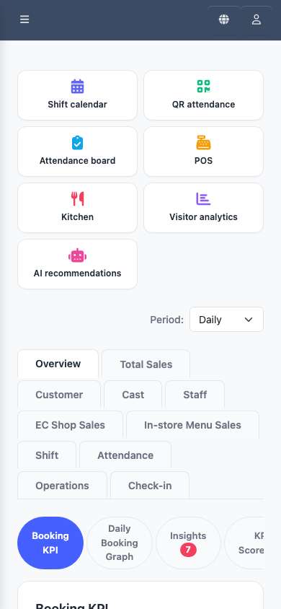
Fully Mobile-Responsive
Both the customer site and admin dashboard work seamlessly on smartphones.
Customer Top Page
Admin Dashboard

Slide 15
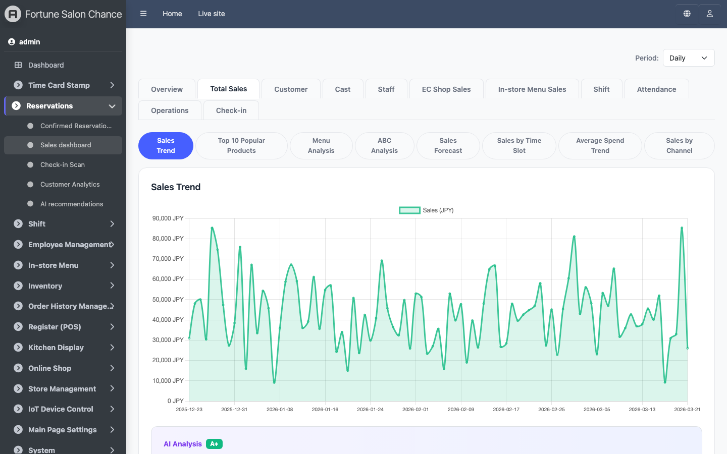
Admin Panel — Sales Dashboard
Business overview at a glance
✓ Daily / weekly / monthly / yearly revenue trends
✓ Reservation KPIs (count, cancellation rate) in real time
✓ Three-channel breakdown: Total, EC Shop, In-store Menu
✓ KPI scorecards for key metrics overview
✓ Business Insights auto-suggest improvements

Slide 16
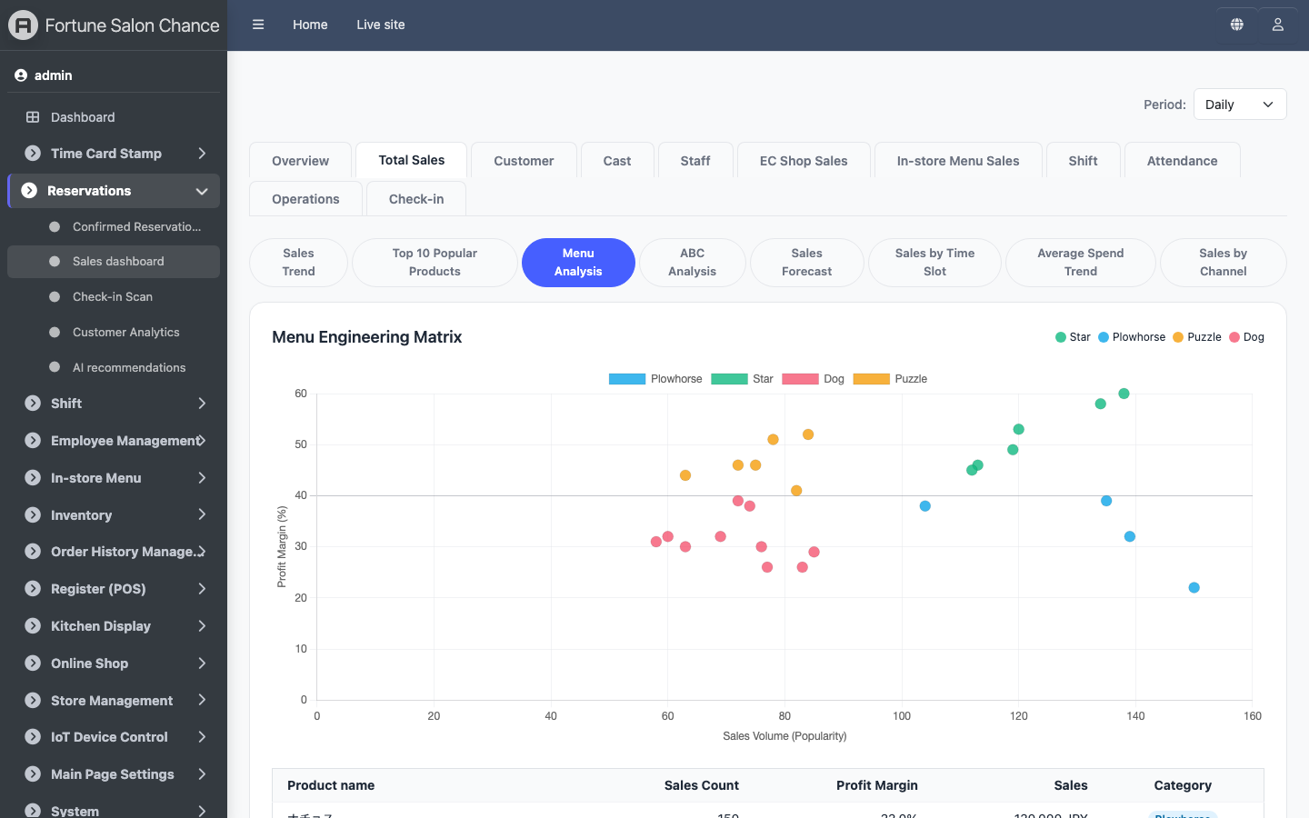
Admin Panel — Sales Analytics (Menu Analysis)
AI-powered profit optimization
✓ Menu Engineering: Star / Plowhorse / Puzzle / Dog 4-quadrant classification
✓ ABC Analysis: Pareto principle to identify top revenue drivers
✓ Revenue Forecast: Prophet AI model predicts 14 days ahead
✓ Hourly sales heatmap for optimal staffing decisions
✓ AOV (Average Order Value) trends for pricing strategy review

Slide 17
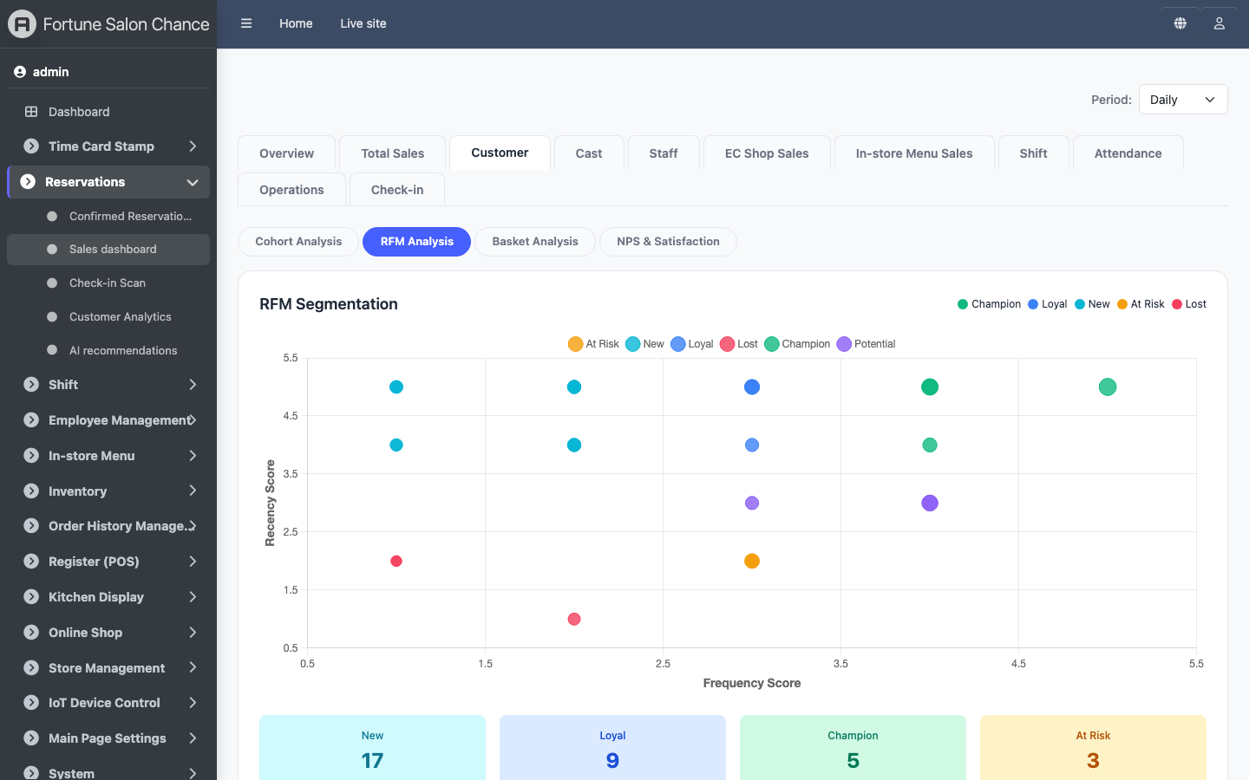
Admin Panel — Sales Analytics (Customer Analysis)
Data-driven customer understanding
✓ RFM Analysis: auto-segment customers by recency, frequency, monetary
✓ Cohort Analysis: visualize monthly new-customer retention rates
✓ Basket Analysis: discover cross-sell patterns and recommendations
✓ AI Summary: analysis results summarized in natural language
✓ Recommended Actions: AI auto-suggests specific improvement steps

Slide 18
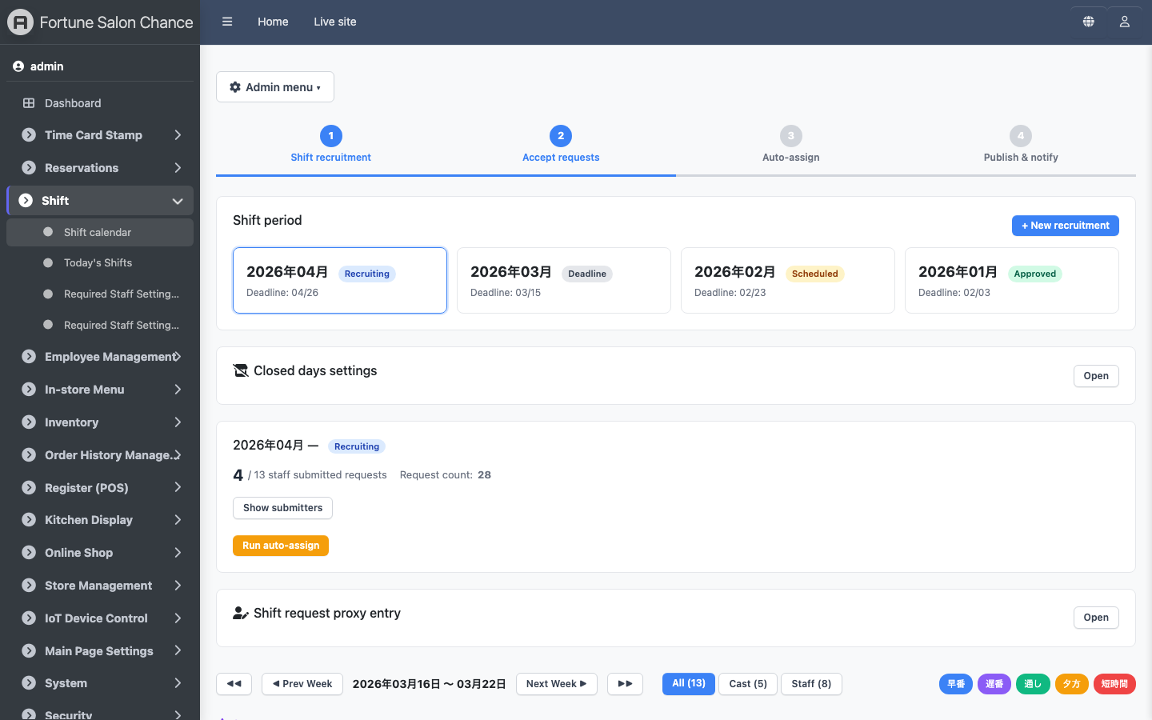
Admin Panel — Shift Calendar
Streamlined shift management
✓ Staff submit shift preferences from their smartphones
✓ Calendar view of all staff schedules at a glance
✓ Auto-scheduling with one-click assignment
✓ Auto-detect understaffed days with alerts
✓ Confirmed shifts auto-notified via LINE

Slide 19
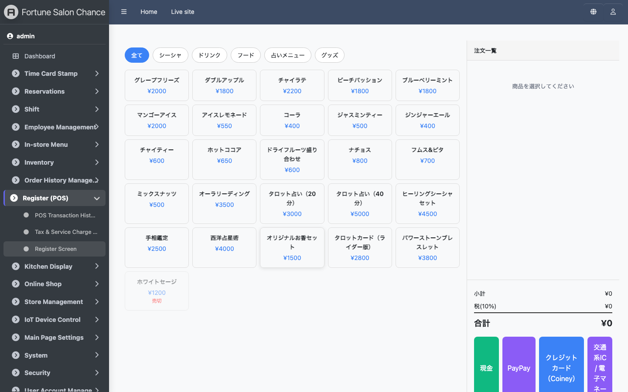
Admin Panel — POS Register
Smooth checkout experience
✓ Category tabs for quick product selection
✓ Cash, credit card, PayPay, and transit IC support
✓ Auto receipt generation and printing
✓ Kitchen display integration for order notifications
✓ Daily and monthly sales reports auto-generated

Slide 20
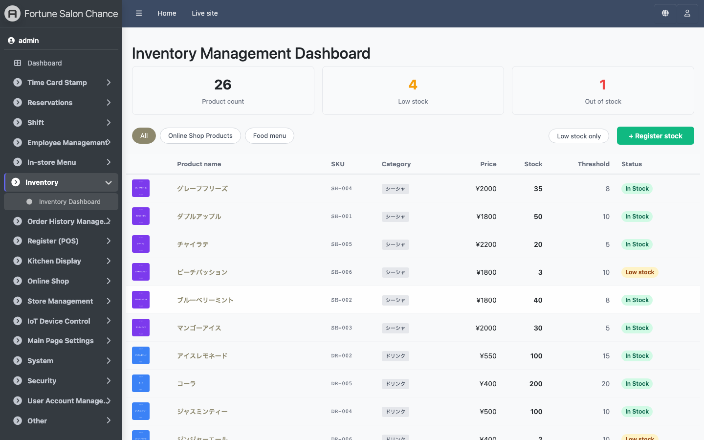
Admin Panel — Inventory Management
Prevent stockouts
✓ Real-time stock levels for all products
✓ Auto-deduct on order receipt
✓ Low stock alerts and notifications
✓ QR code receiving (no barcode scanner needed)
✓ Full stock-in/out history for audit compliance

Slide 21
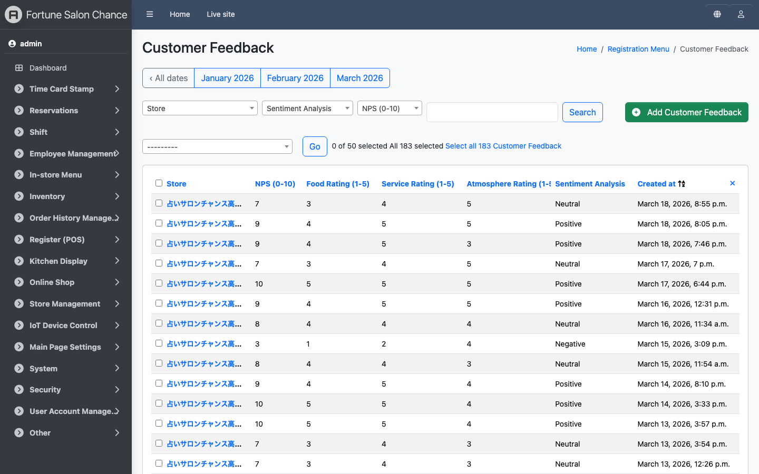
Admin Panel — Customer Feedback (NPS)
Quantify the voice of your customers
✓ NPS (Net Promoter Score) auto-aggregation and trending
✓ Promoter / Passive / Detractor color-coded display
✓ Comment-based feedback for actionable improvements
✓ Linked to order data for service quality analysis
✓ Monthly and staff-level satisfaction trends

Slide 22
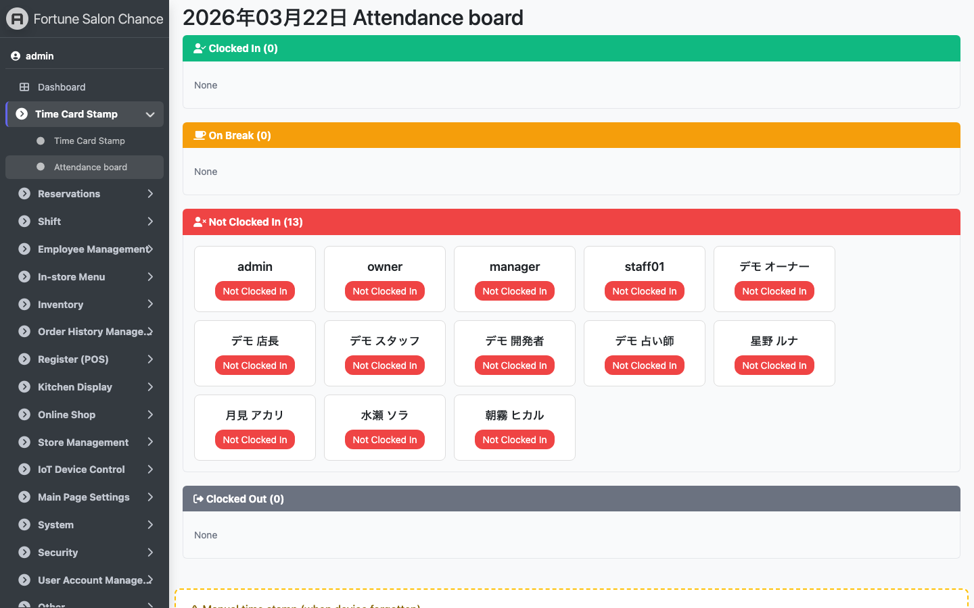
Admin Panel — Attendance Board
Real-time staff attendance status
✓ View on-duty, on-break, and not-clocked-in status at a glance
✓ Auto-refresh every 30 seconds for live tracking
✓ Three clock-in methods: QR code, PIN, or smartphone
✓ Auto-classify overtime, night, and holiday hours
✓ Seamless data flow from attendance to payroll

Slide 23
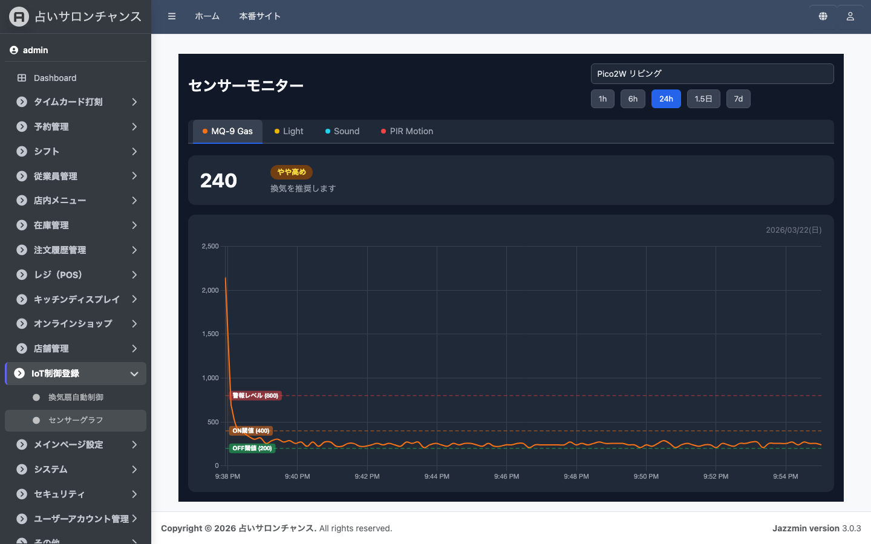
Admin Panel — IoT Sensor Monitor
Real-time store environment monitoring
✓ Temperature, humidity, pressure, gas levels in real time
✓ PIR motion sensor for automatic visitor counting
✓ Alert notifications on anomalies (gas leaks, high temps, etc.)
✓ Time-series charts to track sensor data trends
✓ ESP32 device connectivity monitoring

Slide 24
Benefits
🛡
Zero No-Show Losses
💬
Effortless LINE Booking
📈
Boost Revenue
Prepaid booking confirmation eliminates last-minute cancellations. Toggle between prepaid / postpaid with one click.
Customers book right from LINE chat. No new app installation required.
QR ordering increases add-on order rate. Multi-language support captures international visitors.
⏱
Save Hours of Work
💰
Cut Costs
📊
Data-Driven Decisions
Automate booking, ordering, shifts, and payroll. Free your staff to focus on customer service.
Reservation books, order slips, time cards... Eliminate paper costs and manual effort.
Visualize sales, bookings, and staff performance. Make informed decisions backed by real data.

Slide 25
Getting Started
STEP 1
STEP 2
STEP 3
STEP 4
STEP 5
→
→
→
→
Contact Us
Consultation
Demo & Quote
Account Setup
Go Live
Reach out via phone or our contact form
We learn about your current workflow and pain points
See the product in action. We propose the best plan for you
Register store info and staff. We assist with initial setup
After a quick walkthrough, you're ready to go!
Start using it as soon as the same day. No special hardware or system installation required. Access instantly from your smartphone, tablet, or PC. We provide ongoing support, training, and feature updates after deployment.

Slide 26
Pricing Plans
* Prices below are for reference. We customize plans to fit your needs.
★ Recommended!
Light Plan
Standard Plan
Premium Plan
From $XX/mo
From $XX/mo
From $XX/mo
For small stores
For mid-size stores
Multi-store / Full features
✓ Reservation management (LINE & email)
✓ Staff management (up to 5)
✓ Website management
✓ Email & chat support
✓ All Light Plan features
✓ QR table ordering
✓ Inventory management
✓ Shift management
✓ Unlimited staff
✓ Phone support
✓ All Standard features
✓ Payroll & attendance
✓ Sales dashboard & analytics
✓ Multi-language support (7 languages)
✓ Multi-store management
✓ Priority support
✓ Custom development
* Setup fees and customization charges quoted separately. * Prices exclude tax.

Slide 27
Frequently Asked Questions
Q. Do I need any special equipment?
A. No special hardware required. Use it on your existing smartphone, tablet, or PC. For table ordering, just print QR codes from the admin panel.
Q. Can non-technical staff use it?
A. Yes. If you can use a smartphone, you can use TimeBaiBai. The interface is intuitive and simple. We also provide hands-on training during onboarding.
Q. Can I add or change features later?
A. Absolutely. You can upgrade or change your plan at any time. We recommend starting with core features and scaling up as needed.
Q. How secure is my data?
A. Customer data is encrypted at rest. All communication uses SSL encryption. Credit card information is processed by PCI DSS-compliant payment services — no card data is stored on our servers.
Q. Can I use it for multiple locations?
A. Yes. The Premium plan supports multi-store management. Manage staff and inventory per location while viewing consolidated reports across all stores.

Slide 28
Get in Touch
Request a demo, get a quote, or ask us anything.
TEL: 000-0000-0000
Email: info@example.com
Web: https://timebaibai.com
Company Name Inc.
Address line here
© 2026 TimeBaiBai. All Rights Reserved.

