Slide 1
QuickSort
November 2, 2022

Slide 2
What is Quicksort Algorithm?
Just like merge sort, quicksort uses the “divide and conquer” strategy to sort elements in arrays or lists. It implements this strategy by choosing an element as a pivot and using it to partition the array.
The left subarray contains all elements that are less than the pivot. The right subarray contains all the elements that are greater than the pivot. We recursively repeat this process until we sort the array. We can select the pivot the algorithm uses during this process in different ways:
The first element of the array
The last element of the array
A random element of the array
Median element of the array
Selecting the middle element of the unsorted array. the process of finding that middle element is difficult and time-consuming. Using this strategy involves calculating the array’s length in every iteration and halving it to determine the index of the element in the middle of the array. Using the median element of the array as the pivot, we use the median-of-three technique where we select the pivot based on the median of three values such as the first, middle, and last elements of the array. Therefore, selecting the first, last, random, or median element of the array as the pivot is the best approach.
.

Slide 3
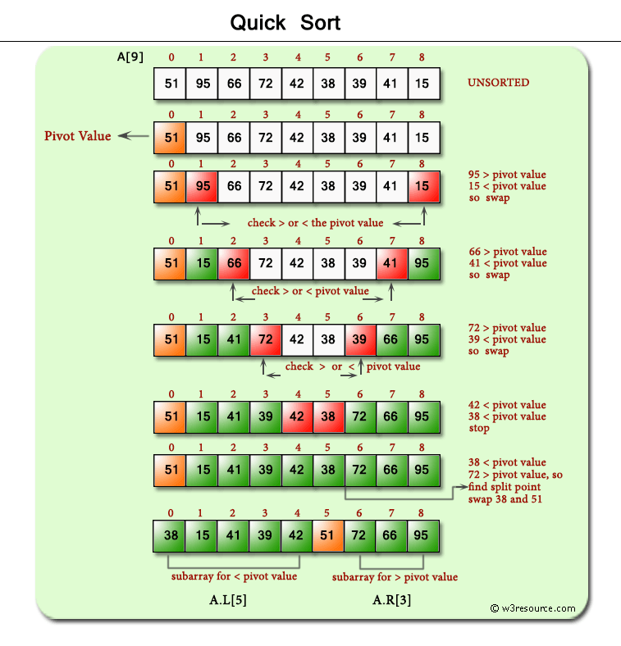

Slide 4
How Does Quicksort Algorithm Work? To illustrate how the quicksort algorithm works, let’s assume we intend to sort this array: int[] array = { 52, 96, 67, 71, 42, 38, 39, 40, 14 }; In this article, let’s take the first element (52) as the pivot as we learn how to implement quicksort. First Partition Level We start traversing the array from the left and right indexes while comparing their elements against the pivot. 96 is greater than the pivot while 14 is less than the pivot so we swap their positions and the array becomes: 52, 14, 67, 71, 42, 38, 39, 40, 96 Next, we can see that 67 is greater than the pivot element while 40 is less than the pivot so we swap their positions: 52, 14, 40, 71, 42, 38, 39, 67, 96 As we traverse the array, 71 is greater than the pivot while 39 is less than the pivot so we swap their positions: 52, 14, 40, 39, 42, 38, 71, 67, 96 38 and 42 are both less than the pivot, which triggers the iteration to stop. The next step is to determine the array’s split point. 38 is less than the pivot so we swap their positions while 71 is greater than the pivot, which becomes the new split point. 38, 14, 40, 39, 42, 52, 71, 67, 96 Given the fact that quicksort is recursive, in the next iteration, we are going to have two subarrays based on the identified splitting points.

Slide 5
Second Partition Level The left subarray is 38, 14, 40, 39, 42 and the right subarray is 71, 67, 96 Let’s start with the right subarray and take 71 as the pivot. 67 is less than the pivot hence, we swap their positions. On the other hand, 96 is greater than the pivot so we don’t swap them and the array becomes sorted: 67, 71, 96 We are going to repeat the same process for the left subarray and select 38 as the pivot for that subarray. 14 is less than the pivot while the rest of the elements are greater than the pivot so the array becomes: 14, 38, 40, 39, 42
Third Partition Level In the last iteration, quicksort takes 40 as the pivot. 39 is less than the pivot so we swap their positions but 42 is greater than the pivot, which completes the sorting process. 39, 40, 42 We can see that by using the divide and conquer strategy we complete the sorting process efficiently with the result being: 14, 38, 39, 40, 42, 67, 71, 96

