Slide 1

MOIN Query Language (aka MQL)
Simon Helsen
SAP AG
14 April 2008

Slide 2
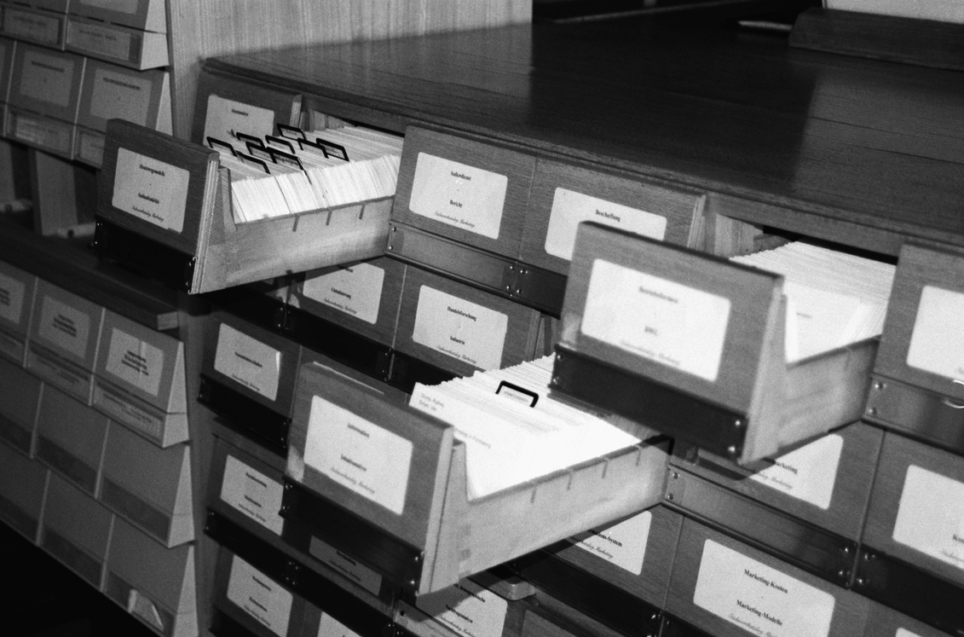
Introduction and Motivation
MQL Overview
Query Examples and Features
MQL Connection API
Other MQL Features

Slide 3
Querying MOIN With JMI
Easily possible using Java Metadata Interfaces (JMI) and regular MOIN APIs
  Use getPackage or getClass on MOIN connection (MOIN API)
  Use refAllOfClass or refAllOfType on RefClass objects (JMI API)
  Navigate in JavaBeans-style manner
  Example:
    DepartmentClass departmentClass = (DepartmentClass) getMOINConnection().getClass(DepartmentClass.CLASS_DESCRIPTOR);
    Collection<RefObject> departments = departmentClass.refAllOfType();
    List<String> departmentNamesStartingWithS = new ArrayList<String>();
    for (RefObject department : departments) {
    String depName = ((Department) department).getName();
    if (depName.startsWith(“s”)) {
    departmentNamesStartingWithS.add(depName);
    }
    }

Slide 4
Querying MOIN With MQL
Not very effective way to query MOIN because
  Java and JMI do not know how to “compress” queries
    Query execution happens step-by-step
  Always loads all partitions in which instances live
  Problem aggravated when navigating around
  No way to limit scope of query (JMI standard does not permit this)
MQL is MOIN’s mechanism to avoid these limitations
  Example:
    String query = "select dep.name “ +
    “from Company::Department as dep “ +
    “where dep.name like ‘s*’”;
    MQLResultSet resultSet = connection.getMQLProcessor().execute(query);
    List<String> depsWithS = new ArrayList<String>(resultSet.size());
    for (int i = 0; i < resultSet.size(); i++) {
    depsWithS.add(resultSet.getAttribute(i, “dep”, “name”))
    }

Slide 5
Querying MOIN With OCL
What about the Object Constraint Language (OCL)?
  OCL could also be used as query language
  Boolean result of regular constraint only special query result
Only syntactic sugar on top of JMI and MOIN API
  OCL is too powerful to map effectively on limited underlying persistence capabilities (e.g. slim index or RDB)
  MOIN’s OCL implementation is interpreted using JMI and MOIN API
  OCL’s allInstances() construct is like JMI’s refAllOfType()
  Example:
    Department.allInstances().name->
    select(depName | depName.substring(1, 1) = ‘s’)

Slide 6
MOIN Query Language Requirements
Query language, which maps good on query index capabilities of underlying facility (e.g. RDB, TREX, etc.)
Minimize or avoid MOIN partition loading during query execution
  Partition load causes performance penalty
    (loaded partitions are optimized for both navigation and editing)
  Partition load causes memory penalty
Automatically mix dirty partition data with persistent partitions
Handle distributed end-storage and overrule Meta-Model navigation restrictions
Permit additional scoping restrictions
  Scope over given set of partitions or containers (aka DCs)
  Allows for better query optimizations

Slide 7
Introduction and Motivation
MQL Overview
Query Examples and Features
MQL Connection API
Other MQL Features

Slide 8
MQL Overview (1)
Mini-SQL-like query language for MOF-like repository
MQL queries always strongly typed against one or more meta models
  No untyped queries such as “getContainedElements” possible
  Use custom methods from MOIN API for these
MQL result set is table-like structure
  Completely calculated during execution
  No lazy data-handling
MQL query processor available on MOIN Connection
  Permits preparation and/or execution of MQL queries
Queries can be formulated as
  Concrete syntax (used in this talk); or
  Abstract class-based syntax

Slide 9
MQL Overview (2)
MQL query structure in concrete syntax
<MQLquery> ::= select <select-clause>
from <from-clause>
(where <where-entry>)*
MQL Syntax
MQL query structure in API abstract syntax (Java API in package com.sap.tc.moin.repository.mql)
public MQLQuery(SelectEntry[] _selectEntries,
FromEntry[] _fromEntries,
WhereEntry[] _whereEntries);
Java API

Slide 10
MQL Overview (3)
MQL Query consists of 3 main blocks
From-clause (mandatory)
  Specifies cartesian product of relevant meta-model types (which can be MOF classes or structure types)
Select-clause (mandatory)
  Specifies elements and/or attributes to appear in result set
Where-clauses (optional zero, one or many)
  Joining where-clauses
    Specifies join conditions on two or more FROM-types
    Also allows for nested queries
  Local (non-joining) where-clauses
    Specifies filter on primitive-typed properties of one from-type
  Multiple where-clauses are always logically AND-connected

Slide 11
Introduction and Motivation
MQL Overview
Query Examples and Features
MQL Connection API
Other MQL Features

Slide 12
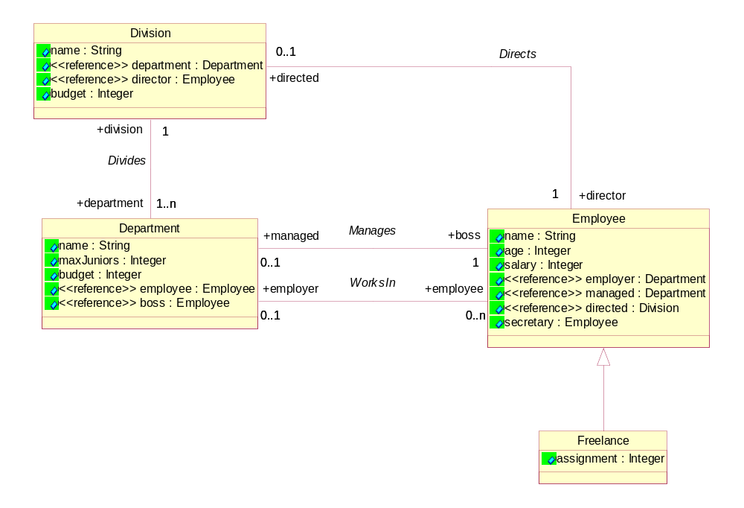
Examples and Features: Example Meta Model

Slide 13
Examples and Features : Example 1
“Return the elements (MRIs) and names of all employees (but not those who freelance), which are younger than 40”
select em, em.name
from “sap.com/moin/company”#Company::Employee
withoutsubtypes as em
where em.age < 40
MQL Syntax
Notes
By default, instances of subtypes are part of the result set
From-type has 2 mandatory parts and one optional part:
  Mandatory: class name (here Employee)
  Mandatory: package path up to the class name (here Company)
  Optional: container (DC) name of meta-model (here “sap.com/moin/company”)

Slide 14
Examples and Features : Example 2
“Return all the company’s divisions and its departments where the division’s name is either ‘NetWeaver’ or does not start with ‘N’”
MQL Syntax
select div, dep
from Company::Division as div,
Company::Department as dep
where div.department = dep
where for div(not(name like ‘N*’)
or name = ‘NetWeaver’)
Notes
Local where-conditions permit arbitrary boolean statements
Multiple where-clauses are always AND-connected
Like operation akin to SQL’s like operation
Syntax for local where clauses with more than one condition different from classic ‘SQL’

Slide 15
Examples and Features : Example 3
What if there is no reference?
  Use association end names
What if the association end is ambiguous?
  Qualify with the association name
“Return all the company’s divisions and their departments”
select div, dep
from Company::Division as div,
Company::Department as dep
where dep.division[Company::Divides] = div
MQL Syntax

Slide 16
Examples and Features : Example 4
“Return the MRIs and names of departments, which do not belong to a division whose budget is more than 1.000.000 euros”
select dep, dep.name
from Company::Department as dep
where dep.division[Company::Divides]
not in (select div
from Company::Division as div
where div.budget > 1000000)
MQL Syntax
Notes
Nested queries can be negated
Nested queries can be arbitrary complex, but the selection has to match the association end of the encompassing navigation

Slide 17
Examples and Features : Example 4
“Return the names of departments, which do not belong to any division at all”
select dep, dep.name
from Company::Department as dep
where dep.division[Company::Divides] = null
MQL Syntax
Notes
Syntactic convenience for a nested query with a negation
Also possible to return the departments, which do belong to a division by writing <> null instead

Slide 18
Examples and Features : Example 6
“Return the budgets of all departments and divisions where the department has a larger budget than the division”
MQL Syntax
select div.budget, dep.budget
from Company::Division as div,
Company::Department as dep
where div.budget < dep.budget
Notes
Cross-type attribute comparisons permit simple comparison operators
No like operator permitted

Slide 19
Examples and Features : Example 7
“Return all departments and their employees (including freelance workers), where the departments are taken from container (DC) sap.com/sap/ag and the employees are not taken from partitions PF.da:DCs/sap.com/sap/_comp/pers_01 and PF.da:DCs/sap.com/sap/_comp/pers_02”
select dep, em
from Company::Employee as em
not in partitions
{“PF.da:DCs/sap.com/sap/_comp/pers_01”,
“PF.da:DCs/sap.com/sap/_comp/pers_02”},
Company::Department as dep
in containers {“PF.da:DCs/sap.com/sap/ag”}
where dep.employee = em
MQL Syntax
Notes
Use pri.toString() and don’t forget the double quotes!
Explicit scope can also be provided on execute method (see below)

Slide 20
Examples and Features : Example 8
“For a given department, provide its employees (including freelance workers)”
select em
from Company::Employee as em,
“PF.da:DCs/sap.com/sap/_comp/deps#ABCD-EFGH” as dep
where dep.employee = em
MQL Syntax
Notes
Use mri.toString() !!
Provided element still has to be type-correct with respect to other parts of the query

Slide 21
Examples and Features : Example 9
“Return the employees (including freelance workers) of the departments identified by the provided MRIs”
select em
from Company::Employee as em,
Company::Department as dep
in elements
{“PF.da:DCs/sap.com/sap/_comp/deps#ABCD-EFGH”,
“PF.da:DCs/sap.com/sap/_comp/deps#IJKL-MNOP”}
where dep.employee = em
MQL Syntax
Notes
Akin to previous example, but here type correctness is enforced

Slide 22
Introduction and Motivation
MQL Overview
Query Examples and Features
MQL Connection API
Other MQL Features

Slide 23
MQL Connection API : MQLProcessor
public interface MQLProcessor {
...
MQLPreparedQuery prepare(String query)
throws MQLPreprocessorException;
MQLResultSet execute(MQLPreparedQuery preparedQuery)
throws MQLExecutionException;
MQLResultSet execute(String query, QueryScopeProvider queryScope)
throws MQLExecutionException;
...
}
Java API
Notes
Preparation and execution separated (although the combination is also possible)
The entire query can be scoped at execution time for partitions or containers
Many standard scope providers are available on MQLProcessor (see JavaDoc)
  E.g. scope provider which takes a given set of partitions
  E.g. scope provider which takes a given set of containers (aka DCs, aka IProjects)
  E.g. scope provider which takes a Container and calculates the scope including the visible Containers
If necessary, you can implement your own scope provider

Slide 24
MQL Connection API : MQLResultSet
public interface MQLResultSet {
...
int getSize();
MRI getModelElement(int position, String alias)
throws MQLResultException;
RefObject getRefObject(int position, String alias)
throws MQLResultException;
java.lang.Object getAttribute(int position, String alias,
String attrName)
throws MQLResultException;
void asCSV(java.io.Writer writer) throws MQLResultException;
...
}
Java API
Notes
Iteration over result set is achieved with counter
Observe the difference between getModelElement and geRefObject (!)
toString() uses asCSV to produce comma-separated value result

Slide 25
MQL Connection API : Example
// we have the query from example 1
String query = ...;
// get an MQL processor
MQLProcessor mql = yourConnection.getMQLProcessor();
// execute
MQLResultSet resultSet = mql.execute(query);
// obtain all the employee names
List<String> names = new ArrayList<String>(resultSet.getSize());
for(i = 0; i < resultSet.getSize(); i++) {
names.add((String)resultSet.getAttribute(i, “em”, “name”));
}
// resolve the k-th element
RefObject kEmployee = resultSet.getRefObject(k, ”em”);
Consult Javadocs for detailed description of individual operations!

Slide 26
Introduction and Motivation
MQL Overview
Query Examples and Features
MQL Connection API
Other MQL Features

Slide 27
Other MQL Features (1)
Queries with structure types
  Treated like classes (formulated with qualified name in from-entry)
  Structure type instances cannot occur in result sets
Queries with enumeration types
  Enumeration labels are treated like strings
  May occur in comparisons both between attributes and with constants
  May occur in result sets
Local where-entries may have following operators
  On booleans: = true, = false
  On Numerals (int, long, double, float): <, <=, >, >=, <>, =
  On Strings: =, <>, like, not like

Slide 28
Other MQL Features (2)
Attribute comparisons (which are joining where-entries) may only have: <, <=, >, >=, <>, =
Class-typed attributes
  Akin to association predicates with references
  E.g. where a.bAttr = b
Type MRIs instead of qualified names in FROM-entry
  E.g. from type “PF.da:DCs/sap.com/tc/moin/uml_1.5/_comp/uml_1.5#3624F134-5368-45CF-20BE-AC33A365” as rel
Reflect::Element supported
  Supertype of all types
  MQL supports queries formulated on MOIN’s Reflect::Element
  Use with scope to avoid getting all instances in MOIN!

Slide 29
Documentation
MQL is extensively documented in the NWDS (Eclipse) Help
The Eclipse Help examples are akin to the ones in this presentation
  Is kept up-to-date with changing MQL features
  All examples compile and run (provided you have content)
The Eclipse Help is also accessible via our WIKI:
  https://wiki.wdf.sap.corp/display/MOIN/Moin+Query+Language

Slide 30
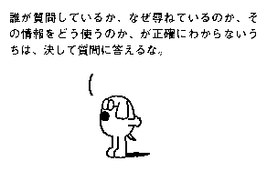
Questions
“Never answer a question unless you know exactly who is asking,
why it is being asked, and what will be done with the information.”
For questions, contact your MOIN Team
For bug reports, post a CSN message

Slide 31
Copyright 2008 SAP AG
All rights reserved
No part of this publication may be reproduced or transmitted in any form or for any purpose without the express permission of SAP AG. The information contained herein may be changed without prior notice.
Some software products marketed by SAP AG and its distributors contain proprietary software components of other software vendors.
SAP, R/3, xApps, xApp, SAP NetWeaver, Duet, SAP Business ByDesign, ByDesign, PartnerEdge and other SAP products and services mentioned herein as well as their respective logos are trademarks or registered trademarks of SAP AG in Germany and in several other countries all over the world. All other product and service names mentioned and associated logos displayed are the trademarks of their respective companies. Data contained in this document serves informational purposes only. National product specifications may vary.
The information in this document is proprietary to SAP. This document is a preliminary version and not subject to your license agreement or any other agreement with SAP. This document contains only intended strategies, developments, and functionalities of the SAP® product and is not intended to be binding upon SAP to any particular course of business, product strategy, and/or development. SAP assumes no responsibility for errors or omissions in this document. SAP does not warrant the accuracy or completeness of the information, text, graphics, links, or other items contained within this material. This document is provided without a warranty of any kind, either express or implied, including but not limited to the implied warranties of merchantability, fitness for a particular purpose, or non-infringement.
SAP shall have no liability for damages of any kind including without limitation direct, special, indirect, or consequential damages that may result from the use of these materials. This limitation shall not apply in cases of intent or gross negligence.
The statutory liability for personal injury and defective products is not affected. SAP has no control over the information that you may access through the use of hot links contained in these materials and does not endorse your use of third-party Web pages nor provide any warranty whatsoever relating to third-party Web pages
Weitergabe und Vervielfältigung dieser Publikation oder von Teilen daraus sind, zu welchem Zweck und in welcher Form auch immer, ohne die ausdrückliche schriftliche Genehmigung durch SAP AG nicht gestattet. In dieser Publikation enthaltene Informationen können ohne vorherige Ankündigung geändert werden.
Einige von der SAP AG und deren Vertriebspartnern vertriebene Softwareprodukte können Softwarekomponenten umfassen, die Eigentum anderer Softwarehersteller sind.
SAP, R/3, xApps, xApp, SAP NetWeaver, Duet, SAP Business ByDesign, ByDesign, PartnerEdge und andere in diesem Dokument erwähnte SAP-Produkte und Services sowie die dazugehörigen Logos sind Marken oder eingetragene Marken der SAP AG in Deutschland und in mehreren anderen Ländern weltweit. Alle anderen in diesem Dokument erwähnten Namen von Produkten und Services sowie die damit verbundenen Firmenlogos sind Marken der jeweiligen Unternehmen. Die Angaben im Text sind unverbindlich und dienen lediglich zu Informationszwecken. Produkte können länderspezifische Unterschiede aufweisen.
Die in diesem Dokument enthaltenen Informationen sind Eigentum von SAP. Dieses Dokument ist eine Vorabversion und unterliegt nicht Ihrer Lizenzvereinbarung oder einer anderen Vereinbarung mit SAP. Dieses Dokument enthält nur vorgesehene Strategien, Entwicklungen und Funktionen des SAP®-Produkts und ist für SAP nicht bindend, einen bestimmten Geschäftsweg, eine Produktstrategie bzw. -entwicklung einzuschlagen. SAP übernimmt keine Verantwortung für Fehler oder Auslassungen in diesen Materialien. SAP garantiert nicht die Richtigkeit oder Vollständigkeit der Informationen, Texte, Grafiken, Links oder anderer in diesen Materialien enthaltenen Elemente. Diese Publikation wird ohne jegliche Gewähr, weder ausdrücklich noch stillschweigend, bereitgestellt. Dies gilt u. a., aber nicht ausschließlich, hinsichtlich der Gewährleistung der Marktgängigkeit und der Eignung für einen bestimmten Zweck sowie für die Gewährleistung der Nichtverletzung geltenden Rechts.
SAP übernimmt keine Haftung für Schäden jeglicher Art, einschließlich und ohne Einschränkung für direkte, spezielle, indirekte oder Folgeschäden im Zusammenhang mit der Verwendung dieser Unterlagen. Diese Einschränkung gilt nicht bei Vorsatz oder grober Fahrlässigkeit.
Die gesetzliche Haftung bei Personenschäden oder die Produkthaftung bleibt unberührt. Die Informationen, auf die Sie möglicherweise über die in diesem Material enthaltenen Hotlinks zugreifen, unterliegen nicht dem Einfluss von SAP, und SAP unterstützt nicht die Nutzung von Internetseiten Dritter durch Sie und gibt keinerlei Gewährleistungen oder Zusagen über Internetseiten Dritter ab.
Alle Rechte vorbehalten.

