Slide 1
GS
GraphQL Shield
Schema-Aware Security Gateway for Preventing GraphQL BOLA Vulnerabilities
Agnihotram Chinmayanand (RA2311053010116) · B.V. Balanilavan (RA2311053010123)
Kapilesh.N (RA2311053010125) · Sakthivel.B (RA2311053010126)
Computer Communication and Network Security · Faculty Viva & Technical Defense
Notes:
Title. Introduce the project: an evidence-grounded security gateway that combines schema-aware static analysis with runtime authorization evidence to block BOLA at the edge while providing exact AST path attribution.

Slide 2
THE PROBLEM
Broken Object Level Authorization
BOLA / IDOR
Why GraphQL amplifies it
An API accepts an object identifier from the client and returns the object without checking that the caller may access THAT object.
Attacker changes id=101 to id=102 and reads someone else's data.
Ranked #1 in the OWASP API Security Top 10.
Prevalent, high-impact, and entirely avoidable.
One endpoint fronts every resource — a huge, discoverable attack surface.
Resolvers traverse the query graph depth-first; auth is easy to forget per field.
Objects are reachable through many nested paths and field aliases.
There is no built-in notion of 'the caller's right to THIS object'.
GraphQL Shield — CCNS Capstone
2
Notes:
Motivate: BOLA is the top API risk; GraphQL's flexibility and nested traversal make centralized enforcement hard. That's the gap.

Slide 3
OBJECTIVES
What the gateway must do
1
Intercept
2
Understand the query
Reject unauthorized object access at the edge, before any resolver executes.
Extract every object type and id from the AST — nested, aliased, variable and fragment based.
3
Understand ownership
4
Fail closed
Resolve ownership from authoritative data, validated against schema-inferred relationships.
If ownership cannot be explained by a rule or tenant context is missing, deny.
5
Score and audit
6
Tenant integrity
Deterministic 0-100 risk per decision, persisted for review.
Derive tenant from validated JWT; reject client header spoofing.
GraphQL Shield — CCNS Capstone
3
Notes:
Six objectives: intercept, understand the query, understand ownership, fail closed, score+audit, and enforce tenant integrity.

Slide 4
ARCHITECTURE
One gateway, ten fail-closed stages
1
2
3
4
5
Authenticate
Tenant Guard
Budget check
Taint analysis
AST extract
JWT -> user, role, tenant
reject X-Tenant spoofing
depth 15 / cost 150
audit-only, fail-safe
(type, id, path, alias)
6
7
8
9
10
Ownership
Policy
Risk score
Audit
Enforce
DB lookup + schema rule
ALLOW / DENY + reason
0-100, low/med/high
persist SQLite row
ALLOW run / DENY 403
Advisory subsystems (read audit stream, cannot change a decision): differential-testing · adaptive anomaly engine · research evaluator
GraphQL Shield — CCNS Capstone
4
Notes:
The gateway is a FastAPI dependency that runs before the GraphQL route. Ten stages, fully fail-closed with tenant identity integrity.

Slide 5
CORE IDEA
Ownership inferred from the schema
The schema already describes ownership
Validated, explainable patterns
type User {
id: ID!
resources: [Resource]
}
type Resource {
id: ID!
owner_id: ID!
}
A — object reference: Resource.owner: User
B — collection: User.resources: [Resource]
C — scalar id: Resource.ownerId: ID
D — nested chains of A/B/C
Matching driven by configurable naming list (owner, user_id, created_by, ...).
Ambiguous matches (createdBy: String) are rejected, not guessed.
Priority: explicit rule > inferred rule > UNKNOWN_OWNERSHIP (deny).
Field names (ownerId -> owner_id) and type names (Resource = ResourceType) are normalized so query and schema line up.
GraphQL Shield — CCNS Capstone
5
Notes:
The schema publishes ownership as fields. We infer and validate those relationships once at startup, keep explicit rules on top, and fail closed when nothing explains ownership.

Slide 6
DECISION
Policy engine and deterministic risk
Policy evaluation
Risk engine (0-100)
Structured AuthorizationContext: user, tenant, role, type, id, path, owner.
OWNER_MATCH -> ALLOW
OWNERSHIP_MISMATCH -> DENY
NESTED_AUTHORIZATION_VIOLATION -> DENY
TENANT_ISOLATION_VIOLATION -> DENY
TENANT_CONTEXT_MISSING -> DENY (fail closed)
SUPERADMIN_CROSS_TENANT_OVERRIDE -> ALLOW (audited)
+80 ownership / authorization / tenant violation
+20 nested access (path contains '.')
+10 >=1 DENY in the last 10 minutes
cap at 100
band: LOW < 30 | MEDIUM < 60 | HIGH >= 60
Deterministic, auditable — no black-box ML in the enforcement path.
GraphQL Shield — CCNS Capstone
6
Notes:
Policy produces a decision and machine-readable reason; risk engine computes score band. Direct BOLA -> 80, nested BOLA -> 100, tenant violation -> 80.

Slide 7
ENFORCEMENT
Block at the edge, audit everything
ALLOW
DENY
LOG
200 / execute
403 / drop
Persist every decision
Control passes to the Strawberry GraphQL engine. The resolver runs only for authorized objects.
HTTP 403 with decision, user, object, reason, risk score and level. The backend is never invoked.
Full decision context written to SQLite audit_logs. Enforcement never depends on audit success.
GraphQL Shield — CCNS Capstone
7
Notes:
Denied requests never reach the backend — the resolver is the expensive, risky part and we short-circuit before it. Every decision is persisted.

Slide 8
PRIMARY CONTRIBUTION
Static-Runtime Evidence Correlation
Evaluated on 115-case benchmark (105 valid: 52 vulnerable / 53 benign, 10 malformed).
M1 Gateway Alone
M2 Static Taint Alone
M3 Correlated (Ours)
100% / 0.0%
54.7% / 81.1%
100% / 0.0%
precision / false-alarm rate
precision / false-alarm rate
precision / false-alarm rate
56.2% exact (65.7% semantic)
90.5% exact (100% semantic)
90.5% exact (100% semantic)
Correlating AST taint findings with runtime evidence eliminates the 81.1% static false-alarm rate on benign owner requests and achieves 90.5% exact canonical match (95/105) and 100.0% semantic target attribution (0 incorrect, 0 missing) — with zero policy divergence.
GraphQL Shield — CCNS Capstone
8
Notes:
PRIMARY contribution: combines schema-aware static analysis with runtime authorization evidence. 105 valid cases denominator; 95 exact canonical matches (90.5%) and 10 nested formatting differences, achieving 100% semantic path attribution with 0 incorrect and 0 missing.

Slide 9
SECONDARY NOVELTY
Adaptive behavioural anomaly detection
Per-event scoring has no principal-level memory. It cannot see a fully-authorized account enumerating every record it can reach, or a low-and-slow scan hiding between ordinary reads.
deny_ratio
target_breadth
velocity
deny_trend
share of requests denied
distinct object ids touched
requests per minute
recent vs earlier denial escalation
Two adaptive mechanisms: a robust median/MAD peer-relative z-score that moves with observed traffic, and a temporal drift term against the principal's own history. Score = 0.6 x weighted-mean + 0.4 x peak. Strictly advisory — it never changes an enforcement decision.
GraphQL Shield — CCNS Capstone
9
Notes:
Secondary novelty. Four behavioural signals, adaptively baselined, combined into an explainable 0-100 score. Advisory only — flags for humans, never alters enforcement.

Slide 10
RESULTS - SECONDARY NOVELTY
Static 50% -> adaptive 100% detection
Principal | Truth | Events | Static risk | Static? | Adaptive | Level | Pattern
101 | benign | 3 | 0 | no | 34 | MEDIUM | NO_PATTERN
102 | attack | 15 | 0 | no | 65 | HIGH | HIGH_VELOCITY_ENUMERATION
103 | benign | 2 | 0 | no | 25 | LOW | NO_PATTERN
104 | attack | 6 | 90 | yes | 80 | HIGH | SUSTAINED_AUTHORIZATION_ABUSE
50.0%
100.0%
Static per-event baseline
structurally misses mass authorized enumeration
Adaptive engine — both attacks caught, both benign users clean. 0% false positives.
GraphQL Shield — CCNS Capstone
10
Notes:
Real gateway traffic, isolated DB. Static detects direct BOLA burst only; adaptive detects mass enumeration too, with zero false positives.

Slide 11
RESULTS - PERFORMANCE
Efficacy and overhead, measured
100%
Latency (2,000 requests)
BOLA attempts blocked by the secured gateway.
0.0%
False positives on 500 legitimate requests.
Authorization decision overhead: ~15-17 ms per request (AST parse + cached ownership + policy).
GraphQL Shield — CCNS Capstone
11
Notes:
Real benchmark: 500 legit + 500 BOLA per endpoint. 100% block, 0% false positives, ~15-17 ms overhead. Acceptable for prototype; reducible with Redis.

Slide 12
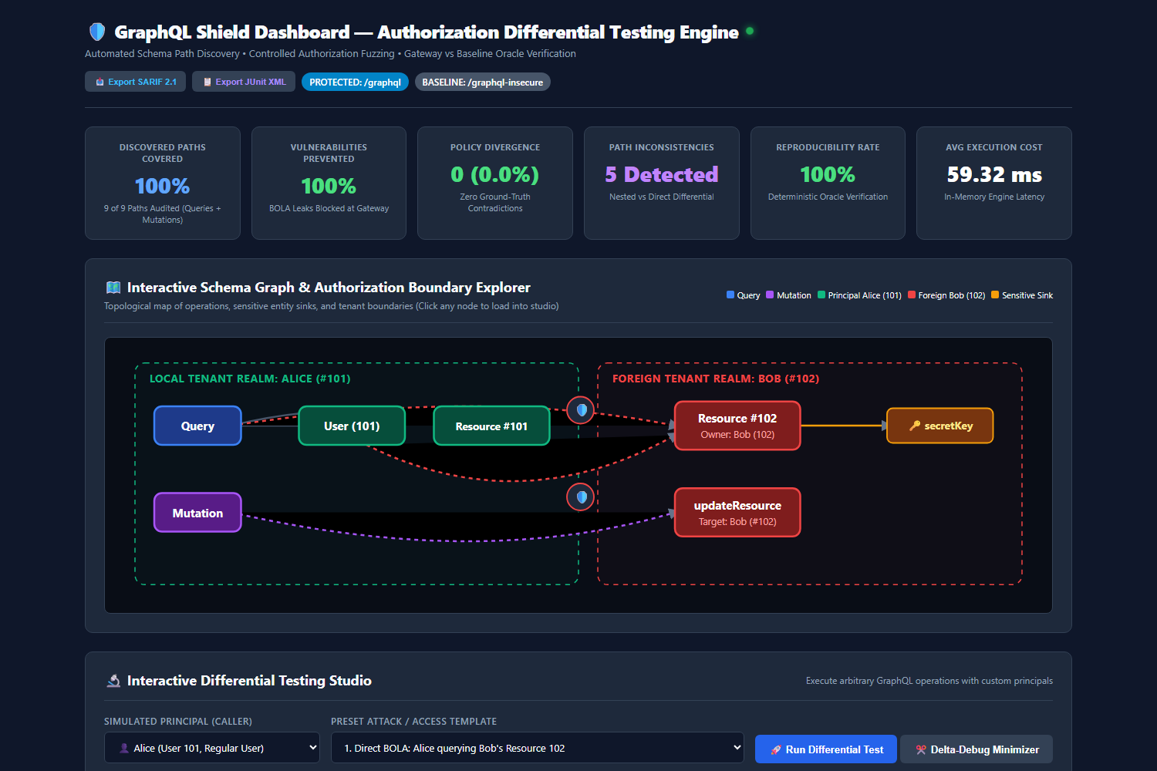
EVIDENCE
Live dashboard from real traffic
Captured from the running gateway
Live audit counters: events, allowed, blocked, BOLA.
Connection + last-update indicators.
Recent decisions table with reason and risk.
Adaptive anomaly panel per principal.
Reflects genuine requests, not simulated data.
GraphQL Shield — CCNS Capstone
12
Notes:
Real screenshot of /dashboard after live traffic: legit access, direct and nested BOLA, forged token, and the anomaly burst.

Slide 13
VERIFICATION
299 automated tests, all passing
299
Coverage
Authentication and JWT tenant claims
Direct, nested, multi-ID, variable and fragment BOLA
Policy engine, multi-tenant ABAC, risk scoring
Audit logging, dashboards, and live events
Schema-aware ownership inference singleton
Security graph and taint propagation
Adaptive anomaly detection (9 dedicated tests)
Real-time research engine (13 dedicated tests)
Automated remediation verification (15 dedicated tests)
passed / 299 collected
28 test files · 0 failures · ~60s runtime
Includes dedicated 15-test automated remediation suite
$ python -m pytest tests/ -q
299 passed in 60.52s
GraphQL Shield — CCNS Capstone
13
Notes:
299 automated tests cover every module. 0 failures across 28 files.

Slide 14
RIGOR & DEFENSE
Five Automated Technical Remediations
1
Live HTTP Gateway
Method B executes over real HTTP POST to /graphql; direct policy kept as explicit baseline.
2
Real Mutation Execution
Actual mutation execution verifies 403 denial with bitwise SQLite state preservation (zero tamper).
3
Metric Disentanglement
Separated binary detection (TP/FP) from exact canonical AST path and object attribution.
4
Tenant Header Anti-Spoof
JWT tenant is authoritative; X-Tenant-Id mismatch rejected (403 TENANT_HEADER_MISMATCH).
5
Statistical Precision
McNemar test uses scientific notation (p < 10^-4); production write endpoints admin-guarded.
Verified in under 7 seconds: python scripts/verify_audit_remediation.py -> 15/15 PASS
GraphQL Shield — CCNS Capstone
14

Slide 15
HONESTY
Limitations and proposed extensions
Current limitations
Proposed extensions (future work)
Schema inference is pattern-based; polymorphic ownership requires explicit rules.
Object-level gateway; does not rewrite queries into partial null fields.
Ownership lookup hits SQLite (mitigated by in-memory TTL cache).
Benchmark results reflect our evaluated corpus under defined configurations.
Anomaly baseline requires at least 2 active principals.
Temporal traversal detection: sequential ID distance + velocity bursts.
Field-level selective masking: nullify unauthorized fields safely.
Cross-platform policy synthesis: export Cedar / Rego OPA policies.
Role-based introspection filtering: hide unauthenticated schema types.
Redis-backed distributed ownership cache for multi-instance gateway.
GraphQL Shield — CCNS Capstone
15
Notes:
Strict academic honesty: we separate implemented capabilities, empirical findings, and proposed future work.

Slide 16
CONCLUSION
Centralized, measurable, defensible
100%
0.0%
90.5%
299/299
BOLA attempts blocked over live gateway
false alarms on benign owner traffic
exact canonical AST path attribution (100% semantic)
automated tests passing (0 failures)
GraphQL Shield demonstrates that combining schema-aware static analysis with runtime authorization evidence provides both strict pre-resolver protection and traceable path attribution — verified across live HTTP execution, genuine mutation safety, multi-tenant anti-spoofing, and 299 automated tests.
Thank you · Questions welcome
GraphQL Shield — CCNS Capstone
16
Notes:
Close on the four headline metrics and verified technical defensibility.

