Slide 1


Slide 2

Prometheus
The light, the shadow and the livers...
Martin Chodúr
FUSAKLA

Slide 3





Project not a company
prometheus/prometheus
fabxc
juliusv
brian-brazil
beorn7

Slide 4

Incubating in
Cloud Native Computing Foundation

Slide 5
Data model
∘ Multidimensional model
∘ Every time-serie identified by name and labels
∘ Metric name is just specifically handled label
∘ Sample consists of millisecond precision timestamp and float64
∘ 4 basic metric types: Counter, Gauge, Summary, Histogram

Slide 6
Counter
http_requests_total{status=”200”, endpoint=”/metrics”} 10
∘ Always rising, cannot decrease at any point
∘ Should have the suffix in metric name
∘ Engine needs to deal with counter resets (application restart)
∘ Should be used with the , and functions
_total
rate
irate
increase

Slide 7
Gauge
node_memory_usage_bytes{node=”fusakla.cz”} 23005456
∘ Represents actual value of some phenomenon
∘ Accuracy relies on the scrape interval you use
∘ Can’t be used with the , and functions
rate
irate
increase

Slide 8
Histogram
http_request_duration_seconds_count{endpoint=”/metrics”} 5
http_request_duration_seconds_sum{endpoint=”/metrics”} 1
http_request_duration_seconds_bucket{endpoint=”/metrics”, le=”0.1”} 1
http_request_duration_seconds_bucket{endpoint=”/metrics”, le=”0.5”} 3
…
http_request_duration_seconds_bucket{endpoint=”/metrics”, le=”+Inf”} 5
∘ Metric type consisting of set of Counters
∘ Describes count, total sum and distribution in given buckets
∘ Using the it’s possible to compute quantiles
histogram_quantile

Slide 9
Summary
http_request_duration_seconds_count{endpoint=”/metrics”} 5
http_request_duration_seconds_sum{endpoint=”/metrics”} 1
http_request_duration_seconds{endpoint=”/metrics”, quantile=”0.5”} 1
http_request_duration_seconds{endpoint=”/metrics”, quantile=”0.9”} 3
…
http_request_duration_seconds{endpoint=”/metrics”, quantile=”0.99”} 5
∘ Same as Histogram only evaluated on exporter side
∘ No need to compute the quantile on the Prometheus side
∘ Hides bucket distribution (Histogram is more used)

Slide 10
Gathering the data
∘ Prometheus uses pull based model
∘ Application exposes metrics on HTTP endpoint
∘ Periodically scrapes data from targets
∘ Variety of client libraries
∘ Exporters. A lots of them...

Slide 11
Exposition format
# HELP grafana_info Information about the Grafana # TYPE grafana_info gauge grafana_info{version="5.1.3"} 1 # HELP grafana_instance_start_total counter for started instances # TYPE grafana_instance_start_total counter grafana_instance_start_total 1 # HELP grafana_page_response_status_total page http response status # TYPE grafana_page_response_status_total counter grafana_page_response_status_total{code="200"} 11808 grafana_page_response_status_total{code="unknown"} 89 # HELP grafana_proxy_response_status_total proxy http response status # TYPE grafana_proxy_response_status_total counter grafana_proxy_response_status_total{code="200"} 981338 grafana_proxy_response_status_total{code="400"} 3 grafana_proxy_response_status_total{code="500"} 49672

Slide 12
Open Metrics
OpenMetrics is a working group to determine a standard for exposing metrics data, influenced by the Prometheus exposition format.
RichiH/OpenMetrics

Slide 13
Running and operating it
∘ Prometheus is single binary with no dependencies written in Go
∘ Configured by YAML file
∘ Prometheus does NOT have any configuration features…
That leaves to the operator
∘ Can be CPU and memory intensive
∘ Needs persistent filesystem (do not use NFS!)

Slide 14



Demo time
Metrics scrape
Dashboard
Server request
PromQL

Slide 15
Go instrumentation
var httpRequestDurationHistogram = prometheus.NewHistogramVec(
prometheus.HistogramOpts{
Name: "http_request_duration_seconds",
Help: "HTTP request latency distribution",
},
[]string{"status", "endpoint"},
)
prometheus.MustRegister(httpRequestDurationHistogram)
httpRequestDurationHistogram.WithLabelValues("200","/demo").Observe(duration.Seconds())
http.Handle("/demo/metrics", promhttp.Handler())

Slide 16
Prometheus configuration
global:
scrape_interval: 5s
evaluation_interval: 10s
scrape_configs:
- job_name: 'prometheus'
static_configs:
- targets: ['localhost:9090']
- job_name: 'error-server'
metrics_path: "/demo/metrics"
scheme: https
static_configs:
- targets: ['fusakla.cz']

Slide 17
TSDB
∘ Prometheus uses own database prometheus/tsdb
∘ Uses 2h WAL and than stores data in blocks on filesystem
∘ Blocks are compacted to longer blocks (6h, 12h)
∘ Not meant for longer retentions
∘ Prometheus allows backups using API

Slide 18
Service discovery
∘ Main feature for pull based model
∘ Implements cca 12 different SD allowing dynamic target load
∘ Well integrated with Kubernetes
coreos/prometheus-operator

Slide 19
PromQL
∘ Powerful query language with variety of operators and functions
∘ Results in one of these: Instant vector, Range vector, Scalar, String
∘ Allows aggregating on all the labels
∘ Cannot create Range vector for function result
∘ Turing complete
rate(http_requests_total{job="api-server"}[5m])

Slide 20
Data and PromQL
increase(http_requests_total{endpoint="/metrics"}[1m])
2 4 5 6 7 8 15 1 2 4 5 5 7 8
Raw data |-+--+---+---+----+---+--+---+---+---+----+--+---+---+--|
| 1m | | | | | | | |
Range vector |------+------+------+------+------+------+------+------|
(4-2) (6-5) -- (15-8) (2-1) (5-4) (7-5) (8-7)
/60 /60 /60 /60 /60 /60 /60
Result 0.03 0.01 -- 0.1 0.01 0.01 0.03 0.01

Slide 21
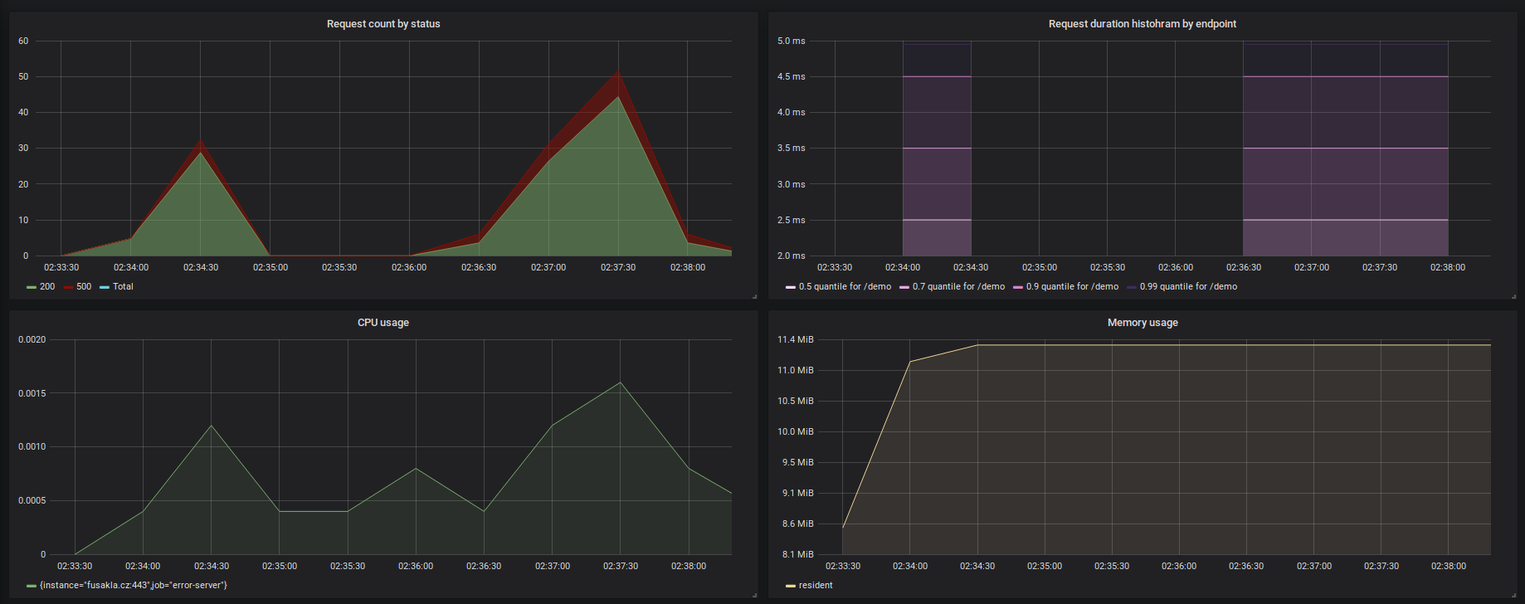
Grafana dashboard

Slide 22
What’s next
∘ Using recording rules to avoid repetitive query evaluation
∘ Explore Prometheus HTTP api and remote read and write API
∘ HA Alerting using alert rules and Alertmanger
∘ Hierarchical federation
∘ Relabeling configs
∘ Long term storage

Slide 23

Closing remarks
Every time when Prometheus exits, last thing it does is writing to the log:
level=info caller=main.go:599 msg="See you next time!"
Wait when you mess up configuration few times in a row… spiteful little troll

Slide 24




Ask questions to
...it’s always better to waste someone else's time than yours
Me:
Community:
FUSAKLA
IRC #prometheus
m.chodur@seznam.cz
prometheus-users
Martin Chodur
@PrometheusIO

