Slide 1
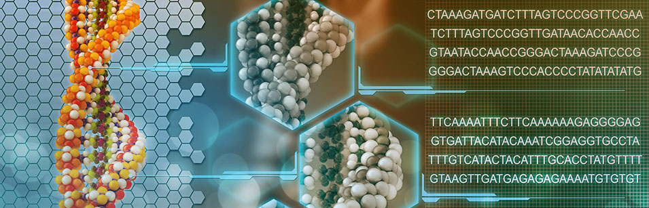
Bioinformatik
Detect splices with PSSM

Slide 2
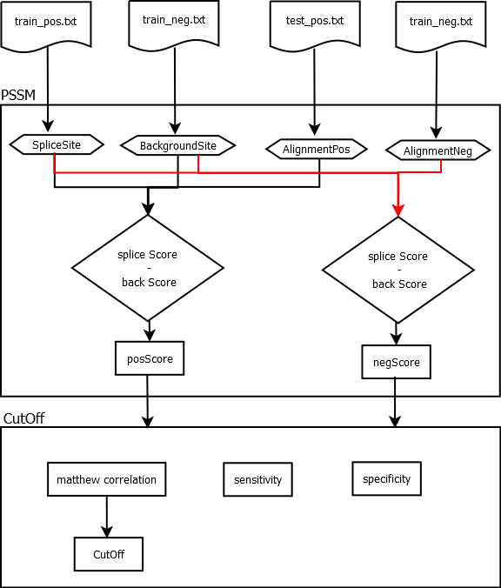
Overview

Slide 3
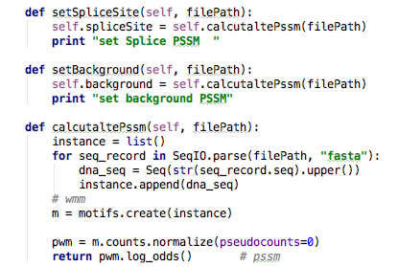
Determine PSSM‘s
Setting Splice Site and Background PSSM

Slide 4
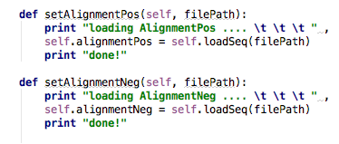
Loading Alignments
Setting positive and negative Alignments

Slide 5
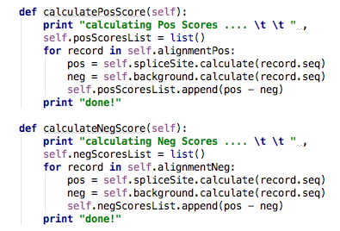
Calculating scores
Positive and Negative scores

Slide 6
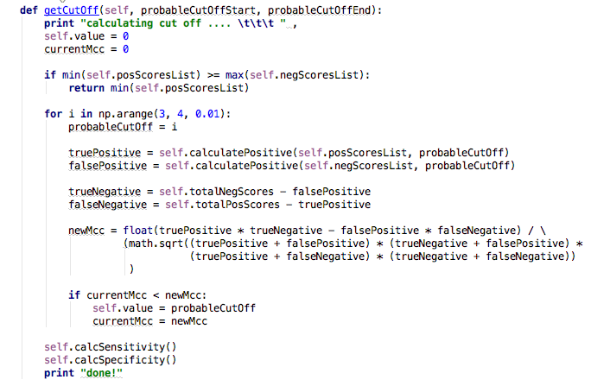
Cut Off 1/2

Slide 7
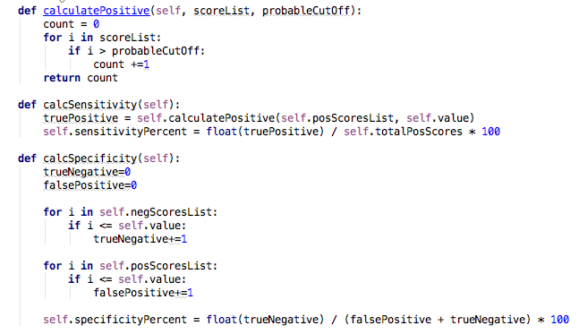
Cut Off 2/2

Slide 8
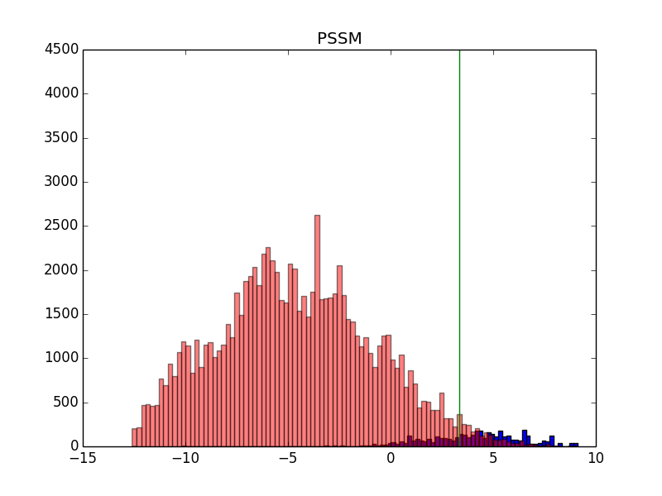
Scores with Cut Off

Slide 9
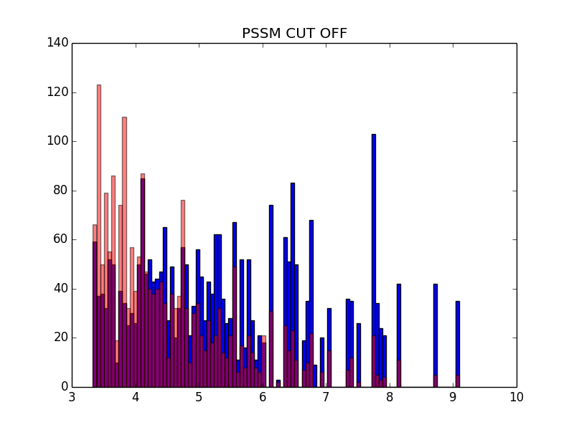
Scores

