Slide 1
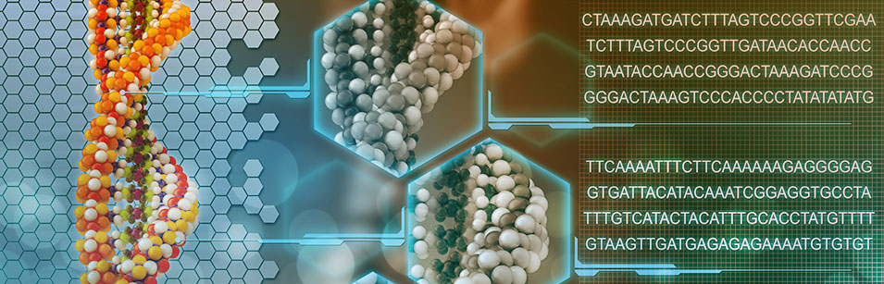
Bioinformatik
Detect splices with PSSM

Slide 2
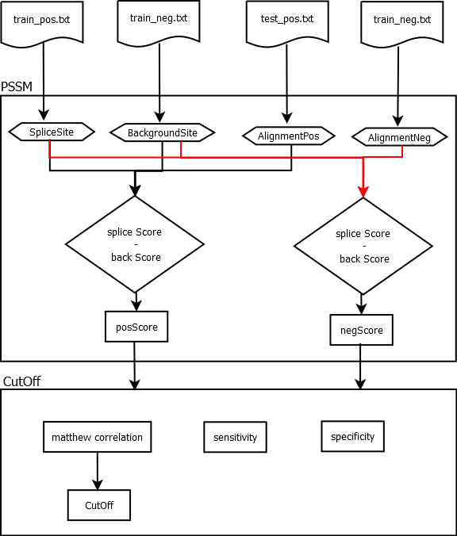
Overview

Slide 3
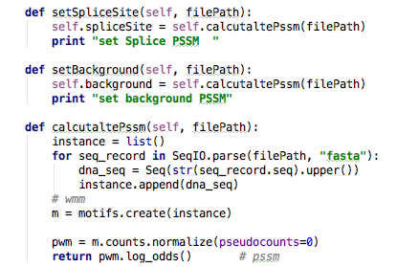
Determine PSSM‘s
Setting Splice Site and Background PSSM

Slide 4
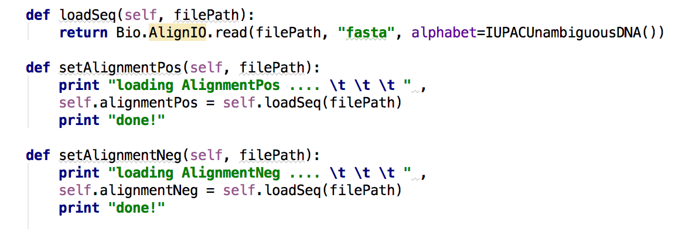
Loading Alignments
Setting positive and negative Alignments

Slide 5
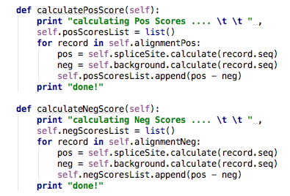
Calculating Scores
Positive and Negative scores

Slide 6
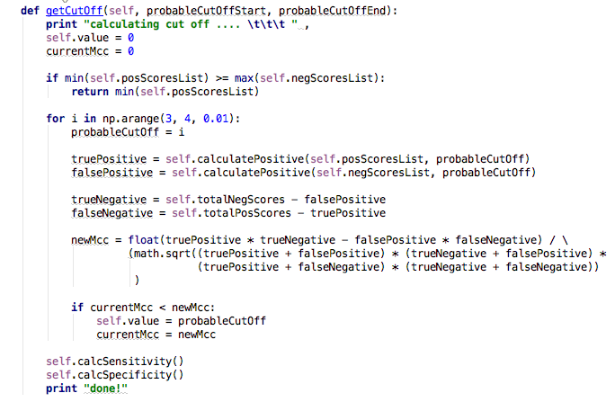
Cut Off 1/2

Slide 7
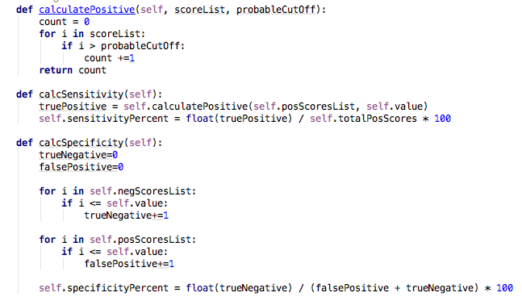
Cut Off 2/2
Notes:
Cut Off Value: 3.33
Sensitivity: 65.45% = Wieviele der Erkrankten werden erkannt?
Specificity: 98.37% = Wieviele der Gesunden sind nach dem Test nicht erkrankt?

Slide 8
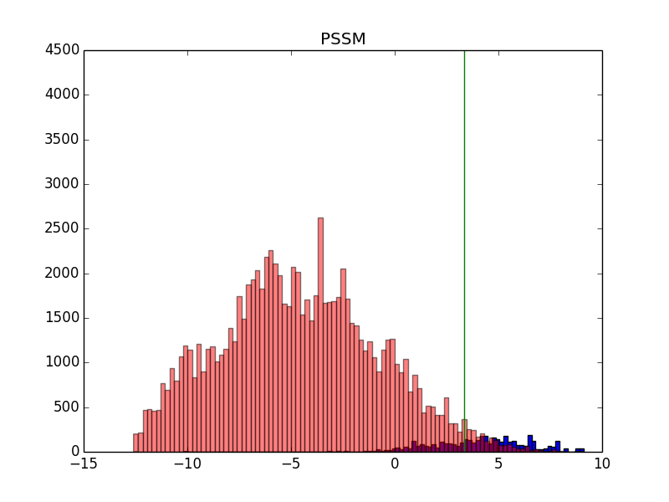
Scores with Cut Off

Slide 9
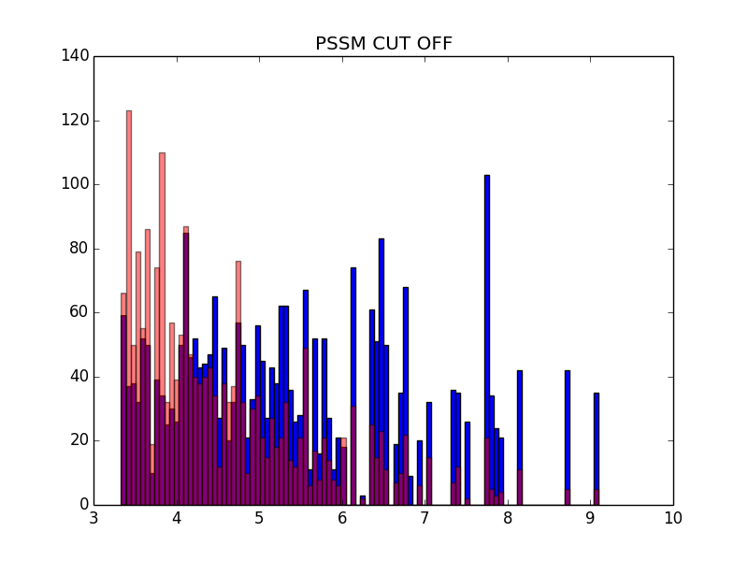
Scores

