Slide 1

Interactive graphics
Gustavo Enrique Nino

Slide 2
Name: ggvis
The goal of ggvis is to make it easy to build interactive graphics for exploratory data analysis. The graphics produced by ggvis are fundamentally web graphics and work very differently from traditional R graphics.
The package allows to change statistics like smoothing functions or distribution functional forms in interactive forms.
The package allows to change colors of the graphics in interactive way to check the best mix of colors.
The package allows to save time checking different kinds statistic parameters and colors to select the best option of plotting.

Slide 3
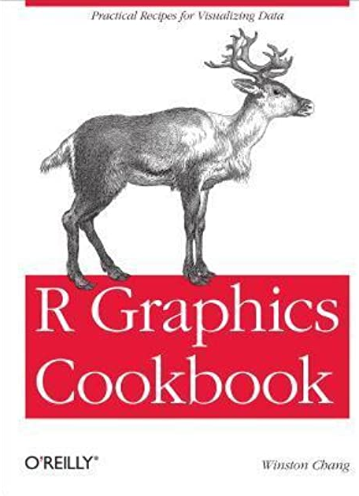

Lead author: Winston Chang
About the author: Ph. D. in Psychology from Northwestern University
Job: Winston is a software engineer at Rstudio
Publications: R Graphics Cookbook

Slide 4
Steps to Use it
1. Install the package with the command—install.packages(“ggvis”)
2.To use the main output of the package you need to tap the data set follow to the sign “%>%”. Then tap the command with the variable:
Dataframe%>%ggvis(~X)

Slide 5
Steps to Use it
3.The command works essentially as plot(). You can add two variables to plot a dispersion:
Dataframe%>%ggvis(~X,~Y)
4.The dynamic part of the graphic comes from the options that can be applied to the command(layer_histograms,layer_points, layer_smooths, etc) :
Dataframe%>%ggvis(~X,~Y) %>%layer_*()

Slide 6
Examples: Interactive Histogram
install.packages("ggvis")
library("ggvis")
mtcars %>%
ggvis(~wt) %>%
layer_histograms(width = input_slider(0, 2, step = 0.10, label = "width"),center = input_slider(0, 2, step = 0.05, label = "center"))
We define the data set first
We use the ggvis command with the variable
In this example we use the option layer_histograms to create a dynamic histogram that can change the width and center dynamically

Slide 7
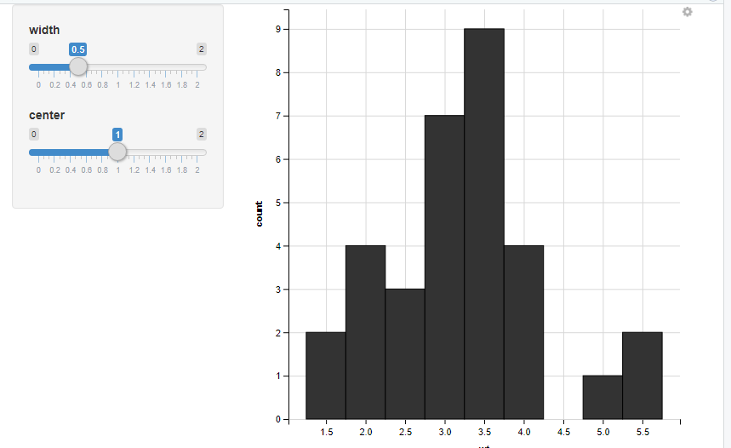
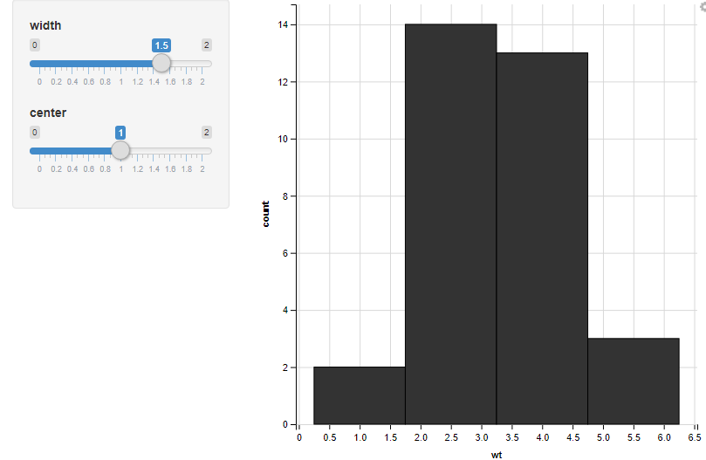
Example Output
You can adjust the width and center of the histogram dynamically in the viewer box of R
Width(0.5)
Width(0.5)

Slide 8
Complex Example: Smoothing a dispersion graph
install.packages("ggvis")
library("ggvis")
mtcars %>%
ggvis(~wt) %>%
mtcars %>% ggvis(~wt, ~mpg) %>%
layer_smooths(span = input_slider(0,1, step = 0.1, value = 0.8,label = "Span")) %>%
layer_points()
We define the data set first
We use the ggvis command with the variable
In this example we use the option layer_smooths to create a dynamic dispersion graph that have a line that has functional form that predicts the behavior. Where 1 means a linear form, and 0 a polynomial form of high degree

Slide 9
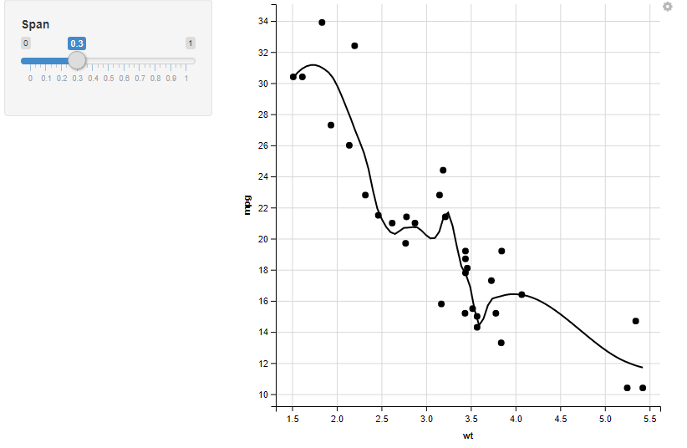

Example Output
You can adjust the span dynamically in the viewer box of R
Span(0.3)
Span(1)

