Slide 1
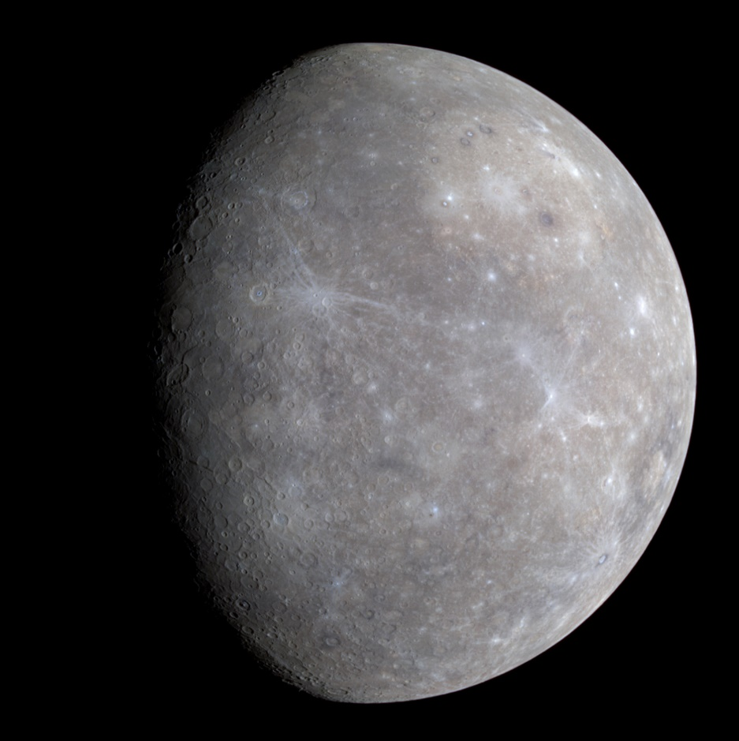

On Mercury, you would weigh:

Slide 2
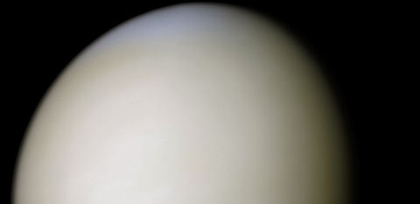
On Venus, you would weigh:

Slide 3
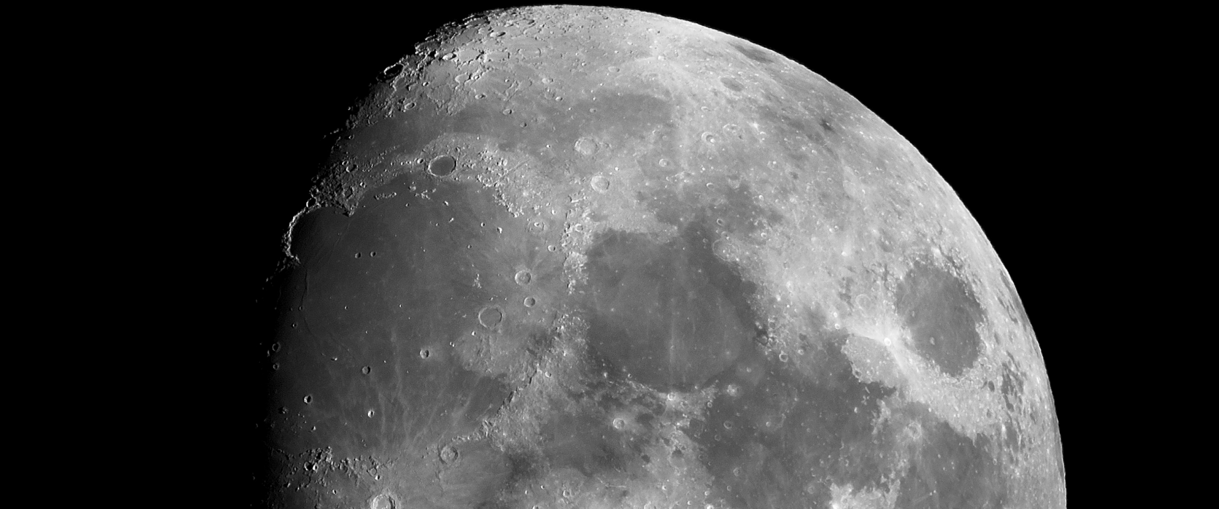
On the Moon, you would weigh:

Slide 4
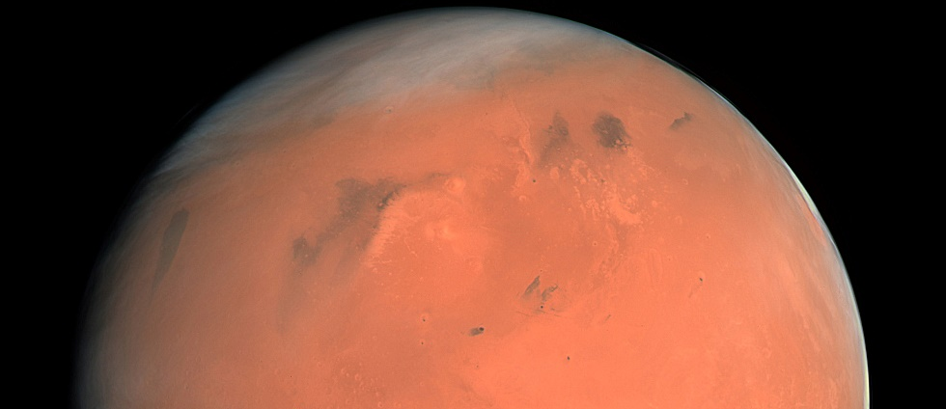
On Mars, you would weigh:

Slide 5
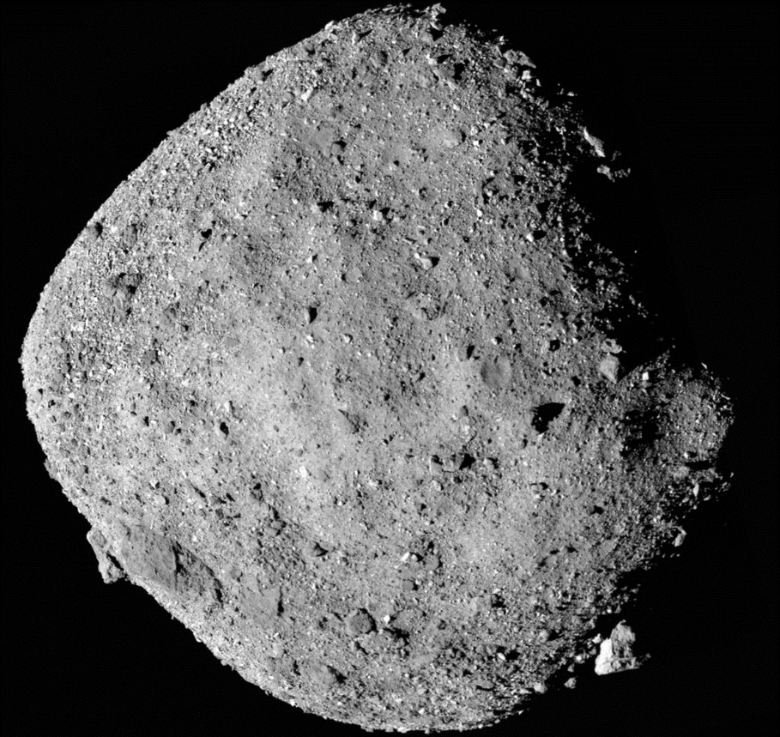
On Bennu, you would weigh:

Slide 6
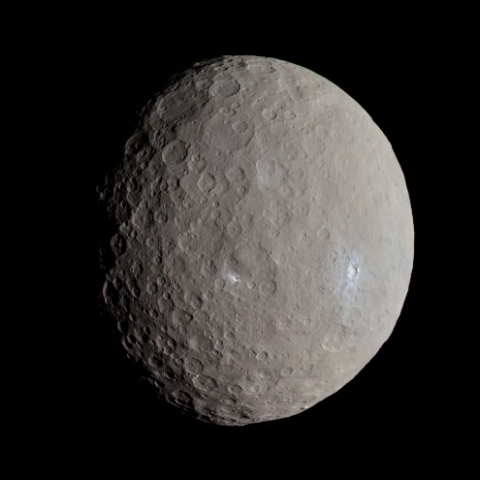
On Ceres, you would weigh:

Slide 7
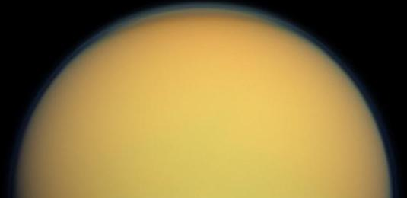
On Titan, you would weigh:

Slide 8
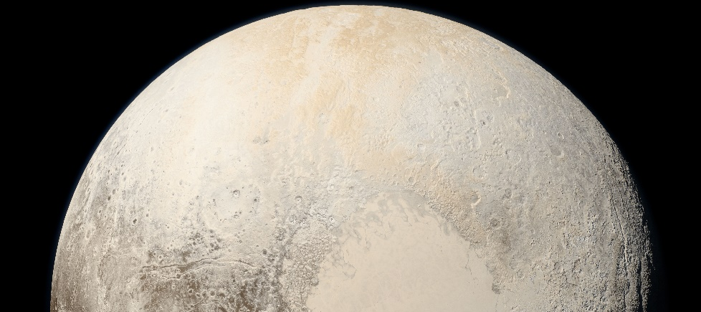
On Pluto, you would weigh:

Slide 9

How Much Would You Weigh on the Moon?
Step on the scale to find out!

