Slide 2
CorPool
… Corporate Carpooling as a Service
Group 7: Sjouke de Vries & Floris Westerman

Slide 3
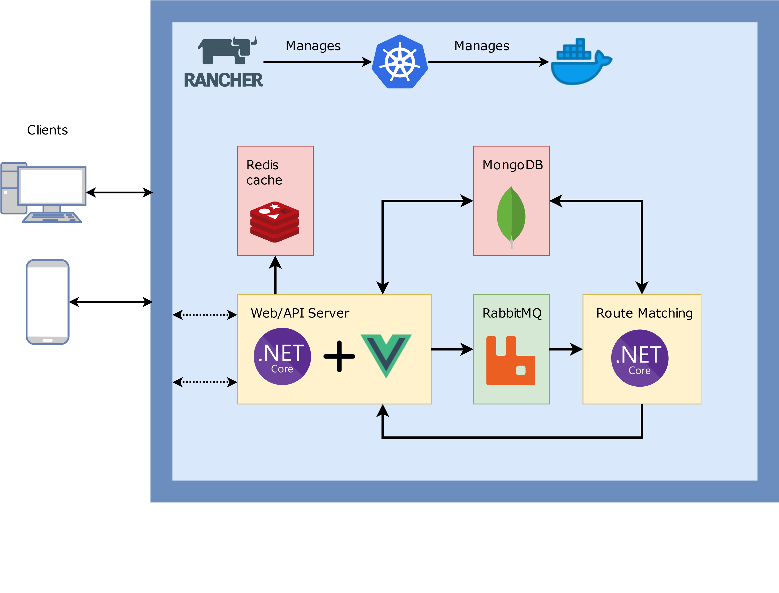
Architectural Overview

Slide 4
Technology Stack: .NET Core
Back-end framework
Cross-platform compatible
Easy to use in Docker/Kubernetes environments

Slide 5
Technology Stack: VueJS
Front-end framework
SPA routing integrated
State storage using Vuex

Slide 6
Technology Stack: RabbitMQ
Messaging queue between web app and route matching service
Allows asynchronous, parallel computation of ride matches

Slide 7
Technology Stack: Storage
Using MongoDB as document store for main data
Using Redis as cache for the back-end with high load

Slide 8
Technology Stack: Orchestration
Using Rancher to manage Kubernetes (networking, ingresses, services, storage)
Using Kubernetes to manage Docker containers
Defining cluster state in Helmfiles

Slide 9
Erg lange titel voor deze template pagina die ik nu maak
Minder lange inhoud voor deze template pagina

