Slide 1

Computer Science
Faculty of Science and Engineering
Exploring architectural design decisions in issue tracking systems
PAttern Changes Identifier TOol (PACITO)
Filipe Alexandre Rosa Capela
S4040112
1 July 2020
Notes:
Hello, my name is Filipe Capela, and the aim of this internship was to create a way to easily explore architectural design decision in issue tracking systems.

Slide 2
Overview
Goals and Motivation
PAttern Changes Identifier TOol (PACITO)
Selected Software
Challenges
Process Flow
Quantitative Analysis
Future Work

Slide 3
Goals and Motivation
Notes:
Help in understanding why certain patterns are added or removed from software systems
Automate this process so that users can make an easy qualitative analysis using data provided by my tool.
I will explain the challenges I overcame, the tool I have developed and the results of this tool, which propose to answer quantitative questions such as:
Is there a relation between the number of commits and patterns changed? Is there any issue type that stands out from a point of view of pattern changes?

Slide 4
PAttern Changes Identifier TOol (PACITO)
Notes:
PACITO, that stands for Pattern Changes Identifier Tool.
This tool will analyze pattern changes between versions of a software and match with the information from the corresponding issues.

Slide 5




Selected Software
Notes:
Pinot – Pattern Inference and Recovery Tool, 2006, IBM
Scans JAVA source code and outputs list of GoF patterns.
Apache Mina uses
JIRA – Issue Tracking System
Git – Version Control System
Latest Commit 2017
Low Number of Commits 2500
Possible others: Zookeeper, Kafka

Slide 6
Challenges
Archie:
No output
Difficulty to incorporate in a script for all versions
Pinot:
Lack of documentation
Problems with Java version
Preprocessing necessary
Maven:
Backwards compatibility issues
Notes:
Regarding the challenges I have faced during this internship, the problems revolved in obtaining the maximum performance out of the pattern inference tool. Starting with the tool on the left, Archie, it was a tool which attempted to detect architectural patterns inside of java projects, with this tool being an Eclipse plug-in. After many unsuccessful attempts, and due to the fact that this tool would be almost surely impossible to include in a cycle to iterate through the commits, the tool was discarded.
The problems with Pinot were many, and the goal was to finetune the analysis so that more patterns could be detected, to improve the output provided by my tool, PACITO. First there was the problem with lack of documentation, which showed off in the beginning where I had problems running the tool since no documentation was given to which were the requirements to run it. After getting the proper version, it was then a matter of testing pinot on several softwares. It was clear that the results were not good, as the tool was only processing very few classes out of many possible java files. After making several tests, using many java versions, it was clear that Pinot depended on the java version, and java 7 was adopted as the version to use. After this problem, the number of valid analysis increased but the processed classes remained very low. It was then tested whether Pinot would be using Java 4’s compiler to check for patterns in the code, which would cause Pinot to fail since features like Generic Types, Annotations and the Diamond Operand were only introduced in versions following Java 4. To test this I have added a preprocessing stage to my application before pinot is executed, so that the source code is cleaned and compliant with pinot’s compiler. After this step the number of processed classes increased sharply, but an additional step was taken. As seen on the right Maven is a part of this project. The reason for this is that usually, Apache programs use Maven to build and use external dependencies. It was hypothesized that, the same way the Java version was passed to CLASSPATH to be used by Pinot, maybe adding the jar files to the CLASSPATH would cause Pinot to process more classes, as it was possibly discarding files since it wouldn’t recognize external libraries features. After creating a preprocessing step to make almost all versions build successfully to obtain the dependencies and adding these to the CLASSPATH, Pinot is believed to be running at almost maximum performance, giving the users the best possible results.

Slide 7
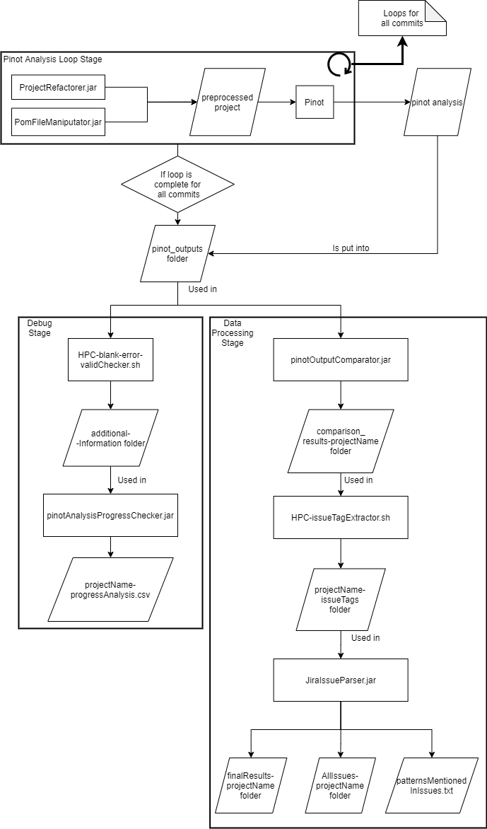
Process Flow
Notes:
Now I'm going to present you the process flow of my application by highlighting the three most important stages in my application, to make you understand the flow of the outputs since I would say my application resembles a bit to the pipes and filters architectural pattern.

Slide 8
Pinot Analysis Loop Stage
Notes:
The first and very important stage in my tool is the pinot analysis loop stage, as mentioned previously this step starts off with two refactoring stages mentioned here in the projectrefactorer.jar and the pomfilemanipulator.jar which will create a preprocessed version of the software which is then fed to pinot which will create a pinot analysis.

Slide 9
Facade Pattern.
DemuxingIoHandler is a facade class.
Hidden types: MessageHandler IdentityHashSet
Facade access types: DemuxingIoHandler
File Location: /data/s4040112/sourcecodes/mina/core/src/main/java/org/apache/mina/handler/demux/DemuxingIoHandler-refactored.java
Facade Pattern.
Main is a facade class.
Hidden types: ServiceRegistry DefaultIoFilterChainBuilder IoSessionManager
Facade access types: Main
File Location: /data/s4040112/sourcecodes/mina/examples/src/main/java/org/apache/mina/examples/httpserver/Main-refactored.java
Facade Pattern.
Main is a facade class.
Hidden types: ServiceRegistry DefaultIoFilterChainBuilder IoSessionManager
Facade access types: Main
File Location: /data/s4040112/sourcecodes/mina/examples/src/main/java/org/apache/mina/examples/echoserver/Main-refactored.java
------------------------------------------
Pattern Instance Statistics:
Creational Patterns
==============================
Abstract Factory 0
Factory Method 0
Singleton 2
------------------------------
Structural Patterns
==============================
Adapter 12
Bridge 8
Composite 2
Decorator 3
Facade 22
Flyweight 14
Proxy 0
------------------------------
Behavioral Patterns
==============================
Chain of Responsibility 0
Mediator 52
Observer 0
State 0
Strategy 31
Template Method 0
Visitor 1
------------------------------
Number of classes processed: 207
Number of files processed: 200
Size of DelegationTable: 1836
Size of concrete class nodes: 123
Size of undirected invocation edges: 258
nMediatorFacadeDual/nMediator = 10/52
nImmutable/nFlyweight = 0/14
nFlyweightGoFVersion = 0
Notes:
An example of the output of Pinot can be observed here. We can see a description of the captured patterns, and a detailed list of the number of patterns detected for the entire source code for a given version of Apache Mina.

Slide 10
Debug Stage
Notes:
Next we have the debug stage this is a step which is not critical for the functioning of the application as we can remove this and we will still have the same output in the end but nonetheless it is a very important stage for the user to understand if there is something wrong with the functioning of pinot by looking into each pinot analysis and outputting problems found in certain commits. This may help in detecting problems with specific files which is something that I had problems with. Apache Mina had an issue with three files which would cause the entire application to crash not giving any output whatsoever and this happened since Pinot was programmed to detect exception handling in such a way that anonymous methods when implemented would need to to include the throws declaration. This was not found inside the source code of Apache Mina, so an Exception would be thrown by Pinot, making unfeasible the possibility to obtain patterns in some versions of Apache Mina. Ultimately this stage is important for users to be able to understand problems and to be able to fine tune pinot according to the needs of the software to be scanned.

Slide 11
Data Processing Stage
Notes:
Now we move onto the last and I would say the most complex part of the application and this is where the pattern changes are evaluated and where D final output is created. This stage is not related to fine tuning any tools it is just about processing the peanut outputs in matching the pattern changes to their corresponding issues and storing these information Inside a single file which will help future users of pasito to make a qualitative analysis and possibly answer the hypothesis presented at the beginning of my internship. The first step in this stage is too compare consecutive commits according to the number of patterns detected. What this means is if we have commit one which has five facade patterns and commit to which has 6 facade patterns a file will be created to store the information Of the addition of one instance of the facade pattern. If two commits don't present changes in any of the patterns, no file is created. After creating all these files it is now time to obtain They git commit messages so that we can possibly obtain The issue keys for each commit where pattern changes were detected. If an issue key is detectors in the commit message then My application Will contact the jira issue repository to obtain the information Which will be necessary to answer any quantitive or qualitative questions. This information Will be compacted into a single line of text separated by commas to create a CSV file where each row will amount to an issue where pattern changes were detected.

Slide 12
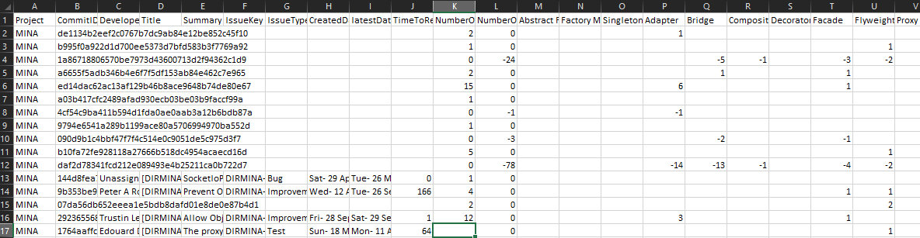
Results
Notes:
The end result will look similar to this. As we can see in this file some lines don't have all the information. These empty lines corresponds to commits that don't have an issue key inside the commit message. For the remaining of the lines where we it was able to make a correspondence between the commit and then issue key we can see that all the information is available such as the developer name the issue type the dates where the issue was created, updated , resolved And I have also created columns representing the time it took 4 an issue to be resolved as well as the number of pattern additions and pattern removals

Slide 13
Quantitative Analysis

Slide 14
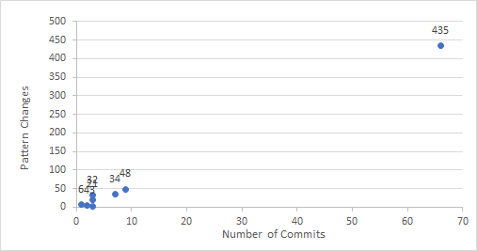
Relation between commits and nº of patterns changed
Notes:
here I present to you some of the quantitative analysis I have made regarding the Apache MENA software. In this graph we can see the relation between the number of commits a certain developer did and the pattern changes that same developer had an impact on It is very hard to make a clear correspondence between these two variables but it is it is possible to see the slides in a slight linear increase or even exponential if we consider that one of the developers did most of the pattern changes and as well as most of the commits spotted by the application. It would be very interesting to merge these data With data from other projects so that a clear answer can be made for this question.

Slide 15
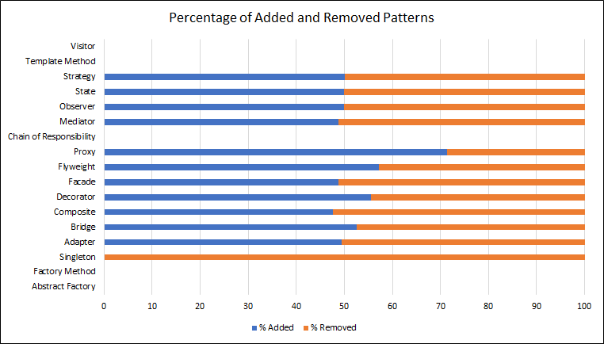
Relation between changes per pattern
Notes:
Here I have made a chart to make a visual representation of the number of patterns added or removed depending on Each individual pattern. We can see that the distribution is almost entirely in the 50% area which makes me believe that there is no clear distinction and there's no indication of a certain pattern being added more than it is removed but there is obviously some fluctuations to this for example the proxy pattern was added more than it was removed and this may have something to do with the software itself but further investigation would need to be done for this. The Singleton pattern Seems to be only removed from this software but no clear results can be extracted from this analysis given that only two changes were made to the Singleton pattern and both of these were removals so there is not enough data to conclude anything regarding these aspects. We can see that the visitor template and chain of responsibility had no changes this is mainly possibly due to the software itself maybe there was no indication of these patterns in the source code an at the bottom we can see the factory and the abstract factory methods patterns though not contain changes as well but this was because peanut had a problem with a given Filing Apache MENA which would cause the software to crash when it was detecting the factory methods and the abstract factory pattern So it was decided that an altered version of peanut would be utilized which does not detect any factory or abstract factory methods but further explanations to this can be found in the report as to how to change the version of peanuts

Slide 16
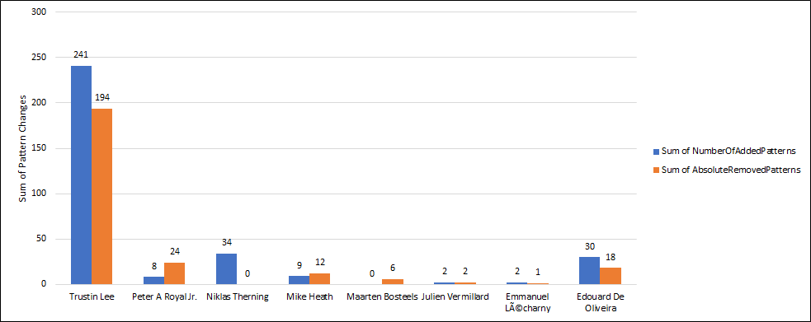
Developers contribution to adding/removing patterns
Notes:
an attempt was made to understand if certain developers contribute more into adding or removing patterns from the system and as mentioned previously this was for a lot of the lifespan of Apache Mina a one man project so we can see that trustingly holds many of the pattern changes since it held a lot of the commits but there is no clear distinction as to it adds more or removes more patterns from the system since these are in the same scale not only for trustingly but also for Edward D Oliveira which is on the right and the remaining and developers we can see that there are some exceptions to this possibly it has something to do with the role these developer had but the third developers counting from the left Nicholas turning only added patterns and maybe it can be related to the fact that he only took care of issue types which were new features so maybe that's the explanation to this

Slide 17
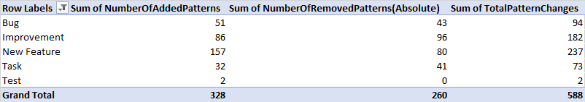
Patterns added/removed per issue type
Notes:
In this table we can see the number of additions and removals of patterns depending on the issue type where this changes occurred. there is only one value that stands out from an quantitative analysis point of view which is the number of edit patterns in the new feature issues we can clearly see that almost twice as many patterns have been added compared to the number of removed patterns . These may indicate that when an issue is a new feature possibly more patterns will be added. it is also interesting that gnu feature issues we're the ones with the most edit patterns these may indicate that this is an issue type where usually patterns are added more compared to the other issue types.

Slide 18
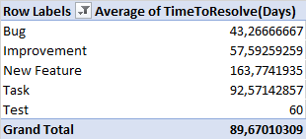
Average time to resolve different issue types
Notes:
so we get to this small table which compares the time it took for an issue to be resolved depending on the issue type and we got very interesting results again for the new feature issue type since we can see that this took fairly longer Times the resolve compared to the other issue types. this may possibly be combined with the results obtained for the number of added patterns and removed for new feature and we can possibly come to the conclusion That issues where patterns are changed more tend to take longer to resolve as new feature and 257 pattern changes which was about 50% of the changes in patterns for all the issues.

Slide 19
Future Work
Notes:
In the future my tool as mentioned should be used two qualitatively answer questions such as why certain patterns are added or removed from the software by the developers and the reason why these patterns are added for example maybe we can come to the conclusion that some patterns may be used in certain situations which will ultimately help in creating better software in the future since maybe some guidelines may be created for specific software in specific domains to be followed. The first step that I considered the most important one is to add a step which would fill in the gaps where the pattern changes were detectives but no issue key was found for that same commit it may be possible to find this by looking into the entire G repository and looking into the commit messages and comparing with the descriptions of the issues and possibly a relation may be found which will then add more data to the CSV file which will ultimately give a better analysis. As mentioned throughout this presentation It is important to test these tools for more projects together more data as well and possibly some alterations may need to be done to pasito so that it can comply and preprocess features of Java which are introduced in Java 811 13 or future releases as well this will allow for Better processing of projects released and programmed using these same Java versions.

Slide 20
Computer Science
Faculty of Science and Engineering
Exploring architectural design decisions in issue tracking systems
INMSTAG-08.2019-2020.2B
Filipe Alexandre Rosa Capela
S4040112
1 July 2020
Notes:
Hello, my name is Filipe Capela, and the aim of this internship was to create a way to easily explore architectural design decision in issue tracking systems.

