Slide 1

Computer Science
Faculty of Science and Engineering
Exploring architectural design decisions in issue tracking systems
PAttern Changes Identifier TOol (PACITO)
Filipe Alexandre Rosa Capela
S4040112
1st July 2020

Slide 2
Overview
Goals and Motivation
PAttern Changes Identifier TOol (PACITO)
Selected Software
Challenges
Process Flow
Quantitative Analysis
Conclusions and Future Work

Slide 3
Goals and Motivation

Slide 4
PAttern Changes Identifier TOol (PACITO)

Slide 5




Selected Software

Slide 6
Challenges
Archie:
No output
Difficulty to incorporate in a script for all versions
Pinot:
Lack of documentation
Problems with Java version
Preprocessing necessary
Maven:
Backwards compatibility issues

Slide 7
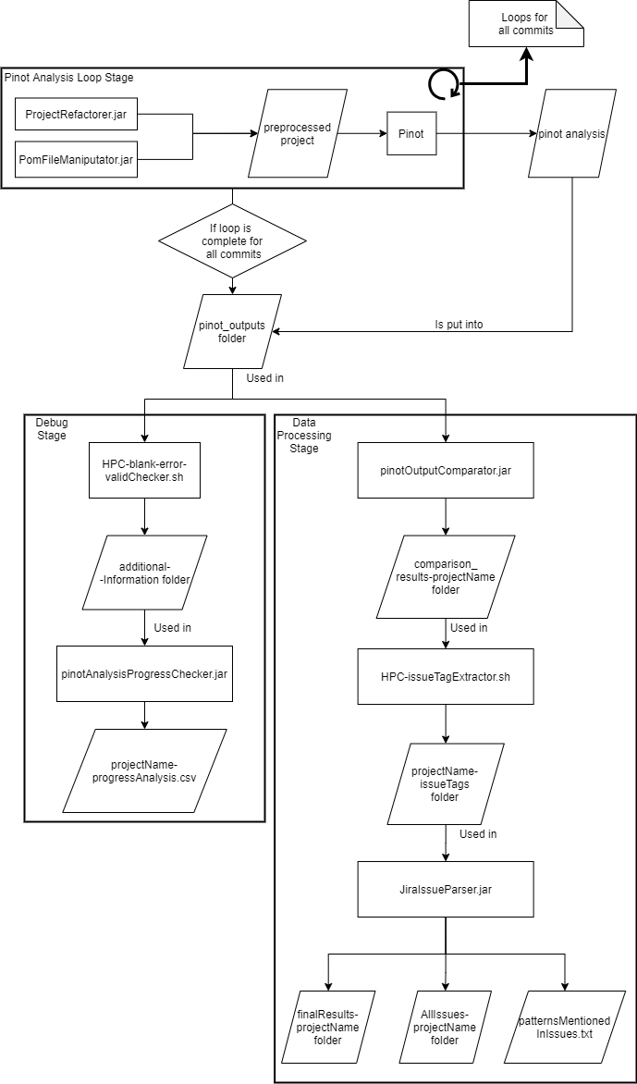
Process Flow

Slide 8
Pinot Analysis Loop Stage

Slide 9
Facade Pattern.
DemuxingIoHandler is a facade class.
Hidden types: MessageHandler IdentityHashSet
Facade access types: DemuxingIoHandler
File Location: /data/s4040112/sourcecodes/mina/core/src/main/java/org/apache/mina/handler/demux/DemuxingIoHandler-refactored.java
Facade Pattern.
Main is a facade class.
Hidden types: ServiceRegistry DefaultIoFilterChainBuilder IoSessionManager
Facade access types: Main
File Location: /data/s4040112/sourcecodes/mina/examples/src/main/java/org/apache/mina/examples/httpserver/Main-refactored.java
Facade Pattern.
Main is a facade class.
Hidden types: ServiceRegistry DefaultIoFilterChainBuilder IoSessionManager
Facade access types: Main
File Location: /data/s4040112/sourcecodes/mina/examples/src/main/java/org/apache/mina/examples/echoserver/Main-refactored.java
------------------------------------------
Pattern Instance Statistics:
Creational Patterns
==============================
Abstract Factory 0
Factory Method 0
Singleton 2
------------------------------
Structural Patterns
==============================
Adapter 12
Bridge 8
Composite 2
Decorator 3
Facade 22
Flyweight 14
Proxy 0
------------------------------
Behavioral Patterns
==============================
Chain of Responsibility 0
Mediator 52
Observer 0
State 0
Strategy 31
Template Method 0
Visitor 1
------------------------------
Number of classes processed: 207
Number of files processed: 200
Size of DelegationTable: 1836
Size of concrete class nodes: 123
Size of undirected invocation edges: 258
nMediatorFacadeDual/nMediator = 10/52
nImmutable/nFlyweight = 0/14
nFlyweightGoFVersion = 0

Slide 10
Debug Stage

Slide 11
Data Processing Stage

Slide 12
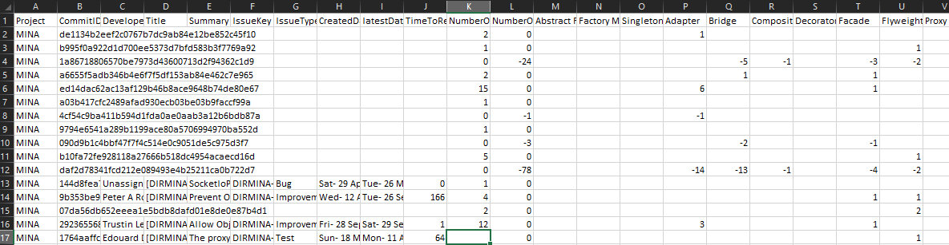
Results

Slide 13
Quantitative Analysis

Slide 14
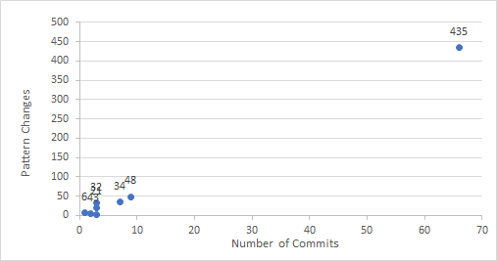
Relation between commits and nº of patterns changed

Slide 15
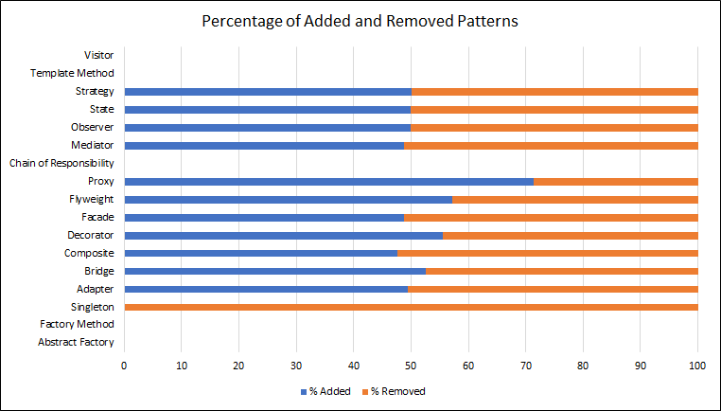
Relation between changes per pattern

Slide 16
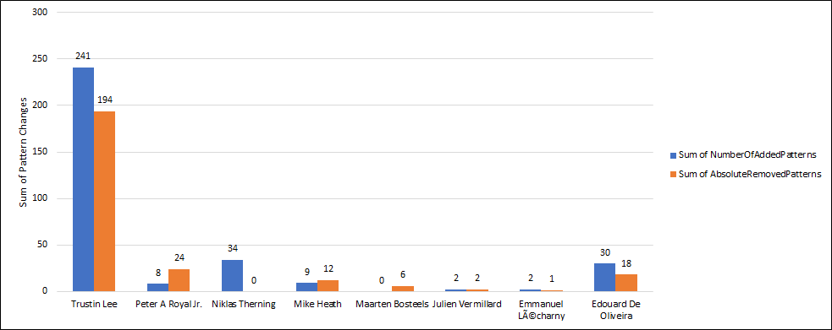
Developers contribution to adding/removing patterns

Slide 17
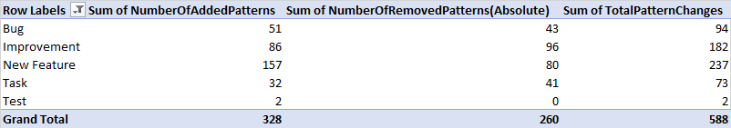
Patterns added/removed per issue type

Slide 18
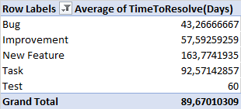
Average time to resolve different issue types

Slide 19
Conclusions and Future Work

Slide 20
Computer Science
Faculty of Science and Engineering
Exploring architectural design decisions in issue tracking systems
PAttern Changes Identifier TOol (PACITO)
Filipe Alexandre Rosa Capela
S4040112
1st July 2020

