Slide 1

Computer Science
Faculty of Science and Engineering
Exploring architectural design decisions in issue tracking systems
INMSTAG-08.2019-2020.2B
Filipe Alexandre Rosa Capela
S4040112
1 July 2020

Slide 2
Goal and Research Question

Slide 3
PAttern Changes Identifier TOol (PACITO)

Slide 4




Selected Software

Slide 5
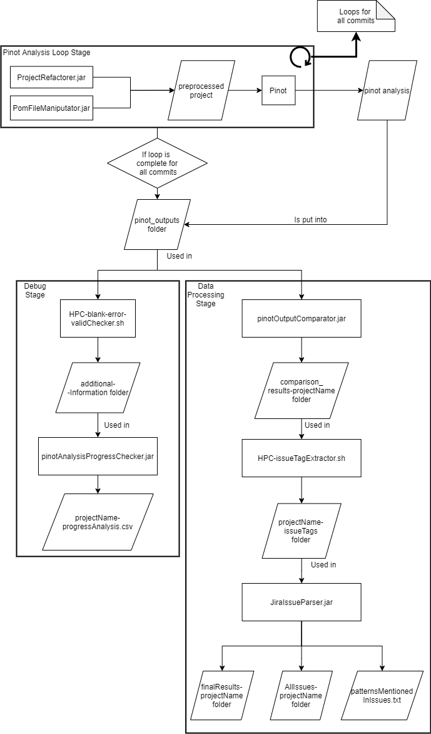
Process Flow

Slide 6
Pinot Analysis Loop Stage

Slide 7
Debug Stage

Slide 8
Data Processing Stage

Slide 9
Challenges
Archie:
No output
Difficulty to incorporate in a script for all versions
Pinot:
Lack of documentation
Problems with Java version
Preprocessing necessary
Maven:
Backwards compatibility issues

Slide 10
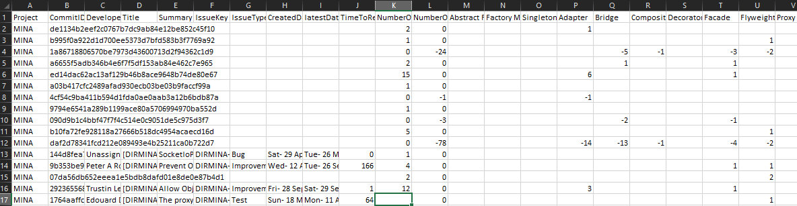
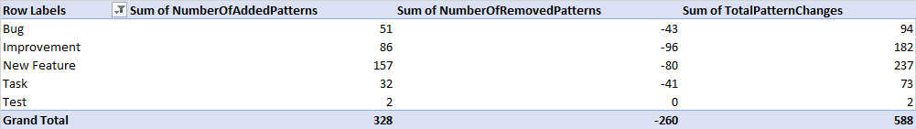
Results

Slide 11
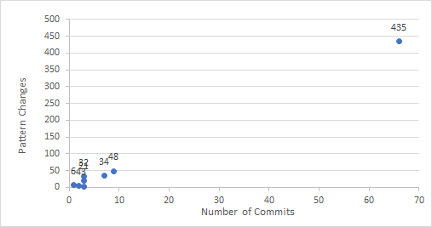
Relation between commits and nº of patterns changed

Slide 12
Patterns added/removed per issue type

Slide 13
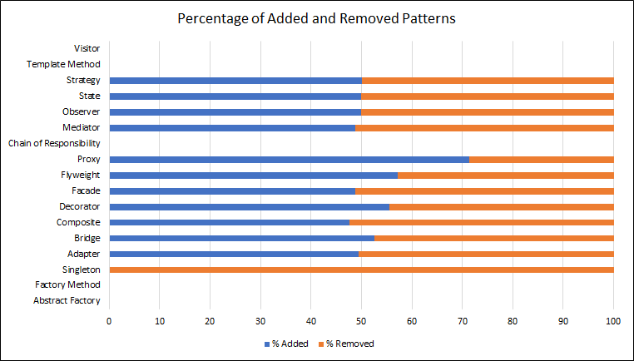
Relation between changes per pattern

Slide 14
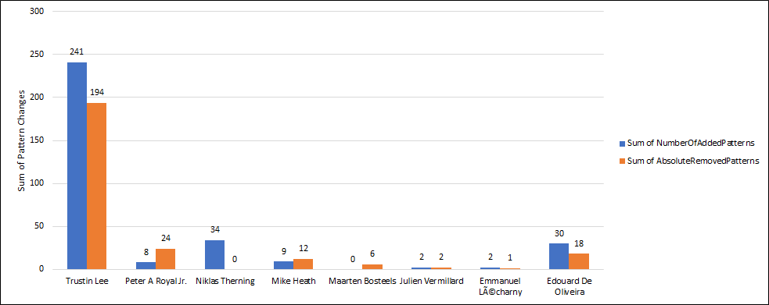
Developers contribution to adding/removing patterns

Slide 15
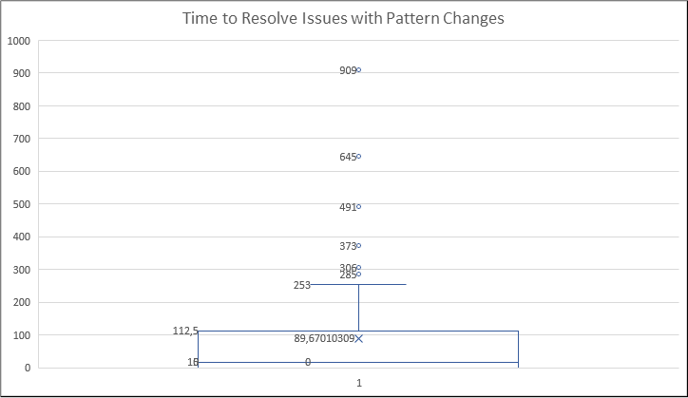
Average time to resolve issues containing pattern changes

Slide 16
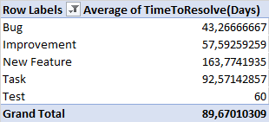
Average time to resolve different issue types

Slide 17
Future Work

