Slide 2
Design Pattern Analysis
… in Apache Mina
Alina Matei & Floris Westerman

Slide 3
Apache MINA
Network Application Framework
Abstract, event-driven, asynchronous API
High performance and scalability
Core packages with additional integrations

Slide 4
Pinot
Analyse Java source code
Detect design patterns
Fork of old open-source IBM Java 1.3 compiler

Slide 5
Pacito
Layer on top of Pinot
Aggregation of results
Pre-processing of source code
Downloading dependencies

Slide 6
Improvements
Dockerized
Paralelized
Native integration with Pinot
Better pattern detection and stability

Slide 7
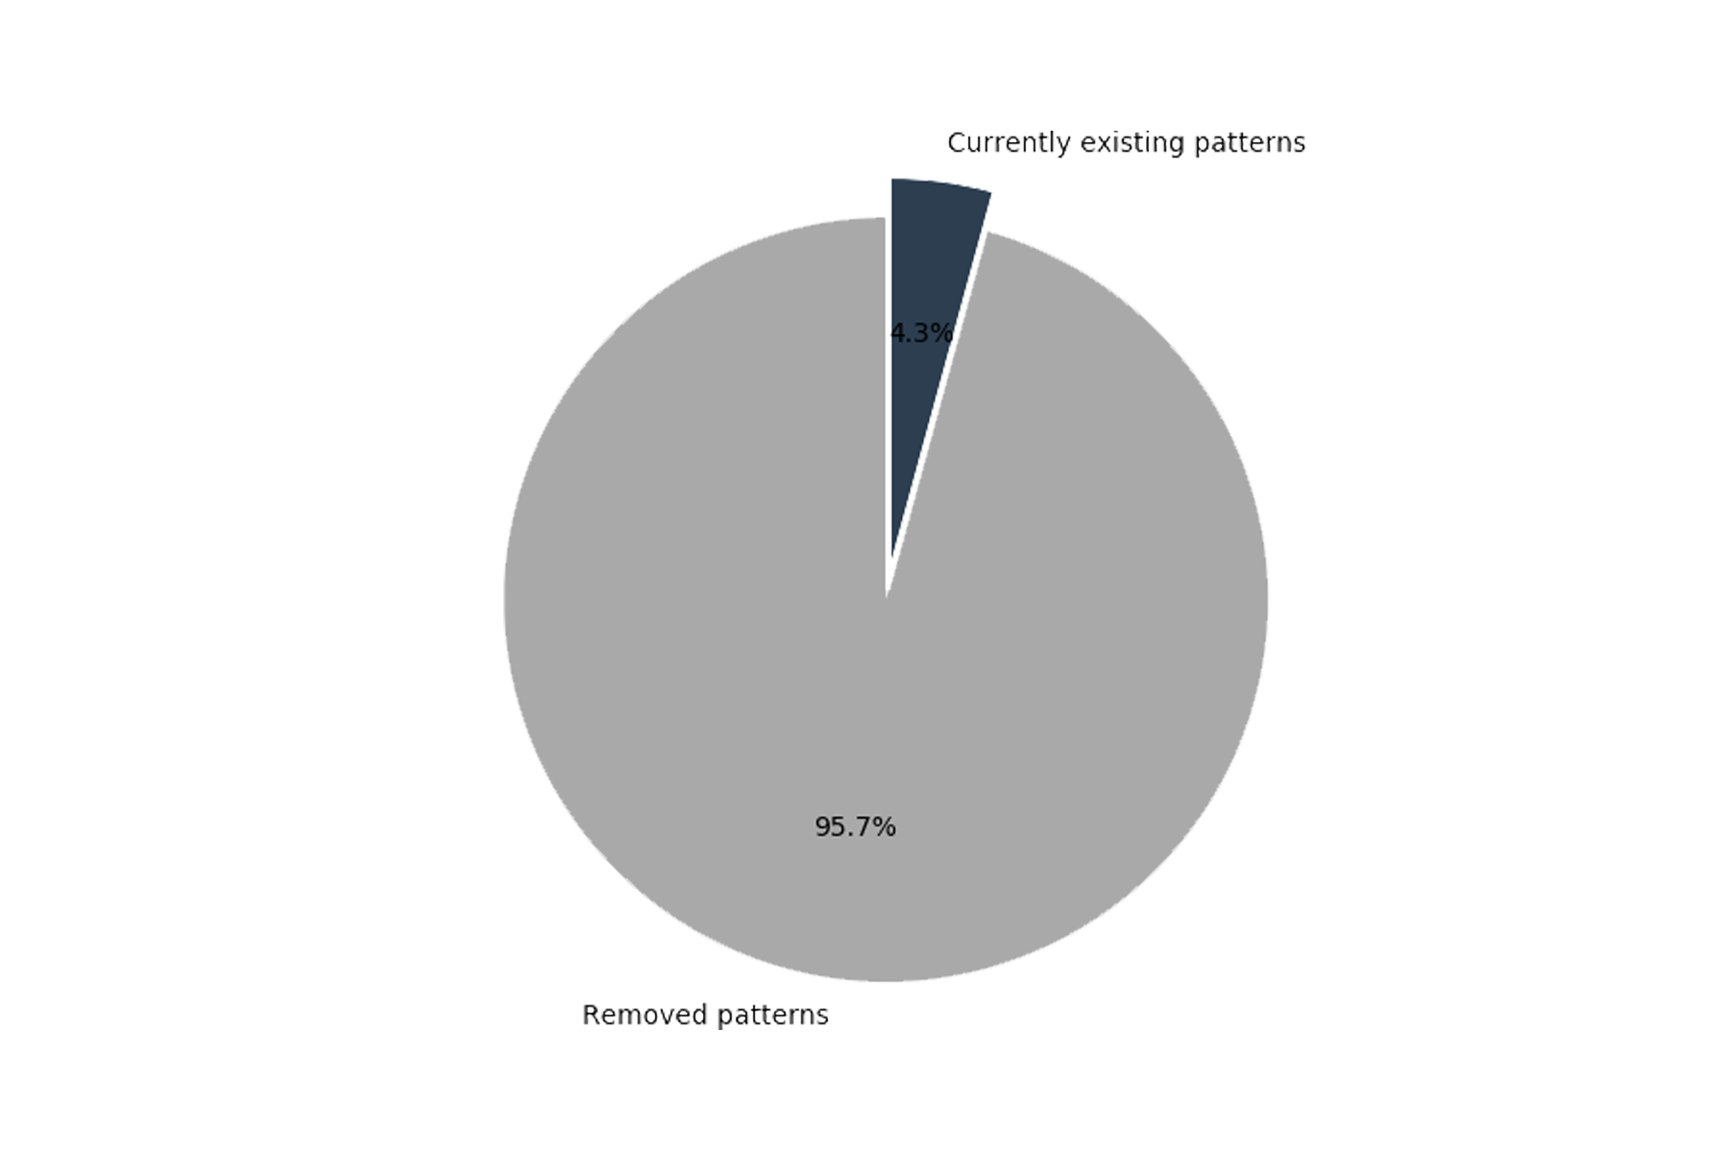
Design Pattern Analysis
15 pattern types
1882 pattern instances over time
80 current pattern instances of 11 types

Slide 8
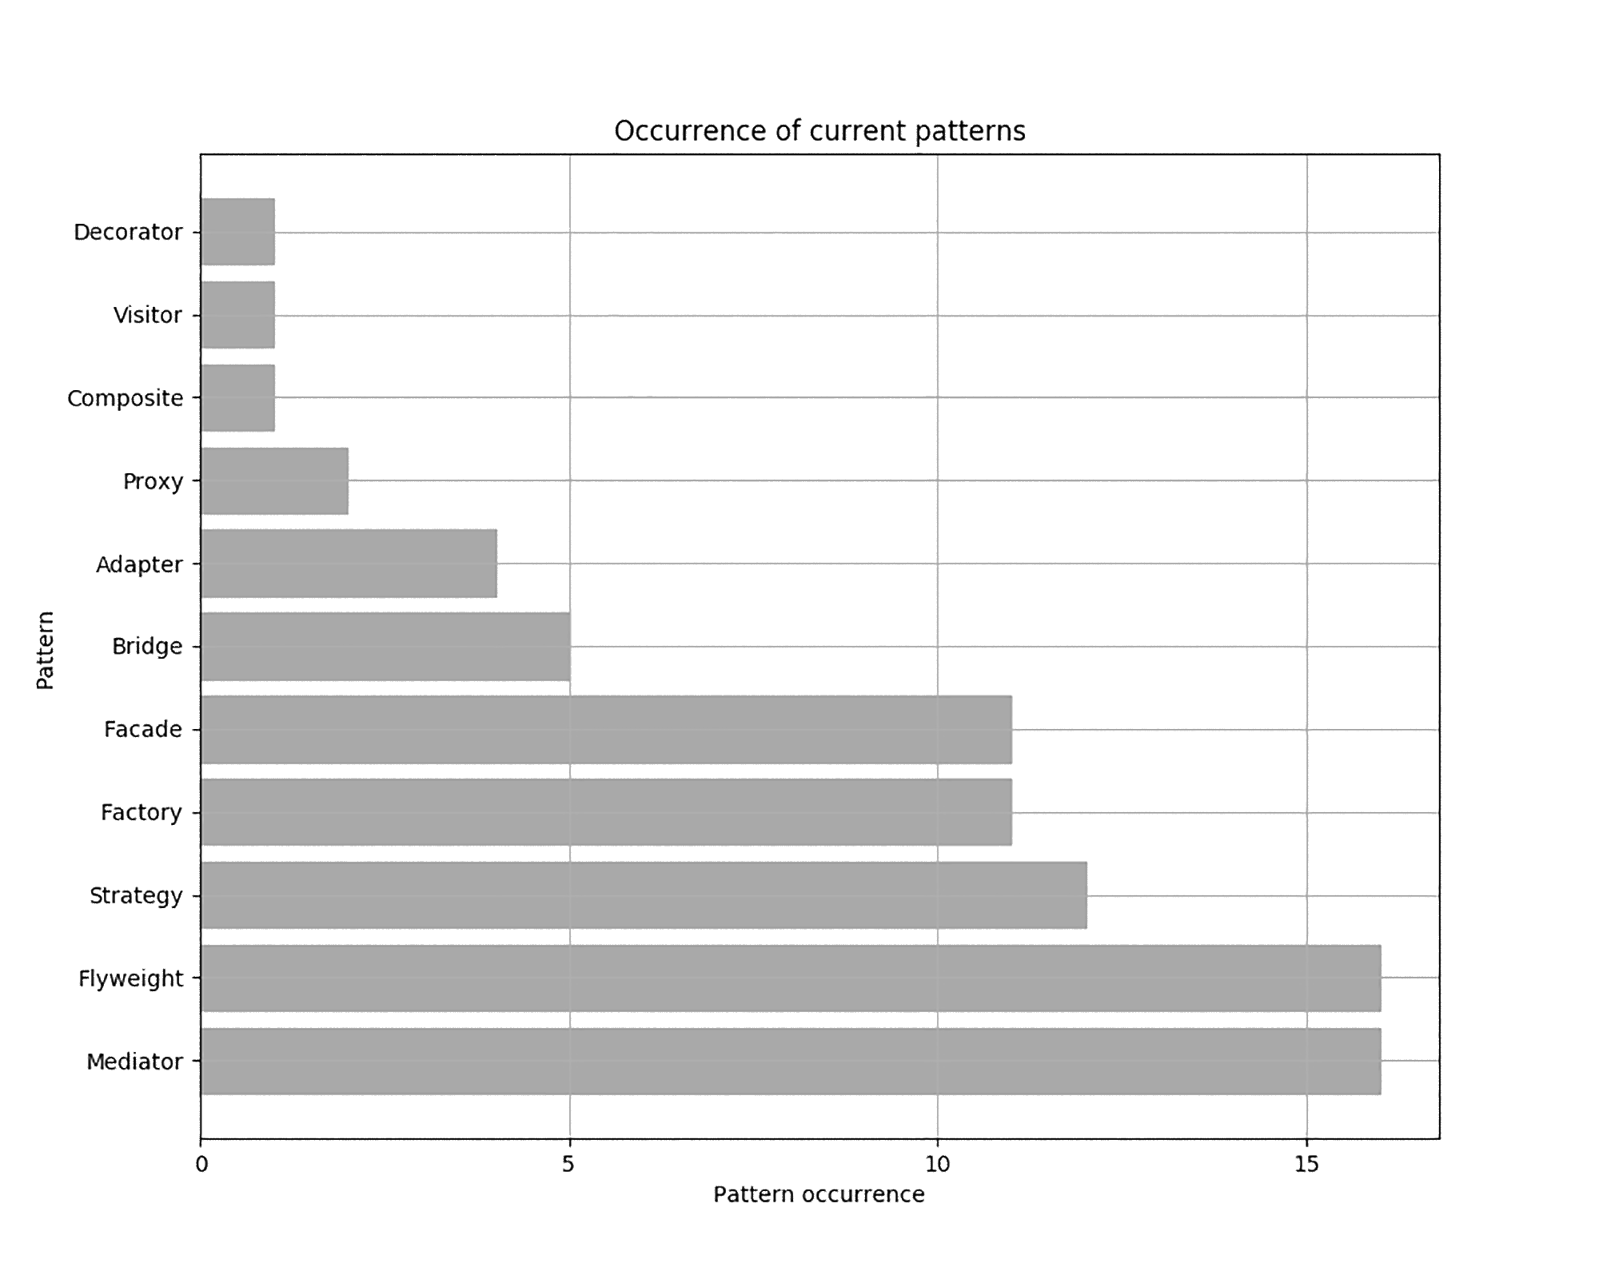
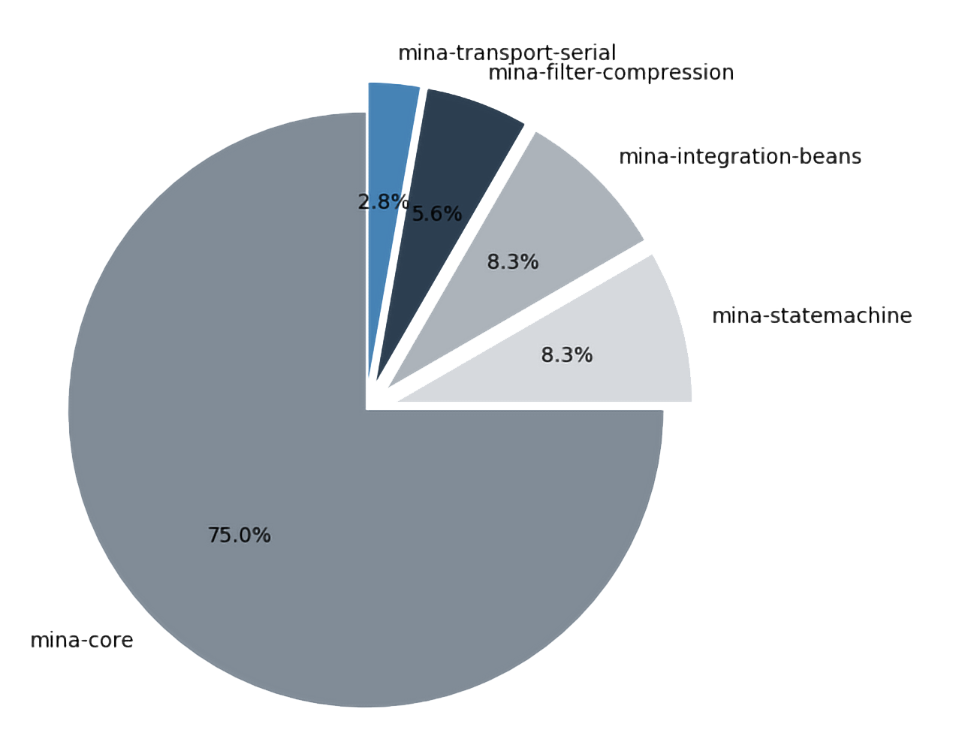
Pattern types and scopes

Slide 9
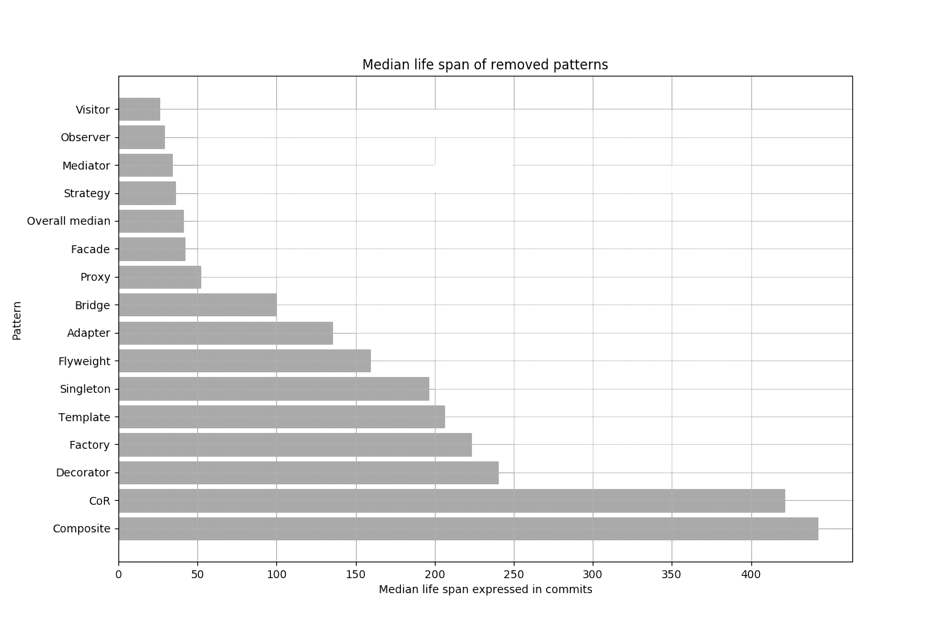
Pattern lifespan

Slide 10
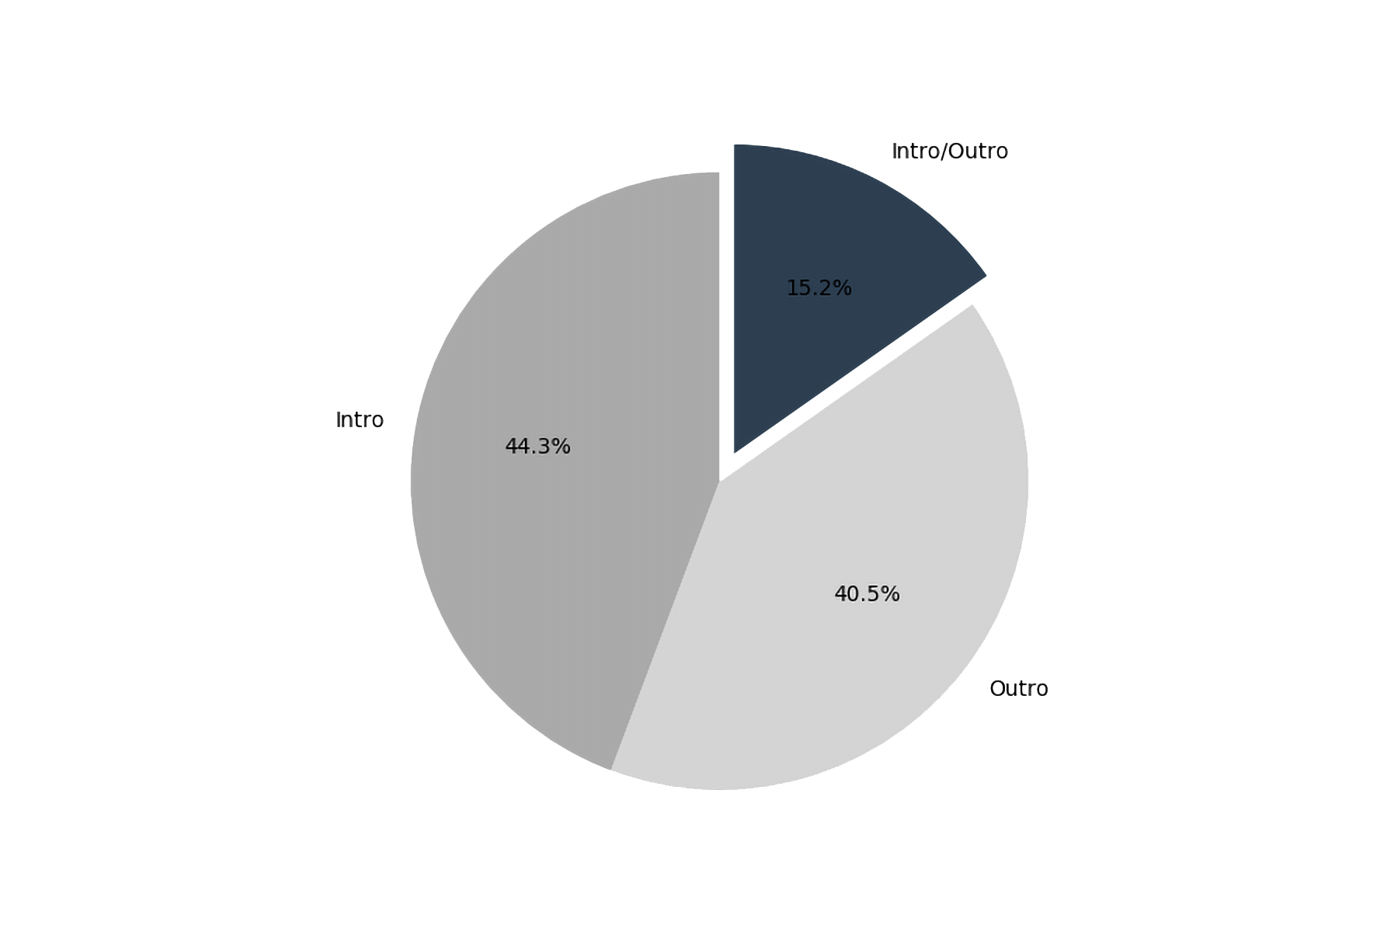
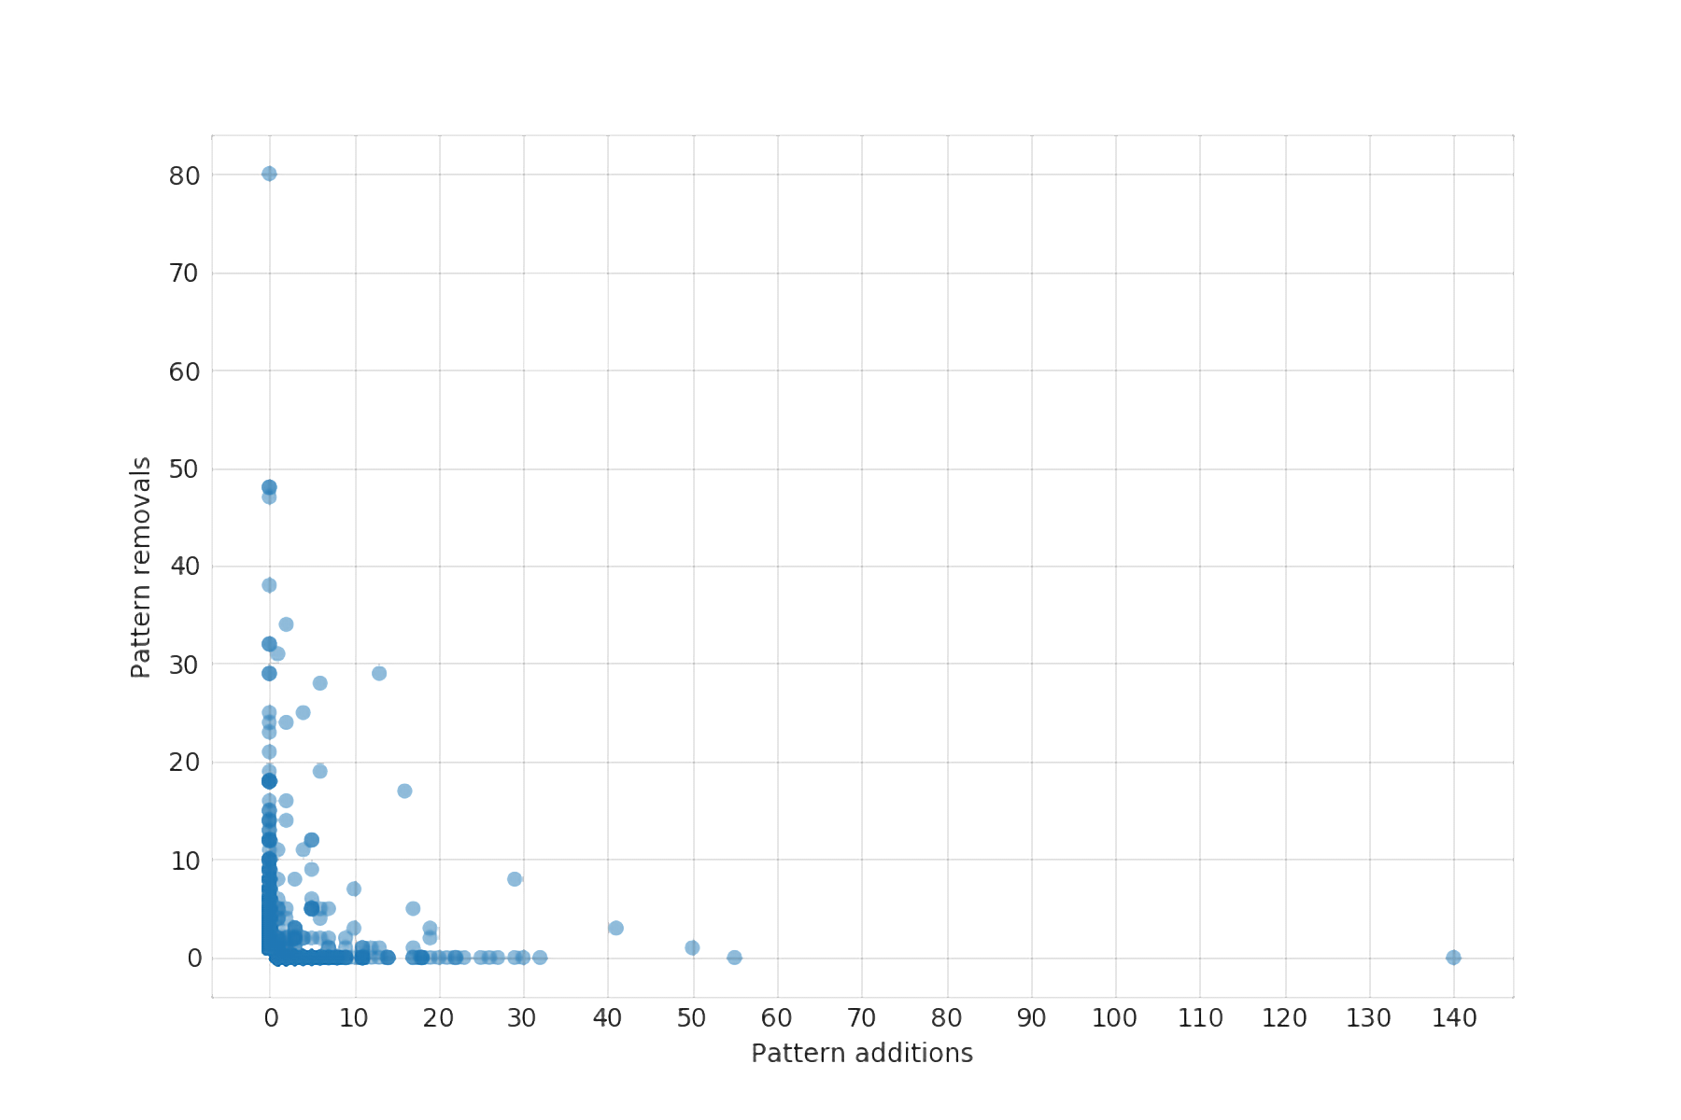
Velocity of Pattern Changes

Slide 11
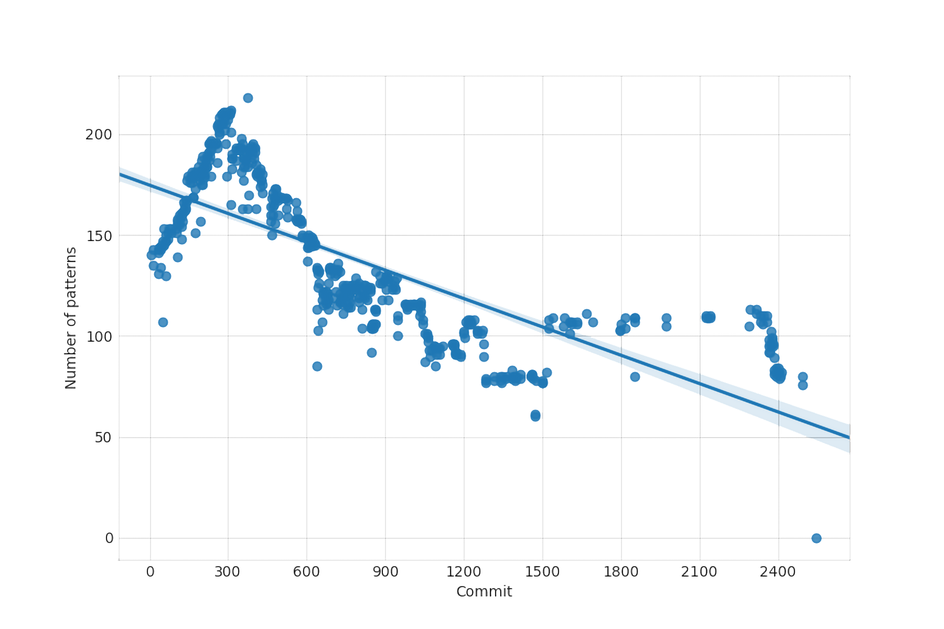
Patterns Evolution

Slide 12
Removed Pattern - Strategy
Scope: mina-core-IOService
“Fundamental” Pattern
Various changes over time
No explicit discussion/mention

Slide 13
Current Pattern – Adapter
Incorrectly detected by Pinot
The identified classes are a Factory pattern

Slide 14
Current Pattern - Factory
Correctly detected
Used throughout codebase – state-machine, integration, filtering, transport
One of most-used patterns in OOP
Developers discussed Factory usage

Slide 15
Conclusions
Why are patterns added?
Tackle complexity, implicit from best practices
Why are patterns removed?
Solving issues, updates to functionality, refactoring
Are patterns discussed among developers?
Discussions are limited

Slide 16
Erg lange titel voor deze template pagina die ik nu maak
Minder lange inhoud voor deze template pagina

