Slide 1

SMART INDIA HACKATHON 2026
Adaptive Path Planning and Collision Avoidance
for Autonomous Vehicles on Unstructured Indian Roads
Problem Statement ID – SIH26037
Problem Statement Title –
Adaptive Path Planning and Collision Avoidance for Autonomous Vehicles on Unstructured Indian Roads
Theme – Smart Vehicles
PS Category – Software
Team ID – 162509
Team Name (Registered on portal) – CraterFinders

Slide 2

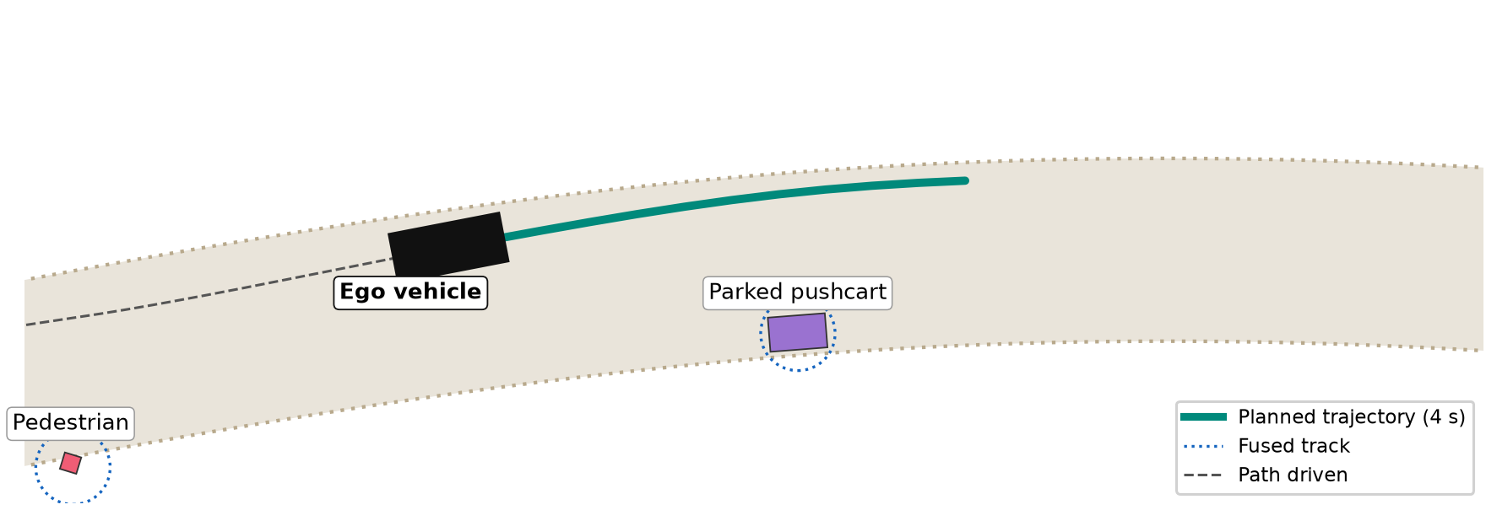






PROPOSED SOLUTION
Problem at Hand
Our Solution
Key Features
No Lanes to Follow: Village and peri-urban roads are unmarked, so lane-keeping ADAS and AV stacks lose their reference path.
Corridor Planning
Frenet lattice over free space, not painted lanes.
Multi-Sensor Fusion
Camera + radar + LiDAR into EKF tracks that survive occlusion.
Mixed, Rule-Free Traffic: Autos, cyclists, pedestrians, cattle and pushcarts share one carriageway with no lane discipline.
Closed-loop simulation: in NUDGE mode the ego plans a smooth path past a parked pushcart on an unmarked village road.
Intent Prediction
Four class-weighted hypotheses per road user.
Why We Stand Out
Unpredictable Intent: A rickshaw may brake, drift or cut in. A single predicted path hides that uncertainty from the planner.
Lane-free by design: plans inside a drivable corridor and passes on either side, as Indian drivers do.
Working prototype today: all 5 required scenarios run end-to-end and complete collision-free, scored against ground truth.
Zero-licence core: toolbox-free MATLAB/Octave code that ports directly to Simulink & Stateflow.
Behaviour FSM
Cruise, Nudge, Yield, Creep and Stop set the planner's limits.
Safety First
Risk-dominated cost, 0.45 m margin and emergency braking.
High Human Cost: India recorded 1,68,491 road deaths in 2022 (MoRTH). Autonomy built for Western roads does not transfer.
Real-Time
10 Hz replanning; 51–66 ms mean cycle.

Slide 3













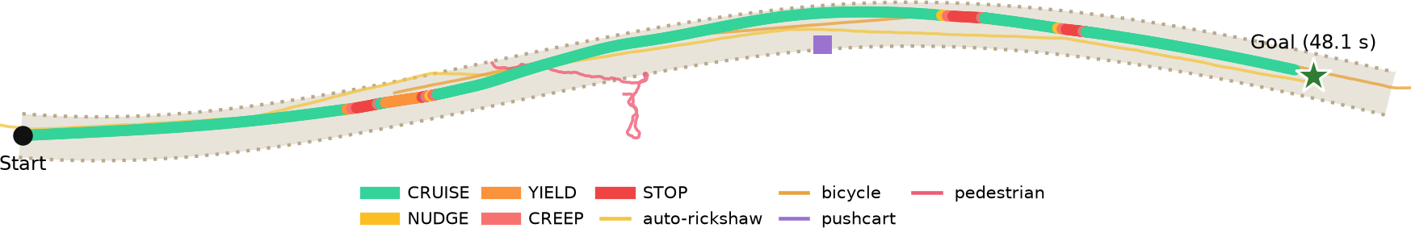
TECHNICAL APPROACH
Closed-Loop Autonomy Pipeline
Technologies Used
Multi-Sensor Sensing
Track Fusion
Intent Prediction
Conflict Risk
MATLAB R2025 / GNU Octave
Toolbox-free algorithm core
Camera 60 m, 100°, class label
Radar 90 m + range-rate
LiDAR 40 m, 360°, occlusion
Hungarian (GNN) association
EKF per track, CTRV model
M-of-N confirm & coast
4 weighted hypotheses/agent
Class-aware: bus ≠ cattle
4 s horizon, growing σ
Swept-disc conflict test
Weighted by hypothesis
Time-discounted, τ = 2 s
Simulink + Stateflow
Closed-loop model, behaviour chart
RoadRunner + ASAM OpenDRIVE
Indian road scenes (.xodr)
closed loop: ego state → world → sensors
YOLO on IDD
Indian road-user detection demo
Vehicle Model
Motion Control
Behaviour FSM
Lattice Planner
Python · Matplotlib · FFmpeg
Replays and metrics figures
Kinematic bicycle model
2.7 m wheelbase, δ ≤ 31°
20 Hz sim · 10 Hz replan
Pure-pursuit steering
PI speed loop
Jerk & steer-rate limits
Cruise · Nudge · Yield
Creep · Stop; sets speed cap,
lateral room, risk tolerance
Frenet quintic + quartic
Lateral d(s), not d(t)
~90 candidates per cycle
Implementation Roadmap
1
Core loop + village-road scenario ✔
2
All 5 scenarios + submission video ✔
3
Simulink closed-loop model
4
Metrics & technical report, dashboard
5
Stateflow, RoadRunner scenes, YOLO-IDD
All 5 scenarios complete collision-free. Shown: the 188 m village road, ego path coloured by behaviour.

Slide 4
FEASIBILITY AND VIABILITY
Technical Feasibility
Measured Results · All 5 Scenarios
Resource Feasibility
All 5 scenarios run: sensing → fusion → prediction → planning → control closes end-to-end.
Tested: 8/8 tests pass, including the full closed-loop regression run (EKF, Frenet, Hungarian, collision, bicycle model).
15× faster planner (919 → 61 ms/cycle) from batched candidate checks.
One scenario spec feeds Octave, Simulink and drivingScenario, so nothing is authored twice.
Scenario | Time | Coll. | Min clear | Replan p95
Village road | 48.1 s | 0 | 0.46 m | 92 ms
Crossroads | 43.5 s | 0 | 3.33 m | 107 ms
Highway merge | 38.0 s | 0 | 3.89 m | 86 ms
Market street | 97.1 s | 0 | 0.13 m | 98 ms
Cattle crossing | 84.2 s | 0 | 1.47 m | 98 ms
Tier 0 · GNU Octave – free, unlimited: algorithms, all 5 scenarios, metrics
Tier 1 · MATLAB Online Basic – free: Simulink closed-loop model
Tier 2 · 30-day trial – used last, only for Stateflow, RoadRunner & YOLO-IDD
Hardware: a standard laptop; no GPU needed.
5 of 5 completed · 0 collisions · clearance scored on ground truth
Potential Challenges & Risks → Strategies for Overcoming Them
# | Challenge / Risk | Strategy to Overcome
1 | Replan latency crosses the 100 ms budget on busy cycles (p95 86–107 ms by scenario) | Batching already cut cost 15×; next, adaptive lattice size and MATLAB Coder C code
2 | Hybrid A* fallback is written and verified, but enabling it made results worse | Kept off: it raised p95 to 250–400 ms and cost a completion; re-enable once search cost and margins are reconciled
3 | Dense market clears by only 0.13 m at its tightest | Most margin-sensitive scenario; tune the safety margin and re-validate all five runs
4 | COCO-trained YOLO mislabels auto-rickshaws and pushcarts | Class-agnostic tracking fallback; fine-tune on the IDD dataset when a GPU is available
5 | RoadRunner is available only in the one-time 30-day trial | Hand-author OpenDRIVE scenes first, so trial days go to assembly, not development

Slide 5









IMPACT AND BENEFITS
1.68 lakh
5
0
₹0
road deaths in India in 2022 (MoRTH): the problem we target
Indian road scenarios — village, crossroads, merge, market, cattle — all completing
collisions across all 5 scenarios, scored against ground truth
licence cost to develop and verify the algorithm core
Who Benefits
Benefits of the Solution
Automotive OEMs & Tier-1s
ADAS/AV behaviour tuned for Indian traffic
Social
Economic
Class-aware caution around pedestrians, cyclists & cattle, the most vulnerable road users
Legible yield/creep behaviour that other road users can anticipate
Free-tier development cuts R&D and licence cost
Reusable scenario library lowers validation cost; indigenous tech for Atmanirbhar Bharat
Logistics & Last-Mile
Autonomous delivery pods, campus shuttles
Rural Mobility
Agri-vehicles and buses on unmarked roads
Environmental
Technological
Students & Researchers
Open, toolbox-free baseline and scenarios
Jerk-limited, smooth speed profiles avoid harsh braking and wasted energy
A natural fit for electric autonomous vehicles and low-emission mobility
Benchmark scenarios and metrics for unstructured roads
Stateflow chart keeps every decision explainable to judges and regulators
Road-Safety & Test Agencies
Repeatable Indian-road test scenarios

Slide 6
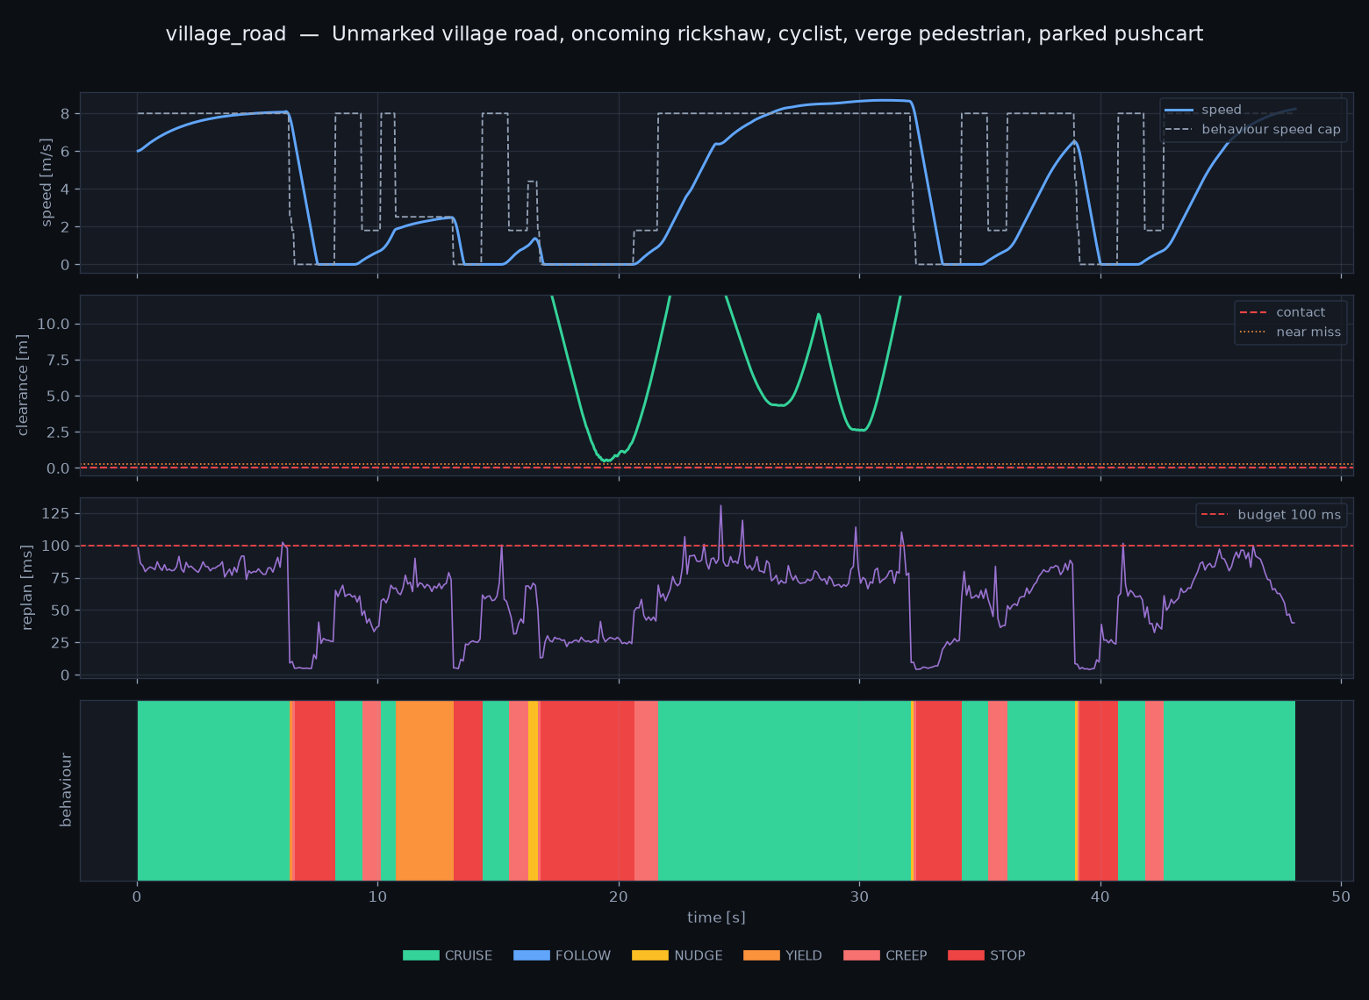


RESEARCH AND REFERENCES
Research Insights That Shaped the Design
Prototype Evidence
Lanes are the wrong prior
IDD shows Indian scenes break lane-centric assumptions, so we plan in a free-space corridor [3].
Keep uncertainty visible
Multi-hypothesis prediction feeds a risk field instead of collapsing to one guess.
Frenet lattices give comfort
Jerk-optimal quintic/quartic trajectories are smooth by construction [1].
Score safety on ground truth
Clearance measured from our own tracks would be circular, so we use true positions.
References
[1] M. Werling, J. Ziegler, S. Kammel, S. Thrun, “Optimal trajectory generation for dynamic street scenarios in a Frenét frame,” IEEE ICRA, 2010.
[2] D. Dolgov, S. Thrun, M. Montemerlo, J. Diebel, “Path planning for autonomous vehicles in unknown semi-structured environments,” IJRR, vol. 29, no. 5, 2010.
[3] G. Varma, A. Subramanian, A. Namboodiri, M. Chandraker, C. V. Jawahar, “IDD: A dataset for exploring problems of autonomous navigation in unconstrained environments,” IEEE WACV, 2019.
[4] R. C. Coulter, “Implementation of the pure pursuit path tracking algorithm,” CMU-RI-TR-92-01, Carnegie Mellon University, 1992.
[5] H. W. Kuhn, “The Hungarian method for the assignment problem,” Naval Research Logistics Quarterly, vol. 2, 1955.
[6] S. Thrun, W. Burgard, D. Fox, Probabilistic Robotics, MIT Press, 2005.
[7] Ministry of Road Transport & Highways, “Road Accidents in India 2022,” Government of India, 2023.
[8] ASAM e.V., “ASAM OpenDRIVE” road-network standard; MathWorks RoadRunner & Automated Driving Toolbox documentation.
Project Links
1) Source Code Repository
github.com/FX-at-Dev/Adaptive-Lane-Free-Path-Planning---Collision-Avoidance-for-Indian-Roads
2) Demo Video: All 5 Scenarios
3) Metrics & Run Data (JSON)

