Slide 1


Slide 2
What is pyGame?
A set of Python modules to make it easier to write games.
  home page: http://pygame.org/
  documentation: http://pygame.org/docs/ref/
PyGame is a package that is not part of the standard Python distribution, so if you do not already have it installed (i.e. import pygame fails), download and install a suitable version from http://pygame.org/download.shtml
pyGame helps you do the following and more:
  Sophisticated 2-D graphics drawing functions
  Deal with media (images, sound F/X, music) nicely
  Respond to user input (keyboard, joystick, mouse)
  Built-in classes to represent common game objects

Slide 3
pyGame at a glance
pyGame consists of many modules of code to help you:
  cdrom cursors display draw event
  font image joystick key mouse
  movie sndarray surfarray time transform
To use a given module, import it. For example:
  import pygame
  from pygame import *
  from pygame.display import *

Slide 4
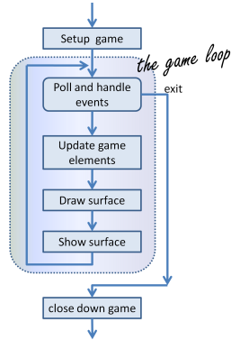
The game loop
The structure of the games we’ll consider always follows this fixed pattern:

Slide 5

Initializing pyGame
To start off our game, we must pop up a graphical window.
Calling display.set_mode creates a window.
  The call returns an object of type Surface, which we will call screen. We can call methods on the screen later.
  Calling display.set_caption sets the window's title.
  from pygame import *
  pygame.init() # starts up pyGame
  screen = display.set_mode((width, height))
  display.set_caption("title")
  ...
  pygame.quit()

Slide 6
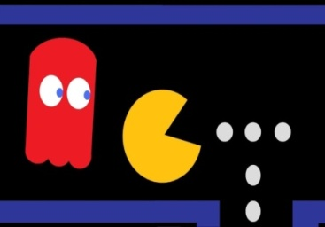
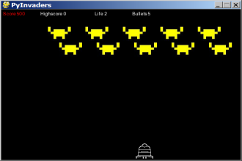
Pygame.sprites
-a pygame module with basic game object classes
Sprites:Simple base class for visible game objects
  It is an object that can move about in a game, and has internal behavior and state of its own and contains Onscreen characters.
  This module contains several simple classes to be used within games.
  For example, a spaceship would be a sprite, the player would be a sprite, and bullets and bombs would all be sprites.
collision detection: Seeing which pairs of sprites touch.
event: An in-game action such as a mouse or key press.
event loop: Many games have an overall loop that:
  waits for events to occur, updates sprites, redraws screen
Note : The use of these classes is entirely optional when using Pygame. The classes are fairly lightweight and only provide a starting place for the code that is common to most of the games.

Slide 7
PyGame Drawing Basics
import pygame module
import pygame
pygame.init()
Opening a Window
#This opens a window of size 640,480, and stores it in a variable called screen
screen = pygame.display.set_mode((640,480))
You have to pass this variable anytime you want to do something to the screen
The screen
  If your screen is of size 640,480: The point (0,0) is at the upper left hand corner of the screen. x coordinates increase from left to right, y coordinates increase from top to bottom
So:
  Upper right is (640,0)
  Lower left is (0,480)
  Lower right is (640,480)

Slide 8
PyGame Drawing Basics
Updating the Screen
Changes you make to the screen—e.g. filling it with color, or drawing on it—do not show up immediately! Instead, you have to call this function
pygame.display.update()
  This shows you all the drawing you did since the last call to pygame.display.update() it is all changes since the screen was created
Why do you have to do this?
  This implements a features called double buffering. Double buffering is a feature of PyGame that lets you make lots of changes to the screen, and then have them all show up together as a single frame. Otherwise, when there is fast animation, the screen would "flicker" and it would be annoying to people playing the game
Colors
  colorName = (r,g,b)n ame the color anything you like.(r=red,g=green,b=blue)
  all three should be integers between 0 and 255, with 255 being brightest, and 0 being darkest
Examples:
  red = (255,0,0) green = (0,255,0) blue = (0,0,255) darkBlue = (0,0,128)
  white = (255,255,255) black = (0,0,0) pink = (255,200,200)

Slide 9
PyGame Drawing Basics
Drawing
Remember that after you draw, you have to call pygame.display.update() before your changes show up.
screen.fill(color)fills the entire screen with the given color
e.g. screen.fill(white)
pygame.draw.lines(screen, color, closed, pointlist, thickness)
  draws a series of lines, connecting the points specified in pointlist
  pointlist is a list of tuples, specifying a series of points, e.g. to draw a ‘V’ you might use [(100,100), (150,200), (200,100)], with closed = False
  closed should be either True or False, indicating whether to connect the last point back to the first
  thickness is the thickness of the line (in pixels).
  Ex: pygame.draw.lines(screen, black, False, [(100,100), (150,200), (200,100)], 1)

Slide 10
PyGame Drawing Basics
pygame.draw.rect(screen, color, (x,y,width,height), thickness)
  draws a rectangle (x,y,width,height) is a Python tuple
  x,y are the coordinates of the upper left hand corner
  width, height are the width and height of the rectangle
  thickness is the thickness of the line. If it is zero, the rectangle is filled
pygame.draw.circle(screen, color, (x,y), radius, thickness)
  draws a circle (x,y) is a Python tuple for the center, radius is the radius
  thickness is the thickness of the line. If it is zero, the rectangle is filled
pygame.draw.arc(screen, color, (x,y,width,height), start_angle, stop_angle, thickness)
  draws an arc (portion of an ellipse)
  (x,y,height,width) are the coordinates of a rectangle that the arc would fit inside if it were drawn all the way around
  if height and width are equal, then the rectangle is a square, and the arc will be a portion of a circle
  start_angle and stop_angle are the angle on the unit circle in radians (not degrees) where the arc stops and starts

Slide 11
Enabling the quit button
To make the quit button work, we need two things:
  An infinite loop, that goes around and around looking for events.
  Some code that looks for a QUIT event, and handles that event
Here is an infinite loop in Python:
while (True):
# do something
  “#do something” will be done over and over again, until we exit the program.
  What is it that we want to do over and over? Each time through the loop, we need to look for quit events and if we find one, we need to quit the program:
for event in pygame.event.get():
if event.type == pygame.QUIT:
pygame.quit(); sys.exit();

Slide 12
Enabling the quit button
  The call to pygame.event.get() returns a list of every event that has happened since we called pygame.init(), or since the last call to pygame.event.get().
  One by one, the variable event is set to each of those events.
  For each one of those, we use an if test to see if that event is equal to pygame.QUIT which is a value that means that the user clicked the red X (or red Circle) to close the window
  If the user did that, then do two things:
    Call pygame.quit() to shut down pygame (this includes closing the window)
    Call sys.exit() to shut down the program (this exits the infinite loop)
We put this code inside a while (True): infinite loop so that we can do it over and over again—we have to keep doing it, because we don't know when the user will click the red X.

Slide 13
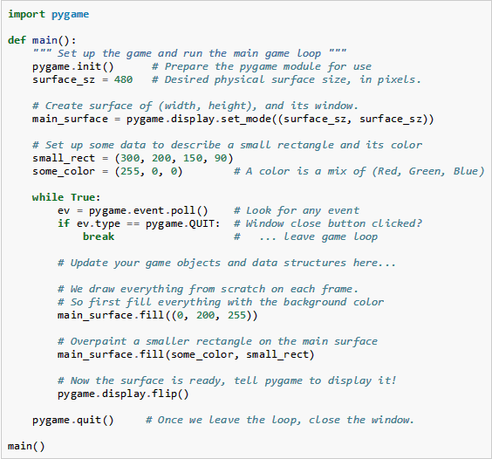
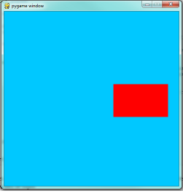
Example-1

Slide 14
Example-2
import pygame
screen = pygame.display.set_mode((640, 480))
running = 1
while running:
event = pygame.event.poll()
if event.type == pygame.QUIT:
running = 0
screen.fill((0, 0, 0))
pygame.draw.line(screen, (0, 0, 255), (0, 0), (639, 479))
pygame.draw.aaline(screen, (0, 0, 255), (639, 0), (0, 479))
pygame.display.flip()
#aaline = antialiased line .Using anti-aliasing can make the line appear
less jagged in some cases.

Slide 15
Screen Coordinates (blit)
To position an object on the screen, we need to tell the blit() function where to put the image. In pygame we always pass positions as an (X,Y) coordinate. This represents the number of pixels to the right, and the number of pixels down to place the image. The top-left corner of a Surface is coordinate (0, 0). Moving to the right a little would be (10, 0), and then moving down just as much would be (10, 10). When blitting, the position argument represents where the topleft corner of the source should be placed on the destination.
Basically, blit means to copy graphics from one image to another. A more formal definition is to copy an array of data to a bitmapped array destination. You can think of blit as just "assigning" pixels. Blitting assigns the color of pixels in our image.

Slide 16
Animation (making drawings move)
To make a drawing move,
  you just put code inside your infinite loop that erases the old drawing (e.g. screen.fill(white) or screen.fill(black))
  draws the new drawing (e.g. using function calls starting with pygame.draw) in a different place than it was before!
  calls pygame.display.update() to make all the changes appear
Remember:
All the changes in between two to pygame.display.update() show up all at once as a new frame (just like a new frame in a movie), So, you can create the illusion of smooth motion
while (True):
# check for quit events
for event in pygame.event.get():
if event.type == pygame.QUIT:
pygame.quit(); sys.exit();
screen.fill(white) # erase the screen
# draw the updated picture
updatePoints(points) # changes the location of the points
pygame.draw.lines(screen,black,false,points,1) # redraw the points
pygame.display.update() # update the screen

Slide 17
Making the motion go faster or slower
There two ways to make the motion go faster or slower
  Insert a call to pygame.time.delay(5) somewhere inside the loop—the number is the number of milliseconds to delay.
  To use a clock: (better way). Put the clock near the start of the program, somewhere after pygame.init() but definitely outside the main loop
clock = pygame.time.Clock()
Inside the loop, put the code
msElapsed = clock.tick(30)
#where 30 is the frame rate you want (e.g. 30 frames per second)
snow_example.py

Slide 18
Exercises
Modify the program to draw the two lines in different colors.
Write a program that draws three color bars in different colors. Take note of the height per bar, so that all three can fit and have some space for movement.
Write a program that draws arc, circles, rectangles on the screen.

