Slide 1
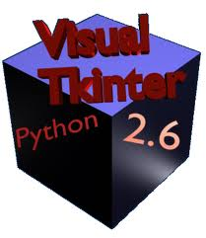

PYTHON GUI PROGRAMMING

Slide 2
Python provides various options for developing graphical user interfaces (GUIs).
Tkinter: Tkinter is the Python interface to the Tk GUI toolkit shipped with Python. (originally developed for the Tcl language)
Tkinter is an open source, portable graphical user interface (GUI) toolkit designed for use in Python scripts.

Slide 3

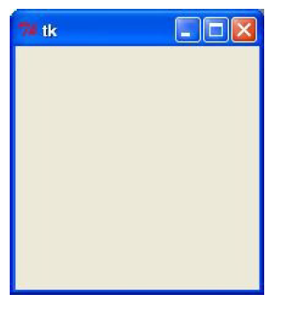
Tkinter Programming
Tkinter is the standard GUI library for Python. Python when combined with Tkinter provides a fast and easy way to create GUI applications. Tkinter provides a powerful object-oriented interface to the Tk GUI toolkit.
Creating a GUI application using Tkinter is an easy task. All you need to do is perform the following steps:
  Example:Import the Tkinter module.
  Create the GUI application main window.
  Add one or more of the widgets to the GUI application.
  Enter the main event loop to take action against each event triggered by the user.
#/usr/bin/python
import Tkinter
top =Tkinter.Tk()
# Code to add widgets will go here...
top.mainloop()

Slide 4
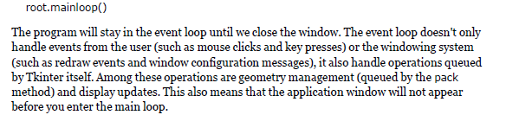
mainloop

Slide 5
Tkinter widgets
Tkinter’s components are called Widgets. Widgets are equivalents to OOP’s objects or components
All widgets inherit from the Widget class
Tkinter provides various controls, such as buttons, labels, and text boxes, used in a GUI application. These controls are commonly called widgets.
Geometry Management:
All Tkinter widgets have access to specific geometry management methods, which have the purpose of organizing widgets throughout the parent widget area. Tkinter exposes the following geometry manager classes: pack, grid, and place.
The pack() Method - This geometry manager organizes widgets in blocks before placing them in the parent widget.
The grid() Method - This geometry manager organizes widgets in a table-like structure in the parent widget.
The place() Method -This geometry manager organizes widgets by placing them in a specific position in the parent widget.

Slide 6
Tkinter button
Python - Tkinter Button
The Button widget is used to add buttons in a Python application. These buttons can display text or images that convey the purpose of the buttons. You can attach a function or a method to a button, which is called automatically when you click the button.
Syntax:
w = Button ( master, option=value, ... )
Parameters:
  master: This represents the parent window.
  options: There are many options for this widget. These options can be used as key-value pairs separated by commas.

Slide 7
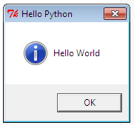

Button example
#!/usr/bin/python
import Tkinter
import tkMessageBox
top = Tkinter.Tk()
def hello():
tkMessageBox.showinfo(“Hello", "Hello World")
B1 = Tkinter.Button(top, text = “Hello", command = hello)
label= Tkinter.Label(top,text="Hello World!")
B1.pack()
label.pack()
top.mainloop()

Slide 8
Tkinter canvas
The Canvas is a rectangular area intended for drawing pictures or other complex layouts. You can place graphics, text, widgets, or frames on a Canvas.
arc . Creates an arc item.
  coord = 10, 50, 240, 210
  arc = canvas.create_arc(coord, start=0, extent=150, fill="blue")
Image:Creates an image item, which can be an instance of either the Bitmap Image or the PhotoImage classes.
  filename = PhotoImage(file = "sunshine.gif")
  image = canvas.create_image(50, 50, anchor=NE, image=filename)
line . Creates a line item.
  line = canvas.create_line(x0, y0, x1, y1,..., xn, yn, options)
oval . Creates a circle or an ellipse at the given coordinates. oval = canvas.create_oval(x0, y0, x1, y1, options)
polygon . Creates a polygon item that must have at least three vertices.
  oval = canvas.create_polygon(x0, y0, x1, y1,..xn, yn, options)

Slide 9
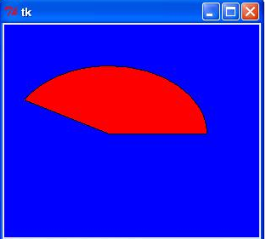
Tkinter canvas example
import Tkinter
top = Tkinter.Tk()
C = Tkinter.Canvas(top, bg="blue", height=250, width=300)
coord = 10, 50, 240, 210
arc = C.create_arc(coord, start=0, extent=150, fill="red")
C.pack()
top.mainloop()

Slide 10
Tkinter check box
from Tkinter import *
import Tkinter
top = Tkinter.Tk()
CheckVar1 = IntVar()
CheckVar2 = IntVar()
C1 = Checkbutton(top, text = "Music", variable = CheckVar1, \
onvalue = 1, offvalue = 0, height=5, width = 20)
C2 = Checkbutton(top, text = "Video", variable = CheckVar2, \
onvalue = 1, offvalue = 0, height=5, width = 20)
C1.pack(side=Tkinter.LEFT)
C2.pack()
top.mainloop()
if (CheckVar1.get() == 1):
print ("Music selected")
Notes:
The get method returns the current value of the variable, as a Python object.

Slide 11
Tkenter entry widget
Python - Tkinter Entry:
The Entry widget is used to accept single-line text strings from a user.
If you want to display multiple lines of text that can be edited, then you should use the Text widget.
If you want to display one or more lines of text that cannot be modified by the user then you should use the Label widget.

Slide 12
import Tkinter
from Tkinter import *
root = Tk()
root.title('Random')
L1 = Label(root, text="User Name")
L1.pack( side = LEFT)
E1 = Entry(root, width=10)
E1.pack(side=TOP,padx=10,pady=10)
def onok():
x = E1.get()
print(x)
Button(root, text='OK', command=onok).pack(side=LEFT)
root.mainloop()

Slide 13
Example
from Tkinter import *
import Tkinter
class App:
def __init__(self, master):
frame = Frame(master)
frame.pack()
self.button = Button(frame, text="QUIT", fg="red", command=frame.quit)
self.button.pack(side=LEFT)
self.hi_there = Button(frame, text="Hello", command=self.say_hi)
self.hi_there.pack(side=LEFT)
def say_hi(self):
print ("hi there, everyone!")
root = Tk()
app = App(root)
root.mainloop()

Slide 14
Events and Bindings
Events can come from various sources, including key presses and mouse operations by the user, and redraw events from the window manager.
For each widget, you can bind Python functions and methods to events.
widget.bind(event, handler)
If an event matching the event description occurs in the widget, the given handler is called with an object describing the event.

Slide 15
Example
from Tkinter import *
root = Tk()
def key(event):
print ("pressed", repr(event.char))
def pushb(event):
frame.focus_set()
print ("clicked at", event.x, event.y)
frame = Frame(root, width=100, height=100)
frame.bind("<Key>", key)
frame.bind("<Button-1>", pushb)
frame.pack()
root.mainloop()

Slide 16
Example-2
import Tkinter
import ttk
class Application:
def __init__(self, root):
self.root = root
self.root.title('Button Demo')
ttk.Frame(self.root, width=250, height=100).pack()
self.init_widgets()
def init_widgets(self):
ttk.Button(self.root, command=self.insert_txt, text='Click Me', width='10').place(x=10, y=10)
self.txt = Tkinter.Text(self.root, width='15', height='2')
self.txt.place(x=10, y=50)
def insert_txt(self):
self.txt.insert(Tkinter.INSERT, 'Hello World\n')
if __name__ == '__main__':
root = Tkinter.Tk()
Application(root)
root.mainloop()

Slide 17
Example - menu
from Tkinter import *
def callback():
print ("called the callback!")
root = Tk()
# create a menu
menu = Menu(root)
root.config(menu=menu)
filemenu = Menu(menu)
menu.add_cascade(label="File", menu=filemenu)
filemenu.add_command(label="New", command=callback)
filemenu.add_command(label="Open...", command=callback)
filemenu.add_separator()
filemenu.add_command(label="Exit", command=callback)
helpmenu = Menu(menu)
menu.add_cascade(label="Help", menu=helpmenu)
helpmenu.add_command(label="About...", command=callback)
root.mainloop()

Slide 18
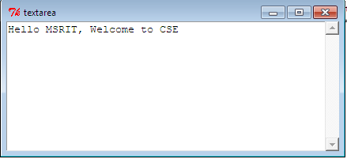
Text Area
from Tkinter import *
class mywidgets:
def __init__(self,root):
frame=Frame(root)
frame.pack()
self.txtfr(frame)
return
def txtfr(self,frame):
#define a new frame and put a text area in it
textfr=Frame(frame)
self.text=Text(textfr,height=10,width=50,background='white')
# put a scroll bar in the frame
scroll=Scrollbar(textfr)
self.text.configure(yscrollcommand=scroll.set)
#pack everything
self.text.pack(side=LEFT)
scroll.pack(side=RIGHT,fill=Y)
textfr.pack(side=TOP)
return
def main():
root = Tk()
s=mywidgets(root)
root.title('textarea')
root.mainloop()
main()

Slide 19
ttk progress bar example
import sys
import ttk
from Tkinter import *
mGui = Tk()
mGui.geometry('450x450')
mGui.title('Hanix Downloader')
mpb = ttk.Progressbar(mGui,orient="horizontal",length = 200, mode ="determinate")
mpb.pack()
mpb["maximum"] = 100
mpb["value"] = 50
mGui.mainloop()

Slide 20
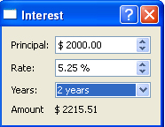
Exercises
Write a dialog-style application that calculates compound interest. The application should be very similar in style and structure to the Currency application, and should look like this:
Write a program that creates a Canvas and a Button. When the user presses the Button, it should draw a circle on the canvas.
Write a program that creates a GUI with a single button. When the button is pressed it should create a second button. When that button is pressed, it should create a label that says, “Nice job!”.

