Slide 1

Python CGI programming

Slide 2
CGI Programming
The Common Gateway Interface, or CGI, is a set of standards that define how information is exchanged between the web server and a custom script or program.
To understand the concept of CGI, lets see what happens when we click a hyper link to browse a particular web page or URL.
  Your browser contacts the HTTP web server and asks for the URL ie. filename.
  Web Server will parse the URL and will look for the filename, if it finds that file it sends to the browser otherwise sends an error message indicating that file could not be found .
  Web browser takes response from web server and displays either the received file or error message.

Slide 3
However, it is possible to set up the HTTP server so that whenever a file in a certain directory is requested that file is not sent back; instead it is executed as a program, and whatever that program outputs is sent back for your browser to display. This function is called the Common Gateway Interface or CGI.
When we run a Python program as a CGI script, the output goes out directly and the file must be executable (+x).
The first line we have to print are the HTTP headers – this tells the browser to read it as either text, or render it as HTML.
Any line after that comprises the actual HTML or text itself

Slide 4
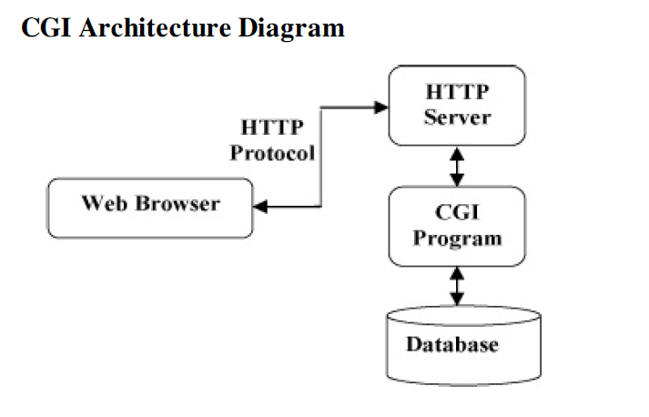

CGI Architecture diagram

Slide 5
What is an HTML File?
HTML stands for Hyper Text Markup Language
An HTML file is a text file containing small markup tags
The markup tags tell the Web browser how to display the page
An HTML file must have an htm or html file extension
An HTML file can be created using a simple text editor

Slide 6
HTML Elements
HTML documents are text files made up of HTML elements.
HTML elements are defined using HTML tags.
HTML Tags
HTML tags are used to mark-up HTML elements
HTML tags are surrounded by the two characters < and >
The surrounding characters are called angle brackets
HTML tags normally come in pairs like <b> and </b>
The first tag in a pair is the start tag, the second tag is the end tag
The text between the start and end tags is the element content
HTML tags are not case sensitive, <b> means the same as <B>

Slide 7
Structure of an HTML document
HTML documents are enclosed with in <HTML> </HTML> tags
  Document Header
    Information placed in the header are essential to the inner working of the document but has nothing to do with the content of document
    Header is enclosed between <HEAD> and </HEAD>
    Typically the document title is placed with in the header <TITLE>document title</TITLE>
  Document Body
    Placed between <BODY> and </BODY>
    The purpose of the <body> tag is to define the HTML element that contains the body of the HTML document.
    Page defaults like Background color, Background, Text Color, Font Size, Font Weight etc can be specified as attributes
    <BODY BACKGROUND=“x.gif” TEXT=“Red”>this is my document body</BODY>

Slide 8
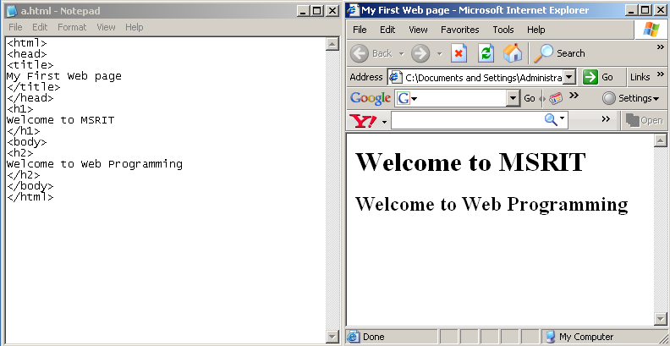
First Web Page
Document Header
Document body

Slide 9
Text Formatting – paragraphs and line breaks
<P> for inserting a new paragraph
  <P>this is a new paragraph
<BR> for line break
Line breaks create forced hard returns in your document.
There is a hard return below this text
<br />
There is a hard return above this text
Note: Use the <br> tag to insert line breaks, not to create paragraphs.
Preserving White Space <pre> </pre>Demo
Example <p><pre> Mary
had a
little
lamb </pre></p>

Slide 10
Linking
Hyperlink
  References other sources such as XHTML documents and images
  Both text and images can act as hyperlinks
  Created using the a (anchor) element
    Attribute href
      Specifies the location of a linked resource
    Link to e-mail addresses using mailto: URL

Slide 11
Linking the documents
HTML allows linking of one HTML document to other as well as images
Use ALINK, VLINK attributes (deprecated) of BODY tag to control the color of the hyperlink that is displayed
Links are created in a web page through <A> tag (anchor tag)
Syntax - <a href="url">Text to be displayed</a>
  Eg: <A HREF=http://www.google.com>This is a search engine</A>

Slide 12
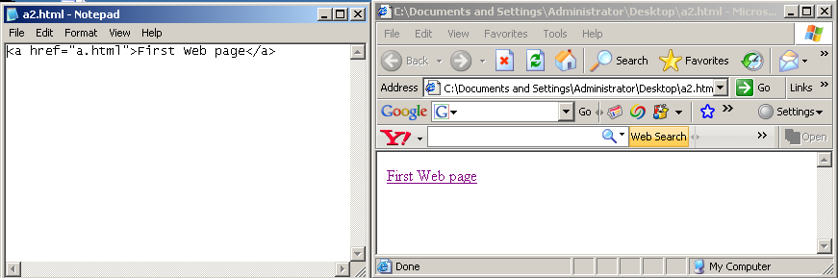
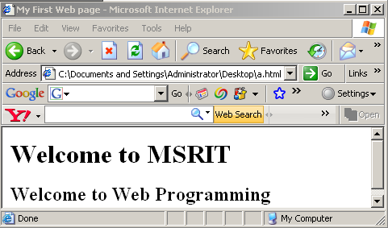

Slide 13
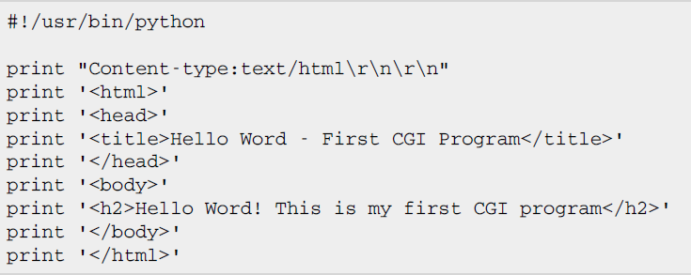

First CGI Program
This line The line Content-type:text/html\r\n\r\n is part of HTTP header is sent back to the browser and specify the content type to be displayed on the browser screen.

Slide 14

xampp an introduction
XAMPP is a free and open source cross-platform web server package, consisting mainly of the Apache HTTP Server, MySQL database, PHP Perl programming languages.
XAMPP is available for Microsoft Windows, Linux, Solaris, and Mac OS X, and is mainly used for web development projects.
Download Xampp software and install in /opt folder
http://www.apachefriends.org/en/xampp-linux.html
Starting of xampp software (You require a root permission)
Open a terminal
#cd /opt/lampp/
~/opt/lampp #./lampp start
The xampp server will start, minimize the window
Check for server running

Slide 15
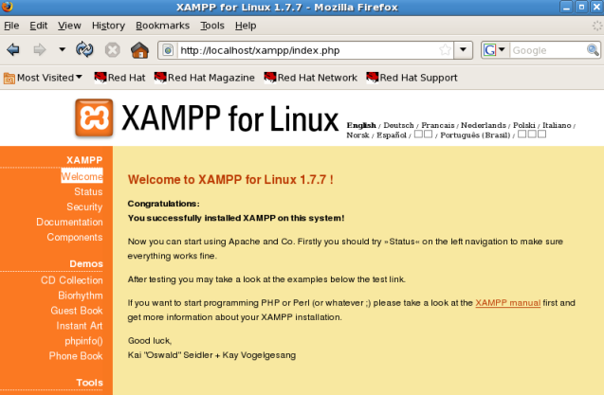
Open any browser and type http://localhost
You will get xampp welcome screen as
Once the server is started you can deploy your html and cgi files

Slide 16
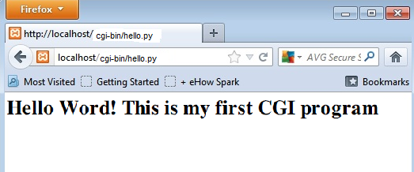
How to execute cgi python files
Type your first cgi program hello.py and keep it in the folder /opt/lampp/cgi-bin
Change mode of file using chmod 755 hello.py UNIX command to make file executable.
This hello.py script is a simple Python script which is writing its output on STDOUT file ie. Screen.
Open the browser and type
http://localhost/cgi-bin/hello.py
You will get the following output on browser

Slide 17
GET and POST Methods
Most frequently browser uses two methods two pass this information to web server. These methods are GET method and POST method
The GET method sends the encoded user information appended to the page request. The page and the encoded information are separated by the ? character as follows:
The GET method is the default method to pass information from browser to web server and it produces a long string that appears in your browser's Location:box. Never use GET method if you have password or other sensitive information to pass to the server. The GET method has size limitation: only 1024 characters can be sent in a request string. The GET method sends information using QUERY_STRING header and will be accessible in your CGI Program through QUERY_STRING environment variable.

Slide 18
Passing Information using POST method
A generally more reliable method of passing information to a CGI program is the POST method. This packages the information in exactly the same way as GET methods, but instead of sending it as a text string after a ? in the URL it sends it as a separate message. This message comes into the CGI script in the form of the standard input.

Slide 19
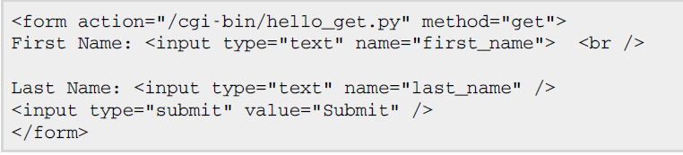
Simple FORM Example: GET Method
The GET method sends the encoded user information appended to the page request. The page and the encoded information are separated by the ? character as follows:
hello.py: save this file in /opt/lampp/htdocs
“post”

Slide 20
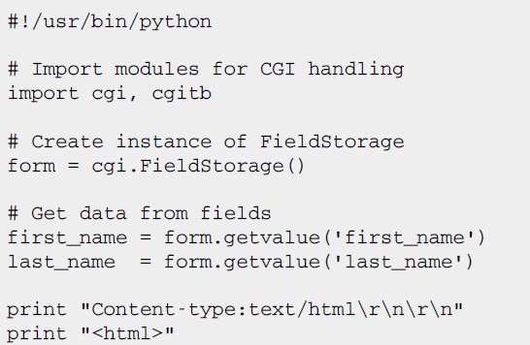
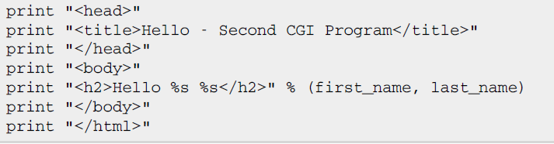
hello_get.py (save this file /opt/lampp/cgi-bin)
Notes:
cgitb is a library that dumps errors to the output – you don’t have to go searching for it in your log file.
cgi.FieldStorage() is a pseudo-dictionary containing all the POST and GET variables and their values.

Slide 21
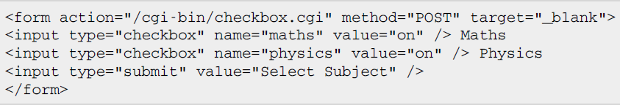
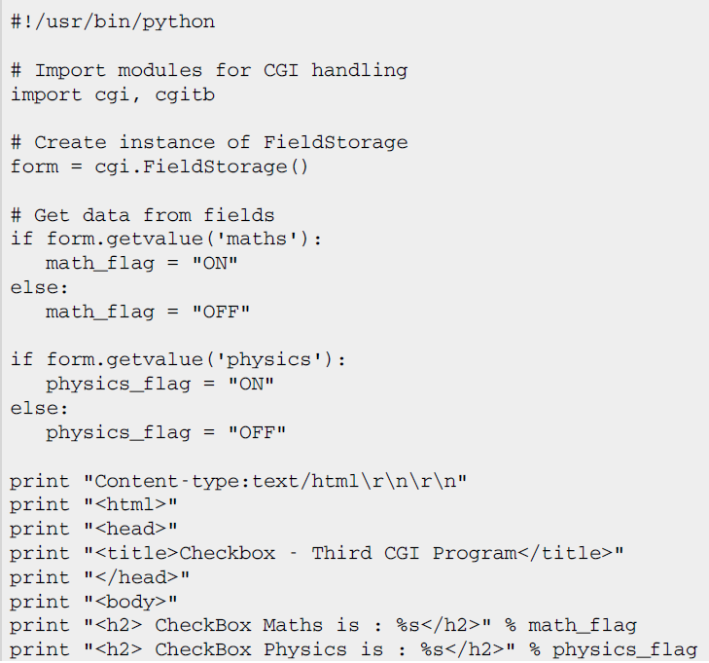
Passing Checkbox Data to CGI Program
Checkboxes are used when more than one option is required to be selected

Slide 22
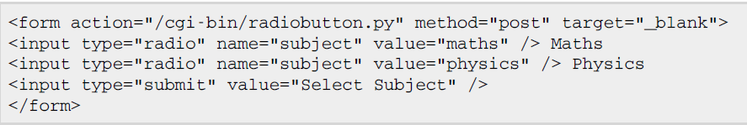
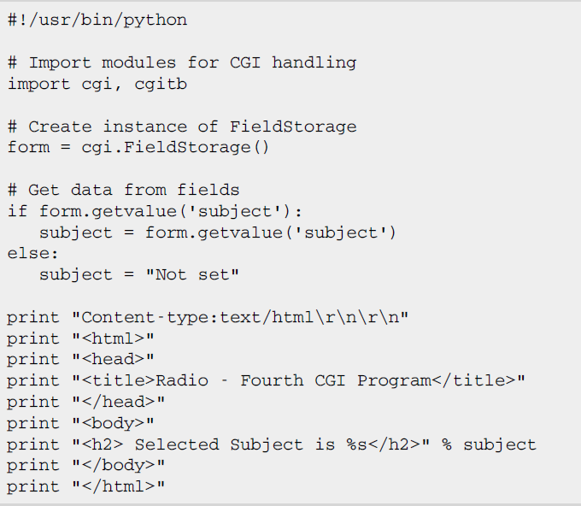
Passing Radio Button Data to CGI Program
Radio Buttons are used when only one option is required to be selected.

Slide 23
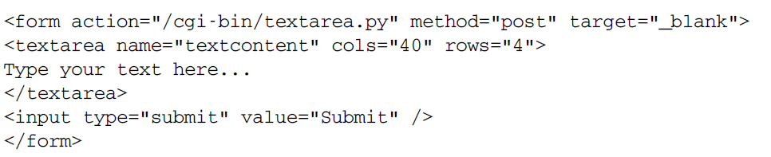
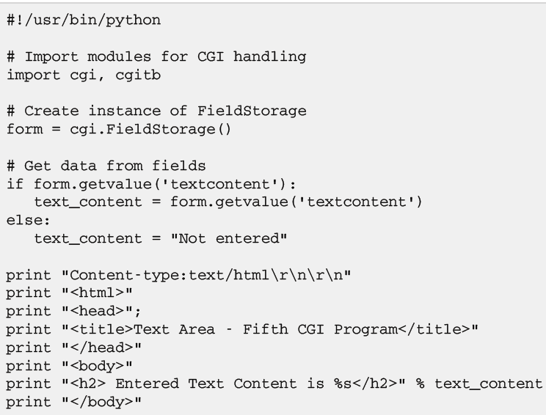
Passing Text Area Data to CGI Program
TEXTAREA element is used when multiline text has to be passed to the CGI Program.

Slide 24
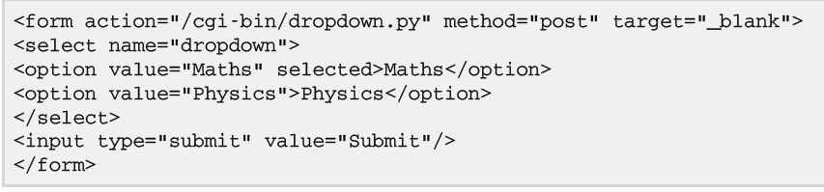

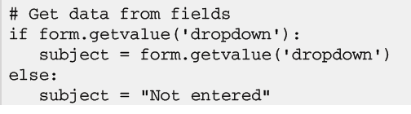
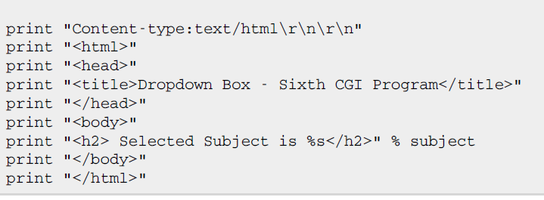
Passing Drop Down Box Data to CGI Program
Drop Down Box is used when we have many options available but only one or two will be selected.

Slide 25
Using Cookies in CGI
Cookie is a small piece of data sent from a website and stored in a user's web browser while a user is browsing a website. Cookies use a plain text format
HTTP protocol is a stateless protocol. But for a commercial website it is required to maintain session information among different pages. For example one user registration ends after completing many pages. But how to maintain user's session information across all the web pages.
How it works?
Your server sends some data to the visitor's browser in the form of a cookie. The browser may accept the cookie. If it does, it is stored as a plain text record on the visitor's hard drive. Now, when the visitor arrives at another page on your site, the cookie is available for retrieval. Once retrieved, your server knows/remembers what was stored.

Slide 26
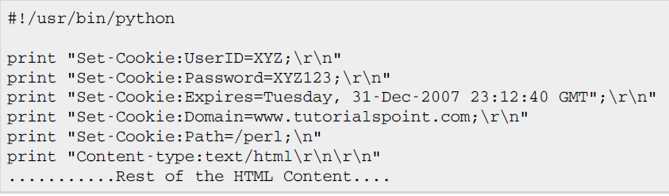
Setting a cookie
This is very easy to send cookies to browser. These cookies will be sent along with HTTP Header before to Content type filed. Assuming you want to set UserID and Password as cookies. So cookies setting will be done as follows

Slide 27
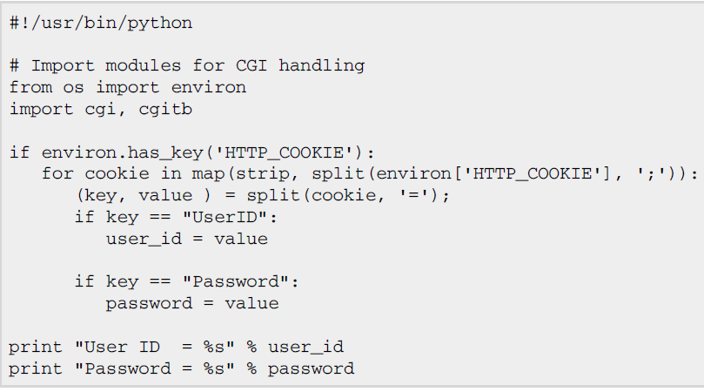
Retrieving a cookie

Slide 28
Exercise
Create a student registration form using all html tags and display the information using python CGI program
Program to accept the User Name and display a greeting message.
Program to accept the User Name, Gender and Age and display a greeting message that is age appropriate.
Eg: 60 year old Gentleman named Francis, display “Namaste Uncle Francis”
60 year old Lady named Benazir, display “Namaste Aunty Benazir”
18 year old guy named Mahesh, display “Hi! Mahesh. How are you dude? “

