Slide 1

Python MySQL Database Access

Slide 2
Databases: an Introduction
A database is a program that manages a set of data
Most databases are relational SQL databases
SQL – Structured Query Language, a standardized syntax for telling a database what to do
Databases take some sort of connection as communication – usually through TCP/IP
Most databases are set up as a group of schemas, each containing a set of tables
Each table contains a set of columns, each with a different data type
Rows are the entries in a table

Slide 3
Mysql and Python
You must download a separate DB API module for each database you need to access.
The DB API provides a minimal standard for working with databases, using Python structures and syntax wherever possible. This API includes the following:
  Importing the api module.
  Acquiring a connection with the database.
  Issuing SQL statements and stored procedures.
  Closing the connection
MySQL is the most widely used open-source database – Python supports it!
Uses library MySQLdb – a mySQL API for Python
Must install this yourself – on Linux with a package manager

Slide 4
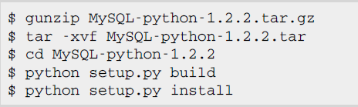
What is MySQLdb?
MySQLdb is an interface for connecting to a MySQL database server from Python.
It implements the Python Database API v2.0, and is built on top of the MySQL C API.
To install MySQLdb module, download it from MySQLdb Download page and proceed as follows:
For fedora
For ubuntu
sudo apt-get install python2.7-mysqldb

Slide 5

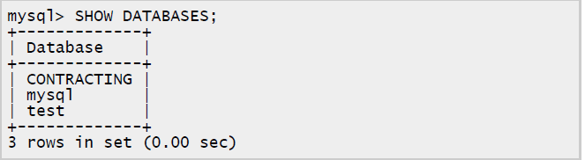
MySQL using XAMPP
#/opt/lampp/bin
#./mysql
Now u should be able to connect and u will see a welcome message and MySQL prompt: mysql>
you can start creating your database as follows:
To verify that the database was created

Slide 6
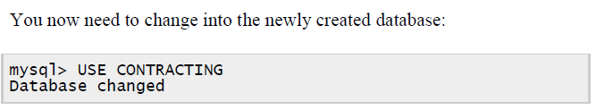
MySQL Contd….
At this time you are ready to start creating tables in the database
mysql> create table student (name varchar (30), age integer(2));
To Enter data into the table
mysql> insert into student values (‘Asha’,23);
To Retrieve the entered data
mysql>select * from student;
View the parameters of the created table, as follows:
mysql> describe student
To view the table structure you created, enter the following command
mysql>show tables
To delete the entry in the table
mysql>delete from student where age=30

Slide 7
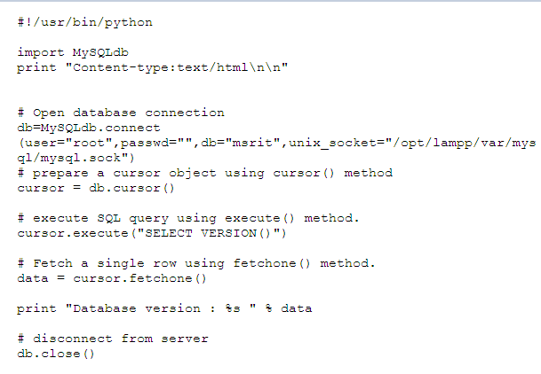
Example-1
Following is the example of connecting with MySQL database

Slide 8
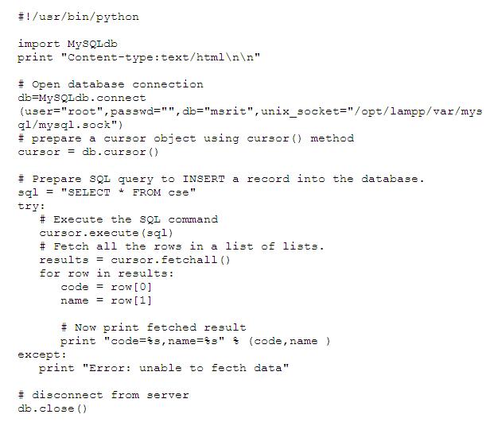
Example-2

Slide 9
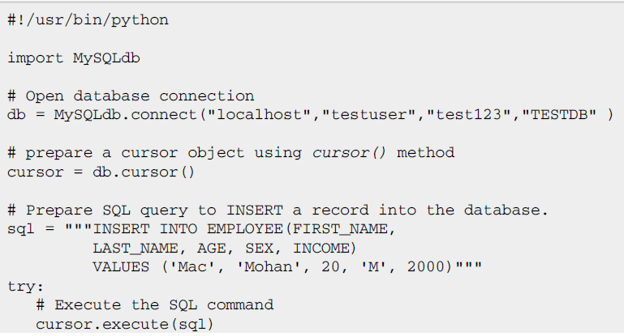
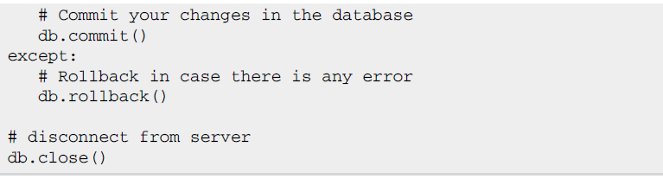
Insert data into the database

Slide 10
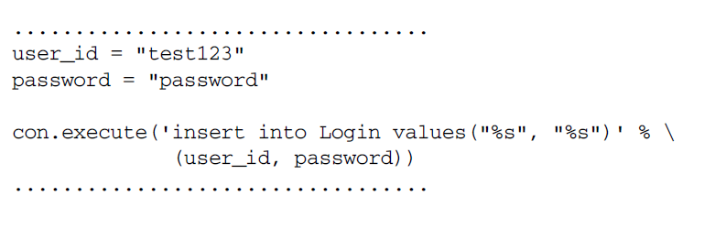
Following code segment is another form of execute where you can pass parameters directly:

Slide 11
Read Operation
READ Operation on any database means to fetch some useful information from the database.
fetchone(): This method fetches the next row of a query result set. A result set is an object that is returned when a cursor object is used to query a table.
fetchall(): This method fetches all the rows in a result set. If some rows have already been extracted from the result set, the fetchall() method retrieves the remaining rows from the result set.
rowcount: This is a read-only attribute and returns the number of rows that were affected by an execute()method.

Slide 12


Update and Delete
UPDATE Operation on any database means to update one or more records which are already available in the database.
DELETE operation is required when you want to delete some records from your database. Following is the procedure to delete all the records from EMPLOYEE where AGE is more than 20.

Slide 13
Exercises
Create a new Database called ‘FinalYears’. Create a Table ‘Student’ with ‘USN’,’Name’ and ‘Age’ as fields. Write a program to insert your USN, Name and Age information into the table from a web page.
Create a new database called ‘Movies’. Create a table called ‘HindiFilms’ with fields ‘Name’, ‘Budget’, ‘Hero’ and ‘Heroine’. Write a program to accept these fields information from a web page and to store those in the table.
Program to search a movie for a title given by the user on a web page and display the search results with proper headings.

