Slide 1

Python Network Programming
An Introduction

Slide 2
Introduction
Python provides two levels of access to network services.
Sockets are the endpoints of a bidirectional communications channel.
Sockets may communicate within a process, between processes on the same machine, or between processes on different continents.
To create a socket, you must use the socket.socket() function available in socket module, which has the general syntax:
s = socket.socket (socket_family, socket_type, protocol=0)

Slide 3
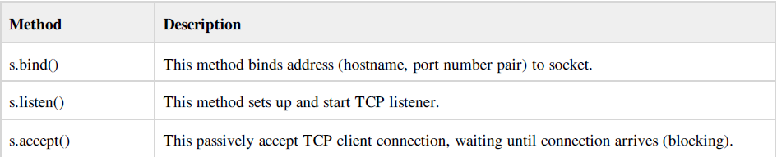

Server Socket Methods
Server Socket Methods:
Client Socket Methods:

Slide 4
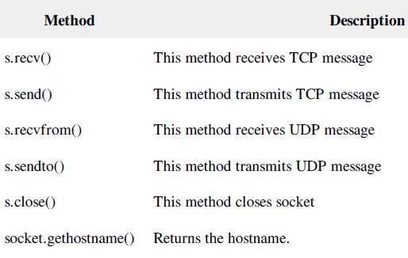
General Socket Methods

Slide 5
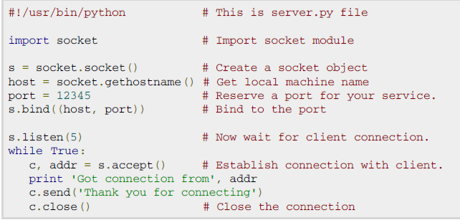
Simple Server program

Slide 6
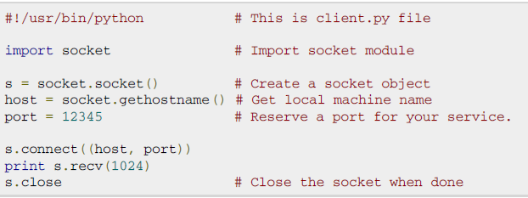
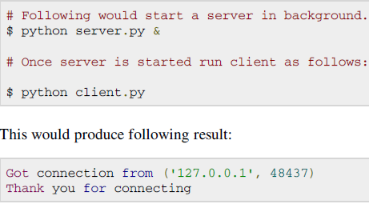
Simple Client Program
Notes:
To run client and server program in different machines we have to assign ip-address of server to host variable in both server and client program. To communicate server and client we have run iptables –-flush all

Slide 7
Introduction to plotting in Python
You need to have the following installed on your computer to be able to make nice plots.
Numpy - this is the module which does most array and mathematical manipulation
Matplotlib - this is the module you will be using for plotting

Slide 8
Basic plots
Two basic plot types which you will find are used very often are (x,y) line and scatter plots and histograms.
Line and scatter plots
A common type of graph to plot is a line relating x-values to particular y-values.

Slide 9
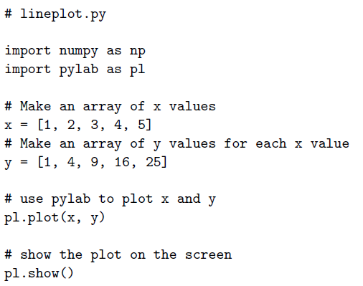
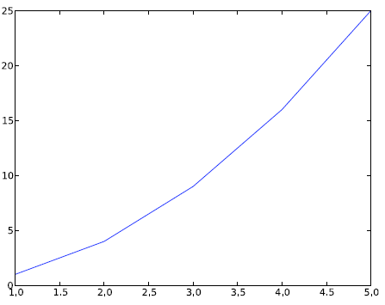
Line plot: example

Slide 10
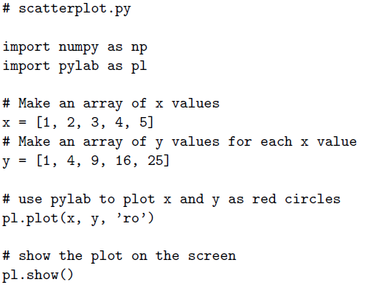
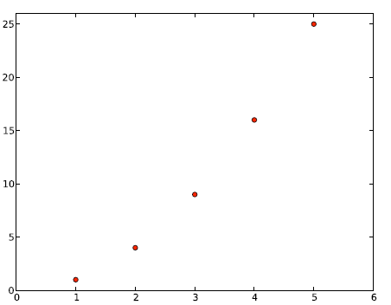
Scatter plots: example

Slide 11
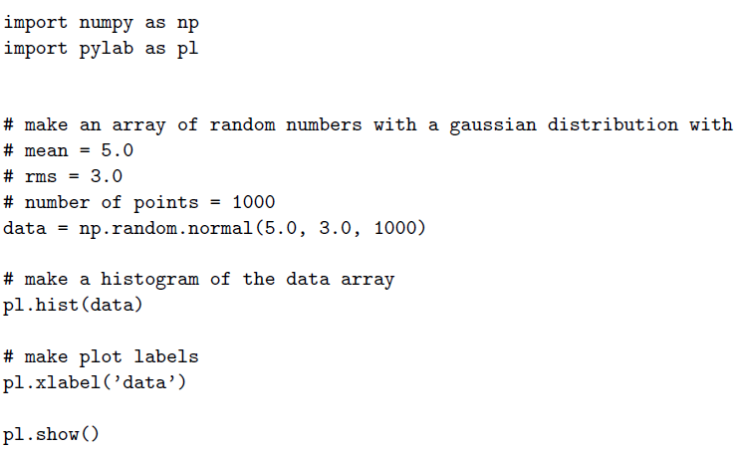
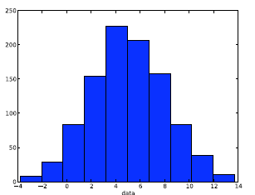
Histograms

