Slide 1

Python Control Flow statements
There are three control flow statements in Python - if, for and while.

Slide 2
Decision making statements
Python programming language assumes any non-zero and non-null values as true and if it is either zero or null then it is assumed as false value.
Python programming language provides following types of decision making statements.

Slide 3
Decision making statements
if statements
An if statement consists of a boolean expression followed by one or more statements.
if...else statements
An if statement can be followed by an optional else statement, which executes when the boolean expression is false.
nested if statements
You can use one if or else if statement inside another if or else if statement(s).

Slide 4
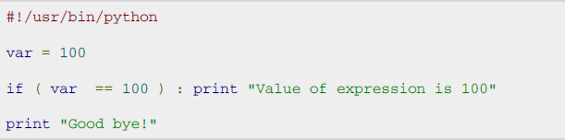

Syntax of if statement
if expression: statement(s)
Single Statement Suites:
If the suite of an if clause consists only of a single line, it may go on the same line as the header statement.
Here is an example of a one-line if clause:

Slide 5
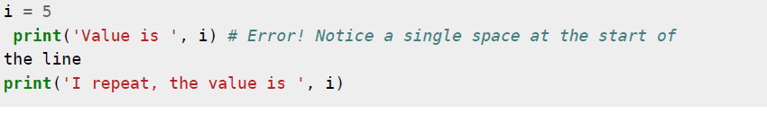
Indentation
White space is important in Python
White space at the beginning of the line is important, is called indentation.
Leading whitespace (spaces and tabs) at the beginning of the logical line (which understand by python) is used to determine the indentation level of the logical line, which in turn is used to determine the grouping of statements.
This means that statements which go together must have the same indentation.
Do not use a mixture of tabs and spaces for the indentation as it does not work across different platforms properly. It is strongly recommend that use a single tab or four spaces

Slide 6

Syntax of If-else statement
if expression:
statement(s)
else:
statement(s)
#!/usr/bin/python
var1 = 100
if var1:
print "1 - Got a true expression value"
print var1
else:
print "1 - Got a false expression value"
print var1

Slide 7
The elif Statement
The elif statement allows you to check multiple expressions for truth value and execute a block of code as soon as one of the conditions evaluates to true.
if expression1:
statement(s)
elif expression2:
statement(s)
elif expression3:
statement(s)
else: statement(s)
Python does not currently support switch or case statements as in other languages.

Slide 8
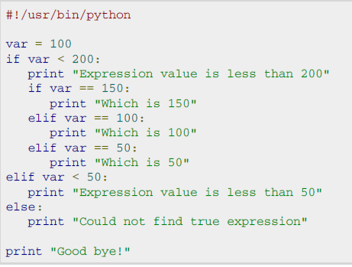

Nested if example
Output

Slide 9
Decision making
while loop
Repeats a statement or group of statements while a given condition is true. It tests the condition before executing the loop body.
for loop
Execute a sequence of statements multiple times and abbreviates the code that manages the loop variable.
nested loops
You can use one or more loop inside any another while, for or do..while loop.

Slide 10

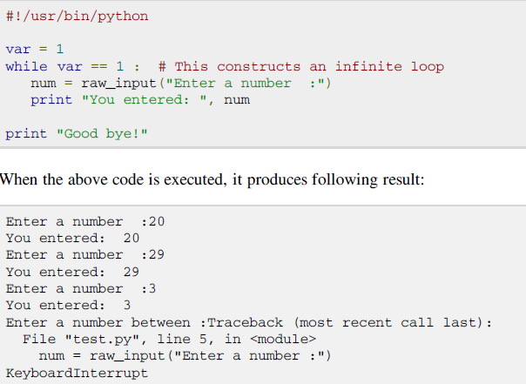
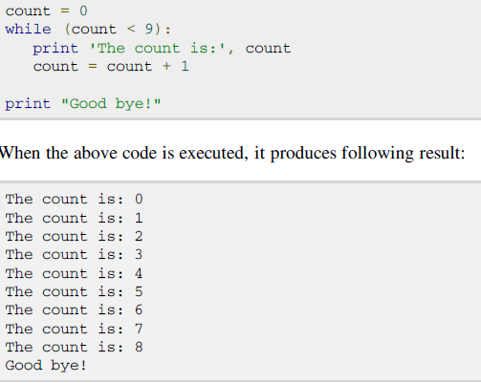
While loop example

Slide 11
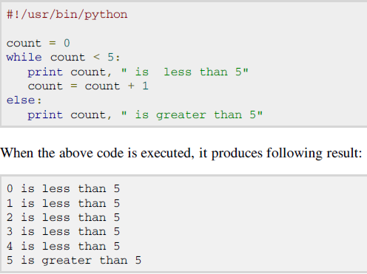
The else Statement Used with Loops

Slide 12
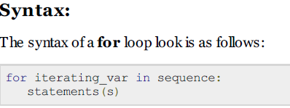
Python For-loop statements
The for loop in Python has the ability to iterate over the items of any sequence, such as a list ,string, tuple and other built-in iterables.
If a sequence contains an expression list, it is evaluated first. Then, the first item in the sequence is assig ned to the iterating variable iterating_var. Next, the statements block is executed. Each item in the list is assig ned to iterating_var, and the statement(s) block is executed until the entire sequence is exhausted.

Slide 13
For loop example
#!/usr/bin/python
for letter in 'Python': #example1
print 'Current Letter :', letter
fruits = ['banana', 'apple', 'mango']
for fruit in fruits: #example2
print 'Current fruit :', fruit
print "Good bye!“
for I in range(1,5): #example3
print (i)
else:
print (“The for loop is over”)

Slide 14
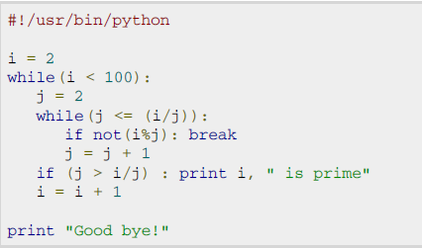
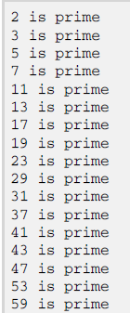
Nested loop (print prime numbers)

Slide 15
Loop Control Statements
break statement
Terminates the loop statement and transfers execution to the statement immediately following the loop.
continue statement
Causes the loop to skip the remainder of its body and immediately retest its condition prior to reiterating.
pass statement
The pass statement in Python is used when a statement is required syntactically but you do not want any command or code to execute.

Slide 16
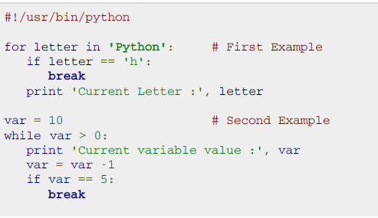
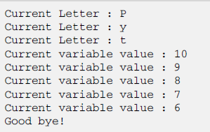
Break statement example
output

Slide 17
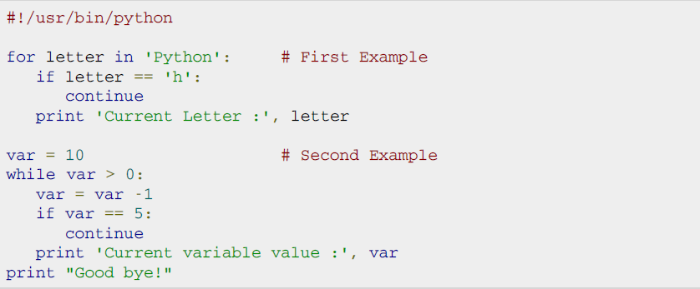

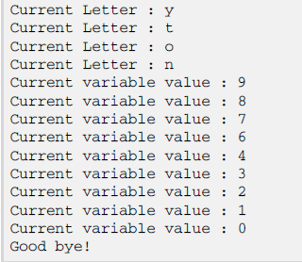
Continue statement example

Slide 18
Pass statement example
for pnum in [1,2, -1, 3]:
if pnum < 0:
pass
else:
print pnum
Output
1
2
3

Slide 19
Exercises
Write a python program to check for validity of password using if statement
Write a python program to check the eligibility for voting using if-else
Write a python program to print student garde using elif
Write a python program to find the factorial of number using while loop
Write a python program to add 10 numbers by inputting each from the keyboard using for loop
Write a python program to print string or number is a palindrome or not.

Slide 20
Steps to install IDLE IDE for python
For linux / Fedora users
#yum install python-tools
For Ubuntu users
#sudo apt-get install idle

