Slide 1

Built-in Data Structures in Python
An Introduction

Slide 2
Python Data Structures
There are four built-in data structures in Python
List
Tuple
Dictionary
Set.
The most basic data structure in Python is the sequence. Each element of a sequence is assigned a number - its position, or index. The first index is zero, the second index is one, and so forth.
We will see how to use each of them and how the make life easier for us.

Slide 3
Lists
A list is a data structure that holds an ordered collection of items i.e. you can store a sequence of items in a list.
The list of items should be enclosed in square brackets so that Python understands that you are specifying a list.
Once you have created a list, you can add, remove or search for items in the list. Since we can add and remove items, we say that a list is a mutable data type i.e. this type can be altered.
list1 = ['physics', 'chemistry', 1997, 2000];
list2 = [1, 2, 3, 4, 5 ];
list3 = ["a", "b", "c", "d"];

Slide 4
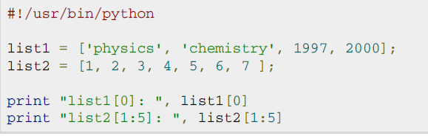

Accessing values in the list

Slide 5
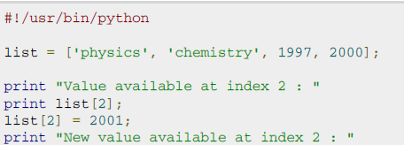

Updating Lists
You can update single or multiple elements of lists by giving the slice on the left-hand side of the assignment operator
You can add to elements in a list with the append() method.

Slide 6
Updating list elements by slicing
By specifying a[0:2] on the left side of the operator, you are telling python you want to use slice assignment, which is very similar to tuple unpacking. This is equivalent to: a[0], a[1] = [4, 5]
>>> a = [1, 2, 3]
>>> a[0:0] = [-3, -2, -1, 0]
>>> a [-3, -2, -1, 0, 1, 2, 3]
>>> a[:] = [1, 2, 3]
>>> a [1, 2, 3]
>>> a[-1:] = [5, 4, 3, 2]
>>> a [1, 2, 5, 4, 3, 2]

Slide 7
Negative List Indices accesses elements from the end of the list counting backwards. The last element of any non-empty list is always li[-1]
>>> li ['a', 'b', 'mpilgrim', 'z', 'example']
>>> li[-1] 'example'
>>> li[-3] 'mpilgrim‘
Slicing Shorthand
>>> li ['a', 'b', 'mpilgrim', 'z', 'example']
>>> li[:3] ['a', 'b', 'mpilgrim']
>>> li[3:] ['z', 'example']
>>> li[:] ['a', 'b', 'mpilgrim', 'z', 'example']

Slide 8
Adding elements to the lists
>>> li ['a', 'b', 'mpilgrim', 'z', 'example']
>>> li.append("new")
>>> li ['a', 'b', 'mpilgrim', 'z', 'example', 'new']
>>> li.insert(2, "new")
>>> li ['a', 'b', 'new', 'mpilgrim', 'z', 'example', 'new']
>>> li.extend(["two", "elements"])
>>> li ['a', 'b', 'new', 'mpilgrim', 'z', 'example', 'new', 'two', 'elements']
Append adds a single element to the end of the list.
Insert inserts a single element into a list to a particular position.
Extend concatenates lists. Note that you do not call extend with multiple arguments; you call it with one argument, a list.

Slide 9
The Difference between extend and append
“extend” takes a single argument, which is always a list, and adds each of the elements of that list to the original list.
”append” takes one argument, which can be any data type, and simply adds it to the end of the list. Here, you're calling the append method with a single argument, which is a list of three elements. Now the original list, which started as a list of three elements, contains four elements. Because the last element that you just appended is itself a list. Lists can contain any type of data, including other lists.

Slide 10
Example for extend & append
>>> li = ['a', 'b', 'c']
>>> li.extend(['d', 'e', 'f'])
>>> li ['a', 'b', 'c', 'd', 'e', 'f']
>>> len(li) 6
>>> li[-1] 'f'
>>> li = ['a', 'b', 'c']
>>> li.append(['d', 'e', 'f'])
>>> li ['a', 'b', 'c', ['d', 'e', 'f']]
>>> len(li) 4
>>> li[-1] ['d', 'e', 'f']

Slide 11
Delete list of elements
>>> a = [-1, 1, 66.25, 333, 333, 1234.5]
>>> del a[0]
>>> a
[1, 66.25, 333, 333, 1234.5]
>>> del a[2:4]
>>> a
[1, 66.25, 1234.5]
>>> del a[:]
>>> a
[]

Slide 12
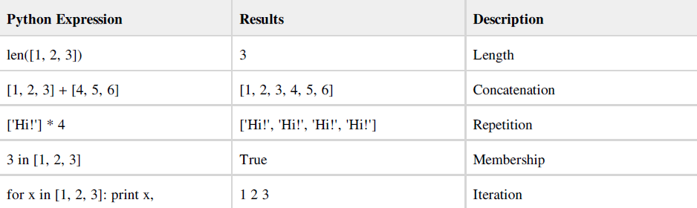
Basic List operations

Slide 13
Remove elements from the list
“remove” removes the first occurrence of a value from a list.
If the value is not found in the list it raises an exception.
Pop does two things: it removes the last element of the list, and it returns the value that it removed. Note that this is different from li[-1], which returns a value but does not change the list, and different from li.remove(value), which changes the list but does not return a value.

Slide 14
Example
>>> li ['a', 'b', 'new', 'mpilgrim', 'z', 'example', 'new', 'two', 'elements']
>>> li.remove("z")
>>> li ['a', 'b', 'new', 'mpilgrim', 'example', 'new', 'two', 'elements']
>>> li.remove("new")
>>> li ['a', 'b', 'mpilgrim', 'example', 'new', 'two', 'elements']
>>> li.remove("c")
Traceback (innermost last): File "<interactive input>", line 1, in ? ValueError: list.remove(x): x not in list
>>> li.pop()
'elements'
>>> li ['a', 'b', 'mpilgrim', 'example', 'new', 'two']

Slide 15
Searching elements
index finds the first occurrence of a value in the list and returns the index.
>>> li ['a', 'b', 'new', 'mpilgrim', 'z', 'example', 'new', 'two', 'elements']
>>> li.index("example")
5
>>> li.index("new")
2
>>> li.index("c")
Traceback (innermost last): File "<interactive input>", line 1, in ? ValueError: list.index(x): x not in list
>>> "c" in li
False

Slide 16
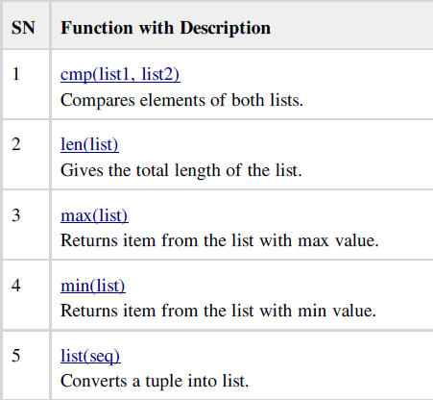
Built-in List Functions

Slide 17
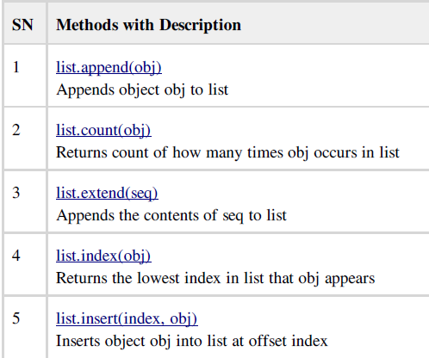
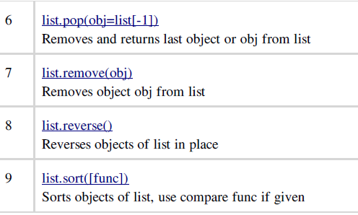
Built-in List Methods

Slide 18
List Comprehensions
List comprehensions provide a concise way to create
lists.
It consists of brackets containing an expression
followed by a for clause, then zero or more for or if
clauses. The expressions can be anything, meaning
you can put in all kinds of objects in lists.
The result will be a new list resulting from evaluating the expression in the context of the for and if clauses which follow it.
The list comprehension always returns a result list.

Slide 19
The basic syntax is
[ expression for item in list if conditional ]
is equivalent to
for item in list:
if conditional:
expression

Slide 20
Example-1
# You can either use loops:
squares = []
for x in range(10):
squares.append(x**2)
print squares
[0, 1, 4, 9, 16, 25, 36, 49, 64, 81]
# Or you can use list comprehensions to get the same result:
squares = [x**2 for x in range(10)]
print squares
[0, 1, 4, 9, 16, 25, 36, 49, 64, 81]

Slide 21
Example-2
listOfWords = ["this","is","a","list","of","words"]
items = [ word[0] for word in listOfWords]
print items
Output: ['t', 'i', 'a', 'l', 'o', 'w']
string = "Hello 12345 World"
numbers = [x for x in string if x.isdigit()]
print numbers
Output: ['1', '2', '3', '4', '5‘]

Slide 22

Tuples--Introduction
A tuple is a sequence of immutable Python objects.
Tuples are sequences, just like lists. The only difference is that tuples can't be changed ie. tuples are immutable
Tuples use parentheses and lists use square brackets.

Slide 23
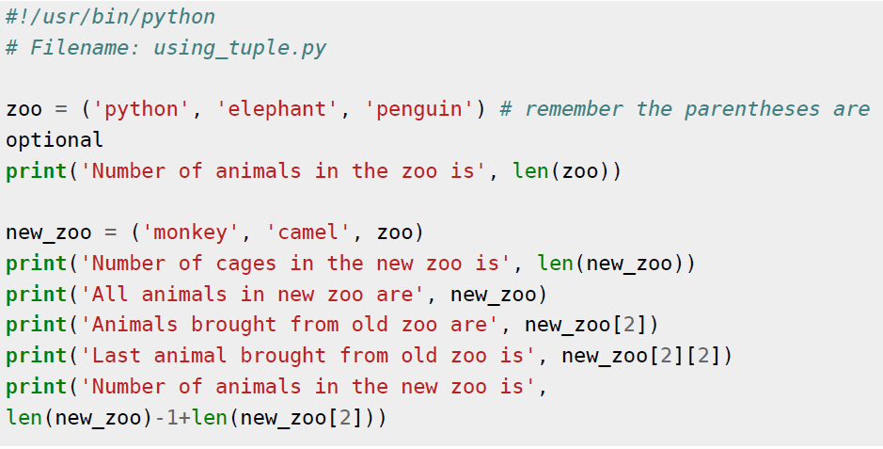
Example on Tuples

Slide 24
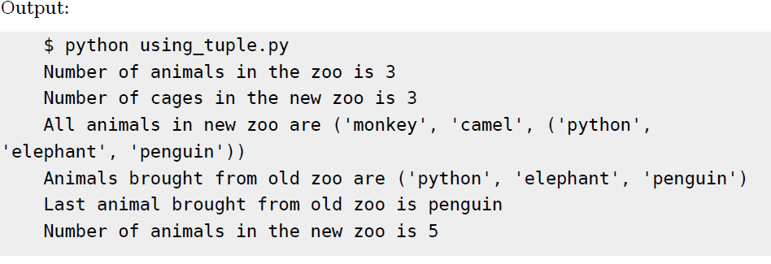

Slide 25
Tuples continued….
The empty tuple is written as two parentheses containing nothing:
tup1 = ();
To write a tuple containing a single value you have to include a comma, even though there is only one value:
tup1 = (50,);
Like string indices, tuple indices start at 0, and tuples can be sliced, concatenated and so on.

Slide 26
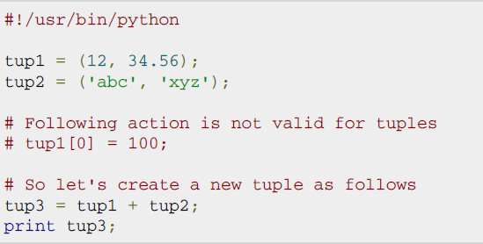
Updating Tuples:
Tuples are immutable which means you cannot update them or change values of tuple elements. But we able to take portions of an existing tuples to create a new tuples as follows. Following is a simple example:

Slide 27
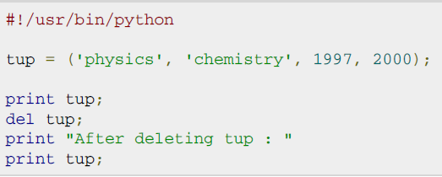
Delete Tuple Elements:
Removing individual tuple elements is not possible. There is, of course, nothing wrong with putting together another tuple with the undesired elements discarded.
To explicitly remove an entire tuple, just use the del statement. This produce the error as after “del tup” tuple does not exist any more

Slide 28
Python Dictionary
A dictionary is mutable and is another container type that can store any number of Python objects, including other container types. Dictionaries consist of pairs (called items) of keys and their corresponding values.
Python dictionaries are also known as associative arrays or hash tables. The general syntax of a dictionary is as follows:
Keys are unique within a dictionary while values may not be. The values of a dictionary can be of any type, but the keys must be of an immutable data type such as strings, numbers, or tuples.

Slide 29
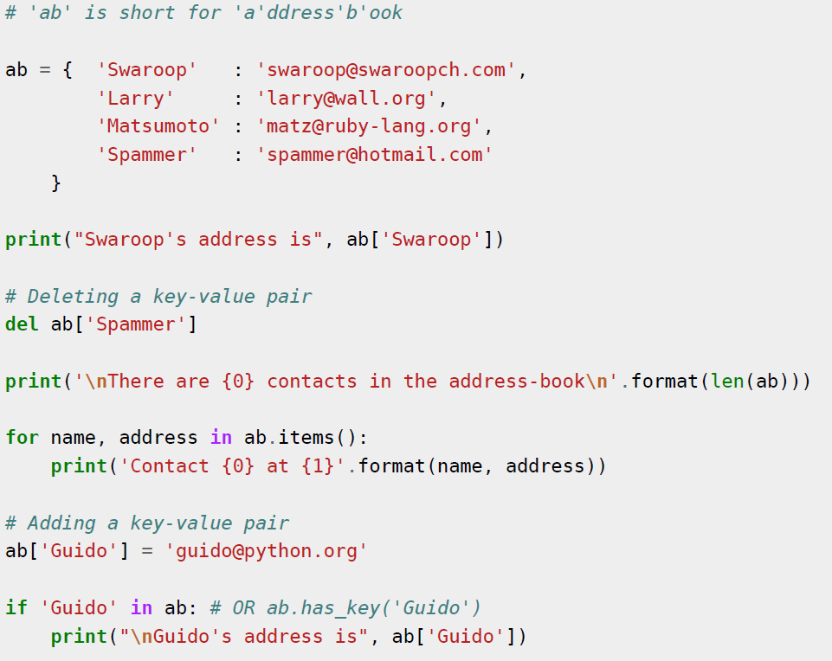
Example

Slide 30
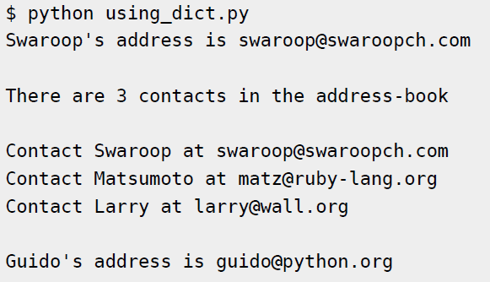
Output

Slide 31
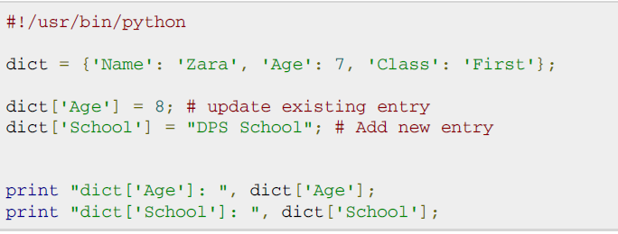

Updating Dictionary

Slide 32
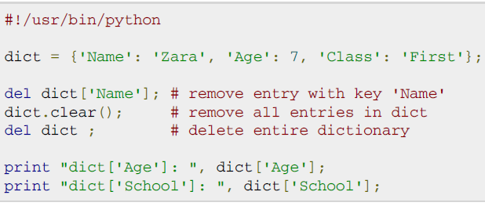
Delete Dictionary elements

Slide 33



Properties of Dictionary Keys
More than one entry per key not allowed. Which means no duplicate key is allowed. When duplicate keys encountered during assignment, the last assignment wins.
Keys must be immutable. Which means you can use strings, numbers, or tuples as dictionary keys but something like ['key'] is not allowed..
Dictionary Keys Are Case-Sensitive

Slide 34
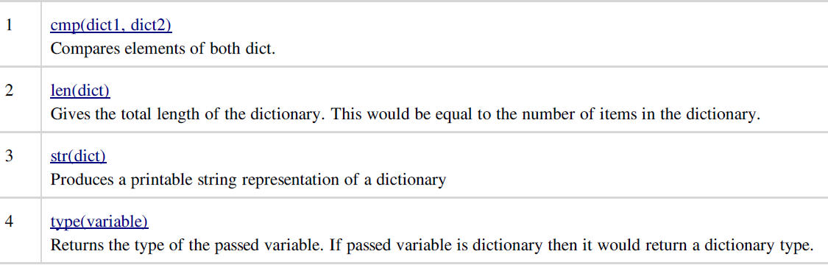
Built-in Dictionary Functions

Slide 35
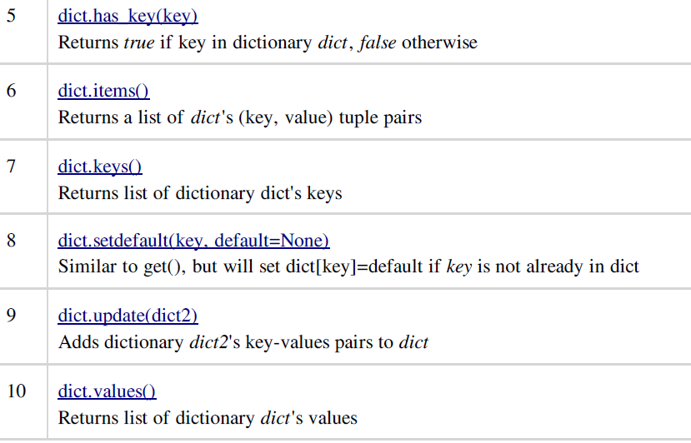
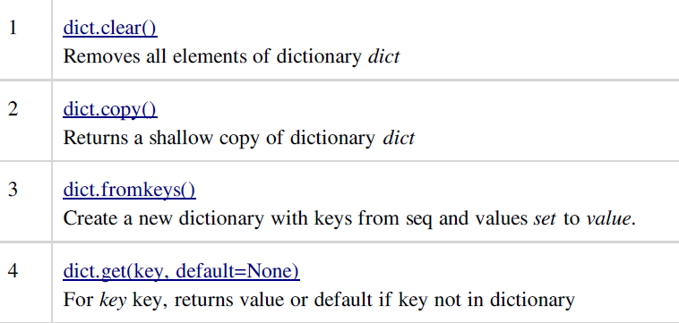
Built-in Dictionary Methods

Slide 37
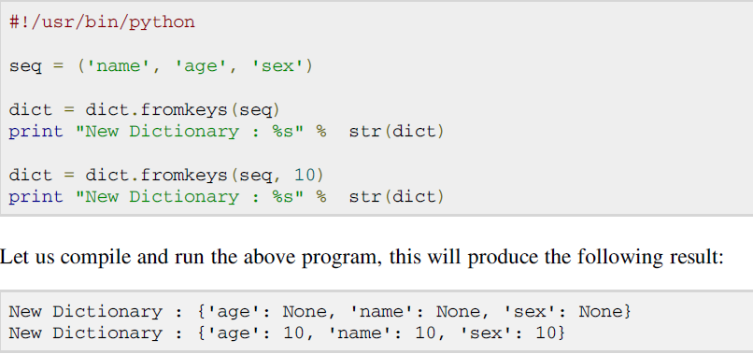
Python dictionary fromkeys() Method
The method fromkeys() creates a new dictionary with keys from seq and values set to value.
dict.fromkeys(seq[, value]))
seq -- This is the list of values which would be used for dictionary keys preparation.
value -- This is optional, if provided then value would be set to this value

Slide 38
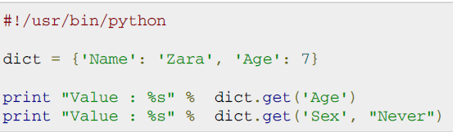

Python dictionary get() Method
The method get() return a value for the given key. If key is not available then returns default value None.
dict.get(key, default=None)

Slide 39
Exercises
Implement a stack and queue using lists
Write a function find_longest_word() that takes a list of words and returns the length of the longest one using tuples.
Write a function filter_long_words() that takes a list of words and an integer ’n’ and returns the list of words that are longer than ’n’.
Create a dictionary state and their capitals and print capital for the given state.
Write a program that maps a list of words into a list of integers representing the lengths of the corresponding words.
Write a tiny Python program numDict.py that makes a dictionary whose keys are the words ‘one’, ‘two’, ‘three’, and ‘four’, and whose corresponding values are the numerical equivalents, 1, 2, 3, and 4 (ints, not strings). Include code to test the resulting dictionary by referencing several of the definitions and printing the results.
Write a program to convert list of Celsius values to Fahrenheit using list comprehension
Write a program that creates the Pythagorean triples using list comprehension (x**2+y**2 = z**2) (you can use tuple to store the triples)

