Slide 1

Python Functions

Slide 2
Defining a Function
You can define functions to provide the required functionality. Here are simple rules to define a function in Python:
Function blocks begin with the keyword def followed by the function name and parentheses ( ( ) ).
Any input parameters or arguments should be placed within these parentheses. You can also define parameters inside these parentheses.
The first statement of a function can be an optional statement - the documentation string of the function or docstring.
The code block within every function starts with a colon (:) and is indented.
The statement return [expression] exits a function, optionally passing back an expression to the caller. A return statement with no arguments is the same as return None.

Slide 3
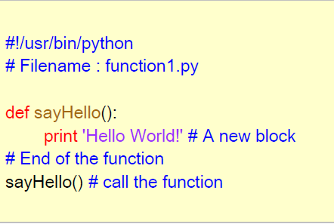
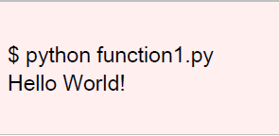
Example Defining a function
Syntax
def functionname( parameters ):
"function_docstring"
function_suite
return [expression]

Slide 4
Doc Strings
Python has a feature called documentation strings, usually referred as docstrings. DocStrings are an important tool that you should make use of since it helps to document the program better and makes it easier to understand.
Docstrings provide a convenient way of associating documentation with Python modules, functions, classes, and methods.
It's specified in source code that is used, like a comment, to document a specific segment of code.
This allows the program to inspect these comments at run time, for instance as an interactive help system, or as metadata
The doc string line should begin with a capital letter and end with a period. The first line should be a short description.
def my_function():
"""Do nothing, but document it.
No, really, it doesn't do anything. """
pass
>>> print my_function.__doc__
Do nothing, but document it.
No, really, it doesn't do anything.

Slide 5
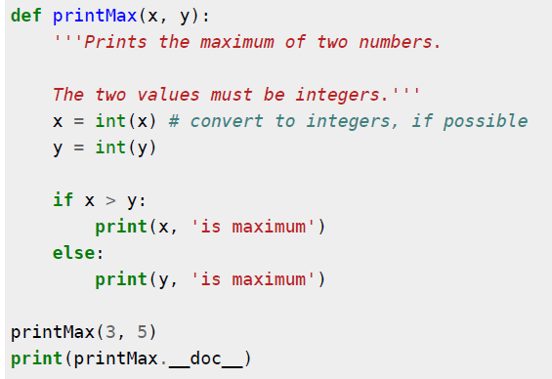

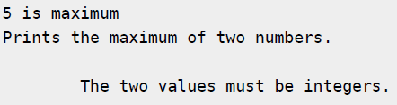
Example

Slide 6
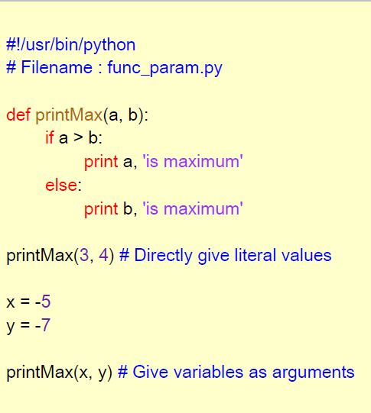
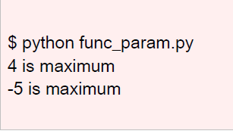
Function parameters

Slide 7
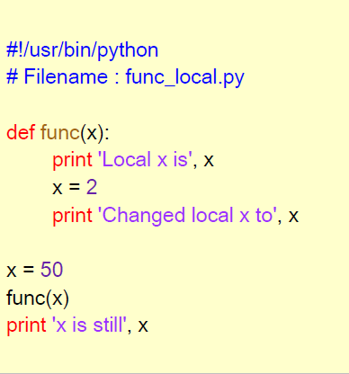
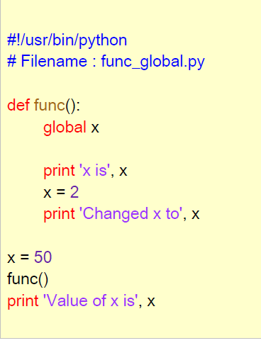
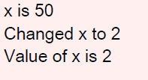
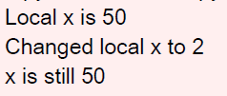
Local & global variables
Using of local variables
Using of global variable
‘global’ key word is used to declare global variable

Slide 8
Function arguments
Types of formal arguments are
Default arguments
Keyword arguments
Required arguments
Variable-length arguments
Keyword –only Parameters

Slide 9
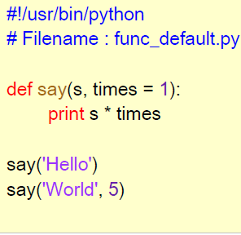

default argument values
For some functions, you may want to make some parameters as optional and use default values if the user does not want to provide values for such parameters. This is done with the help of default argument values.
Note that the default argument value should be immutable.
you cannot use mutable objects such as lists for default argument values.
Note : Only those parameters which are at the end of the parameter list can be given as default argument values.
For Eg. def fun (a,b=5)→valid
def fun (a=1,b) → Invalid

Slide 10
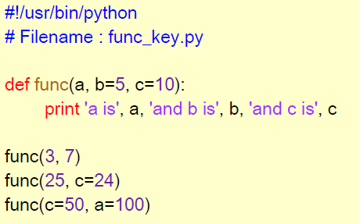

keyword arguments
If you have some functions with many parameters and you want to specify only some parameters, then you can give values for such parameters by naming them this is called keyword arguments.
We use the name instead of the position which we have been using all along.
This has two advantages - One, using the function is easier since we do not need to worry about the order of the arguments.
Two, we can give values to only those parameters which we want, provided that the other parameters have default argument values.

Slide 11
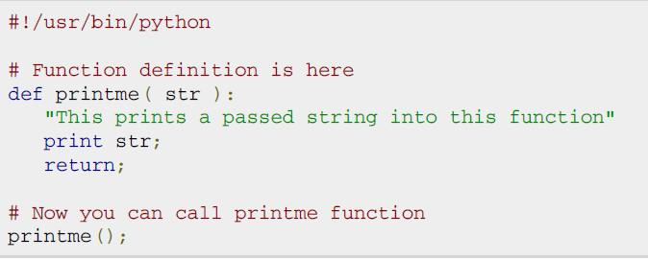
Required arguments
Required arguments are the arguments passed to a function in correct positional order. Here the number of arguments in the function call should match exactly with the function definition.
To call the function printme() you definitely need to pass one argument otherwise it would give a syntax error

Slide 12
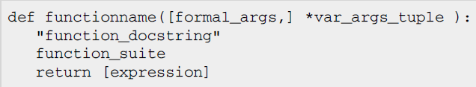
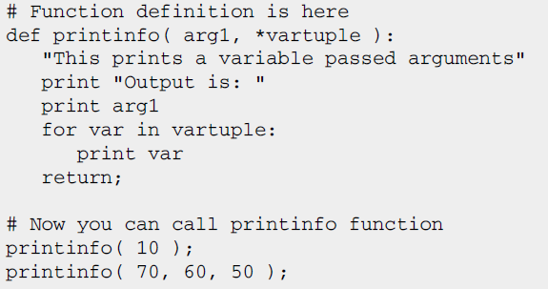
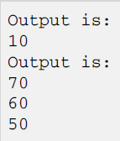
Variable length arguments
You may need to process a function for more arguments than you specified while defining the function. These arguments are called variable-length arguments and are not named in the function definition, unlike required and default arguments. The syntax is
An asterisk (*) is placed before the variable name that will hold the values of all nonkeyword variable arguments. This tuple remains empty if no additional arguments are specified during the function call.

Slide 13
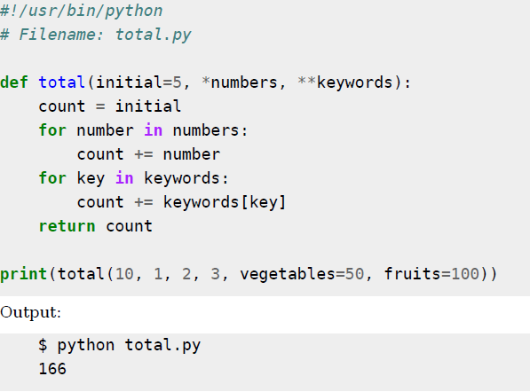
Example for variable length arguments
Note :
When we declare a starred parameter such as *param, then all the positional arguments from that point till the end are collected as a list called 'param'.
When we declare a double-starred parameter such as **param, then all the keyword arguments from that point till the end are collected as a dictionary called 'param'.

Slide 14
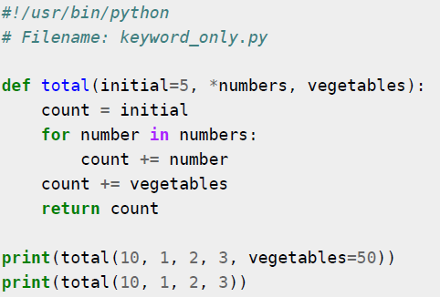
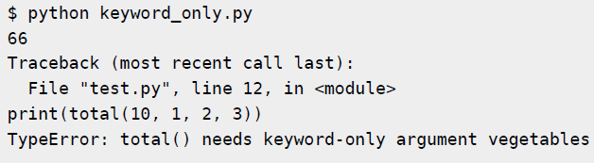
Keyword-only Parameters
If we want to specify certain keyword parameters to be available as keyword-only and not as positional arguments, they can be declared after a starred parameter

Slide 15
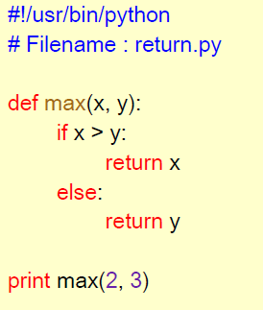


return statement
The return statement is used to return from a function i.e. break out of the function. We can optionally return a value from the function as well.
Every function implicitly contains a return None statement. You can see this by running print someFunction() where the function someFunction does not use the return statement

Slide 16
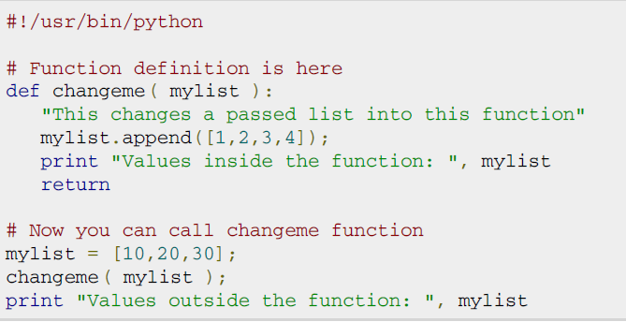
Pass by reference vs value
All parameters (arguments) in the Python language are passed by reference. It means if you change what a parameter refers to within a function, the change also reflects back in the calling function.

Slide 17
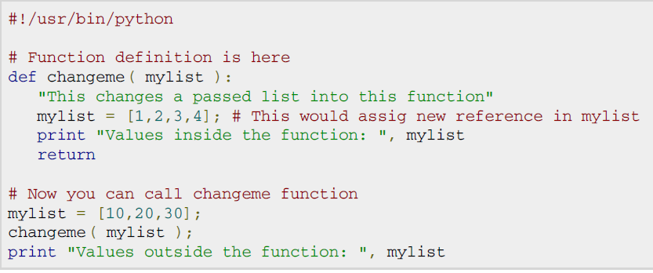

Function example
There is one more example where argument is being passed by reference but inside the function, but the reference is being over-written.

Slide 18
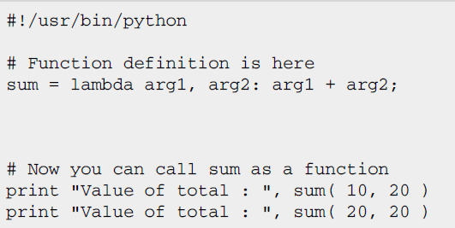

The Anonymous Functions
You can use the lambda keyword to create small anonymous functions. These functions are called anonymous because they are not declared in the standard manner by using the def keyword.
Lambda forms can take any number of arguments but return just one value in the form of an expression. They cannot contain commands or multiple expressions.
An anonymous function cannot be a direct call to print because lambda requires an expression.
Lambda functions have their own local namespace and cannot access variables other than those in their parameter list and those in the global namespace.
Although it appears that lambda's are a one-line version of a function, they are not equivalent to inline statements in C or C++, whose purpose is by passing function stack allocation during invocation for performance reasons.

Slide 19
Exercises
Define a function max_of_three() that takes three numbers as arguments and returns the largest of them using default arguments
Define a function sum() and a function multiply() that sums and multiplies (respectively) all the numbers in a list of numbers. For example, sum([1, 2, 3, 4]) should return 10, and multiply([1, 2, 3, 4]) should return 24 using VarArgs.
Define a function generate_n_chars() that takes an integer n and a character c and returns a string, n characters long. For example, generate_n_chars(5,"x") should return the string "xxxxx“ using keyword only parameters.

Slide 20
Exercises
Define a procedure histogram() that takes a list of integers and prints a histogram to the screen. For example,histogram ([4, 9, 7]) should print the following:
****
*********
*******
Write python function for binary search

