Slide 1

Python Modules
An Introduction

Slide 2
Introduction
A module is a file containing Python definitions and statements. The file name is the module name with the suffix .py appended.
Within a module, the module’s name (as a string) is available as the value of the global variable __name__.
A module allows you to logically organize your Python code. Grouping related code into a module makes the code easier to understand and use.
The import Statement Syntax
import module1[, module2[,... moduleN]
A module can contain executable statements as well as function definitions. These statements are intended to initialize the module. They are executed only the first time the module is imported somewhere.

Slide 3
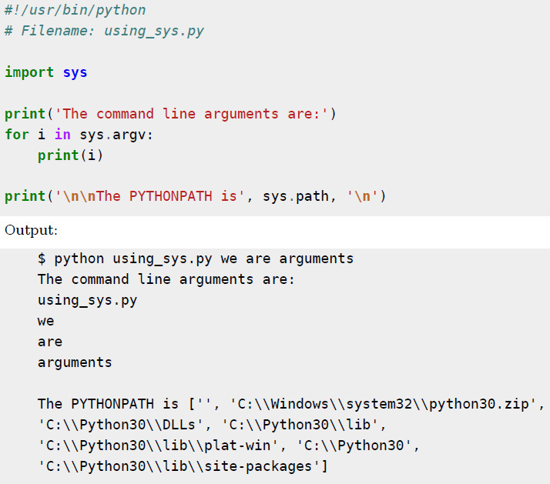
Importing standard library modules

Slide 4
The from...import Statement
Python's from statement lets you import specific attributes from a module into the current namespace. The from...import has the following syntax:
from modname import name1[, name2[, ... nameN]]
#!/usr/bin/python
from sys import argv
for i in argv
print i

Slide 5
Imports happen only once
Modules are loaded and run on the first ‘import’ or ‘from’ because importing is an expensive operation, by default python does it just once per file, per process. Later import operations simply fetch the already loaded module object.
For eg. Consider the file simple.py
>>>import simple #first import loads and runs the file code
Hello
>>>simple.spam #assignment makes an attribute
1
>>>simple.spam=2 #change attribute in module
>>>import simple #just fetches already loaded module
>>>simple.spam #code wasn’t return, attribute unchanged
2
#simple.py
print (“hello”)
spam=1 #Initialize variable

Slide 6
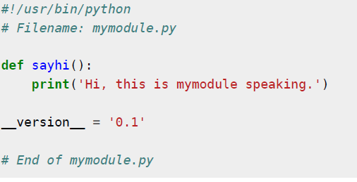
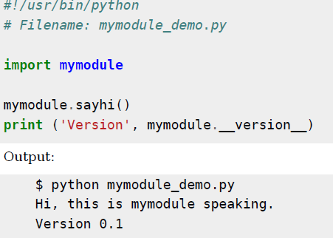
Making our own modules
(user defined modules)

Slide 7
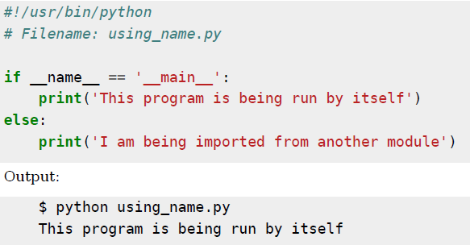
A module's __ name__
Every module has a name and statements in a module can find out the name of its module.
This is handy in the particular situation of figuring out if the module is being run standalone or being imported.

Slide 8
# file one.py
def func():
print("func() in one.py")
print("top-level in one.py")
if __name__ == "__main__":
print("one.py is being run directly")
else:
print("one.py is being imported into another module")
func()
# file two.py
import one
print("top-level in two.py")
one.func()
if __name__ == "__main__":
print("two.py is being run directly")
else:
print("two.py is being imported into another module")
#python one.py
func() in one.py
top-level in one.py one.py is being run directly
#python two.py
top-level in two.py
func() in one.py
top-level in one.py
one.py is being imported into another module
two.py is being run directly

Slide 9
Byte- compiled . pyc files
Importing a module is a relatively costly affair, so Python does some tricks to make it faster.One way is to create byte-compiled files with the extension .pyc which is an intermediate form that Python transforms the program into
This .pyc file is useful when you import the module the next time from a different program - it will be much faster since a portion of the processing required in importing a module is already done. Also, these byte-compiled files are platform-independent.

Slide 10
from ….import* statement
It is also possible to import all names from a module into the current namespace by using the following import statement:
from modname import *
This provides an easy way to import all the items from a module into the current namespace; however, this statement should be used sparingly.

Slide 11
import vs from import statement
‘import’ gives a name that refers to the whole module object. We must go through the module name to fetch its attribute.
‘from import’ copies names from one file over to another scope also it allows to use the copied names directly in the script without module name.

Slide 12
Example
#module1.py
def printer(x): #module attribute
print(x)
The import statement
>>>import module1 #Get module as a whole
>>>module1.printer(“Hello World”) #Qualify to get names
Hello World
The from statement
>>>from module1 import printer #Copy out one variable
>>>printer(“Hello World”) #No need to qualify names
Hello World
The from * statement
>>>from module1 import * #Copy out all variables
>>>printer(“Hello World”) #No need to qualify names
Hello World

Slide 13
The dir() Function
The built-in function dir() is used to find out which names a module defines. It returns a sorted list of strings:
>>>import math
>>>print dir (math)
It lists all types of names: variables, modules, functions, etc. dir() does not list the names of built-in functions and variables. If you want a list of those, they are defined in the standard module __builtin__:
>>> import __builtin__
>>> dir(__builtin__)

Slide 14
Packages in Python:
A package is a hierarchical file directory structure that defines a single Python application environment that consists of modules and subpackages and sub-subpackages, and so on.
A package is a set of modules or sub-packages. A package is actually a directory containing either .py files or sub-directories defining other packages.
When loading a package, the __init__.py file is executed. If the __init__.py defines classes, functions, etc... they become available at once.

Slide 15
Steps to create a package
Create a directory as package name. eg
#/home/guest1/mkdir mypack
Copy the .py files (modules which you want to keep under package) to mypack directory. Eg. Hello.py, Hello1.py
Cretae __init__.py file in mypack directory and import all the modules which you want to keep in package eg
#cd mypack and create the file with the following code
#/!usr/bin/python/
#File name :__init__.py
import Hello or (import mypack.hello)
import Hello1 or (import mypack.hello1)
Create another python file to run the package in home directory (eg. packex.py)

Slide 16
#cd ..
#guest1>
#!/usr/bin/python
#Filename: packex.py
import mypack
mypack.Hello.fun1()
mypack.Hello1.fun2()
Execute the package to run the modules in the package
#guest1> python packex.py
Will execute all the modules (Hello.py,Hello1.py)

Slide 17
Exercises
Write a program named mean.py that takes a sequence of numbers on the command line and returns the mean and median of their values.
Implement a calculator using python modules.
Write a module to generate fibonacci numbers.
Create a package using python to execute the following a) area of circle b) area of triangle c) area of rectangle.
Create a package using python to do the following a) check for Palindrome b) check for prime c) check for Armstrong number

