Slide 1
Python Sets and Strings

Slide 2
Introduction
Sets are unordered collections of simple objects.
These are used when the existence of an object in a collection is more important than the order or how many times it occurs.
Using sets, you can test for membership, whether it is a subset of another set, find the intersection between two sets, and so on.

Slide 3
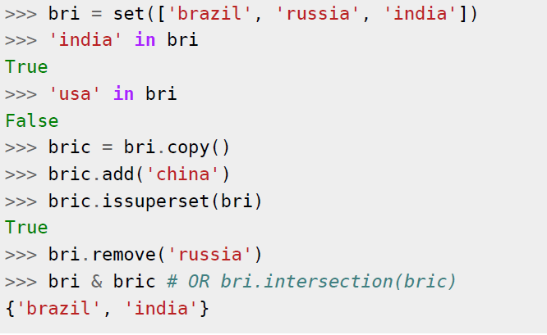
Example of sets

Slide 4
References
When you create an object and assign it to a variable, the variable only refers to the object and does not represent the object itself!
The variable name points to that part of your computer's memory where the object is stored. This is called as binding of the name to the object.

Slide 5
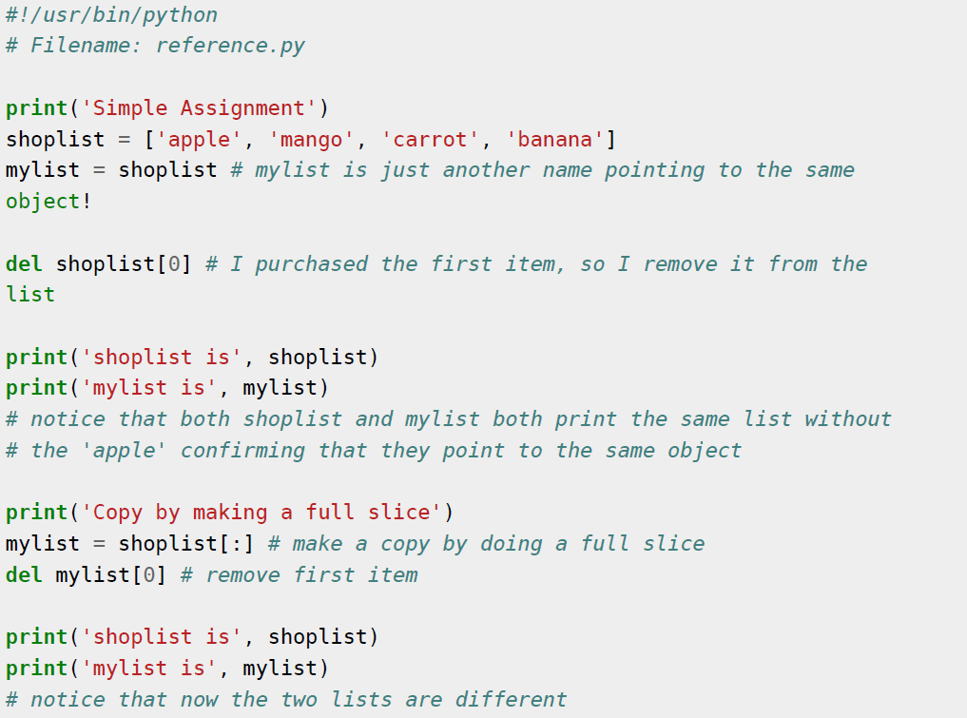

Slide 6
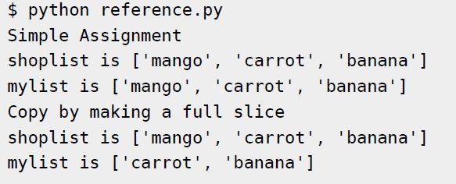
Output

Slide 7
Strings--Introduction
Strings are amongst the most popular types in Python.
We can create them simply by enclosing characters in quotes.
Python treats single quotes the same as double quotes.
Creating strings is as simple as assigning a value to a variable. For example:
var1 = 'Hello World!'
var2 = "Python Programming"

Slide 8
String special operators

Slide 9
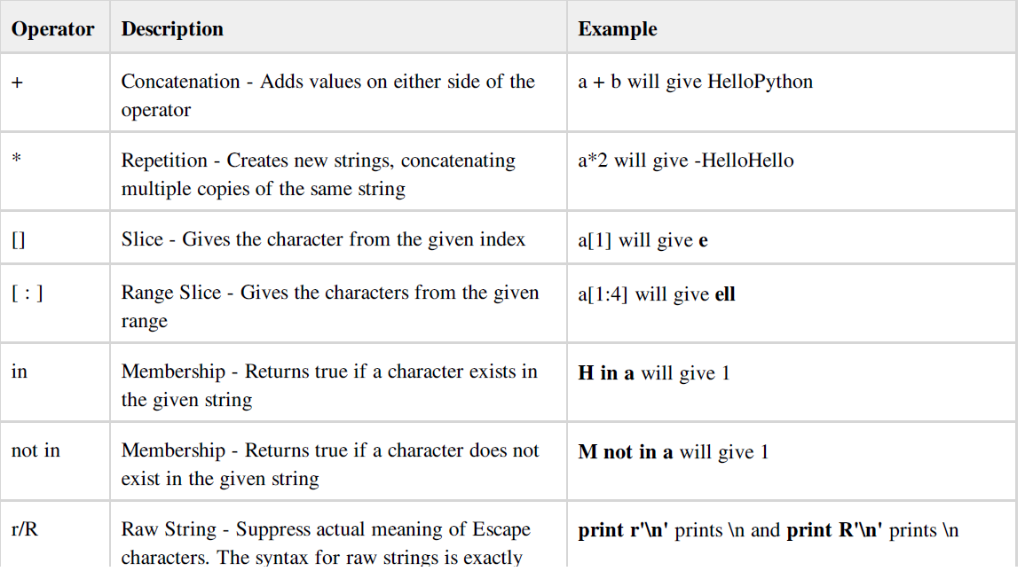
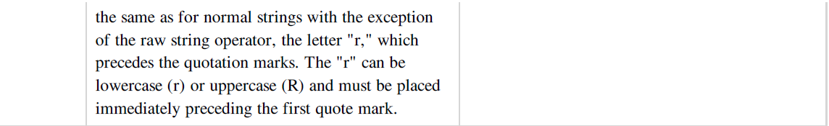

Slide 10
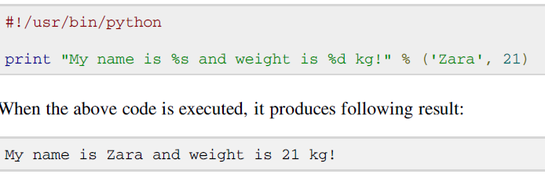
String formatting operator
One of Python's coolest features is the string format operator %.
This operator is unique to strings and makes up for the pack of having functions from C's printf() family

Slide 11
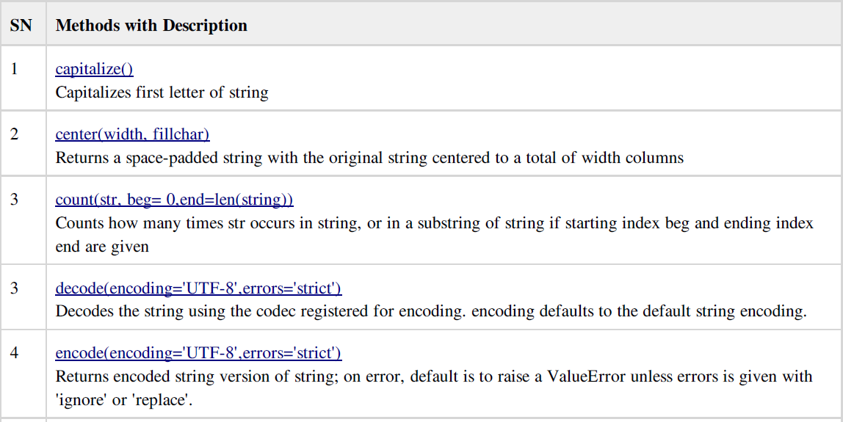
Built-in Strings methods

Slide 12
String conversions
>>> a = "58"
>>> type(a)
<type 'str'>
>>> b=int(a)
>>> b
58
>>> type(b)
<type 'int'>
>>> f = float('1.2e-3')
>>> f # uses 'repr'
0.0011999999999999999
>>> print f # uses 'str'
0.0012
>>> eval('23-12')
11
Convert data types using functions ‘str’, ‘int’, ‘float’
‘repr’ is a variant of ‘str’
  intended for strict, code-like representation of values
  ‘str’ usually gives nicer-looking representation
Function ‘eval’ interprets a string as a Python expression
>>> c = int('blah') # what happens when something illegal is done?
Traceback (most recent call last):
File "<pyshell#34>", line 1, in -toplevel-
c = int('blah')
ValueError: invalid literal for int(): blah

Slide 13
String operations
>>> a = "Part 1"
>>> b = "and part 2"
>>> a + ' ' + b # concatenation, adding strings
'Part 1 and part 2'
>>> s = a * 2 # repeat and concatenate string
>>> print s
Part 1Part 1
>>> s[0] # index: one single character, offset 0 (zero)
'P'
>>> s[0:4] # slice: part of string
'Part'
>>> s[5:] # leave out one boundary: to the end
'1Part 1'
>>> >>> s[6:-1] # negative index counts from the end
'Part '
>>> len(s) # function ‘len’ to get length of string
12
>>> 'p' in s # membership test
False
>>> 'P' in s
True
>>> 'Part' in s # also works for substrings (new feature)
True

Slide 14
String methods
Strings have a set of built-in methods
No method ever changes the original string!
Several methods produce new strings
>>> s = 'a string, with stuff'
>>> s.count('st') # how many substrings?
2
>>> s.find('stu') # give location of substring, if any
15
>>> three = '3'
>>> three.isdigit() # only digit characters in string?
True
>>> supper = s.upper() # convert to upper case
>>> supper
'A STRING, WITH STUFF'
>>> s.rjust(30) # right justify by adding blanks
' a string, with stuff'
>>> "newlines\n\n\n".strip() # a string literal also has methods!
'newlines'
>>> s.replace('stuff', 'characters') # replace substring (all occurrences)
'a string, with characters'
>>> s.replace('s', 'X', 1) # replace only once
'a Xtring, with stuff'

Slide 15
Simple String Processing
Another use – converting an int that stands for the month into the three letter abbreviation for that month.
Store all the names in one big string:
“JanFebMarAprMayJunJulAugSepOctNovDec”
Use the month number as an index for slicing this string:
monthAbbrev = months[pos:pos+3]

Slide 16
Simple String Processing
# month.py
# A program to print the abbreviation of a month, given its number
def main():
# months is used as a lookup table
months = "JanFebMarAprMayJunJulAugSepOctNovDec"
n = input("Enter a month number (1-12):" )
# compute starting position of month n in months
pos = (n-1) * 3
# Grab the appropriate slice from months
monthAbbrev = months[pos:pos+3]
# print the result
print ("The month abbreviation is", monthAbbrev + ".")
main()
>>> main()
Enter a month number (1-12): 1
The month abbreviation is Jan.
>>> main()
Enter a month number (1-12): 12
The month abbreviation is Dec.

Slide 17
Simple String Processing
One weakness – this method only works where the potential outputs all have the same length.
How could you handle spelling out the months?

Slide 18
# month2.py
# A program to print the month name, given it's number.
# This version uses a list as a lookup table.
def main():
# months is a list used as a lookup table
months = ["January", "Feb", "March", "Apr", "May", "Jun",
"Jul", "Aug", "September", "Oct", "Nov", "Dec"]
n = input("Enter a month number (1-12):")
print ("The month abbreviation is", months[n-1] + ".")
main()

Slide 19
Strings and Secret Codes
Inside the computer, strings are represented as sequences of 1’s and 0’s, just like numbers.
A string is stored as a sequence of binary numbers, one number per character.
It doesn’t matter what value is assigned as long as it’s done consistently.

Slide 20
Strings and Secret Codes
In the early days of computers, each manufacturer used their own encoding of numbers for characters.
ASCII system (American Standard Code for Information Interchange) uses 127 bit codes
Python supports Unicode (100,000+ characters)

Slide 21
Strings and Secret Codes
The ord function returns the numeric (ordinal) code of a single character.
The chr function converts a numeric code to the corresponding character.
>>> ord("A")
65
>>> ord("a")
97
>>> chr(97)
'a'
>>> chr(65)
'A'

Slide 22
Strings and Secret Codes
Using ord and char we can convert a string into and out of numeric form.
The encoding algorithm is simple:
get the message to encode
for each character in the message:
print the letter number of the character
A for loop iterates over a sequence of objects, so the for loop looks like:
for ch in <string>

Slide 23
Strings and Secret Codes
# text2numbers.py
# A program to convert a textual message into a sequence of
# numbers, utlilizing the underlying Unicode encoding.
def main():
print("This program converts a textual message into a sequence")
print ("of numbers representing the Unicode encoding of the message.\n")
# Get the message to encode
message = raw_input("Please enter the message to encode: ")
print("\nHere are the Unicode codes:")
# Loop through the message and print out the Unicode values
for ch in message:
print(ord(ch))
main()

Slide 24
Strings and Secret Codes
We now have a program to convert messages into a type of “code”, but it would be nice to have a program that could decode the message!
The outline for a decoder:
get the sequence of numbers to decode
message = “”
for each number in the input:
convert the number to the appropriate character
add the character to the end of the message
print the message

Slide 25
Strings and Secret Codes
The variable message is an accumulator variable, initially set to the empty string, the string with no characters (“ “).
Each time through the loop, a number from the input is converted to the appropriate character and appended to the end of the accumulator.

Slide 26
Strings and Secret Codes
How do we get the sequence of numbers to decode?
Read the input as a single string, then split it apart into substrings, each of which represents one number.

Slide 27
Strings and Secret Codes
The new algorithm
get the sequence of numbers as a string, inString
message = “”
for each of the smaller strings:
change the string of digits into the number it represents
append the ASCII character for that number to message
print message
Strings are objects and have useful methods associated with them

Slide 28
Strings and Secret Codes
One of these methods is split. This will split a string into substrings based on spaces.
>>> "Hello string methods!".split()
['Hello', 'string', 'methods!']

Slide 29
Strings and Secret Codes
Split can be used on characters other than space, by supplying the character as a parameter.
>>> "32,24,25,57".split(",")
['32', '24', '25', '57']
>>>

Slide 30
Strings and Secret Codes
How can we convert a string containing digits into a number?
Use our friend eval.
>>> numStr = "500"
>>> eval(numStr)
500
>>> x = eval(raw_input("Enter a number "))
Enter a number 3.14
>>> print x
3.14
>>> type (x)
<type 'float'>

Slide 31
Strings and Secret Codes
# numbers2text.py
# A program to convert a sequence of Unicode numbers into
# a string of text.
def main():
print ("This program converts a sequence of Unicode numbers into")
print ("the string of text that it represents.\n")
# Get the message to encode
inString = raw_input("Please enter the Unicode-encoded message: ")
# Loop through each substring and build Unicde message
message = ""
for numStr in inString.split(“ "):
# convert the (sub)string to a number
codeNum = eval(numStr)
# append character to message
message = message + chr(codeNum)
print("The decoded message is:", message)
main()

Slide 32
Strings and Secret Codes
The split function produces a sequence of strings. numString gets each successive substring.
Each time through the loop, the next substring is converted to the appropriate Unicode character and appended to the end of message.

Slide 33
Strings and Secret Codes
-------------------------------------------------------------------------
This program converts a textual message into a sequence
of numbers representing the Unicode encoding of the message.
Please enter the message to encode: CS120 is fun!
Here are the Unicode codes:
67 83 49 50 48 32 105 115 32 102 117 110 33
--------------------------------------------------------------------------
This program converts a sequence of Unicode numbers into
the string of text that it represents.
Please enter the ASCII-encoded message: 67 83 49 50 48 32 105 115 32 102 117 110 33
The decoded message is: CS120 is fun!

Slide 34
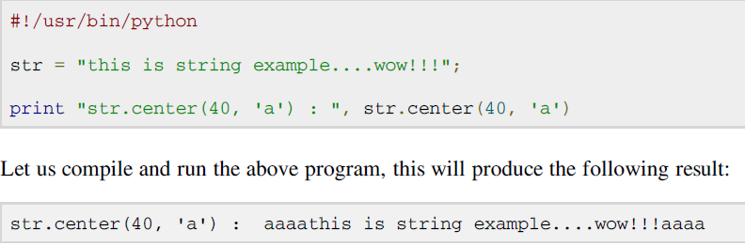
Python string “center” method
The method center() returns centered in a string of length width. Padding is done using the specifiedfillchar. Default filler is a space.

Slide 35
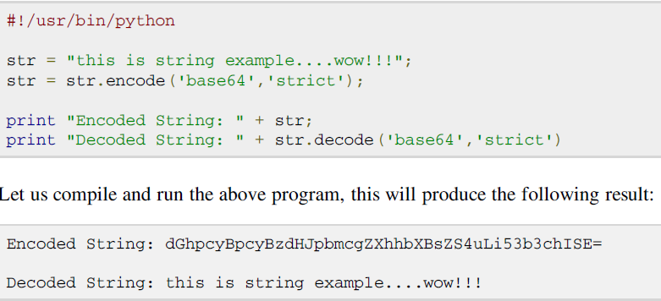
String decode method
The method decode() decodes the string using the codec registered for encoding. It defaults to the default string encoding.
str.decode(encoding='UTF-',errors='strict')

Slide 36
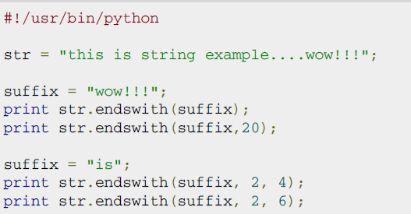
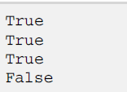
String endswith fucntion
The method endswith() returns True if the string ends with the specified suffix, otherwise return False optionally restricting the matching with the given indices start and end.

Slide 37
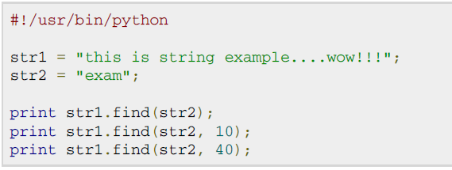

Python string find method
The method find() determines if string str occurs in string, or in a substring of string if starting index beg and ending index end are given.
This method returns index if found and -1 otherwise.

Slide 38
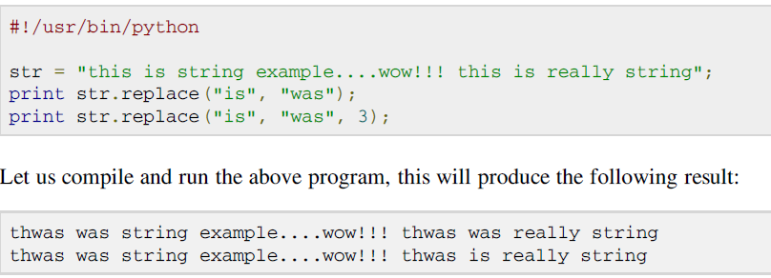
String replace method
The method replace() returns a copy of the string in which the occurrences of old have been replaced with new, optionally restricting the number of replacements to max.

Slide 39
Exercises
Write a function char_freq() that takes a string and builds a frequency listing of the characters contained in it. Represent the frequency listing as a Python dictionary.
Eg.char_freq("abbabcbdbabdbdbabababcbcbab").
The third person singular verb form in English is distinguished by the suffix -s, which is added to the stem of the infinitive form: run -> runs. A simple set of rules can be given as follows:
  If the verb ends in y, remove it and add ies
  If the verb ends in o, ch, s, sh, x or z, add es
  By default just add s
Your task in this exercise is to define a function make_3sg_form() which given a verb in infinitive form returns its third person singular form. Test your function with words like try, brush, run and fix. Note however that the rules must be regarded as heuristic, in the sense that you must not expect them to work for all cases. Tip: Check out the string method endswith().

