Slide 1
Python Objects and Classes

Slide 2
Over view of OOPS
Class: A user-defined prototype for an object that defines a set of attributes that characterize any object of the class. The attributes are data members (class variables and instance variables) and methods, accessed via dot notation.
Data member: A class variable or instance variable that holds data associated with a class and its objects.
Function overloading: The assignment of more than one behavior to a particular function. The operation performed varies by the types of objects (arguments) involved.
Inheritance : The transfer of the characteristics of a class to other classes that are derived from it.
Instance: An individual object of a certain class. An object obj that belongs to a class Circle, for example, is an instance of the class Circle.
Method : A special kind of function that is defined in a class definition.
Object : A unique instance of a data structure that's defined by its class. An object comprises both data members (class variables and instance variables) and methods.
Operator overloading: The assignment of more than one function to a particular operator.

Slide 3
Defining a Class
A class is a special data type which defines how to build a certain kind of object.
  The ‘class’ also stores some data items that are shared by all the instances of this class.
  ‘Instances’ are objects that are created which follow the definition given inside of the class.
Python doesn’t use separate class interface definitions as in some languages. You just define the class and then use it.

Slide 4
Methods in Classes
You can define a method in a class by including function definitions within the scope of the class block.
  Note that there is a special first argument self in all of the method definitions.
  Note that there is usually a special method called __init__ in most classes.

Slide 5
Definition of student class
class student:
“““A class representing a student.”””
def __init__(self,n,a):
self.full_name = n
self.age = a
def get_age(self):
return self.age

Slide 6
Instantiating Objects
There is no “new” keyword as in Java.
You merely use the class name with () notation and assign the result to a variable.
  b = student(“Bob Smith”, 21)
The arguments you pass to the class name are actually given to its .__init__() method.

Slide 7
Constructor: __init__
__init__ acts like a constructor for your class.
  When you create a new instance of a class, this method is invoked. Usually does some initialization work.
  The arguments you list when instantiating an instance of the class are passed along to the __init__ method.
  b = student(“Bob”, 21)
  So, the __init__ method is passed “Bob” and 21.

Slide 8
Constructor: __init__
Your __init__ method can take any number of arguments.
  Just like other functions or methods, the arguments can be defined with default values, making them optional to the caller.
However, the first argument self in the definition of __init__ is special…

Slide 9
Self
The first argument of every method is a reference to the current instance of the class.
  By convention, we name this argument self.
In __init__, self refers to the object currently being created; so, in other class methods, it refers to the instance whose method was called.
  Similar to the keyword ‘this’ in Java or C++.
  But Python uses ‘self’ more often than Java uses ‘this.’

Slide 10
Self
Although you must specify self explicitly when defining the method, you don’t include it when calling the method.
Python passes it for you automatically.
Defining a method: Calling a method:
(this code inside a class definition.)
def set_age(self, num): >>> x.set_age(23)
self.age = num

Slide 11
No Need to “free”
When you are done with an object, you don’t have to delete or free it explicitly.
  Python has automatic garbage collection.
  Python will automatically detect when all of the references to a piece of memory have gone out of scope. Automatically frees that memory.
  Generally works well, few memory leaks.

Slide 12
__del__ method
Class can implement the special method __del__(), called a destructor, that is invoked when the instance is about to be destroyed.
This method might be used to clean up any nonmemory resources used by an instance.

Slide 13
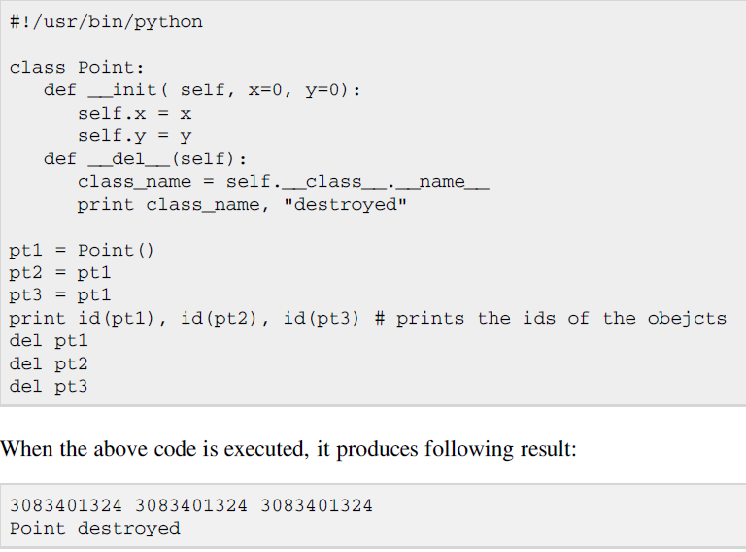

Slide 14
Access to Attributes and Methods
>>> f = student (“Bob Smith”, 23)
>>> f.full_name # Access an attribute.
“Bob Smith”
>>> f.get_age() # Access a method.
23

Slide 15
Accessing unknown members
What if you don’t know the name of the attribute or method of a class that you want to access until run time…
Is there a way to take a string containing the name of an attribute or method of a class and get a reference to it (so you can use it)?

Slide 16
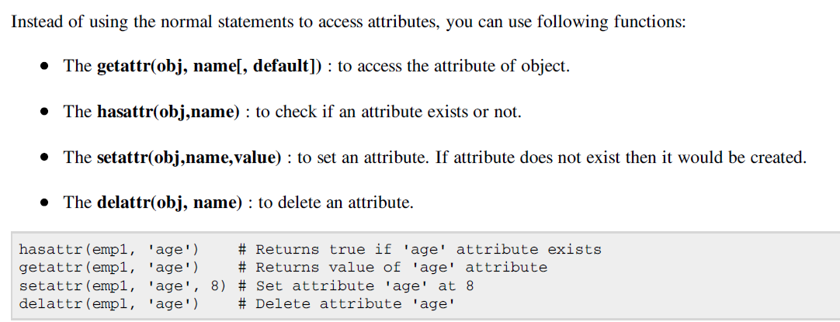

Slide 17
getattr(object_instance, string)
>>> f = student(“Bob Smith”, 23)
>>> getattr(f, “full_name”)
“Bob Smith”
>>> getattr(f, “get_age”)
<method get_age of class studentClass at 010B3C2>
>>> getattr(f, “get_age”)() # We can call this.
23
>>> getattr(f, “get_birthday”)
# Raises AttributeError – No method exists.

Slide 18
hasattr(object_instance,string)
>>> f = student(“Bob Smith”, 23)
>>> hasattr(f, "full_name")
True
>>> hasattr(f, "get_age")
True
>>> hasattr(f, "get_birthday")
False

Slide 19
Two Kinds of Attributes
The non-method data stored by objects are called attributes. There’s two kinds:
  Data attribute:
  Variable owned by a particular instance of a class.
  Each instance can have its own different value for it.
  These are the most common kind of attribute.
  Class attributes:
  Owned by the class as a whole.
  All instances of the class share the same value for it. Called “static” variables in some languages. Good for class-wide constants or for building counter of how many instances of the class have been made.

Slide 20
Data Attributes
You create and initialize a data attribute inside of the __init__() method.
  Remember assignment is how we create variables in Python; so, assigning to a name creates the attribute.
  Inside the class, you refer to data attributes using self – for example, self.full_name
class teacher:
“A class representing teachers.”
def __init__(self,n):
self.full_name = n
def print_name(self):
print self.full_name

Slide 21
Class Attributes
All instances of a class share one copy of a class attribute, so when any of the instances change it, then the value is changed for all of them.
We define class attributes outside of any method.
Since there is one of these attributes per class and not one per instance, we use a different notation:
  We access them using self.__class__.name notation.
class sample: >>> a = sample()
x = 23 >>> a.increment()
def increment(self): >>> a.__class__.x
self.__class__.x += 1 24

Slide 22
Data vs. Class Attributes
class counter:
overall_total = 0
# class attribute
def __init__(self):
self.my_total = 0
# data attribute
def increment(self):
counter.overall_total = \ counter.overall_total + 1
self.my_total = \
self.my_total + 1
>>> a = counter()
>>> b = counter()
>>> a.increment()
>>> b.increment()
>>> b.increment()
>>> a.my_total
1
>>> a.__class__.overall_total
3
>>> b.my_total
2
>>> b.__class__.overall_total
3

Slide 23
Data Hiding
Any attribute or method with two leading underscores in its name (but none at the end) is private. It cannot be accessed outside of that class.
  Note-1:
  Names with two underscores at the beginning and the end are for built-in methods or attributes for the class.
  Note-2:
  There is no ‘protected’ status in Python; so, subclasses would be unable to access these private data either.

Slide 24
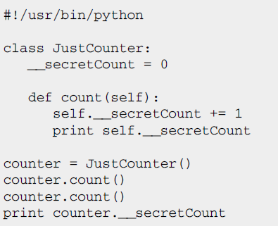
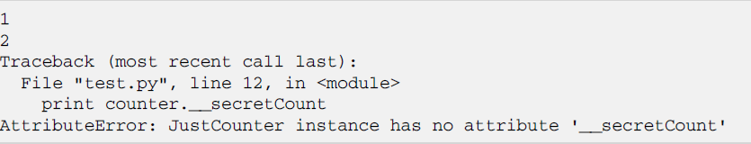

Example

Slide 25
Inheritance(Subclasses)
A class can extend the definition of another class in order to use (or redefine) methods and attributes already defined in the previous one.
  New class: “subclass.” Original: “parent” or “ancestor.”
When defining a subclass, you put the name of the parent in parentheses after the subclass’s name on the first line of the definition.
class ai_student(student):
  Python has no ‘extends’ keyword like Java.
  Multiple inheritance is supported.

Slide 26
Inheritance
class ai_student (student):
“A class extending student.”
def __init__(self,n,a,s):
student.__init__(self,n,a)
self.section_num = s
def get_age(self):
print “Age: ” + str(self.age)
ais1= ai_student("aaa",20,"a")
ais1.get_age()
class student:
“A class representing a student.”
def __init__(self,n,a):
self.full_name = n
self.age = a
def get_age(self):
return self.age
Output
20

Slide 27
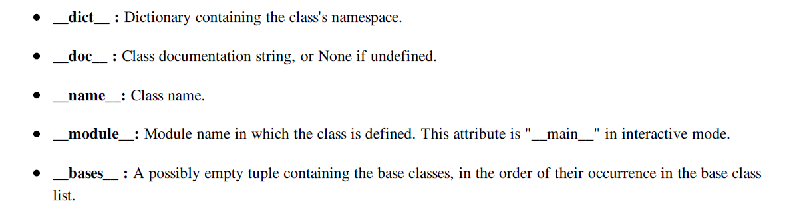
:
Built-In Class Attributes

Slide 28
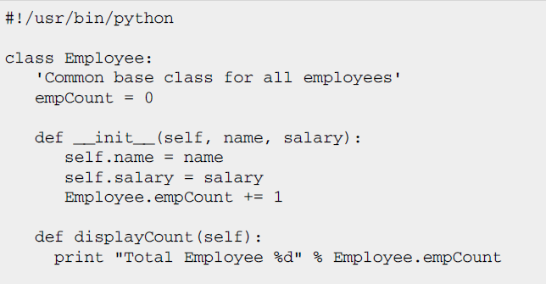
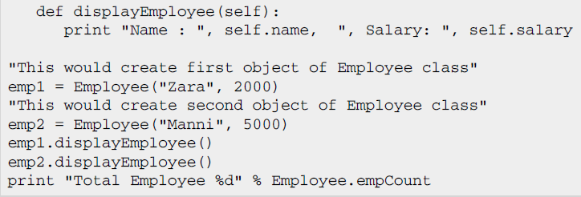

Slide 29
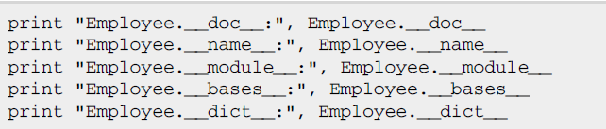
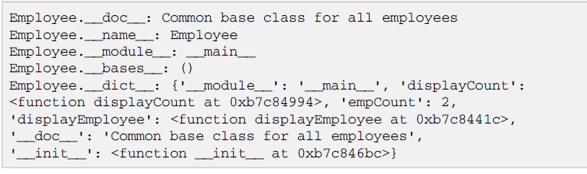

Slide 30
You can use issubclass() or isinstance() functions to check a relationships of two classes and instances:
The issubclass(sub, sup) boolean function returns true if the given subclass sub is indeed a subclass of the superclass sup.
The isinstance(obj, Class) boolean function returns true if obj is an instance of class Class or is an instance of a subclass of Class

Slide 31
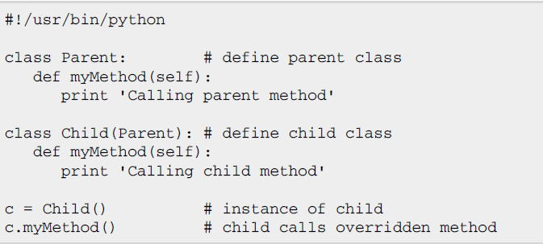

Overriding Methods:
You can always override your parent class methods. One reason for overriding parent's methods is because you may want special or different functionality in your subclass

Slide 32
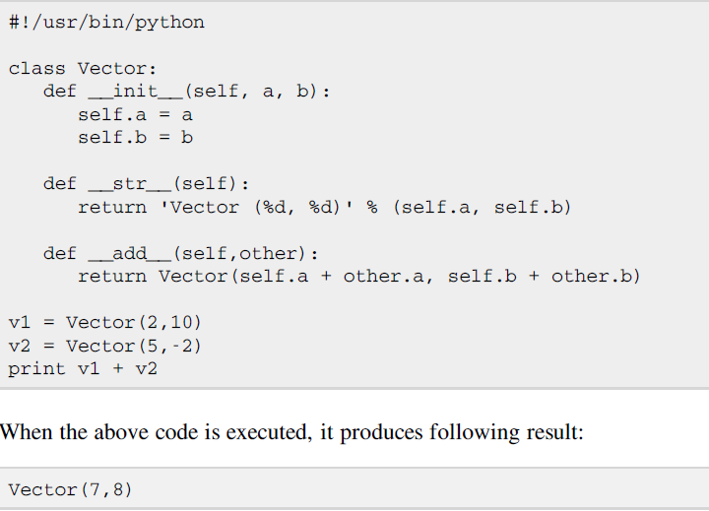
Overloading Operators:

Slide 33
Exercises
Write code to create an instance of this class and set its attributes:
class Dog():
age = 0
name = ""
weight = 0
Write code to create two different instances of this class and set attributes for both objects:
class Person():
  name = ""
  cellPhone = ""
  email = ""

Slide 34
Exercises
For the code below, write a class that has the appropriate class name and attributes that will allow the code to work.
myBird = Bird()
myBird.color = "green"
myBird.name = "Sunny"
myBird.breed = "Sun Conure"
Develop a program that calculate class average for each of the three tests for a class of 20 students and the program should also calculate the average of each of the student scores in those three test. Should also display the results in descending order per test i.e a student name and the corresponding test result of the student.

Slide 35
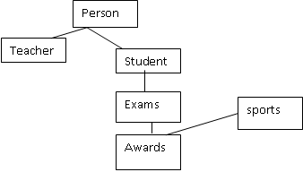
Exercises
Write a python program to implement the following
Employee
Clerk Software Engineer
Team Leader

Slide 36
Exercises
Write a class called Mylist that shadows a python list: it should overload + operator to append the data to the list. Also provide constructor for your class that takes an existing list.
Create a class called time. Its three members all type int should be called hours, minutes and seconds. Write a program that prompts the user to enter a time values separately. The Program should then store the time in the object and finally printout the total no of seconds represented by this value. Use appropriate member functions.
Develop python program to compute the area of geometrical objects and display the computed area.

