Slide 1

Python Exceptions

Slide 2
Introduction
Python provides an important features to handle any unexpected error in your Python programs and to adddebugging capabilities in them called Exception Handling
What is Exception?
An exception is an event, which occurs during the execution of a program, that disrupts the normal flow of the program's instructions. In general, when a Python script encounters a situation that it can't cope with, it raises anexception. An exception is a Python object that represents an error.

Slide 3
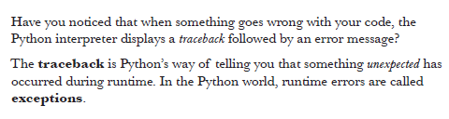
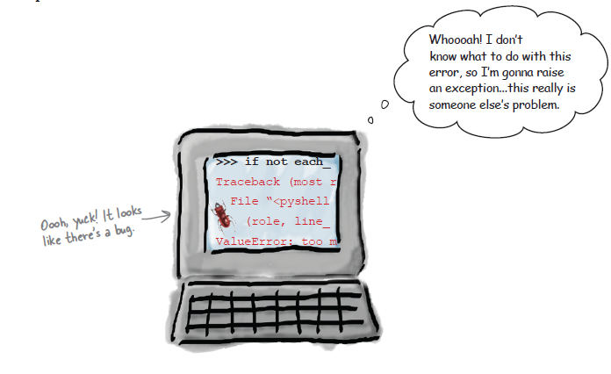
Exception Handling

Slide 4
Handling an exception:
If you have some suspicious code that may raise an exception, you can defend your program by placing the suspicious code in a try: block. After the try: block, include an except: statement, followed by a block of code which handles the problem as elegantly as possible.

Slide 5
Exceptions
Exceptions are events that can modify the flow or control through a program.
They are automatically triggered on errors.
try/except : catch and recover from raised by you or Python exceptions
try/finally: perform cleanup actions whether exceptions occur or not
raise: trigger an exception manually in your code
assert: conditionally trigger an exception in your code

Slide 6
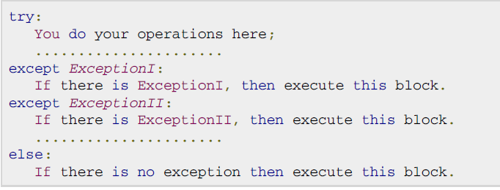
Syntax

Slide 7
try/except/else
try:
<block of statements> #main code to run
except <name1>: #handler for exception
<block of statements>
except <name2>,<data>: #handler for exception
<block of statements>
except (<name3>,<name4>): #handler for exception
<block of statements>
except: #handler for exception
<block of statements>
else: # optional, runs if no exception occurs
<block of statements>

Slide 8
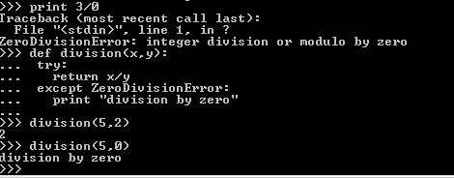
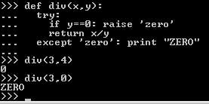
Example

Slide 9
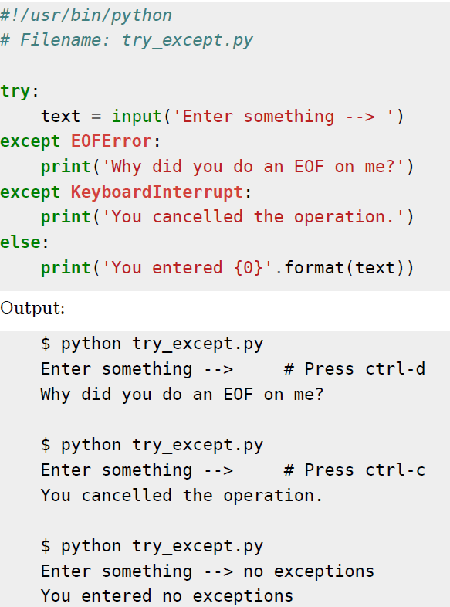

Slide 10
More Examples
while True:
try:
x = int(raw_input("Please enter a number: "))
break
except ValueError:
print "That was not a valid number. Try again...“
Output :
Please enter a number: kjdfs
That was not a valid number. Try again...
Please enter a number: 1

Slide 11
..More Examples
dic={‘abc’:1,’def’:2}
try:
dic['ddsf']
except KeyError :
print 'bad key'
>>>dic[‘jhi’]
bad key

Slide 12
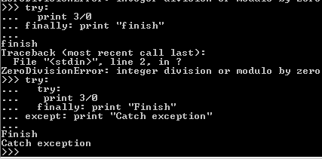
Examples (Finally)

Slide 13
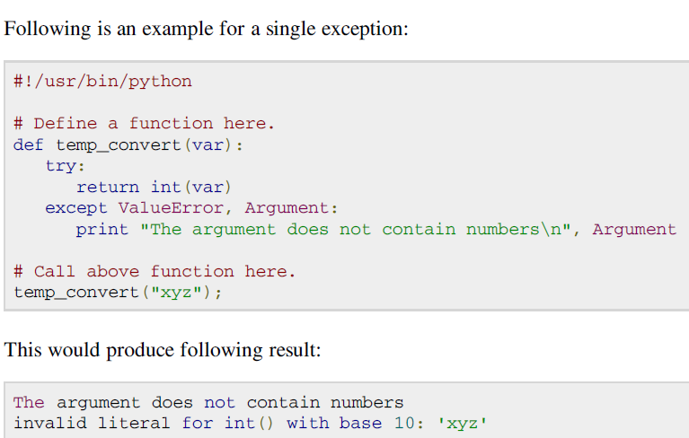
An exception can have an argument, which is a value that gives additional information about the problem. The contents of the argument vary by exception. You capture an exception's argument by supplying a variable in the except clause

Slide 14
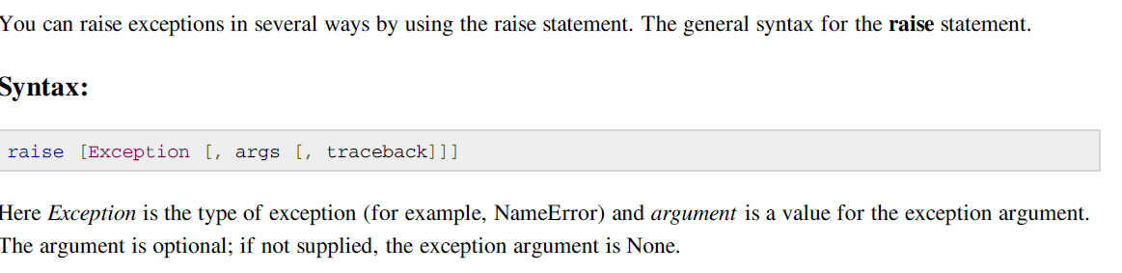
Raising an Exception

Slide 15
raise
raise triggers exceptions explicitly
raise <name>
raise <name>,<data> # provide data to handler
raise #re-raise last exception
>>>try:
raise ‘zero’, (3,0)
except ‘zero’: print “zero argument”
except ‘zero’, data: print data
Last form may be useful if you want to propagate cought exception to another handler.
Exception name: built-in name, string, user-defined class

Slide 16
Raise
def a(branch):
if branch=="CSE":
return 1;
elif branch=="ISE":
return 2;
else:
try:
raise NameError,"Invalid Branch "
except NameError,myarg:
print myarg
print a("CS")
Invalid Branch

Slide 17
Common Exceptions
exception ArithmeticError : OverflowError , ZeroDivisionError
exception IOError :
exception TypeError
exception NameError
exception IndexError
Exception ValueError

Slide 18


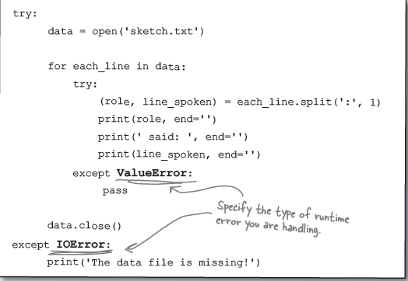

Slide 19
exception OverflowError: Raised when the result of an arithmetic operation is too large to be represented. This cannot occur for long integers
exception NameError: Raised when a local or global name is not found. This applies only to unqualified names. The associated value is an error message that includes the name that could not be found.
exception TypeError: Raised when an operation or function is applied to an object of inappropriate type. The associated value is a string giving details about the type mismatch.
exception ValueError: Raised when a built-in operation or function receives an argument that has the right type but an inappropriate value.
exception IndexError: Raised when a sequence subscript is out of range. (Slice indices are silently truncated to fall in the allowed range; if an index is not a plain integer,TypeError is raised.)

Slide 20
Python built-in exceptions
Accessing a non-existent dictionary key will raise a KeyError exception.
Searching a list for a non-existent value will raise a ValueError exception.
Calling a non-existent method will raise an AttributeError exception.
Referencing a non-existent variable will raise a NameError exception.
Mixing datatypes without coercion will raise a TypeError exception.

Slide 21
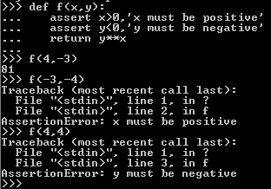
assert
assert is a conditional raise
assert <test>, <data>
assert <test>
If <test> evaluates to false, Python raises AssertionError with the <data> as the exception’s extra data.

Slide 22
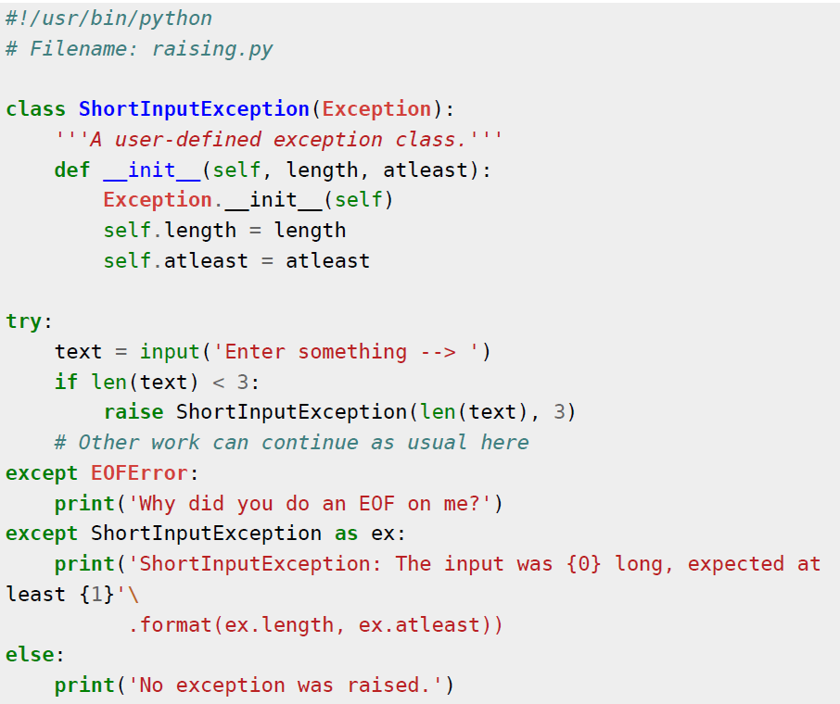
User defined exceptions
Programs may name their own exceptions by creating a new exception class Exceptions should typically be derived from the Exception class, either directly or indirectly. For example:

Slide 23

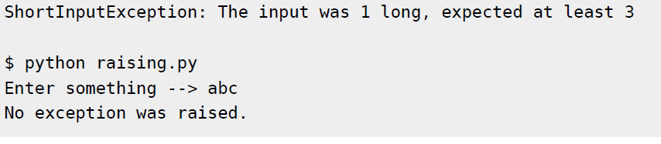

Slide 24
Exercises
Write a program to illustrate common exceptions
Write a program to simulate saving account processing in a bank using constructors also use destructor at the end of program (Hint : Create Deposit and Withdraw with other member functions) and Check for Validation while withdrawing the amount.
Write a program to calculate the area of the circle and catch appropriate exception
Write an interactive program to compute the square root of a number. The input values must be tested for validity. If it is negative, the user defined method MySqrt() should raise an exception.
Write a class called “NoMatch” Exception is raised when branch is not equal to CSE.
Write a program to find average of ‘n’ numbers. Use input through command line argument. The program should read value of ‘n’ first. If the input ‘n’ happens to be zero or negative a suitable user defined exception should be thrown. If the given input is not a valid integer then exception must be thrown. Use suitable try-except block.

Slide 25
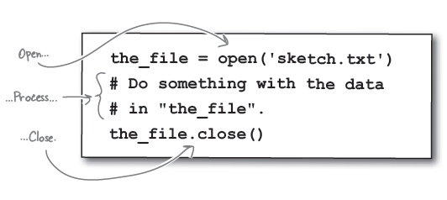
File Handling in Python
Python provides basic functions and methods necessary to manipulate files by default. You can do your most of the file manipulation using a file object.
Before you can read or write a file, you have to open it using Python's built-in open() function. This function creates a file object which would be utilized to call other support methods associated with it.
Syntax:

Slide 26
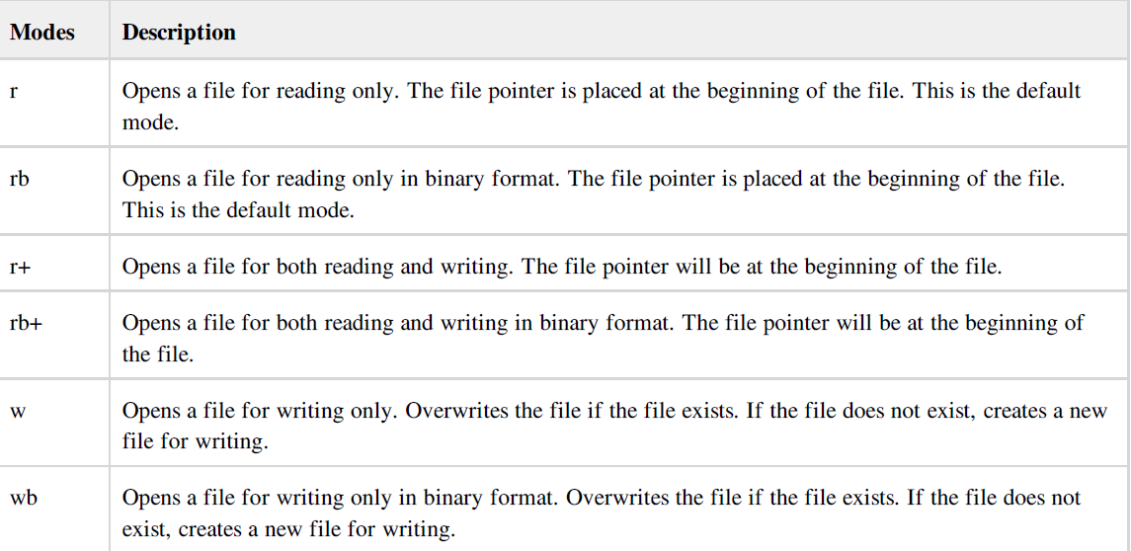
File modes

Slide 27
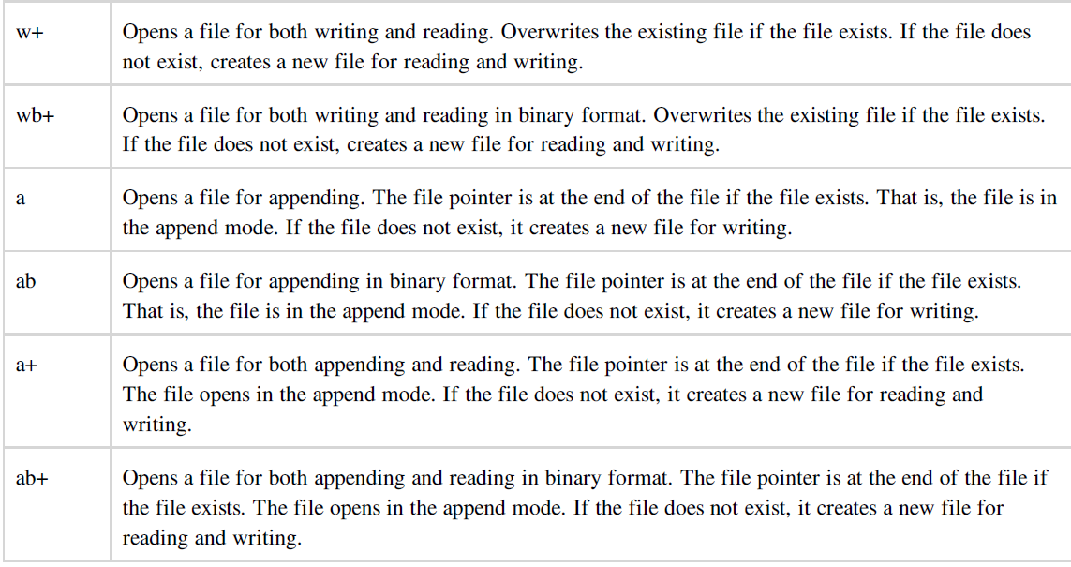

Slide 28

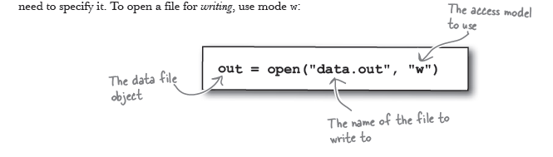

Slide 29
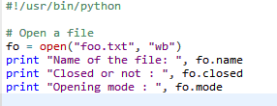

File object attributes

Slide 30
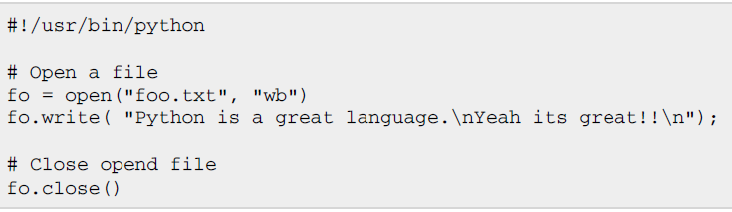
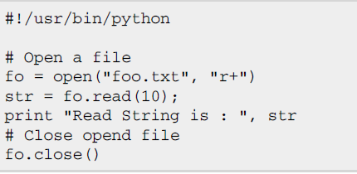

Reading and Writing files

Slide 31
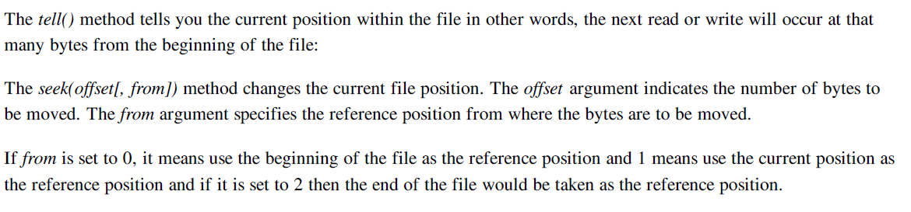
File positions

Slide 32
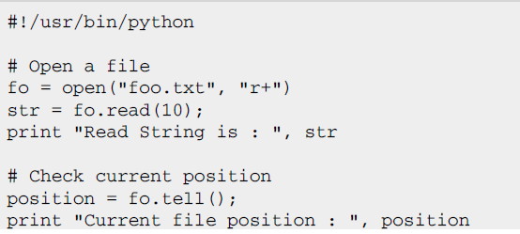
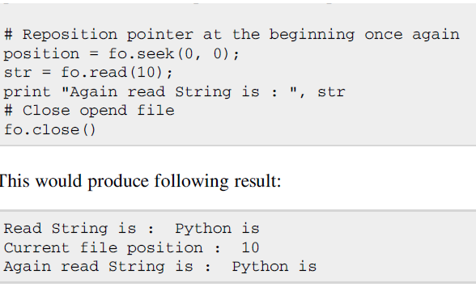
Example-1

Slide 33
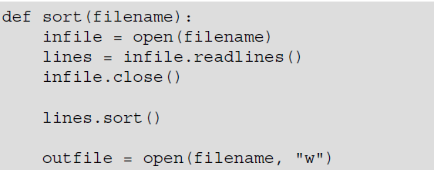

Example-2
Write a function that sorts that contents of the file. The function should accept the filename as argument

Slide 34
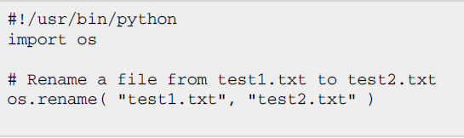
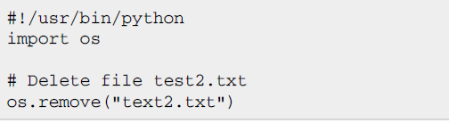
Renaming and Deleting files
Python os module provides methods that help you perform file-processing operations, such as renaming and deleting files.
To use this module you need to import it first and then you can all any related functions.

Slide 35




Directories in Python
All files are contained within various directories, and Python has no problem handling these too. The os module has several methods that help you create, remove, and change directories.
mkdir() :
chdir() :
getcwd():
rmdir() :

Slide 36
Exercises
Develop a fileLineCount( name ) which opens a file with the given name and examines all of the lines of the file. Each line should have strip applied to remove leading and trailing spaces. If the resulting line is of length zero, it was effectively blank, and can be skipped. If the resulting line begins with # the line is entirely a comment, and can be skipped. All remaining lines should be counted, and fileLineCount( name ) returns this count
Convert the contents of the file ‘graffit.txt’ to all uppercase letters.
Create a text file that contains student data and print data from the given position.
Create a text file contains Employee data and display Employees whose salary > 50000.
Implement copy command using files.

